Slide 1
Guide Me, O Thou Great Jehovah
CWM RHONDDA
8.7.8.7.4.7
Words: | William Williams (1745); Tr. vs. 1, Peter Williams (1771); Tr. vss. 2-3, William Williams (1772)
Music: | John Hughes (1907)
4/4
G/D - SOL
Verses: 3
Lead - | SOL
Alto - | MI
Tenor - | DO
Bass - | DO
PDHymns.com

Slide 2
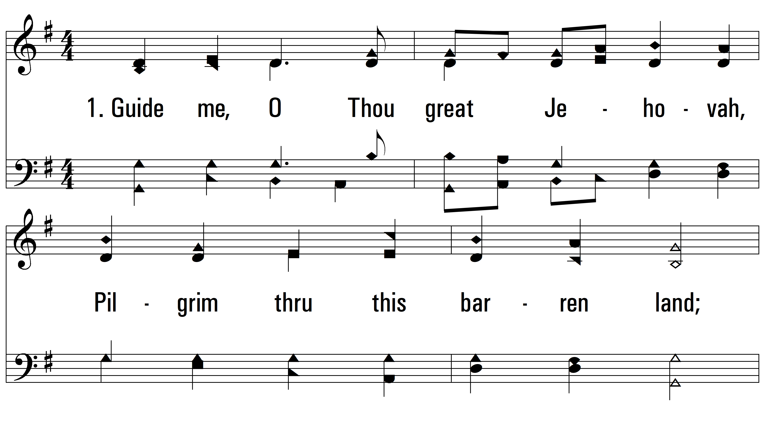
vs. 1 ~ Guide Me, O Thou Great Jehovah

Slide 3
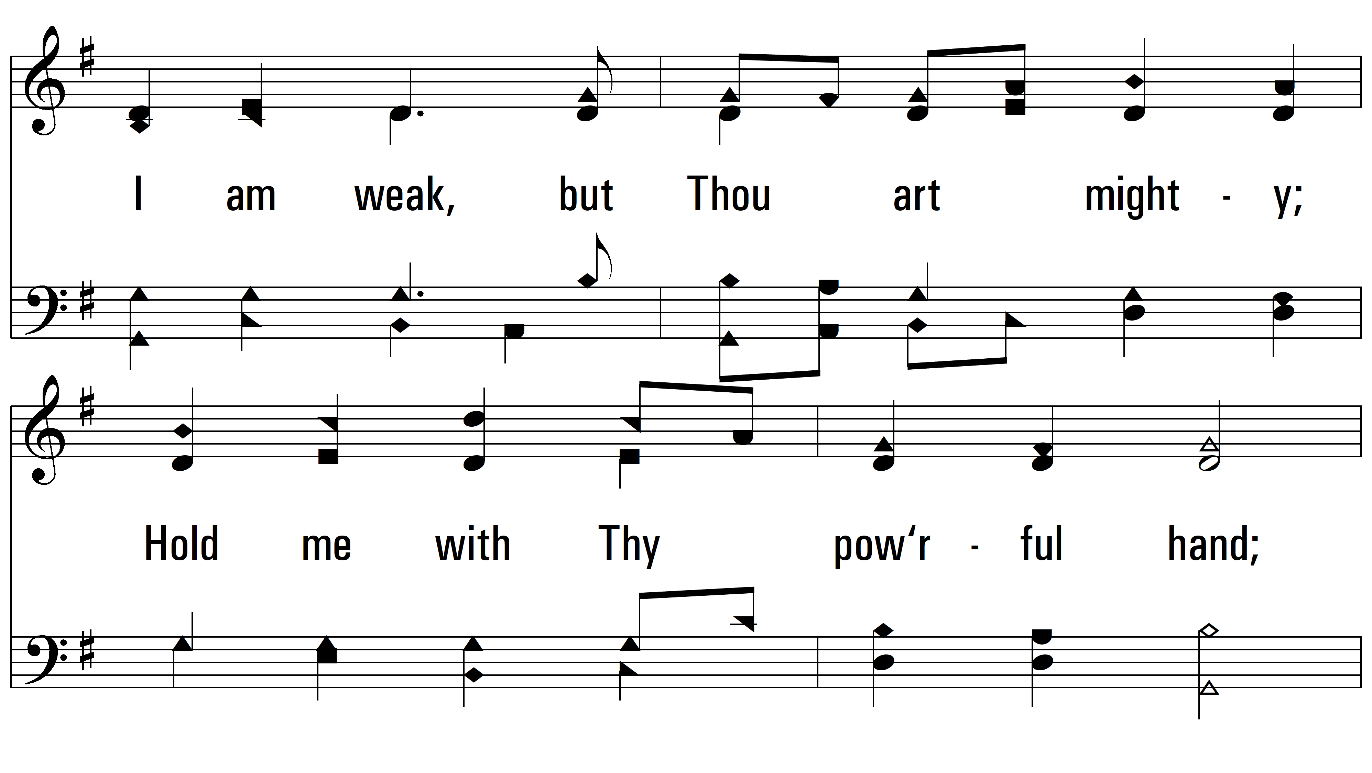
vs. 1

Slide 4
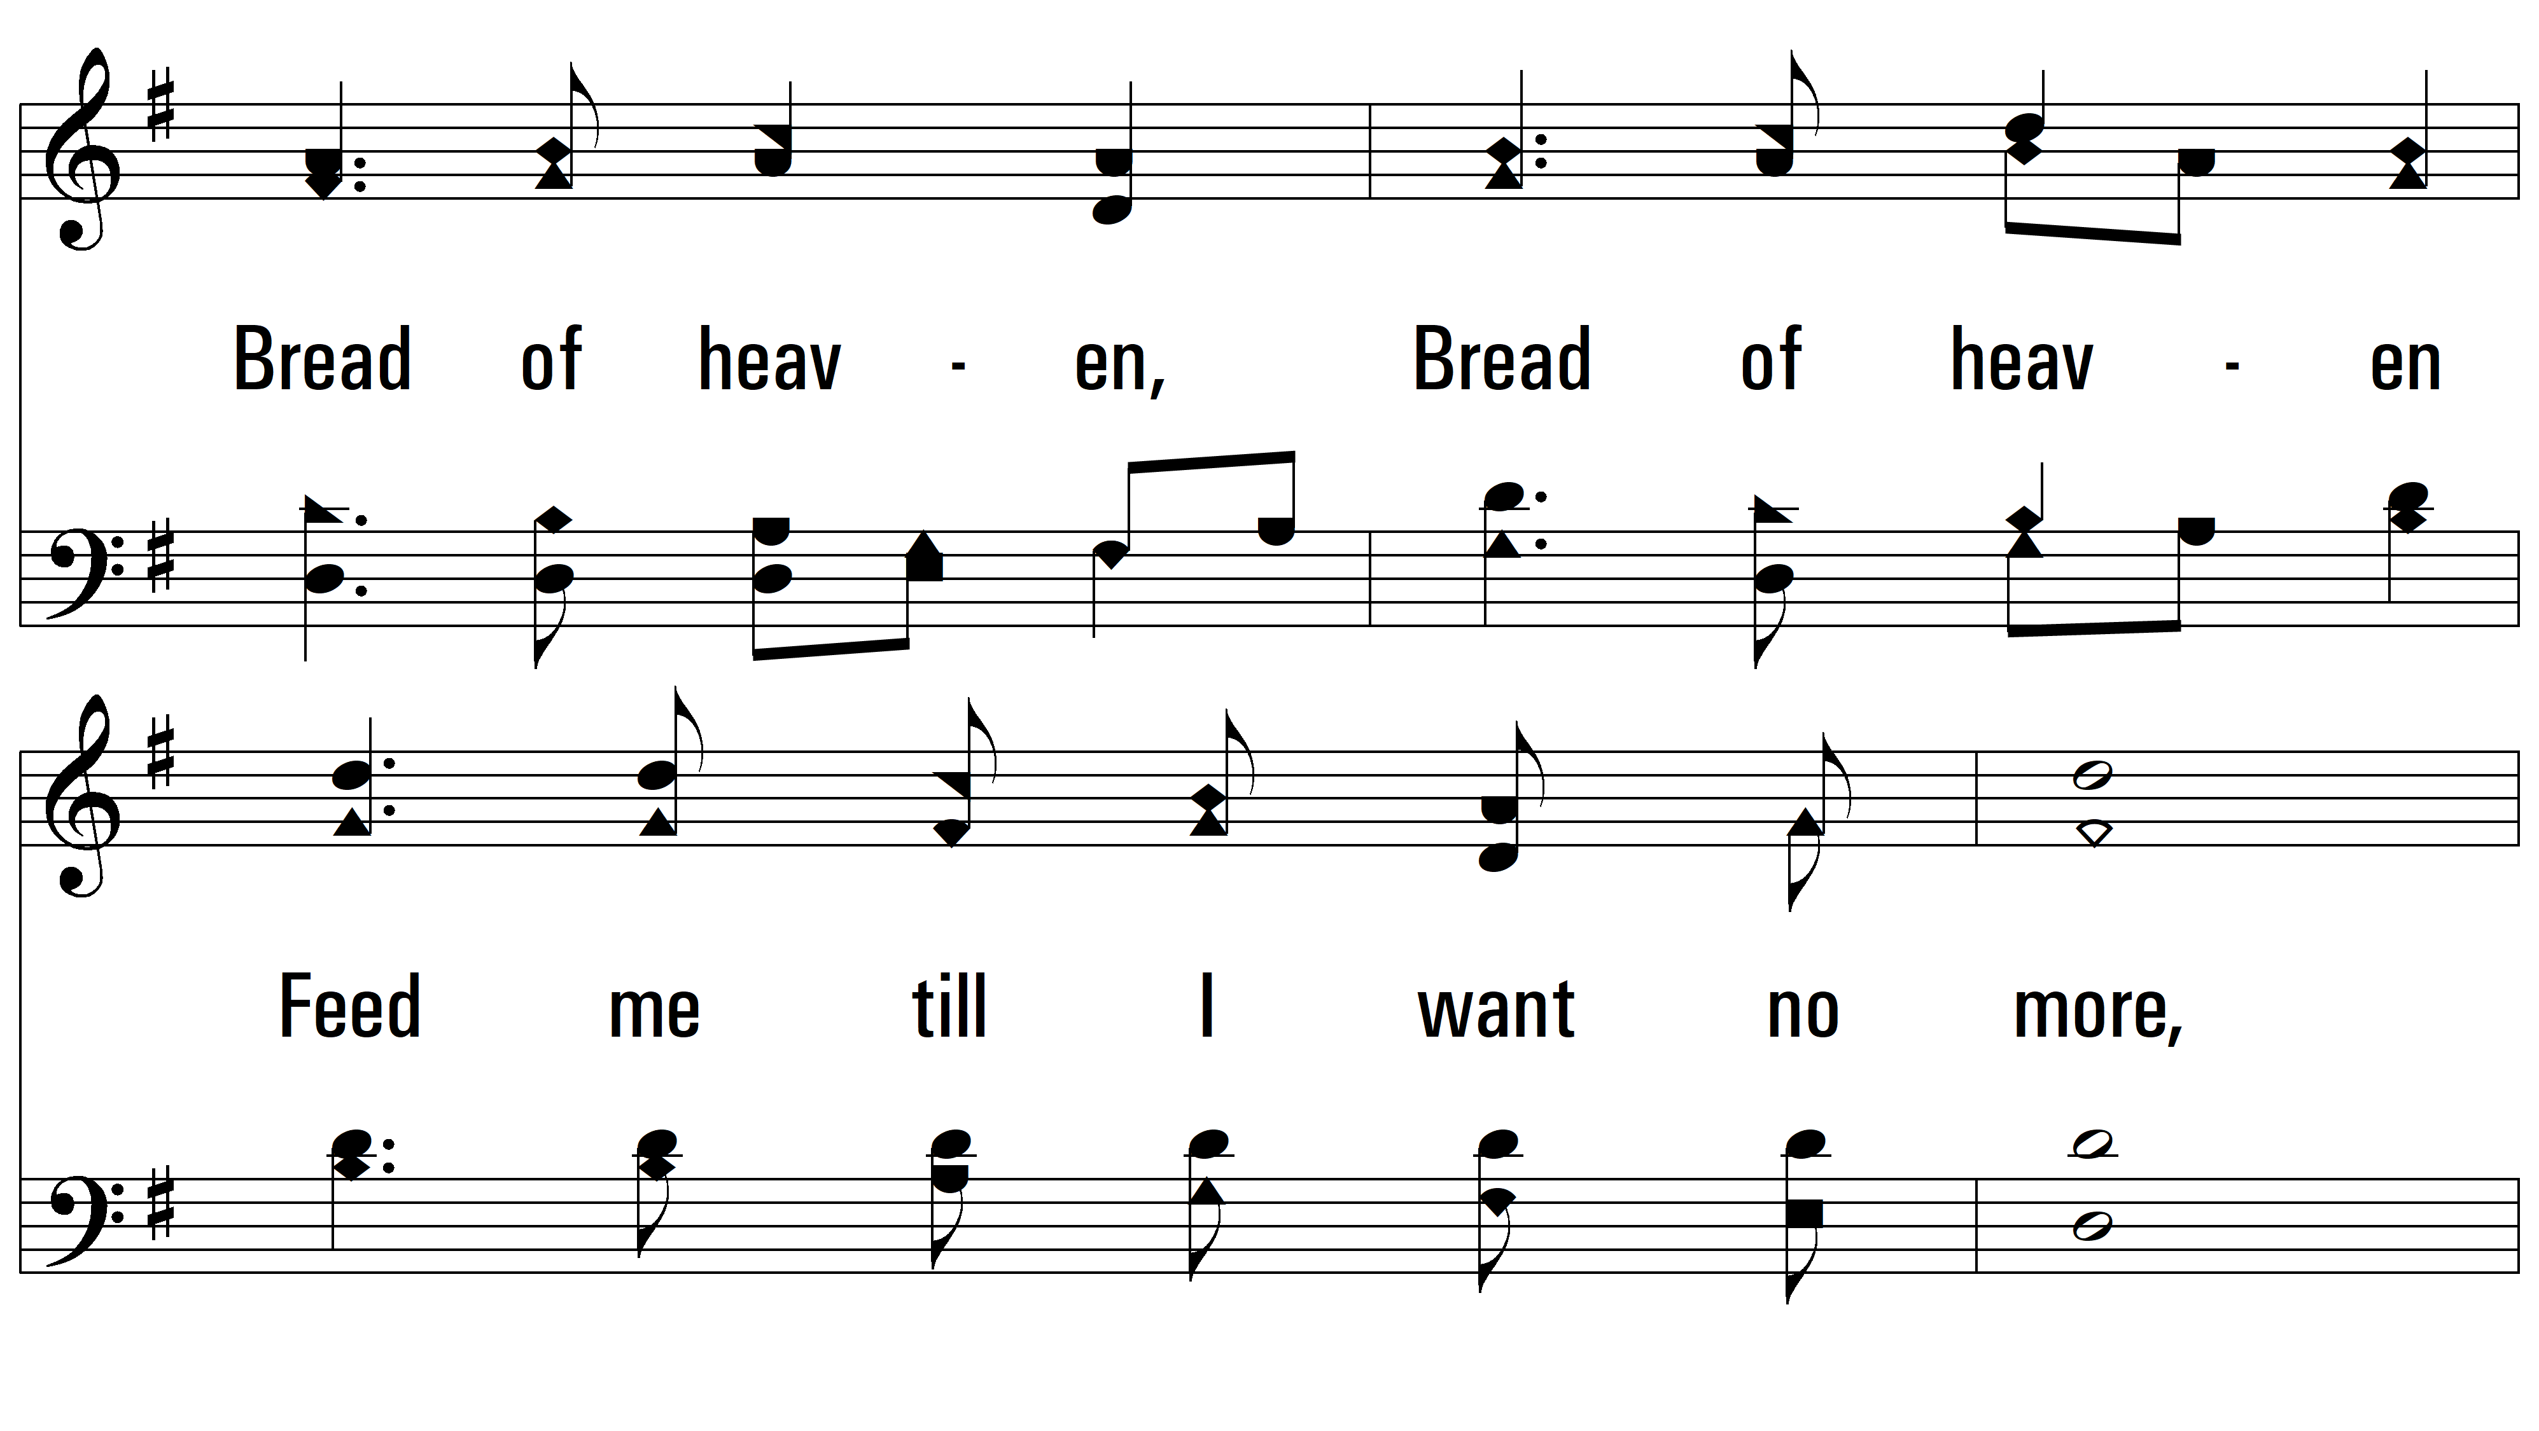
vs. 1

Slide 5
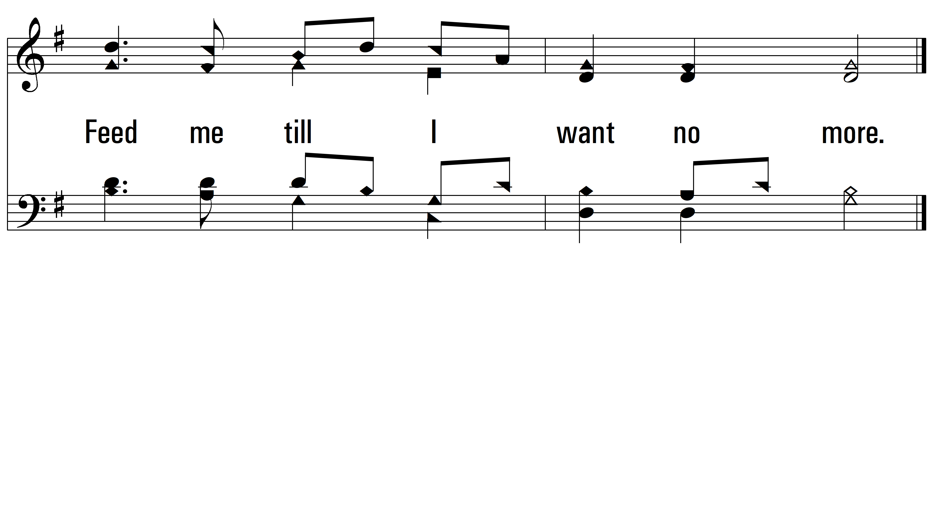
vs. 1

Slide 6
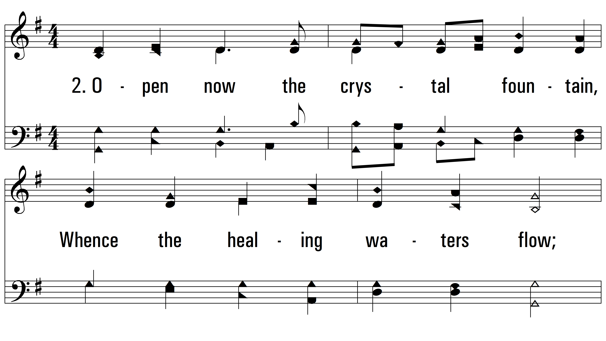
vs. 2 ~ Guide Me, O Thou Great Jehovah

Slide 7
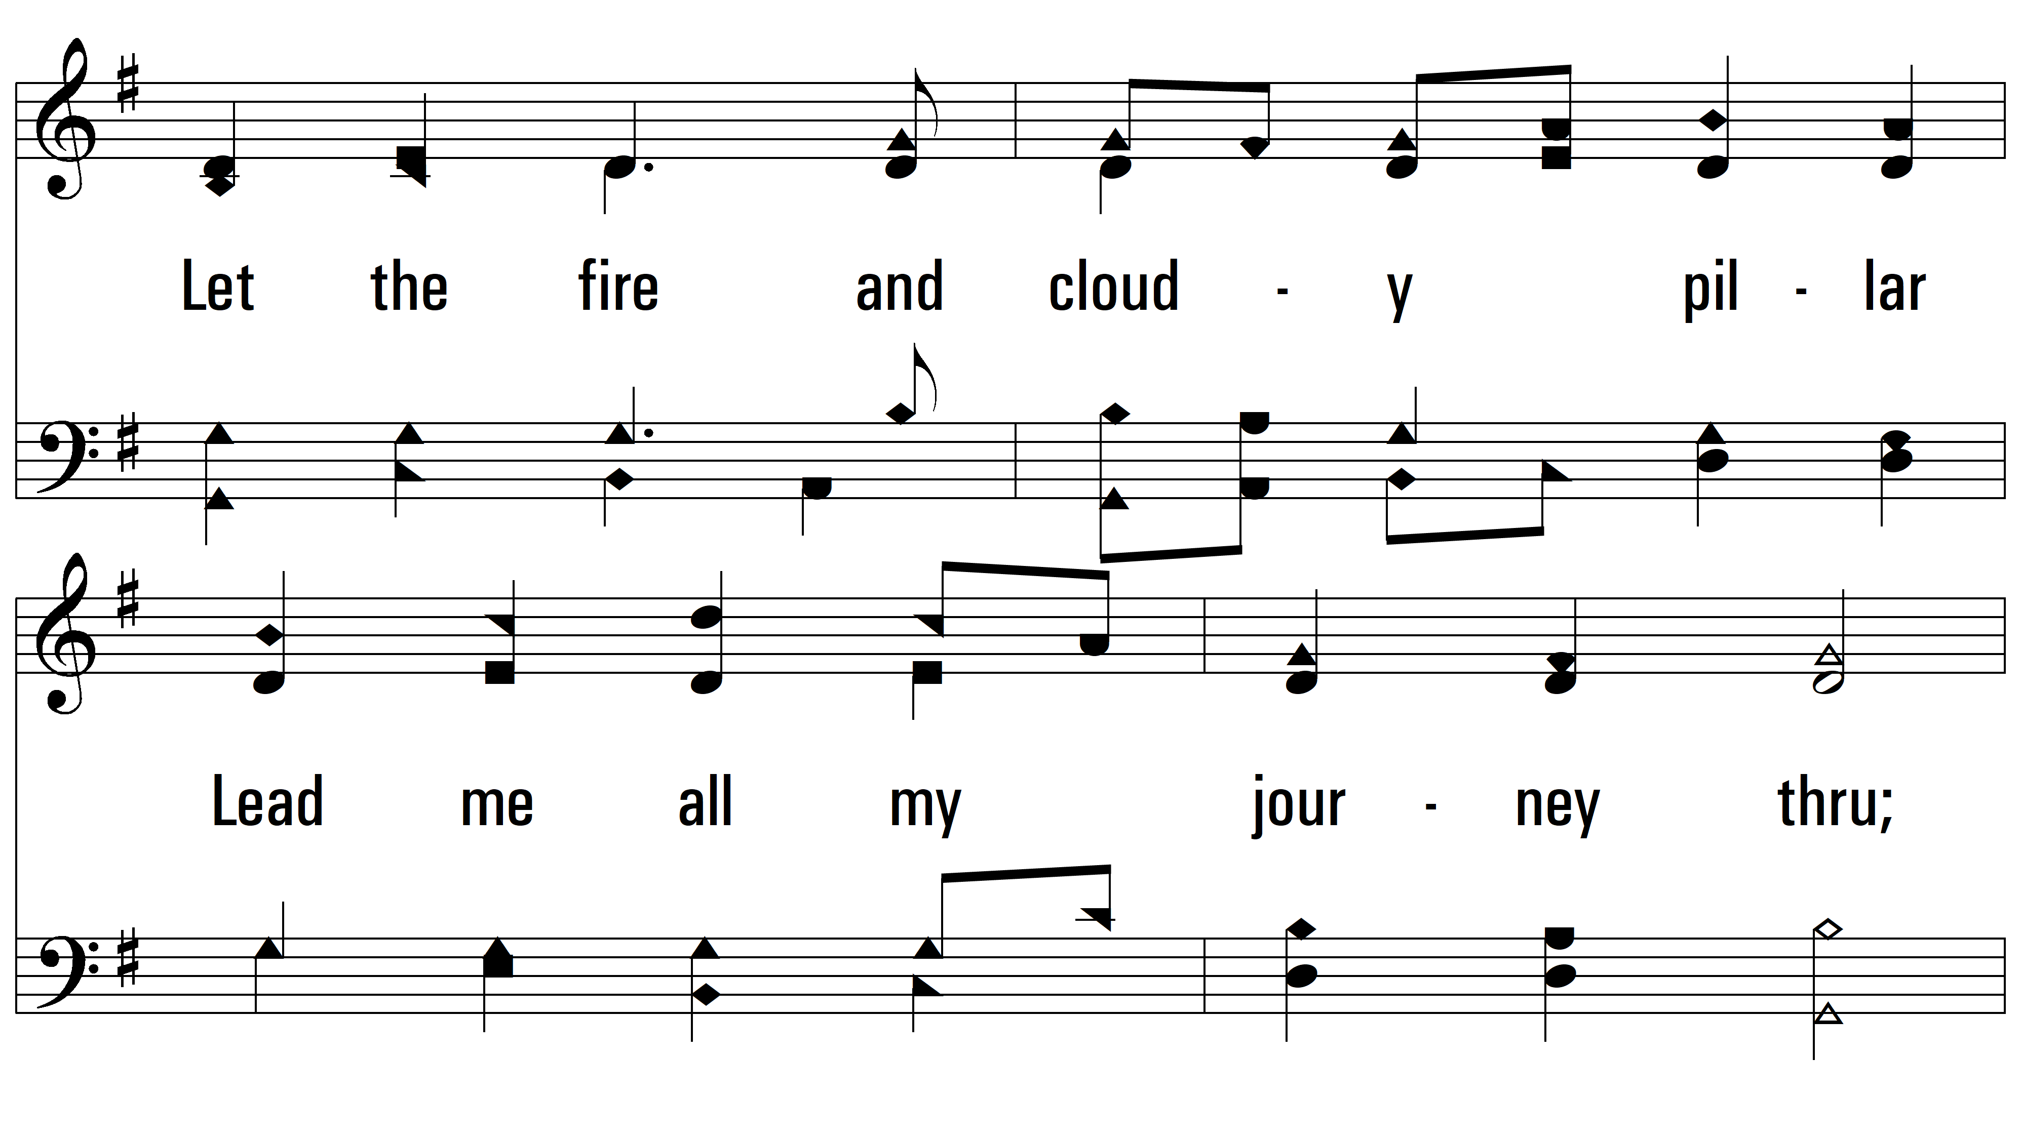
vs. 2

Slide 8
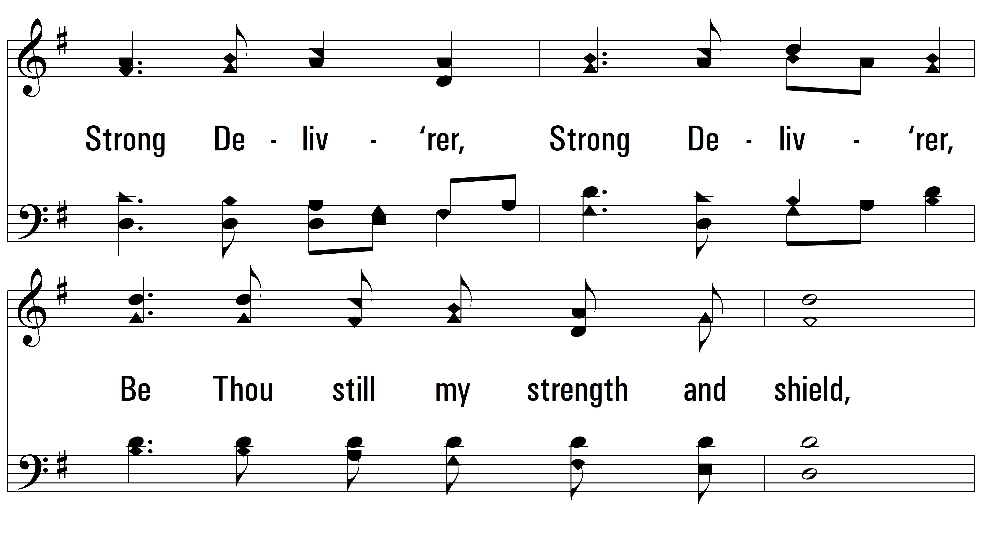
vs. 2

Slide 9
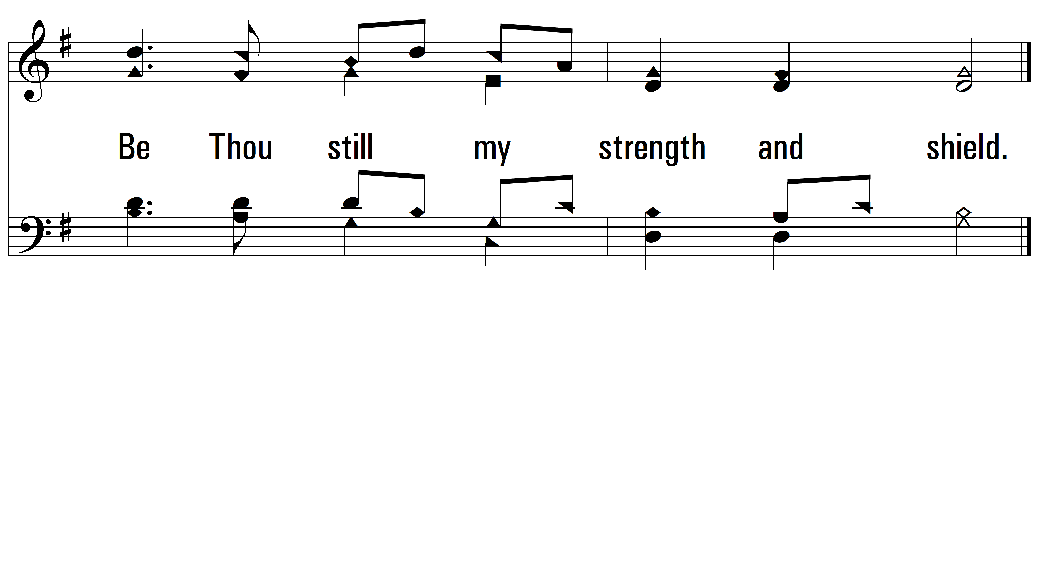
vs. 2

Slide 10
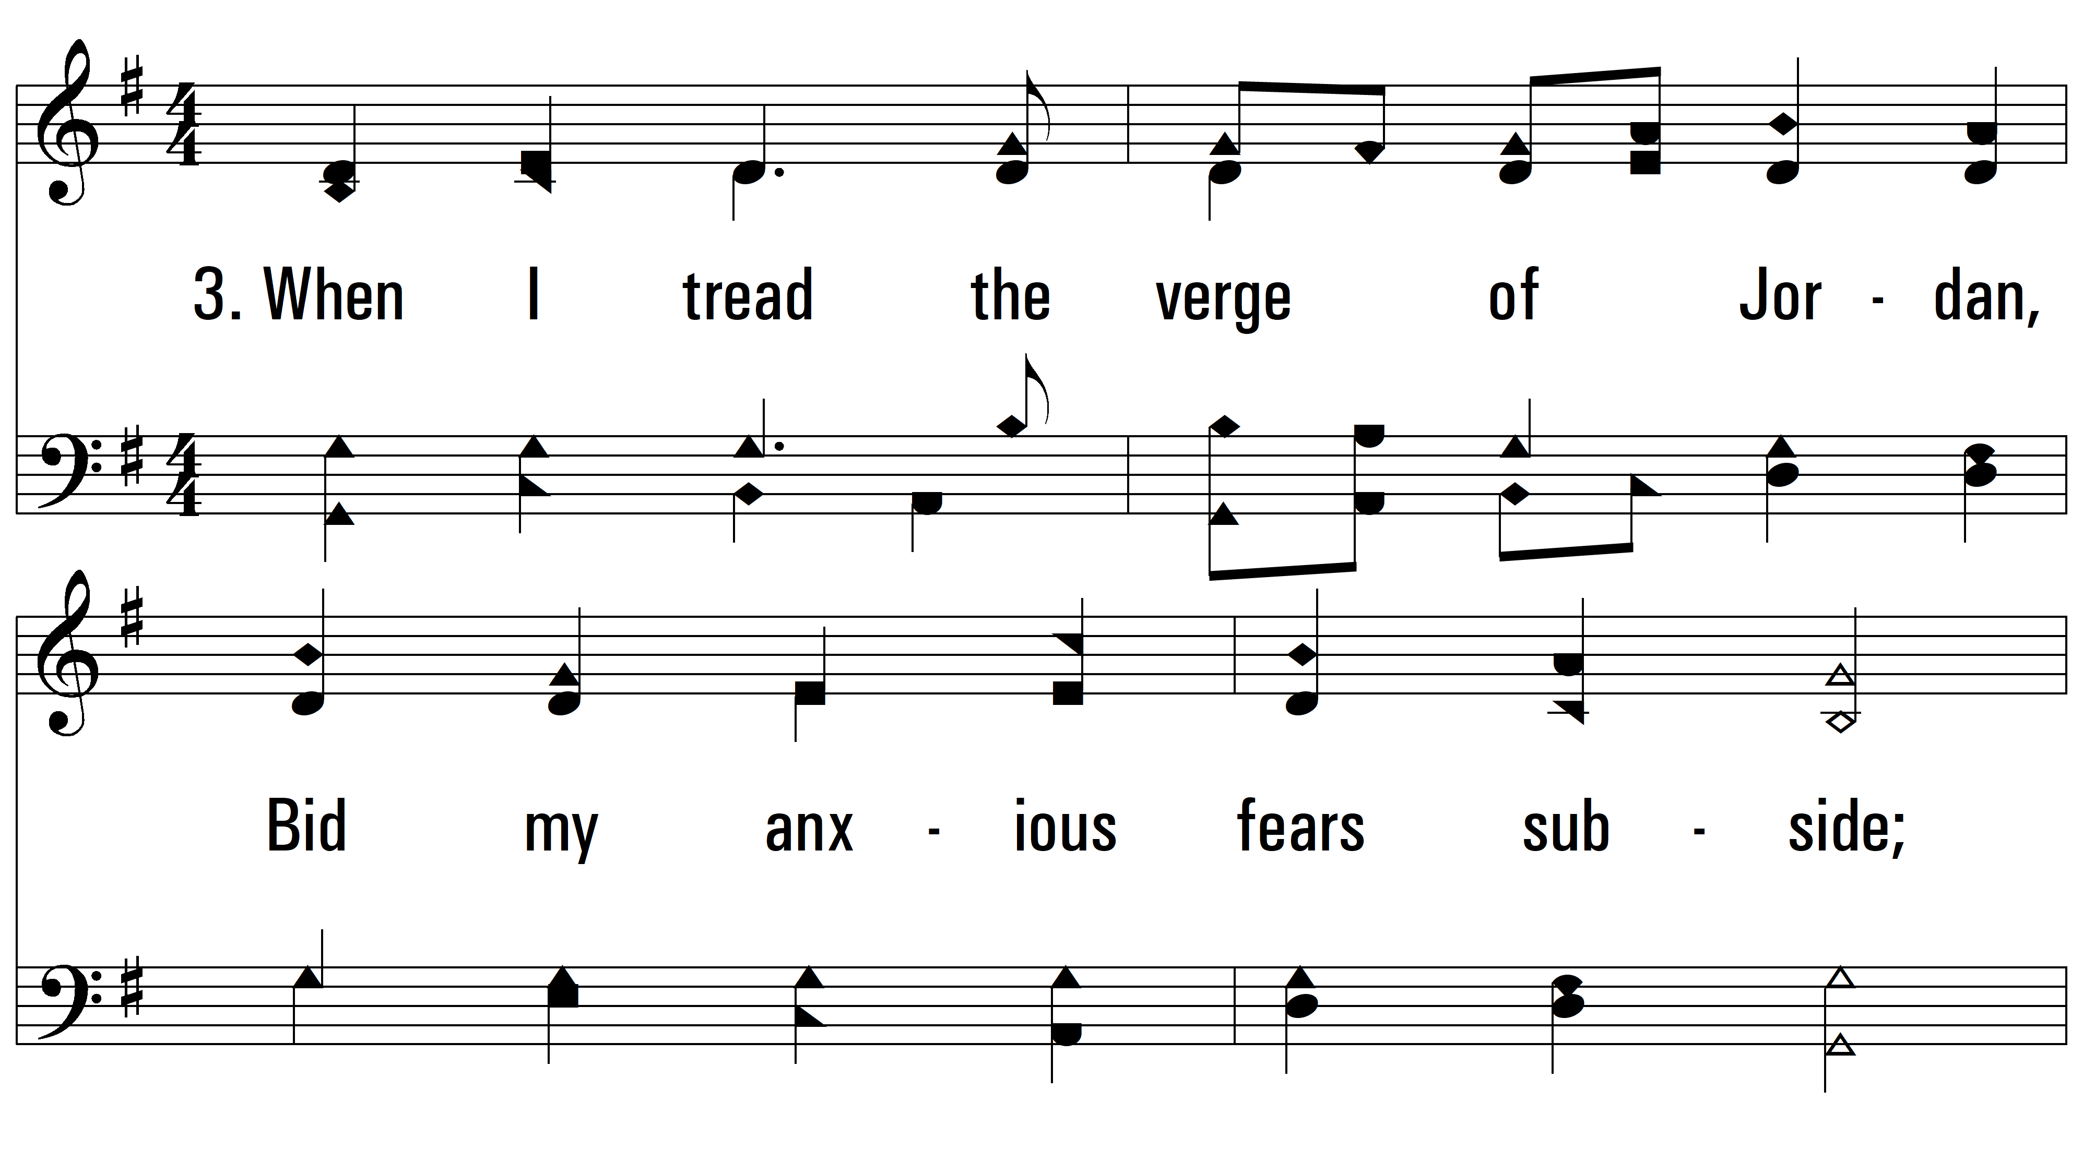
vs. 3 ~ Guide Me, O Thou Great Jehovah

Slide 11
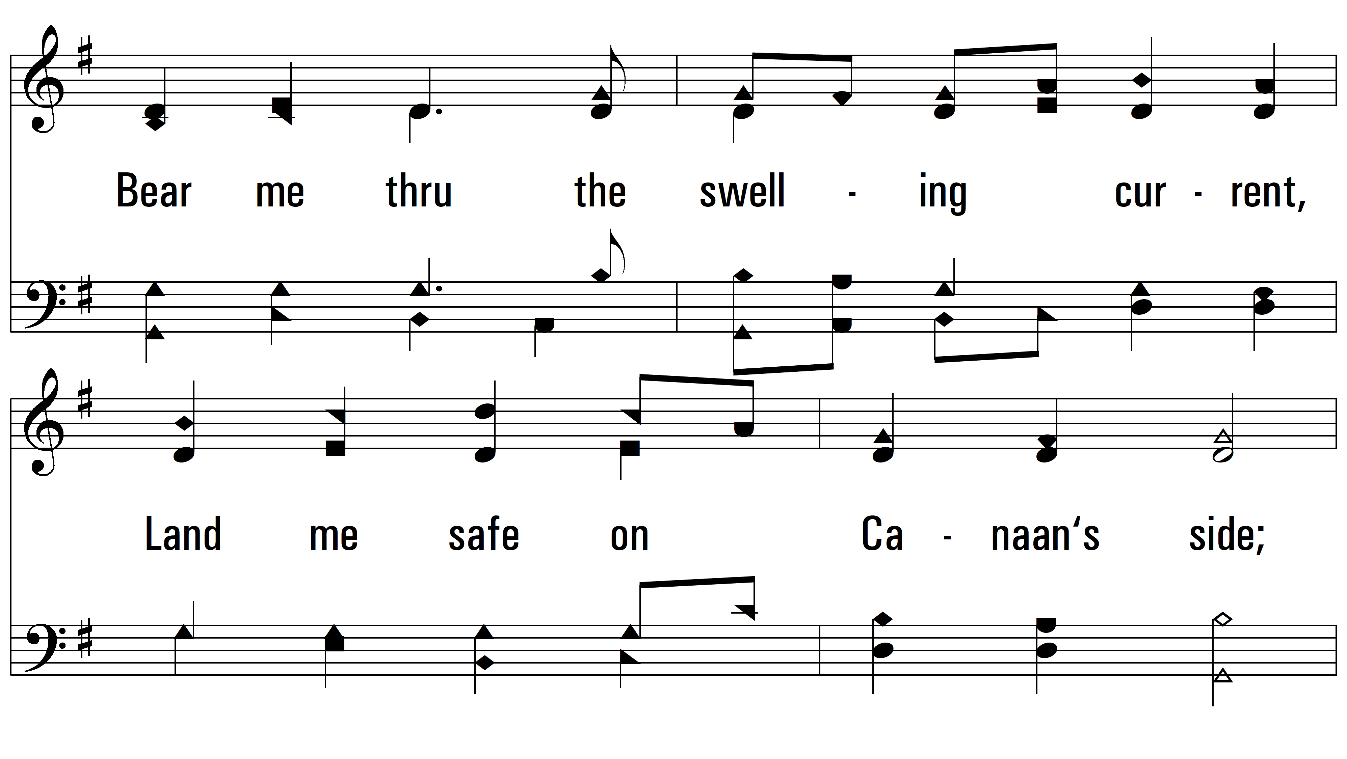
vs. 3

Slide 12
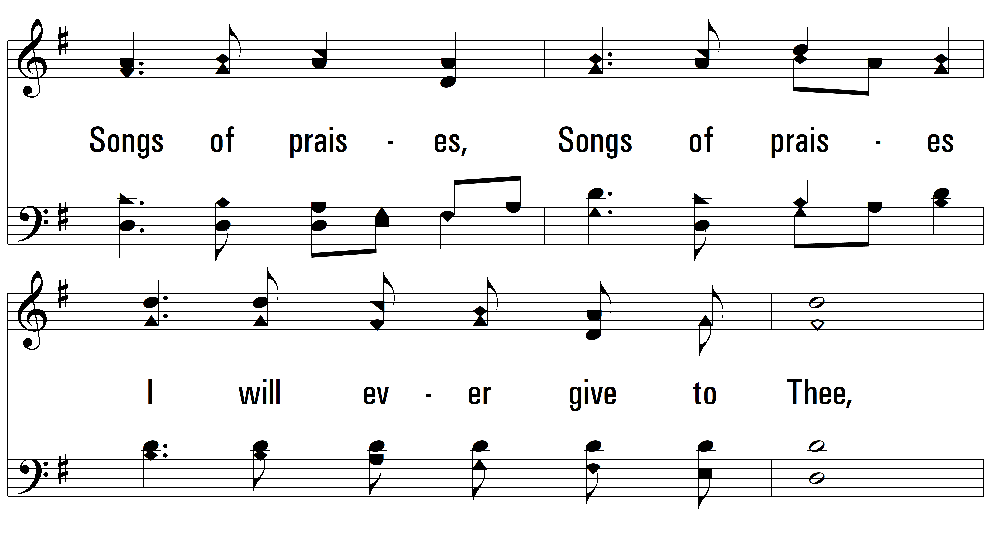
vs. 3

Slide 13
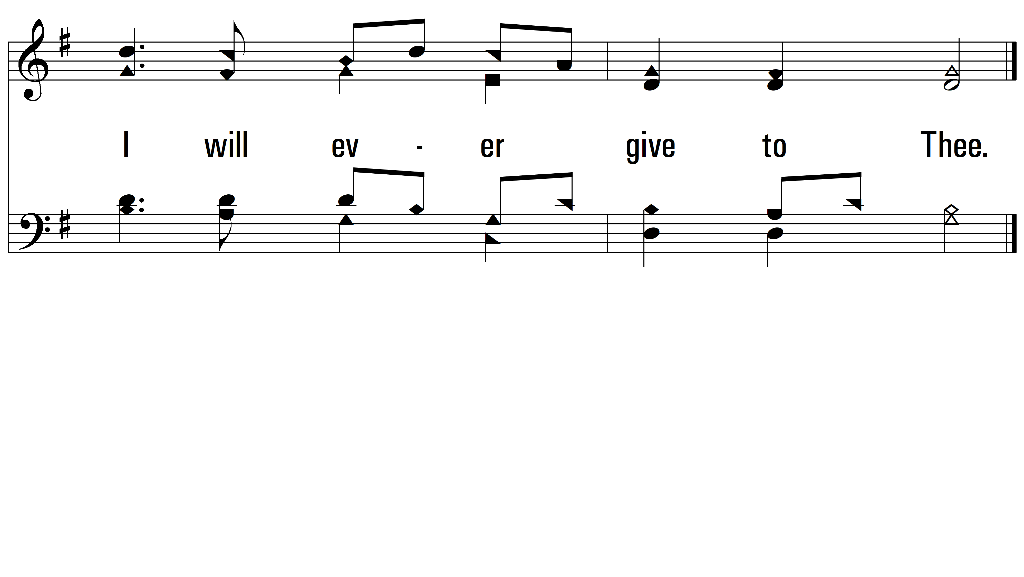
vs. 3
PDHymns.com
END

