Slide 1
Grace Greater Than Our Sin
Words: | Julia H. Johnston (1910)
Music: | Daniel B. Tower (1910)
3/4
G/G - DO
Verses: 3/Chorus
Lead - | DO
Alto - | SOL
Tenor - | MI
Bass - | DO
PDHymns.com

Slide 2
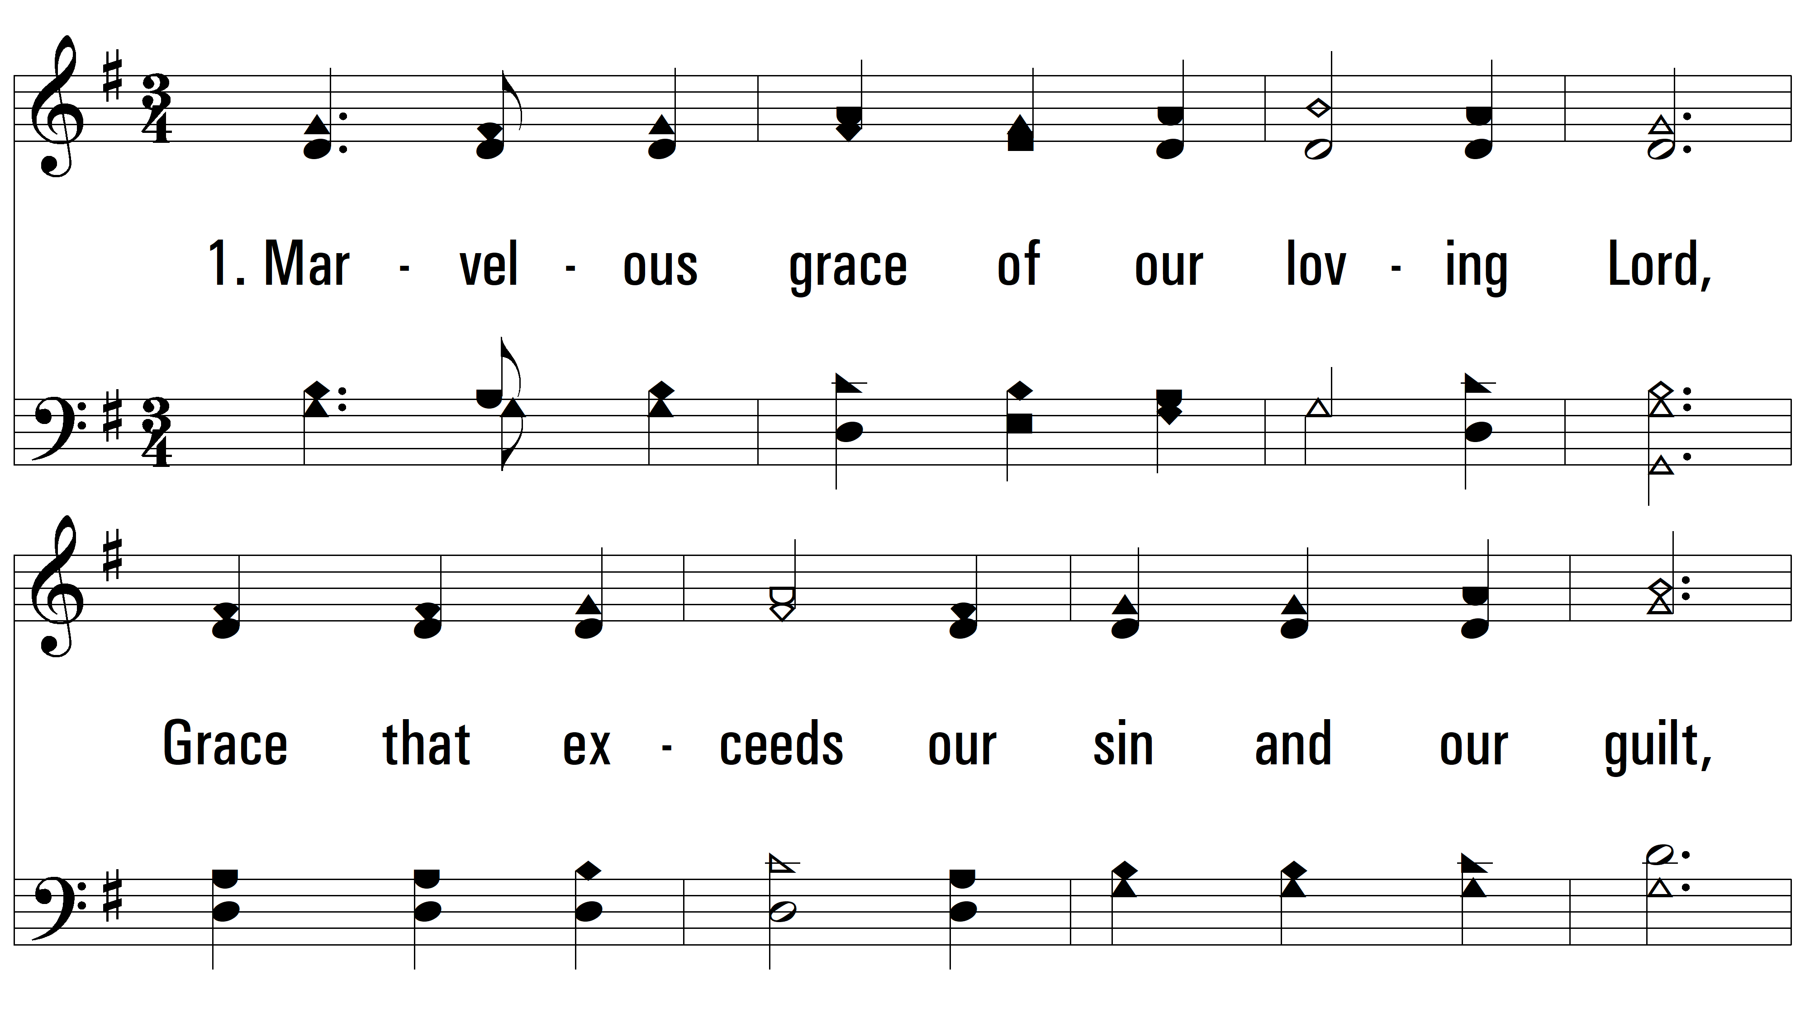
vs. 1 ~ Grace Greater Than Our Sin

Slide 3
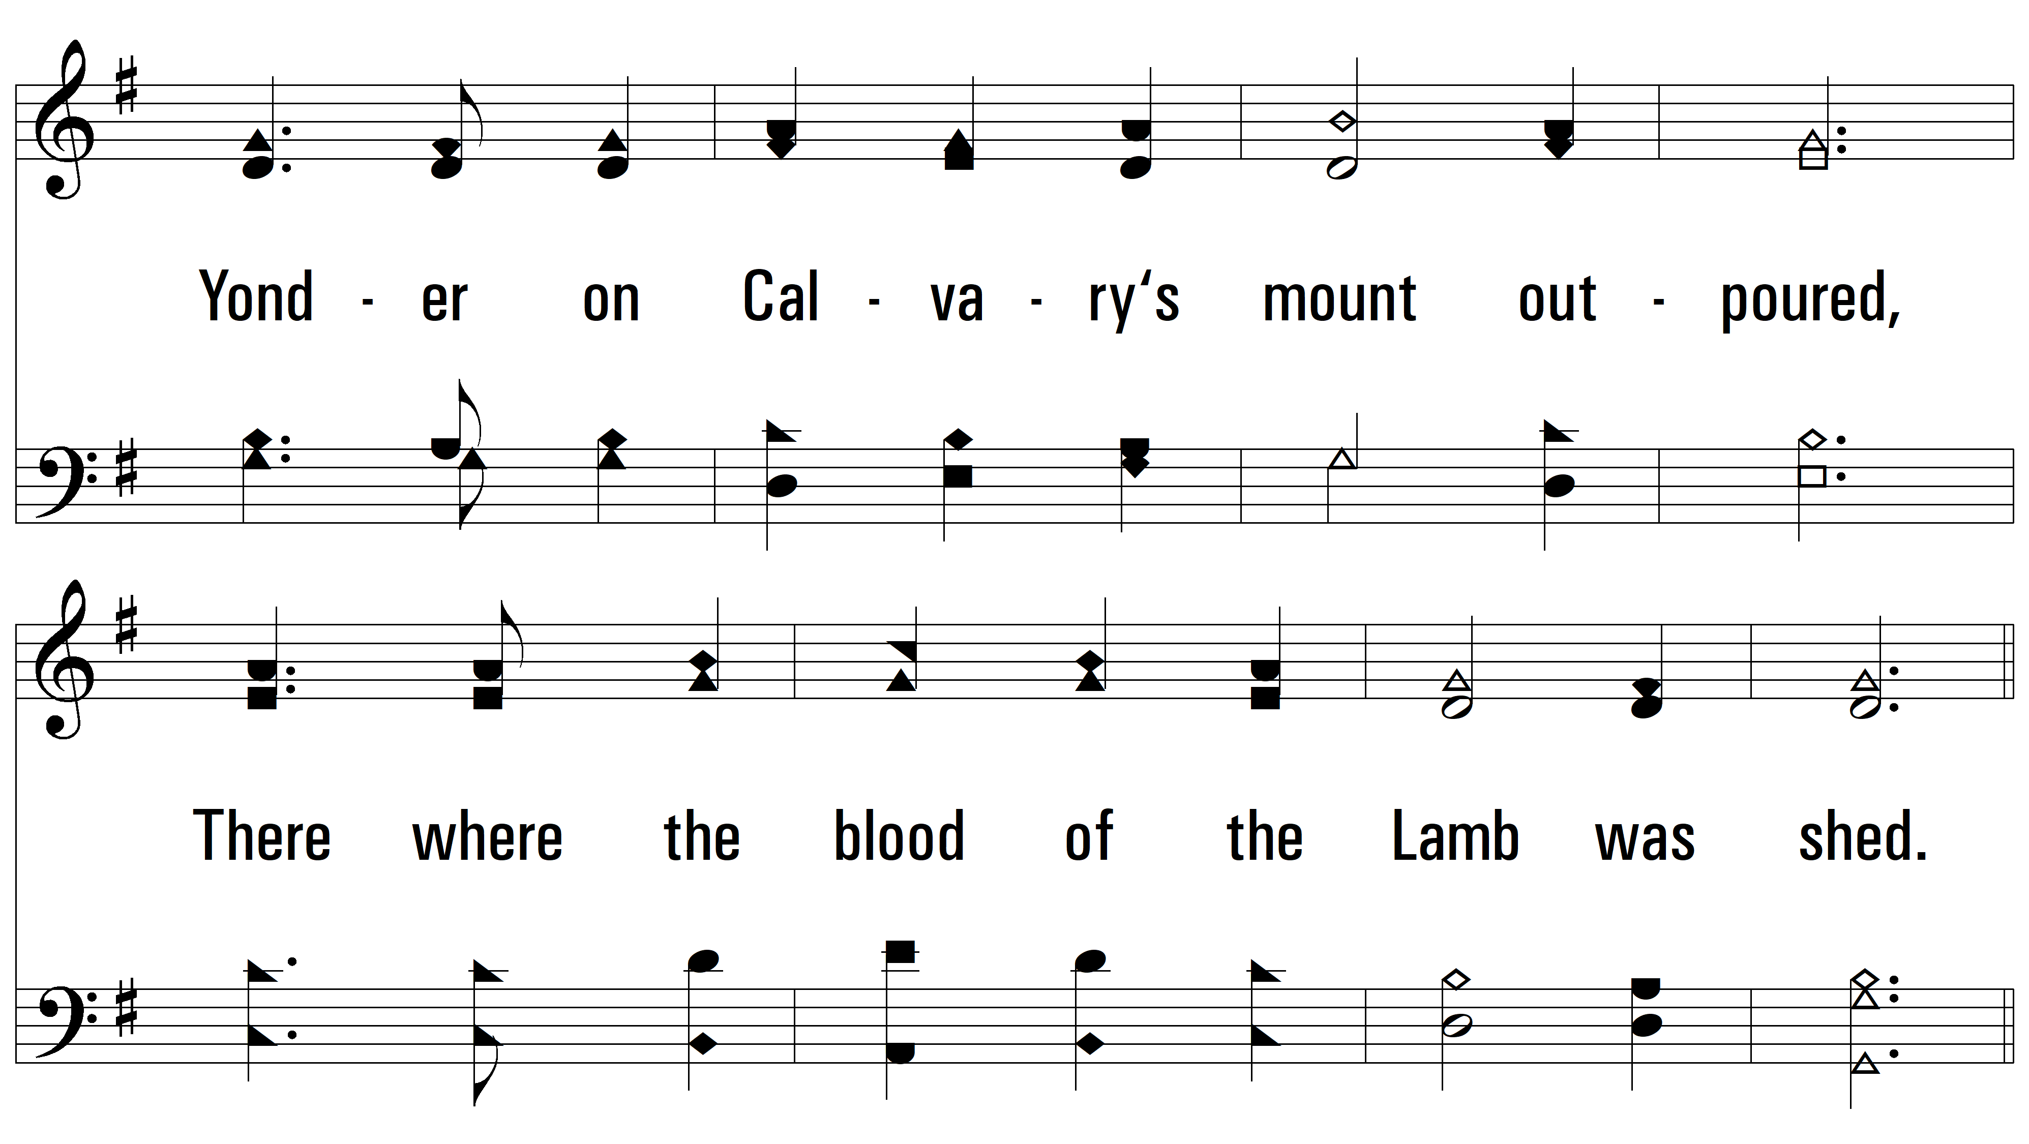
vs. 1

Slide 4
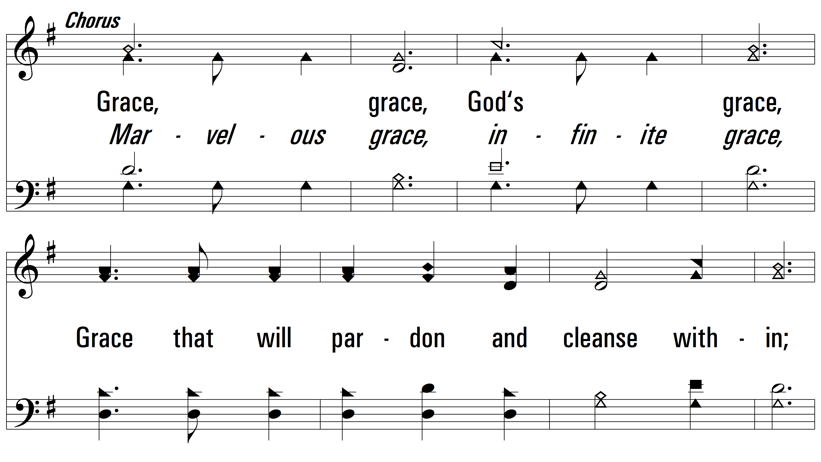
vs. 1

Slide 5
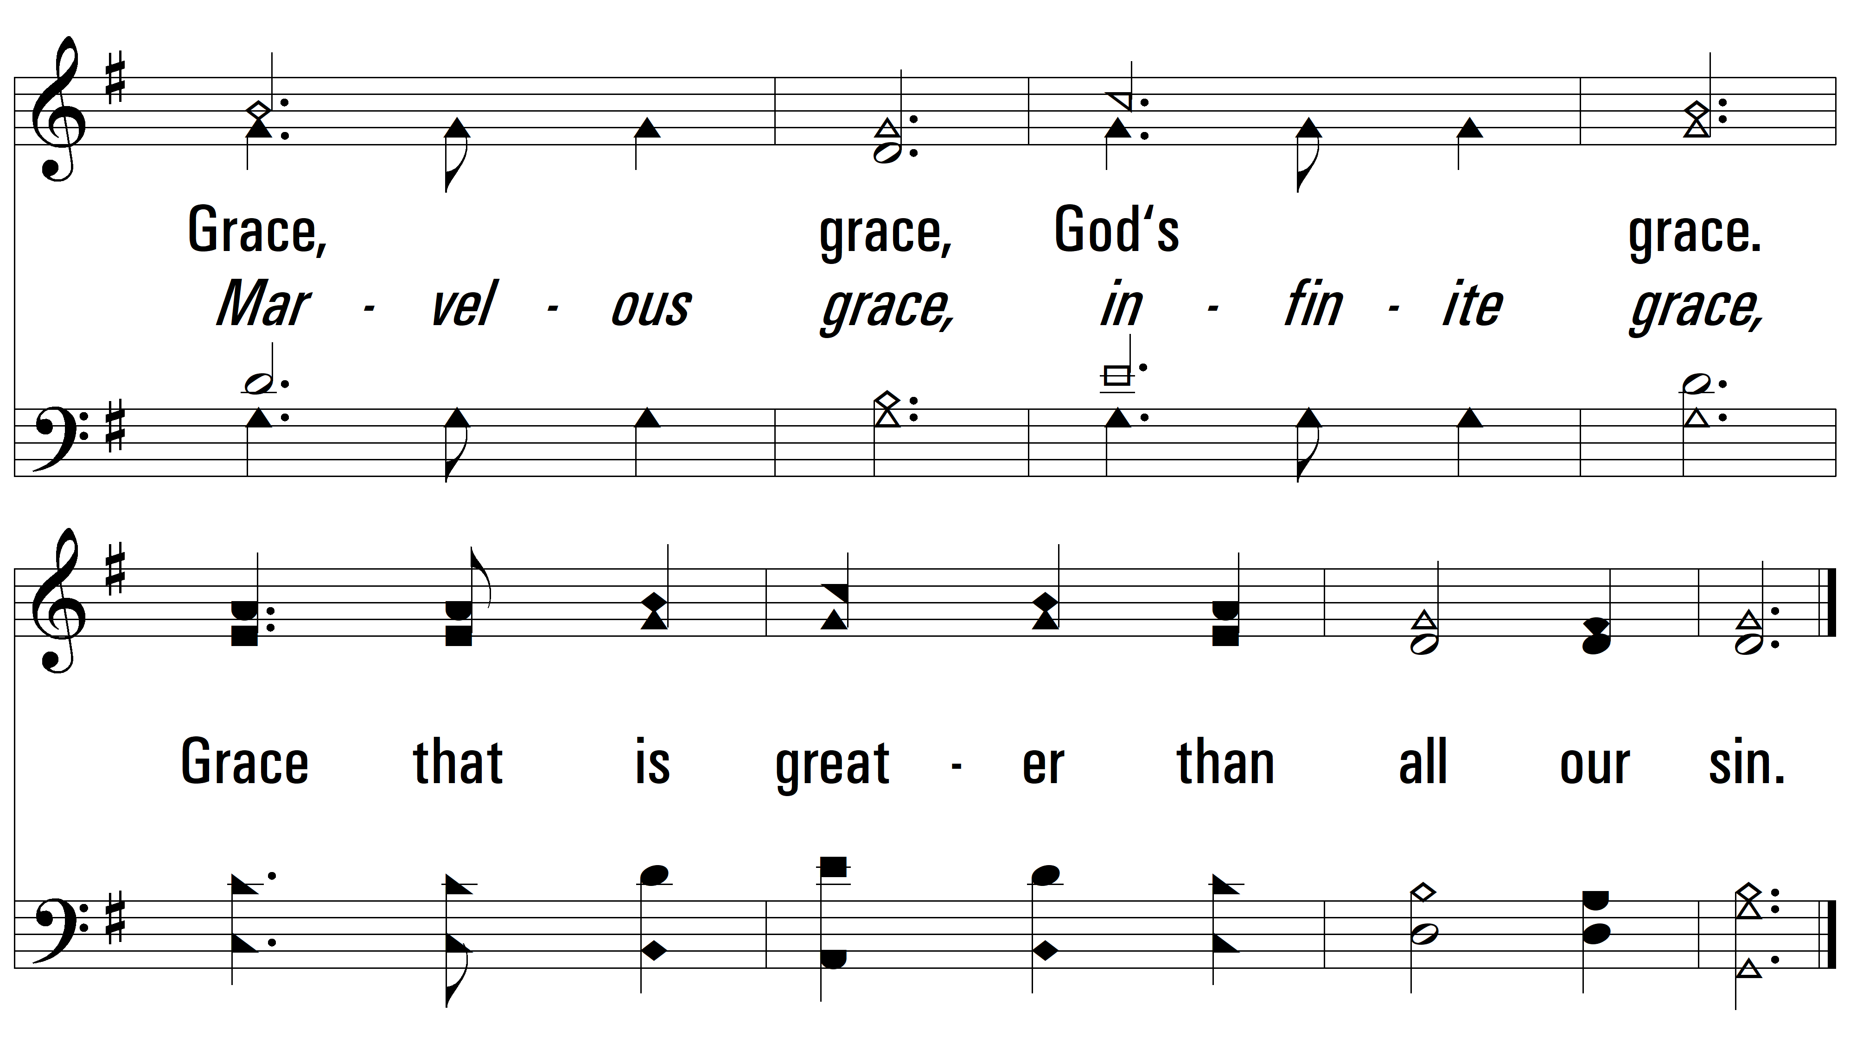
vs. 1

Slide 6
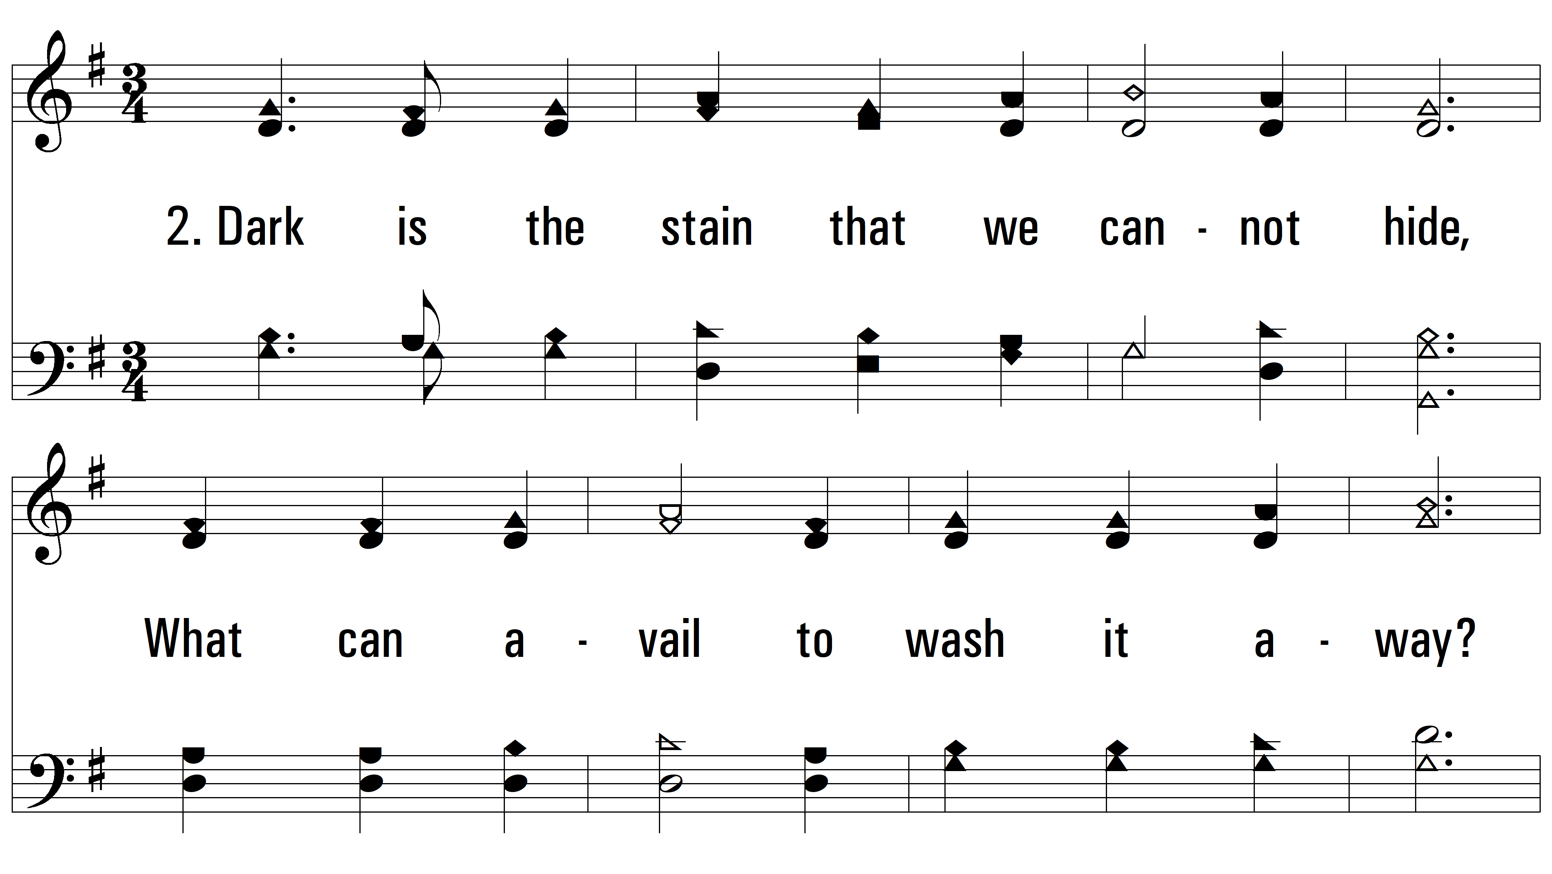
vs. 2 ~ Grace Greater Than Our Sin

Slide 7
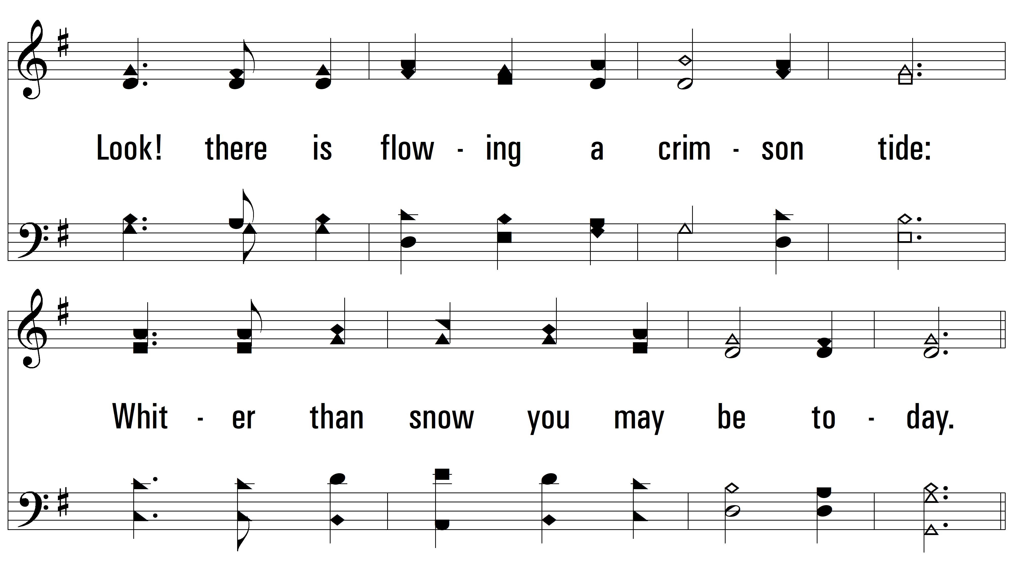
vs. 2

Slide 8
vs. 2

Slide 9
vs. 2

Slide 10
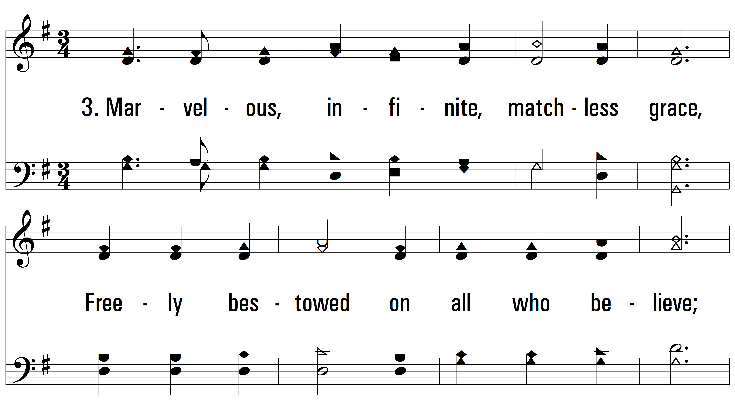
vs. 3 ~ Grace Greater Than Our Sin

Slide 11
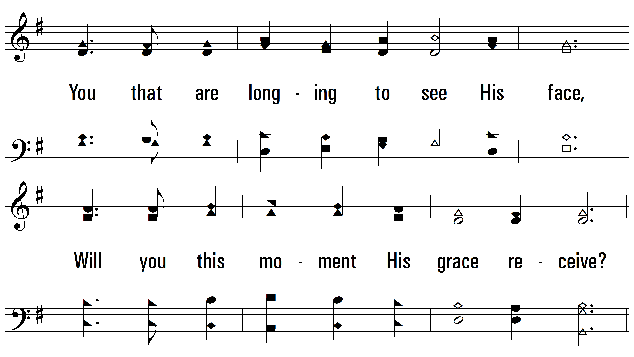
vs. 3

Slide 12
vs. 3

Slide 13
vs. 3
PDHymns.com
END

