Slide 1
God Of Our Fathers
NATIONAL HYMN
10.10.10.10
Words: | Daniel C. Roberts (1876)
Music: | George W. Warren (1876)
4/4
F/F - DO
Verses: 4
Lead - | DO
Alto - | SOL
Tenor - | MI
Bass - | DO
PDHymns.com

Slide 2
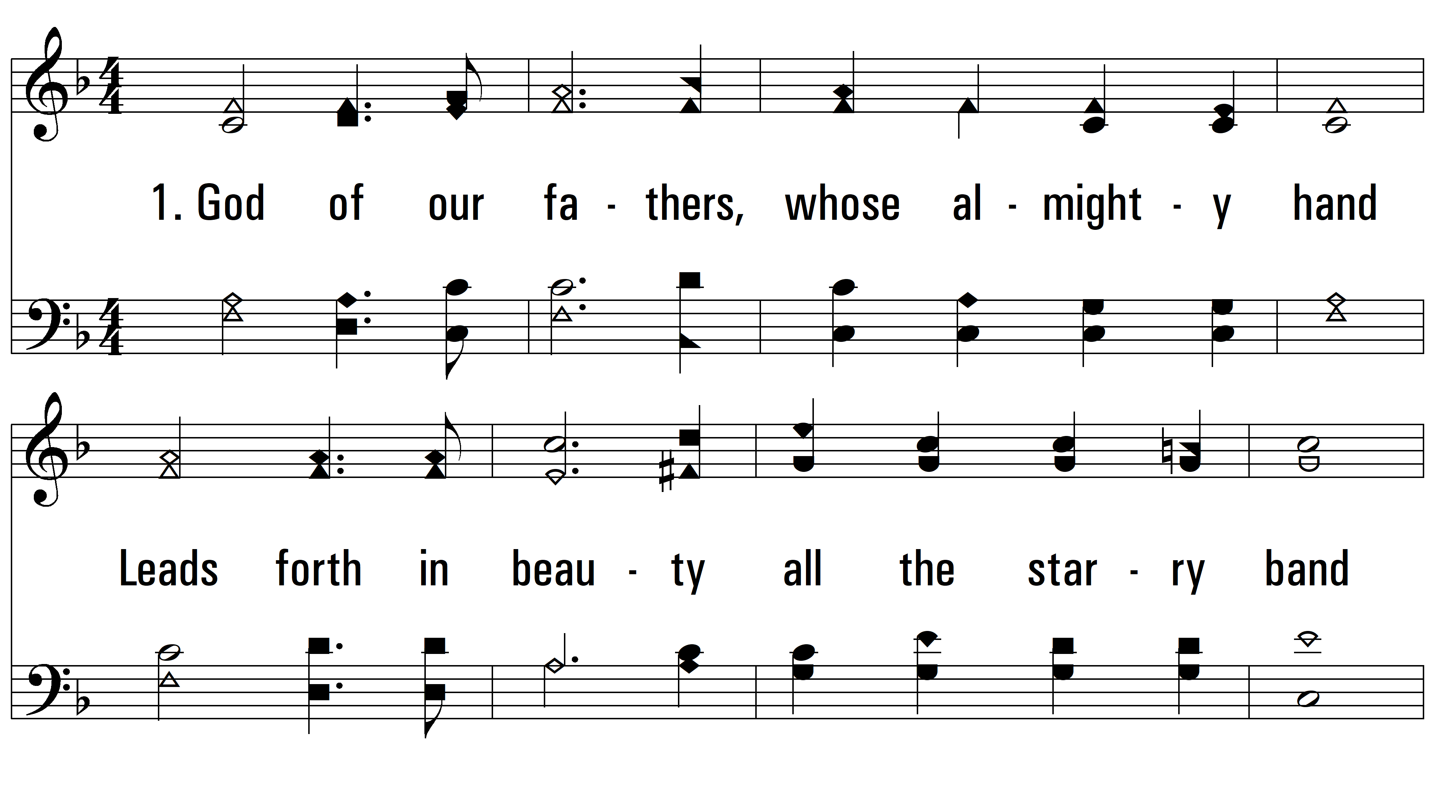
vs. 1 ~ God Of Our Fathers

Slide 3
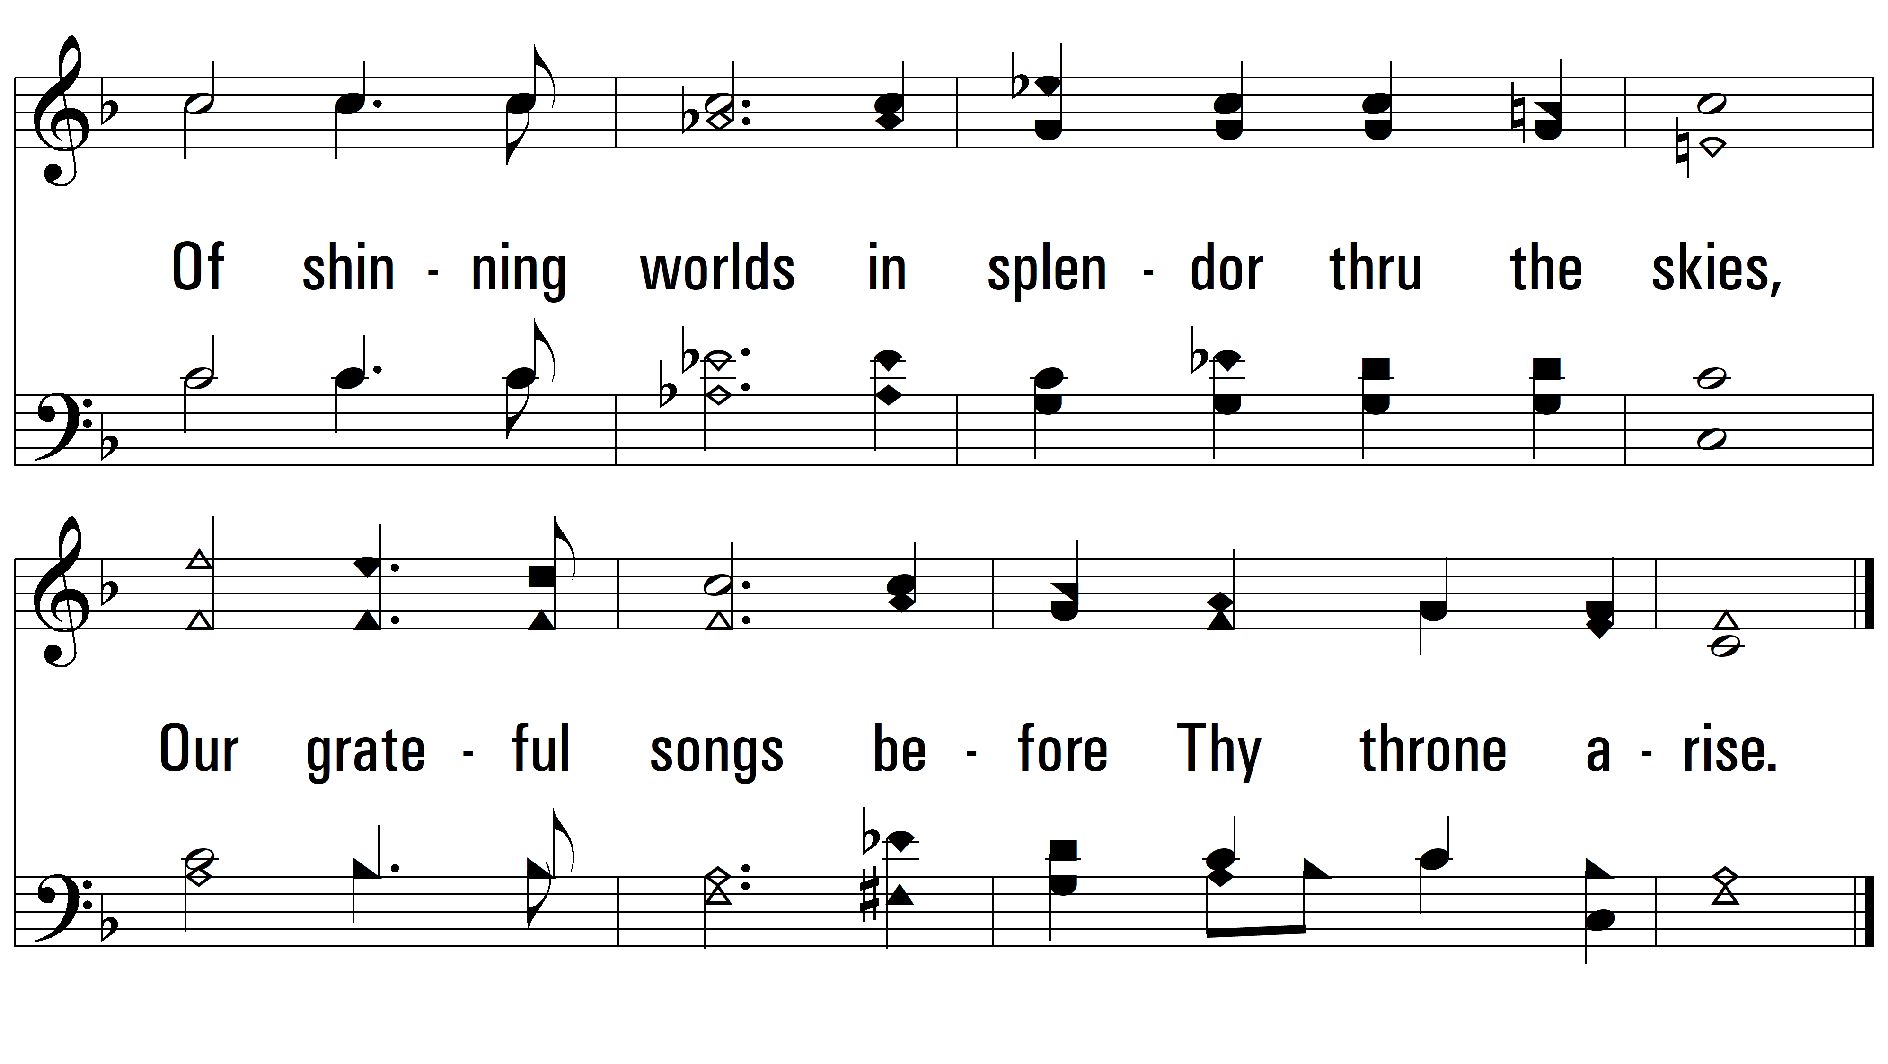
vs. 1

Slide 4
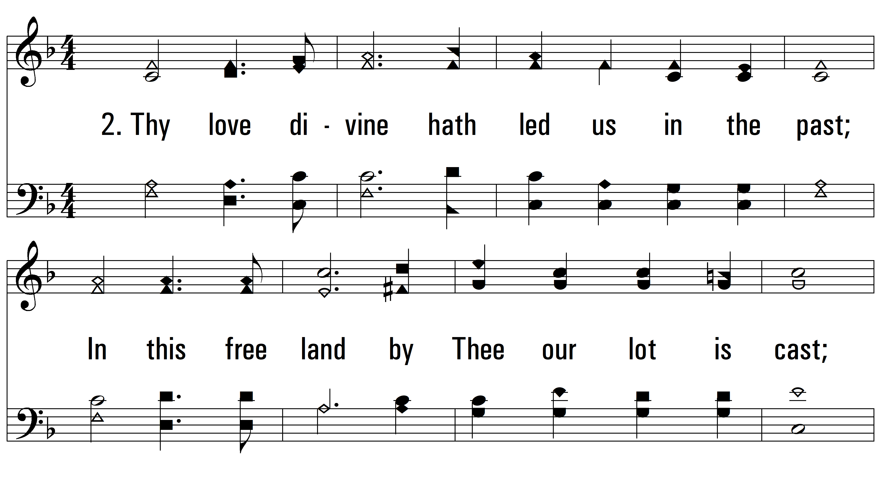
vs. 2 ~ God Of Our Fathers

Slide 5
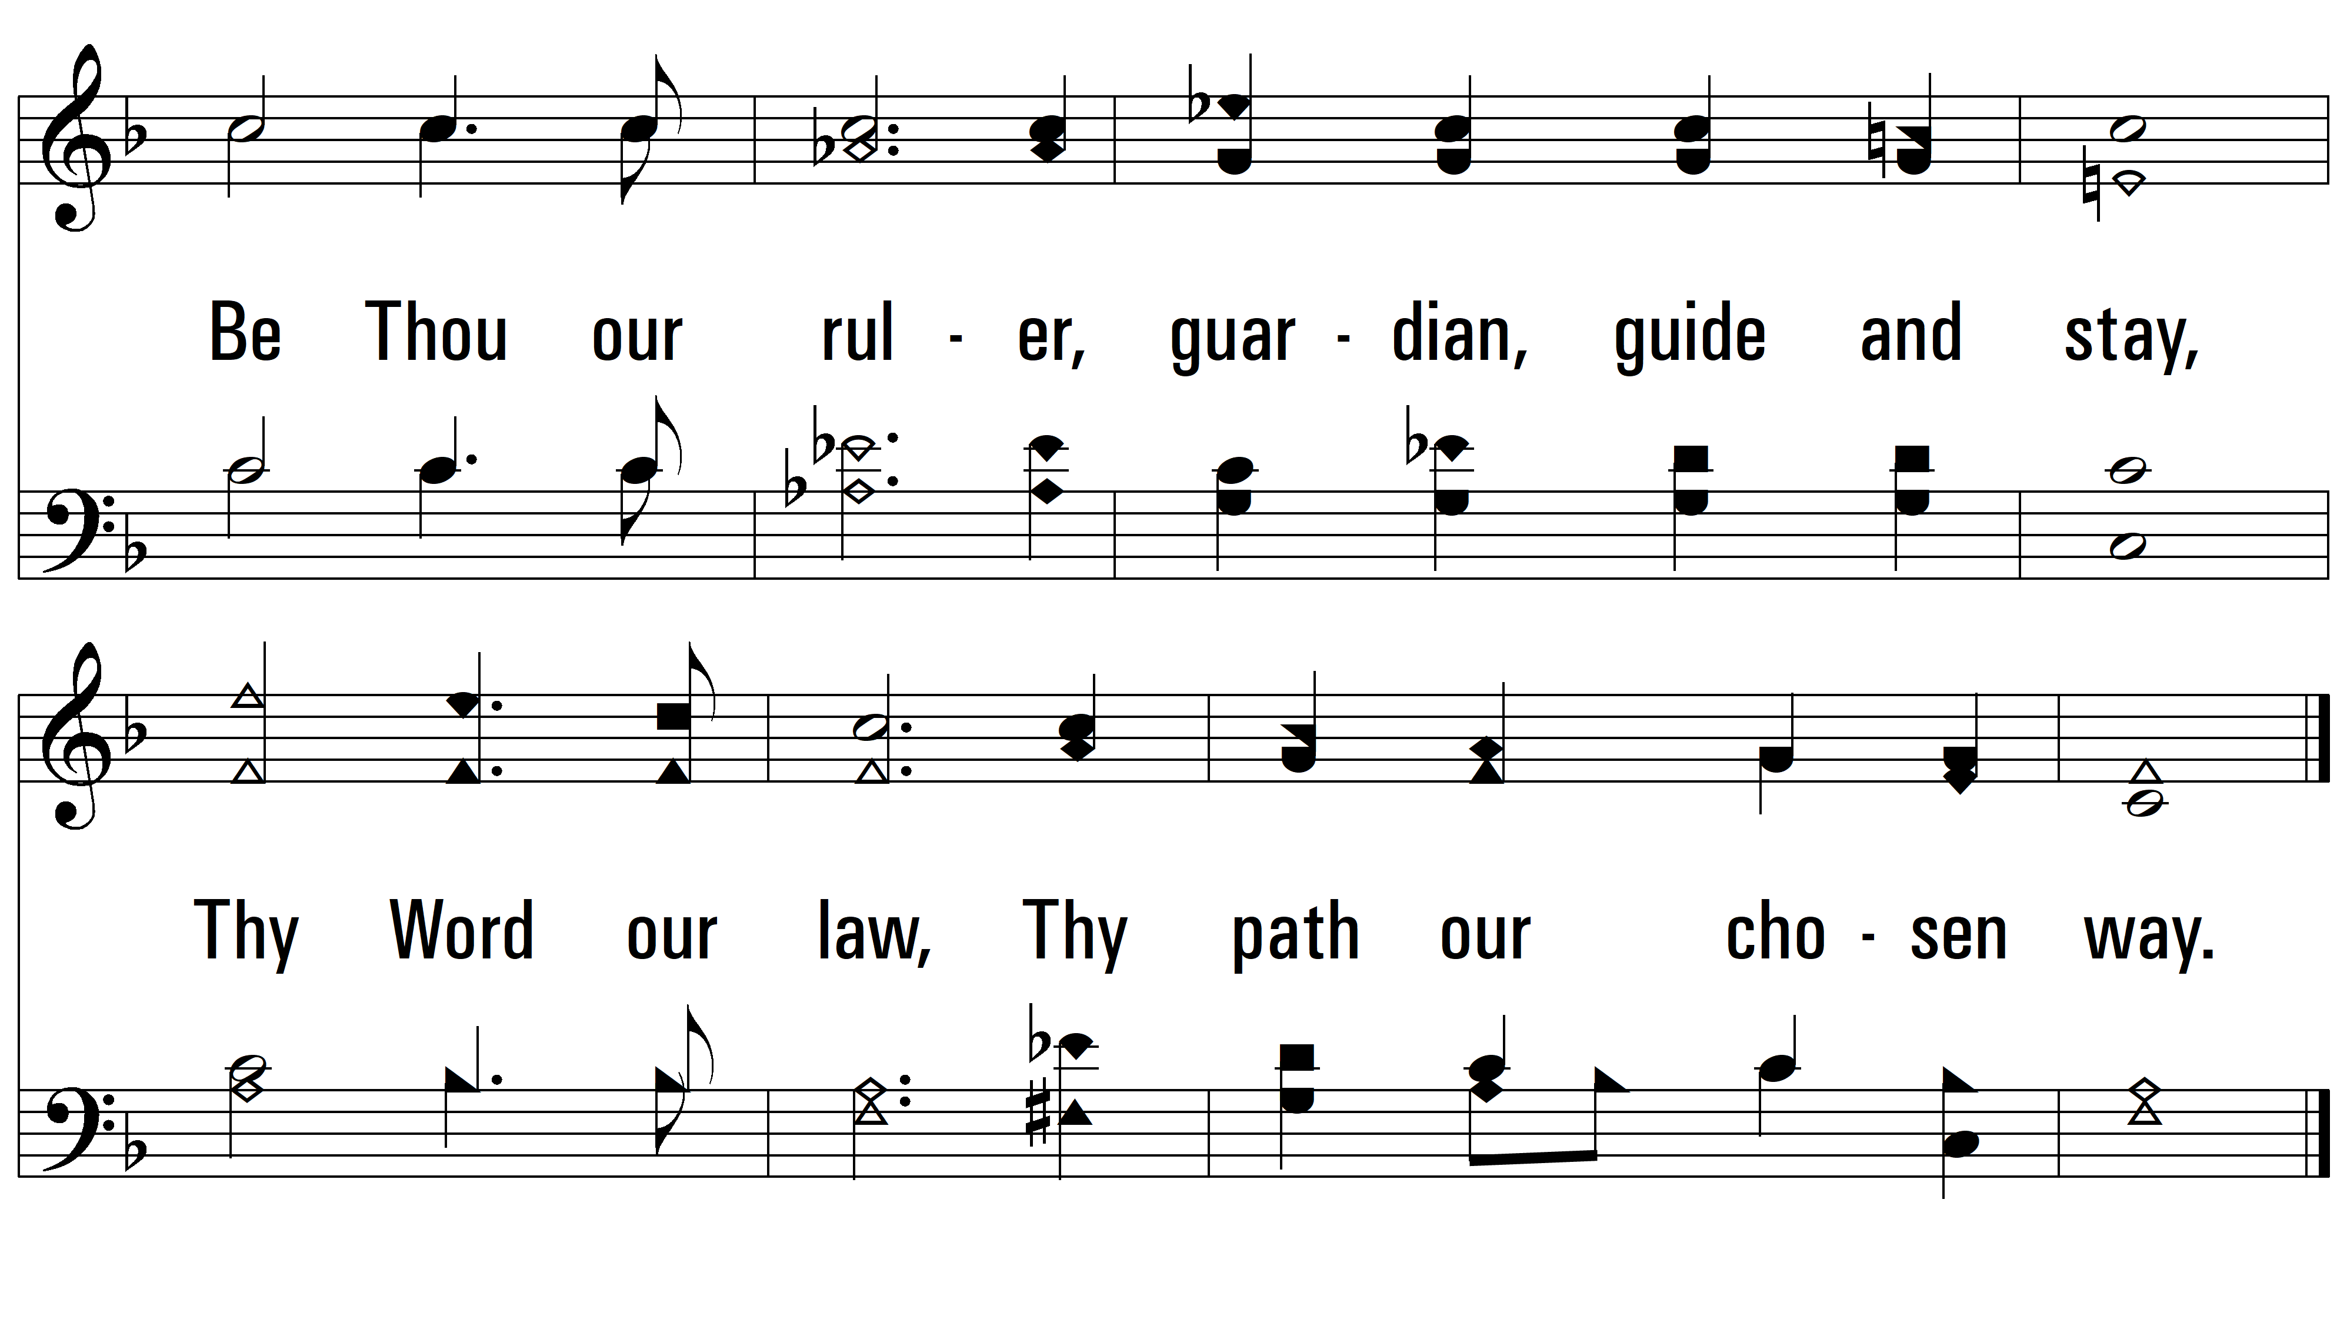
vs. 2

Slide 6
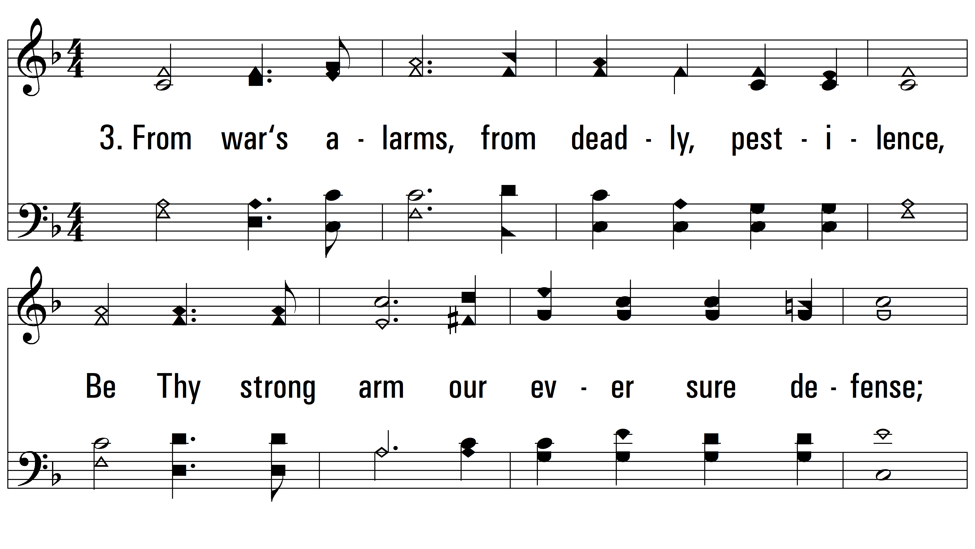
vs. 3 ~ God Of Our Fathers

Slide 7
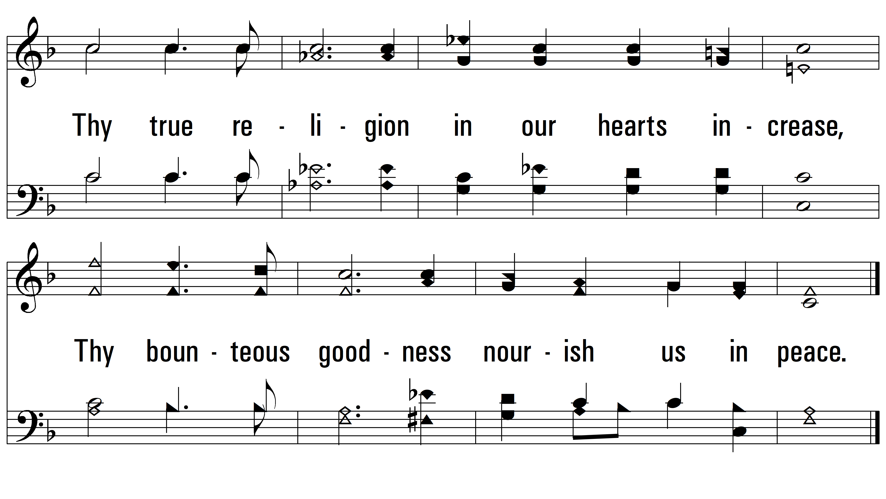
vs. 3

Slide 8
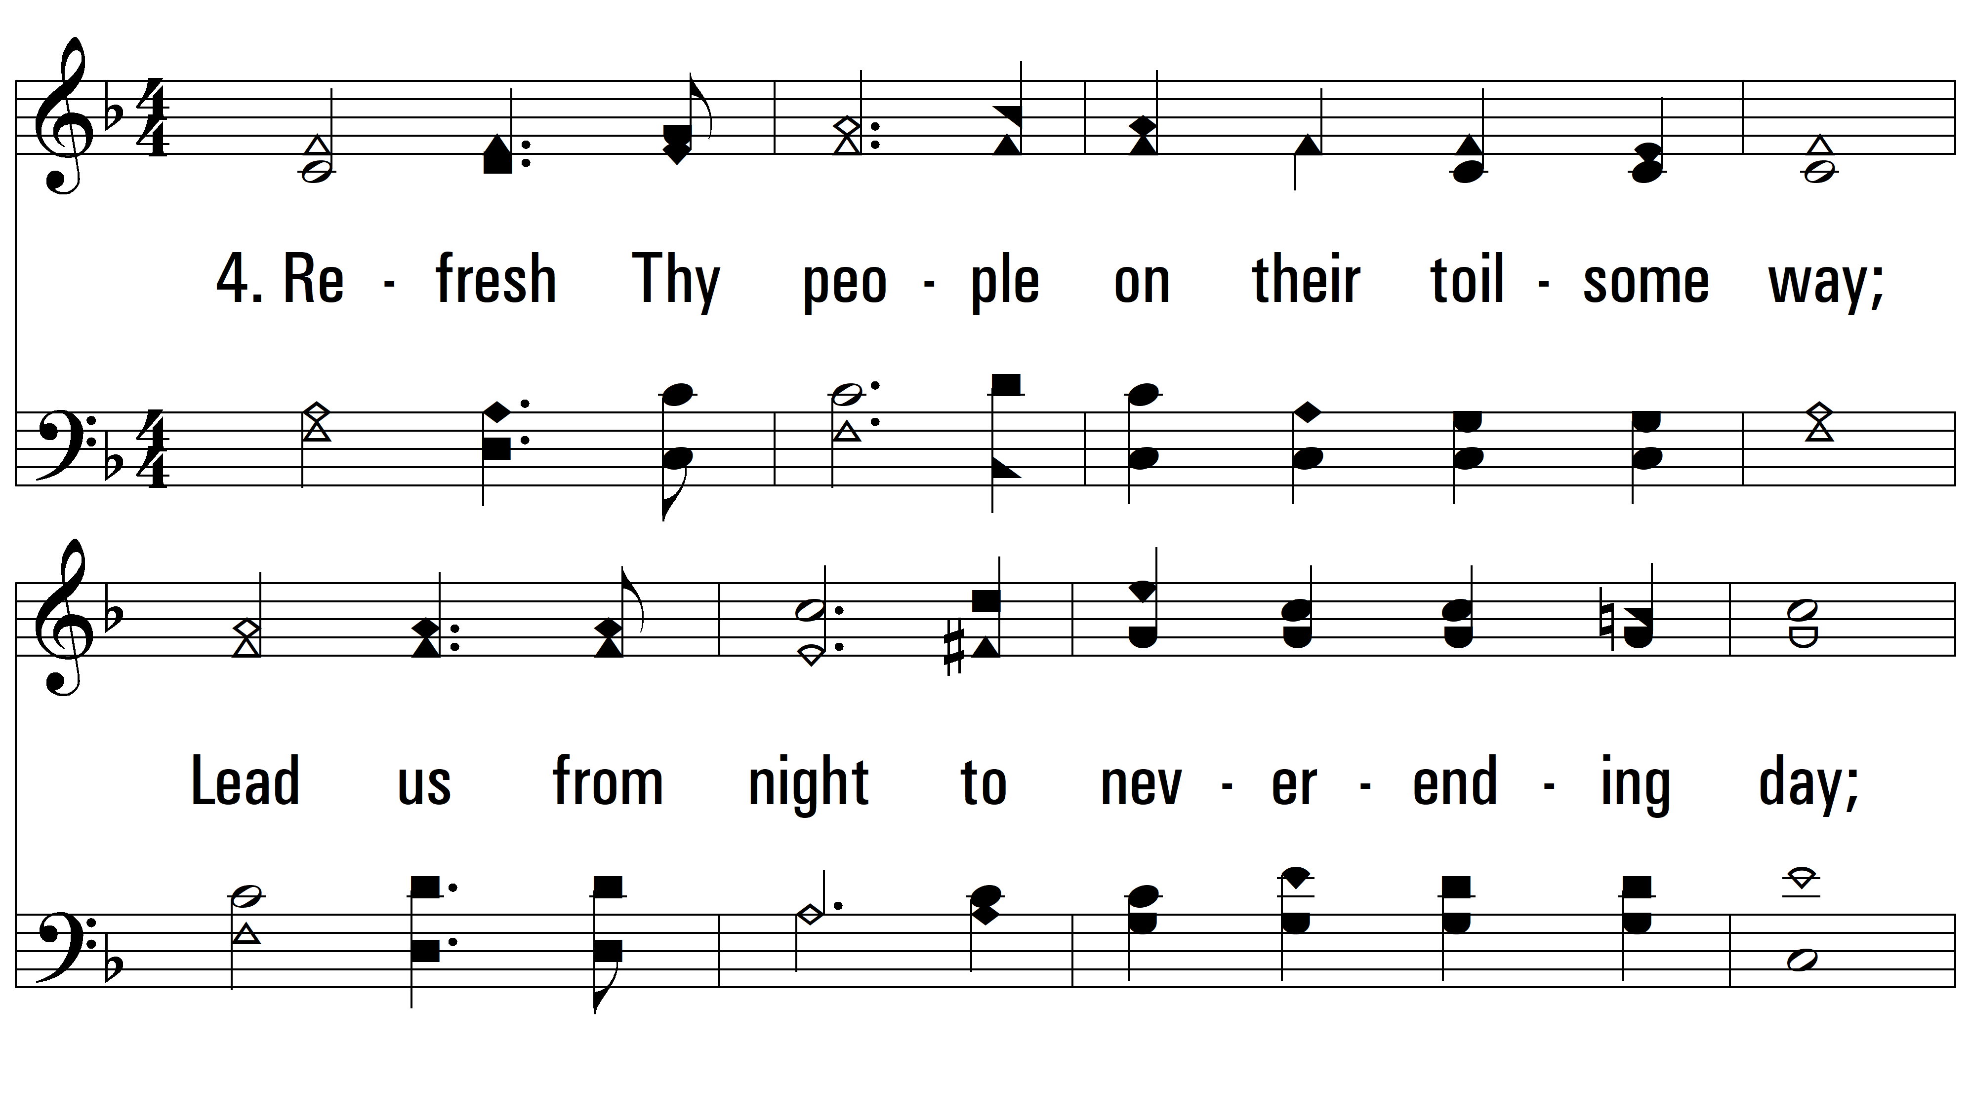
vs. 4 ~ God Of Our Fathers

Slide 9
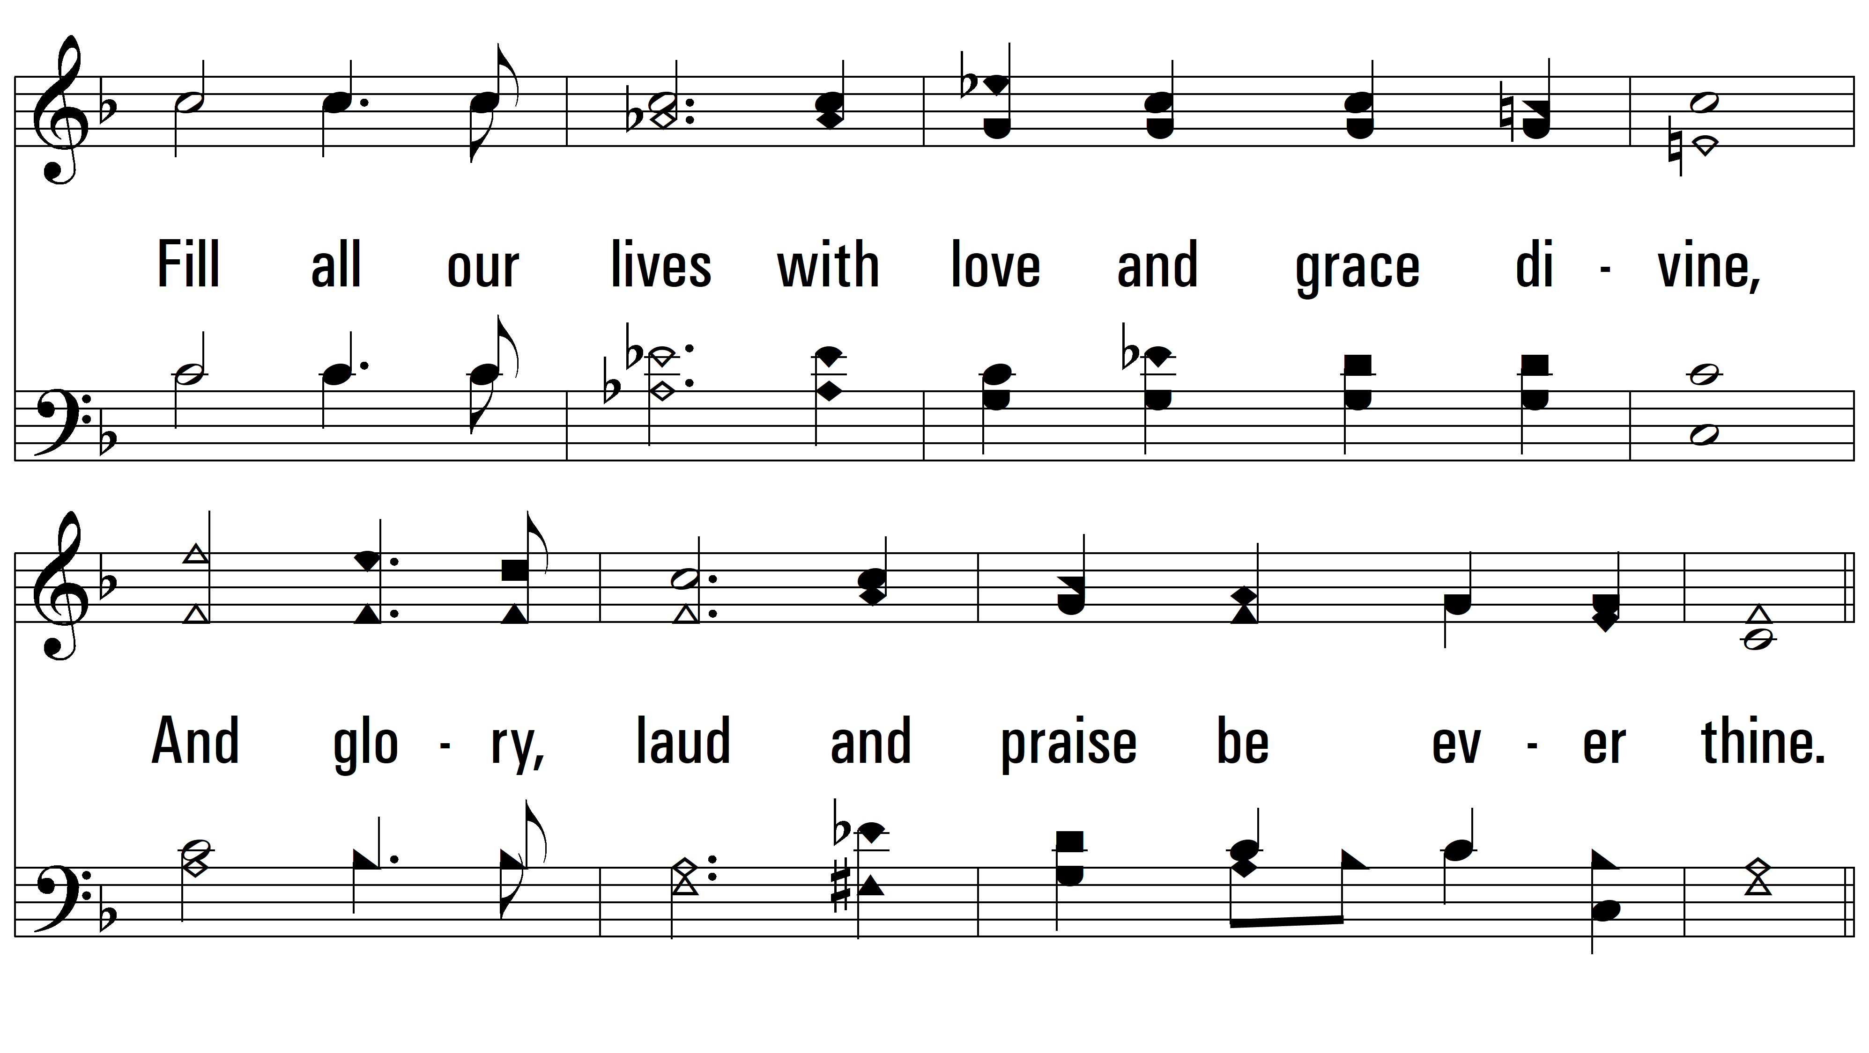
vs. 4
PDHymns.com
END

