Slide 1
God Is The Fountain Whence
GERAR
SM
Words: | Benjamin Beddome (1817)
Music: | Lowell Mason (1839)
3/4
F/F - DO
Verses: 3
Lead - | DO
Alto - | DO
Tenor - | DO
Bass - | DO
PDHymns.com

Slide 2
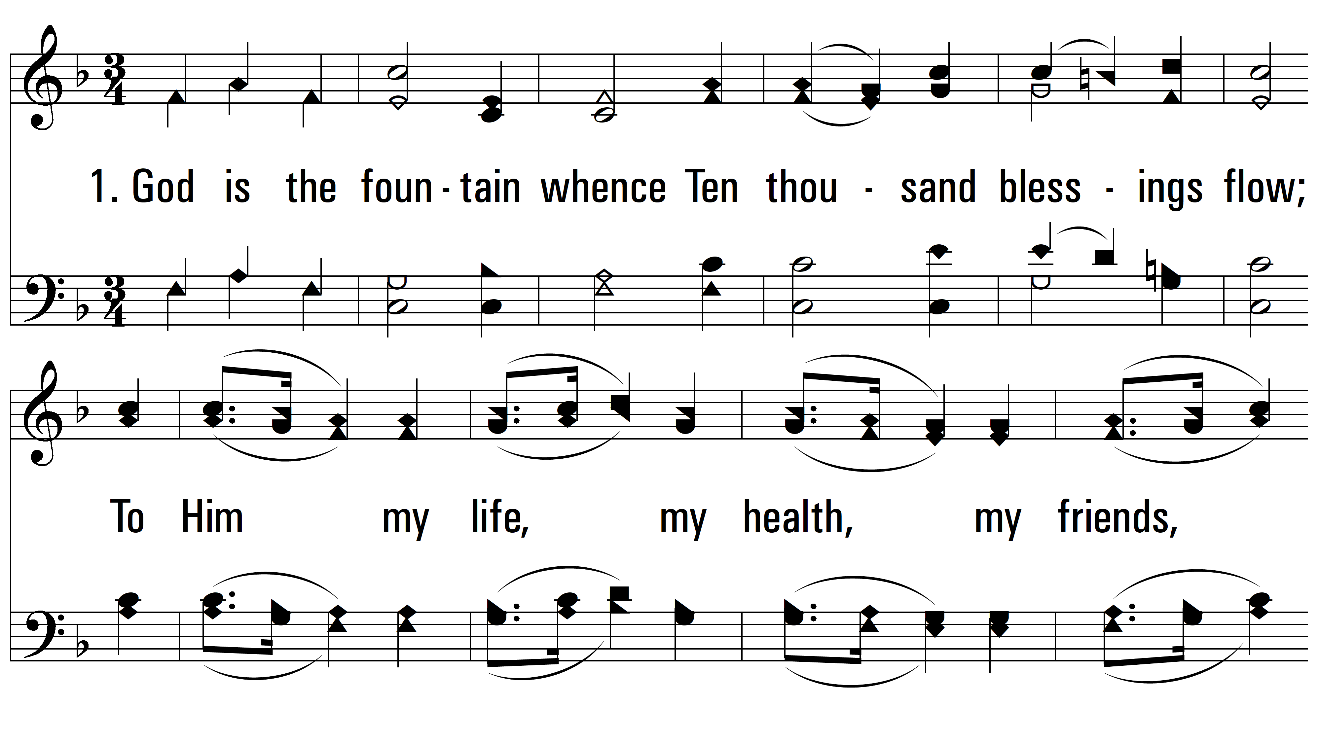
vs. 1 ~ God Is The Fountain Whence

Slide 3
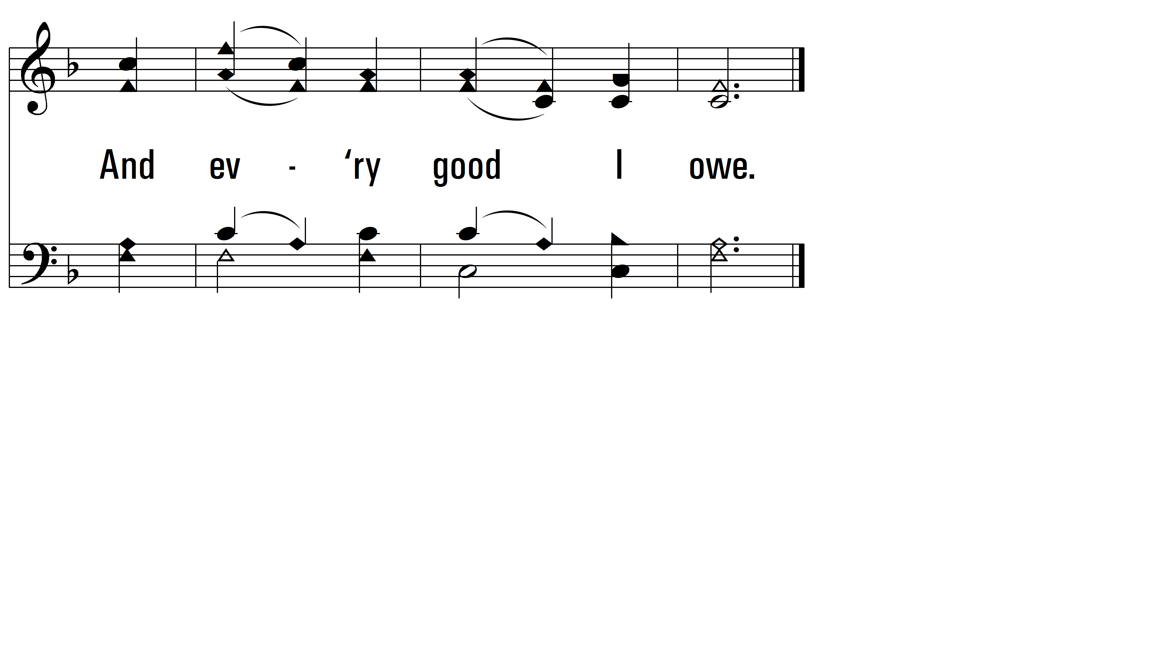
vs. 1

Slide 4
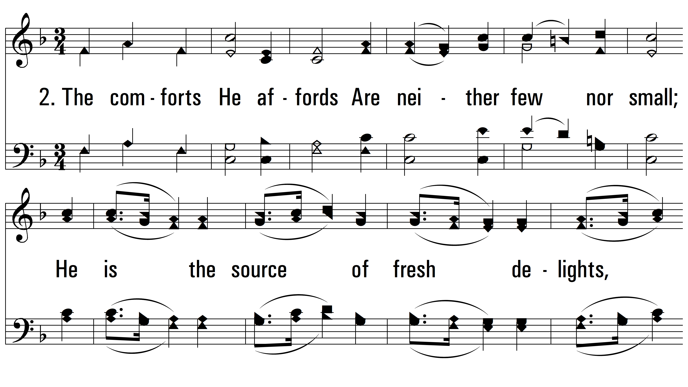
vs. 2 ~ God Is The Fountain Whence

Slide 5
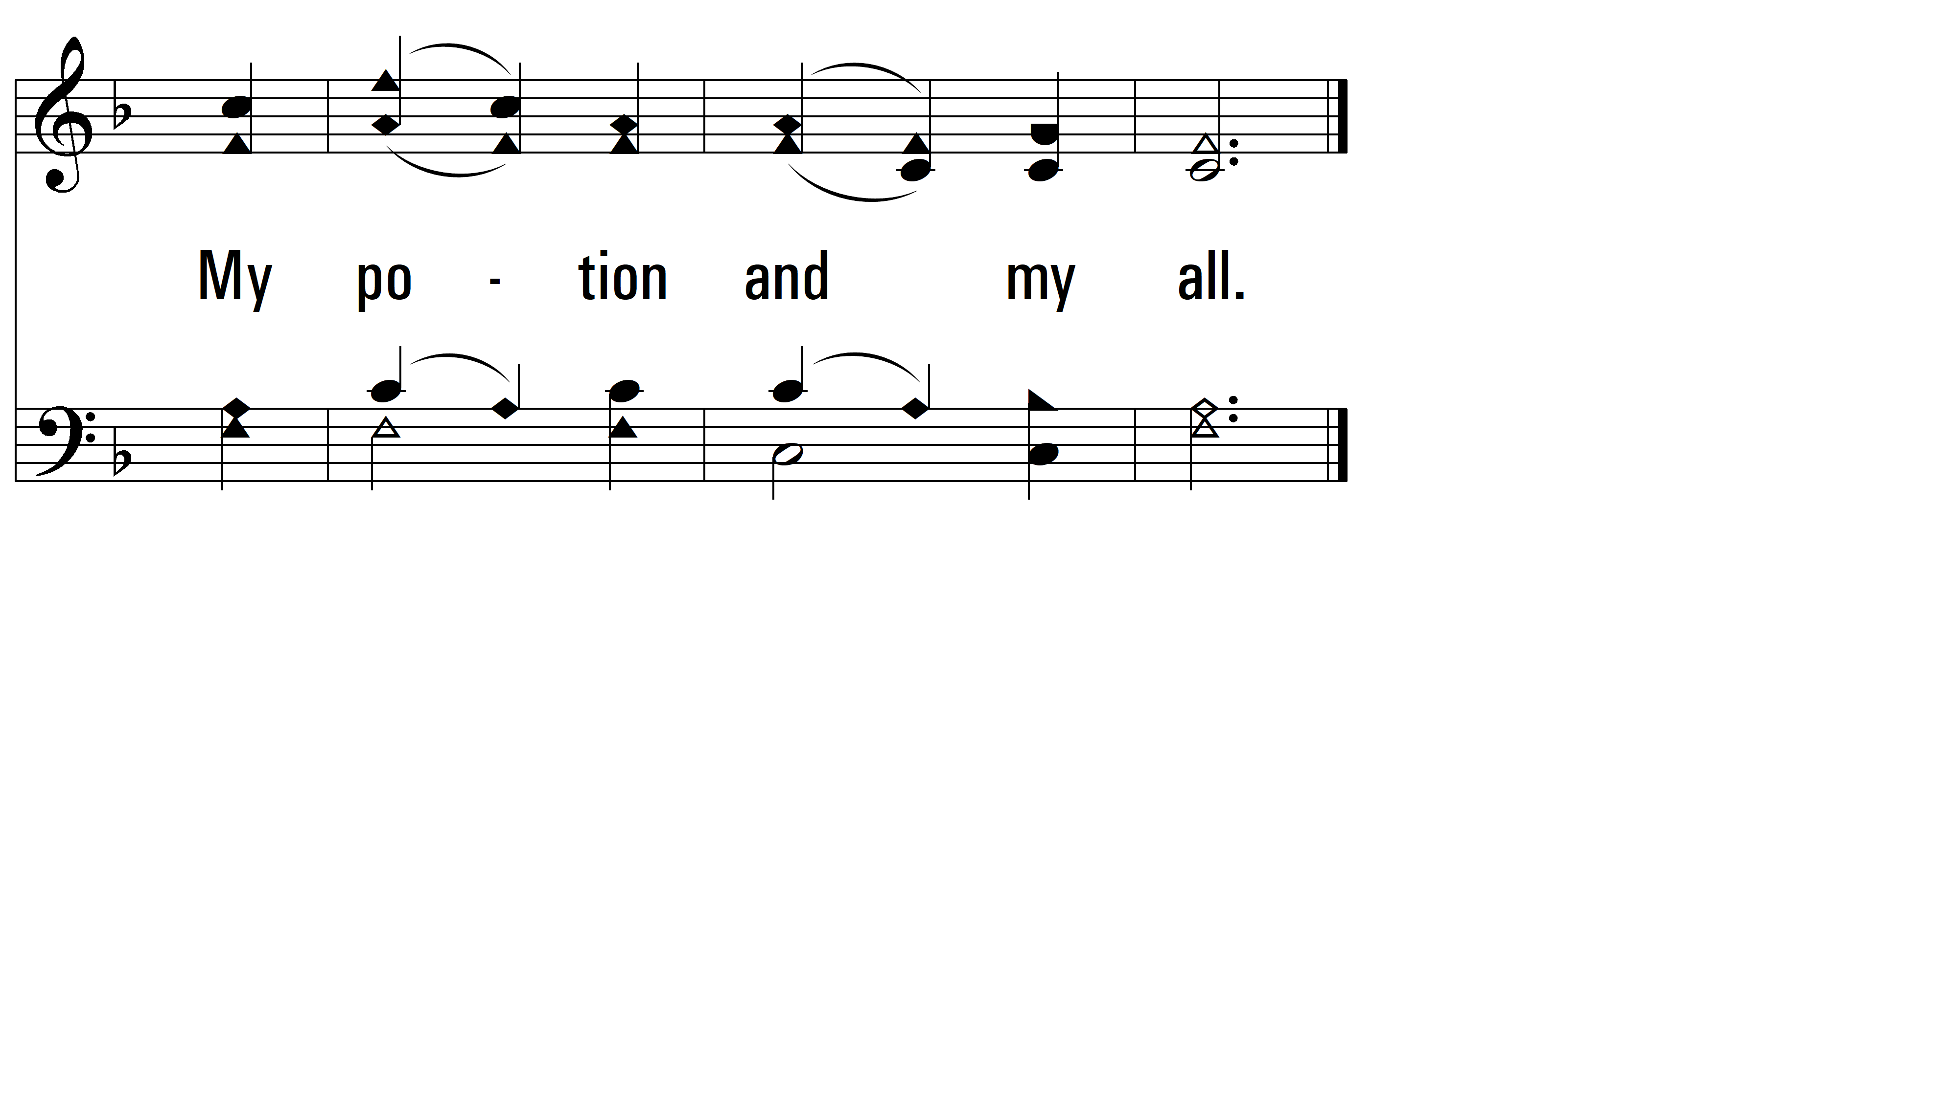
vs. 2

Slide 6
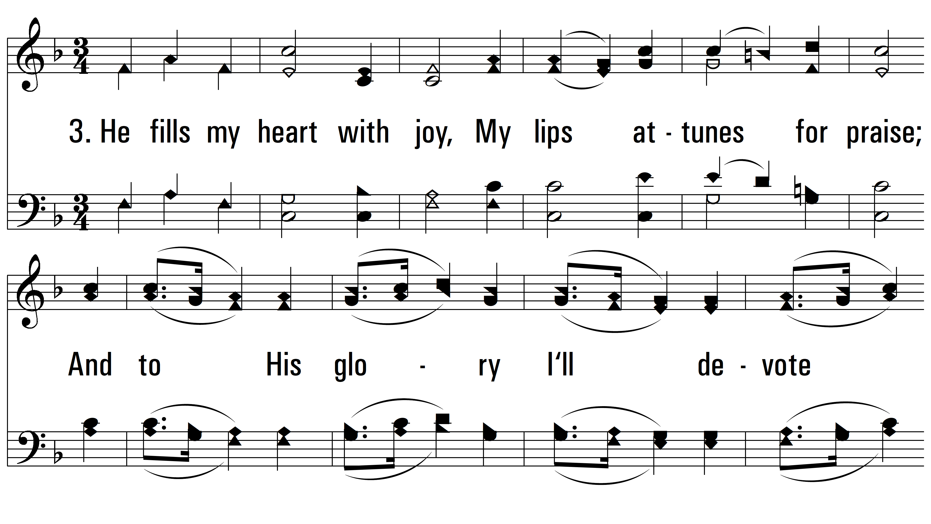
vs. 3 ~ God Is The Fountain Whence

Slide 7
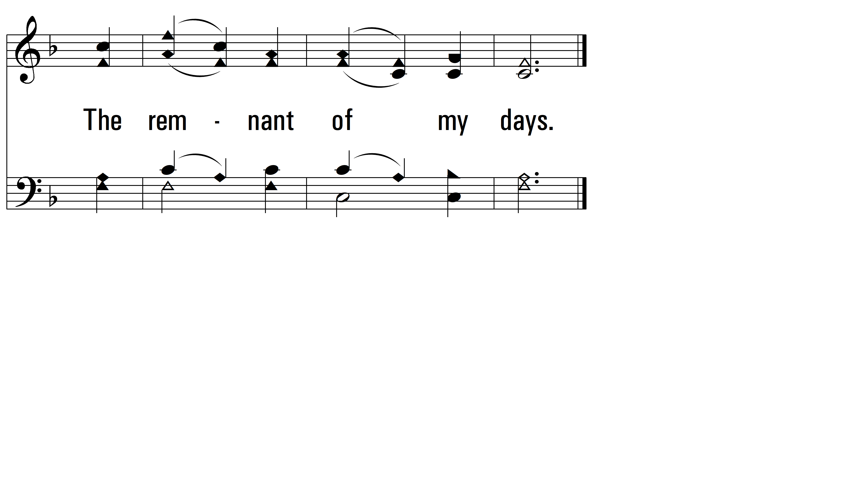
vs. 3
PDHymns.com
END

