Slide 1
God Is Love
Words: | Millard’s & Badger’s Hymns & Spirital Songs (1849) Arr. by E. S. Lorenz (1886)
Music: | E. S. Lorenz (1886)
4/4
D/D - DO
Verses: 3/Chorus
Lead - | DO
Alto - | DO
Tenor - | MI
Bass - | DO
PDHymns.com

Slide 2
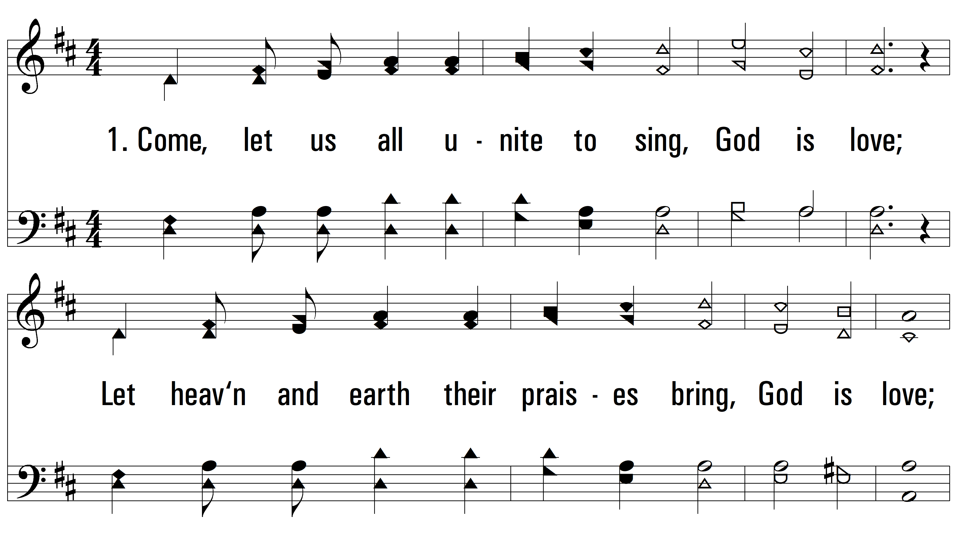
vs. 1 ~ God Is Love

Slide 3
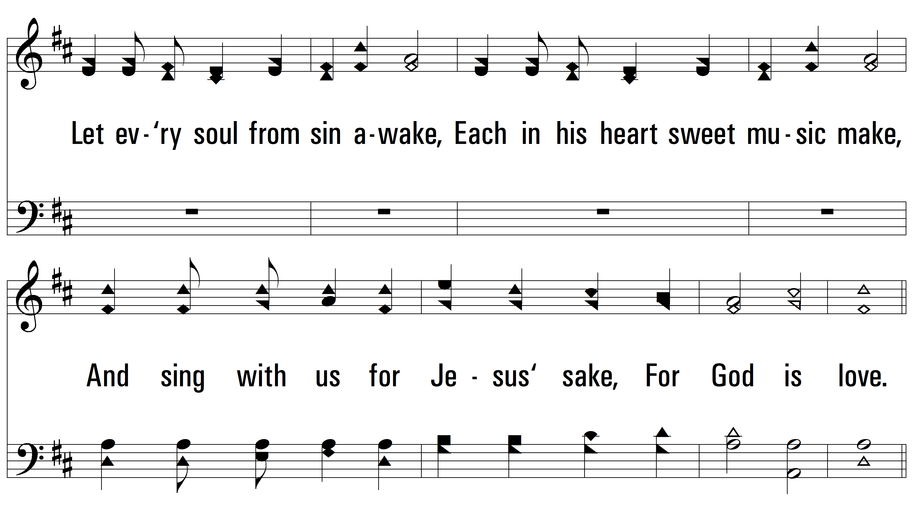
vs. 1

Slide 4
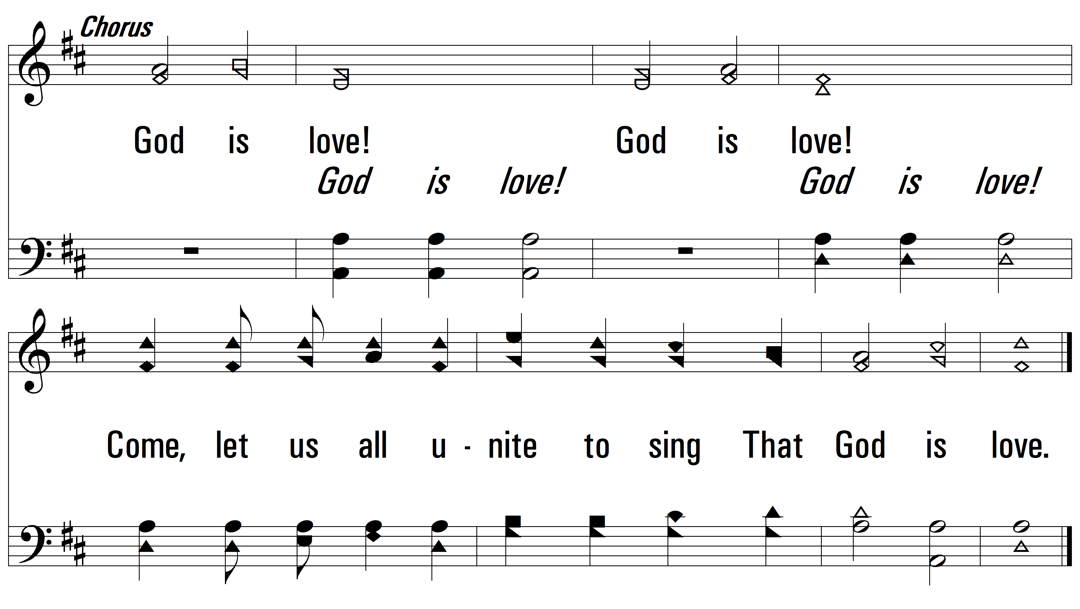
vs. 1

Slide 5
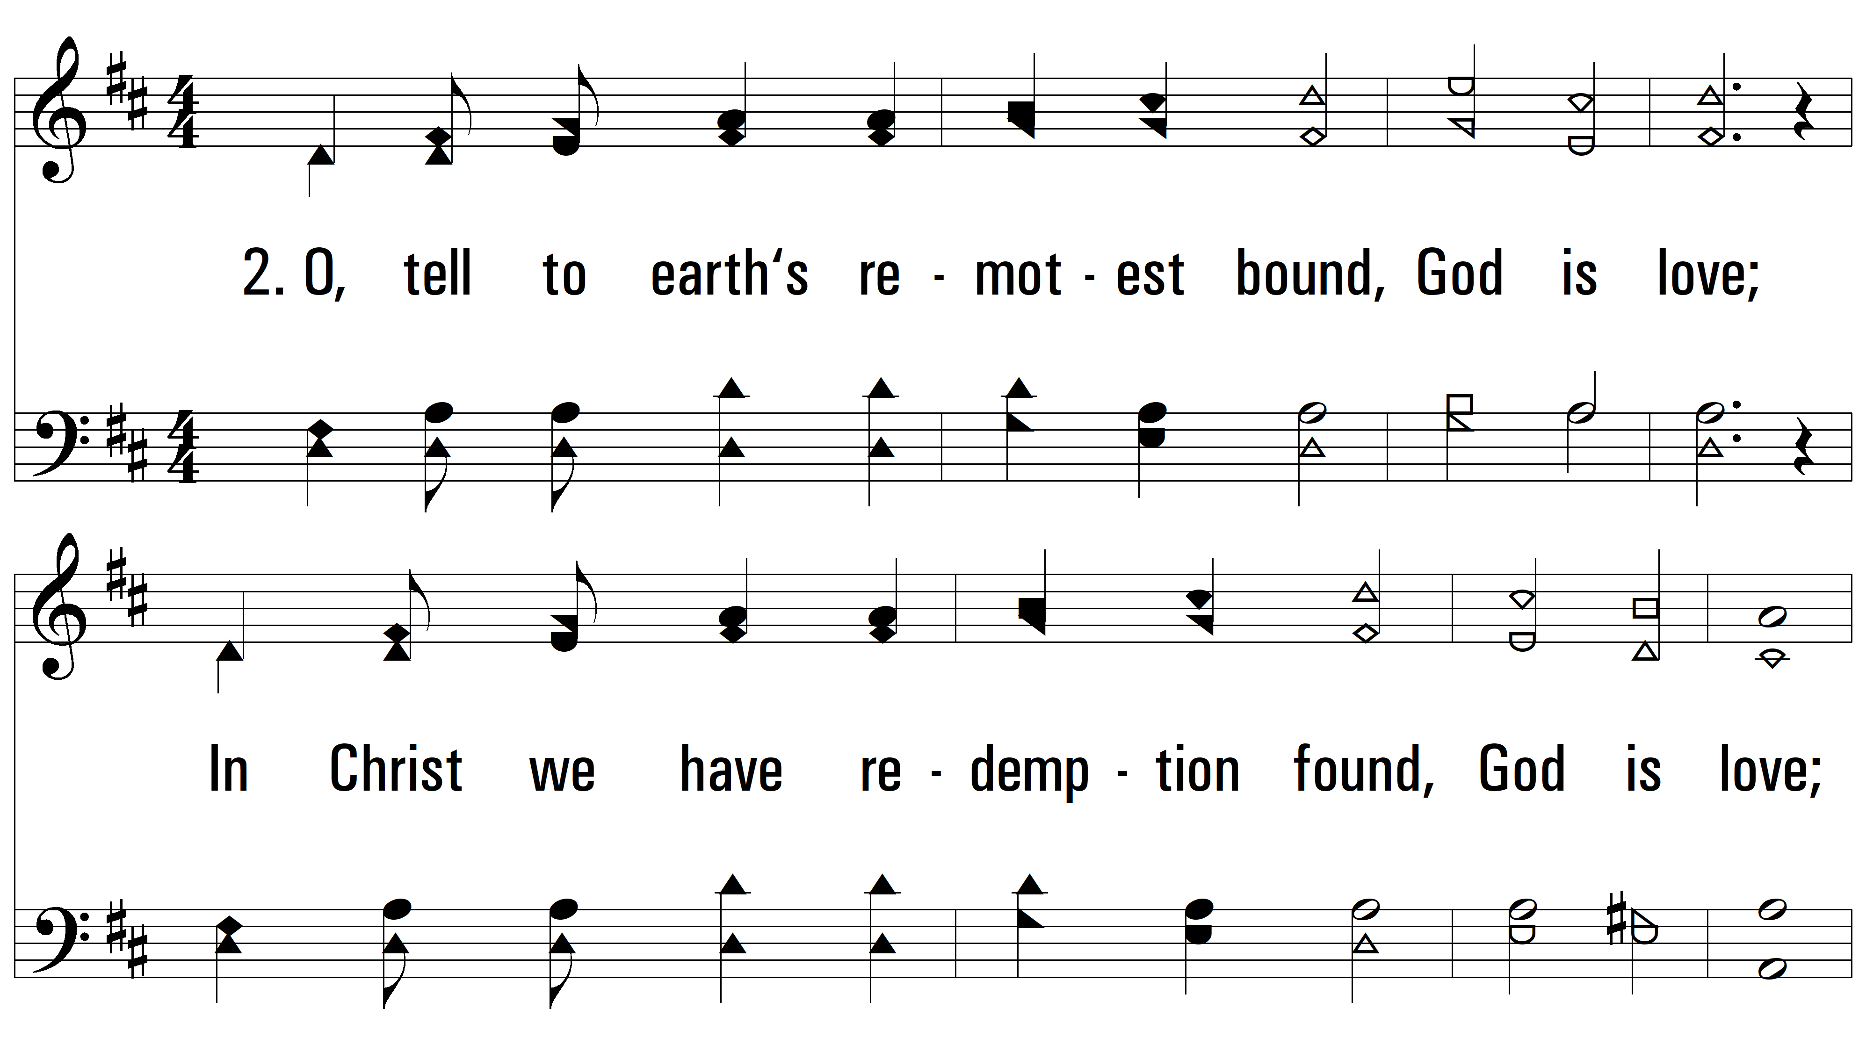
vs. 2 ~ God Is Love

Slide 6
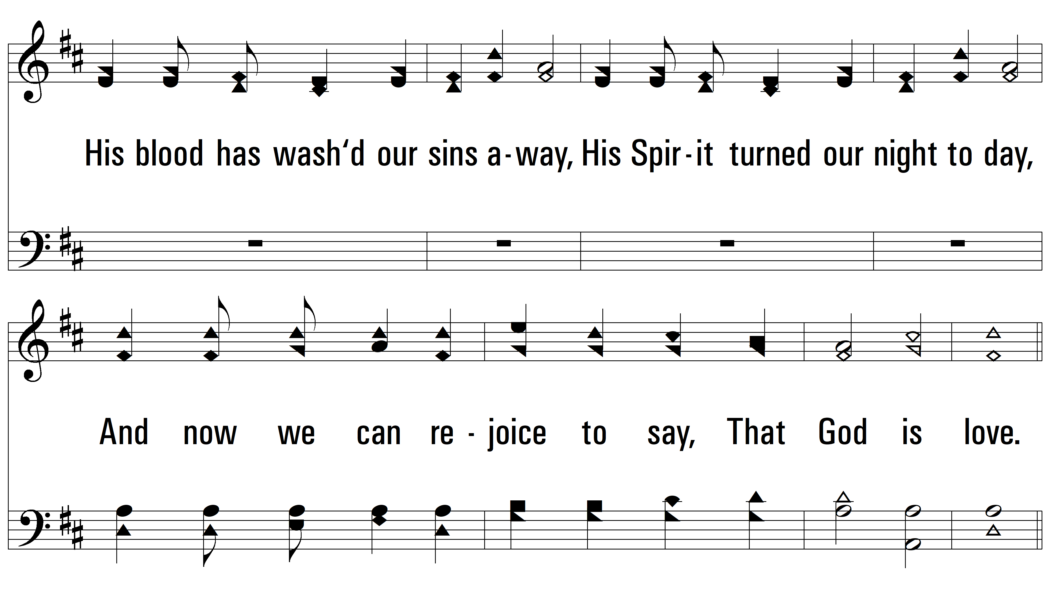
vs. 2

Slide 7
vs. 2

Slide 8
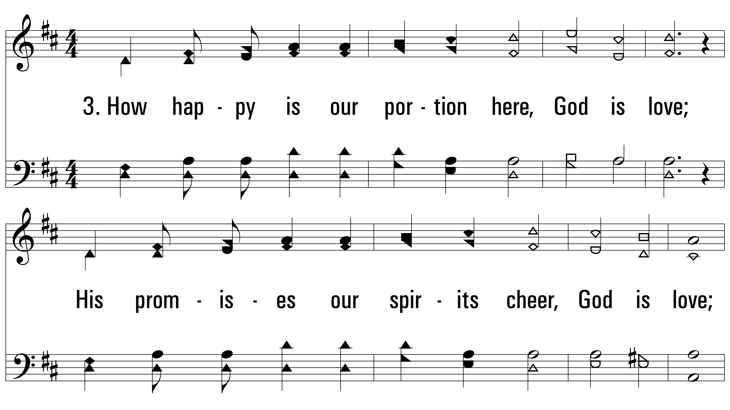
vs. 3 ~ God Is Love

Slide 9
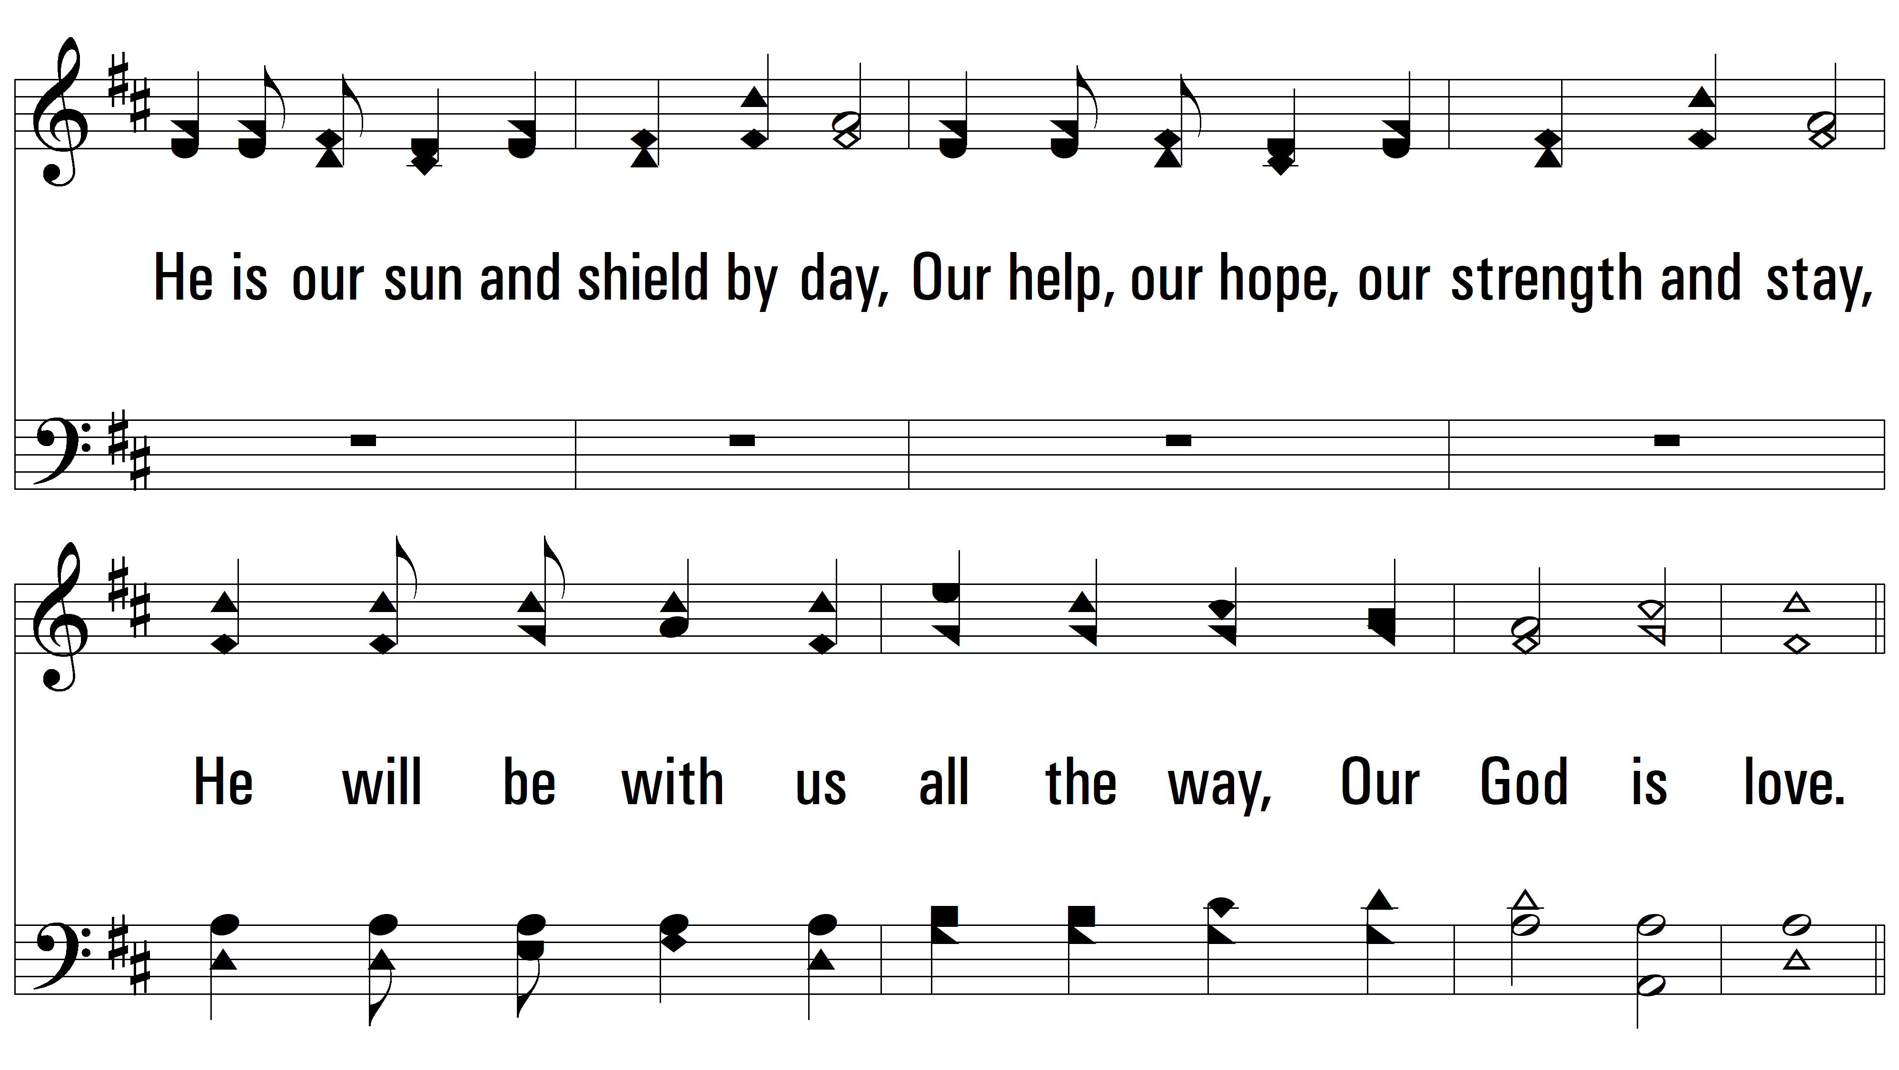
vs. 3

Slide 10
vs. 3
PDHymns.com
END

