Slide 1
God Calling Yet
This hymn is FREE to be used for the glory of God.
Words: | Gerhard Tersteegen (1735), Tr. by Jane Borthwick (1855)
Music: | John G. Foote (1894)
4/4
B^{b}/F - SOL
Verses: 3/Chorus
Lead - | SOL
Alto - | MI
Tenor - | DO
Bass - | DO
PDHymns.com

Slide 2
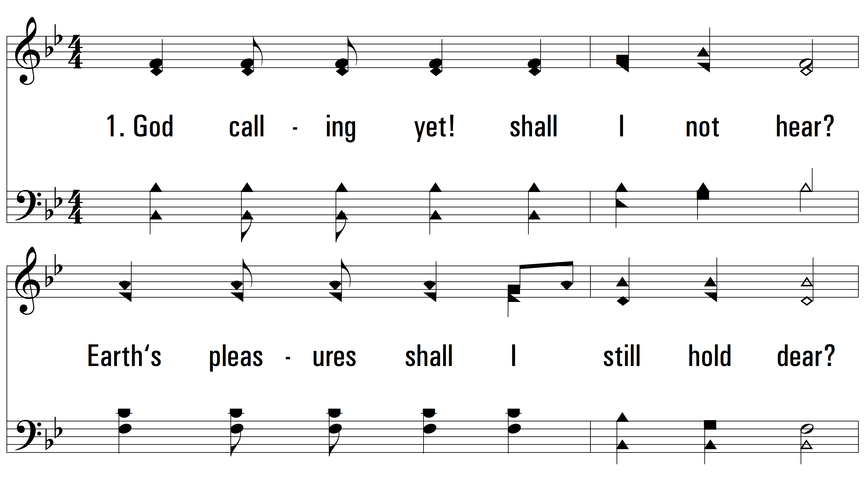
vs. 1 ~ God Calling Yet

Slide 3
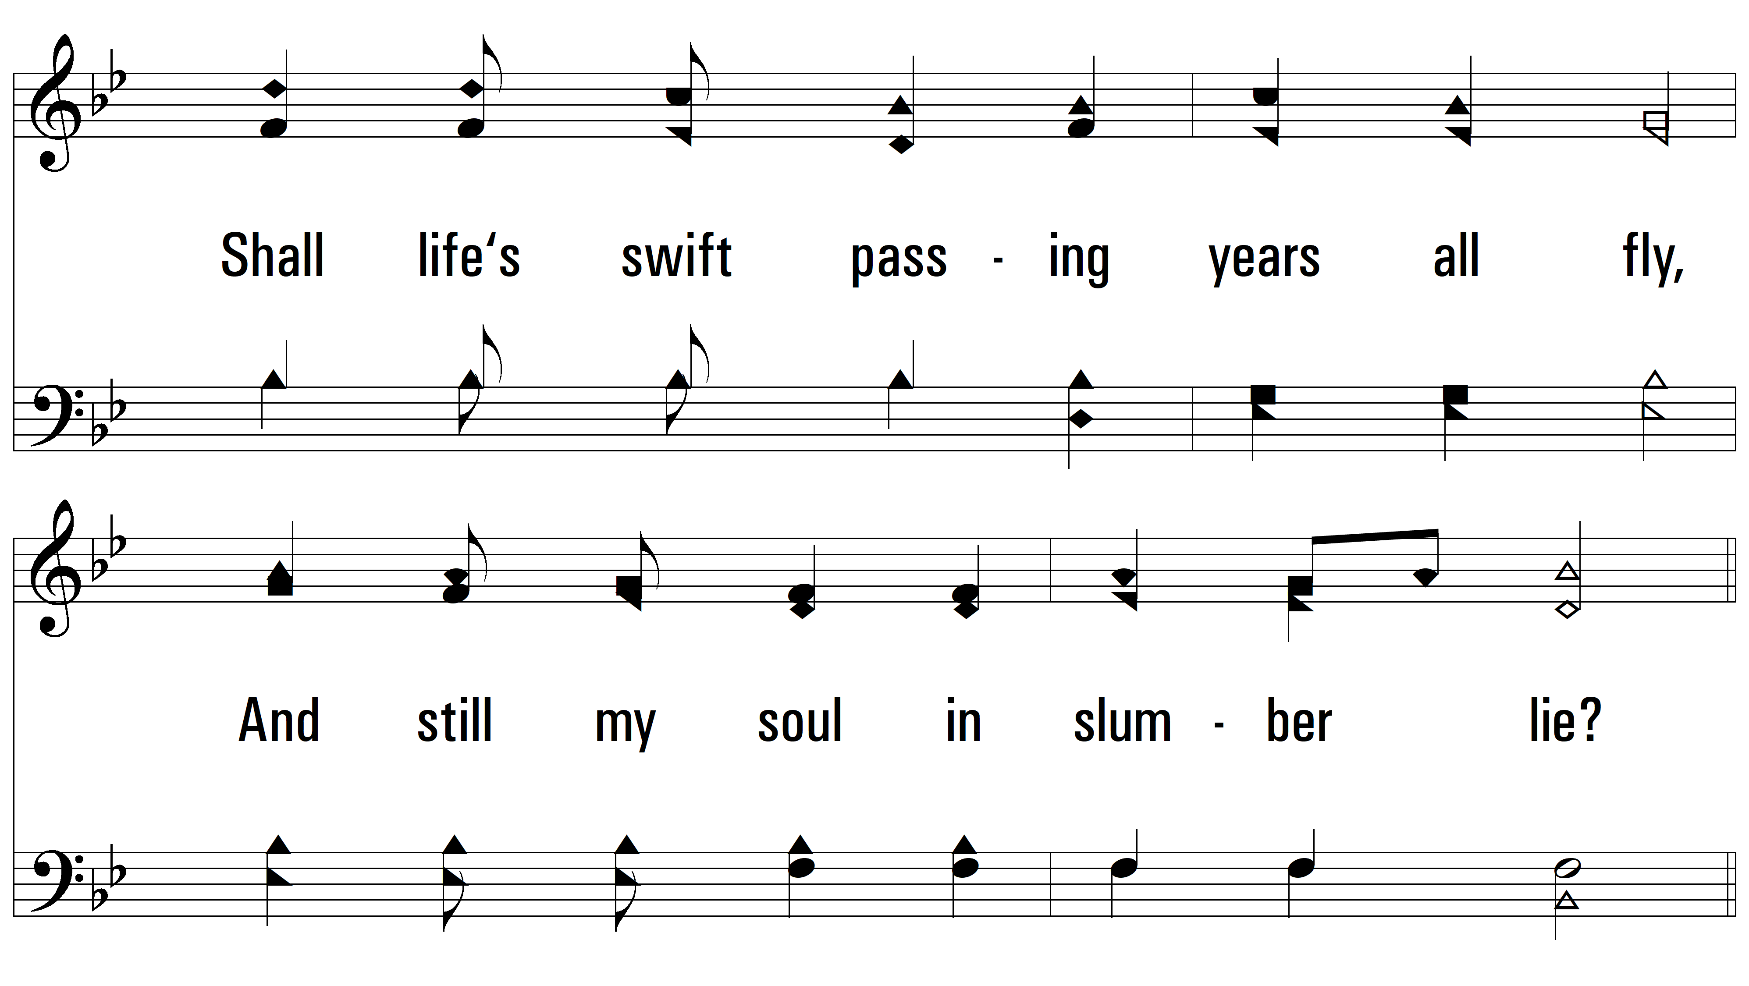
vs. 1

Slide 4
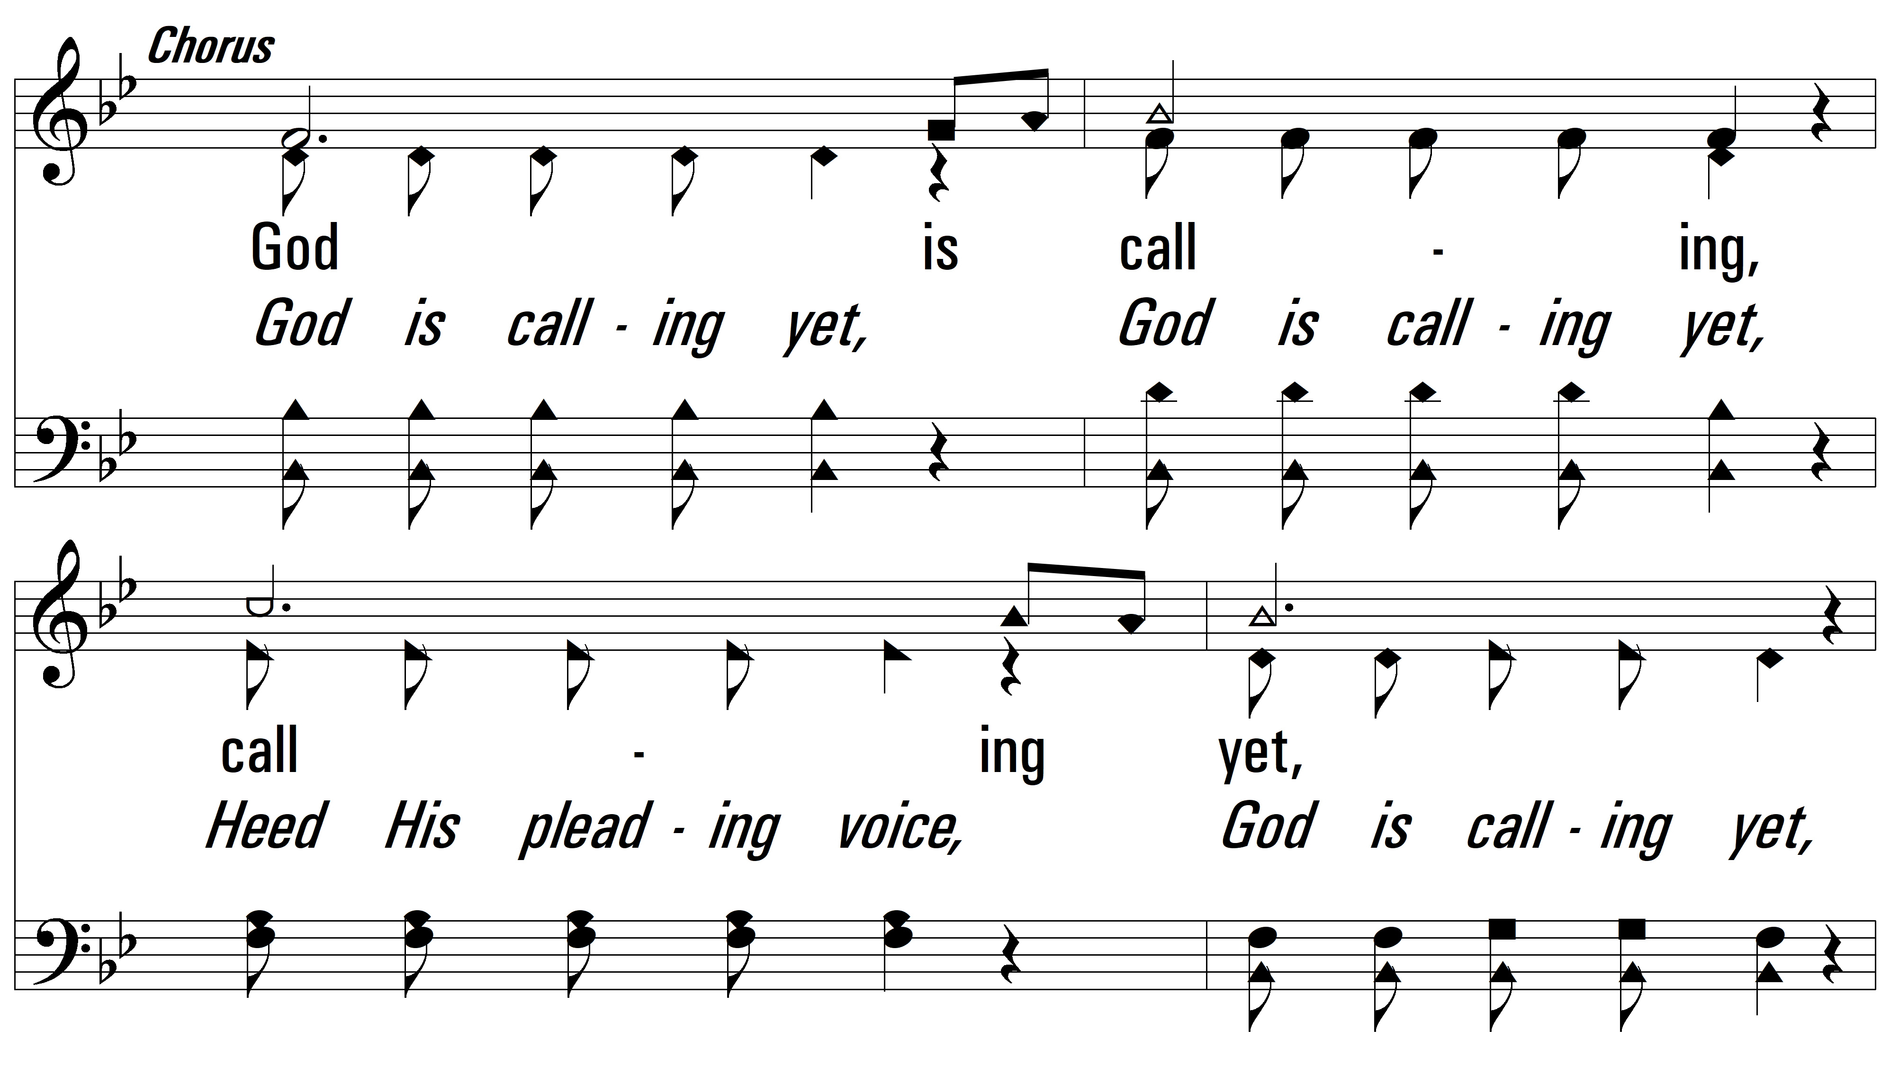
vs. 1

Slide 5
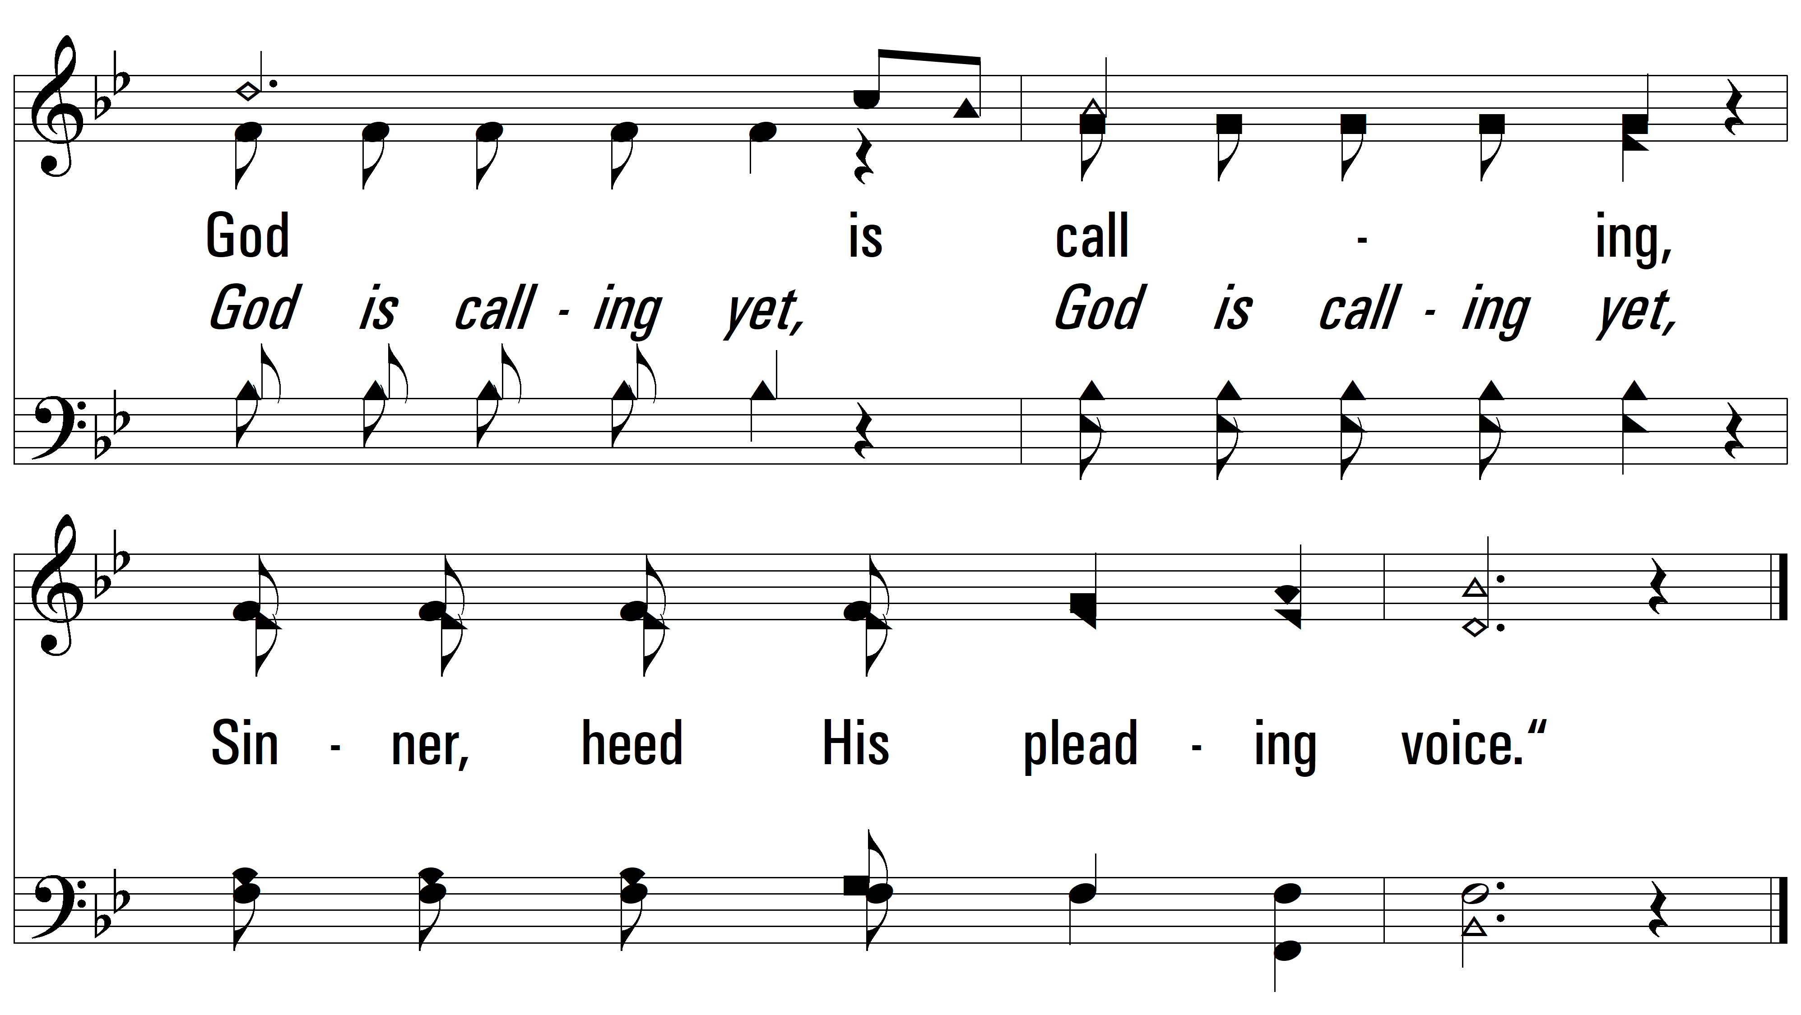
vs. 1

Slide 6
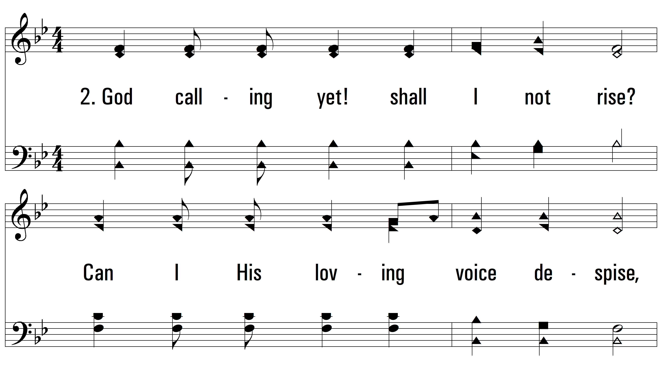
vs. 2 ~ God Calling Yet

Slide 7
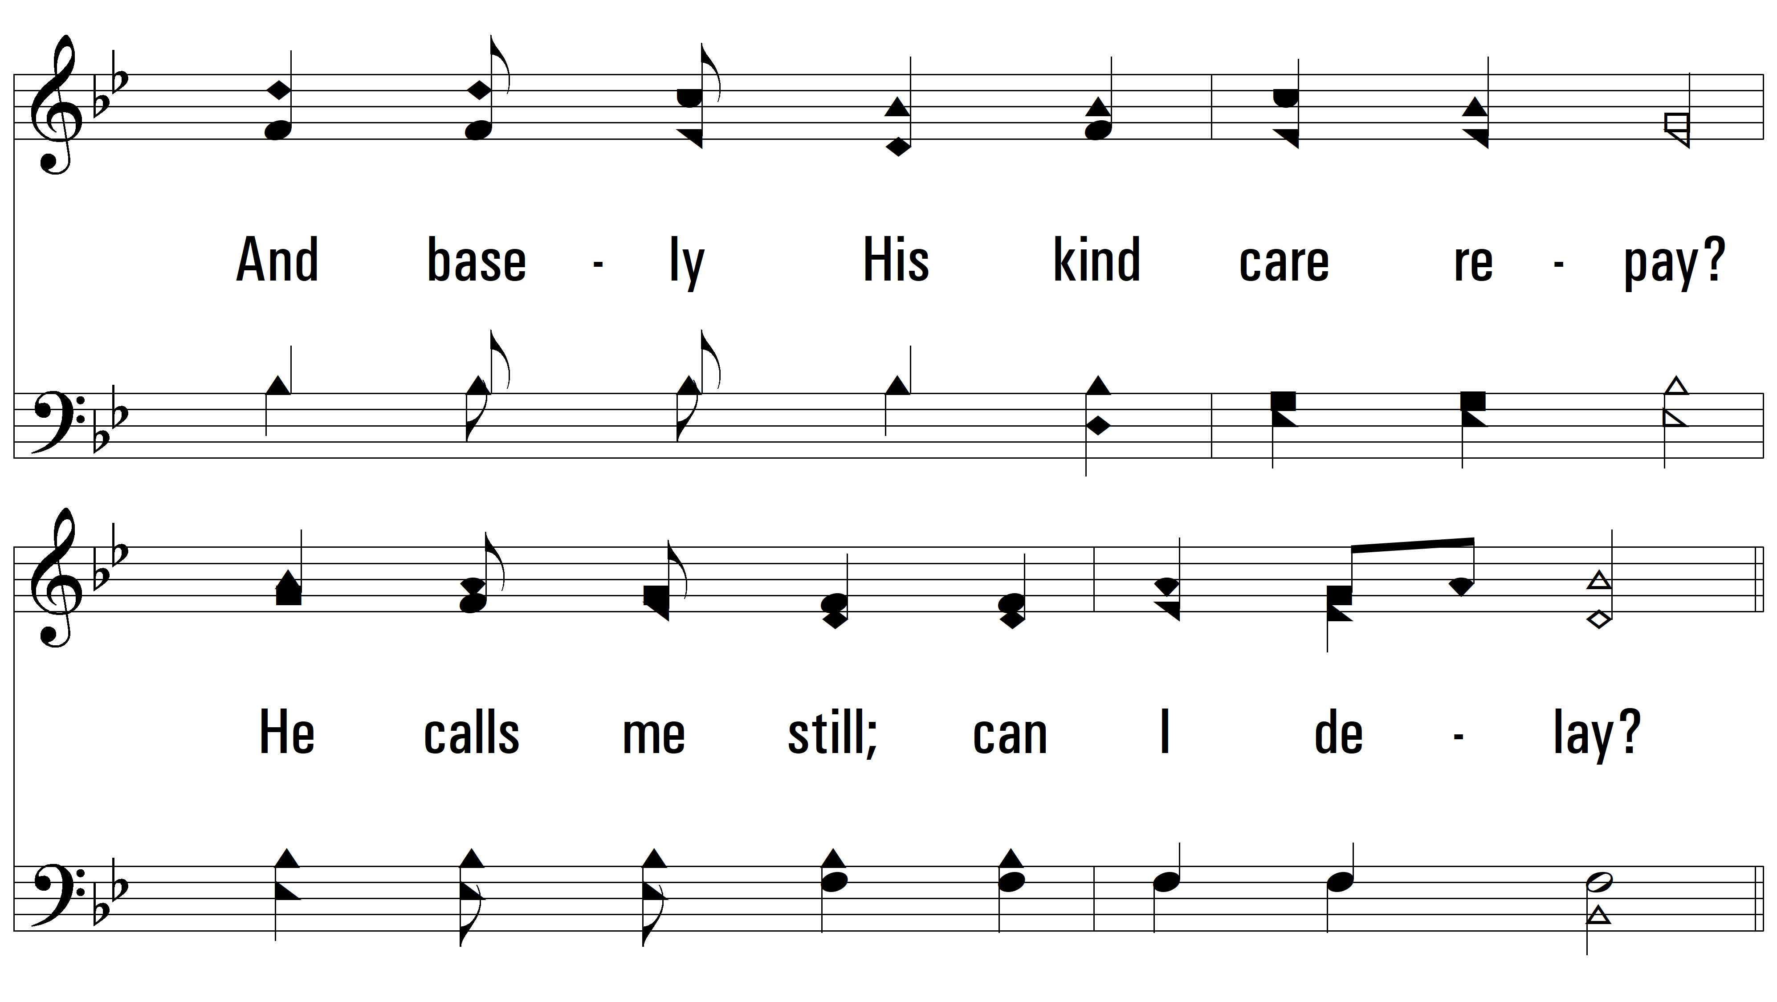
vs. 2

Slide 8
vs. 2

Slide 9
vs. 2

Slide 10
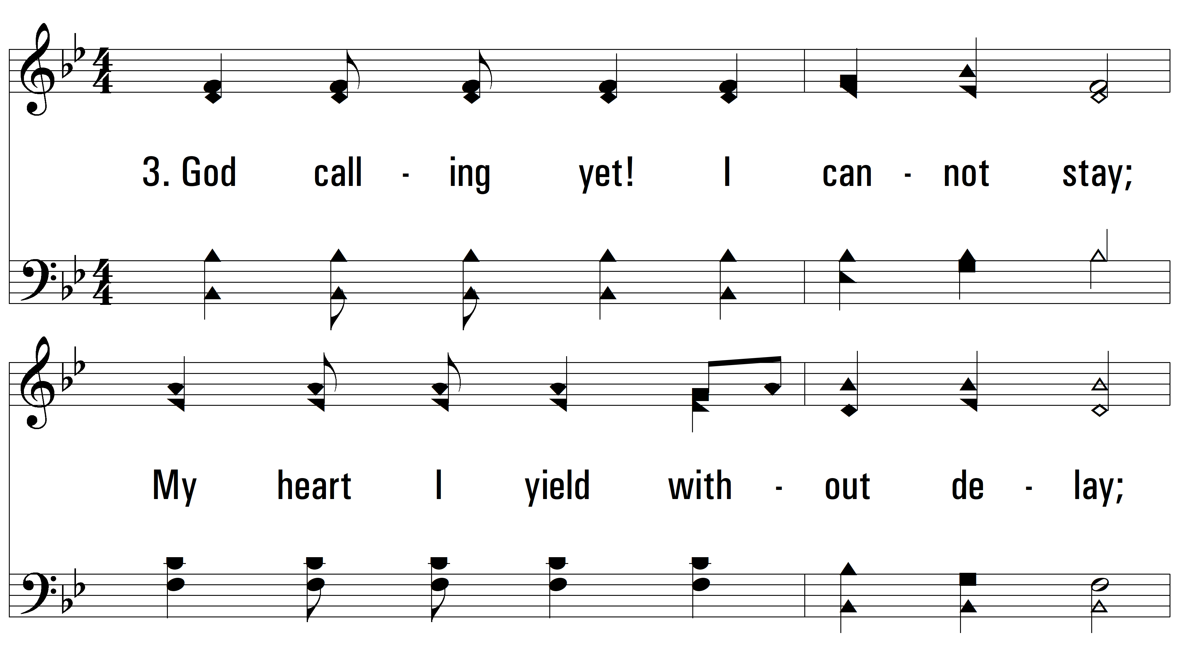
vs. 3 ~ God Calling Yet

Slide 11
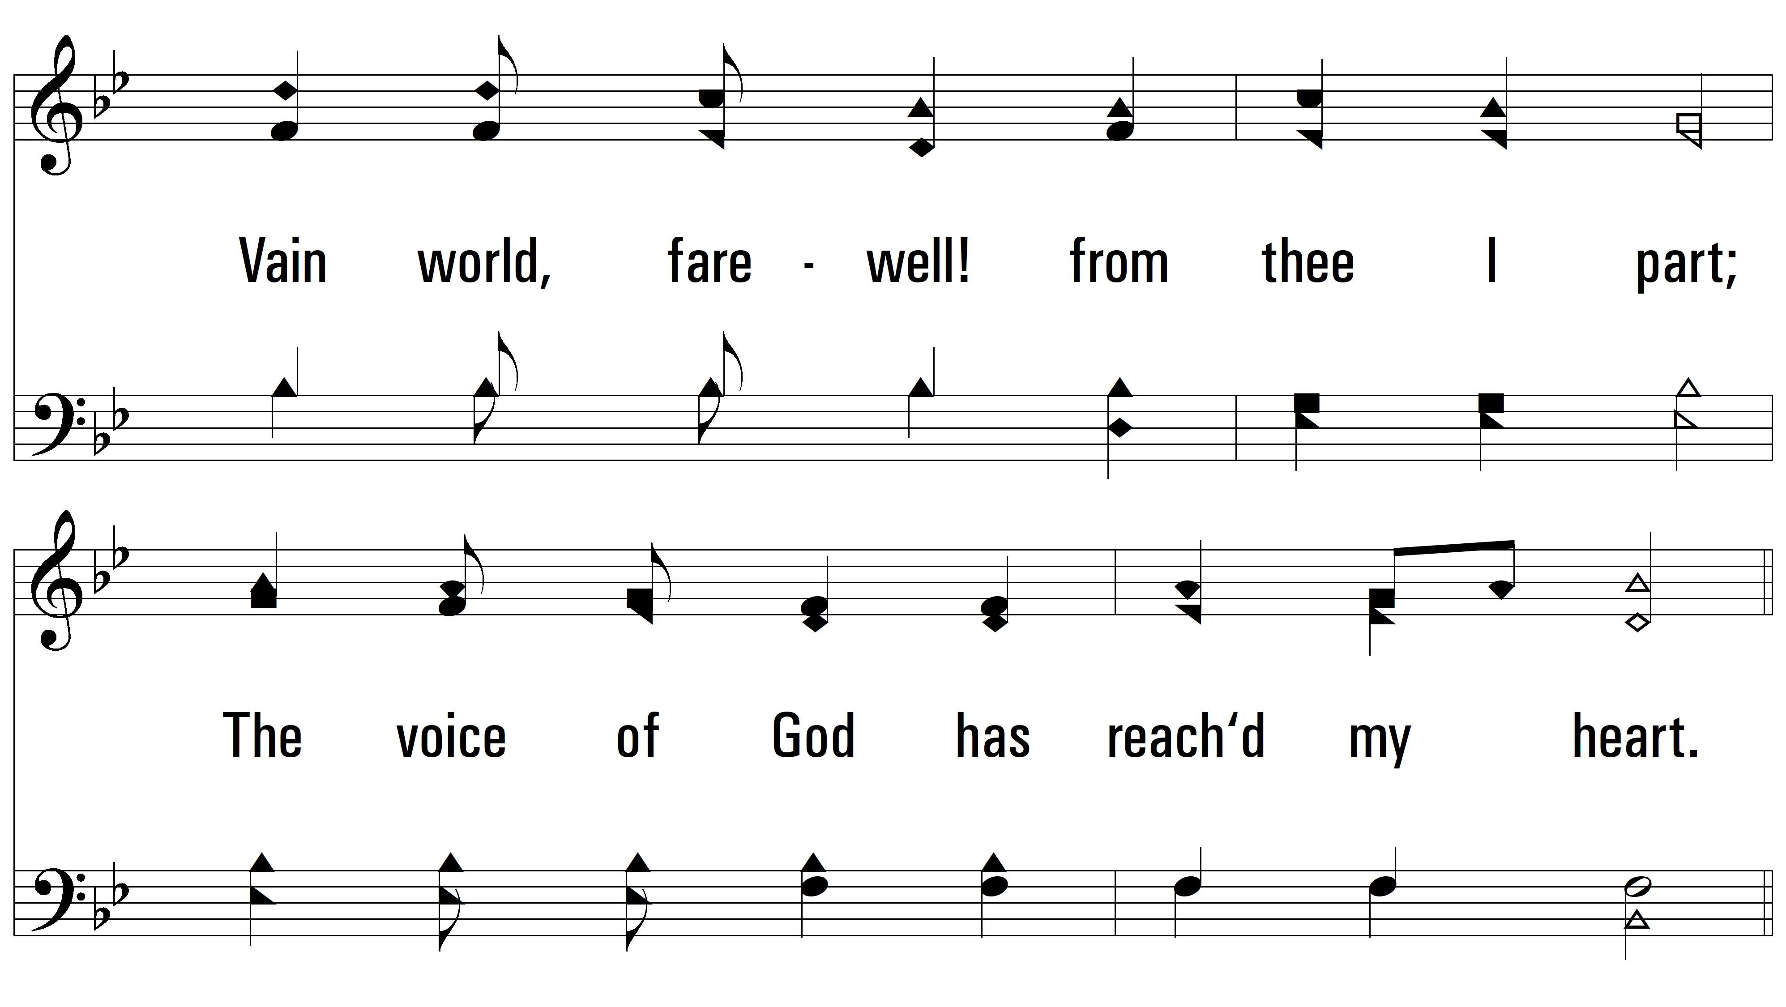
vs. 3

Slide 12
vs. 3

Slide 13
vs. 3
PDHymns.com
END

