Slide 1
Go Tell It On The Mountain
GO TELL IT
IRREGULAR
Words: | Spiritual, vss. John W. Work, Jr. (1907)
Music: | Spiritual
4/4
G/B - MI
Verses: 3/Chorus
Lead - | MI
Alto - | MI
Tenor - | MI
Bass - | MI
PDHymns.com

Slide 2
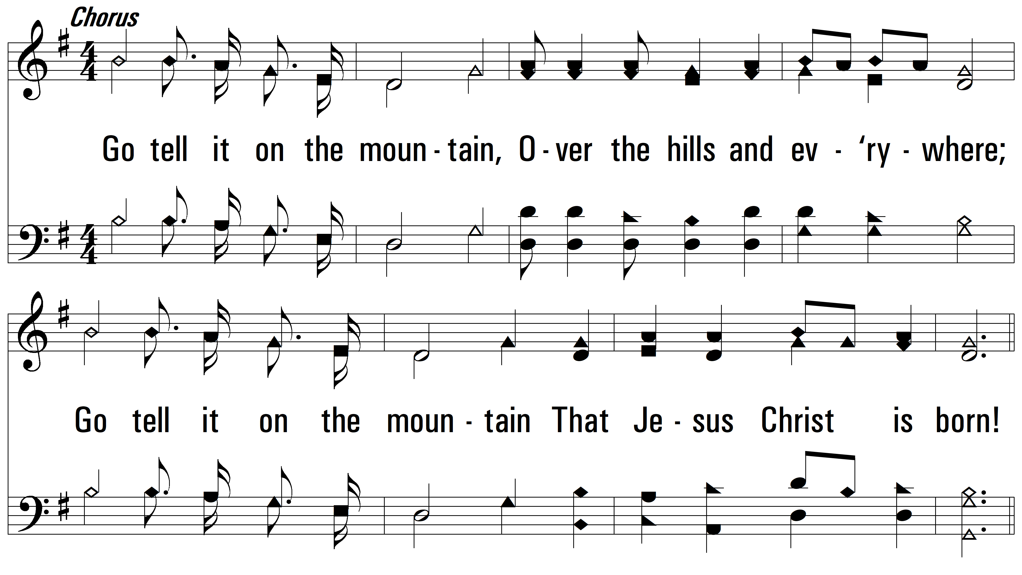
vs. 1 ~ Go Tell It On The Mountain

Slide 3
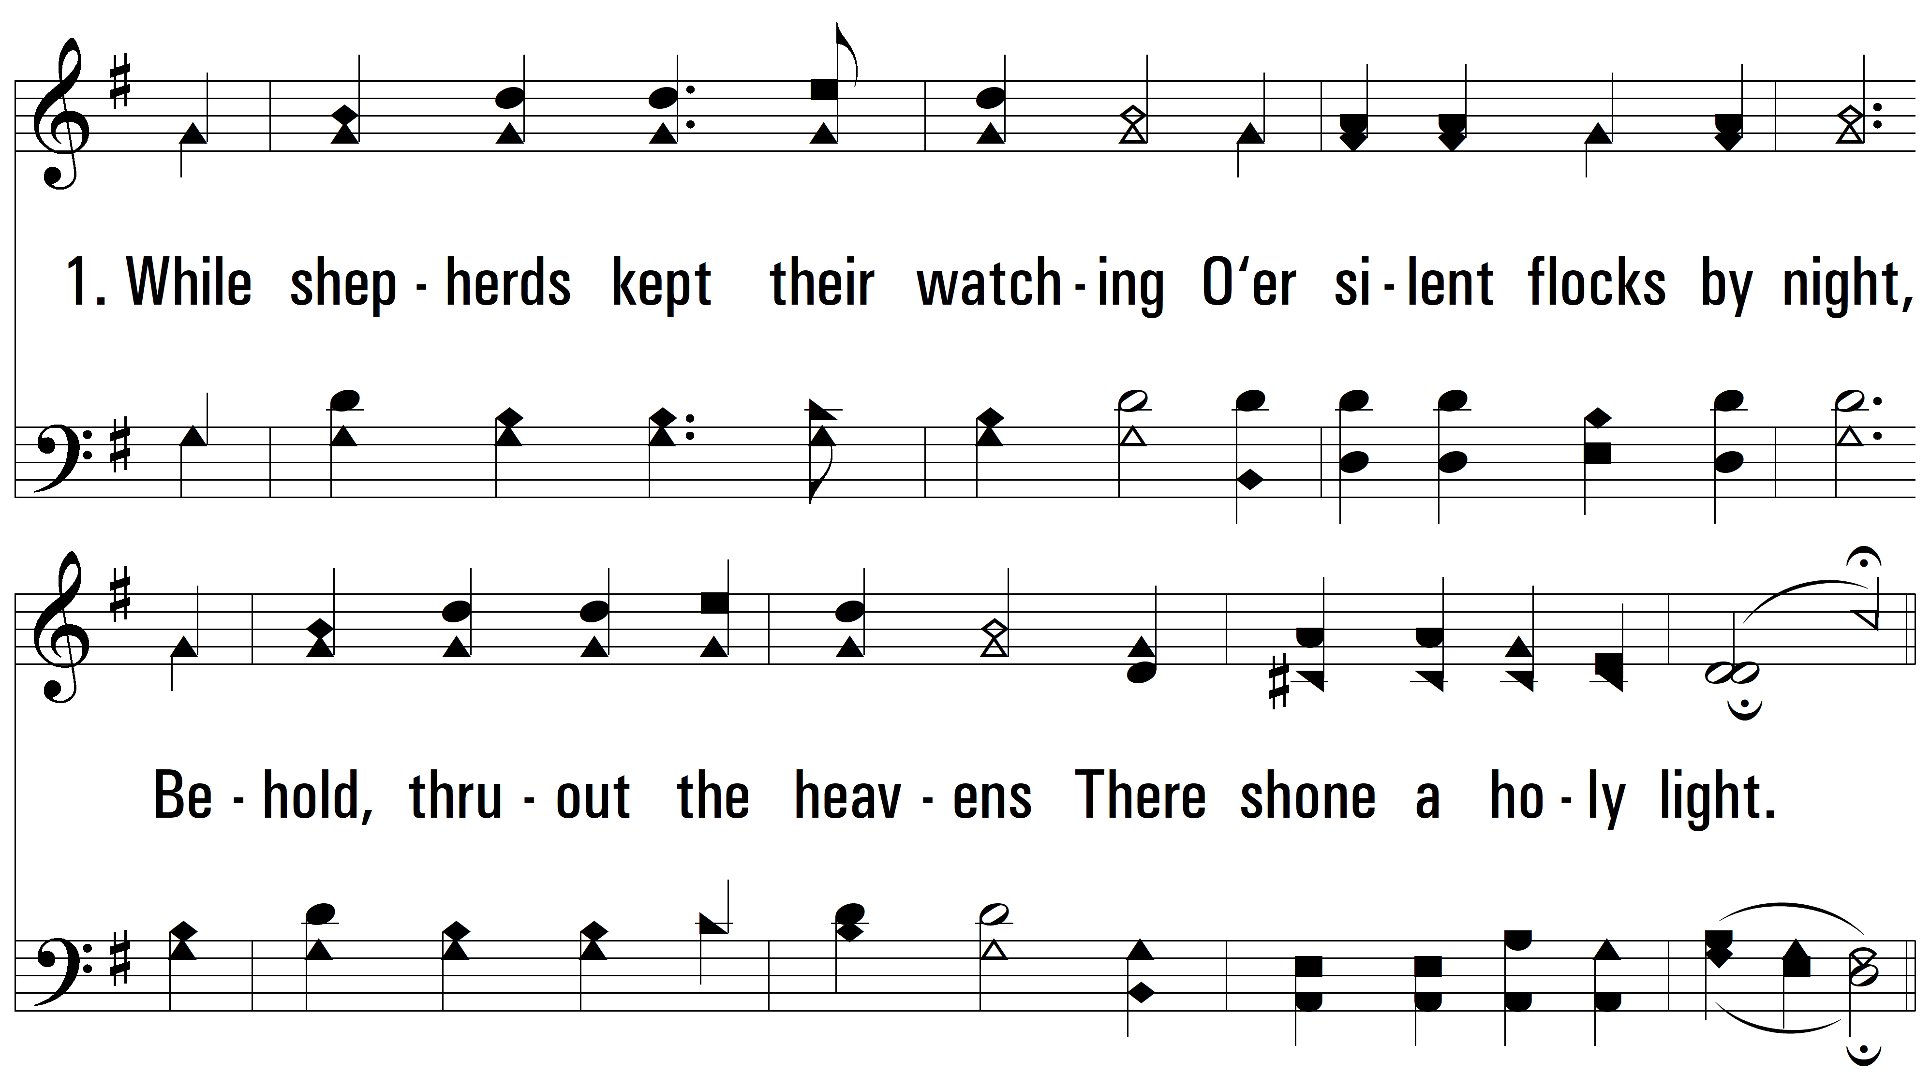
vs. 1

Slide 4
vs. 2 ~ Go Tell It On The Mountain

Slide 5
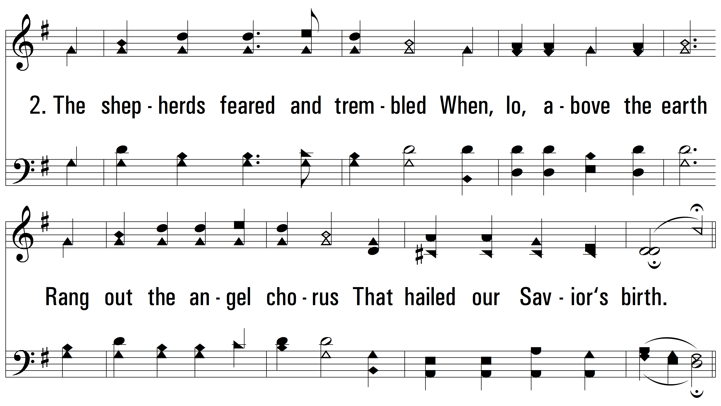
vs. 2

Slide 6
vs. 3 ~ Go Tell It On The Mountain

Slide 7
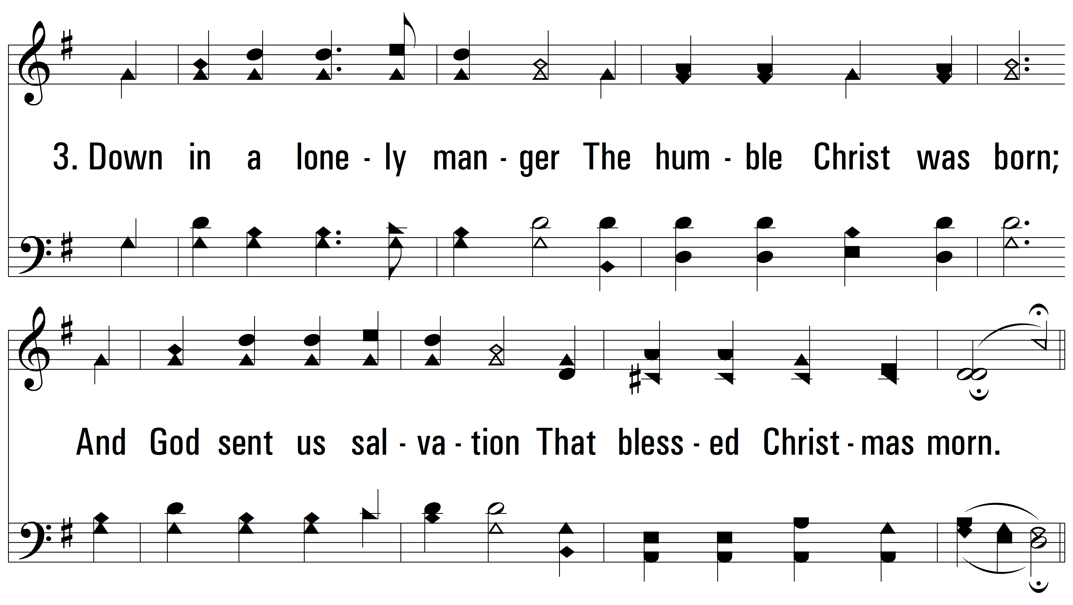
vs. 3

Slide 8
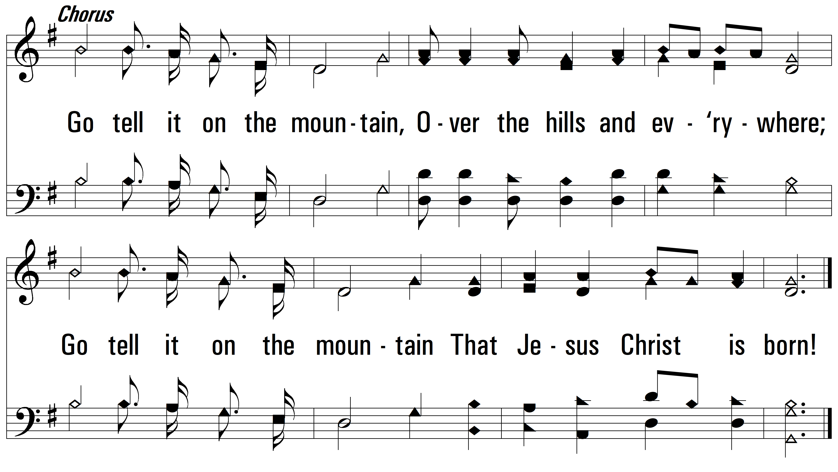
vs. 3
PDHymns.com
END

