Slide 1
Glory Be To God The Father
CWM RHONDDA
8.7.8.7.4.7
Words: | Horatius Bonar (1866)
Music: | John Hughes (1907)
4/4
G/D - SOL
Verses: 3
Lead - | SOL
Alto - | MI
Tenor - | DO
Bass - | DO
PDHymns.com

Slide 2
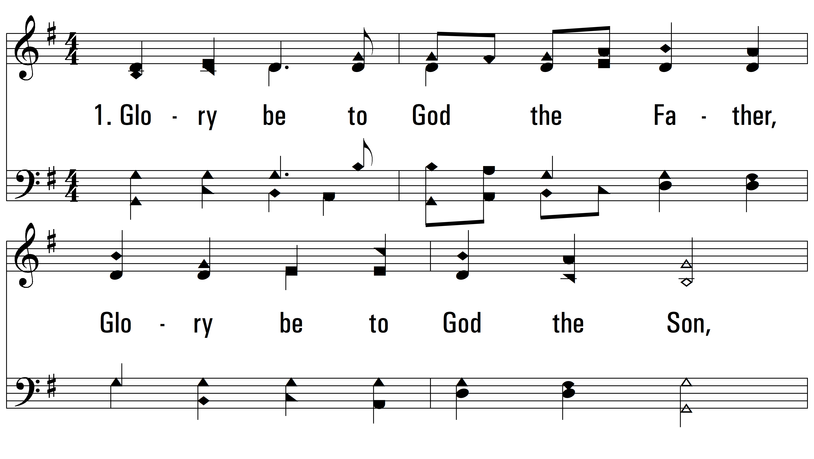
vs. 1 ~ Glory Be To God The Father

Slide 3
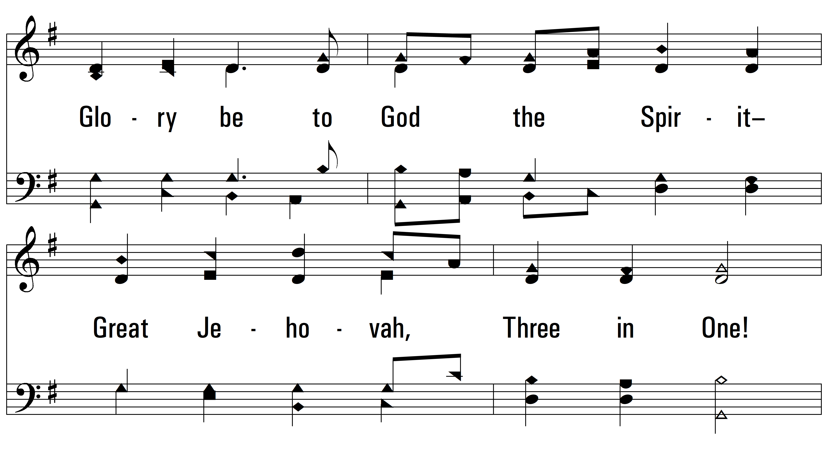
vs. 1

Slide 4
vs. 1

Slide 5
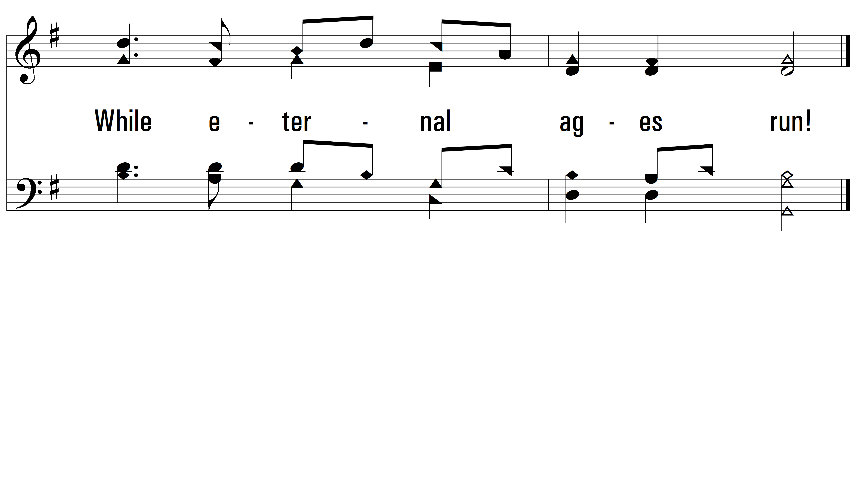
vs. 1

Slide 6
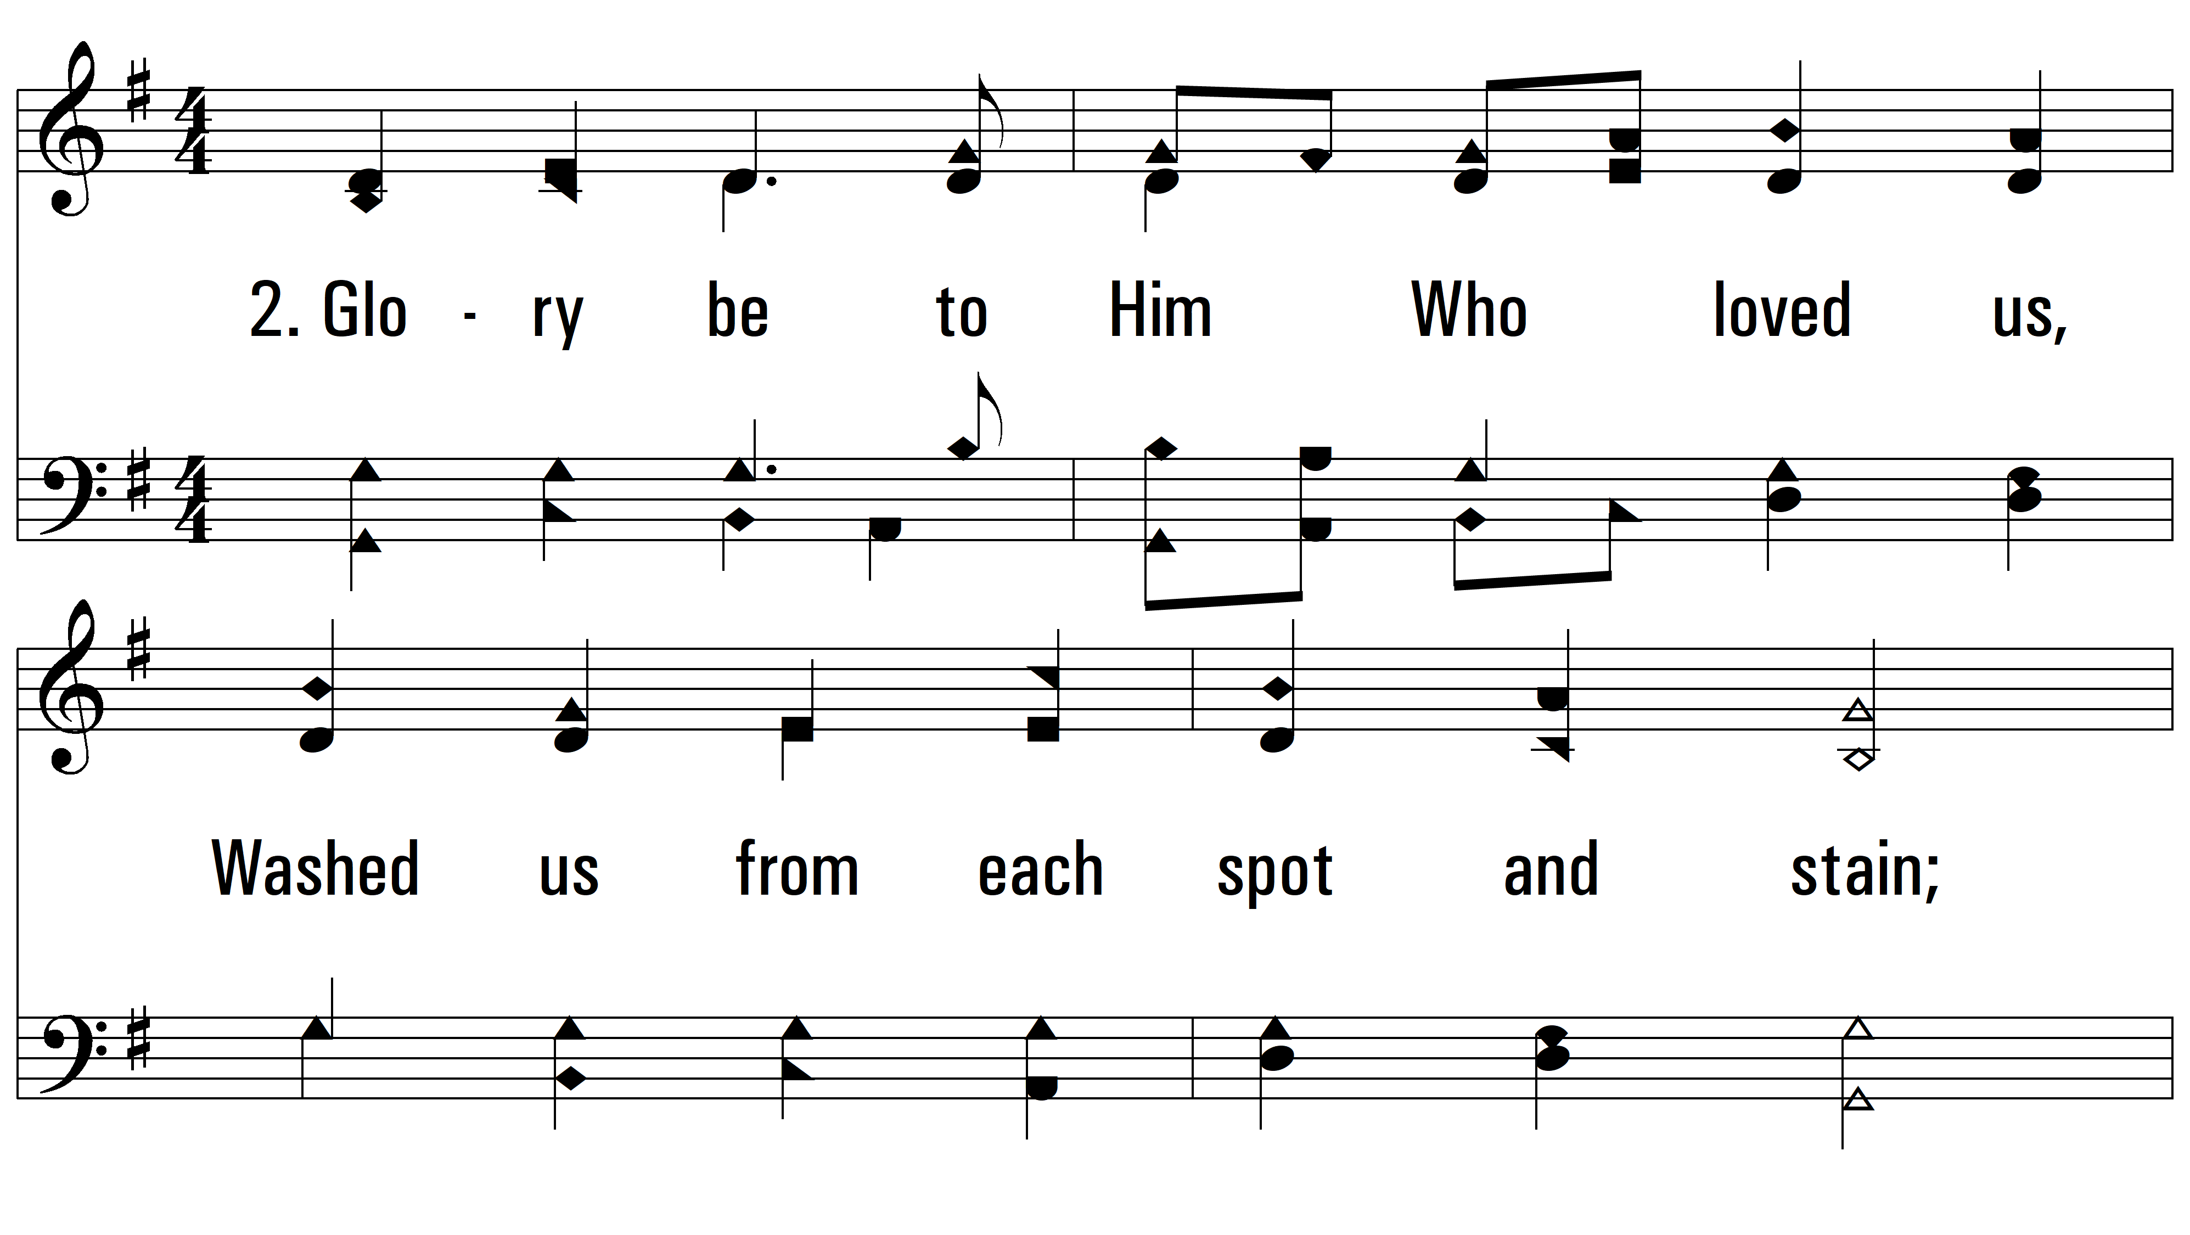
vs. 2 ~ Glory Be To God The Father

Slide 7
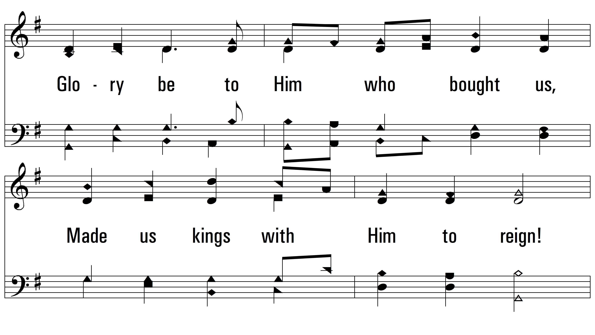
vs. 2

Slide 8
vs. 2

Slide 9
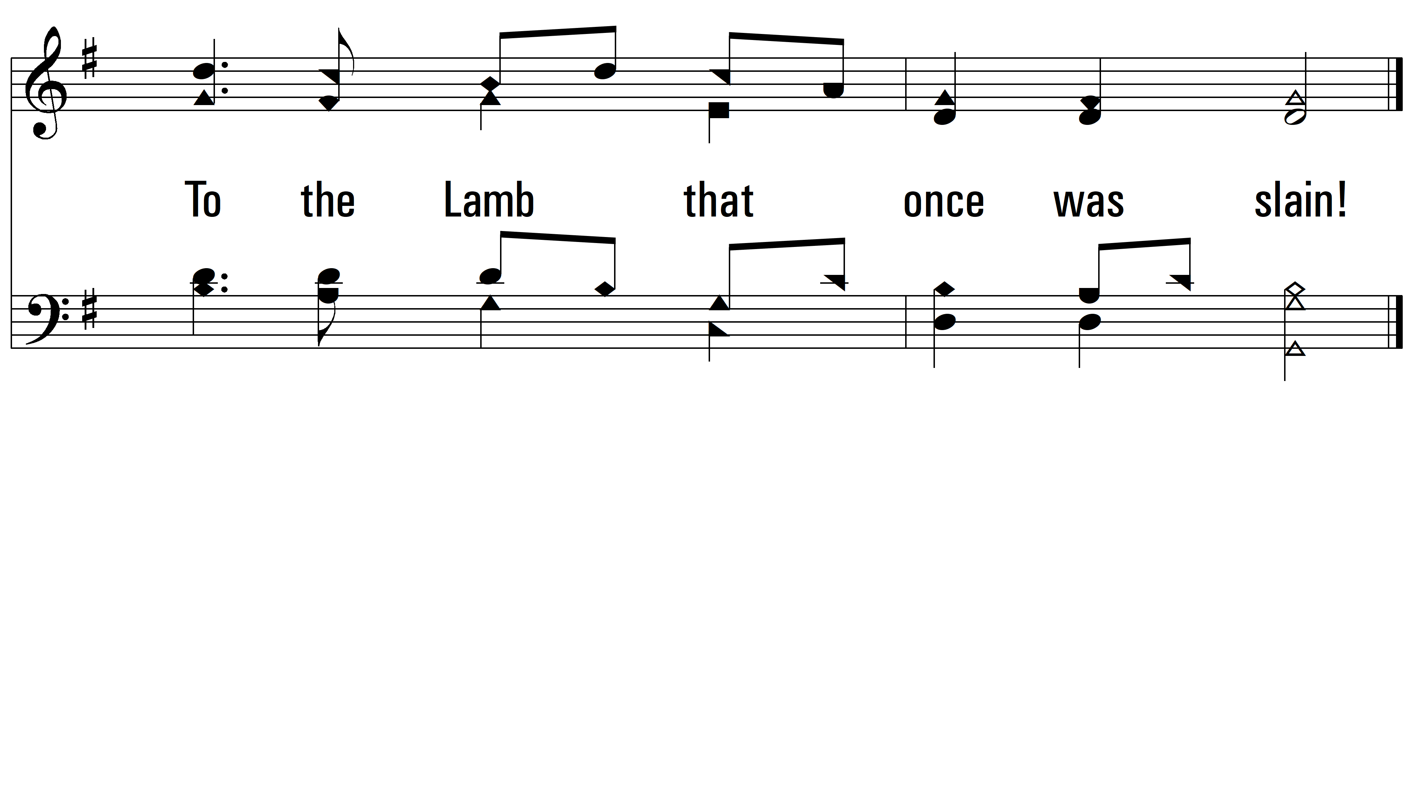
vs. 2

Slide 10
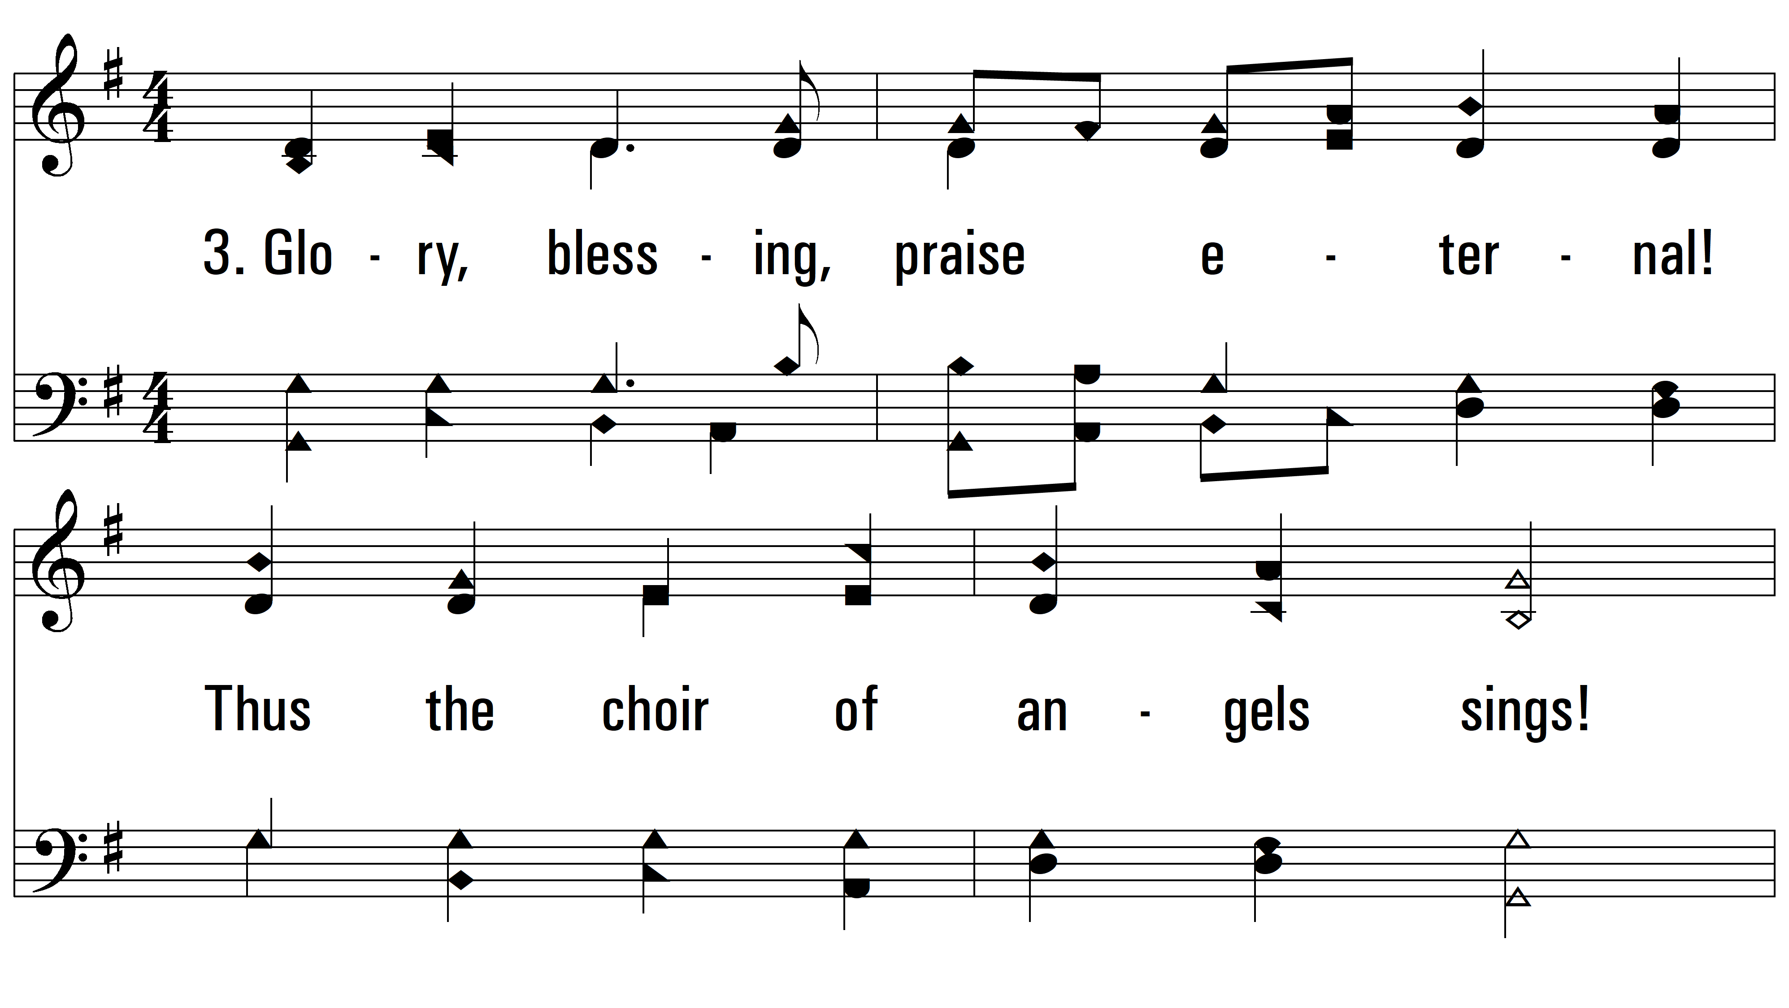
vs. 3 ~ Glory Be To God The Father

Slide 11
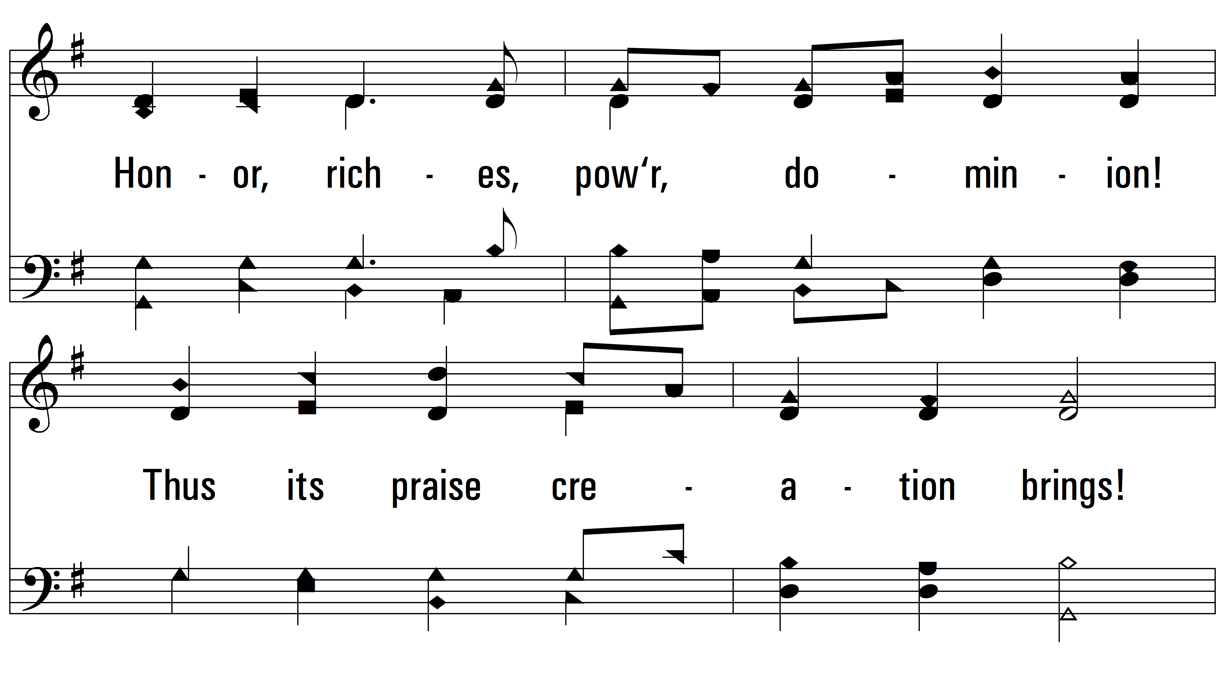
vs. 3

Slide 12
vs. 3

Slide 13
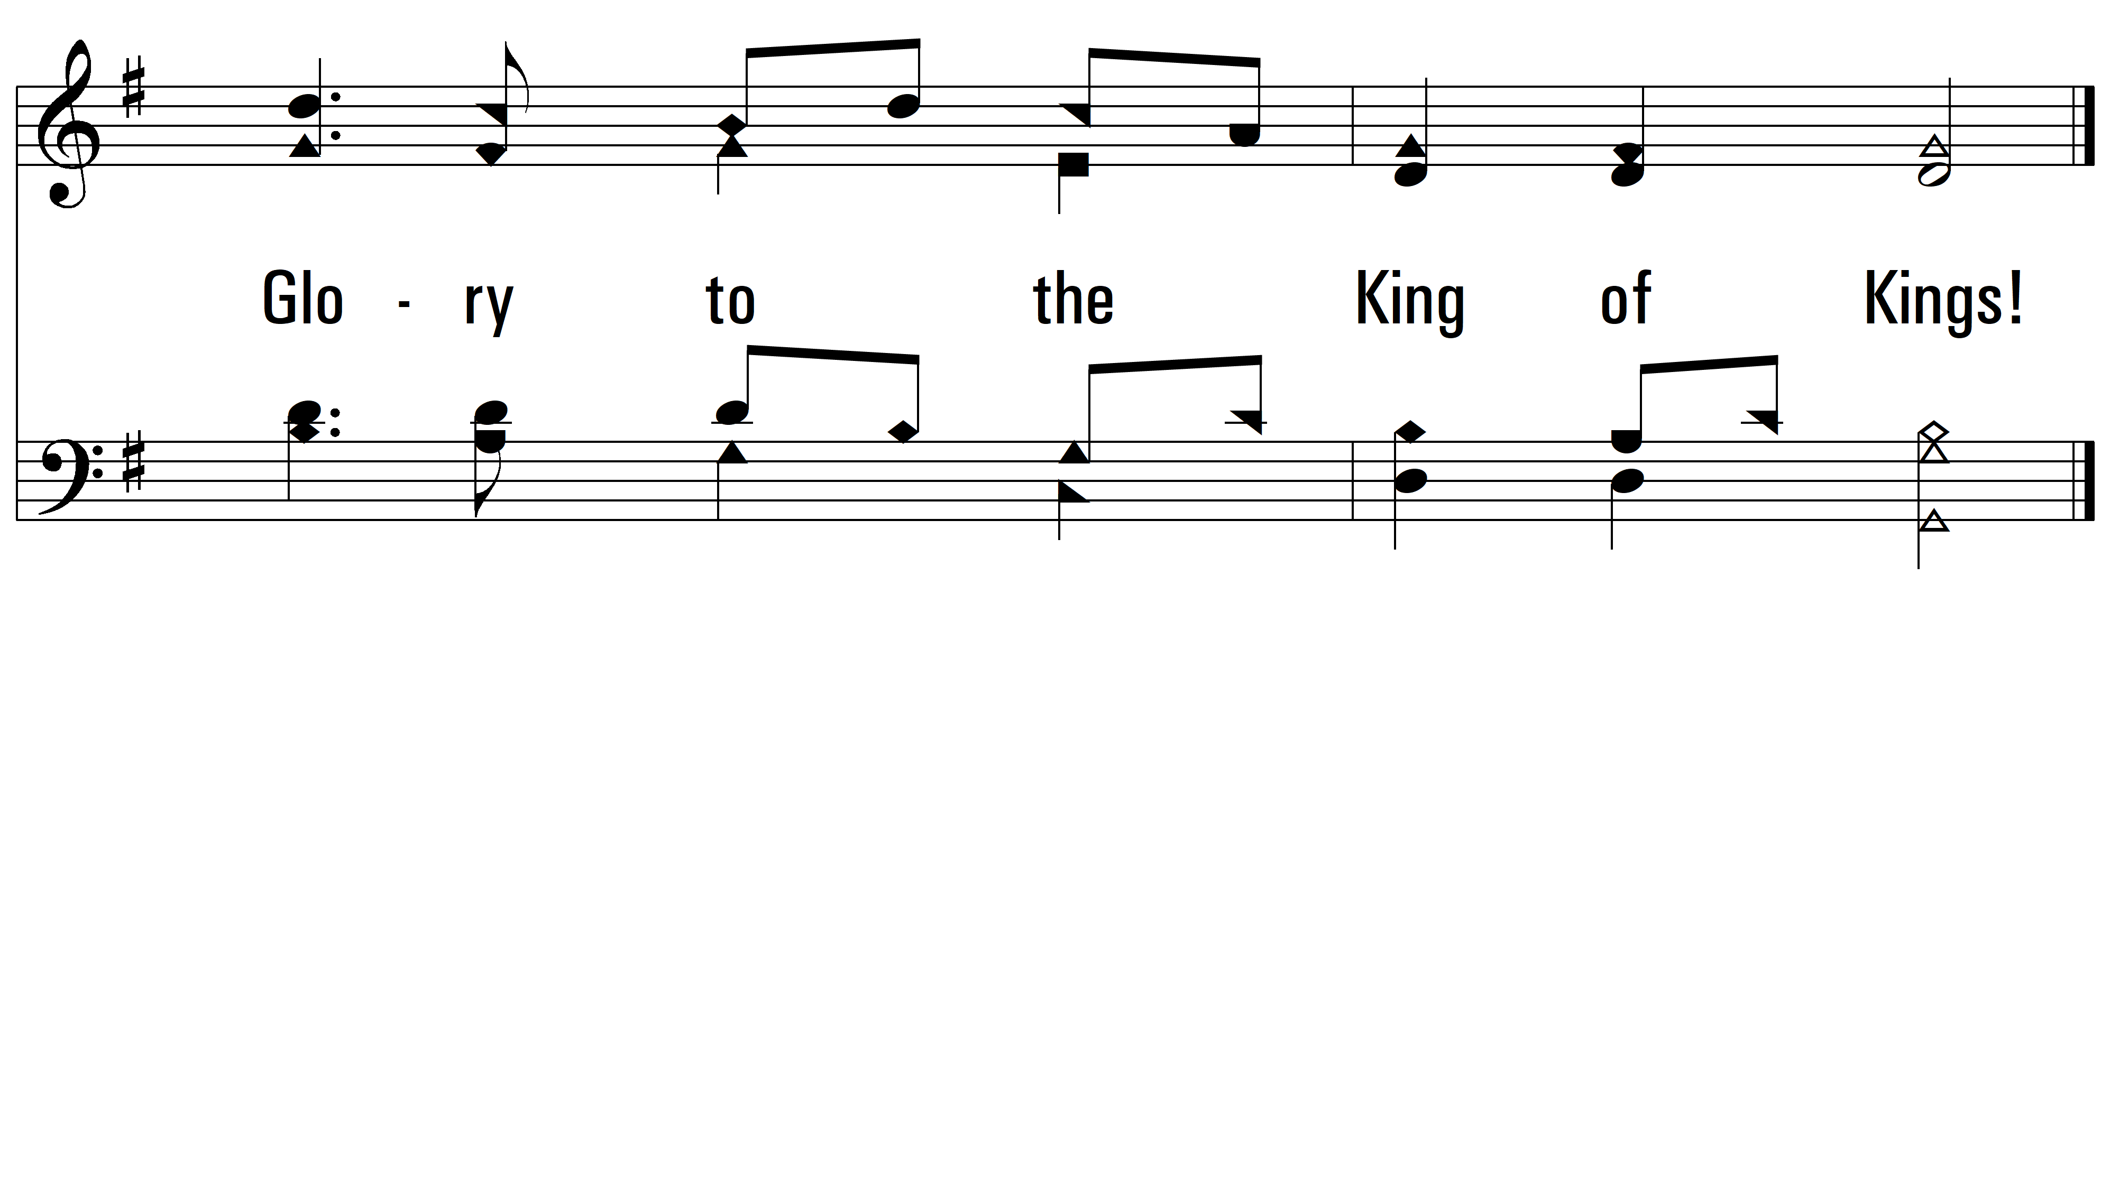
vs. 3
PDHymns.com
END

