Slide 1
Give To The Winds Your Fears
DIADEMATA
SMD
Words: | Paul Gerhardt (1653), para. of Psalms 37, Tr. by John Wesley (1739)
Music: | George J. Elvey (1868)
4/4
D/D - DO
Verses: 2
Lead - | DO
Alto - | SOL
Tenor - | MI
Bass - | DO
PDHymns.com

Slide 2
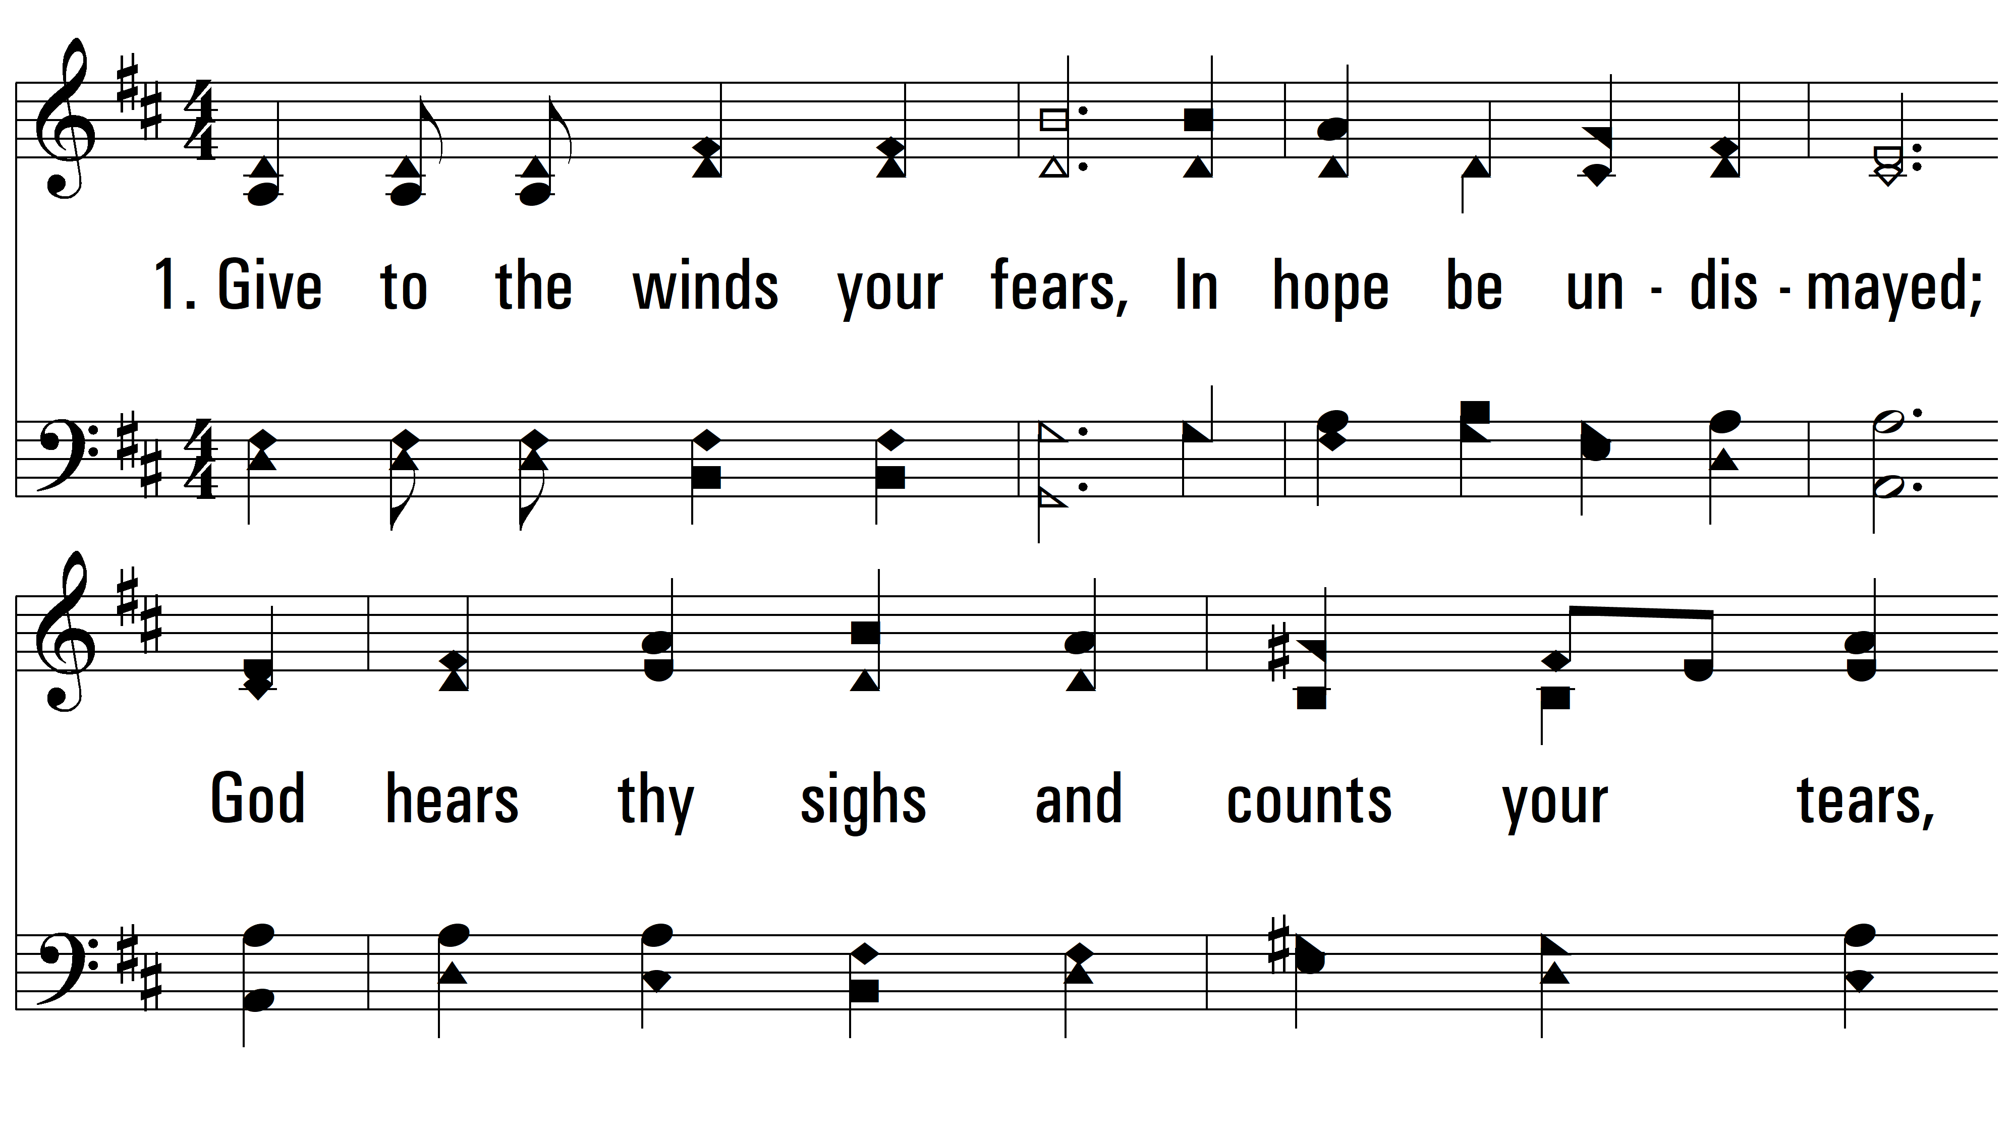
vs. 1 ~ Give To The Winds Your Fears

Slide 3
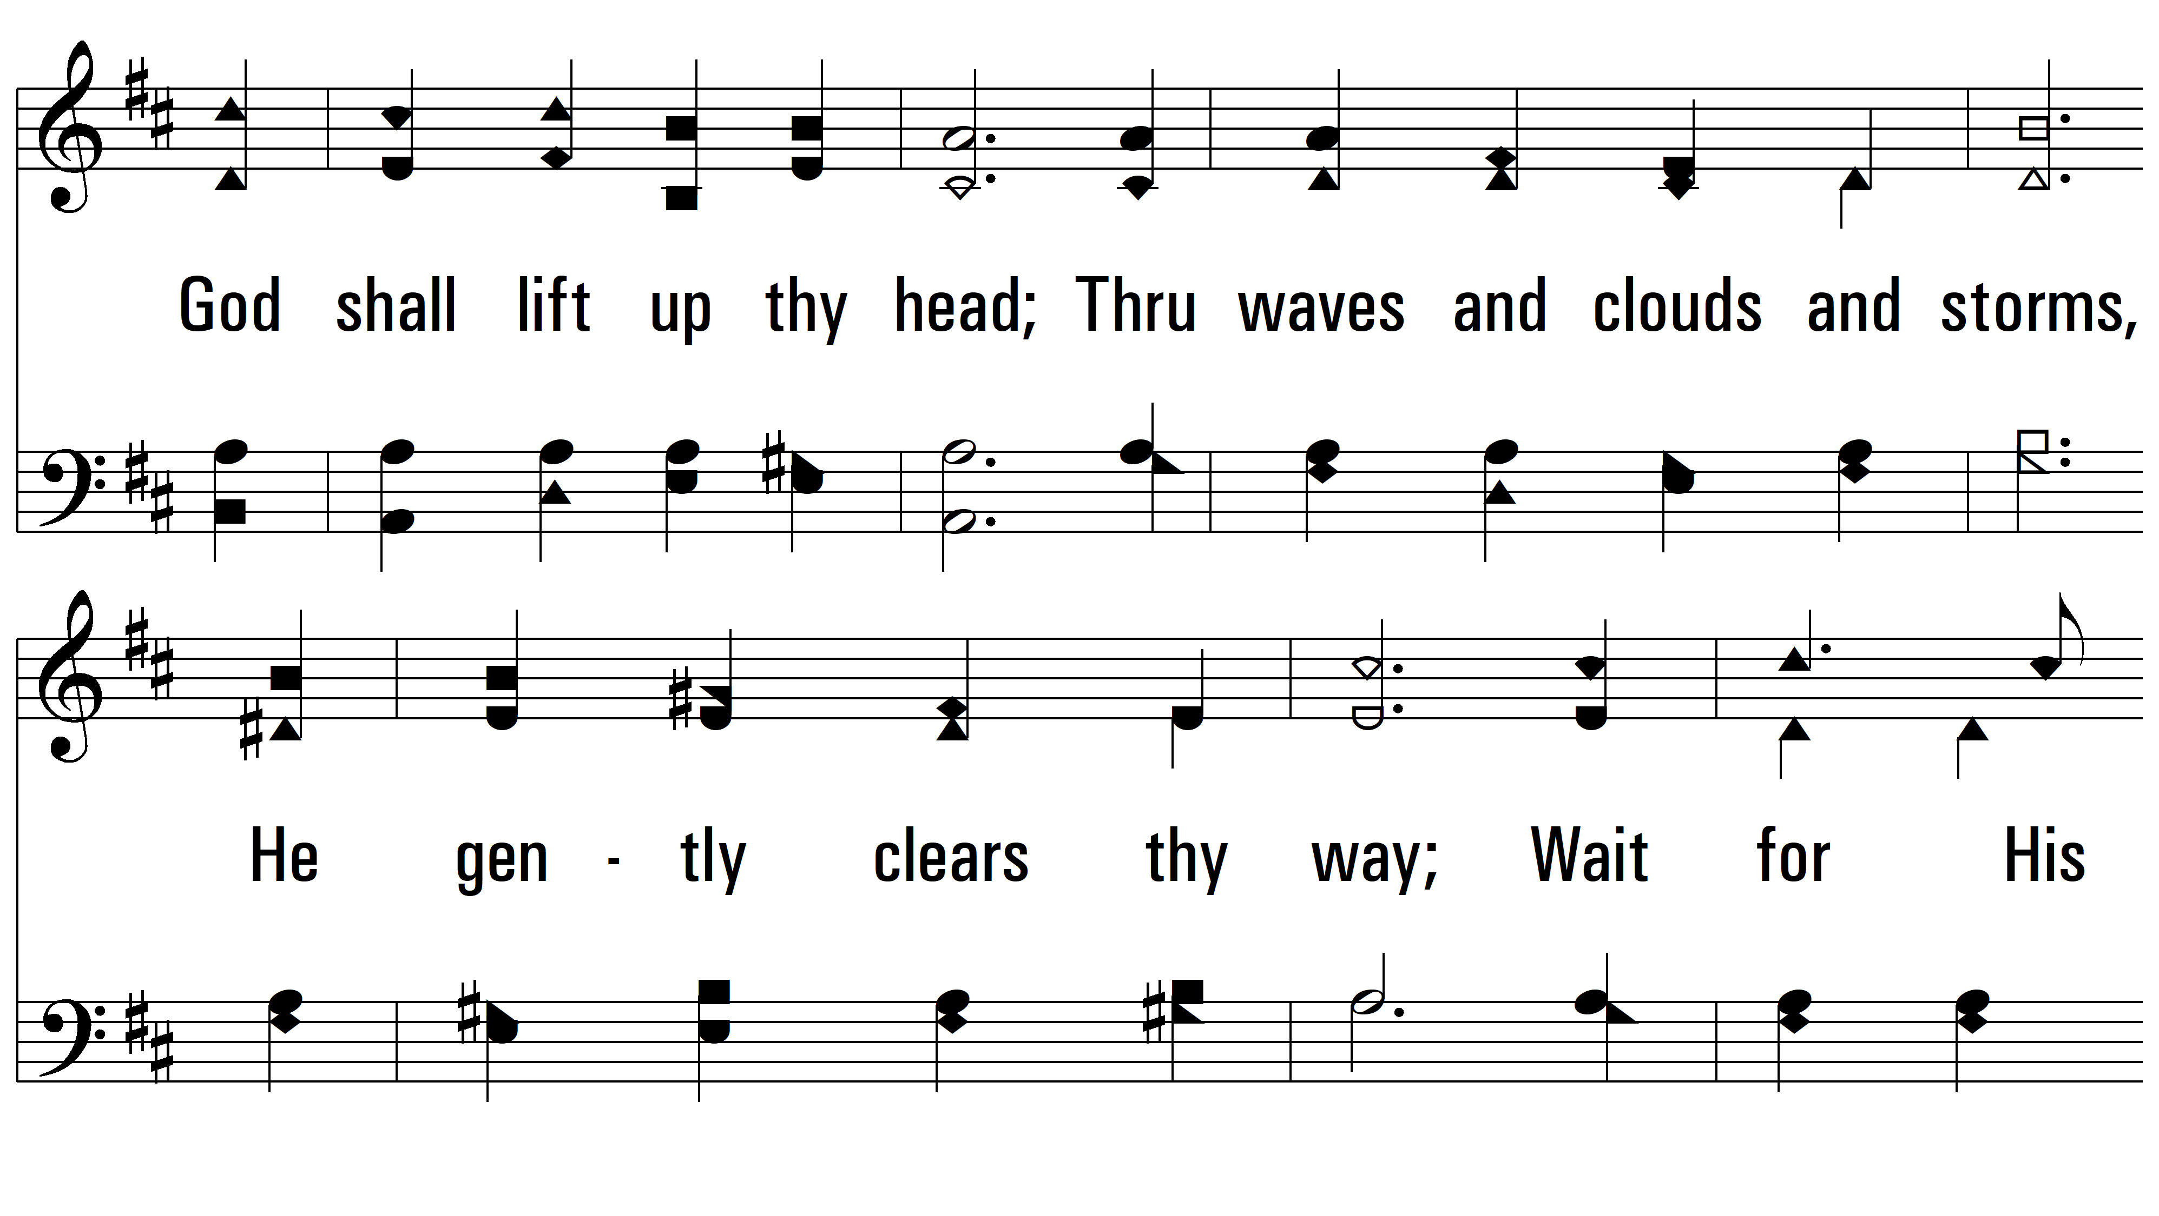
vs. 1

Slide 4
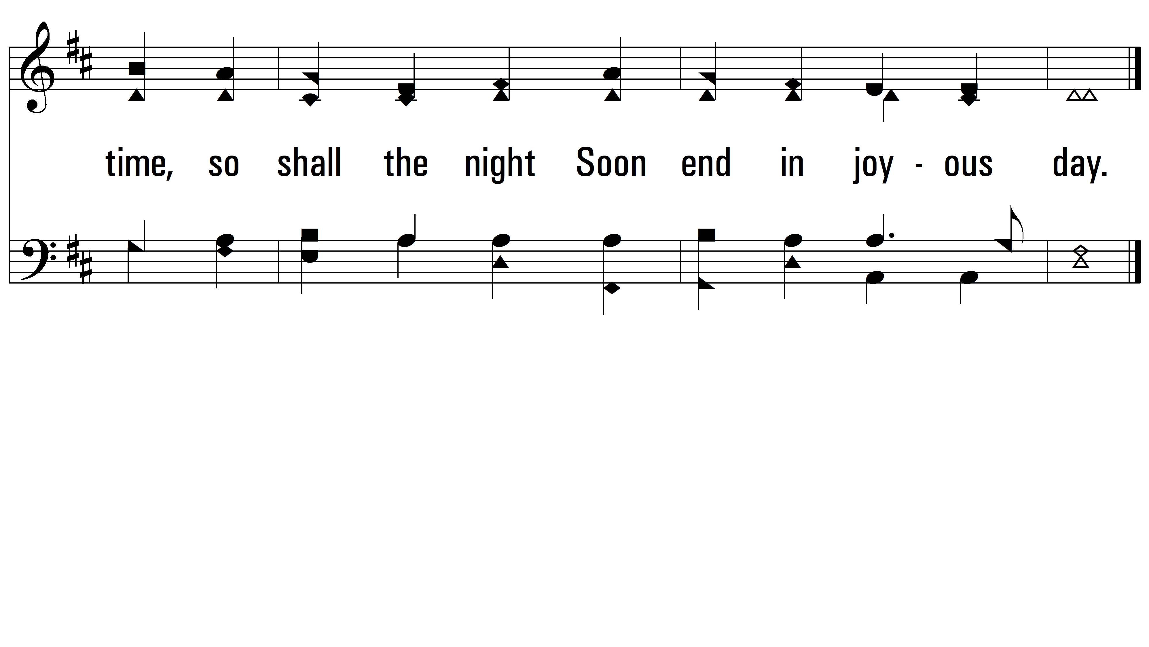
vs. 1

Slide 5
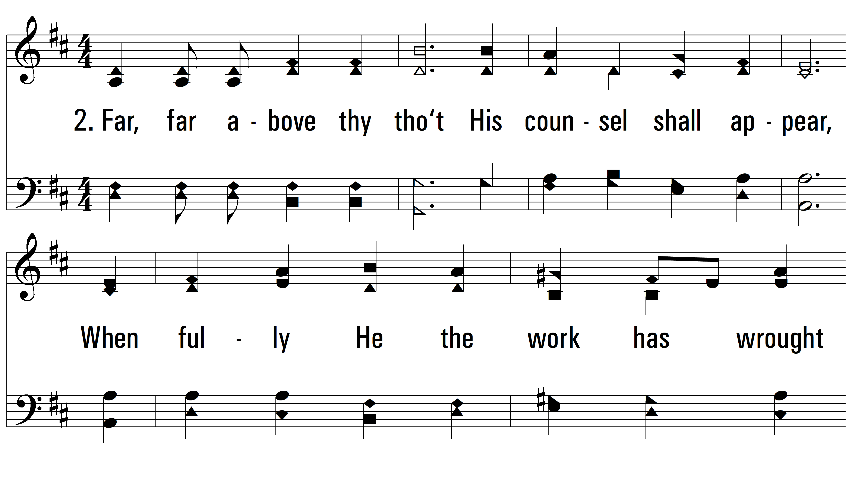
vs. 2 ~ Give To The Winds Your Fears

Slide 6
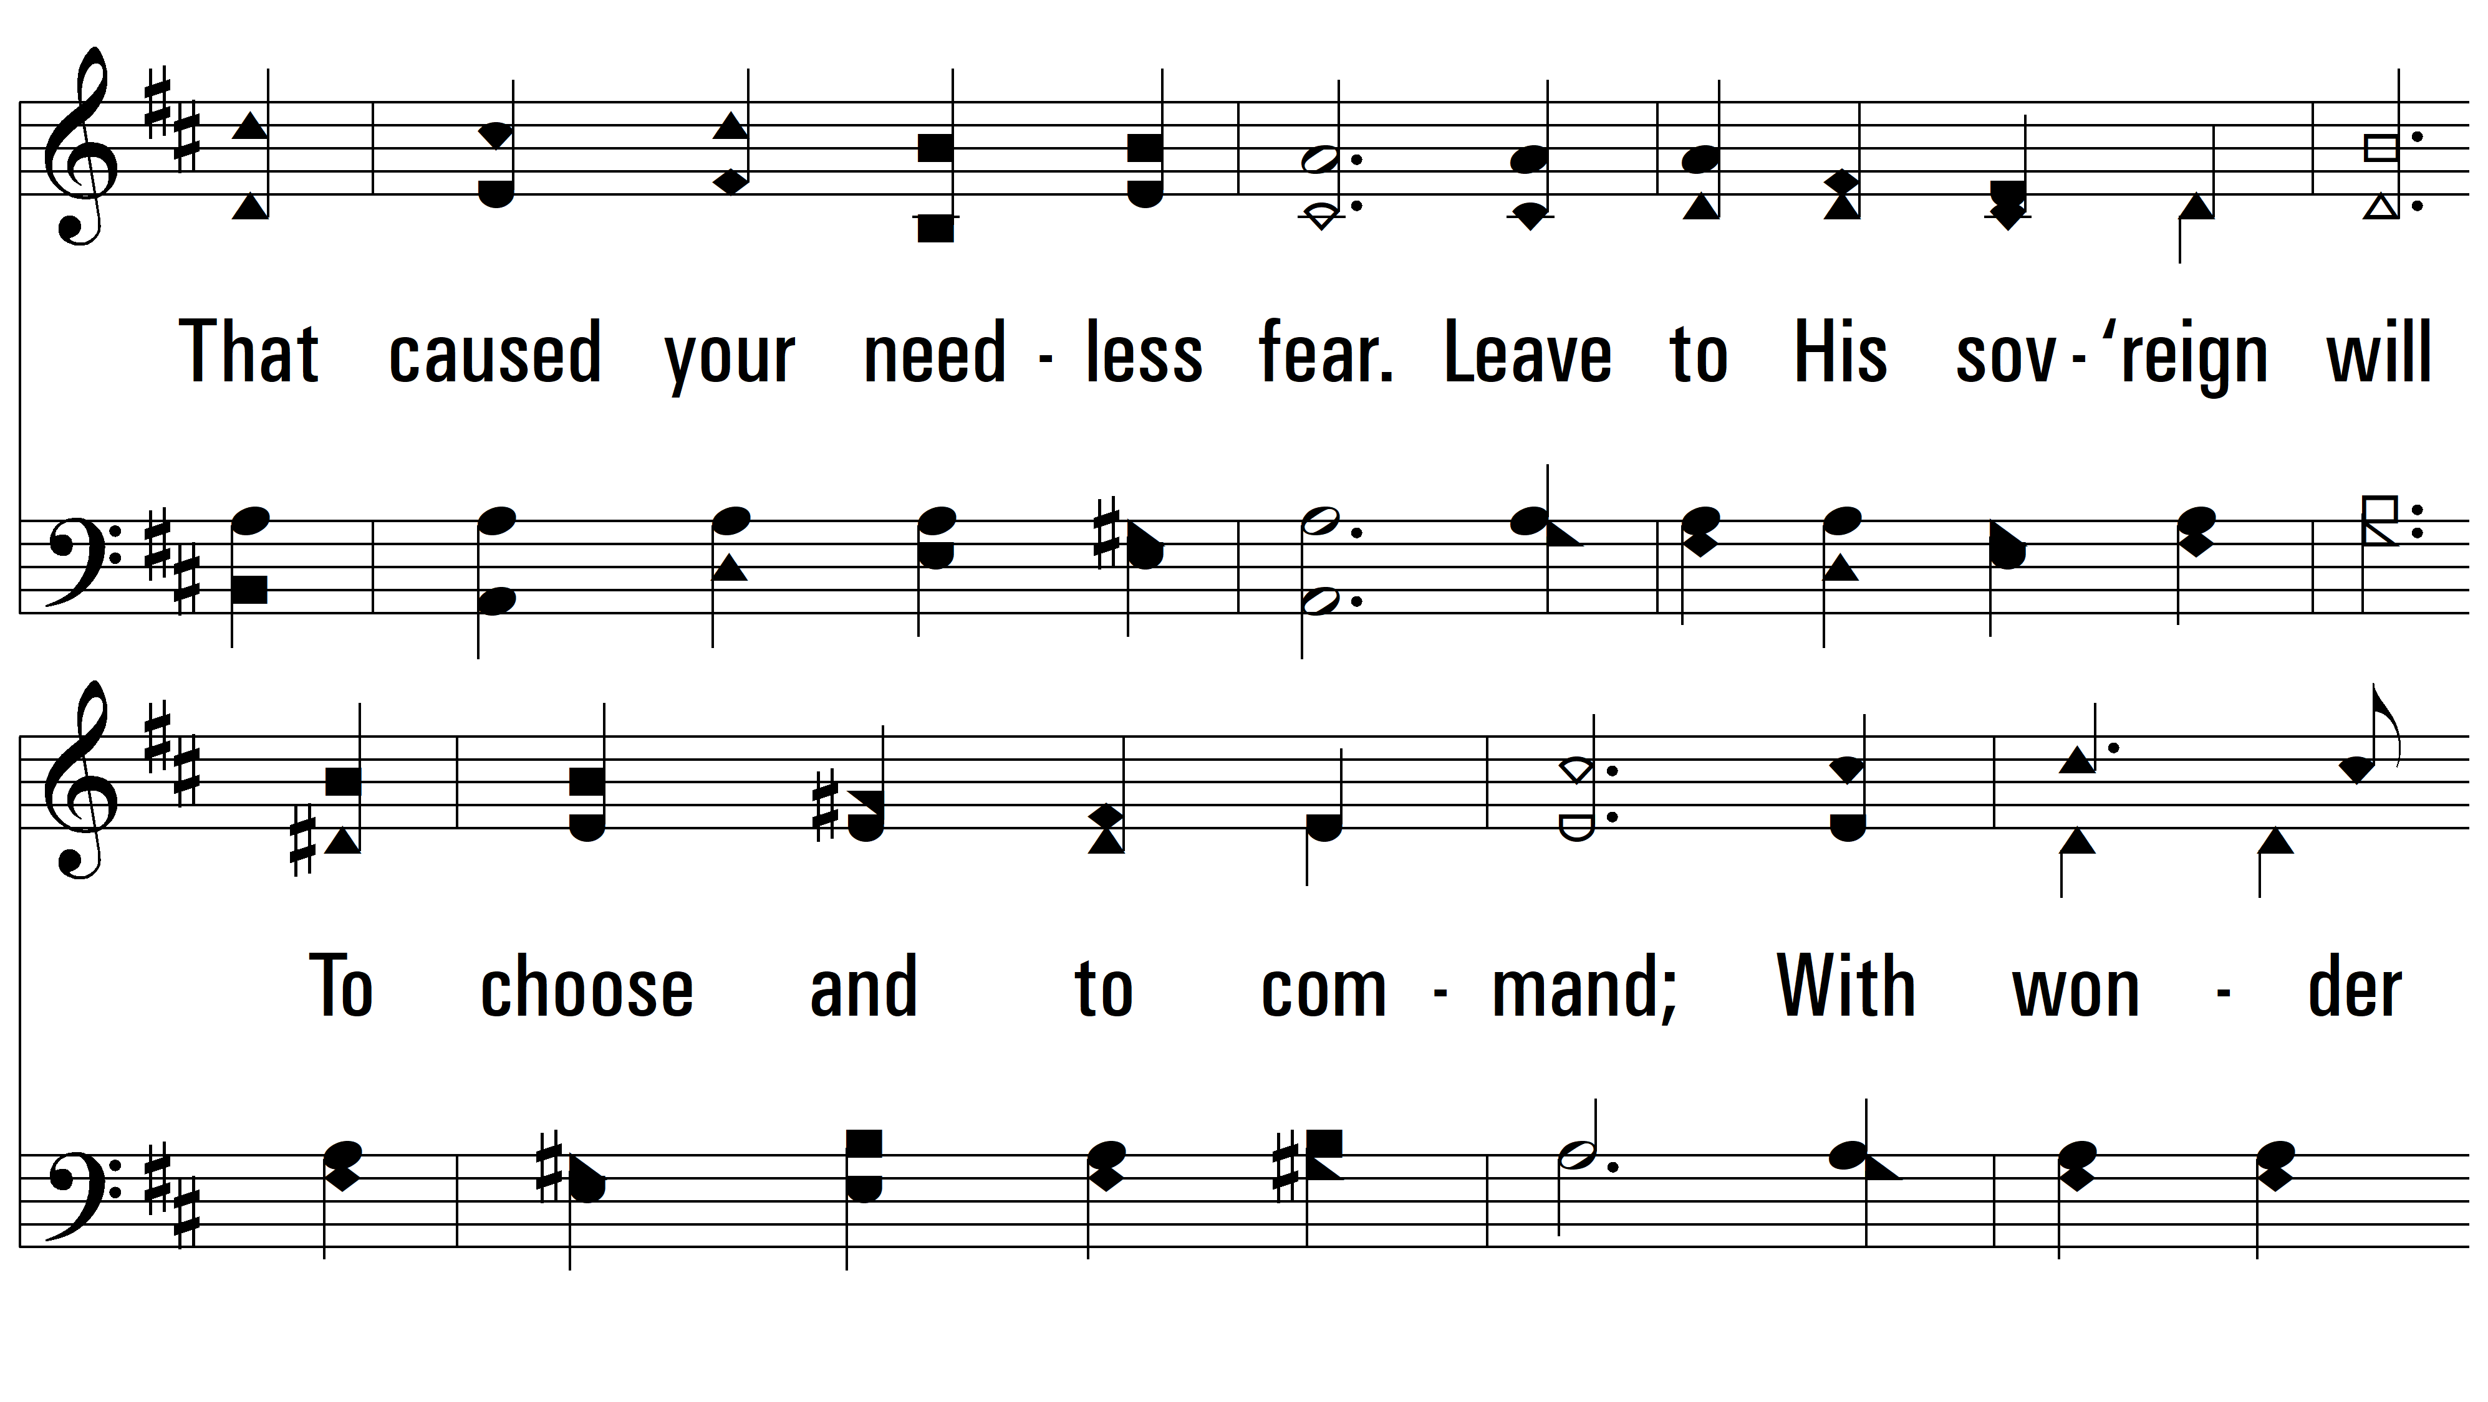
vs. 2

Slide 7
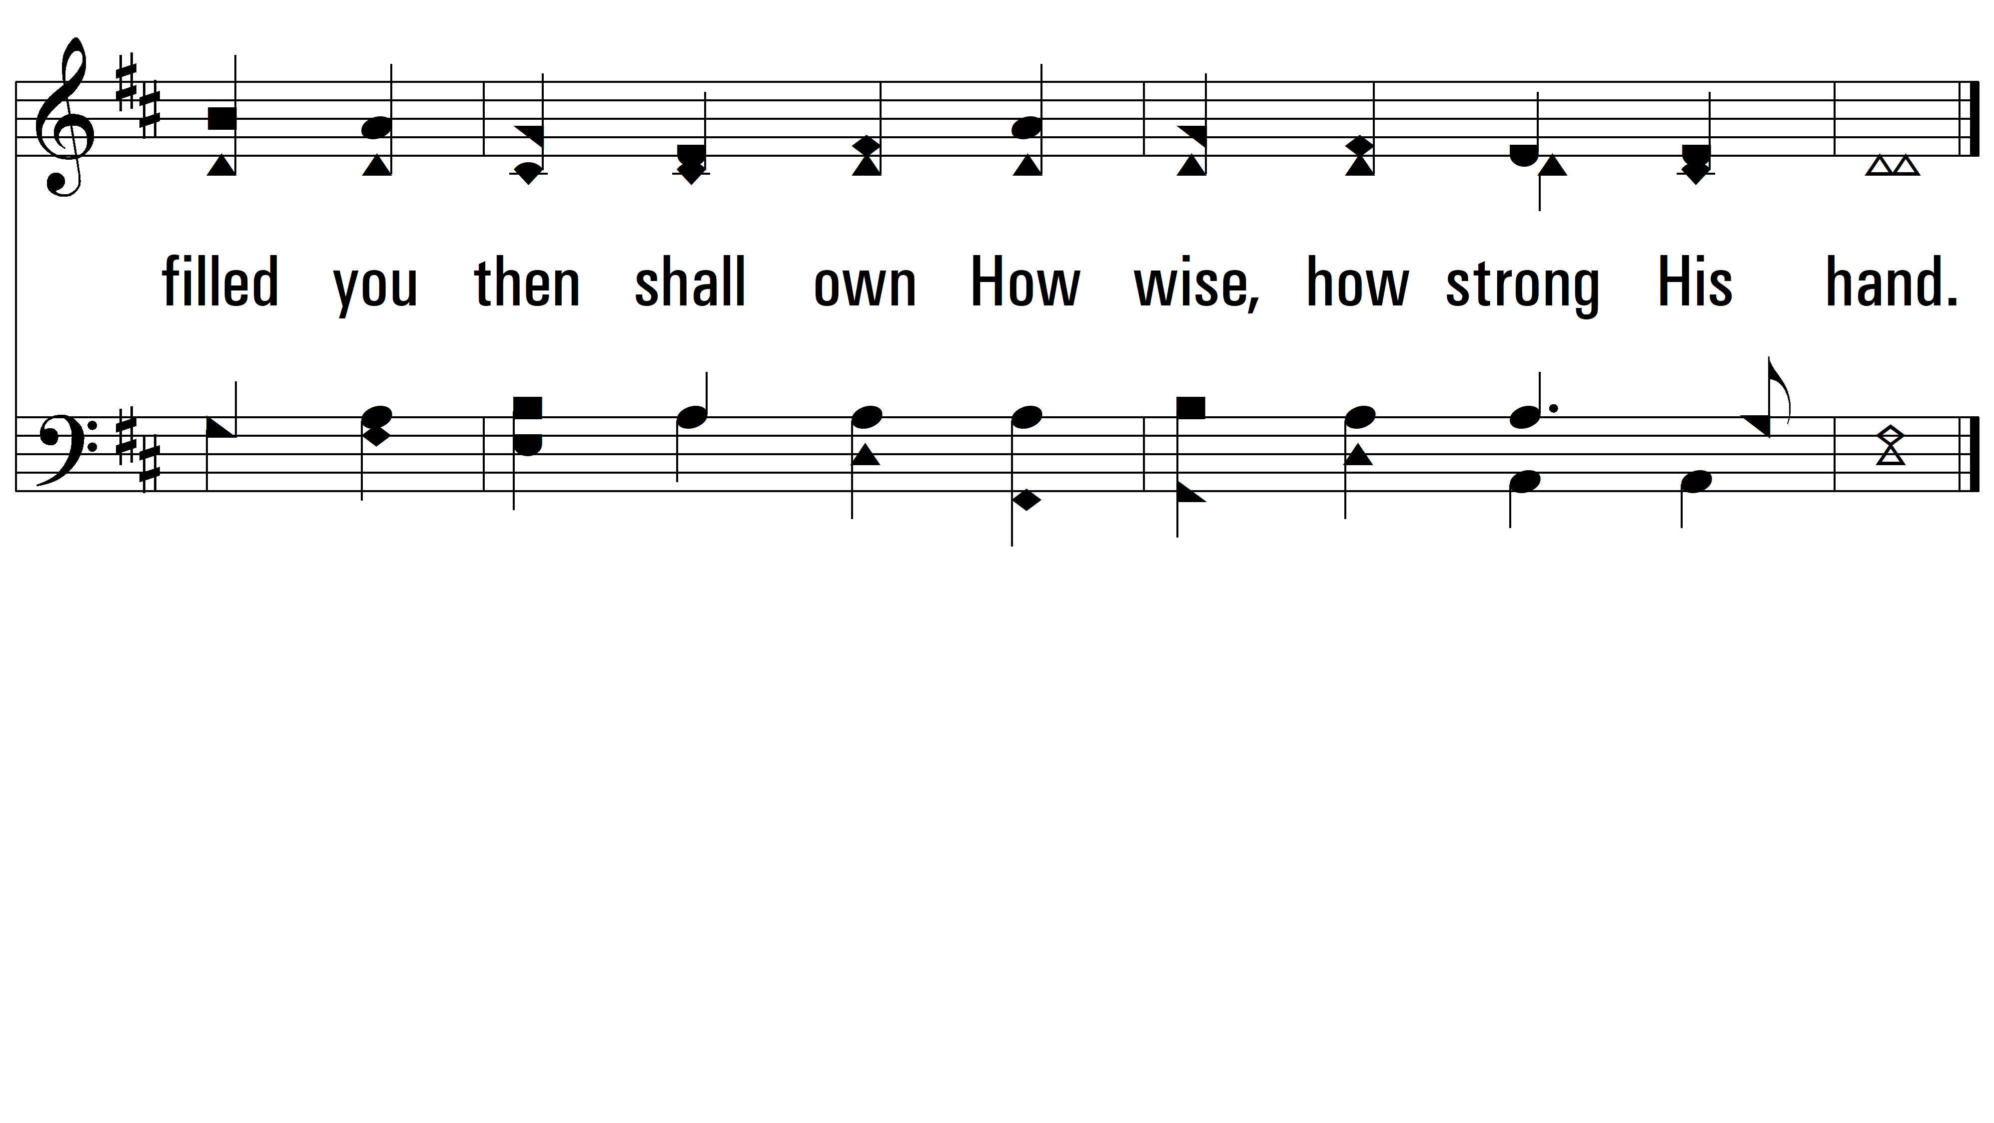
vs. 2
PDHymns.com
END

