Slide 1
From Every Stormy Wind
RETREAT
8.8.8.8
Words: | Hugh Stowell (1828)
Music: | Thomas Hastings (1841)
6/4
C/E - MI
Verses: 3
Lead - | MI
Alto - | DO
Tenor - | SOL
Bass - | DO
PDHymns.com

Slide 2
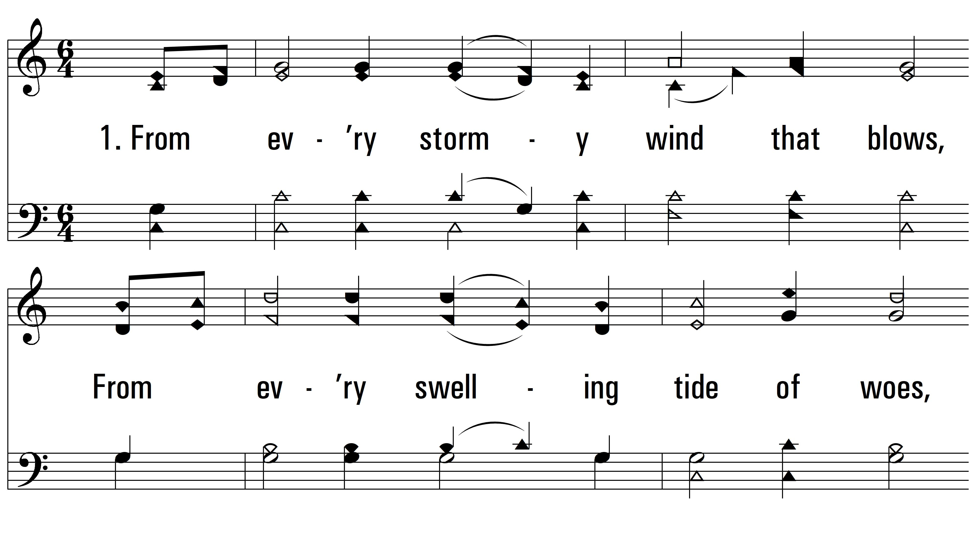
vs. 1 ~ From Every Stormy Wind

Slide 3
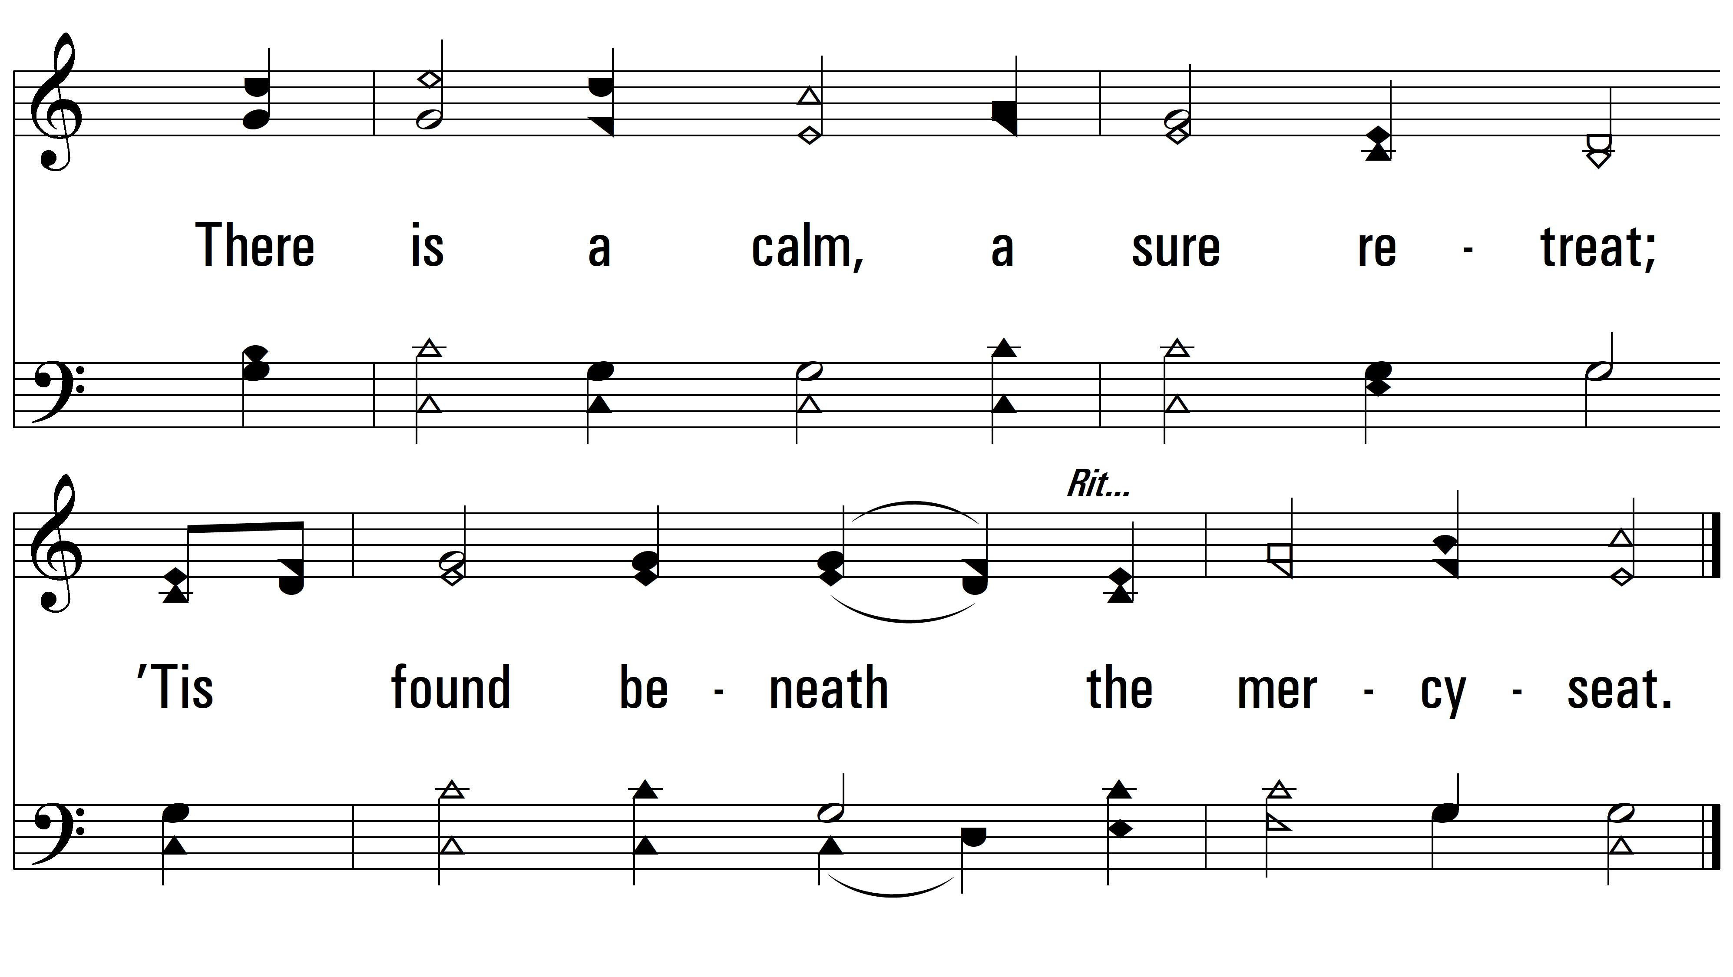
vs. 1

Slide 4
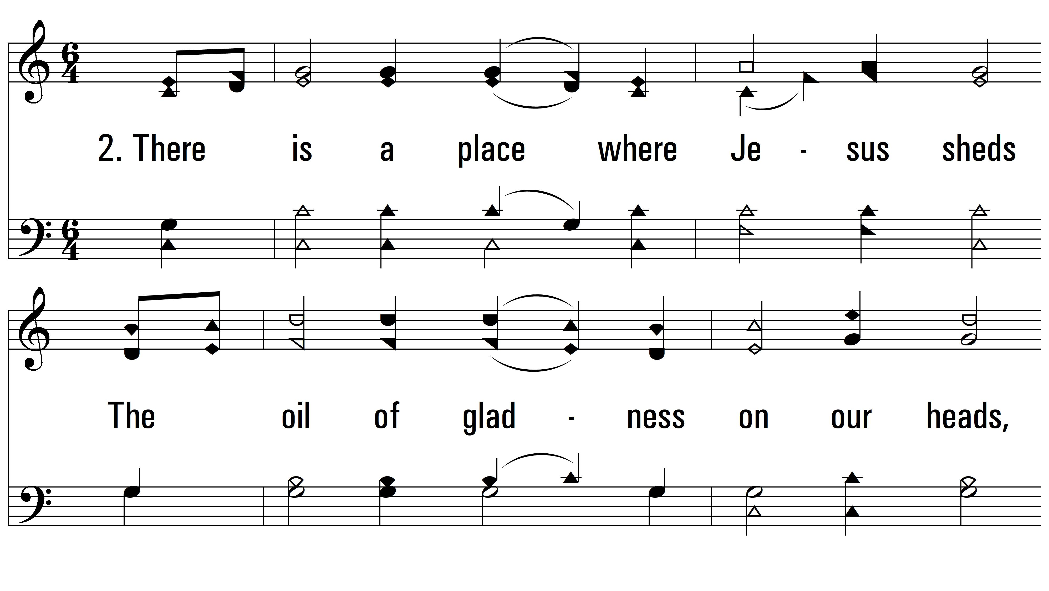
vs. 2 ~ From Every Stormy Wind

Slide 5
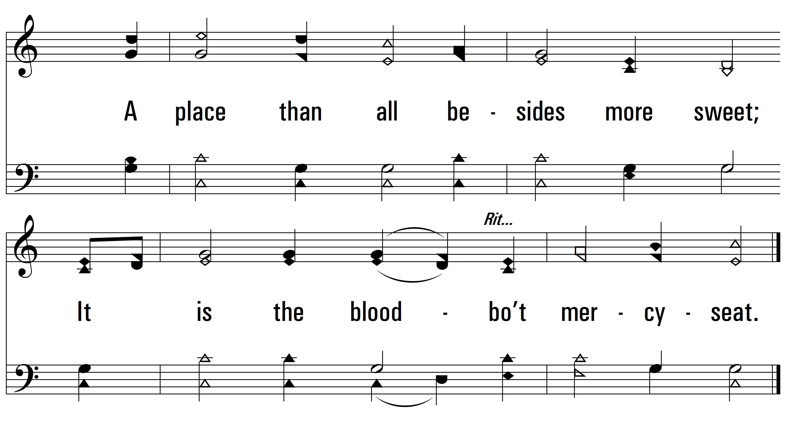
vs. 2

Slide 6
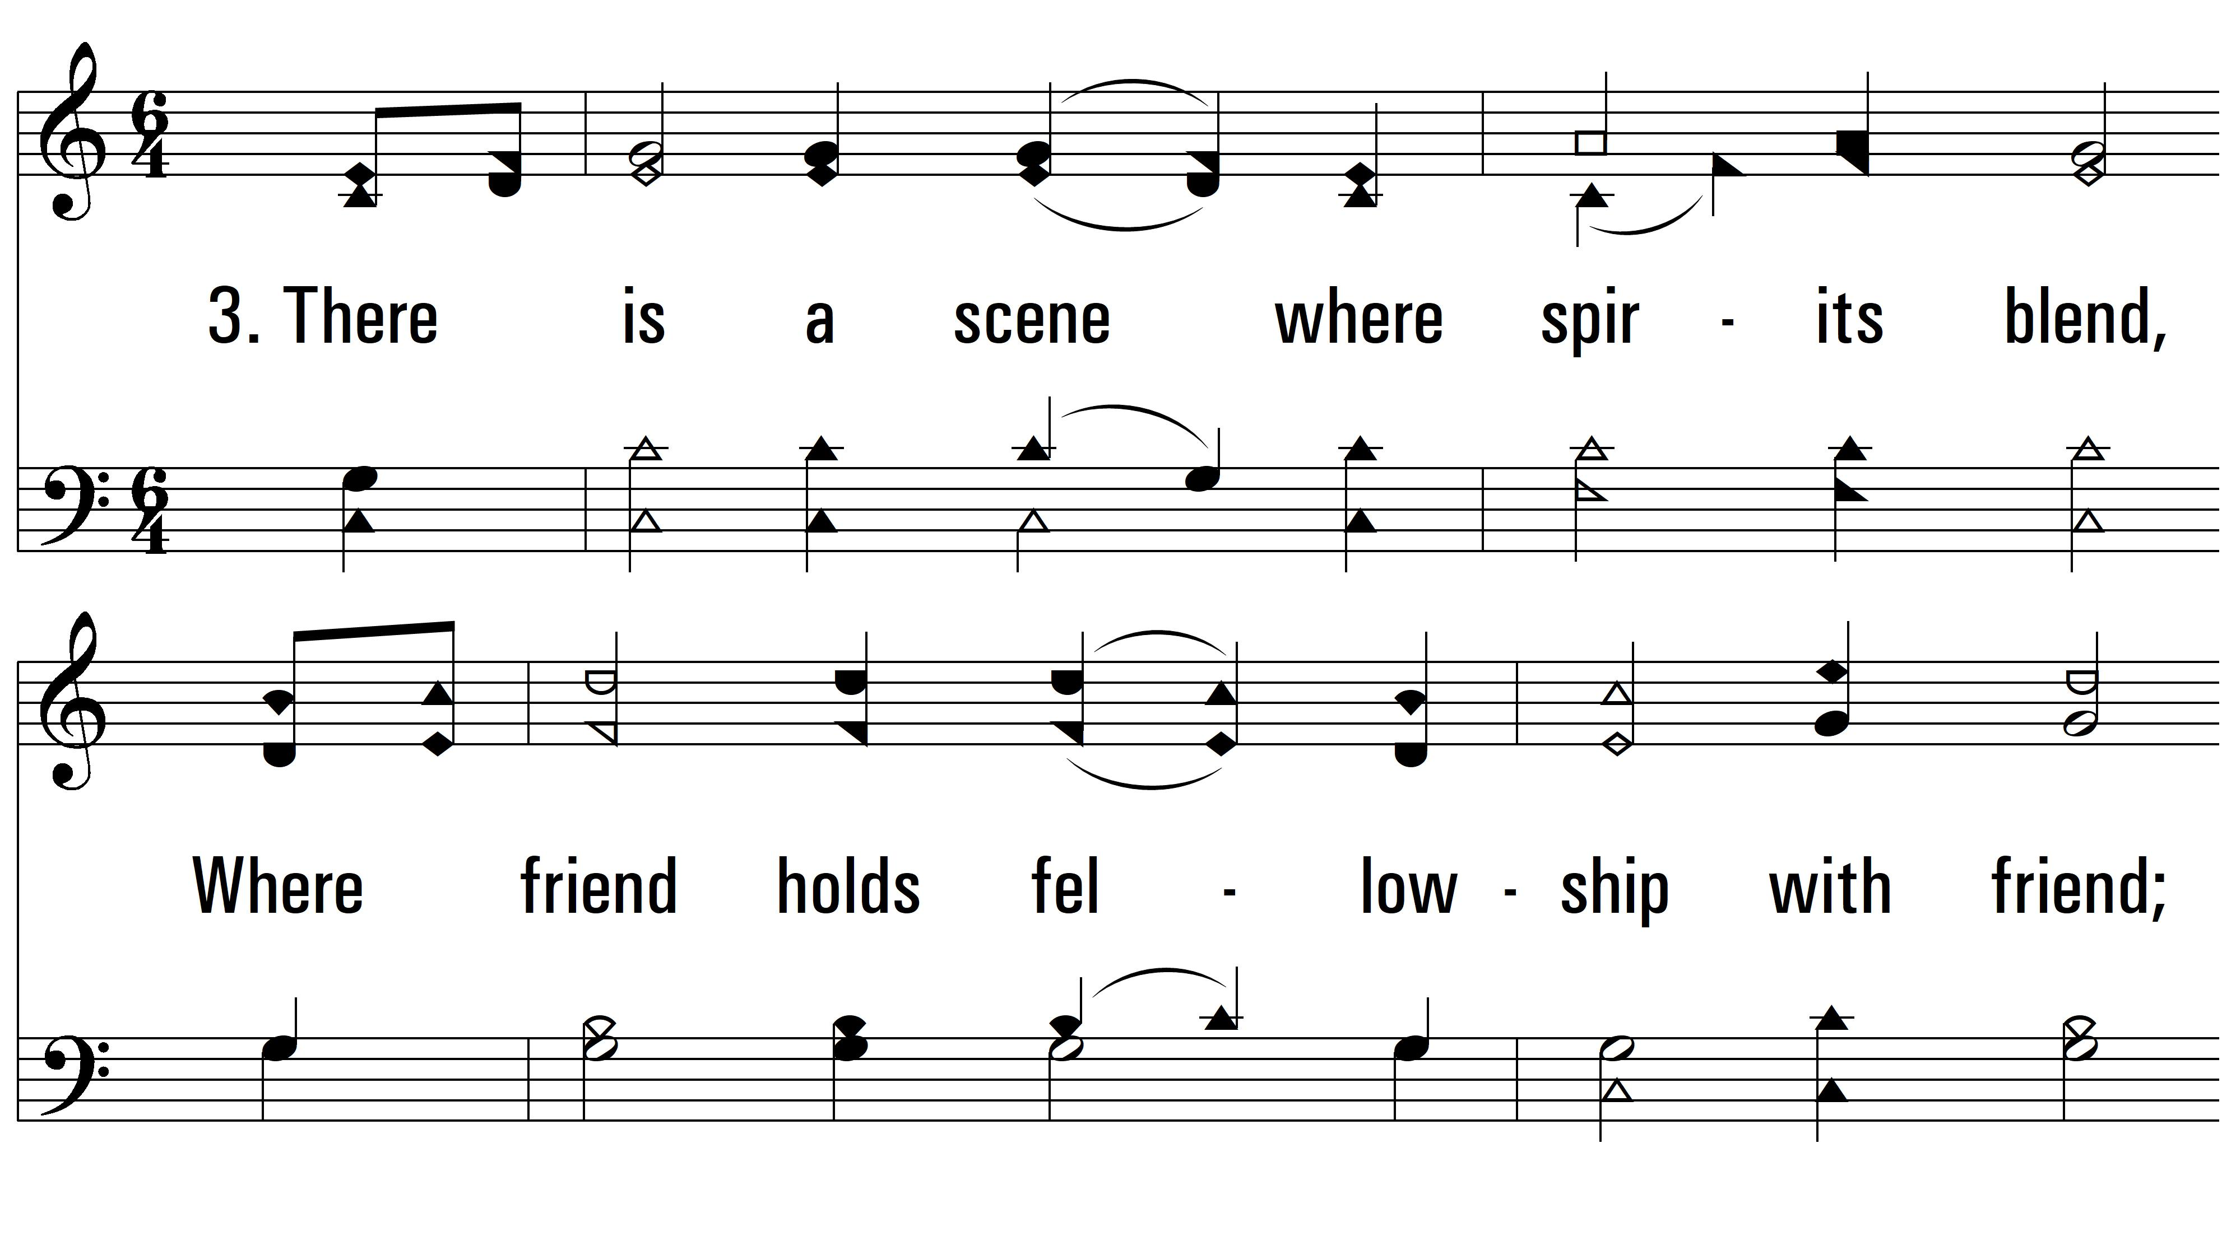
vs. 3 ~ From Every Stormy Wind

Slide 7
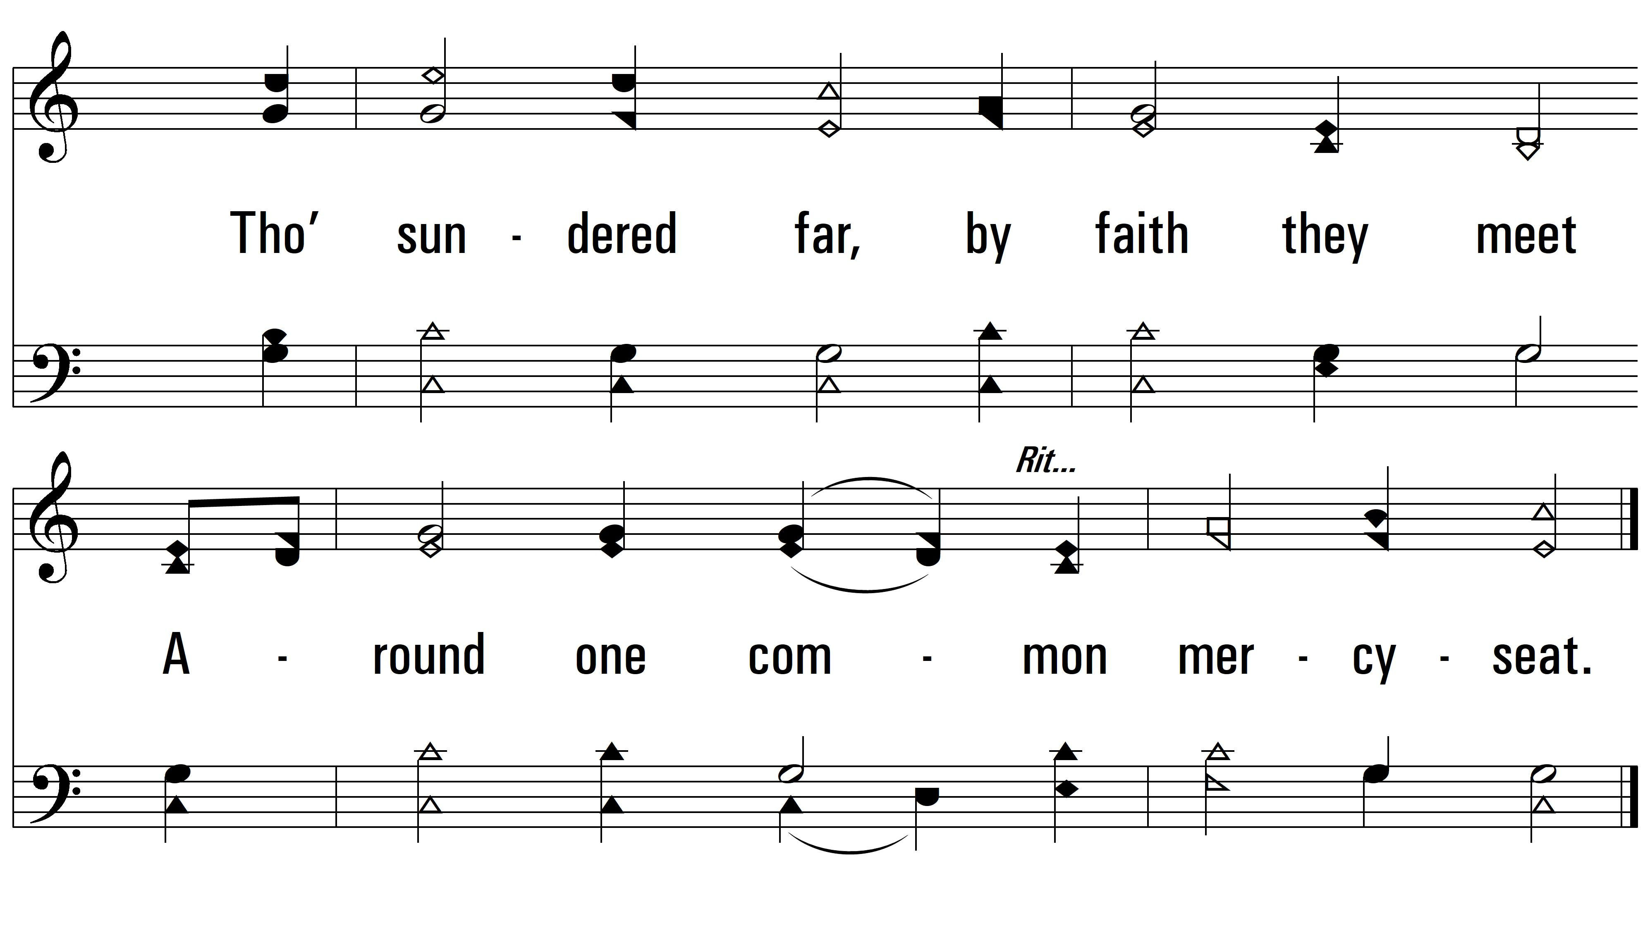
vs. 3

Slide 8
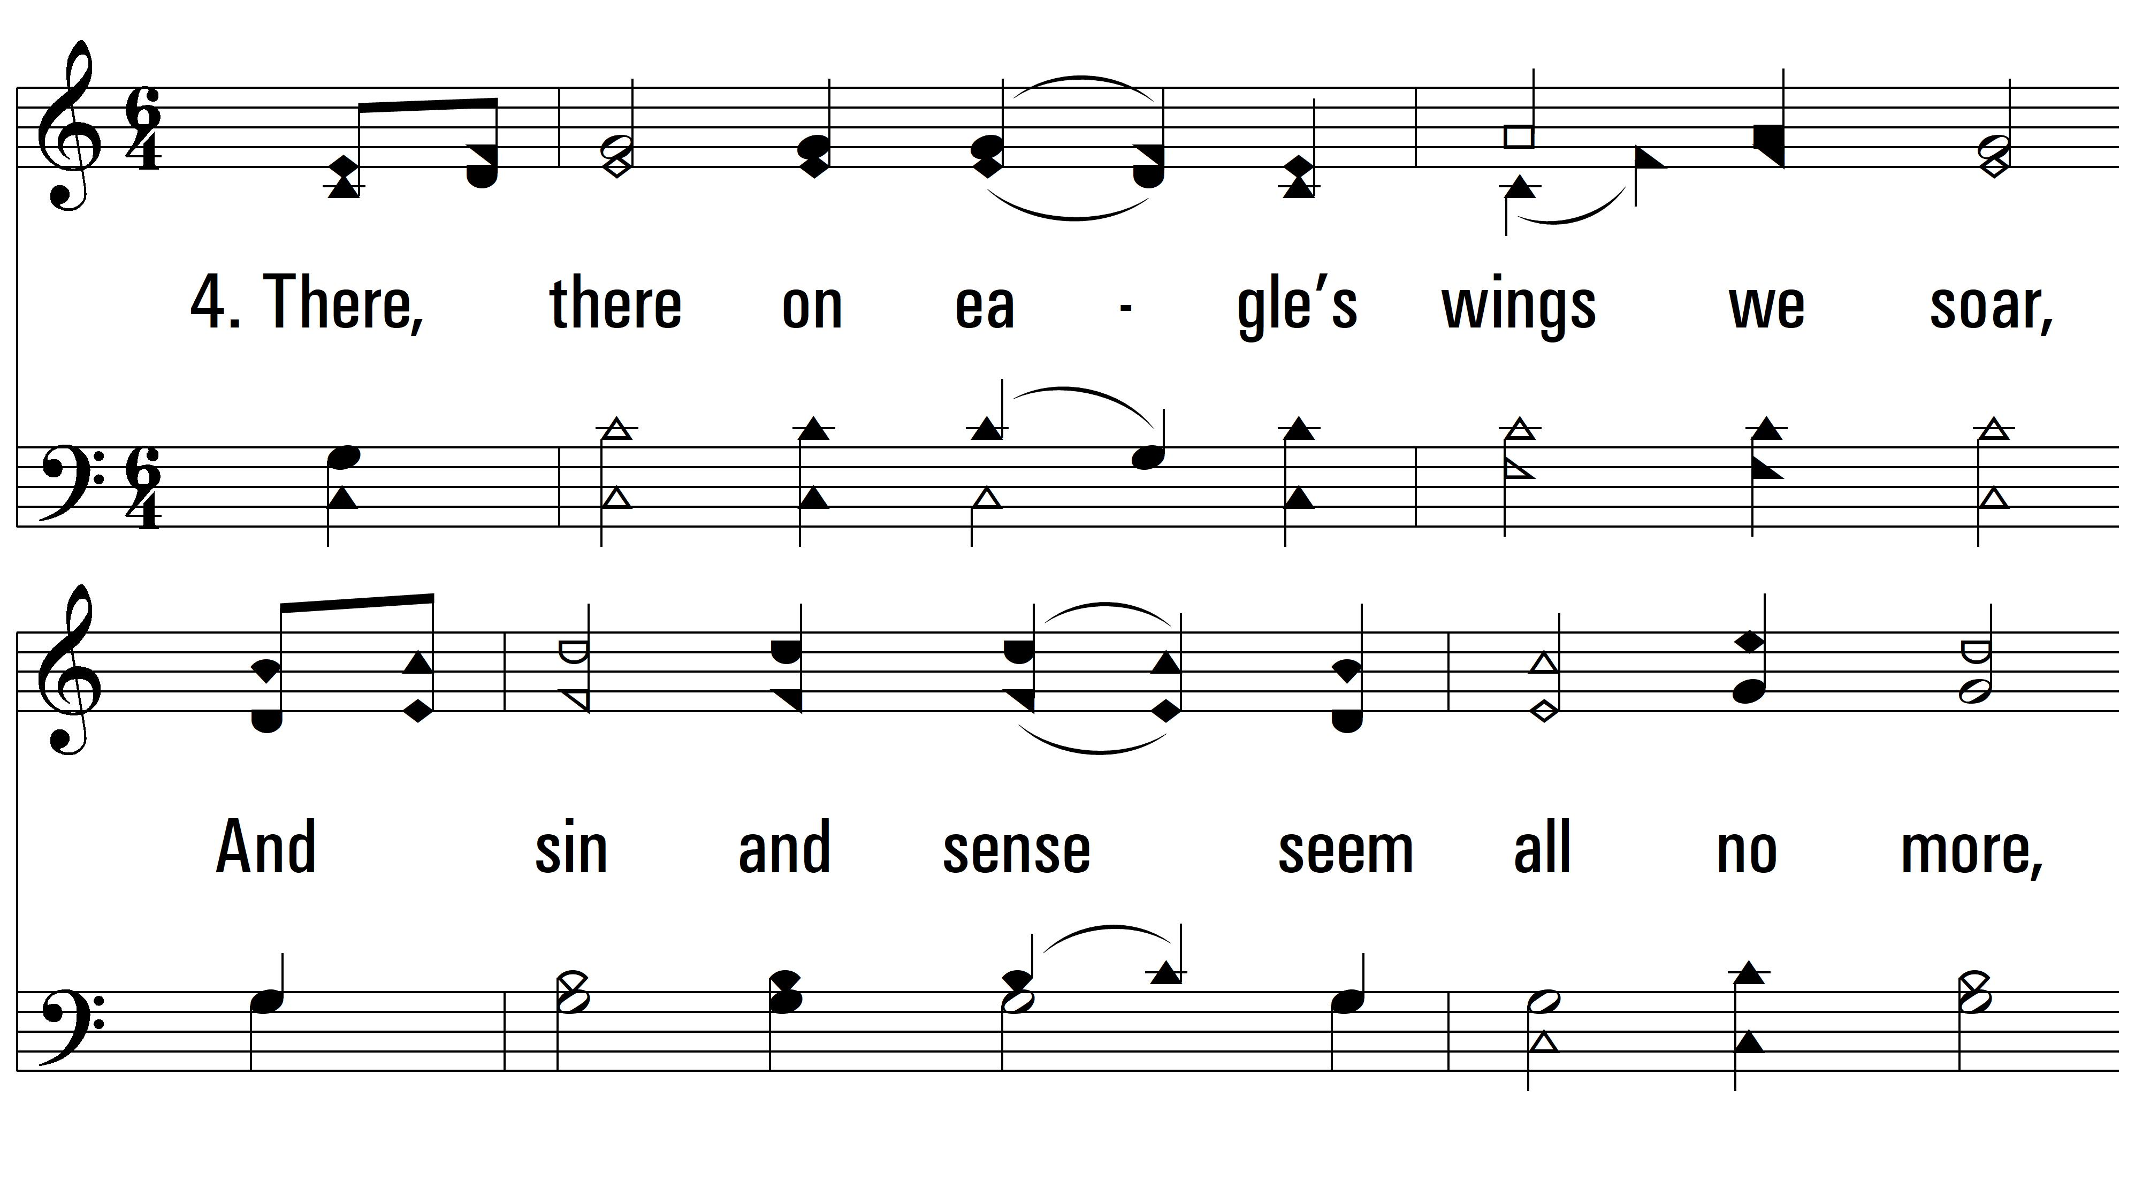
vs. 4 ~ From Every Stormy Wind

Slide 9
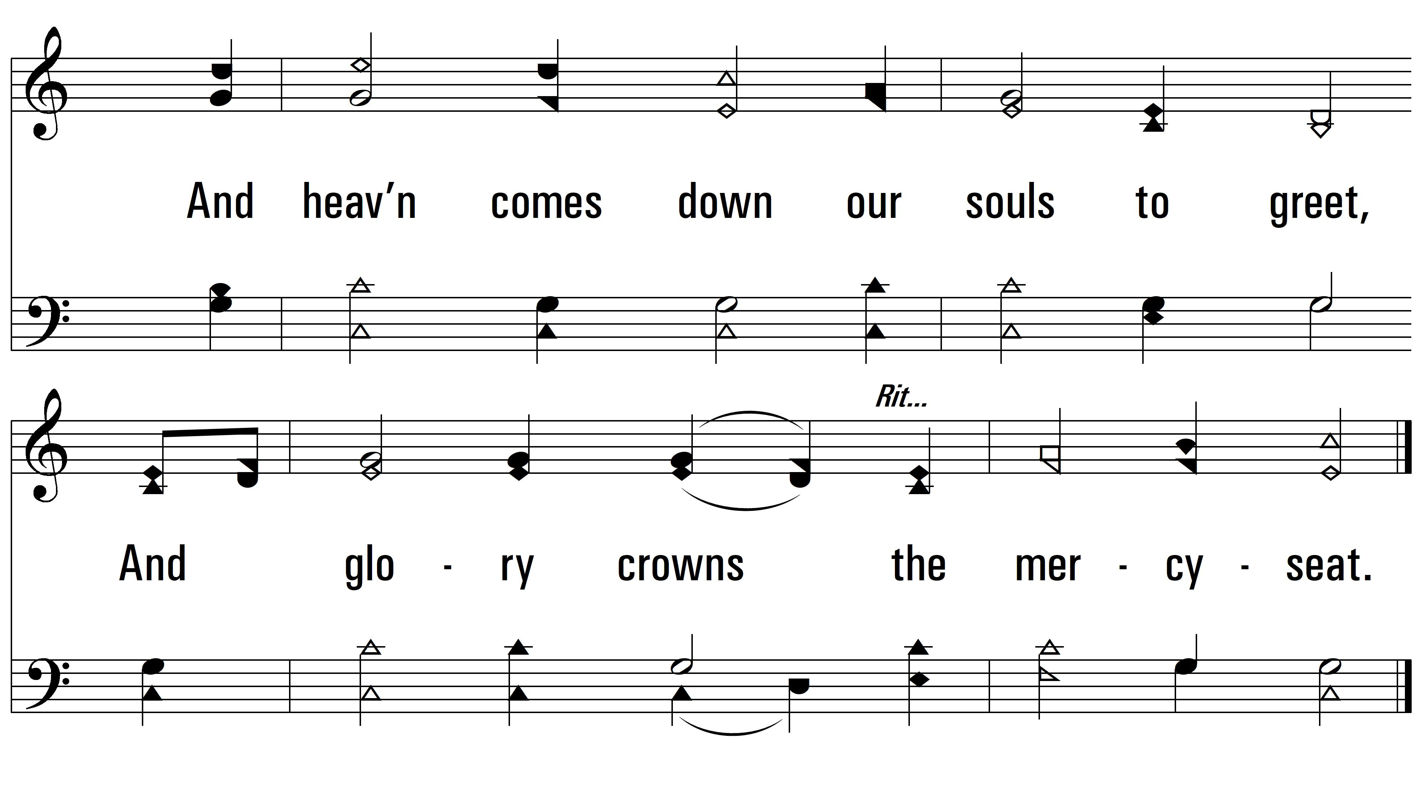
vs. 4
PDHymns.com
END

