Slide 1
Forever With The Lord
Words: | James Montgomery (1835)
Music: | R. Schuman, Arr. by Lowell Mason
4/4
A^{b}/E^{b} - SOL
Verses: 3
Lead - | SOL
Alto - | MI
Tenor - | DO
Bass - | DO
PDHymns.com

Slide 2
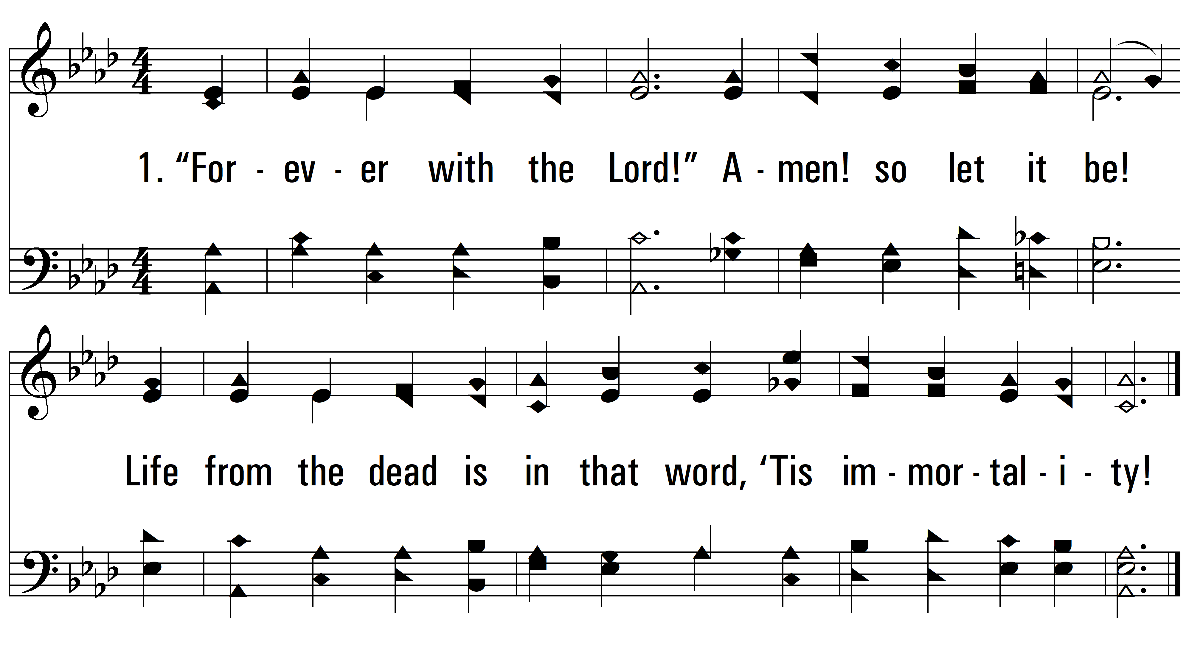
vs. 1 ~ Forever With The Lord

Slide 3
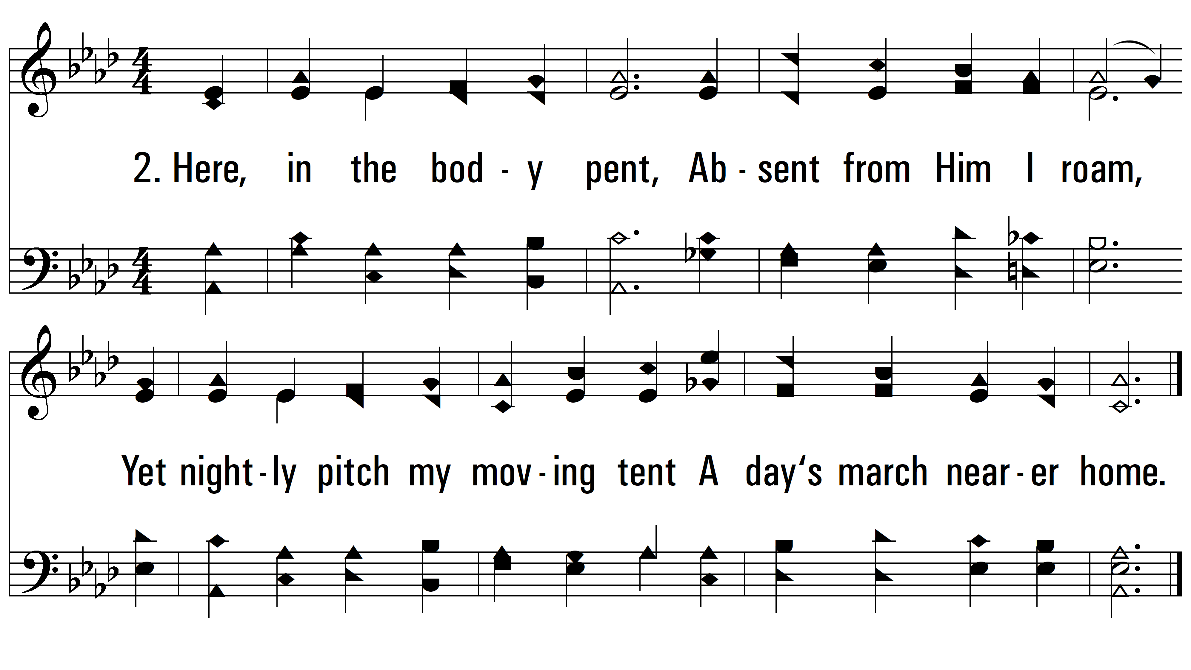
vs. 2 ~ Forever With The Lord

Slide 4
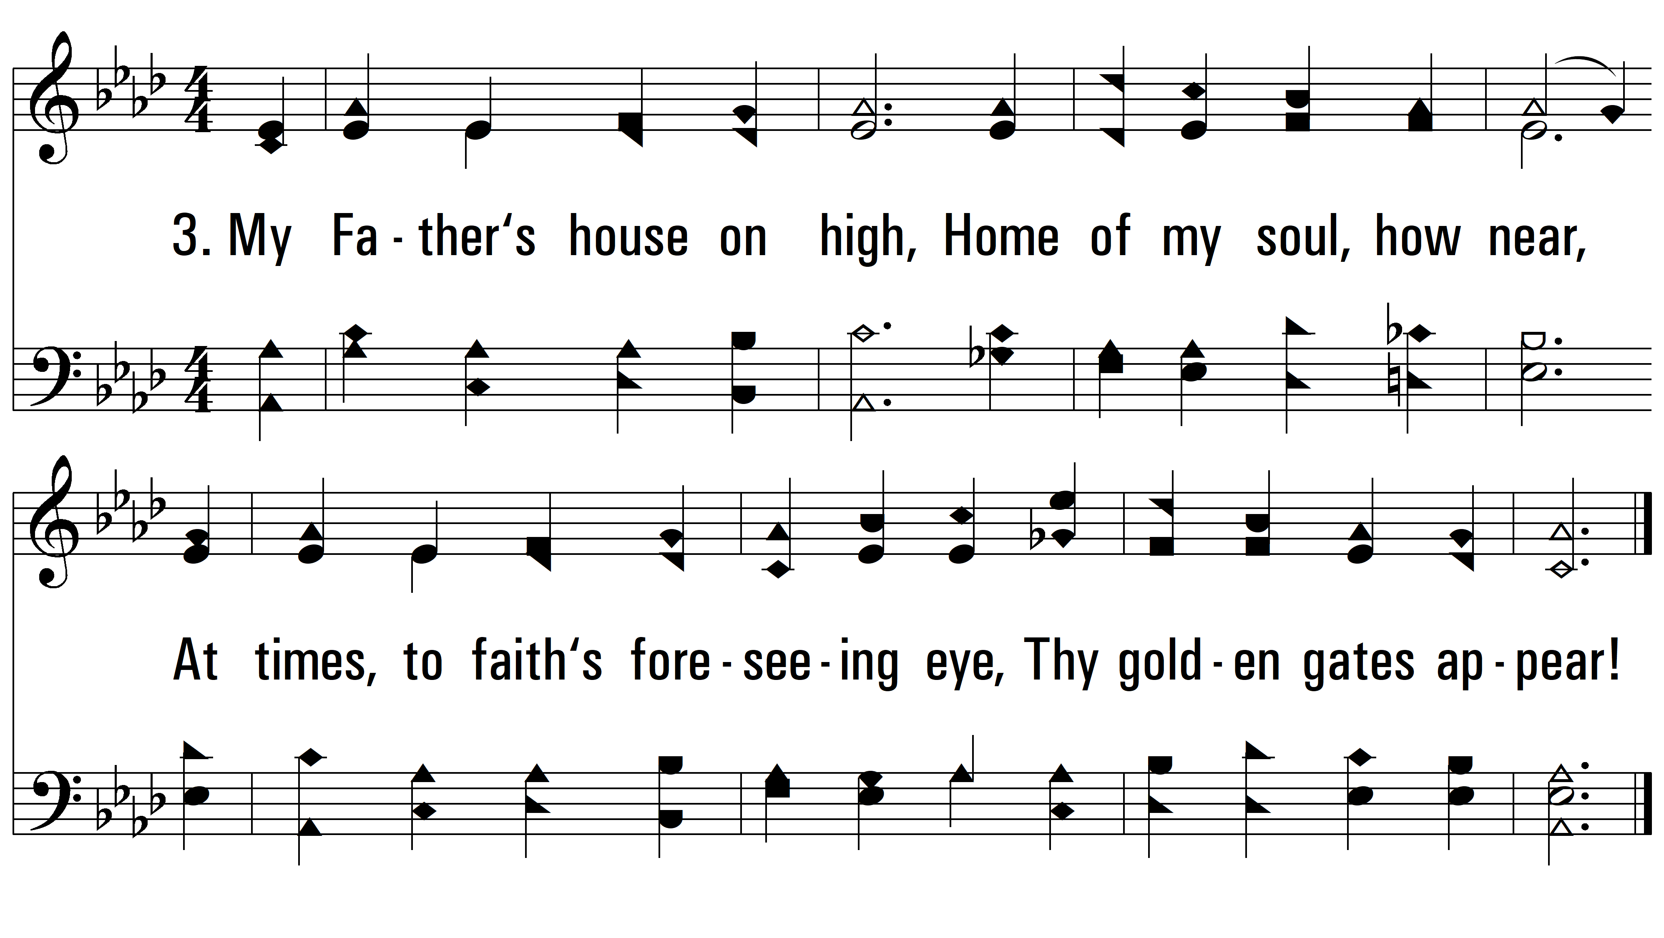
vs. 3 ~ Forever With The Lord
PDHymns.com
END

