Slide 1
For The Beauty Of The Earth
DIX
7.7.7.7.7.7
Words: | Folliott S. Pierpoint (1864)
Music: | Conrad Kocher (1838), Adpt. William H. Monk (1861)
4/4
A^{b}/A^{b} - DO
Verses: 4/Chorus
Lead - | DO
Alto - | SOL
Tenor - | MI
Bass - | DO
PDHymns.com

Slide 2
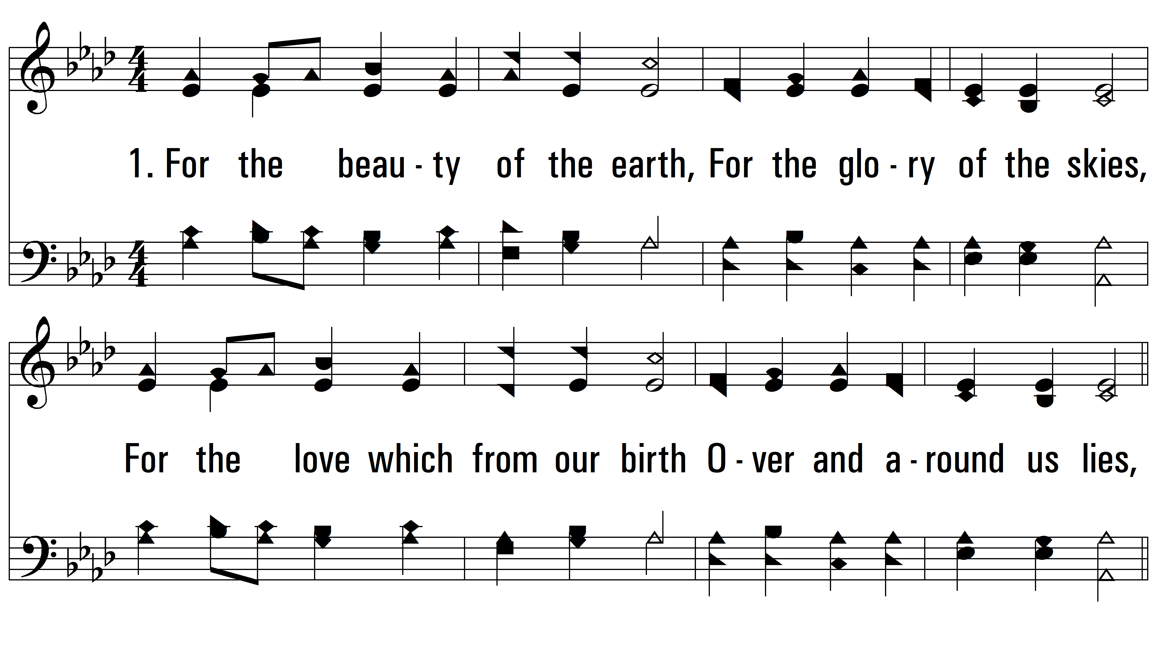
vs. 1 ~ For The Beauty Of The Earth

Slide 3
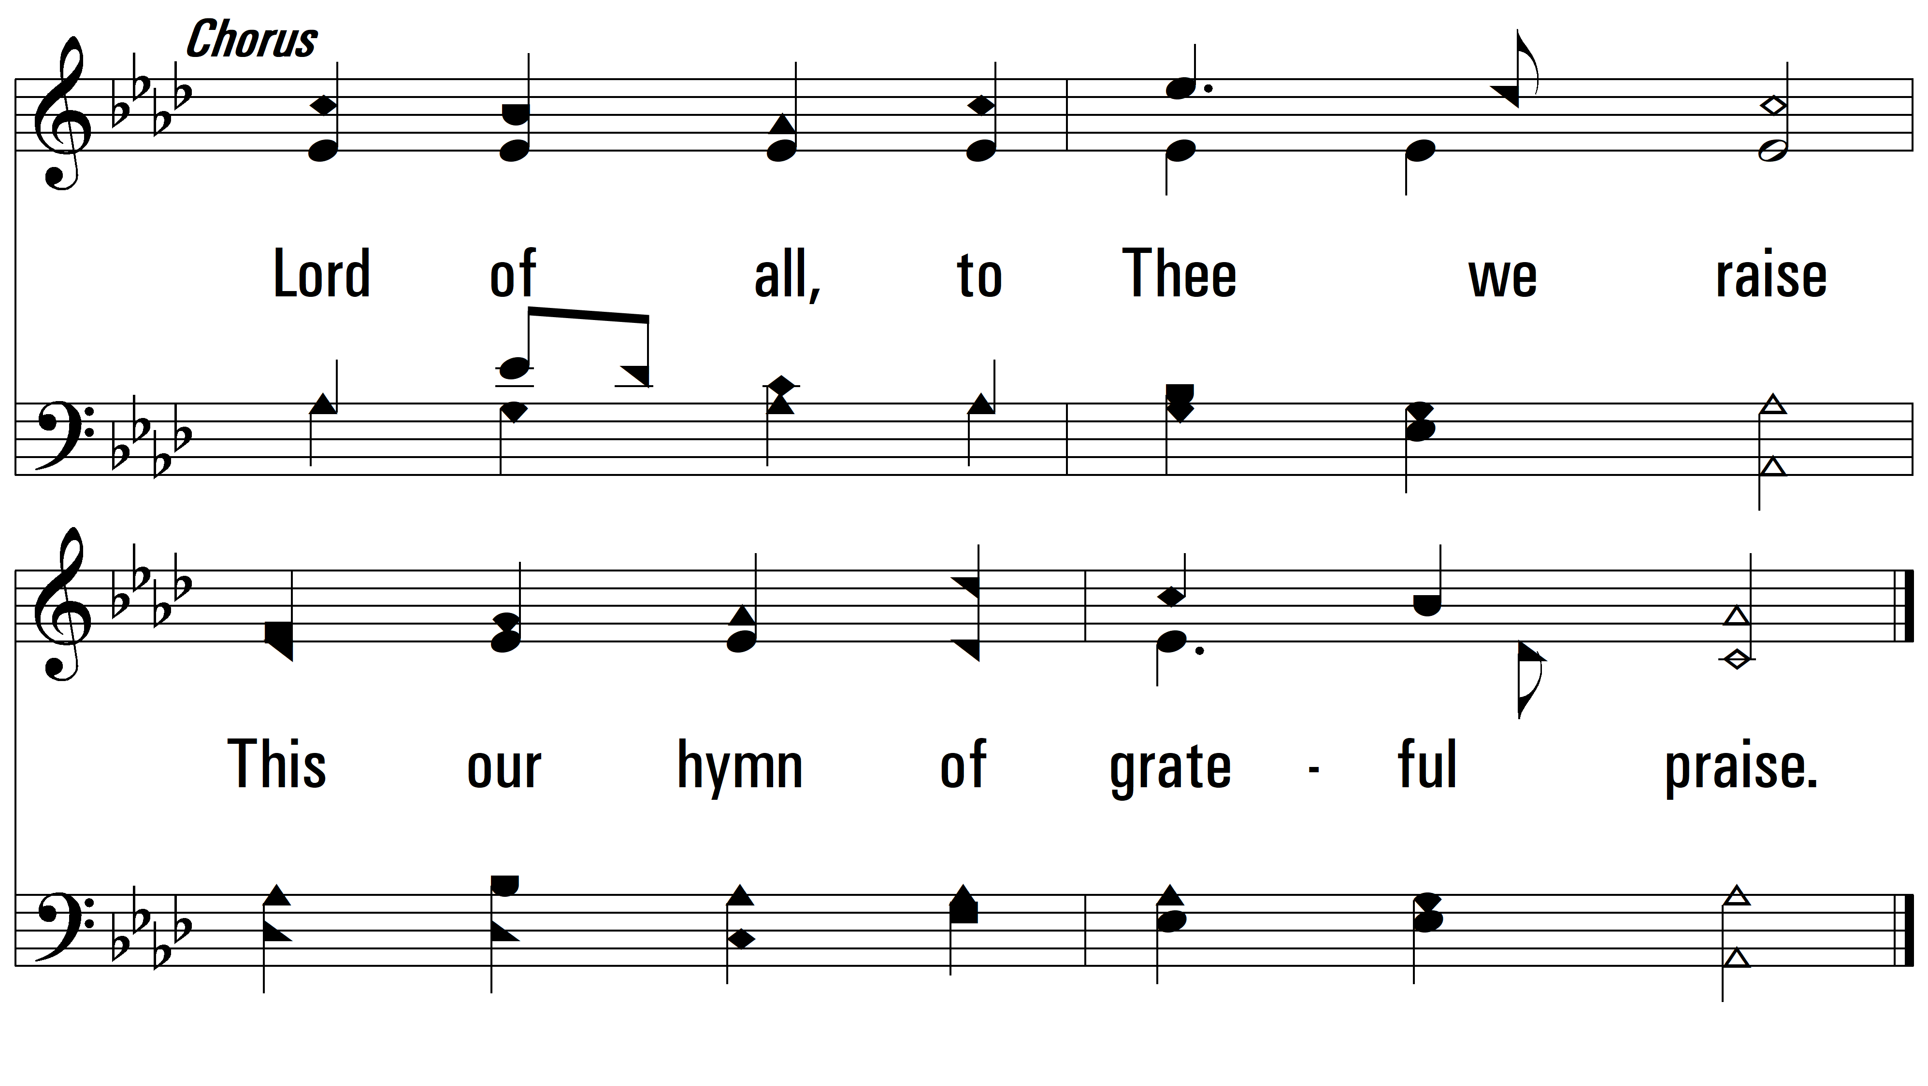
vs. 1

Slide 4
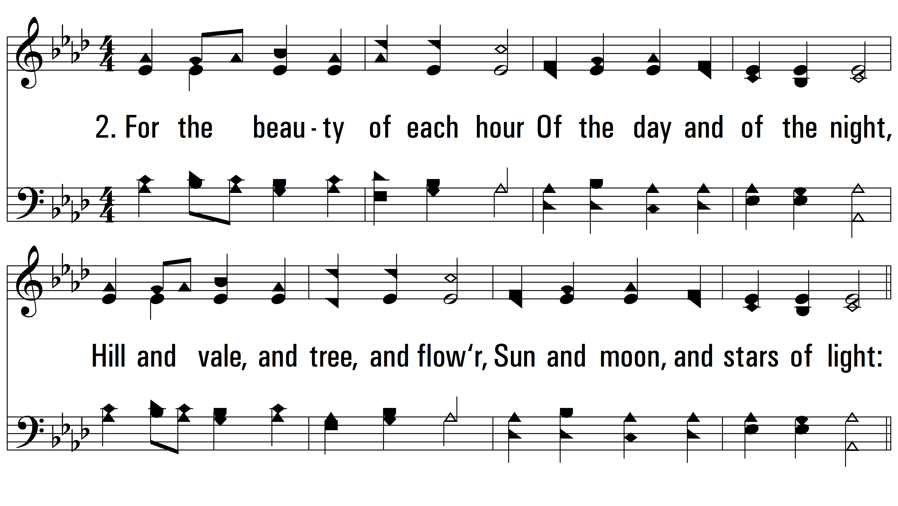
vs. 2 ~ For The Beauty Of The Earth

Slide 5
vs. 2

Slide 6
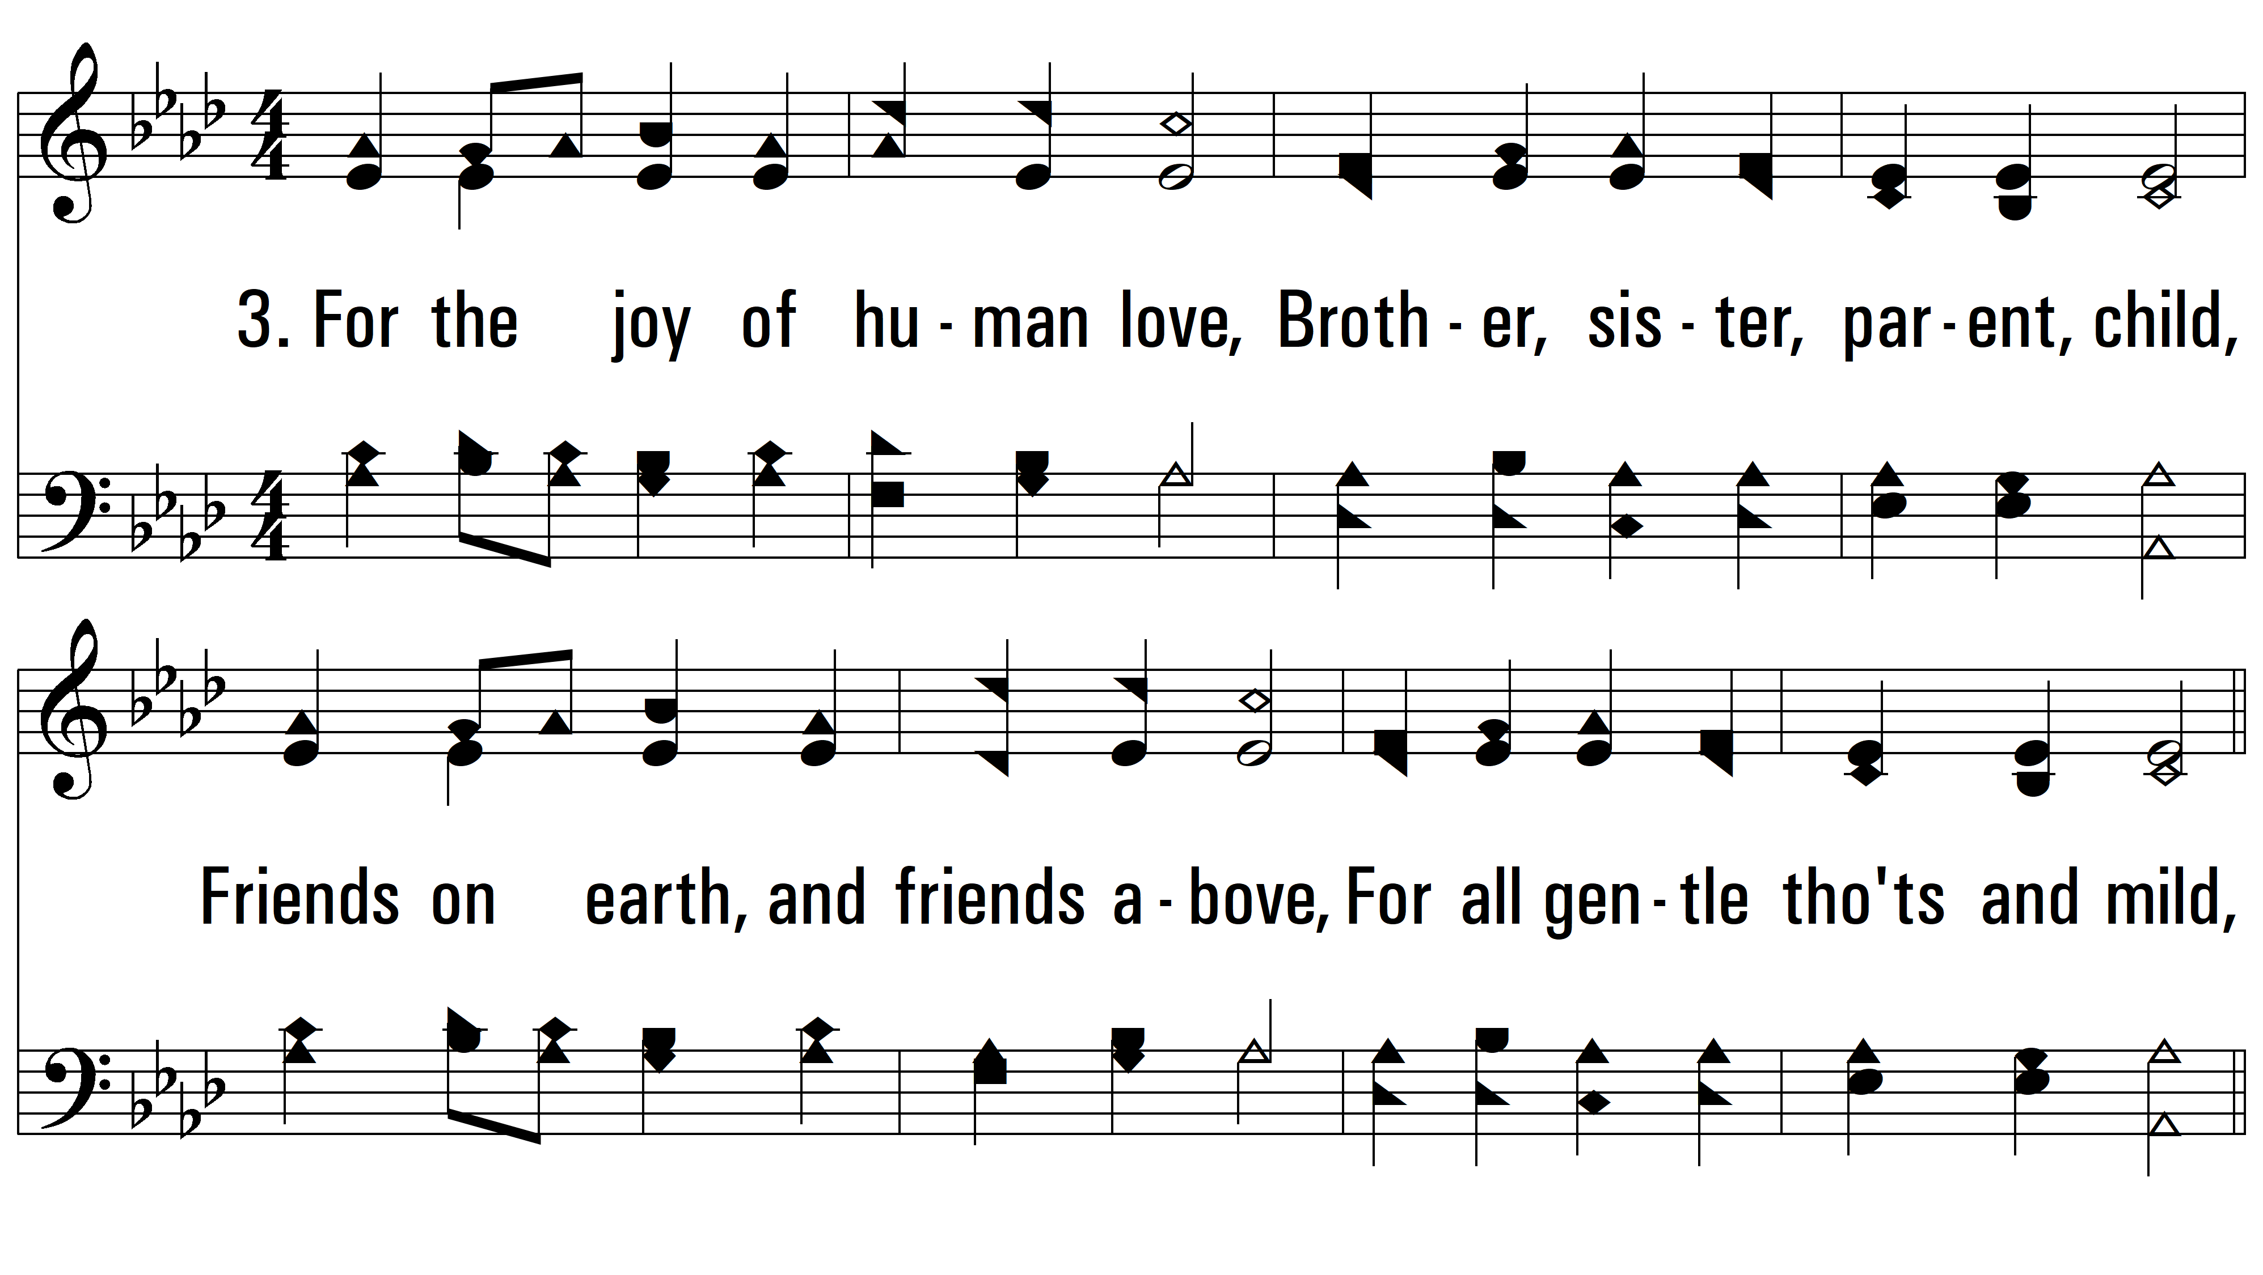
vs. 3 ~ For The Beauty Of The Earth

Slide 7
vs. 3

Slide 8
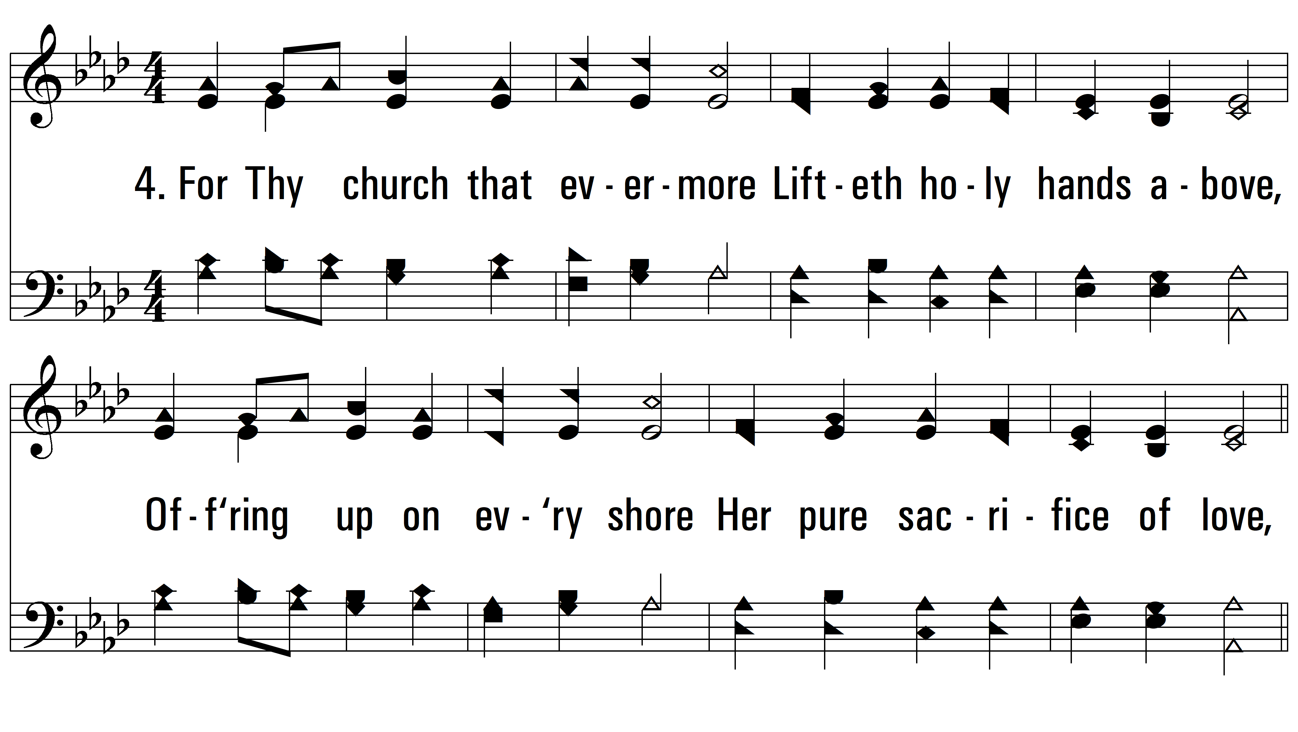
vs. 4 ~ For The Beauty Of The Earth

Slide 9
vs. 4
PDHymns.com
END

