Slide 1
Footprints Of Jesus
Words: | Mary D. C. Slade (1871)
Music: | A. B. Everett (1871)
4/4
E^{b}/G - MI
Verses: 5/Chorus
Lead - | MI
Alto - | DO
Tenor - | SOL
Bass - | DO
PDHymns.com

Slide 2
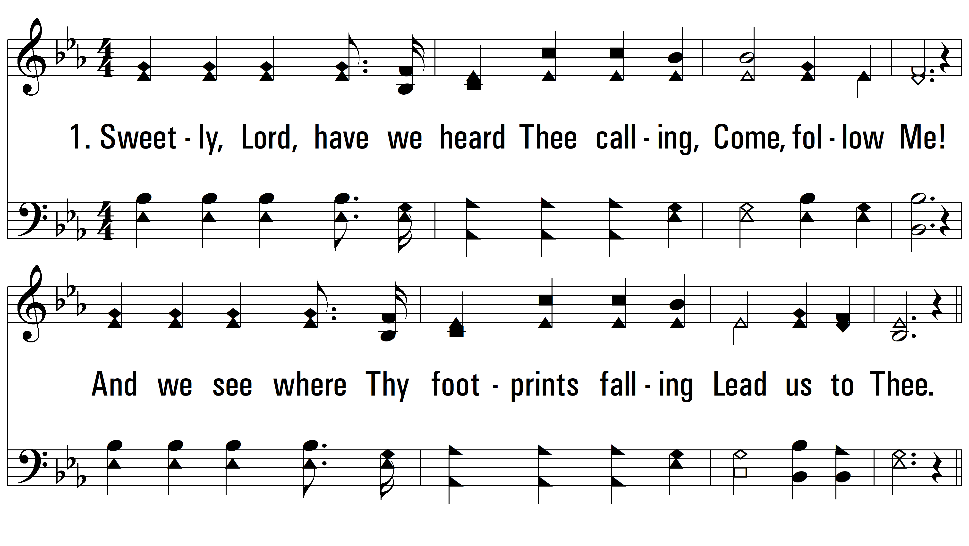
vs. 1 ~ Footprints Of Jesus

Slide 3
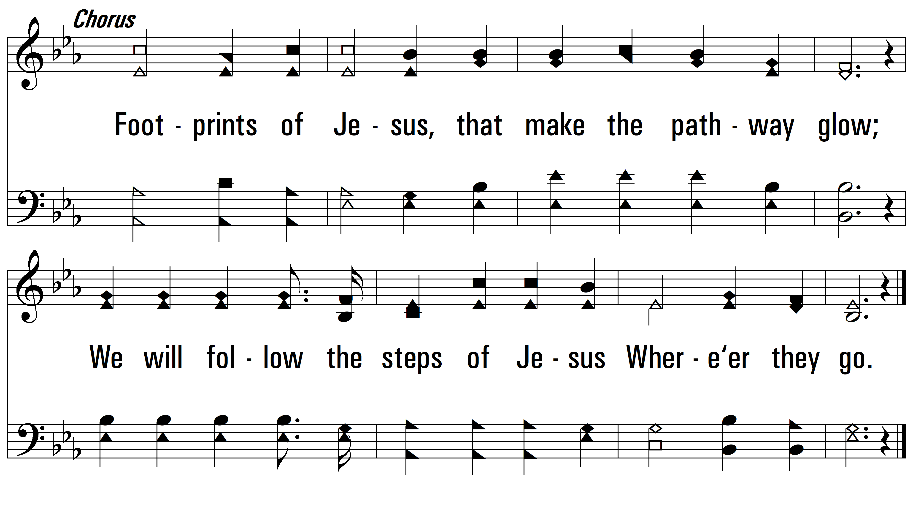
vs. 1

Slide 4
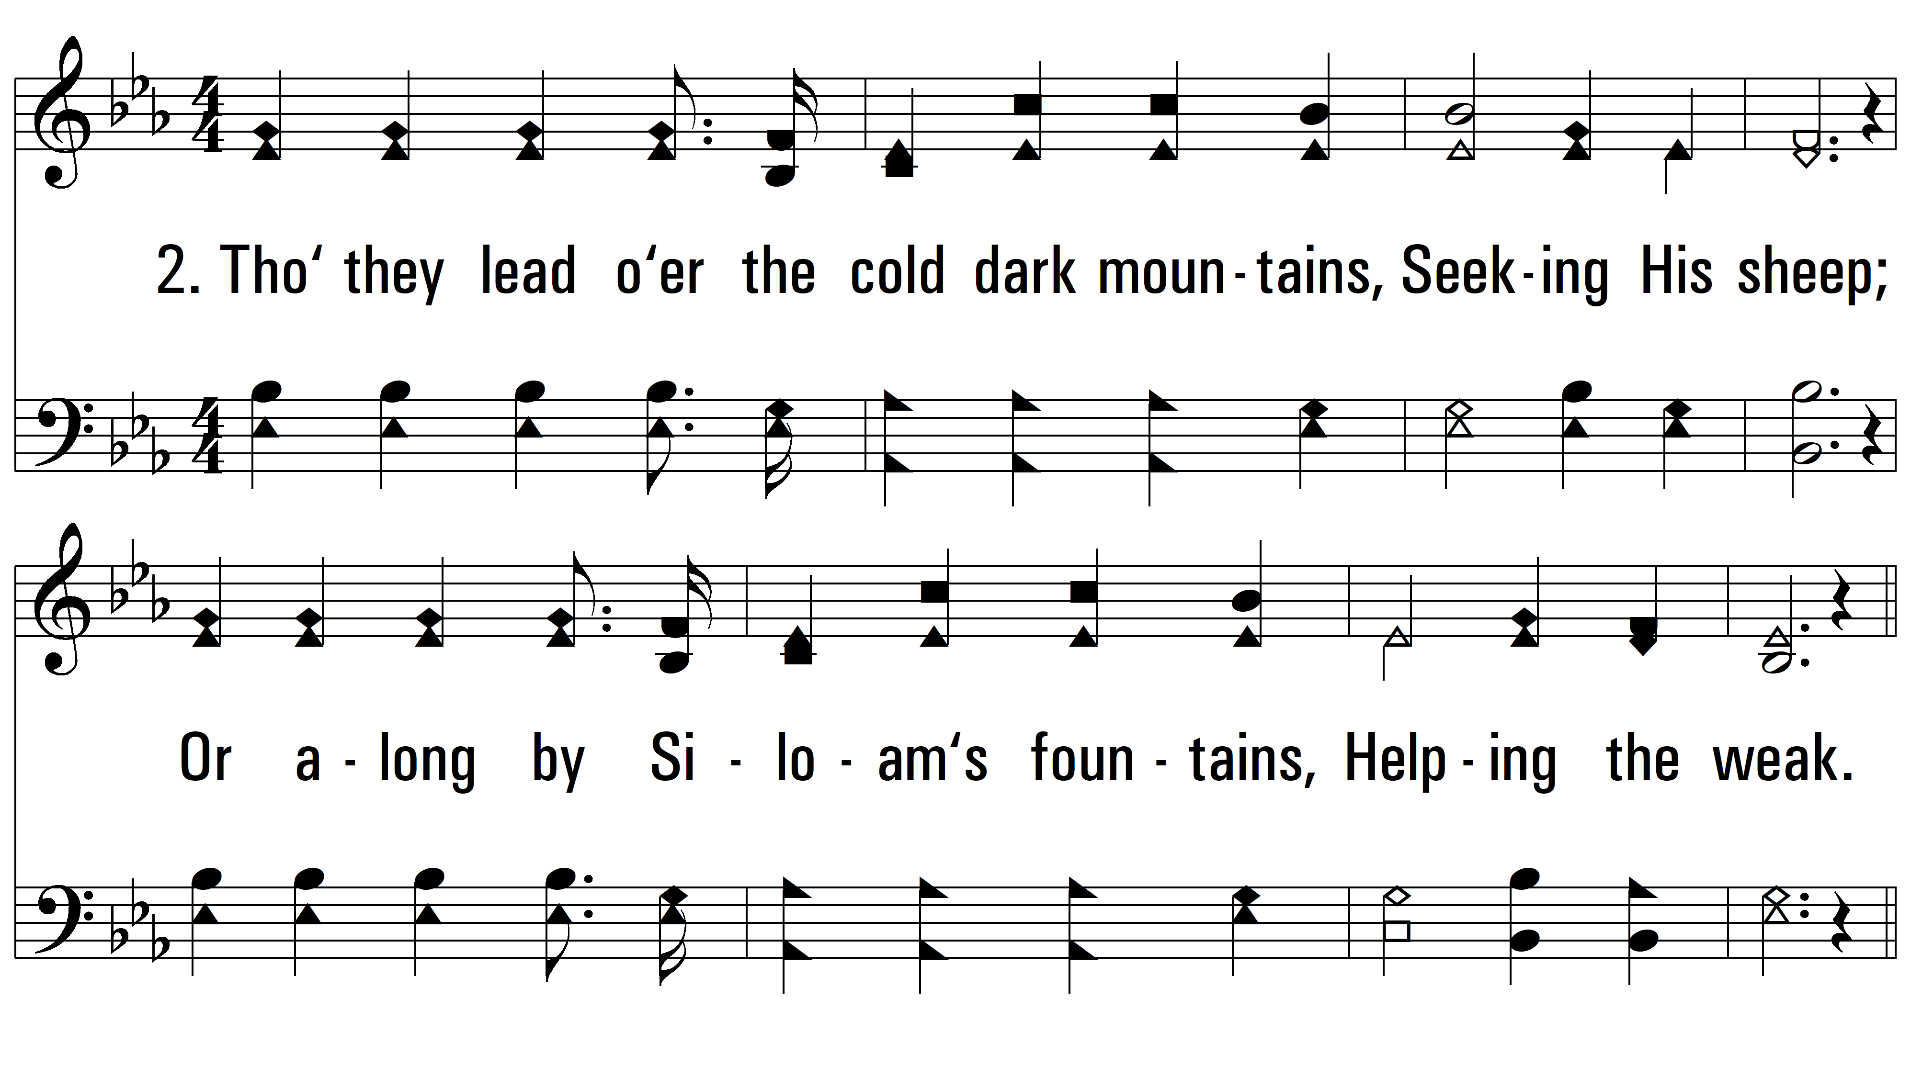
vs. 2 ~ Footprints Of Jesus

Slide 5
vs. 2

Slide 6
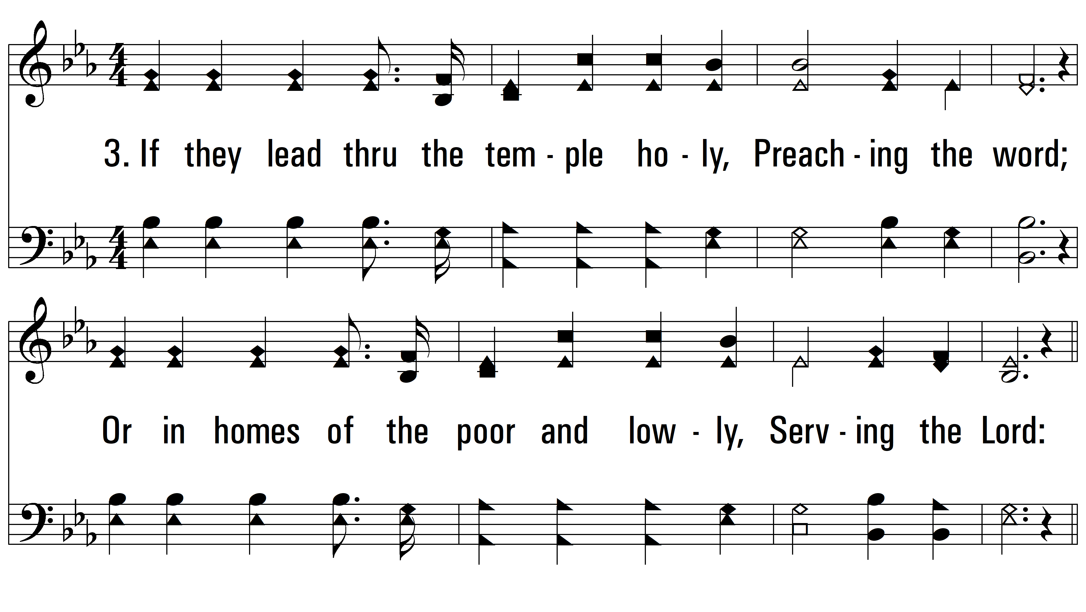
vs. 3 ~ Footprints Of Jesus

Slide 7
vs. 3

Slide 8
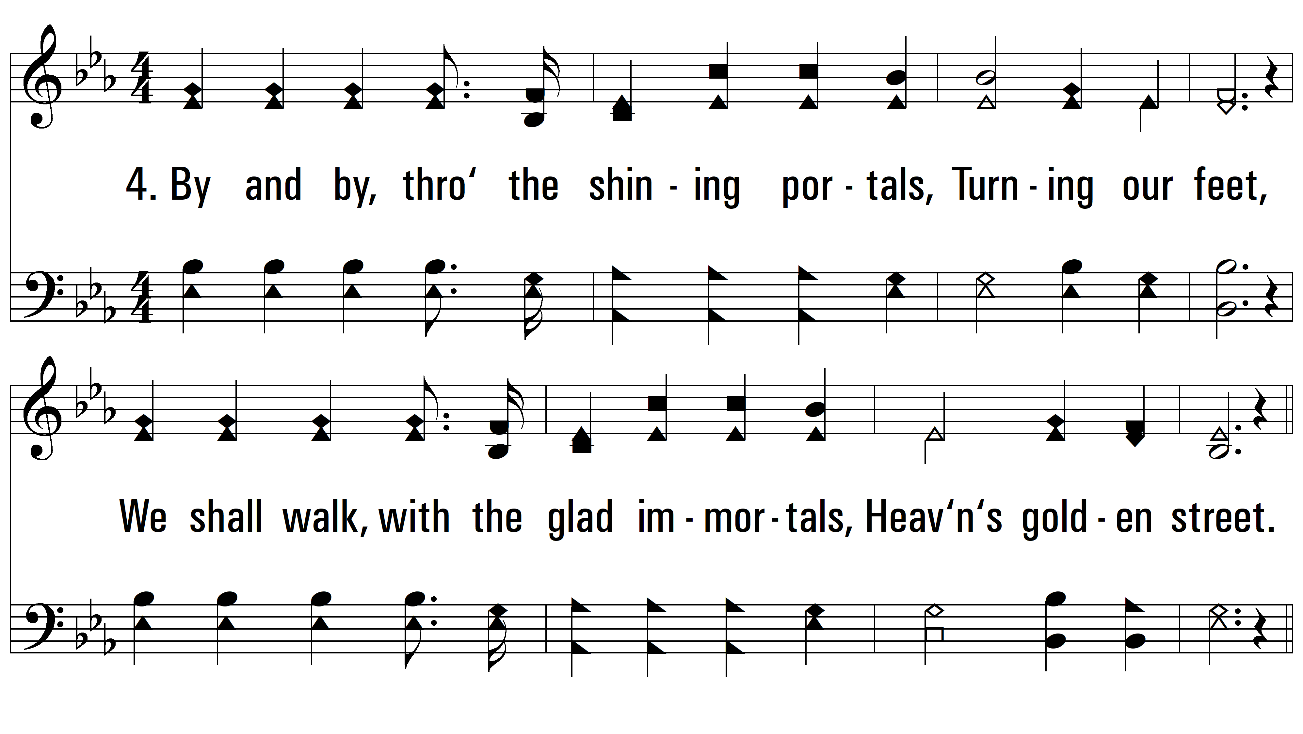
vs. 4 ~ Footprints Of Jesus

Slide 9
vs. 4

Slide 10
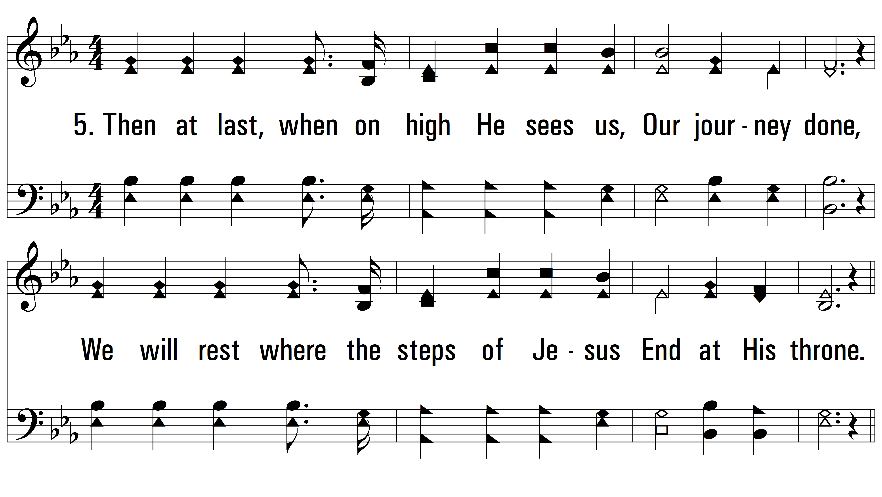
vs. 5 ~ Footprints Of Jesus

Slide 11
vs. 5
PDHymns.com
END

