Slide 1
Father, We Thank Thee
WESTON
LM
Words: | Rebecca Weston (1884)
Music: | Jorenson’s Great Songs of the Church (1921)
4/4
F/F - DO
Verses: 2
Lead - | DO
Alto - | SOL
Tenor - | MI
Bass - | DO
PDHymns.com

Slide 2
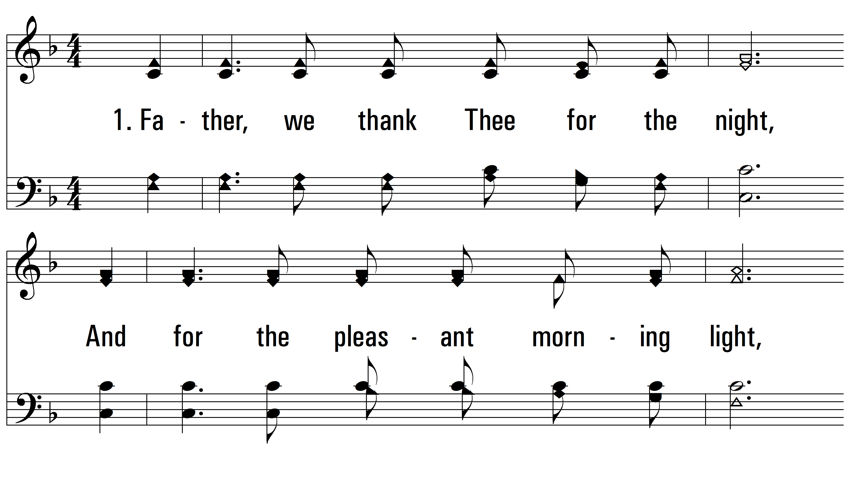
vs. 1 ~ Father, We Thank Thee

Slide 3
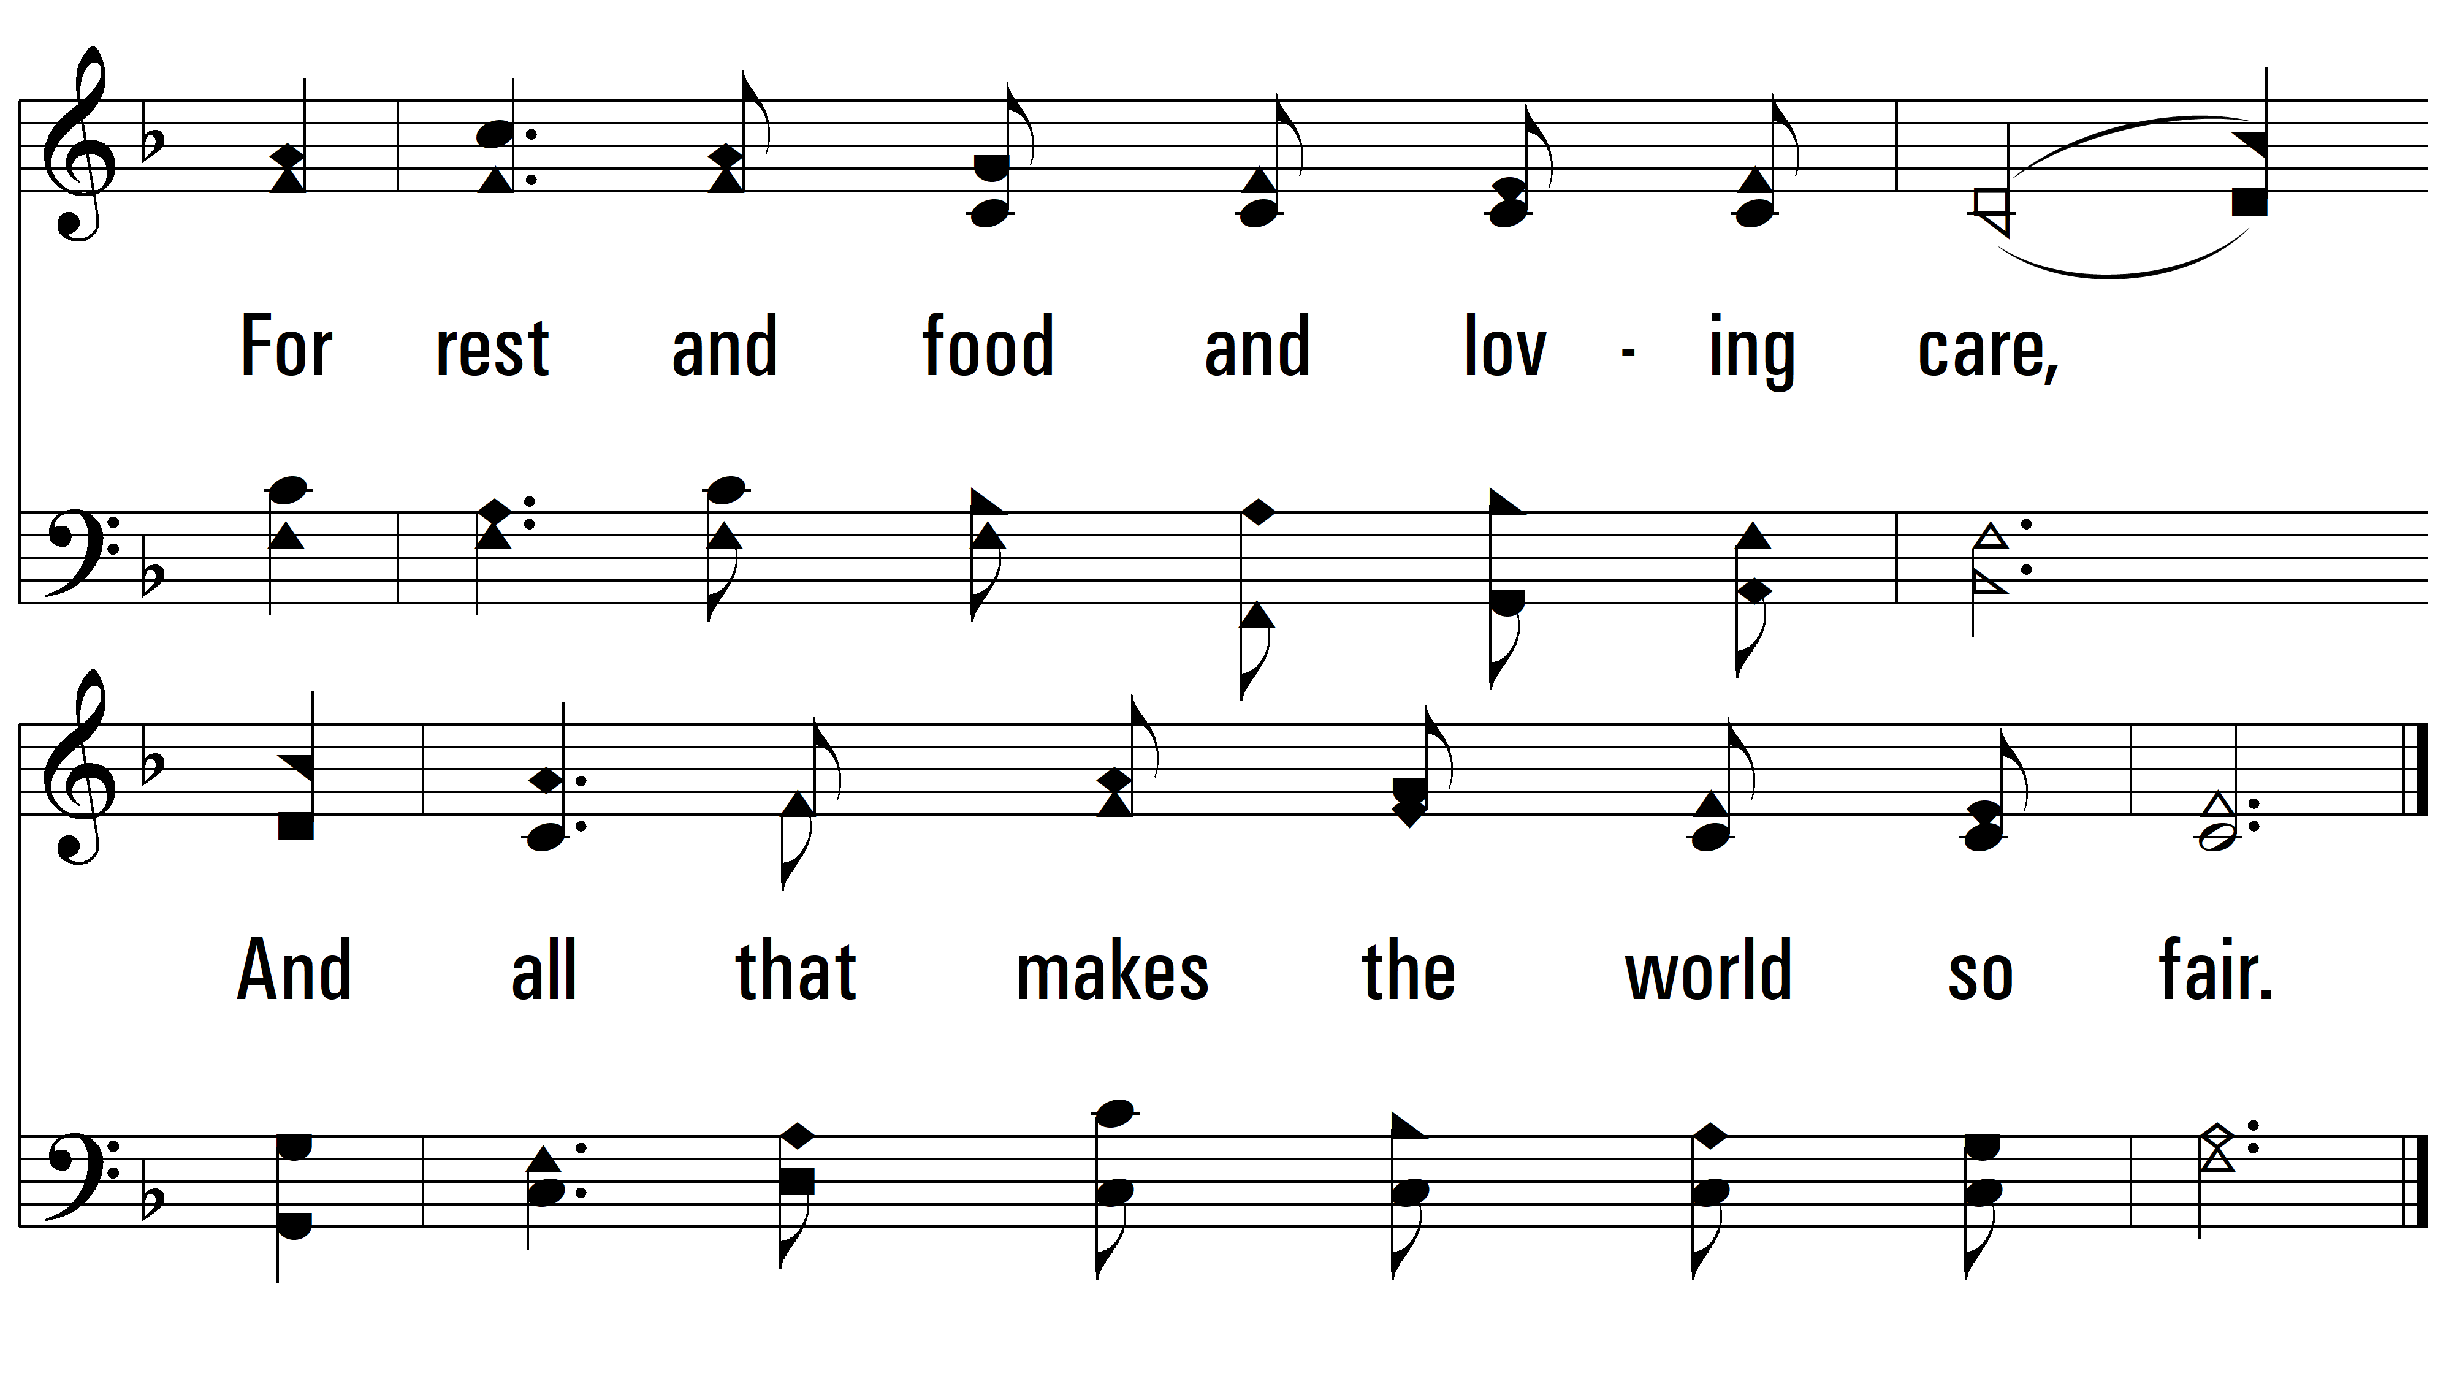
vs. 1

Slide 4
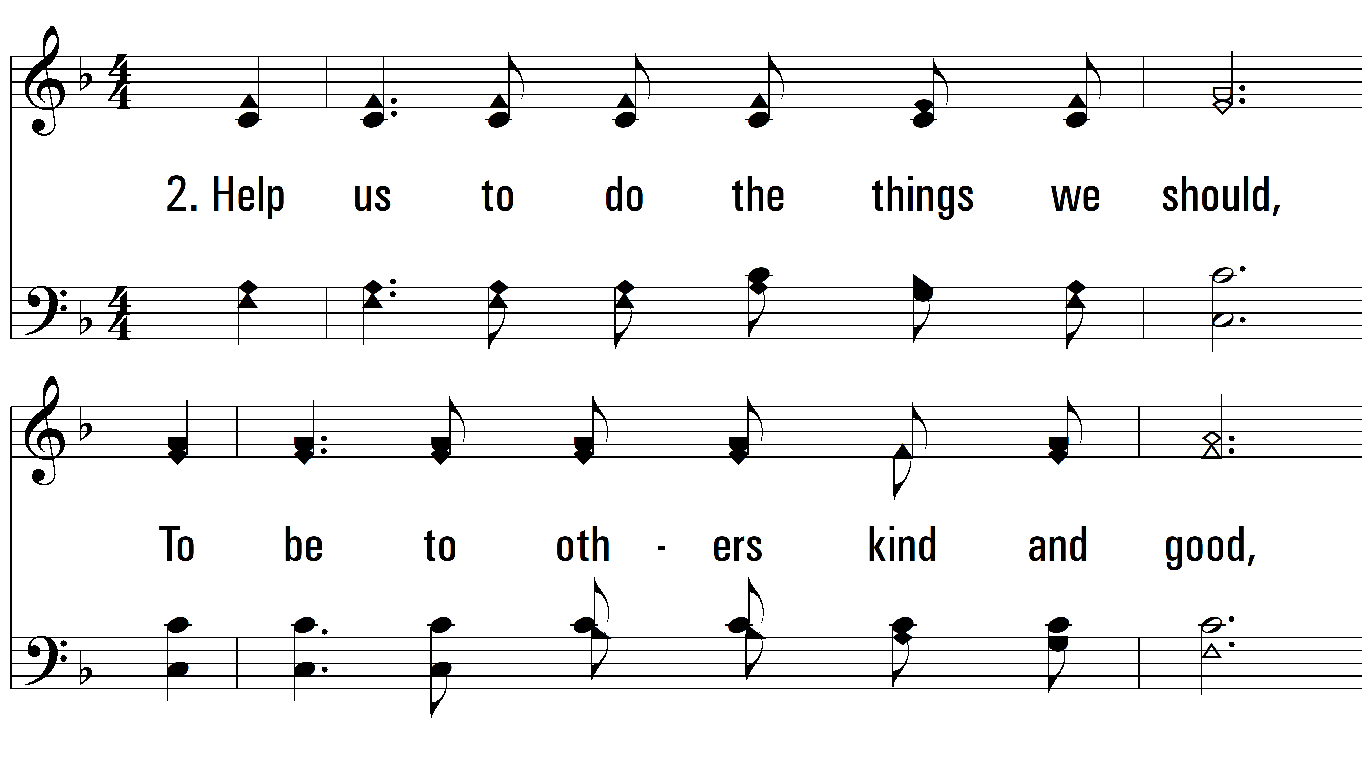
vs. 2 ~ Father, We Thank Thee

Slide 5
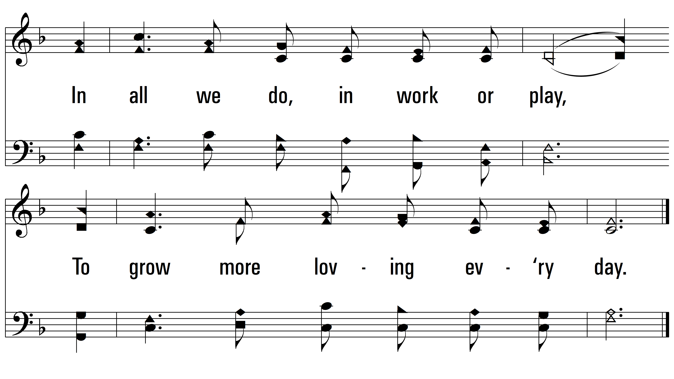
vs. 2
PDHymns.com
END

