Slide 1
Father Of Mercies
ELEOS
LM
Words: | Fredrick W. Faber (1849), vss. 2&3 Alice Flowerdew (1803)
Music: | English Folk Melody
3/4
F/A - SOL
Verses: 3
Lead - | MI
Alto - | SO
Tenor - | SOL
Bass - | DO
PDHymns.com

Slide 2
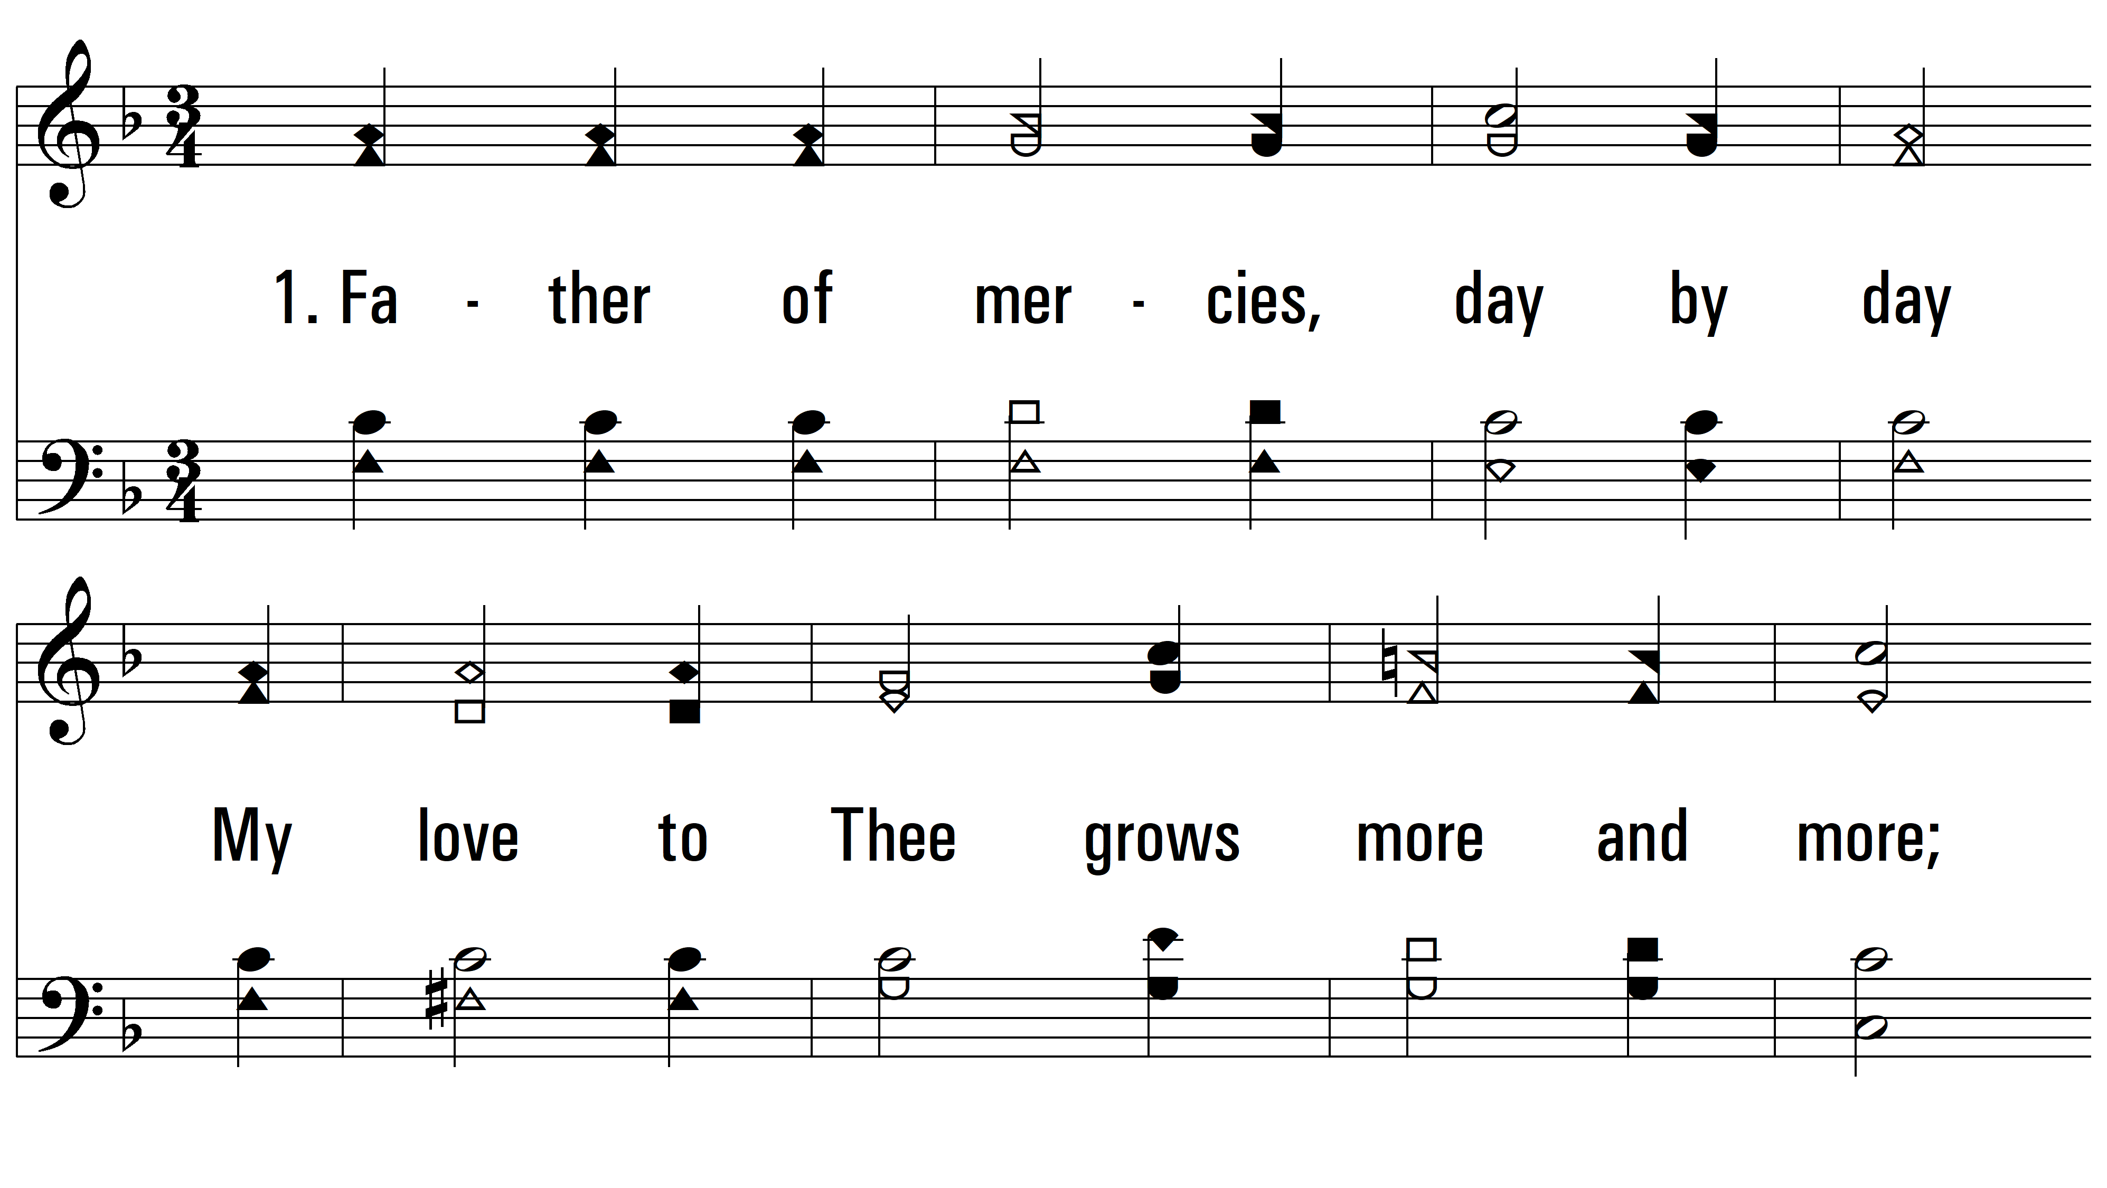
vs. 1 ~ Father Of Mercies

Slide 3
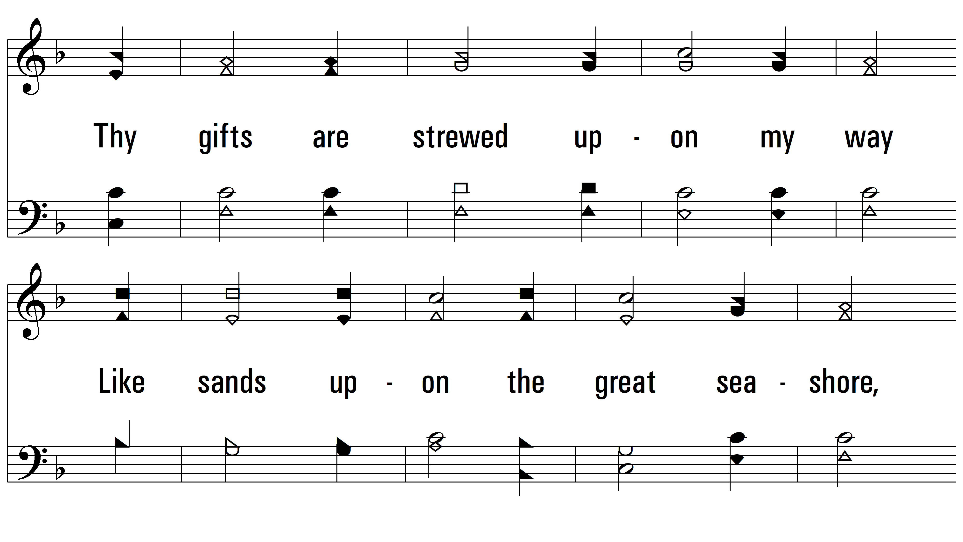
vs. 1

Slide 4
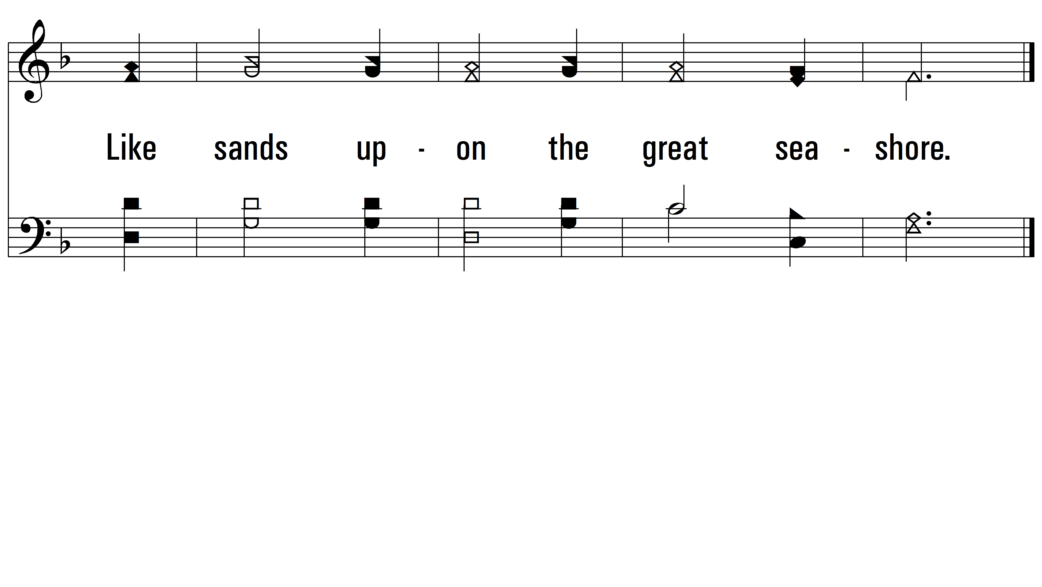
vs. 1

Slide 5
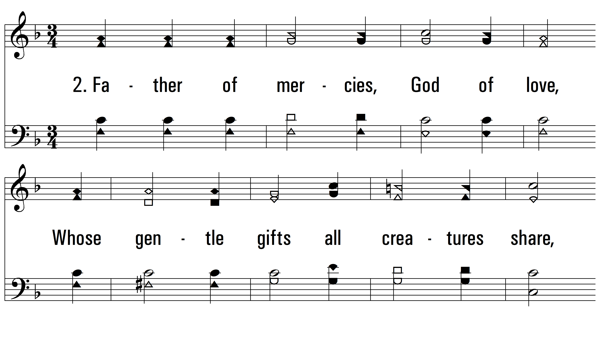
vs. 2 ~ Father Of Mercies

Slide 6
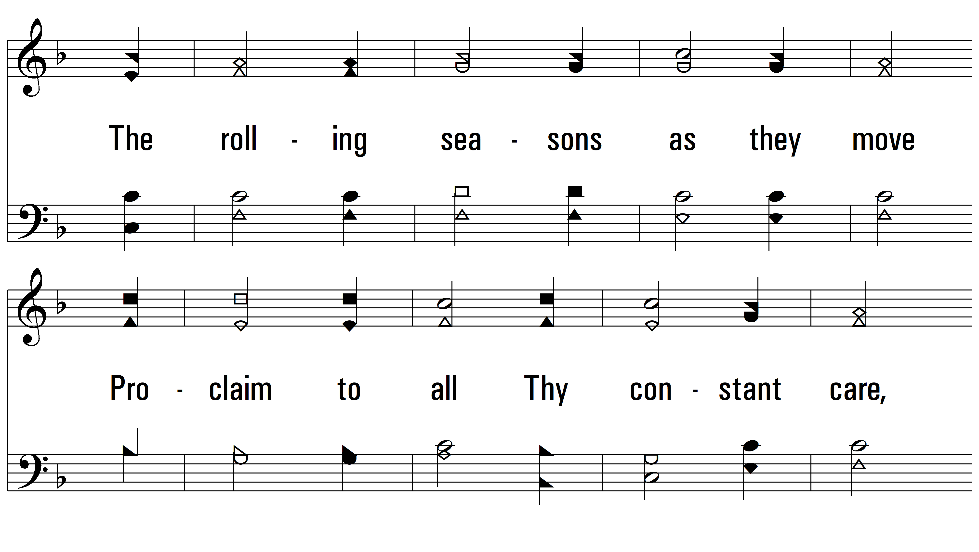
vs. 2

Slide 7
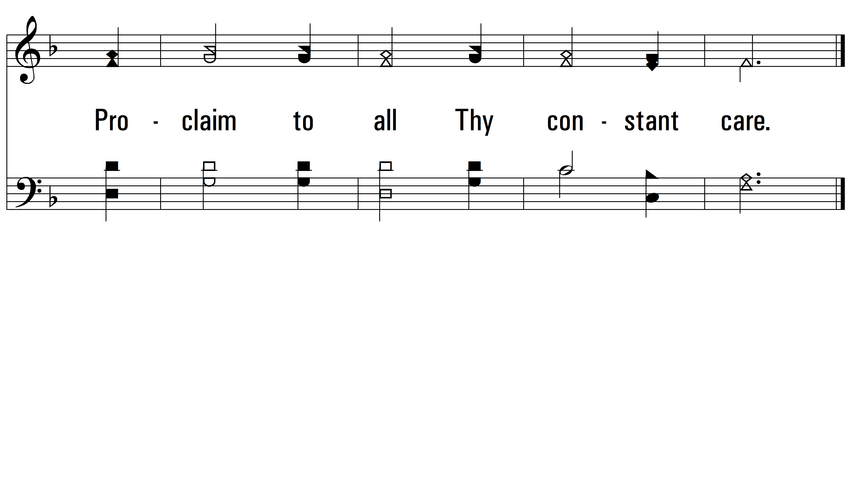
vs. 2

Slide 8
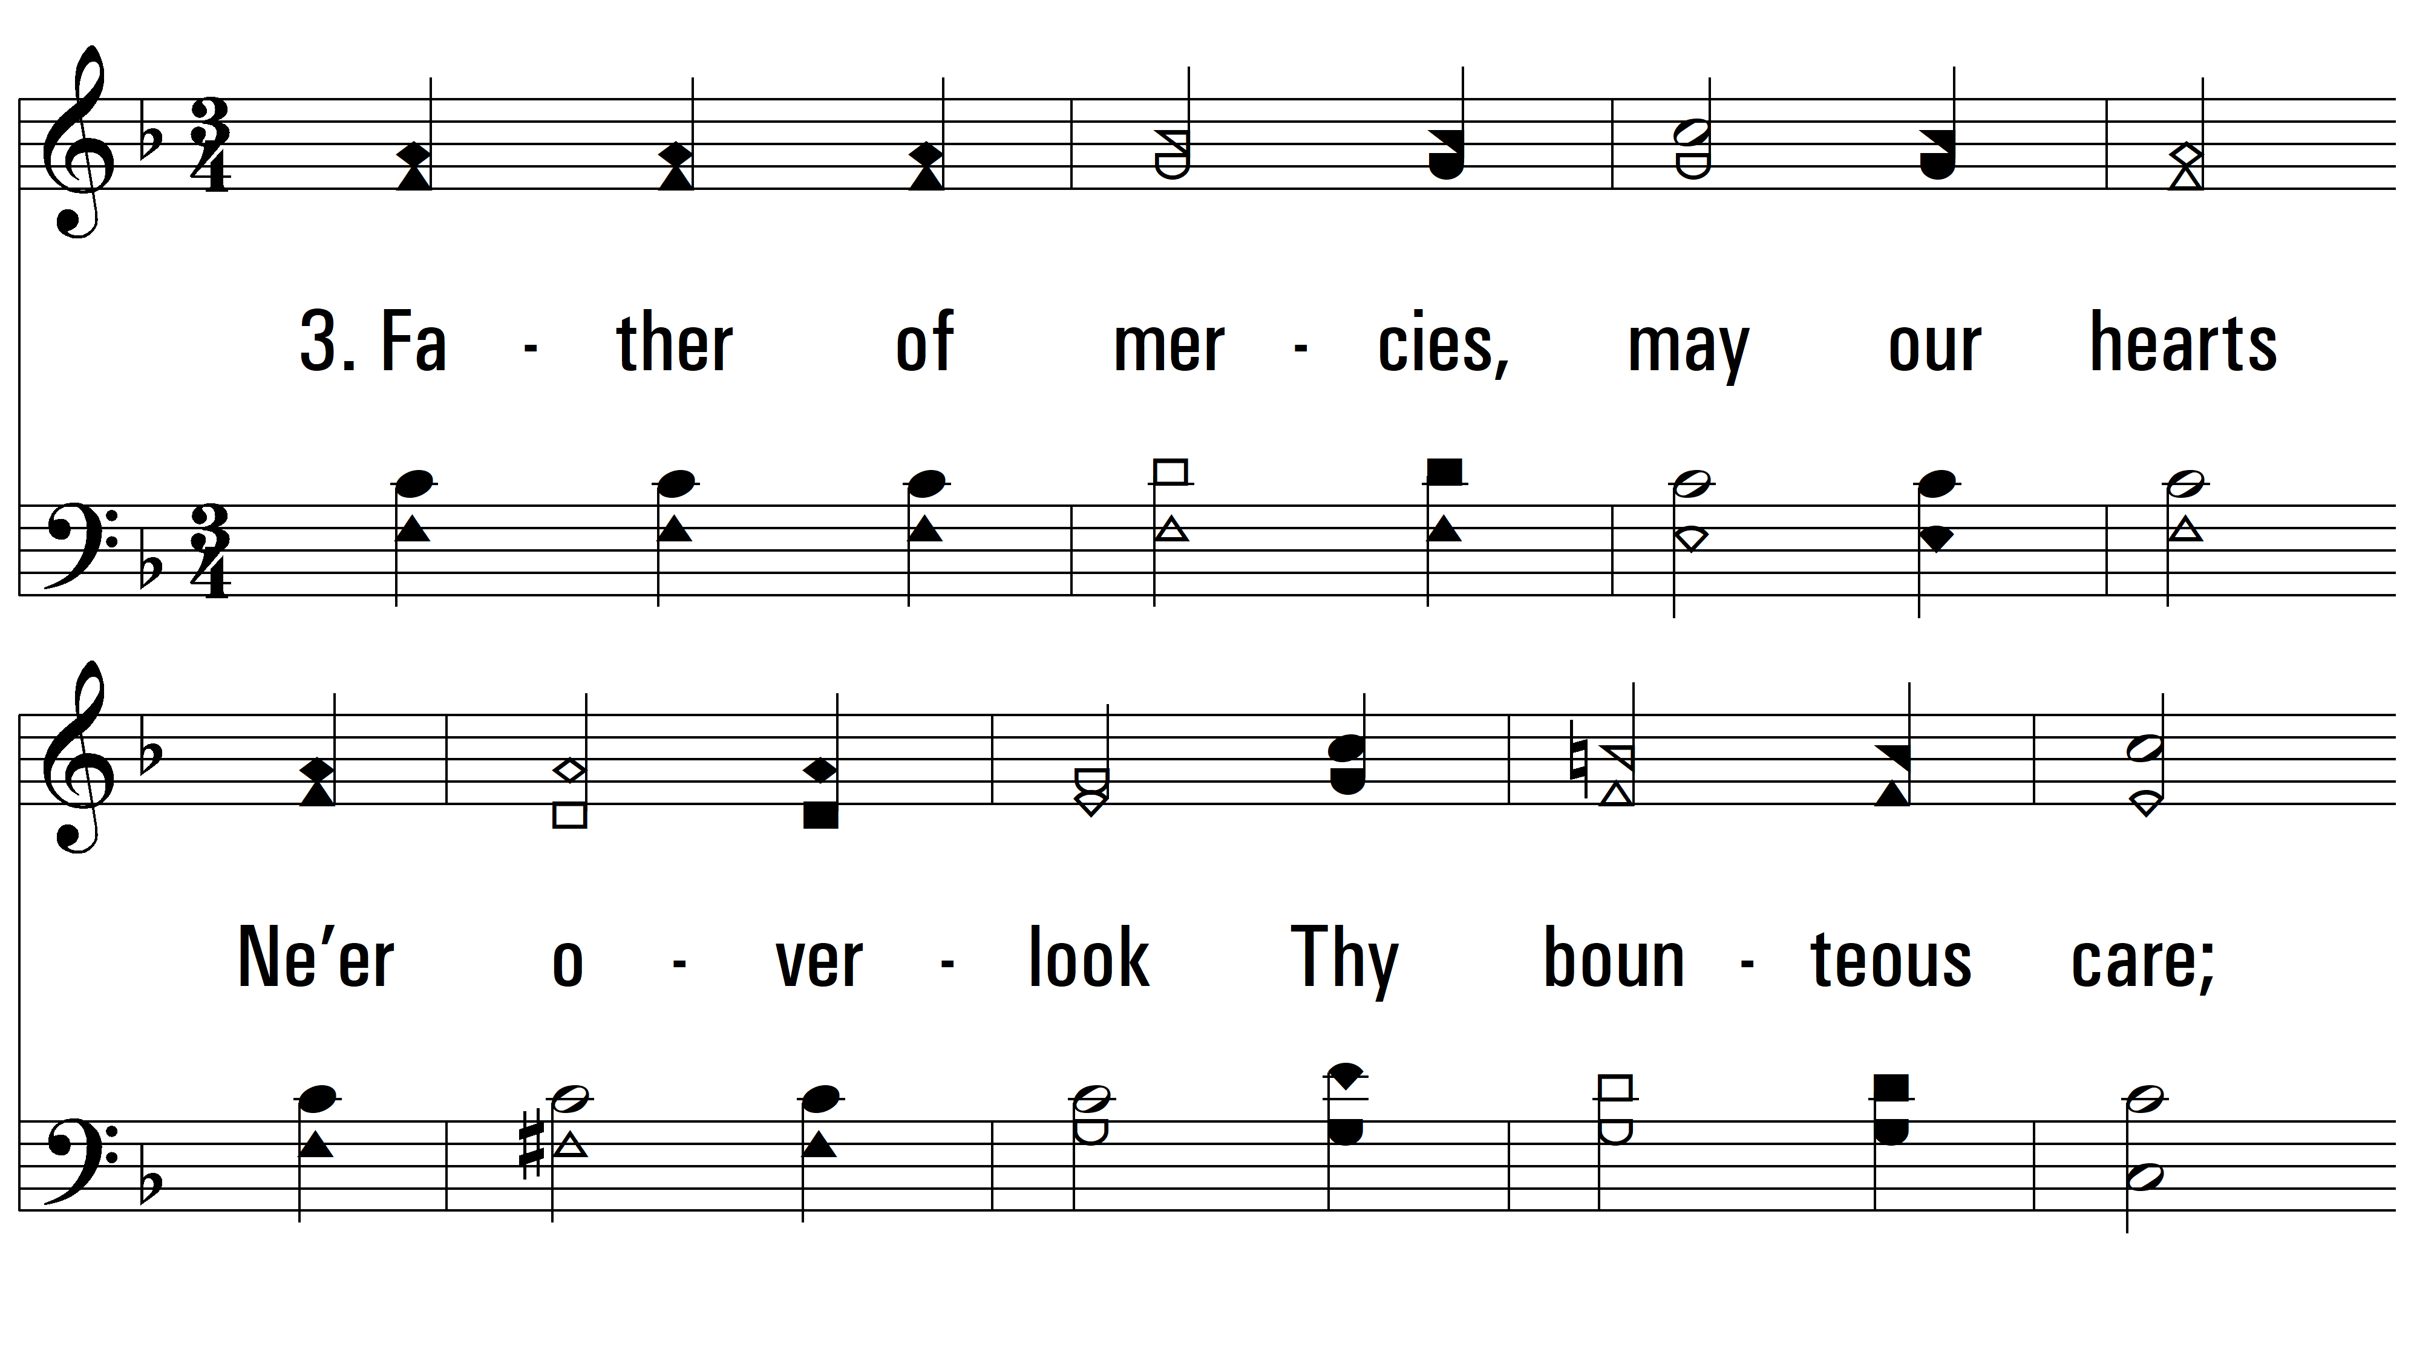
vs. 3 ~ Father Of Mercies

Slide 9
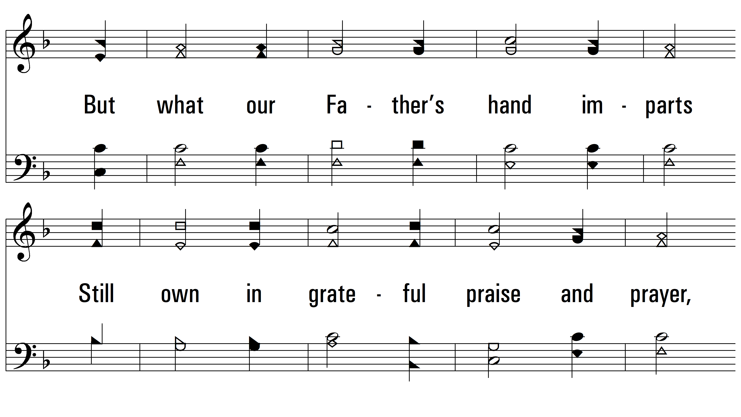
vs. 3

Slide 10
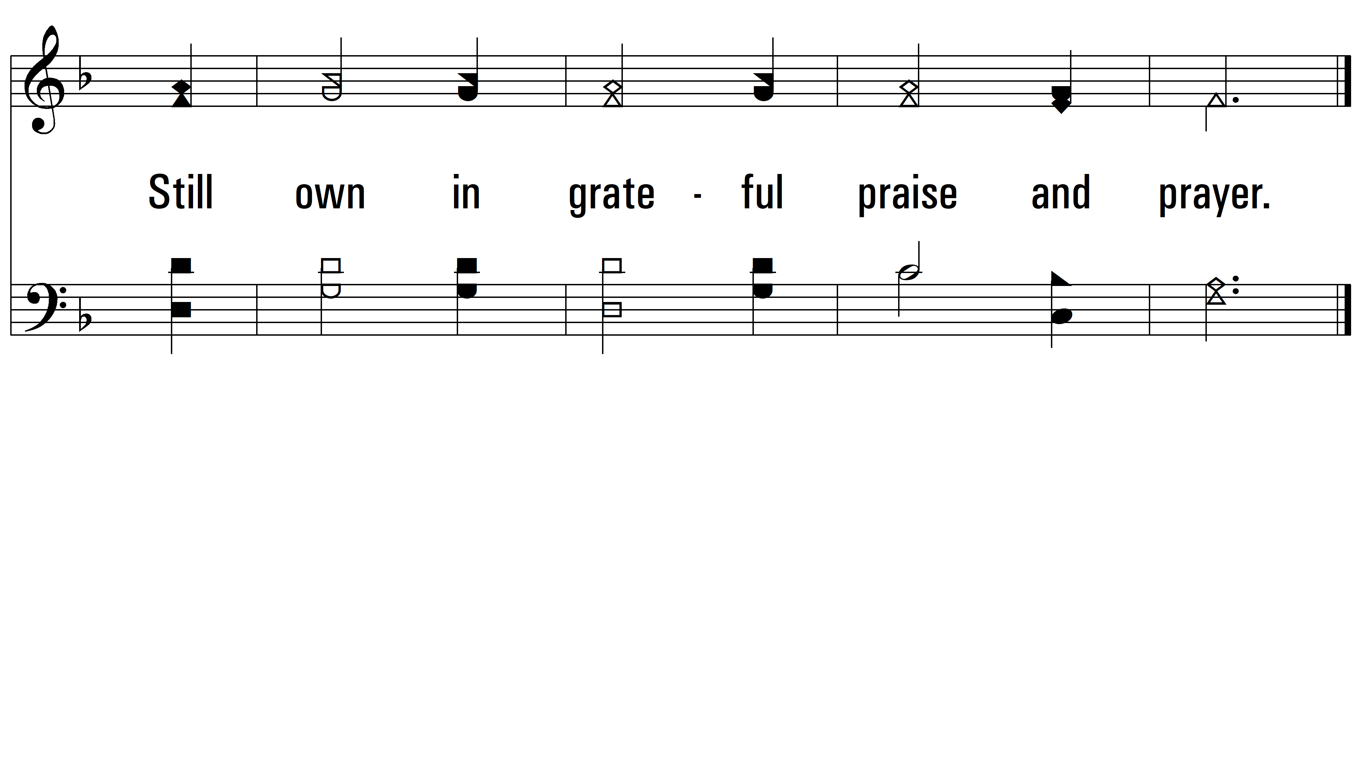
vs. 3
PDHymns.com
END

