Slide 1
Father Of Heaven
QUEBEC
LM
Words: | Edward Cooper (1805)
Music: | Henry Baker (1854)
4/4
F/A - MI
Verses: 4
Lead - | MI
Alto - | DO
Tenor - | SOL
Bass - | DO
PDHymns.com

Slide 2
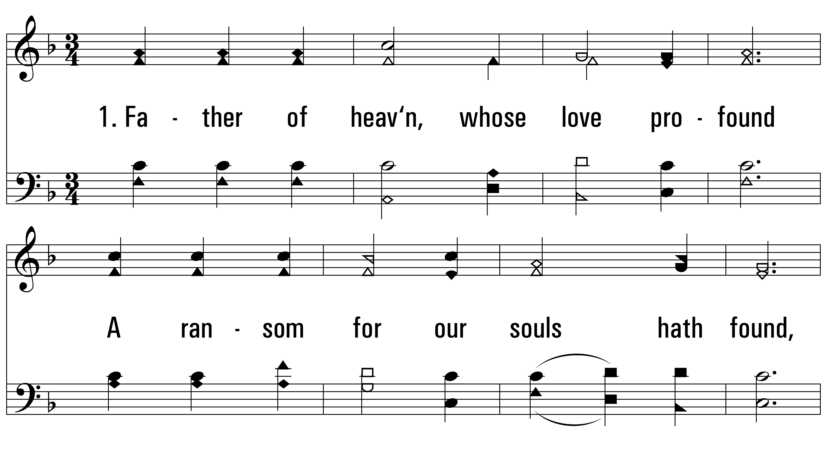
vs. 1 ~ Father Of Heaven

Slide 3
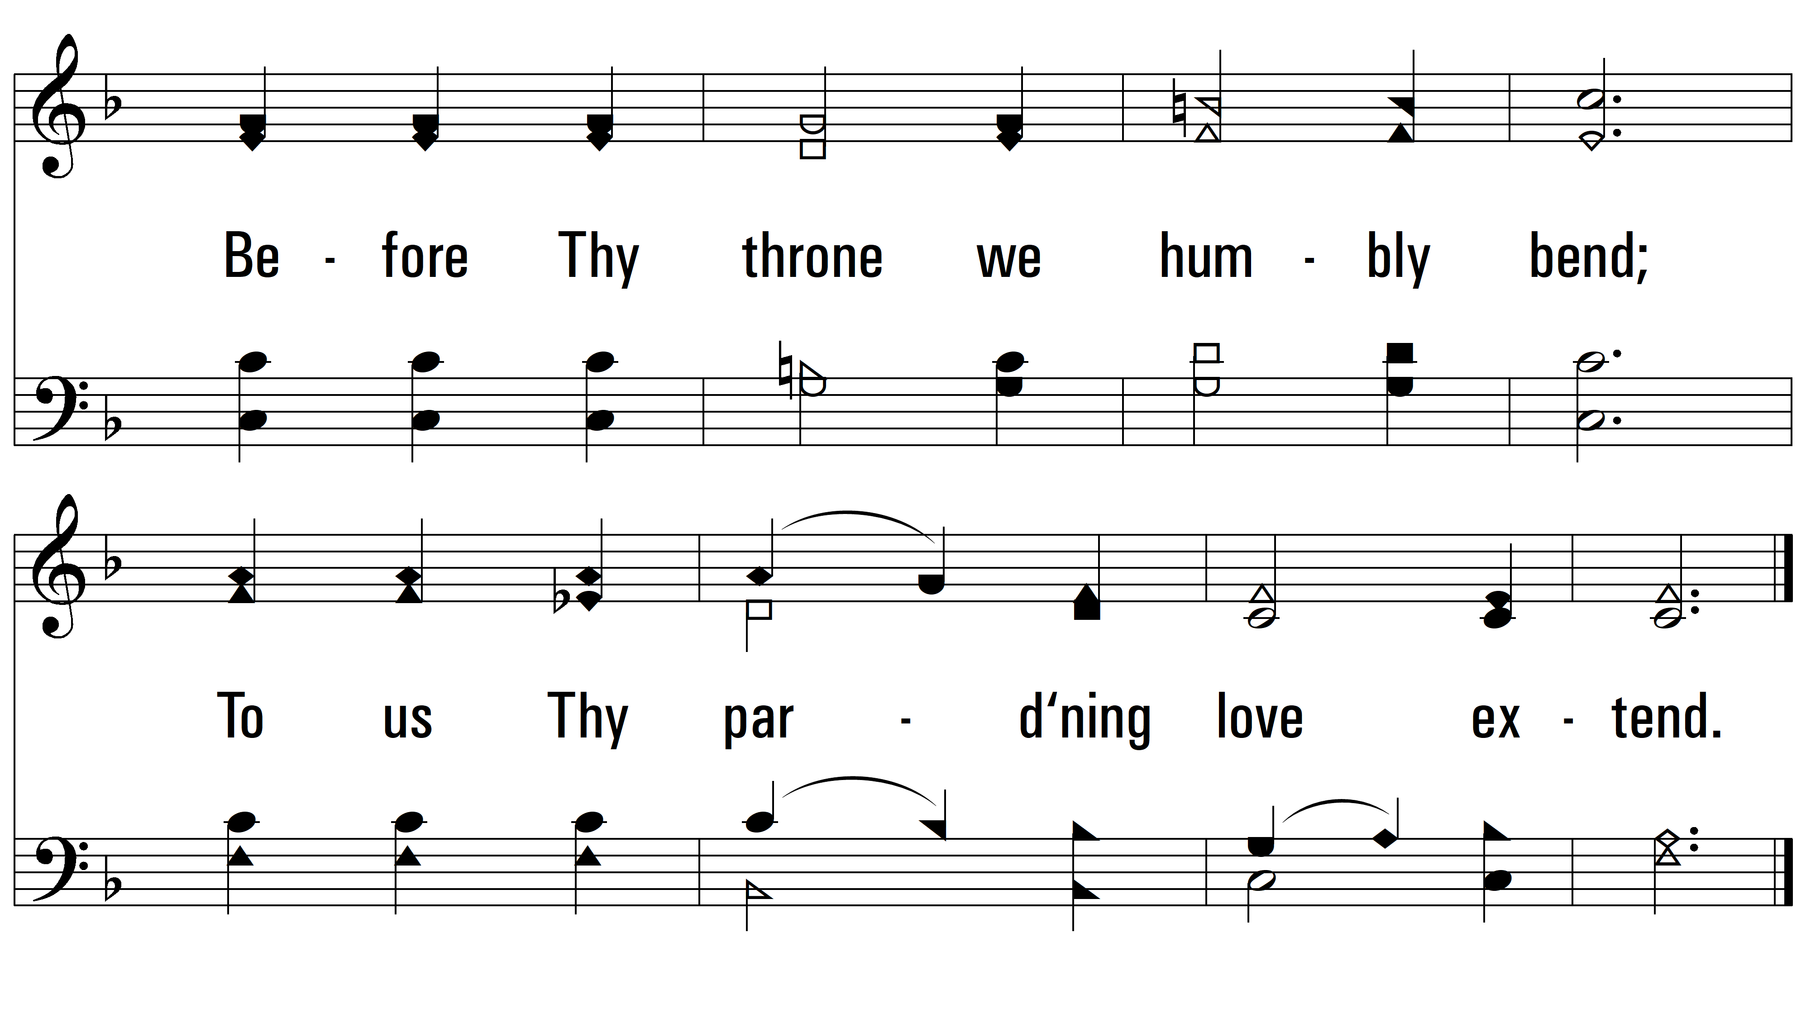
vs. 1

Slide 4
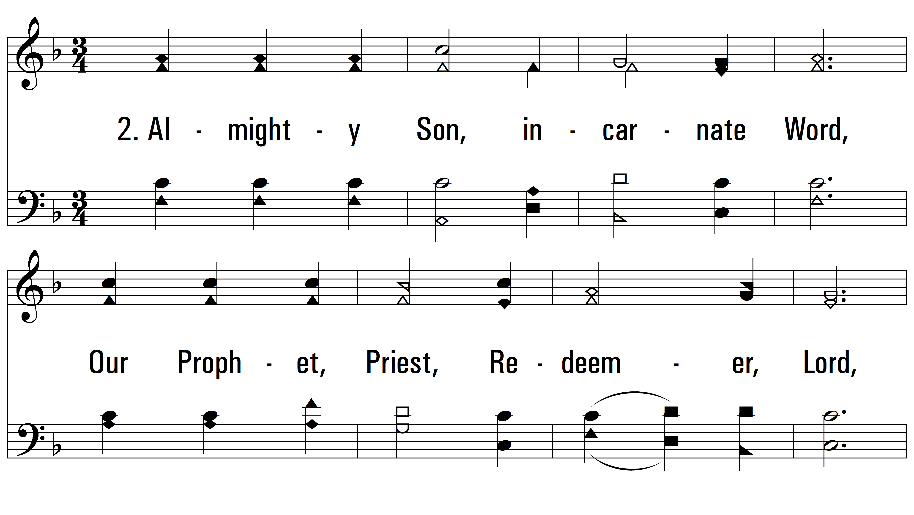
vs. 2 ~ Father Of Heaven

Slide 5
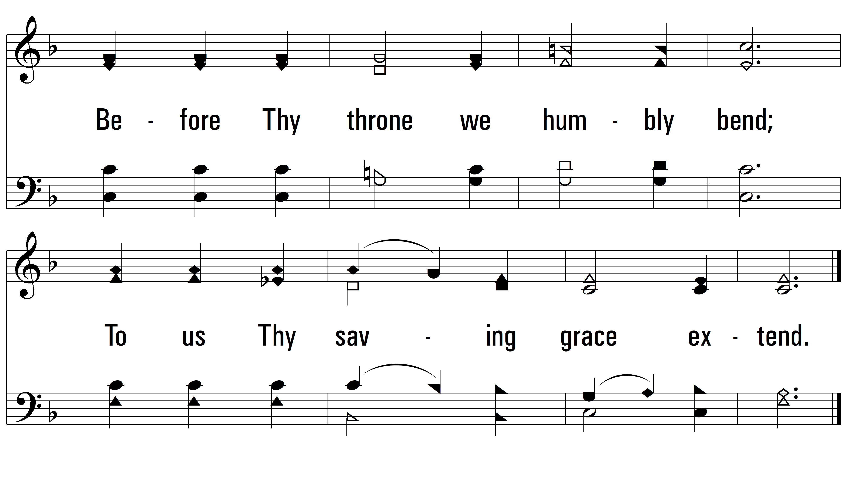
vs. 2

Slide 6
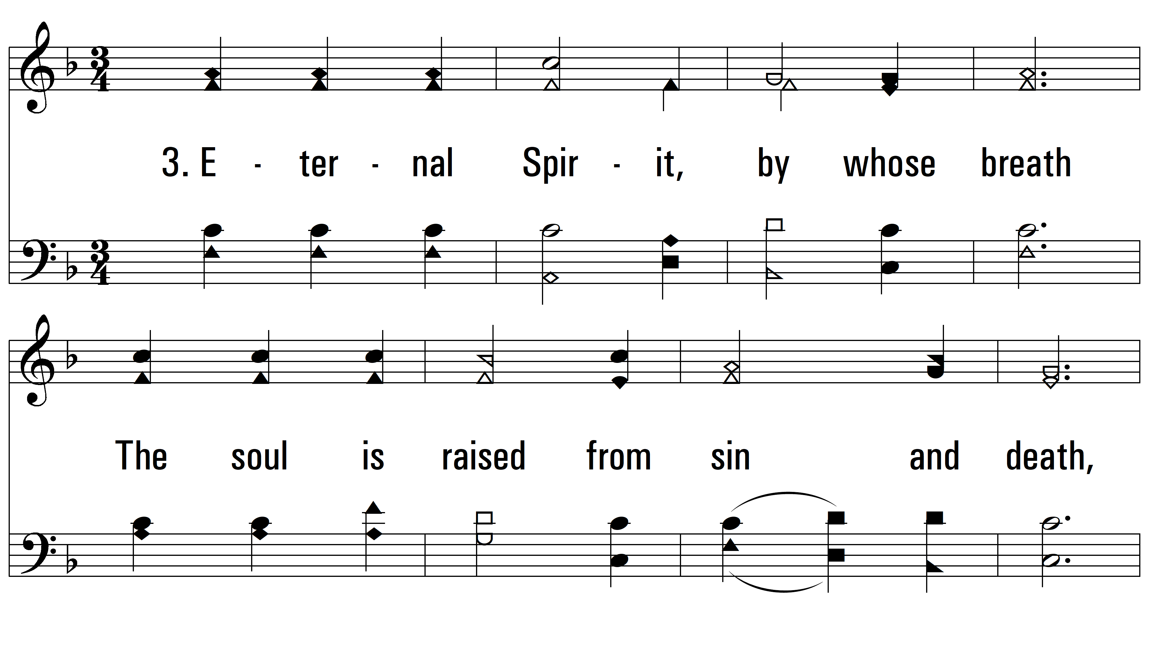
vs. 3 ~ Father Of Heaven

Slide 7
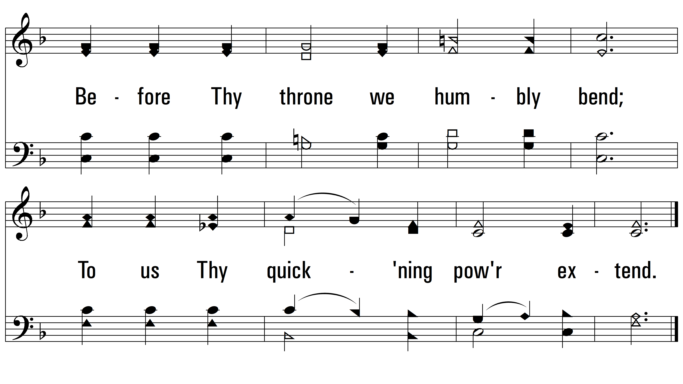
vs. 3

Slide 8
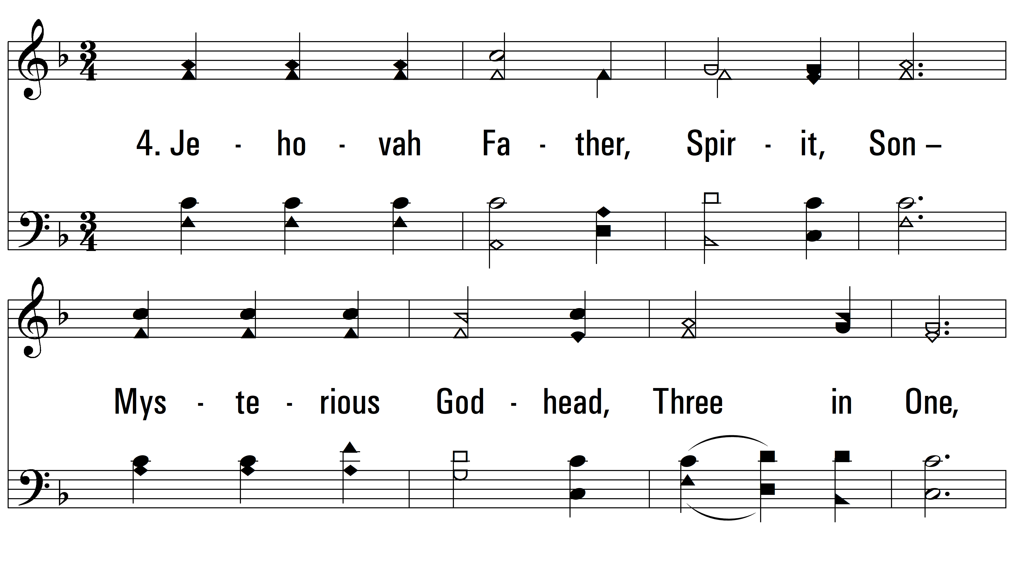
vs. 4 ~ Father Of Heaven

Slide 9
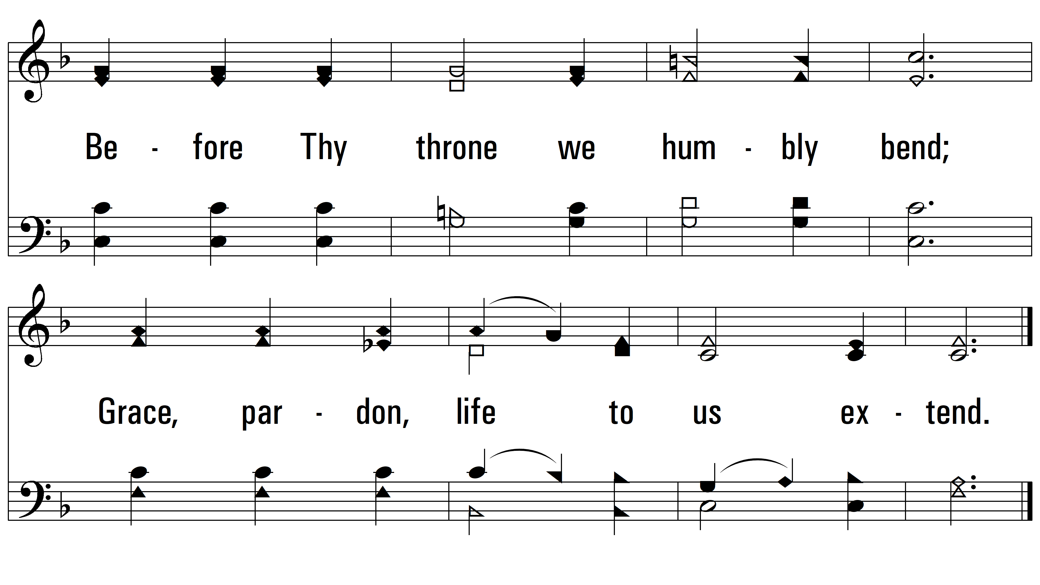
vs. 4

