Slide 1
Far And Near
(The Call For Reapers)
Words: | John O. Thompson (1885)
Music: | J. B. O. Clemm (1885)
3/4
A^{b}/C - MI
Verses: 3/Chorus
Lead - | MI
Alto - | SOL
Tenor - | DO
Bass - | DO
PDHymns.com

Slide 2
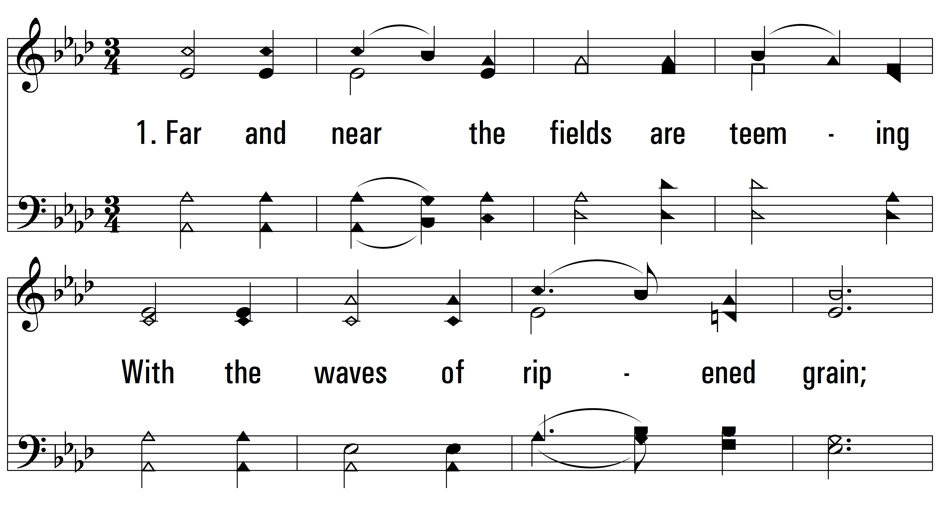
vs. 1 ~ Far And Near

Slide 3
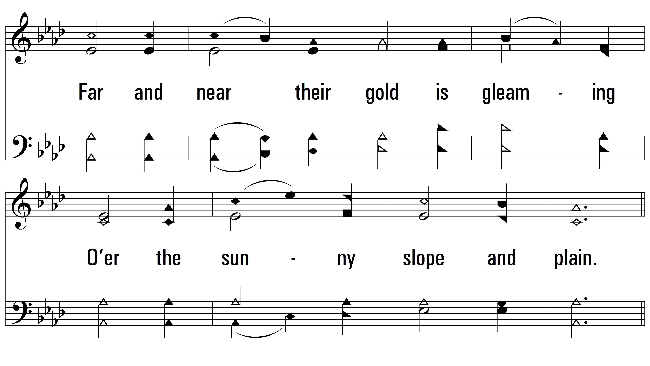
vs. 1

Slide 4
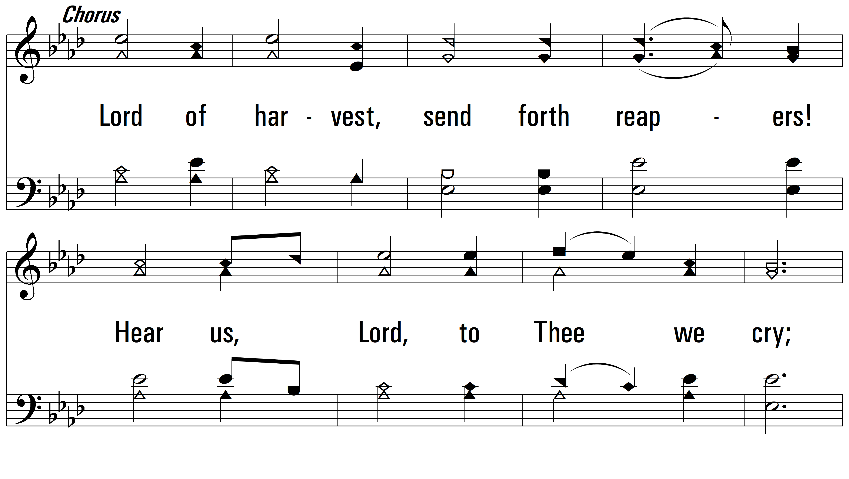
vs. 1

Slide 5
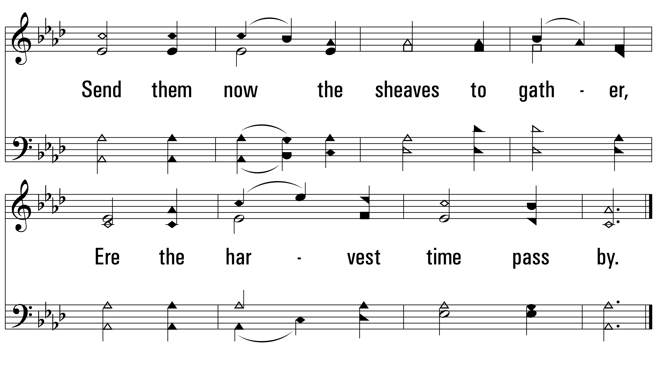
vs. 1

Slide 6
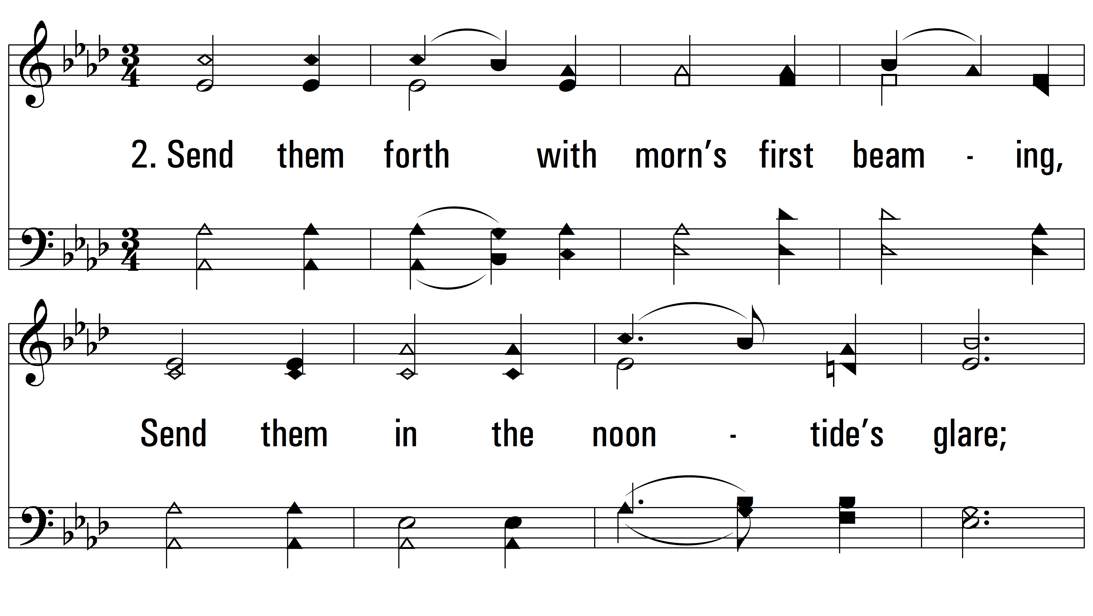
vs. 2 ~ Far And Near

Slide 7
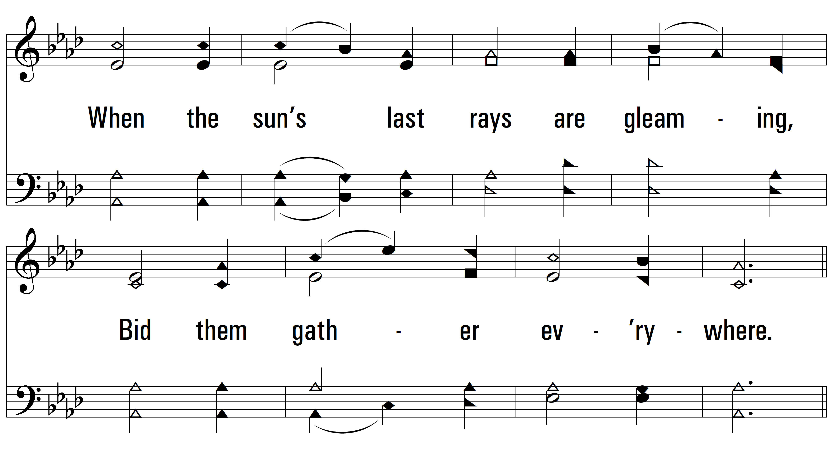
vs. 2

Slide 8
vs. 2

Slide 9
vs. 2

Slide 10
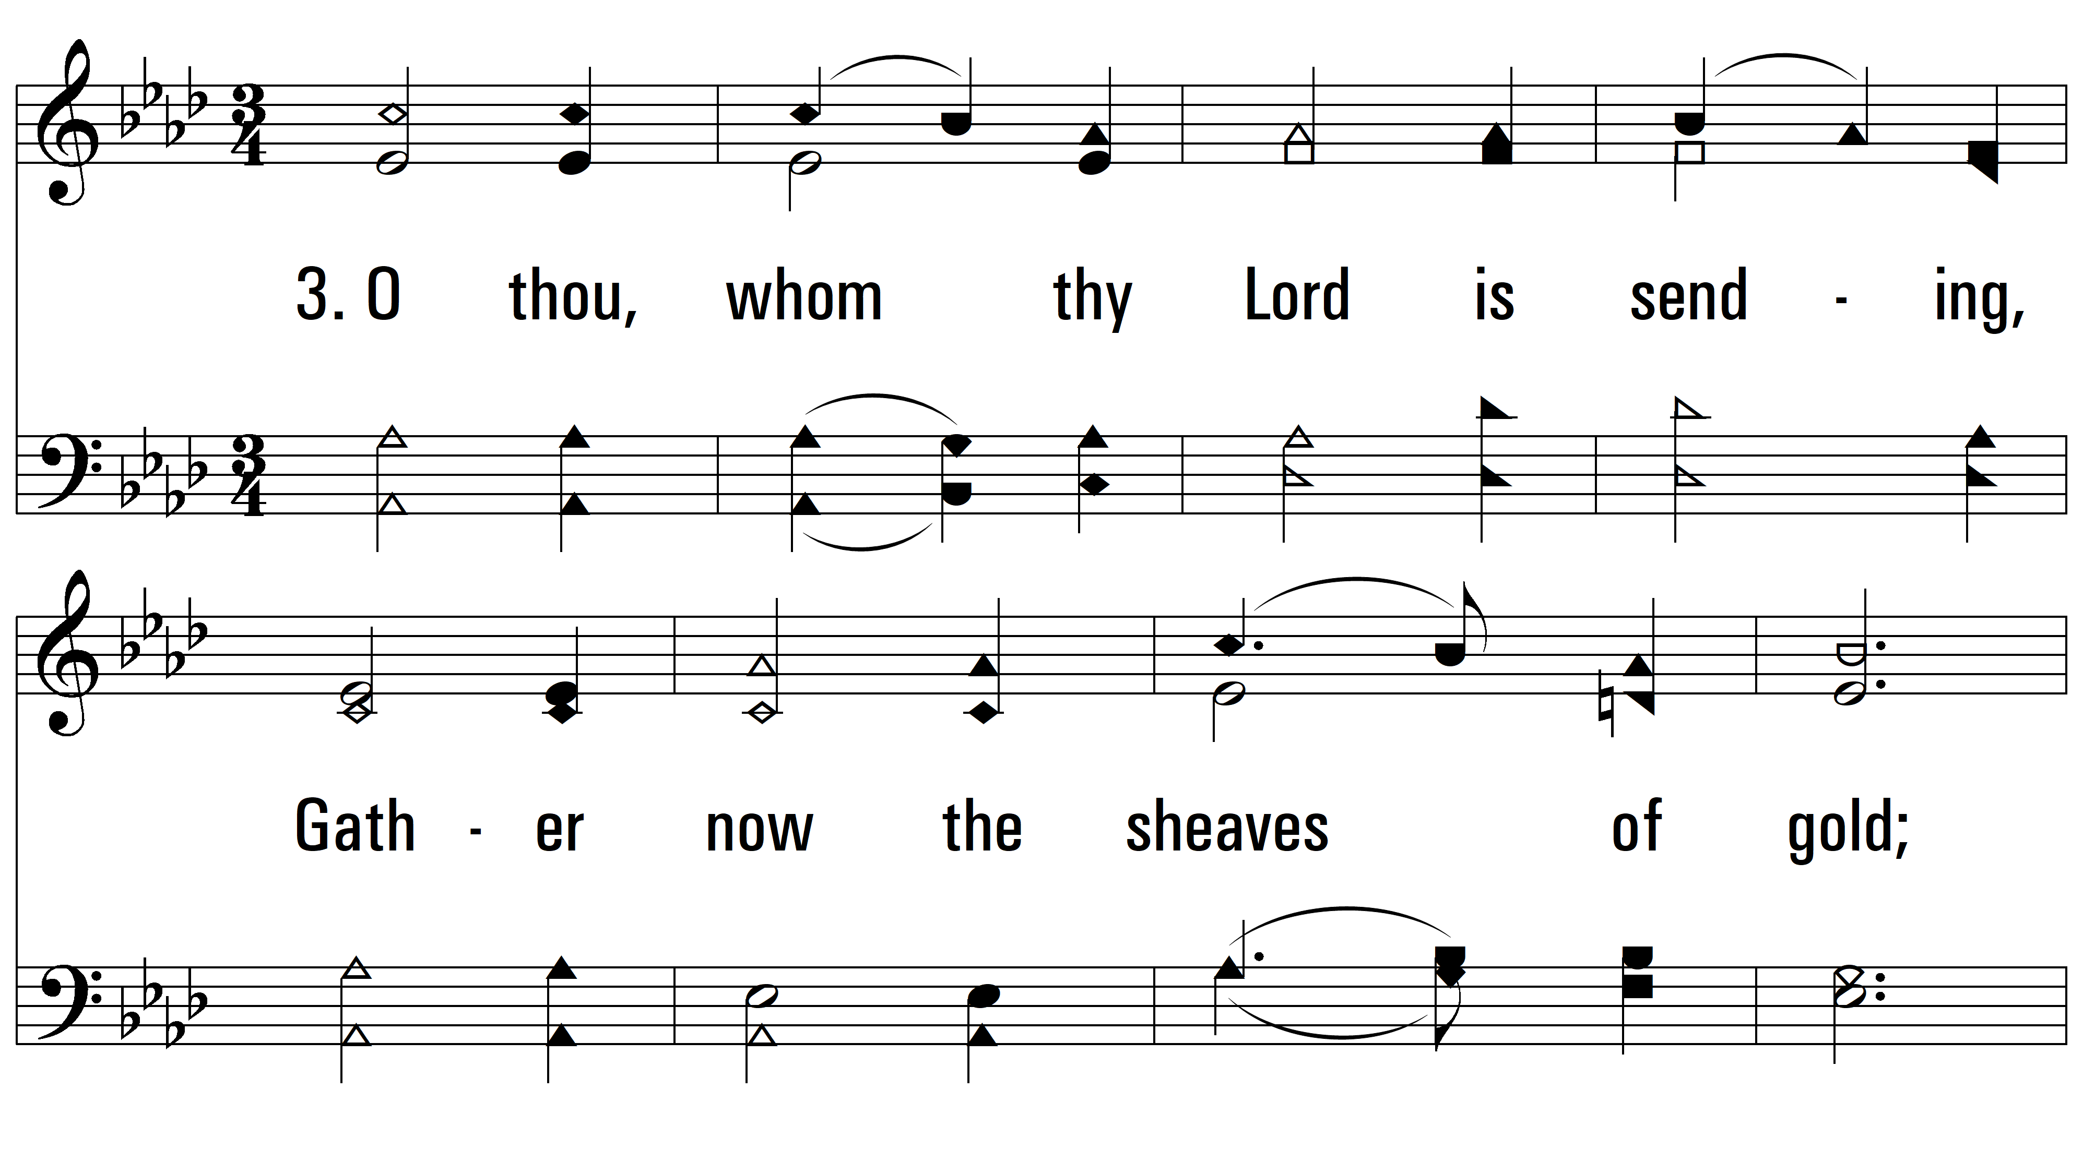
vs. 3 ~ Far And Near

Slide 11
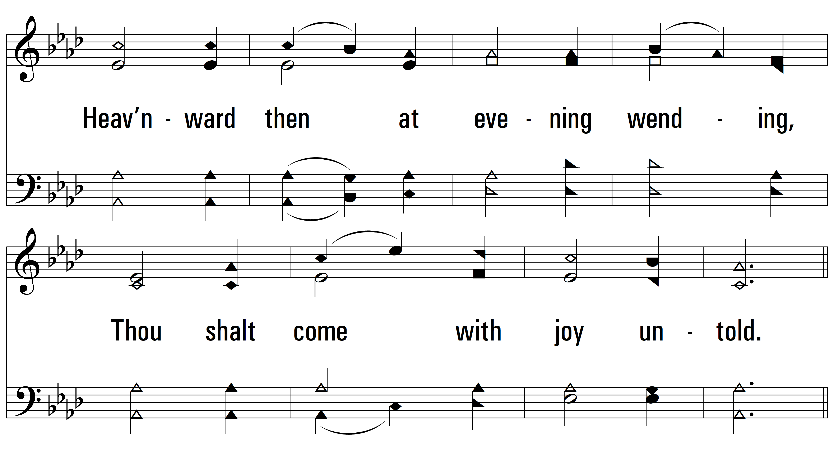
vs. 3

Slide 12
vs. 3

Slide 13
vs. 3
PDHymns.com
END

