Slide 1
Faith Is The Victory
Words: | John H. Yates (1891)
Music: | Ira D. Sankey (1891)
6/8
F/C - SOL
Verses: 4/Chorus
Lead - | SOL
Alto - | DO
Tenor - | MI
Bass - | DO
PDHymns.com

Slide 2
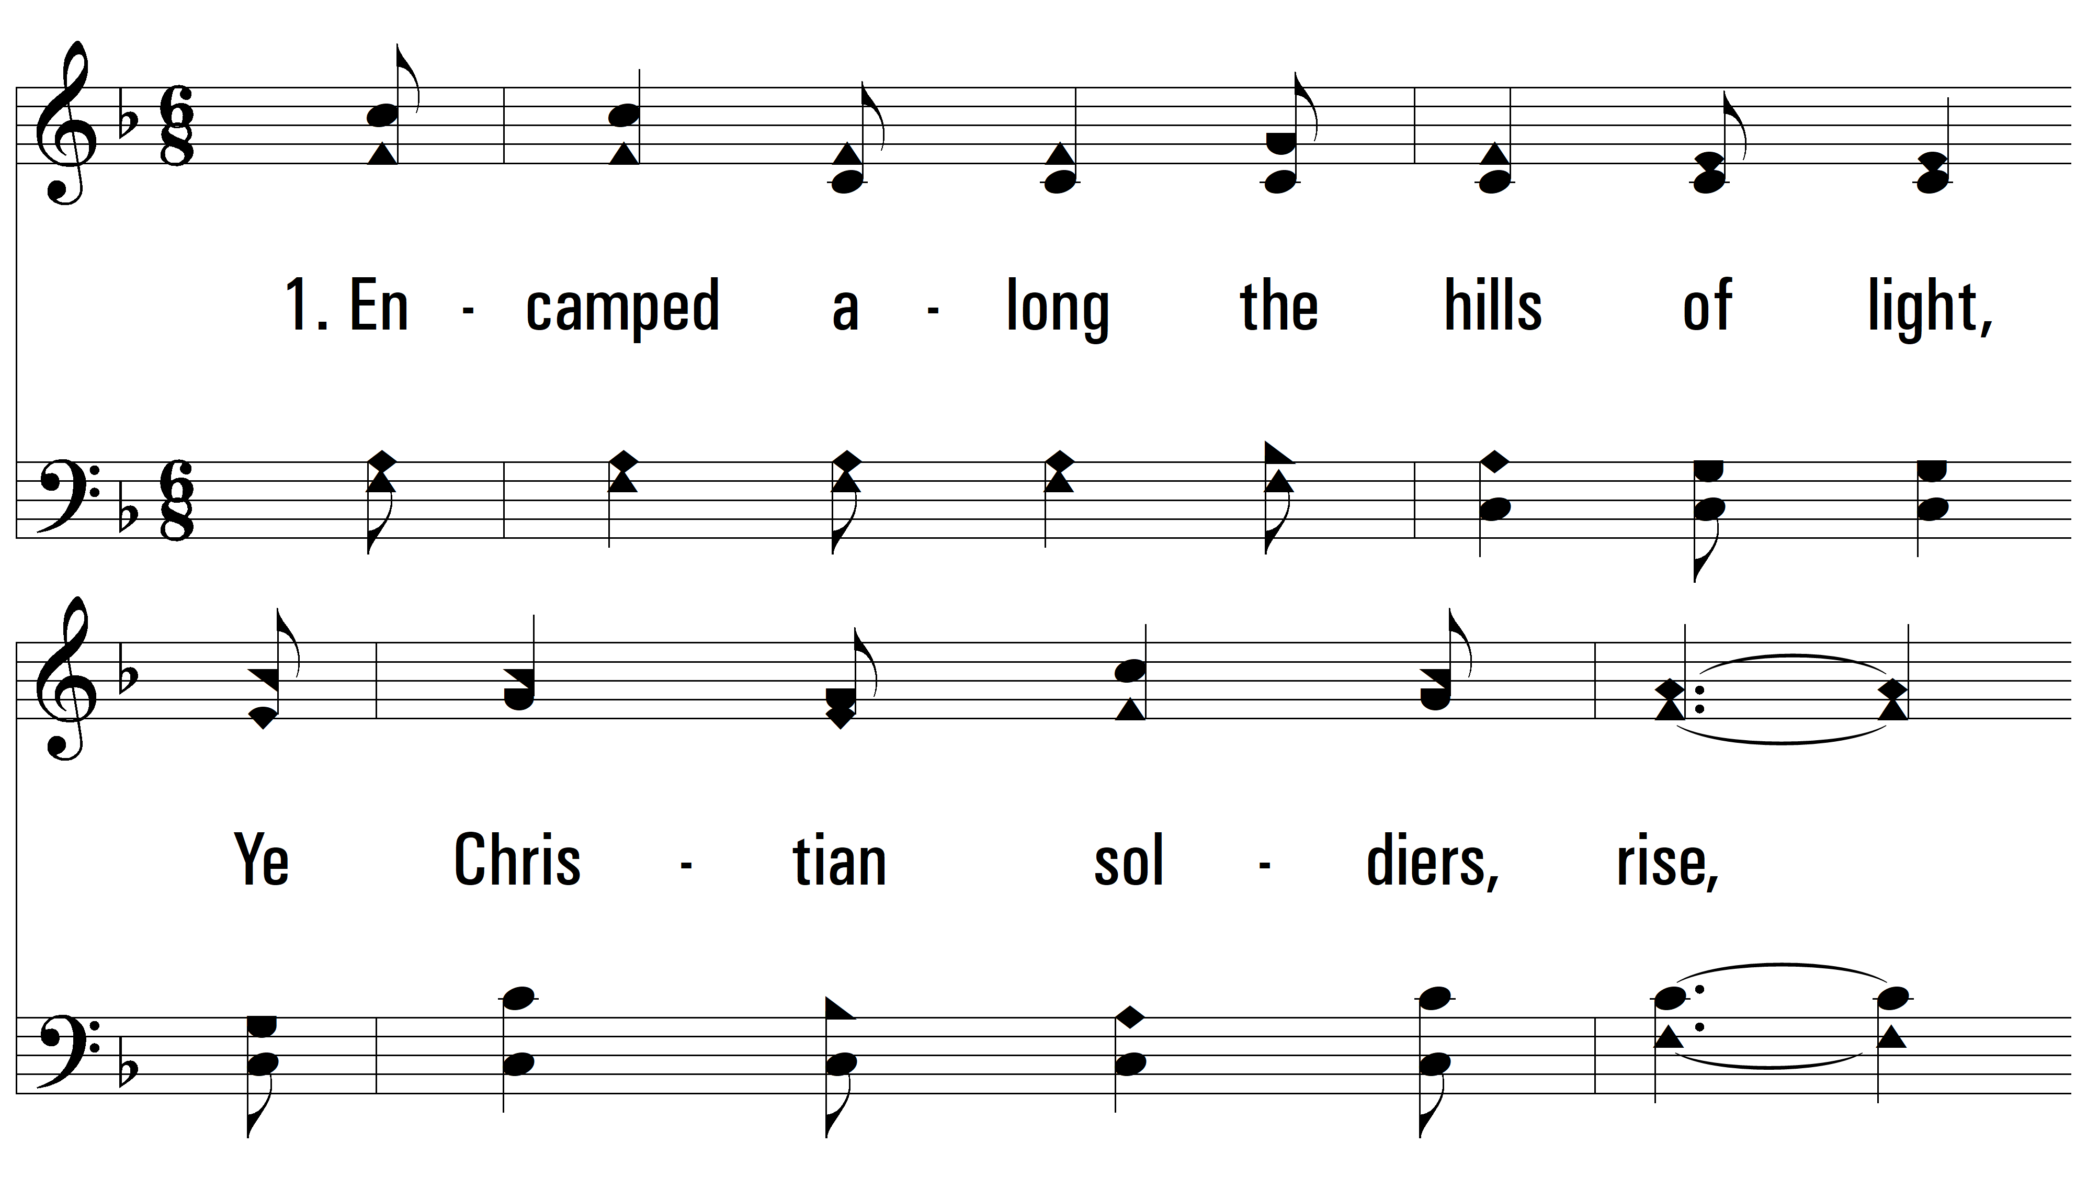
vs. 1 ~ Faith Is The Victory

Slide 3
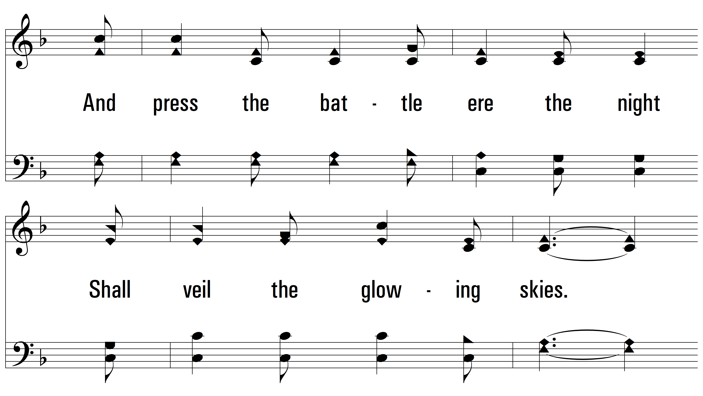
vs. 1

Slide 4
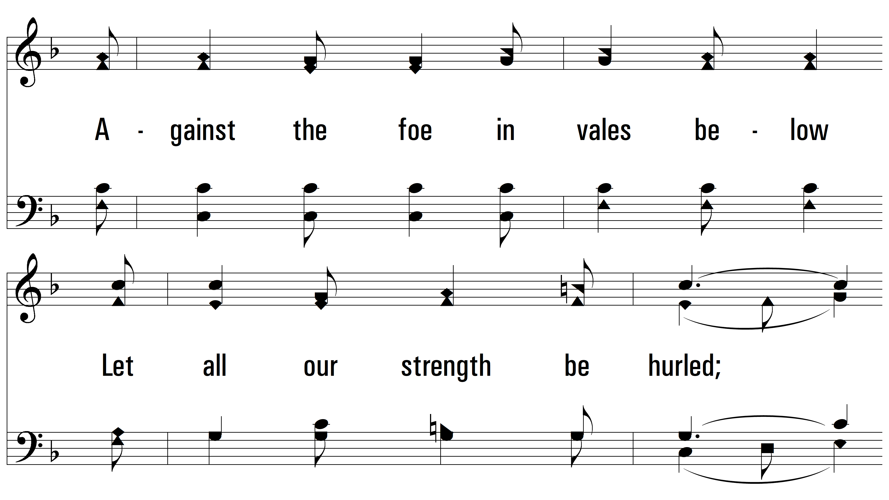
vs. 1

Slide 5
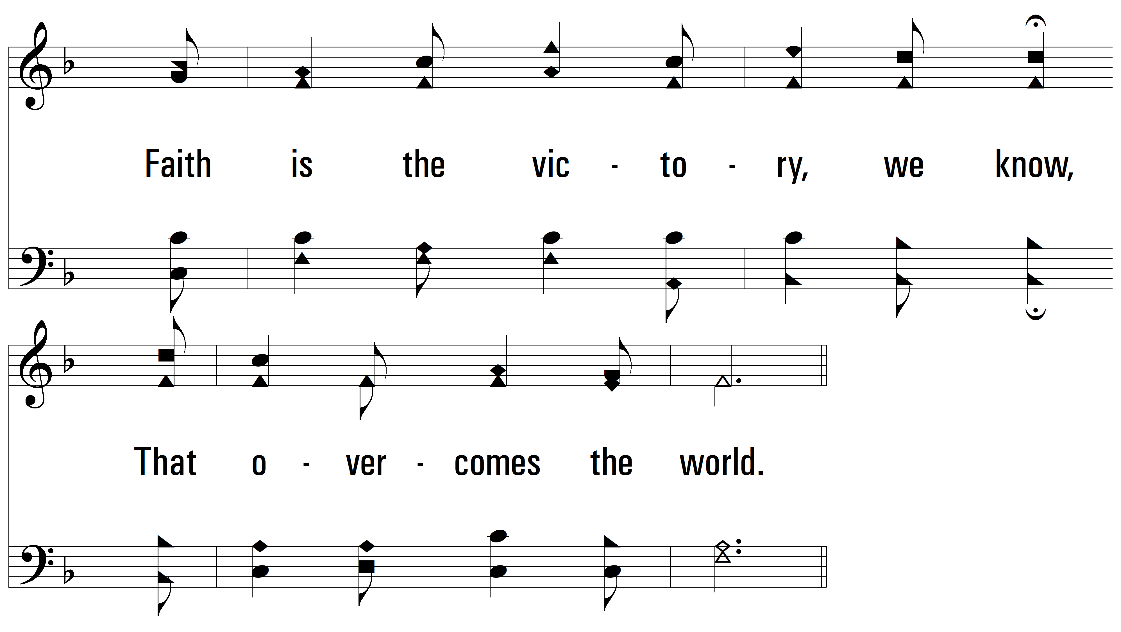
vs. 1

Slide 6
vs. 1

Slide 7
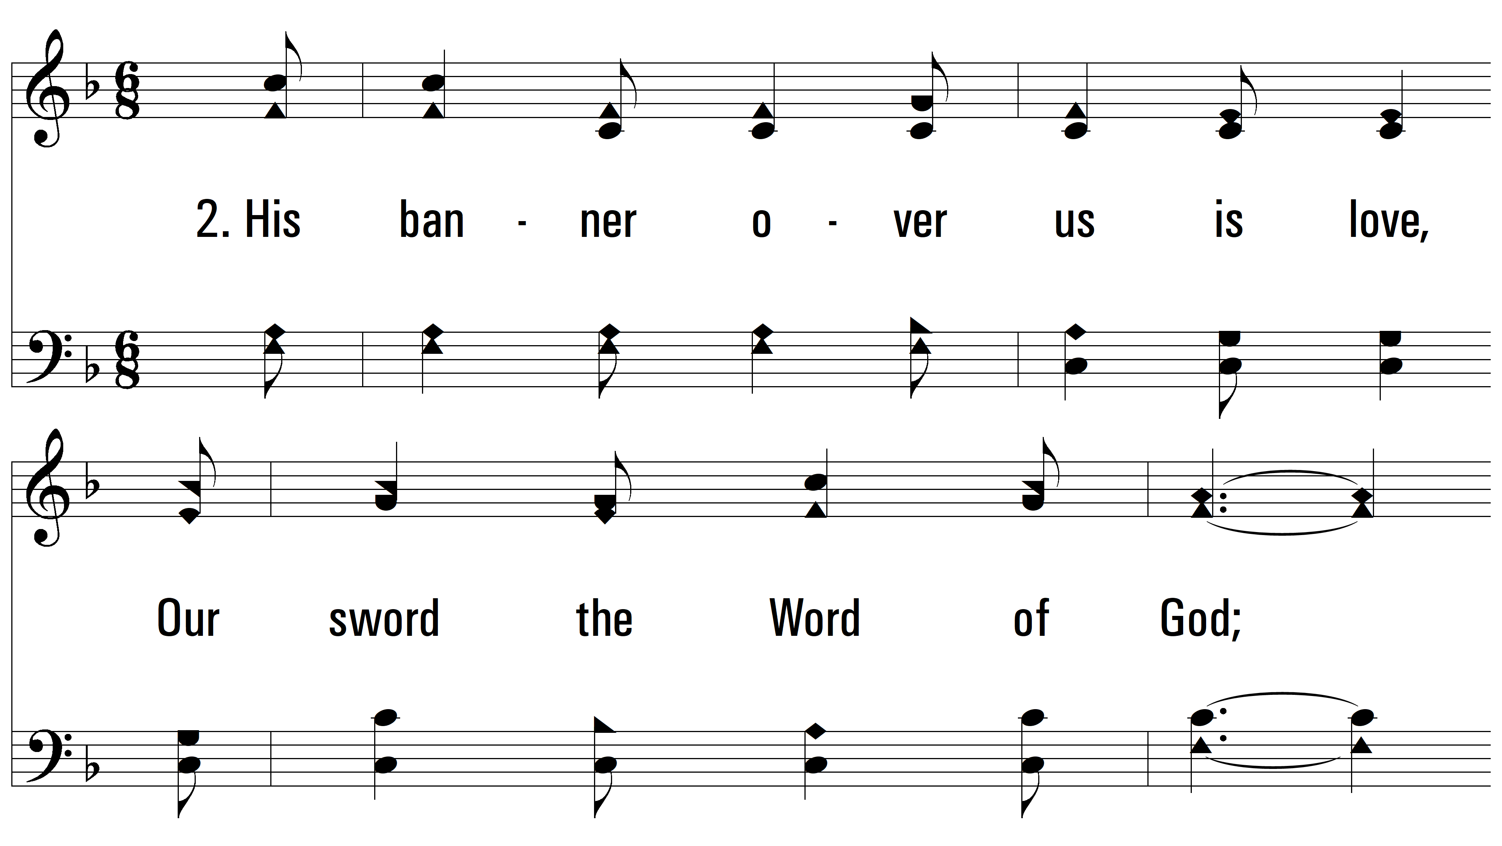
vs. 2 ~ Faith Is The Victory

Slide 8
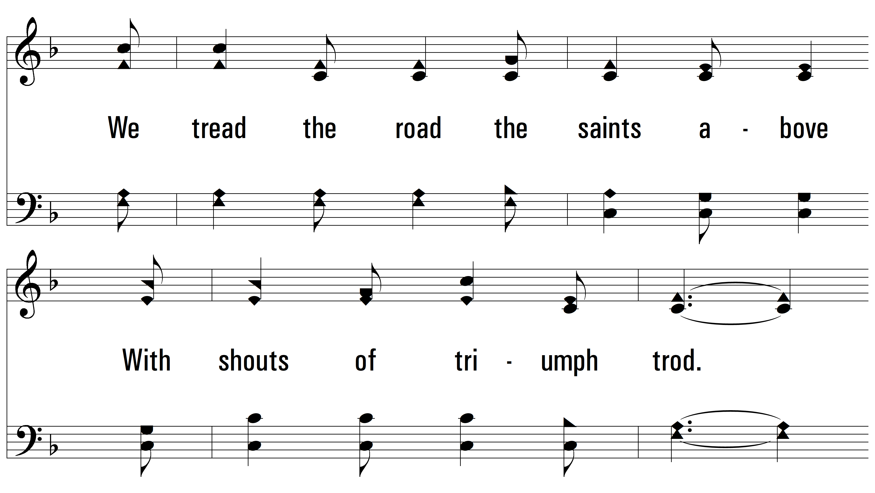
vs. 2

Slide 9
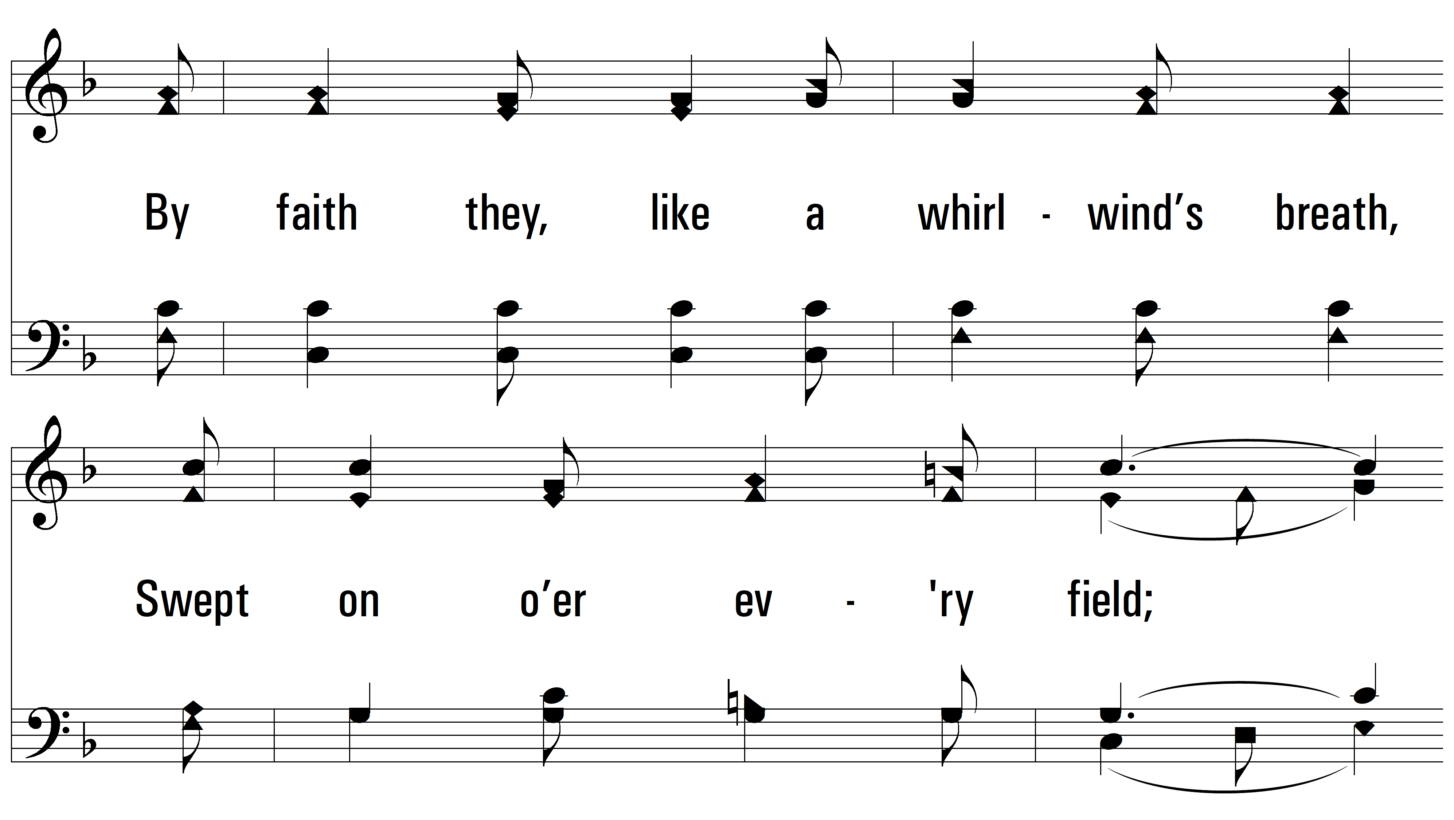
vs. 2

Slide 10
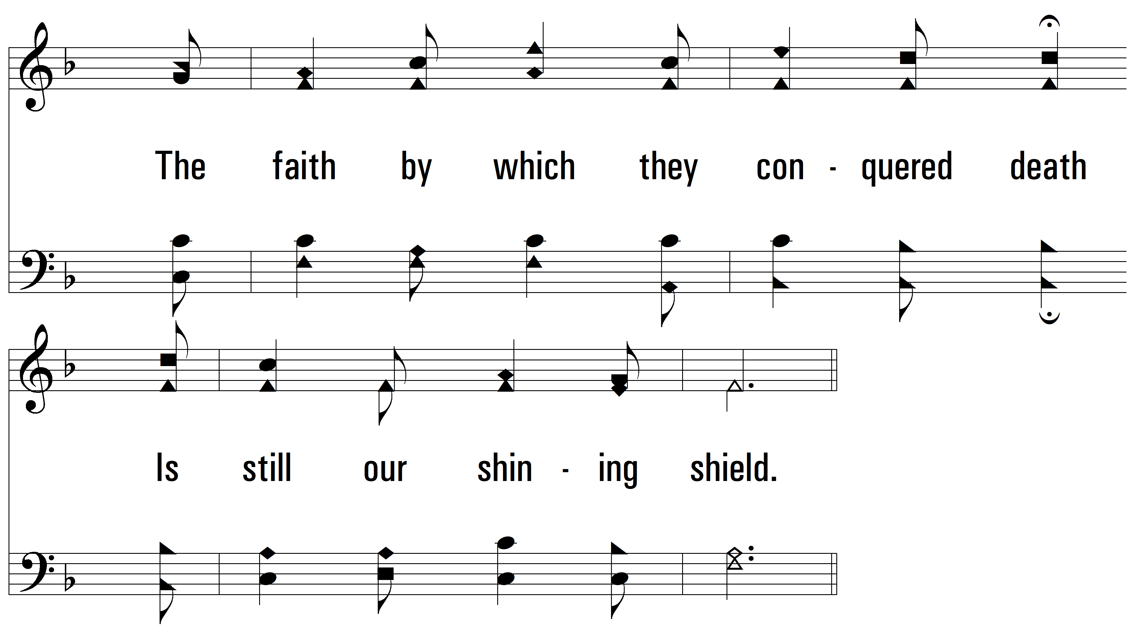
vs. 2

Slide 11
vs. 2

Slide 12
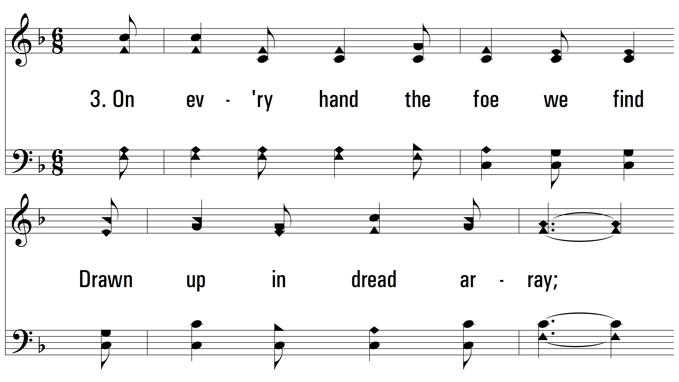
vs. 3 ~ Faith Is The Victory

Slide 13
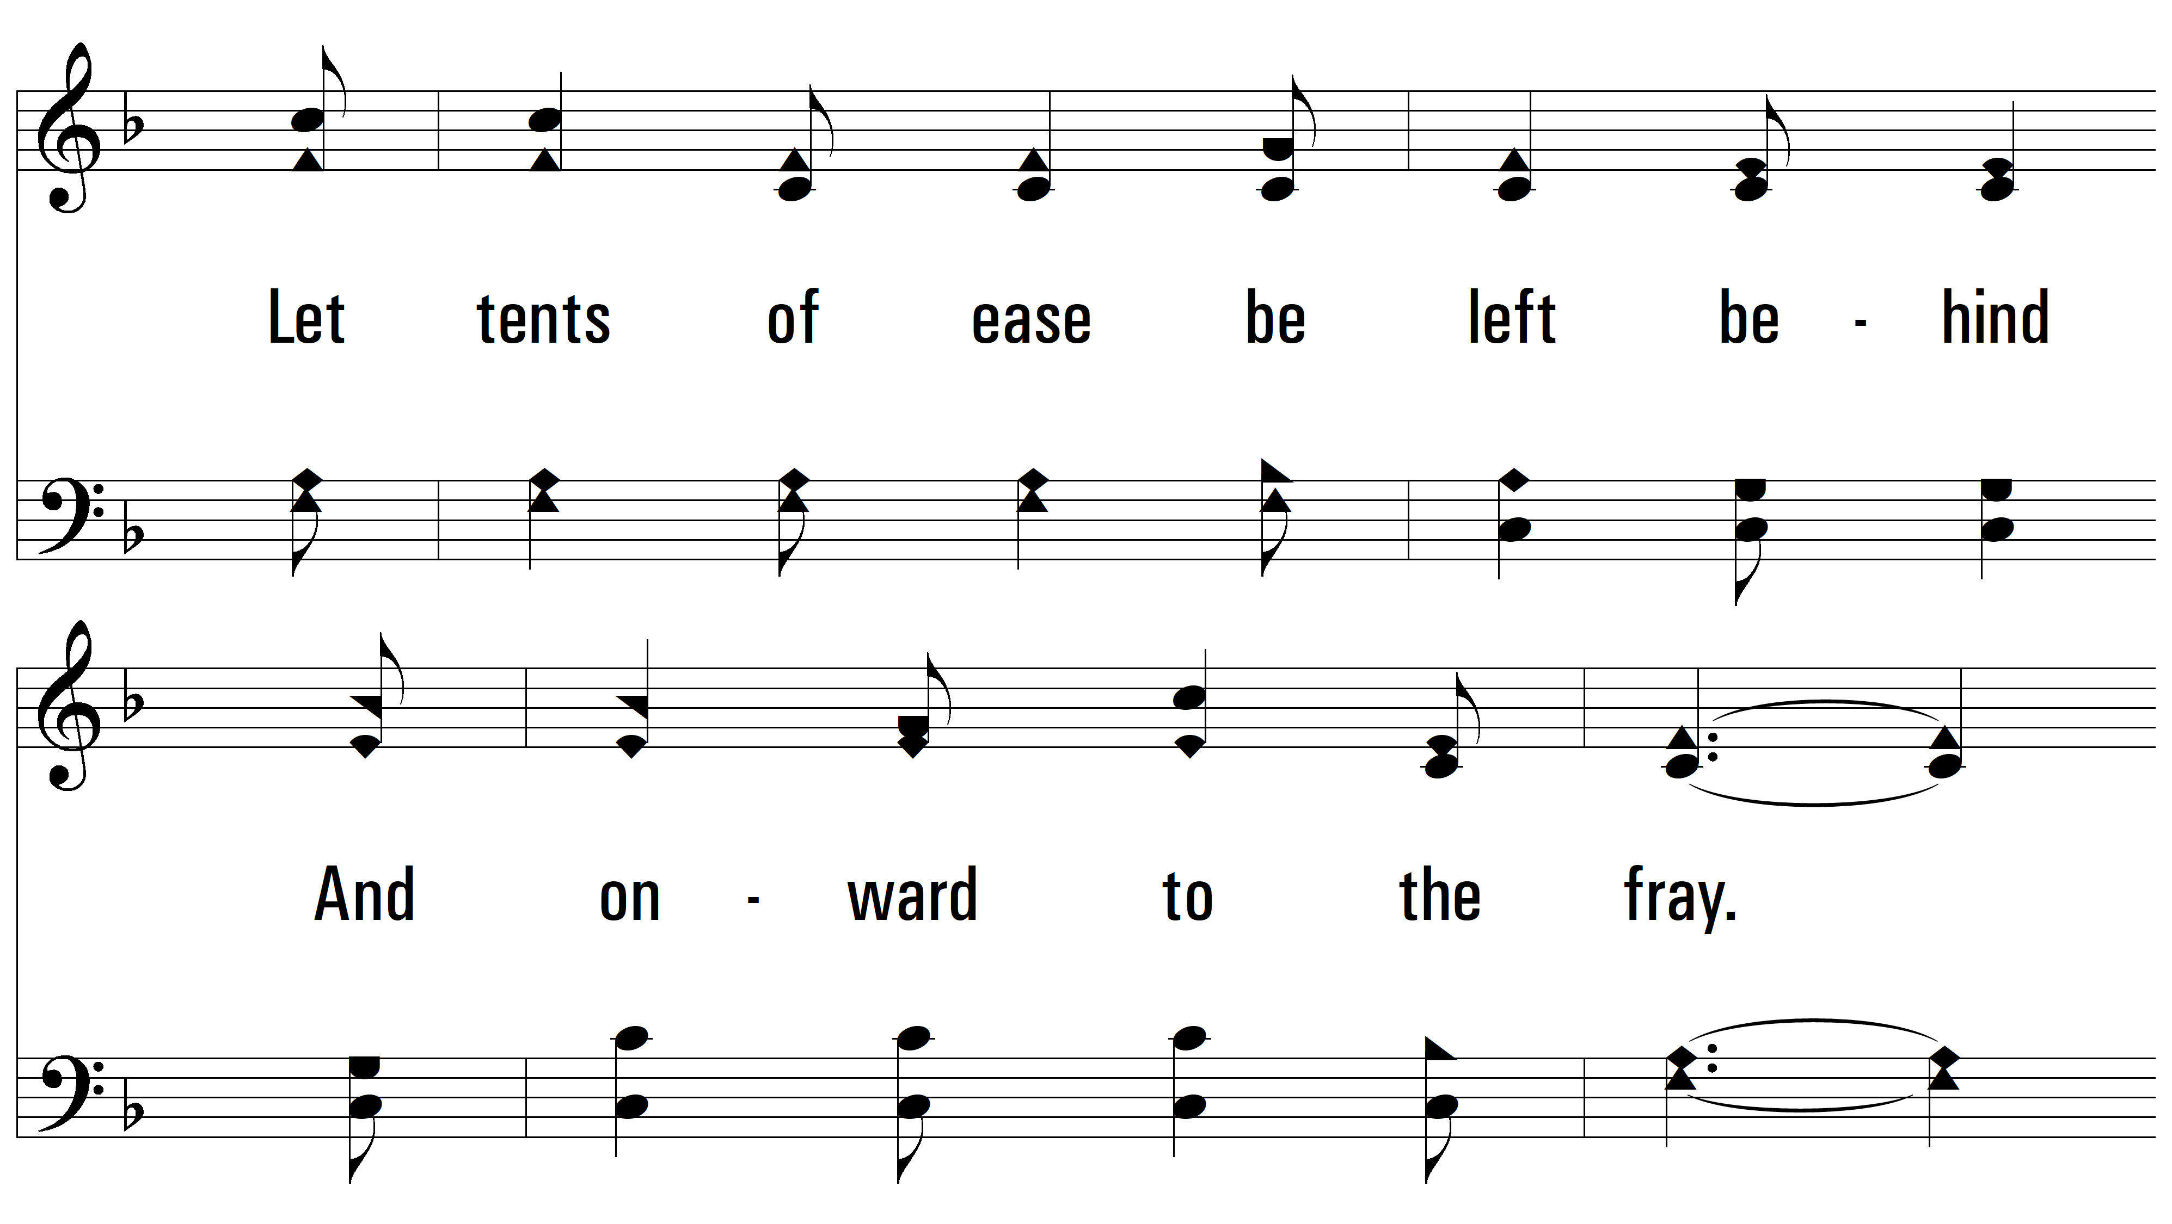
vs. 3

Slide 14
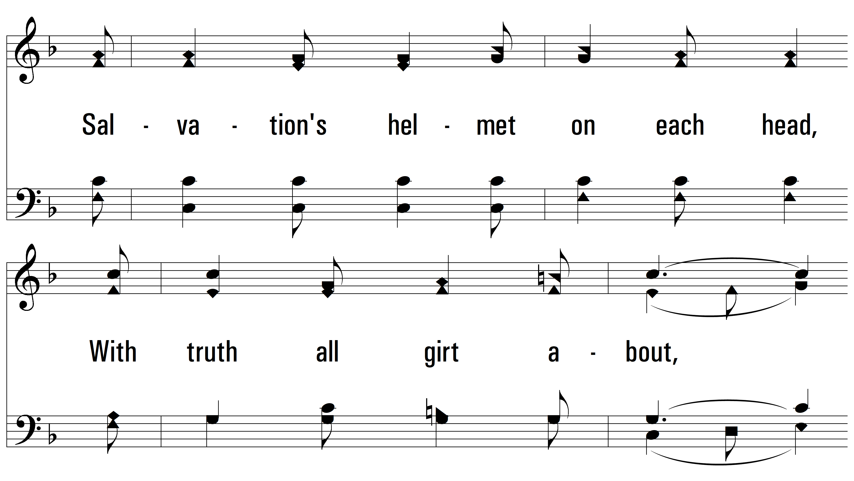
vs. 3

Slide 15
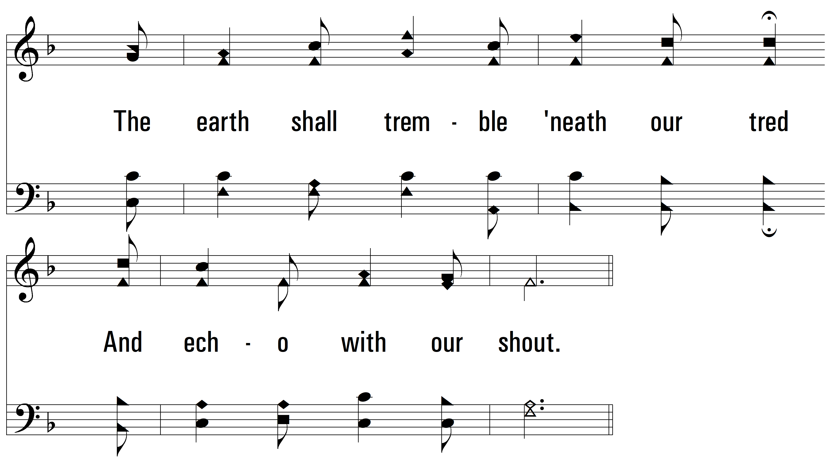
vs. 3

Slide 16
vs. 3

Slide 17
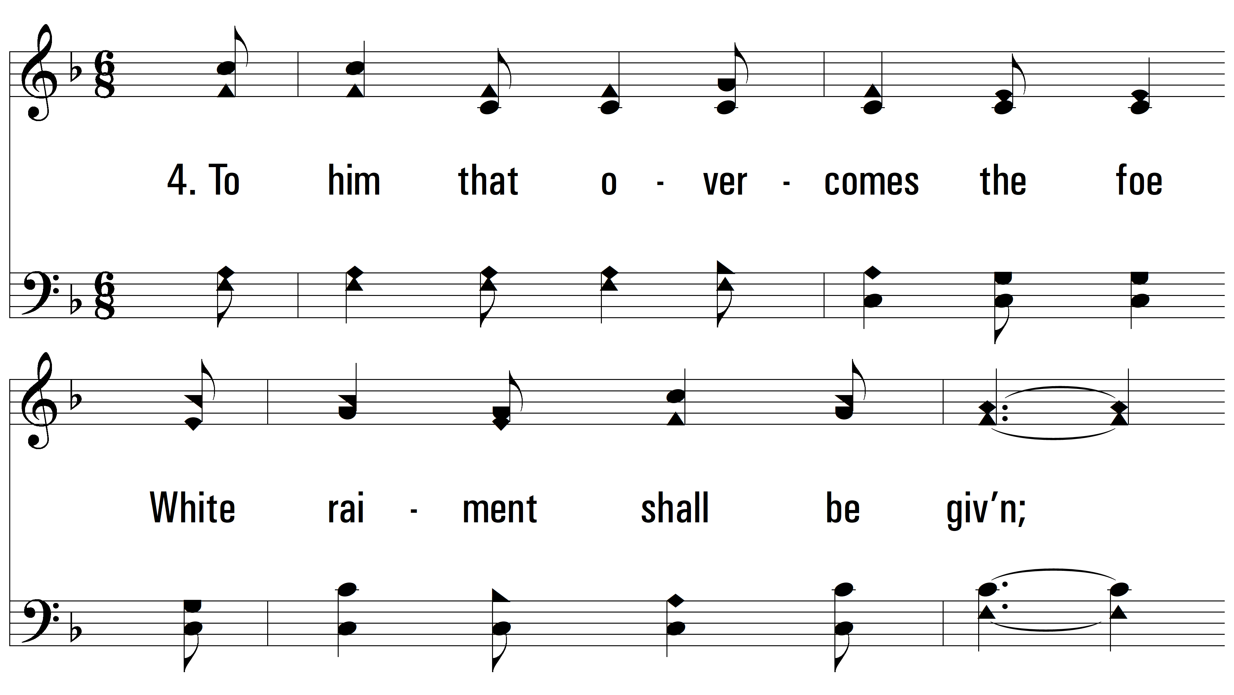
vs. 4 ~ Faith Is The Victory

Slide 18
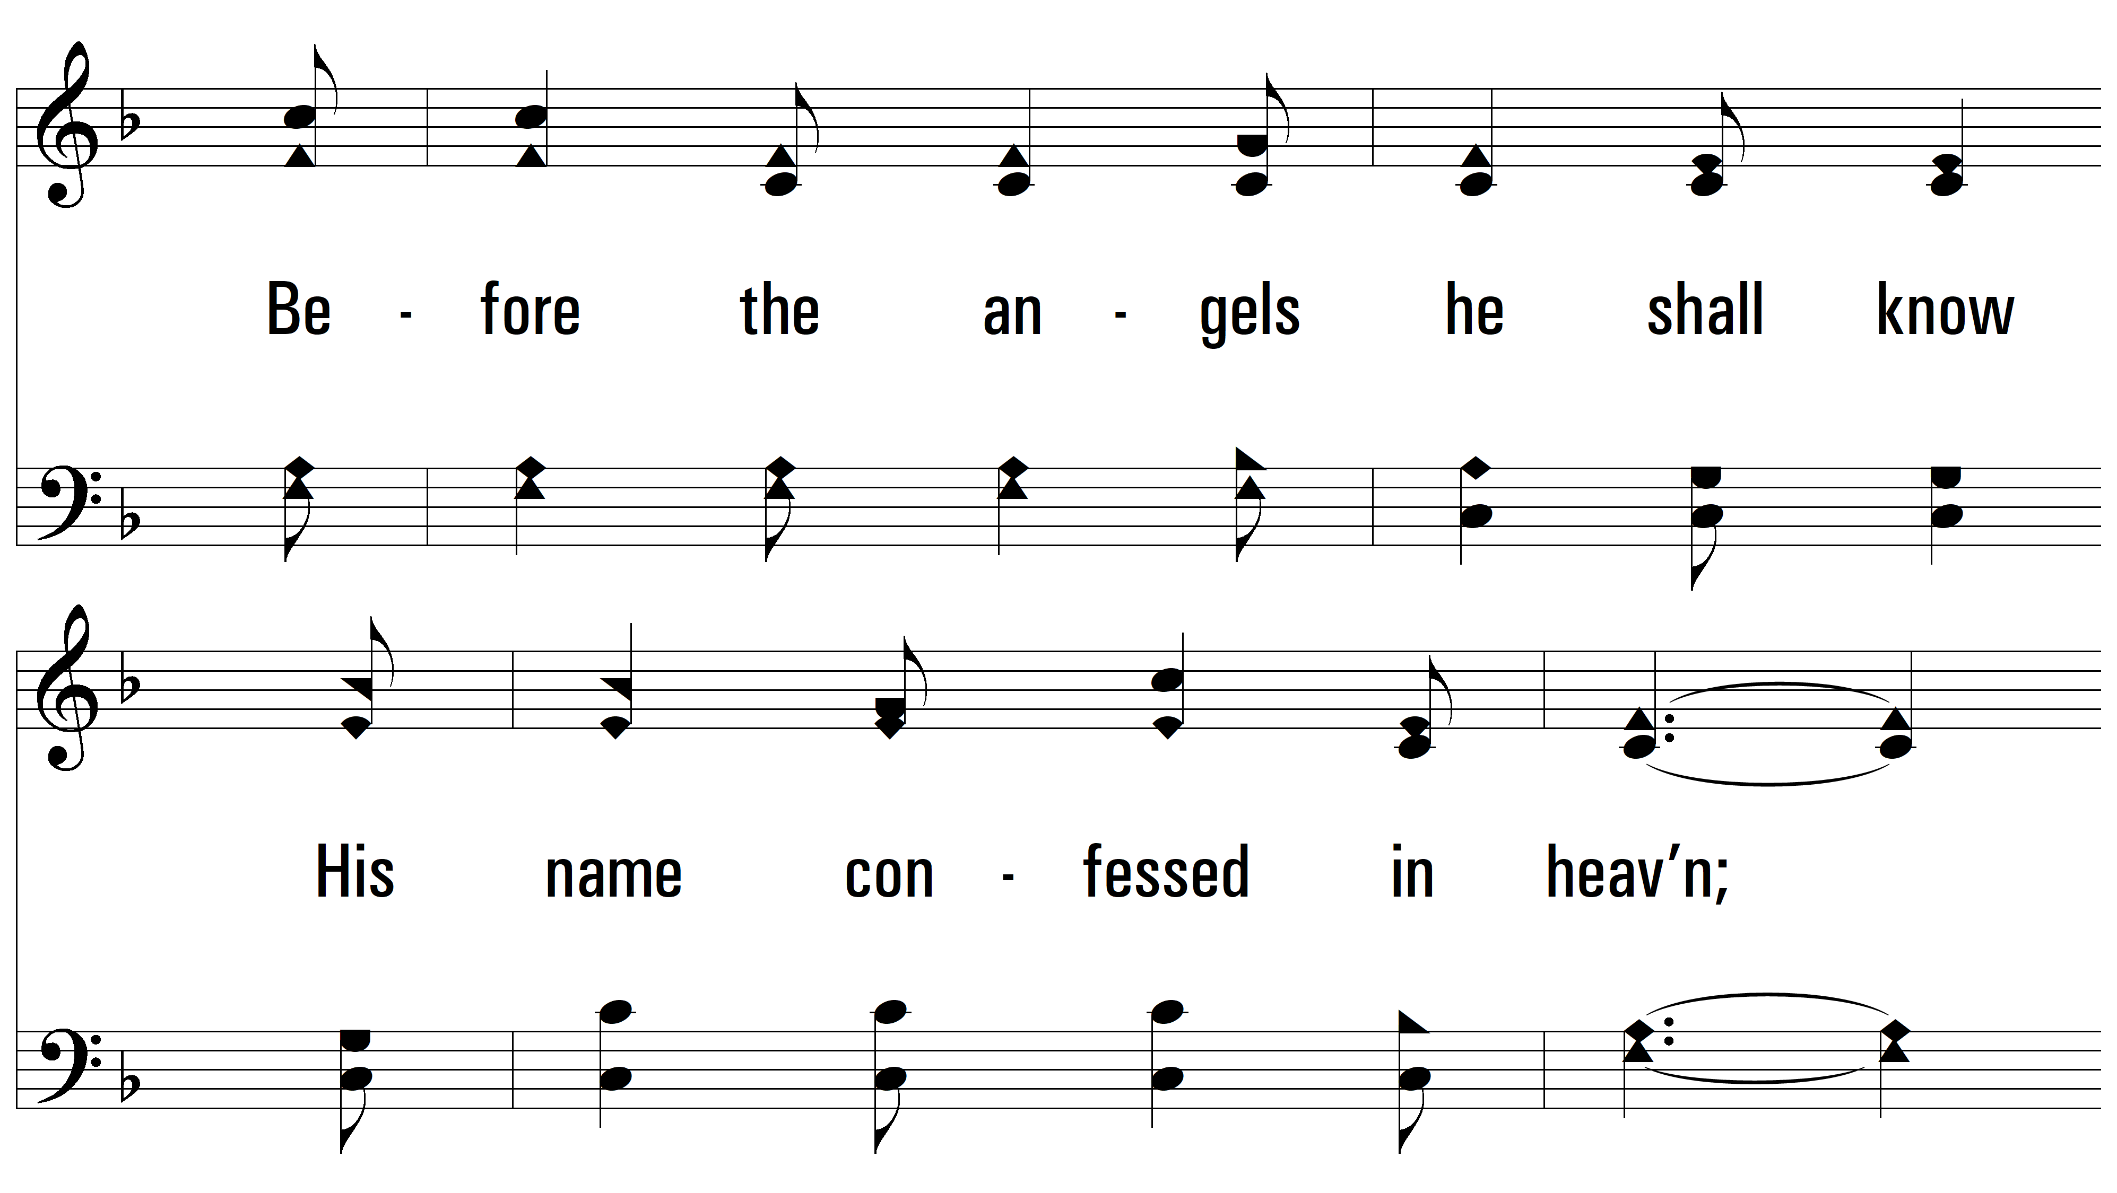
vs. 4

Slide 19
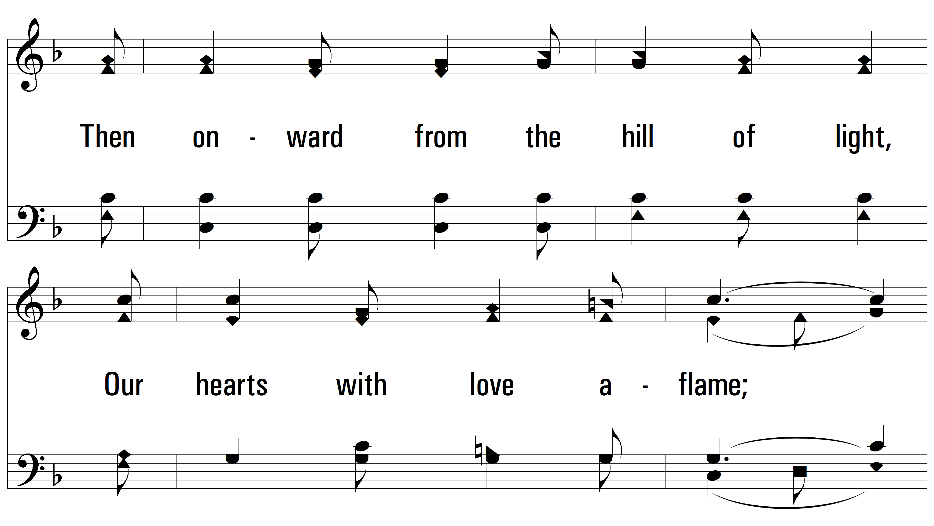
vs. 4

Slide 20
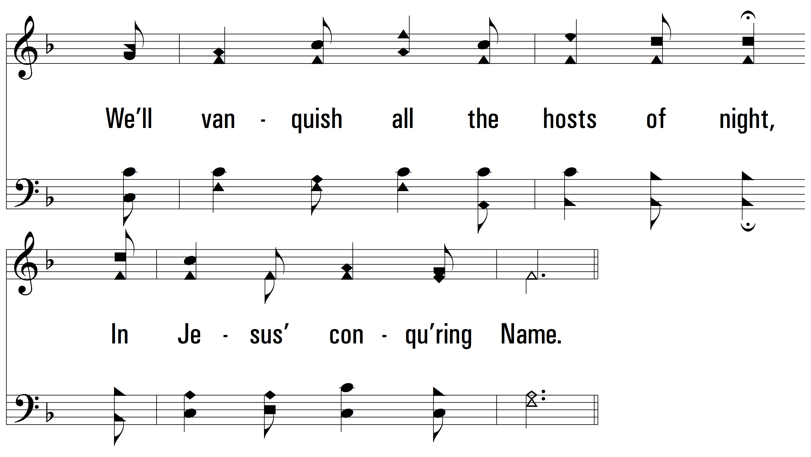
vs. 4

Slide 21
vs. 4
PDHymns.com
END

