Slide 1
Fairest Lord Jesus
CRUSADER’S HYMN
5.6.8.5.5.8
Words: | 17th Century German Hymn (1677), Tr. by Richard S. Willis (1850)
Music: | Old German Hymn, Arr. by Richard S. Wills (1850)
4/4
E/E - DO
Verses: 4
Lead - | DO
Alto - | SOL
Tenor - | MI
Bass - | DO
PDHymns.com

Slide 2
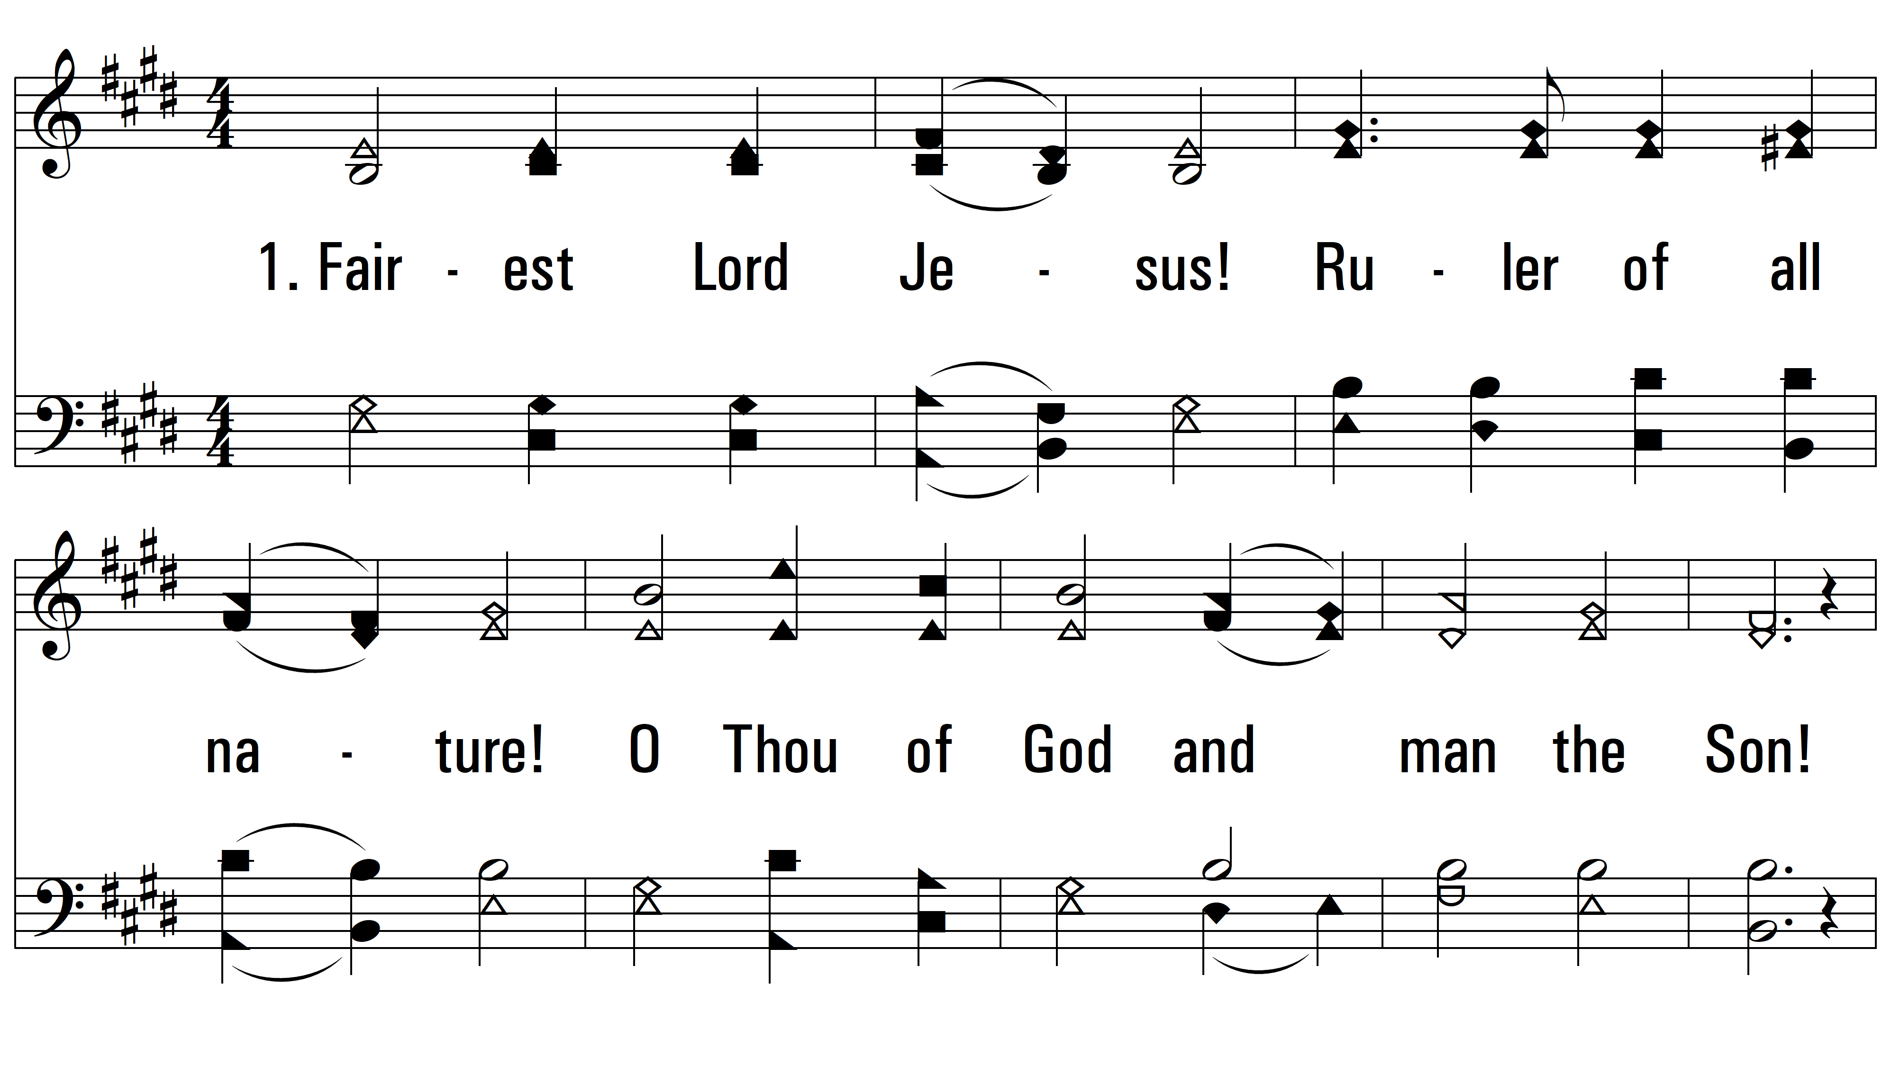
vs. 1 ~ Fairest Lord Jesus

Slide 3
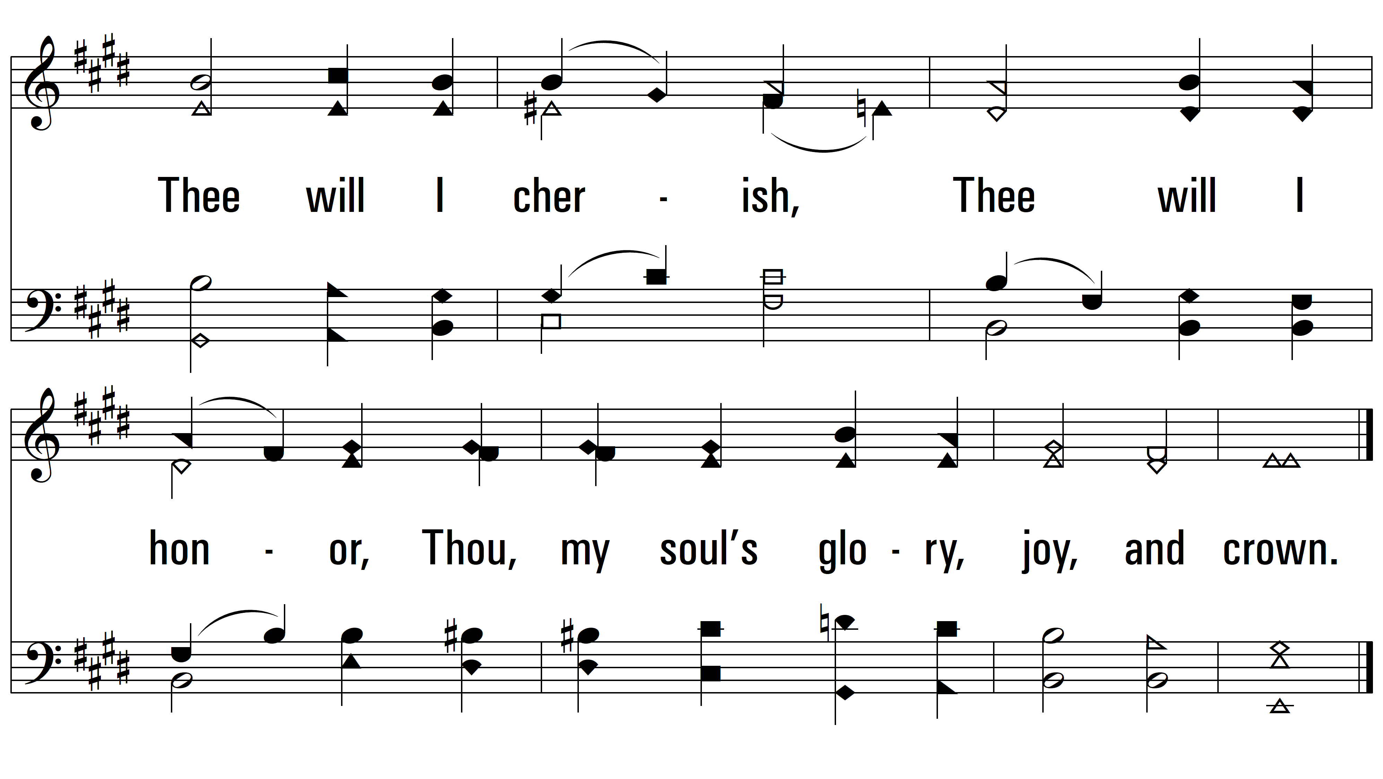
vs. 1

Slide 4
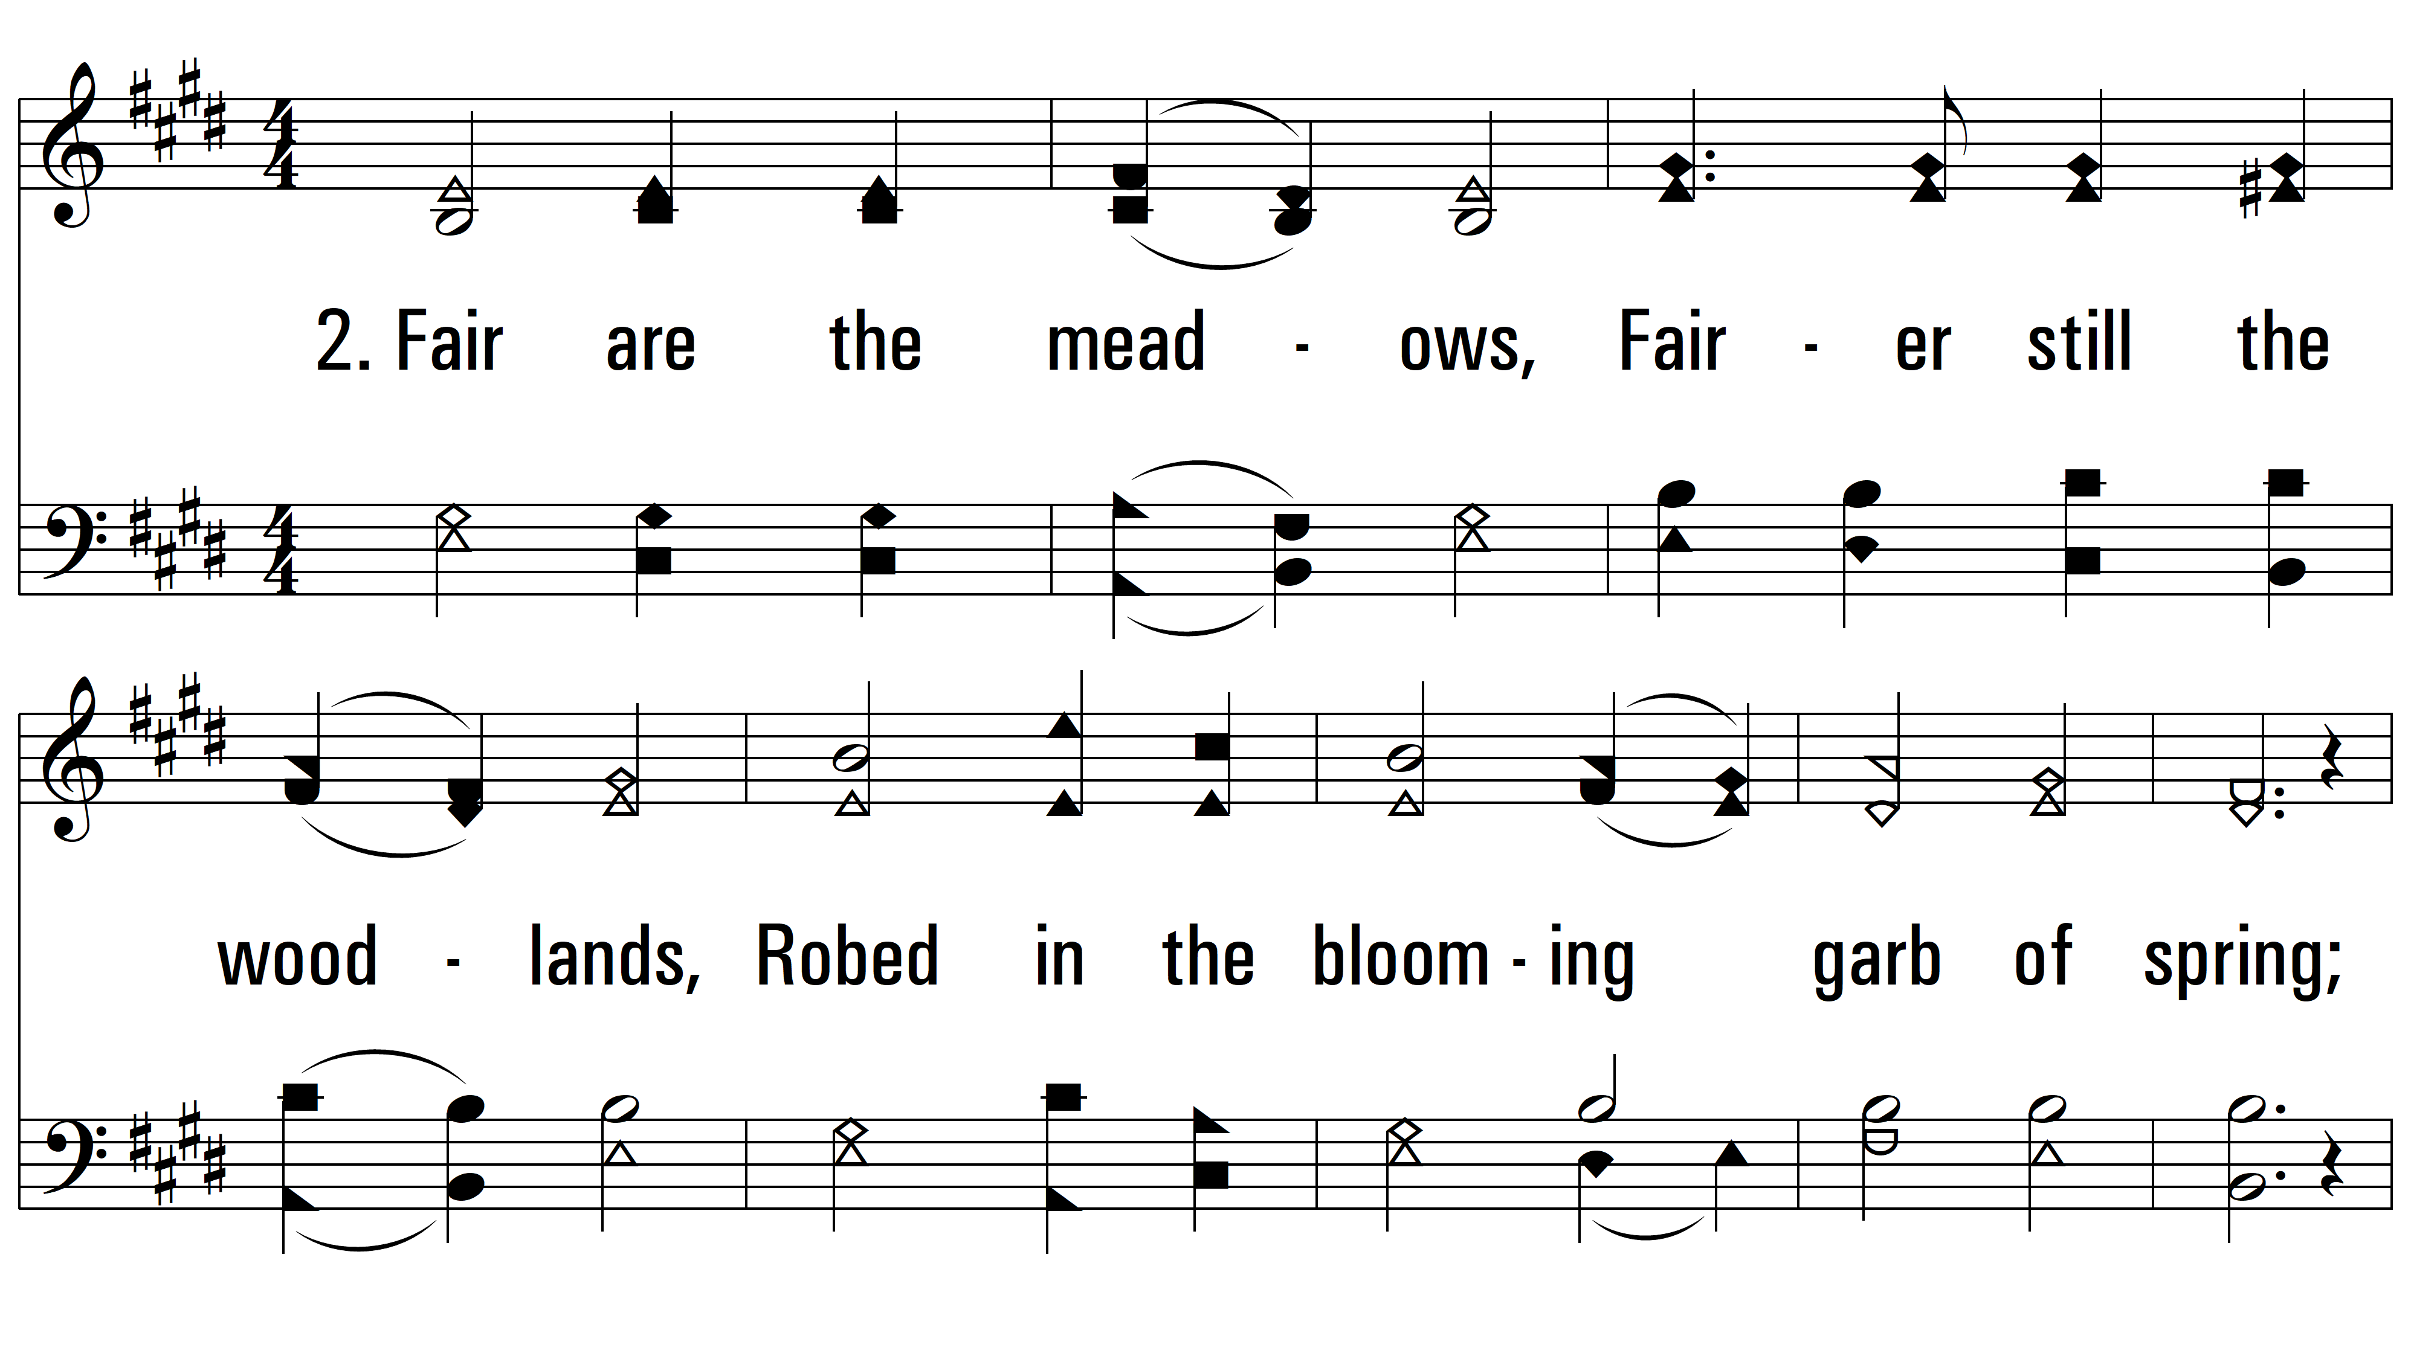
vs. 2 ~ Fairest Lord Jesus

Slide 5
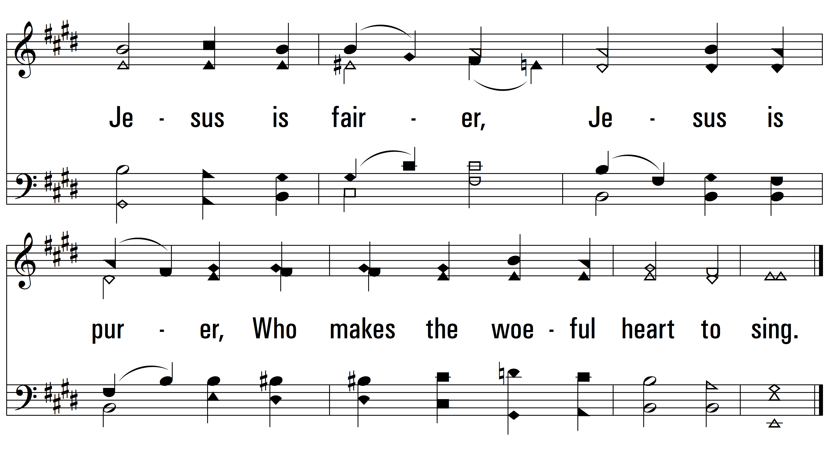
vs. 2

Slide 6
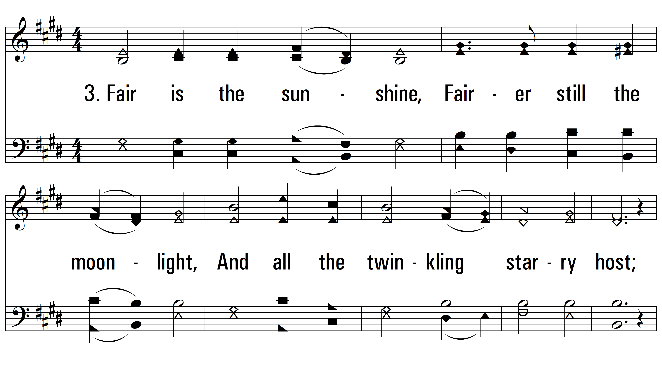
vs. 3 ~ Fairest Lord Jesus

Slide 7
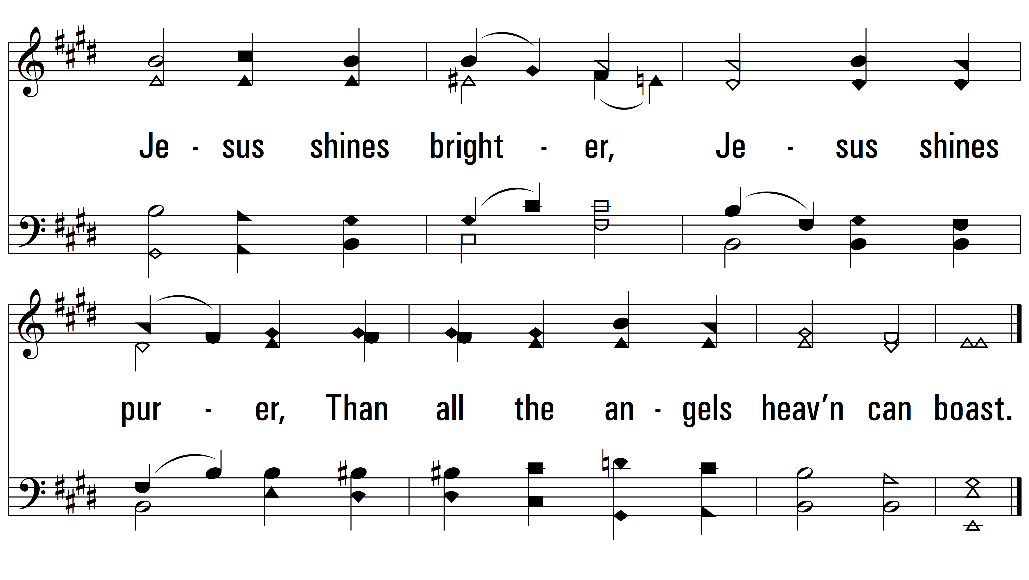
vs. 3

Slide 8
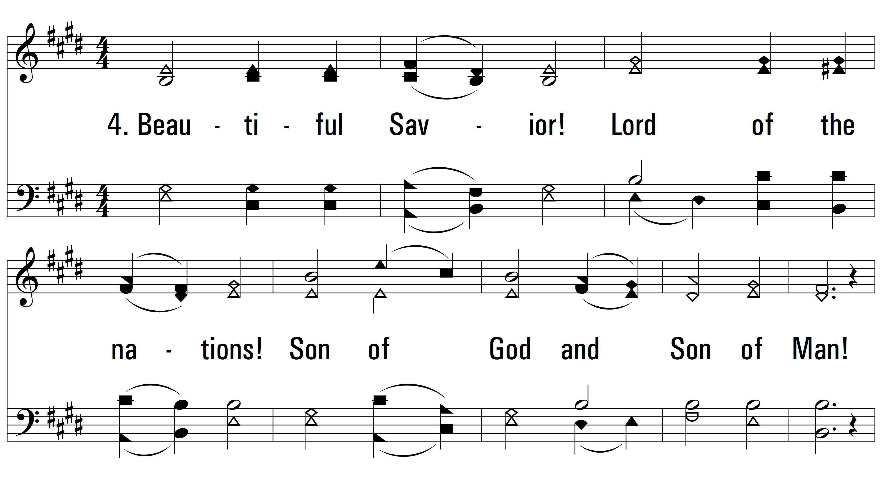
vs. 4 ~ Fairest Lord Jesus

Slide 9
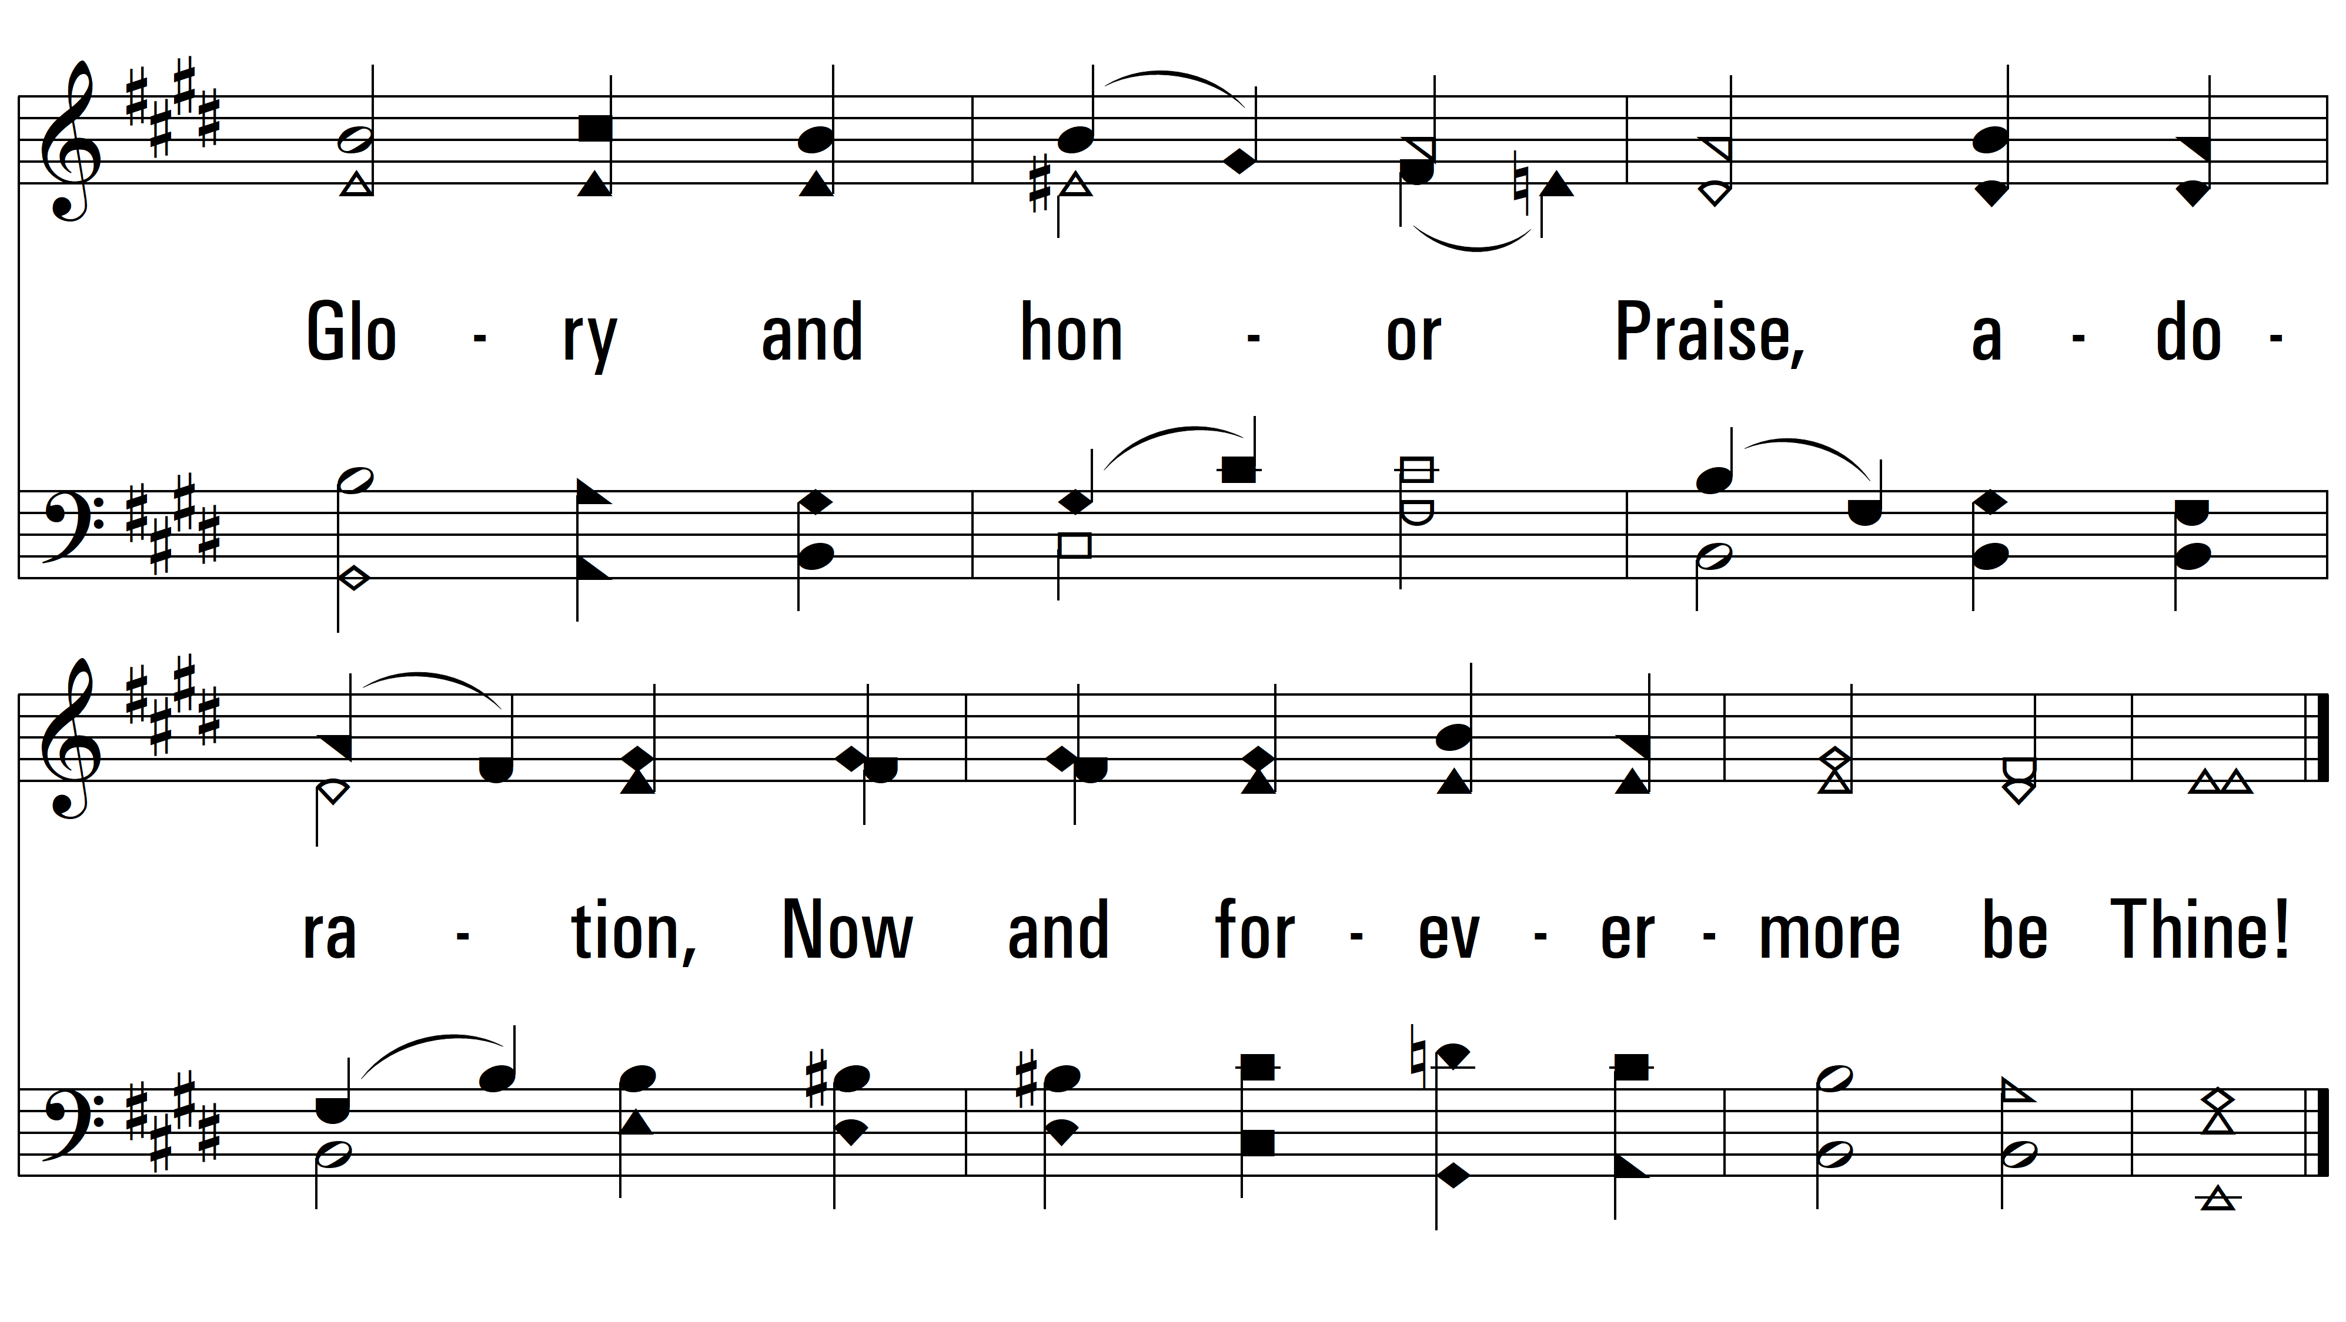
vs. 4
PDHymns.com
END

