Slide 1
Everybody Will Be Happy Over There
Words: | E. M. Bartlett
Music: | E. M. Bartlett
4/4
C/G - SOL
Verses: 3/Chorus
Lead - | SOL
Alto - | MI
Tenor - | DO
Bass - | DO
PDHymns.com

Slide 2
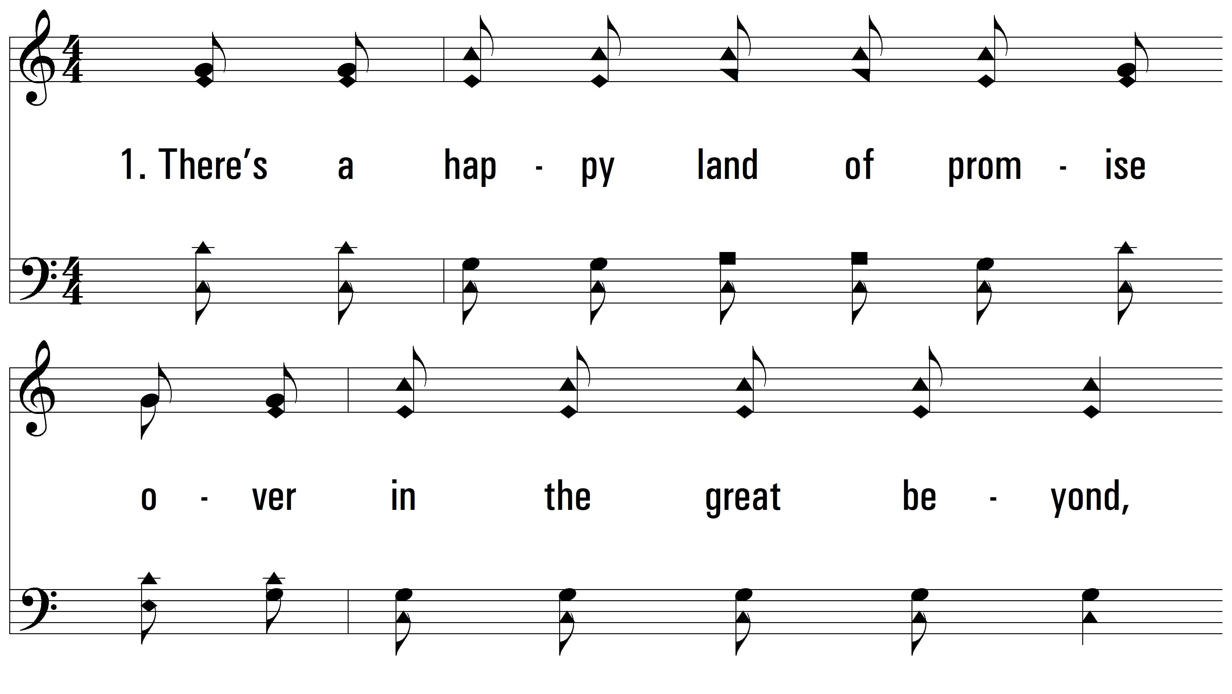
vs. 1 ~ Everybody Will Be Happy Over There

Slide 3
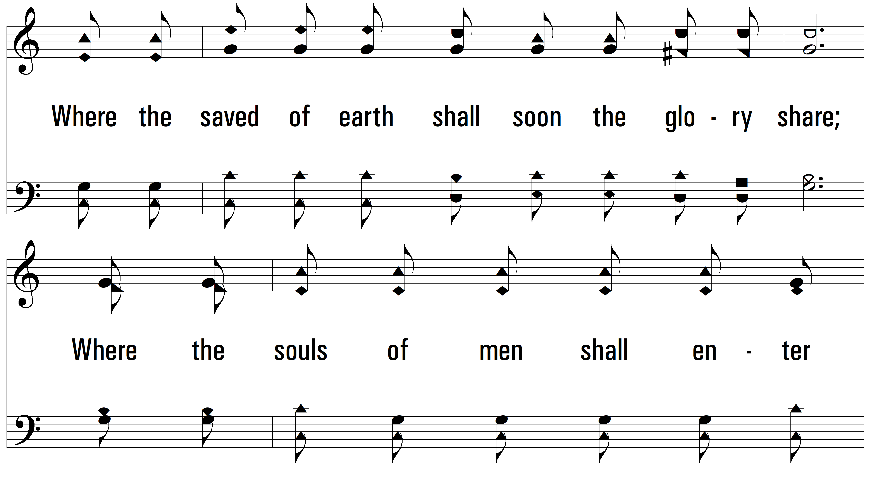
vs. 1

Slide 4
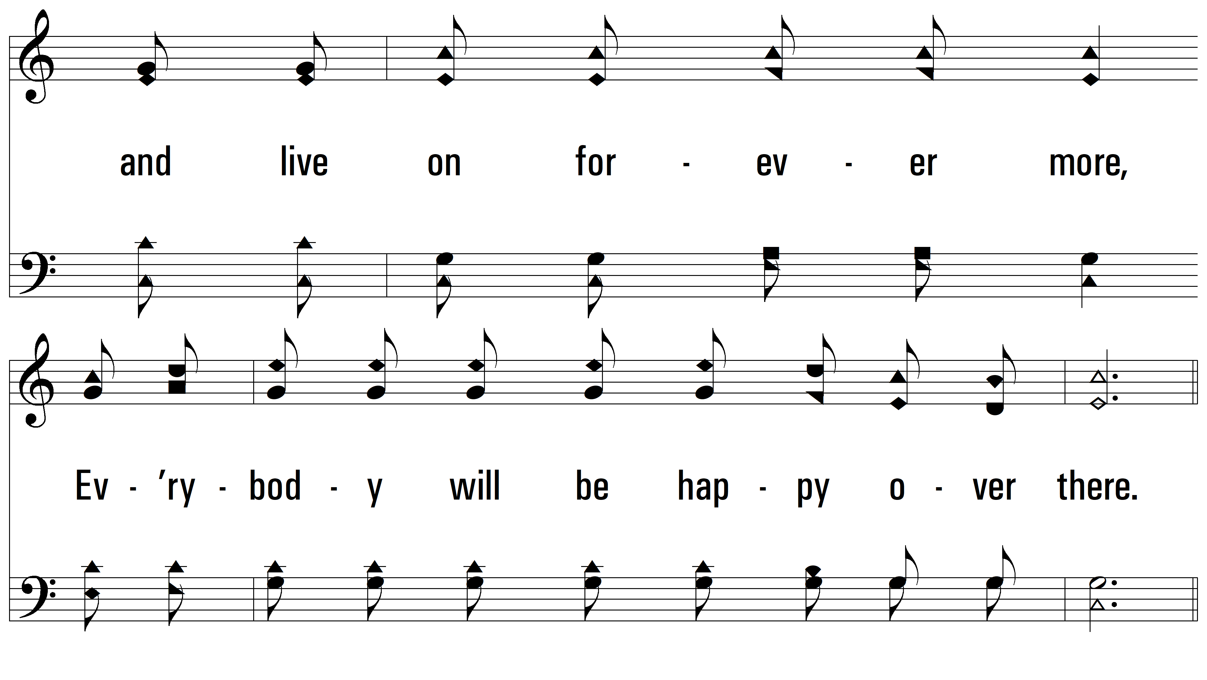
vs. 1

Slide 5
vs. 1

Slide 6
vs. 1

Slide 7
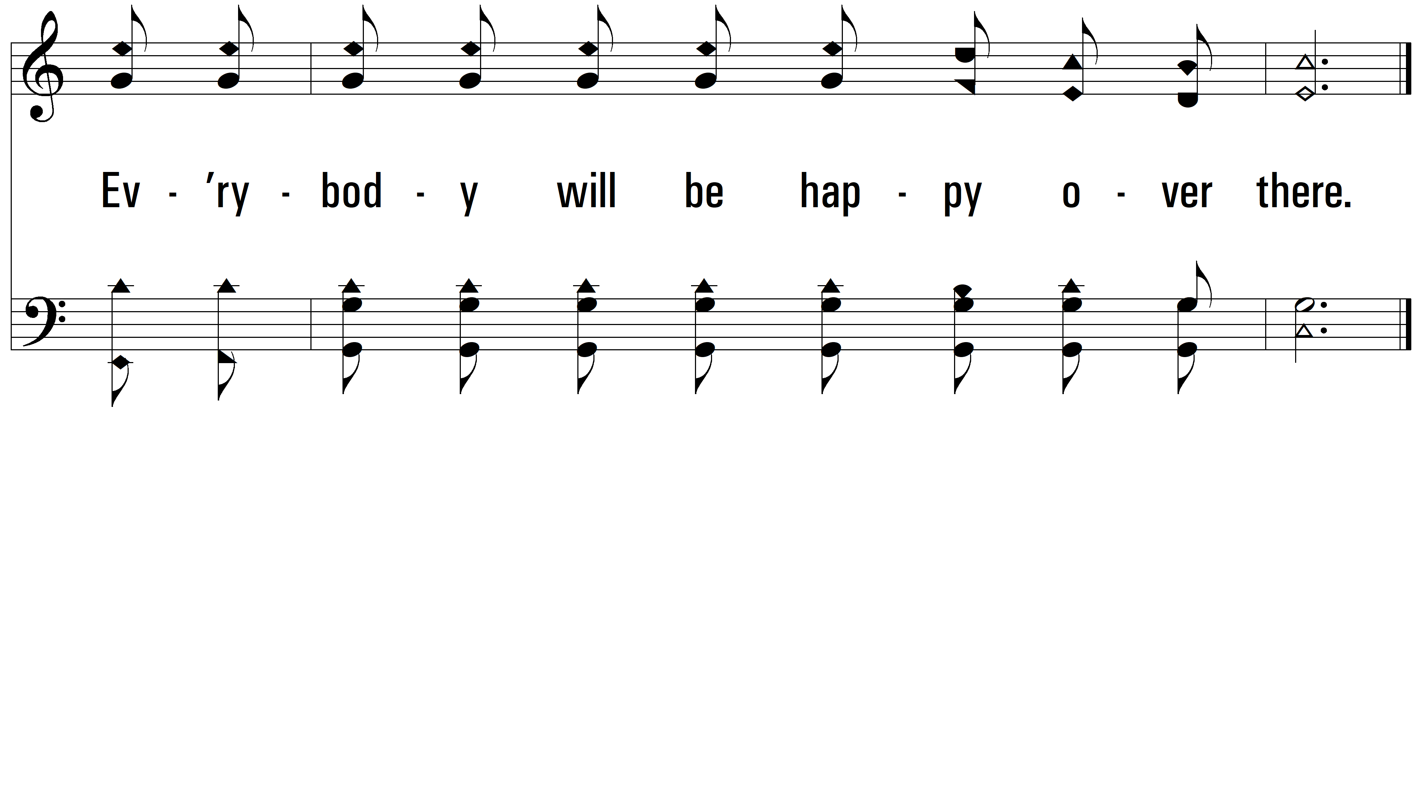
vs. 1

Slide 8
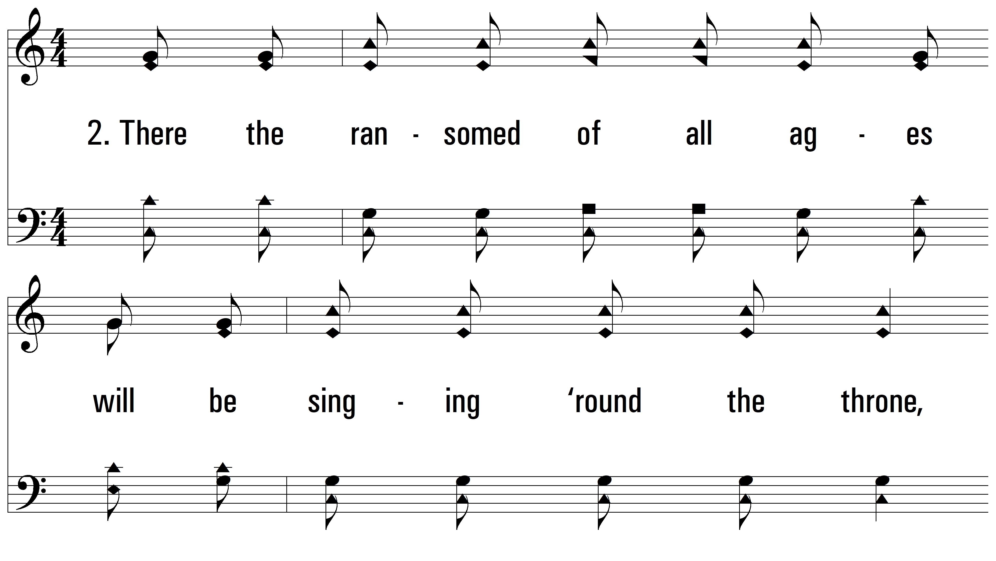
vs. 2 ~ Everybody Will Be Happy Over There

Slide 9
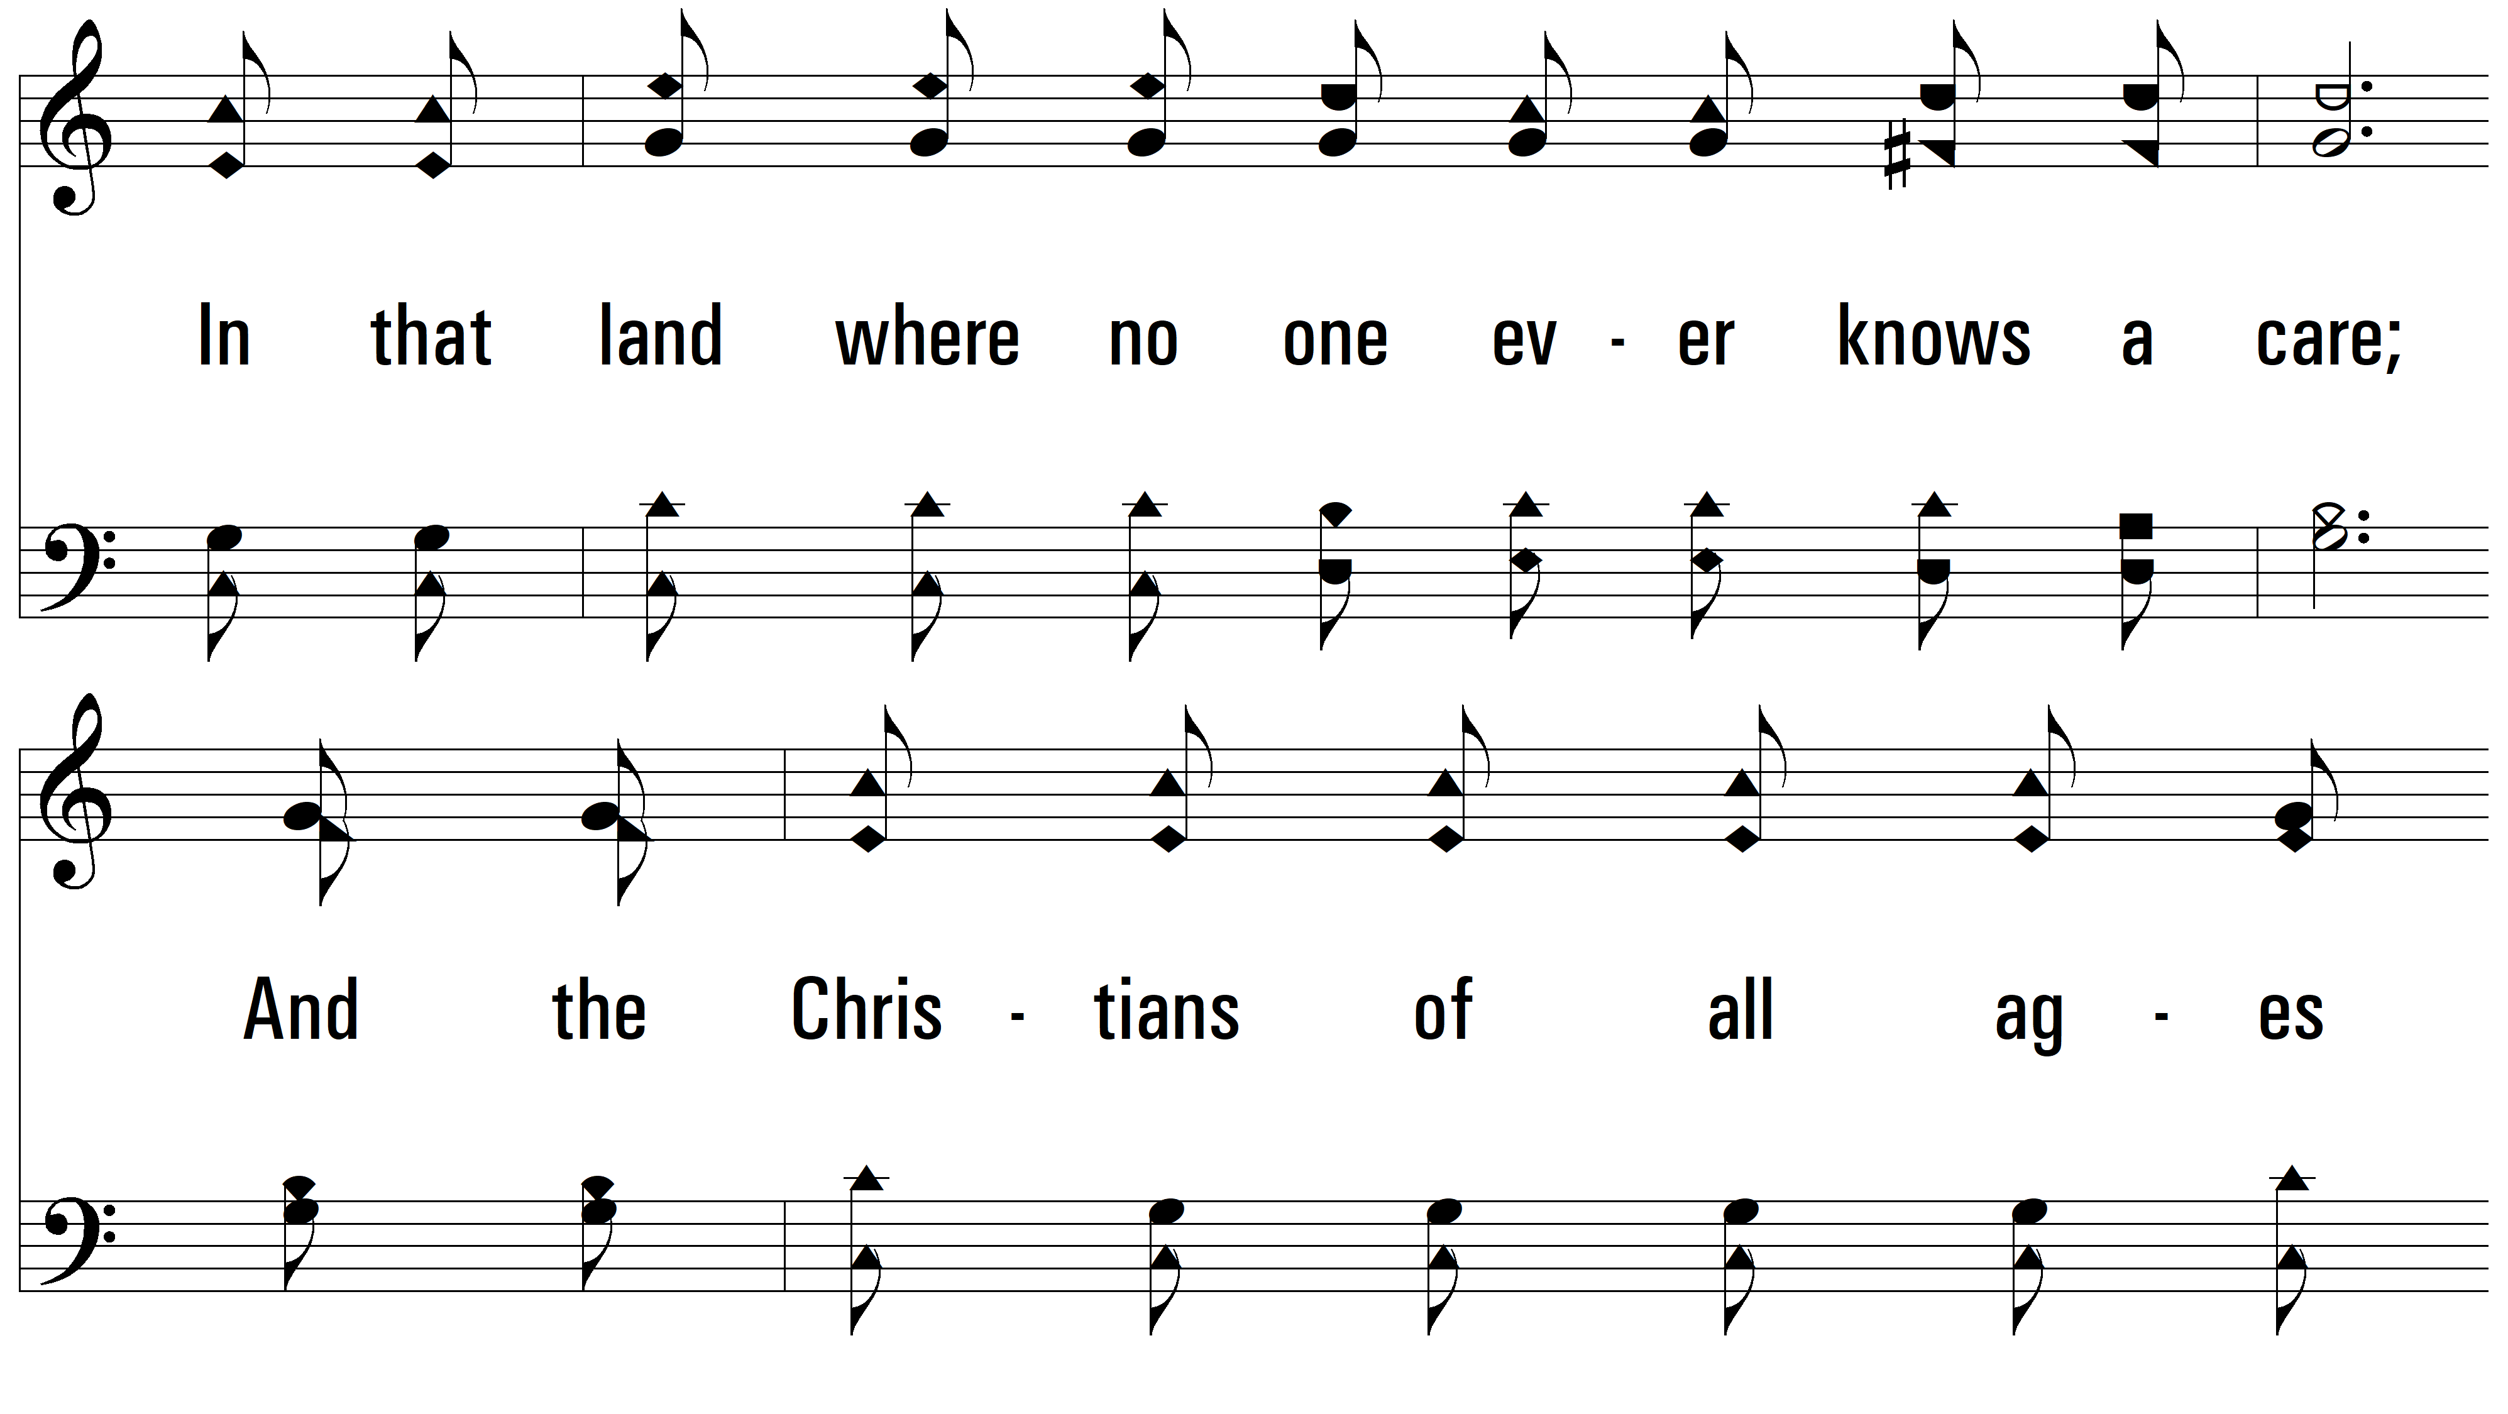
vs. 2

Slide 10
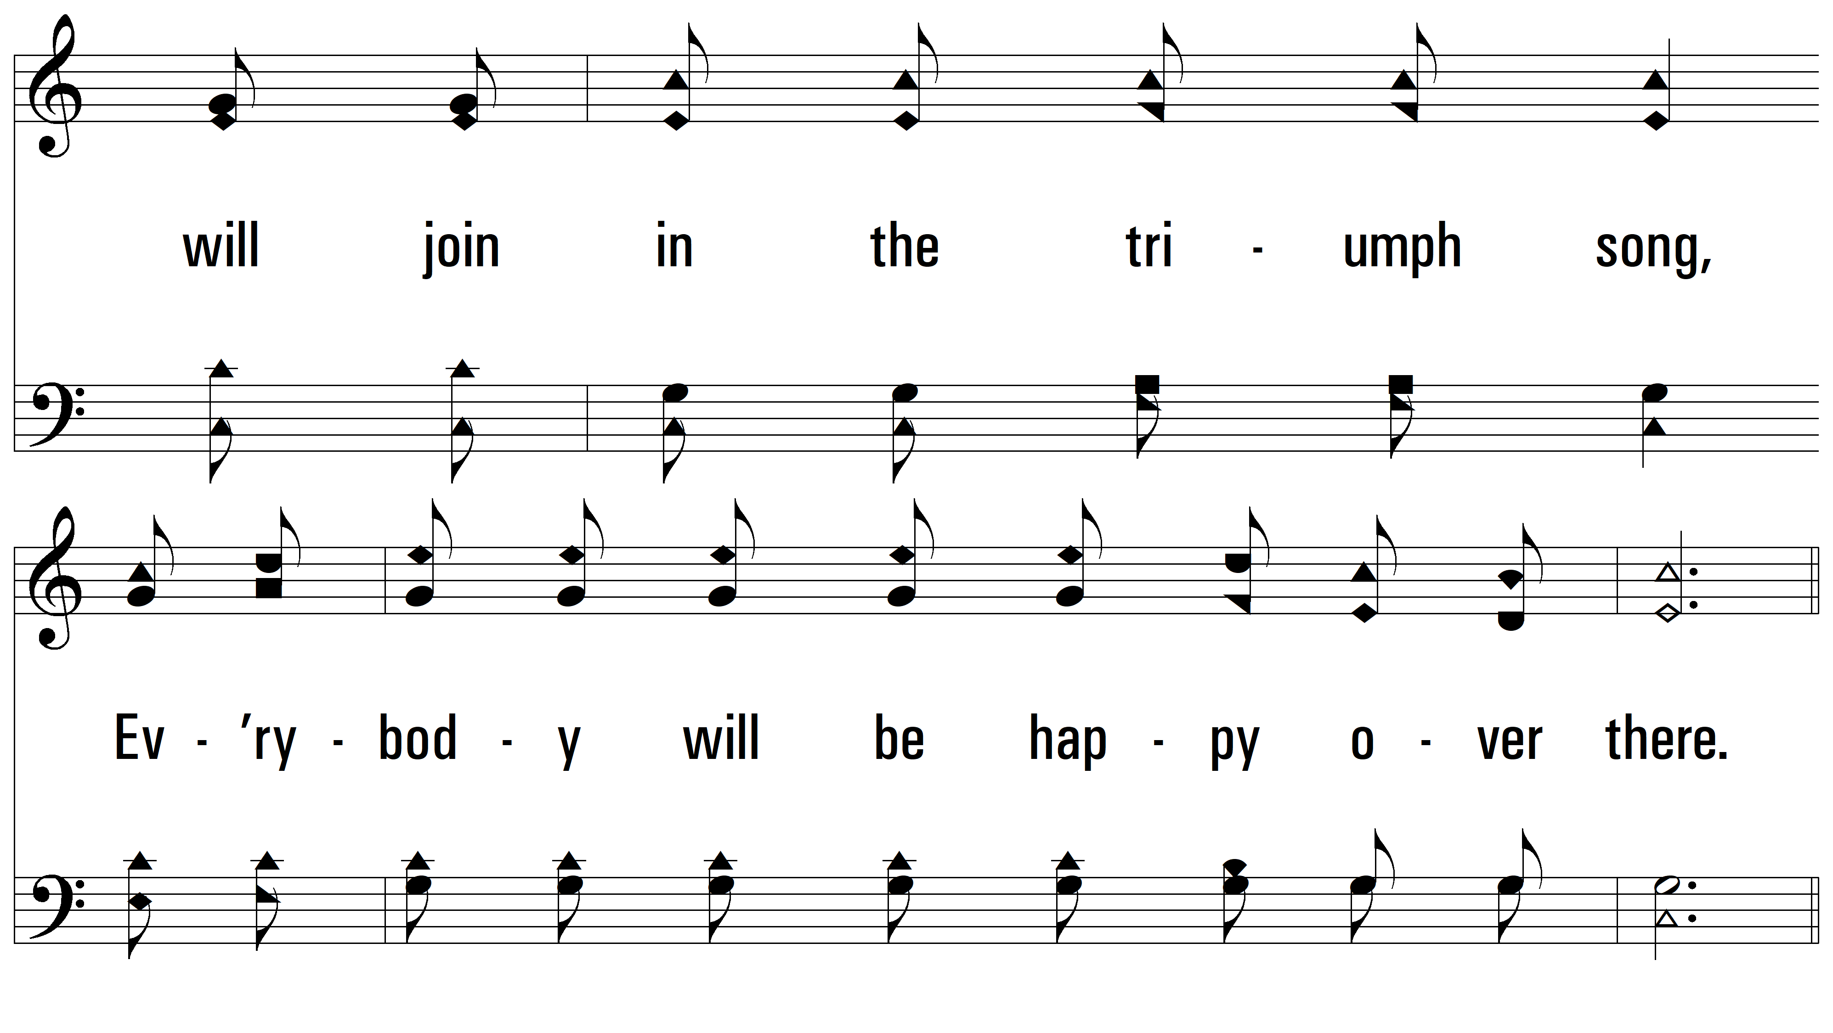
vs. 2

Slide 11
vs. 2

Slide 12
vs. 2

Slide 13
vs. 2

Slide 14
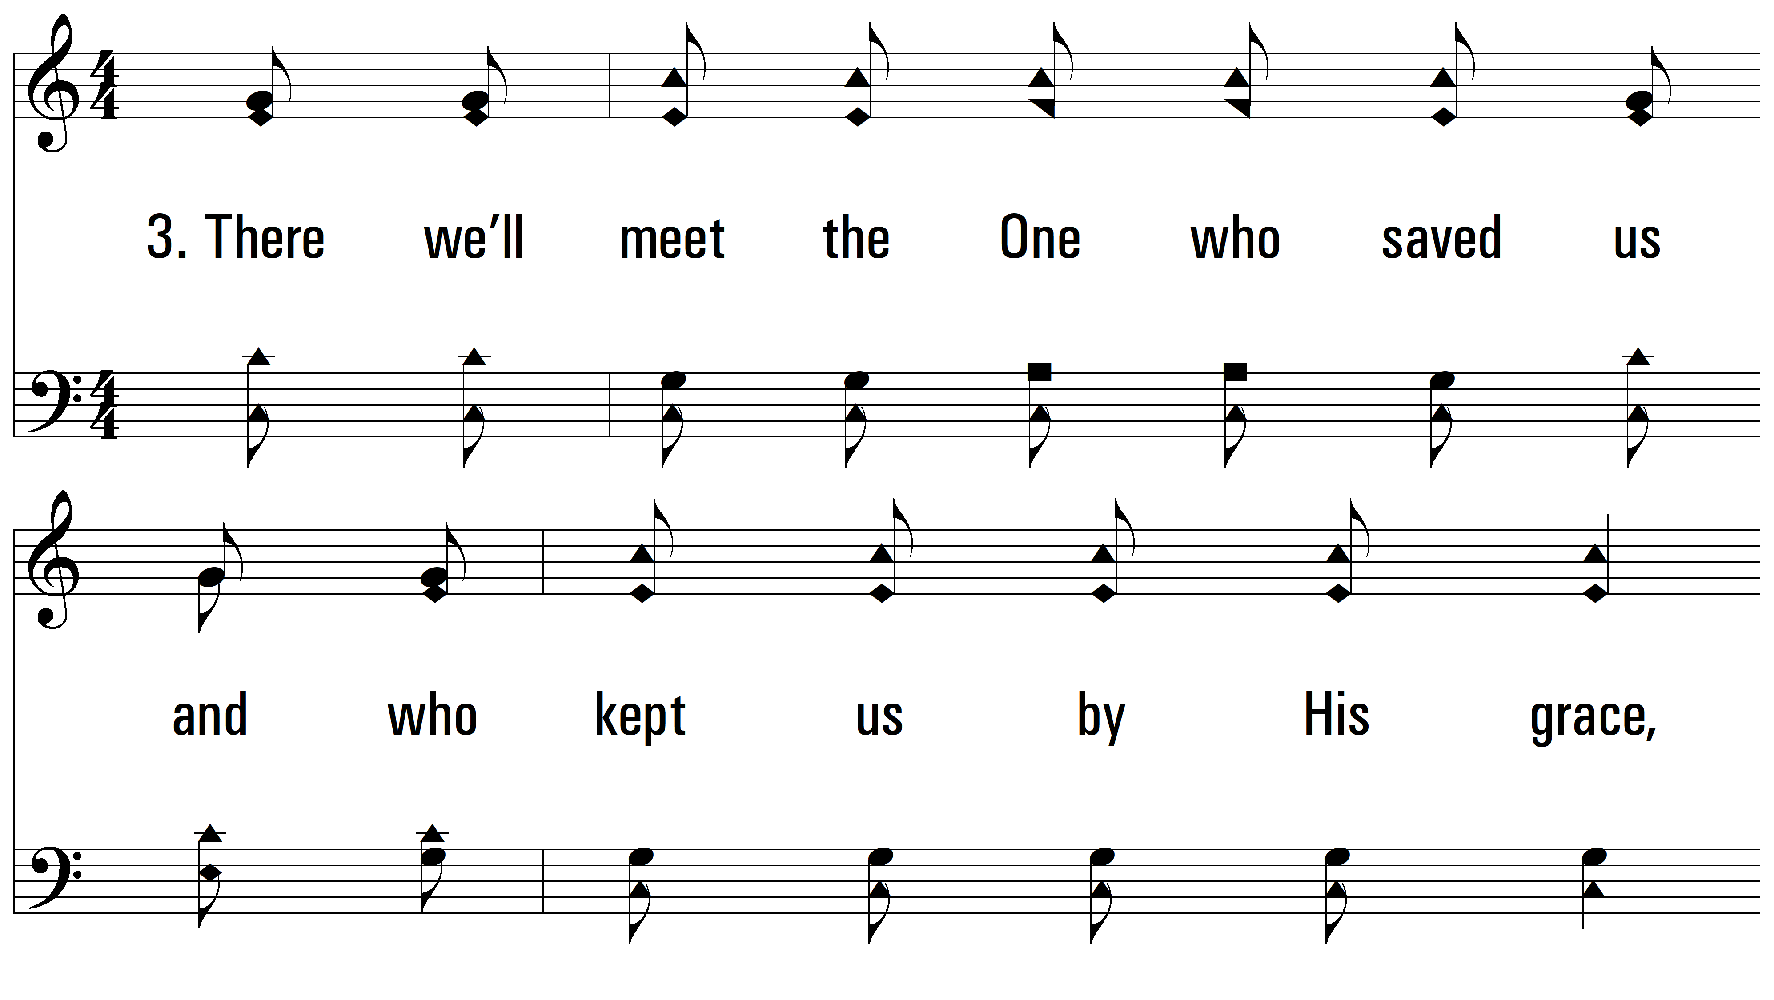
vs. 3 ~ Everybody Will Be Happy Over There

Slide 15
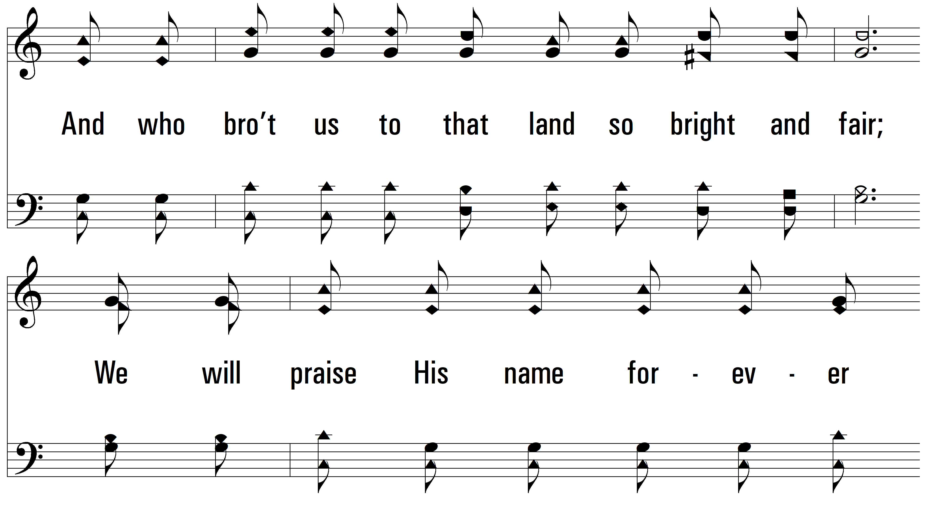
vs. 3

Slide 16
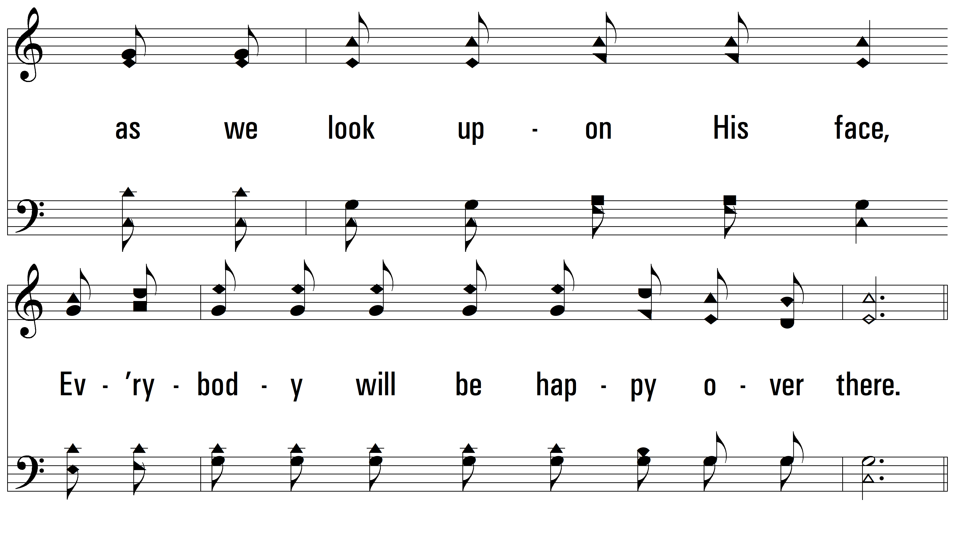
vs. 3

Slide 17
vs. 3

Slide 18
vs. 3

Slide 19
vs. 3
PDHymns.com
END

