Slide 1
Eternal Father, Strong To Save
MELITA
8.8.8.8.8.8
Words: | William Whiting (1860)
Music: | John B. Dykes (1861)
4/4
C/C - DO
Verses: 3
Lead - | DO
Alto - | DO
Tenor - | MI
Bass - | DO
PDHymns.com

Slide 2
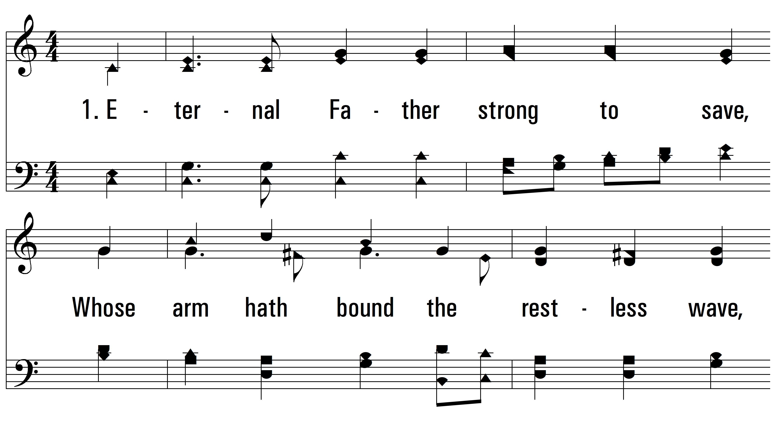
vs. 1 ~ Eternal Father, Strong To Save

Slide 3
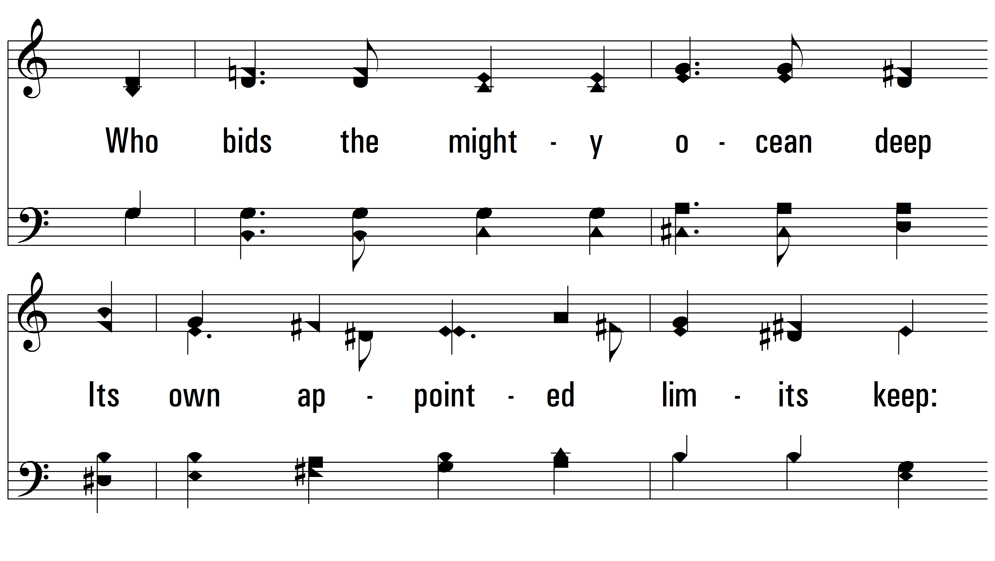
vs. 1

Slide 4
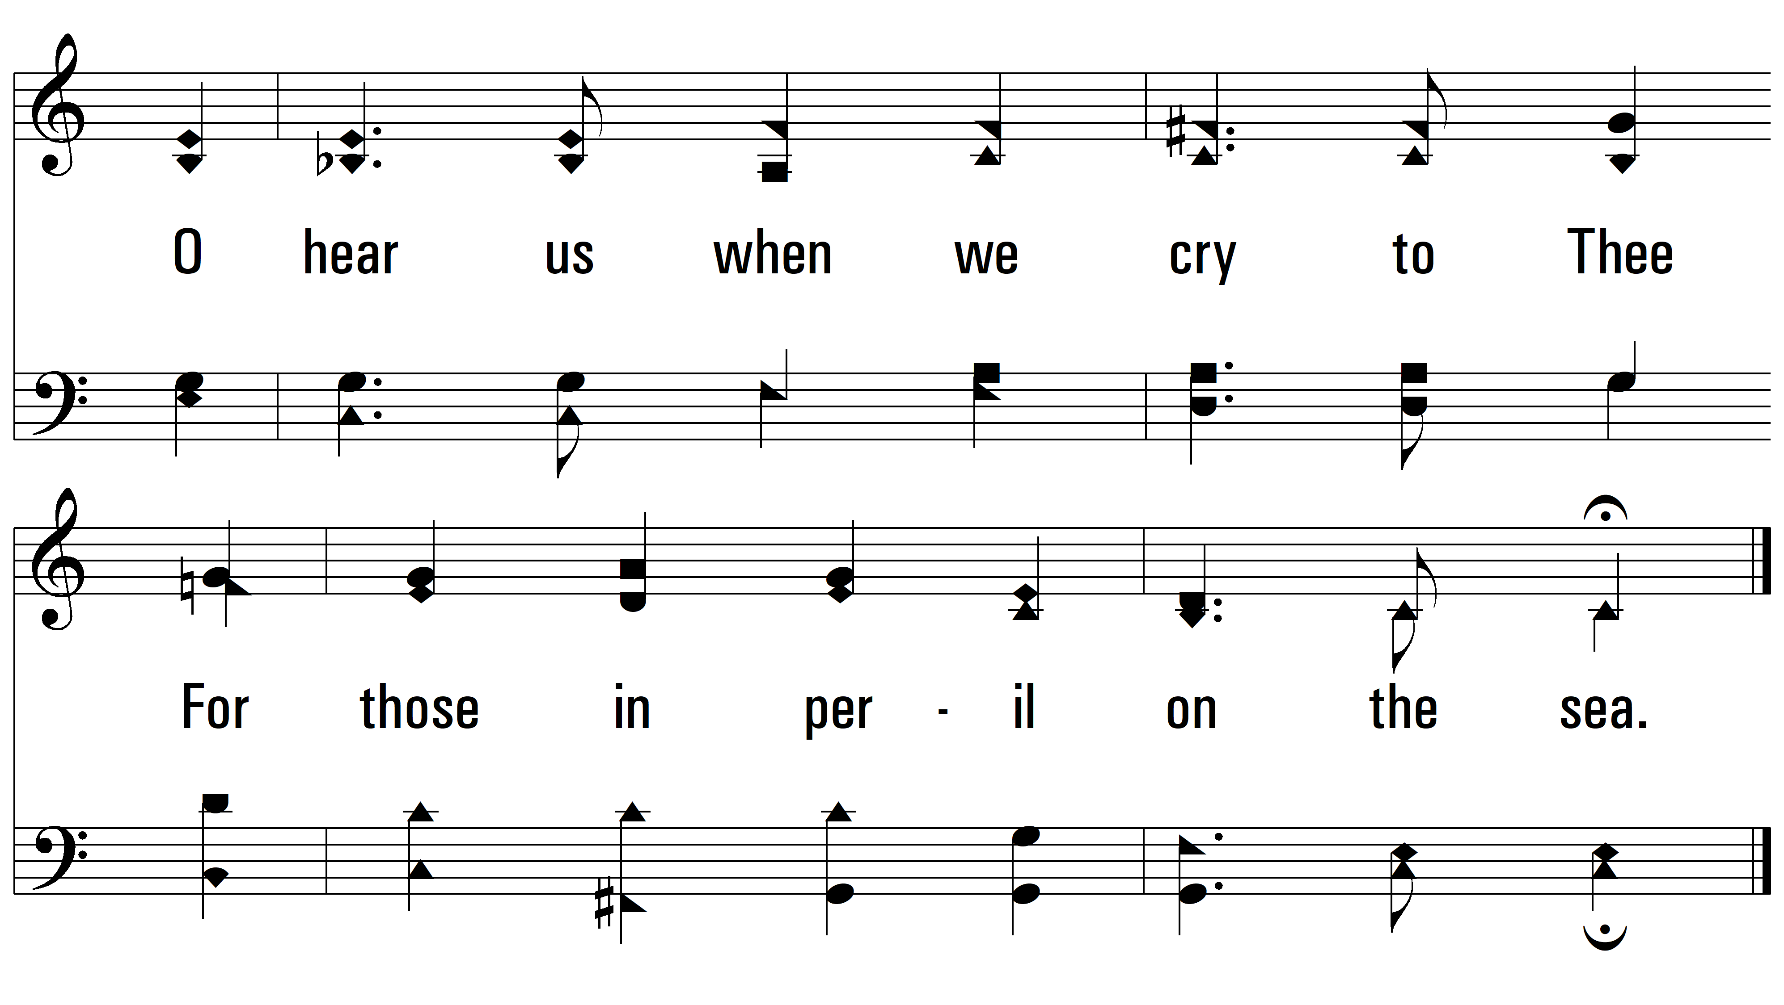
vs. 1

Slide 5
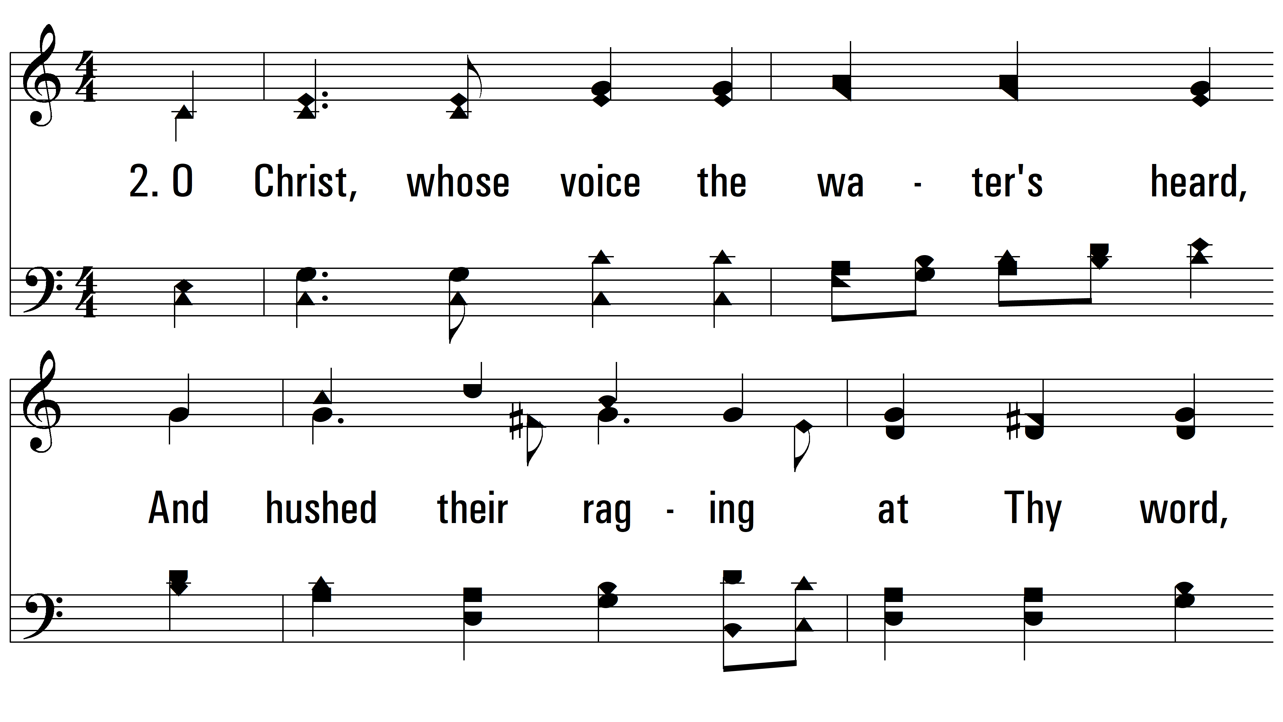
vs. 2 ~ Eternal Father, Strong To Save

Slide 6
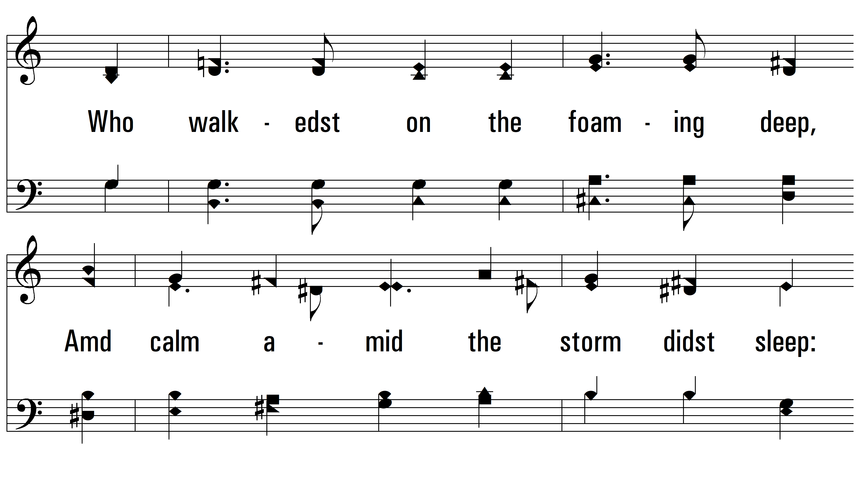
vs. 2

Slide 7
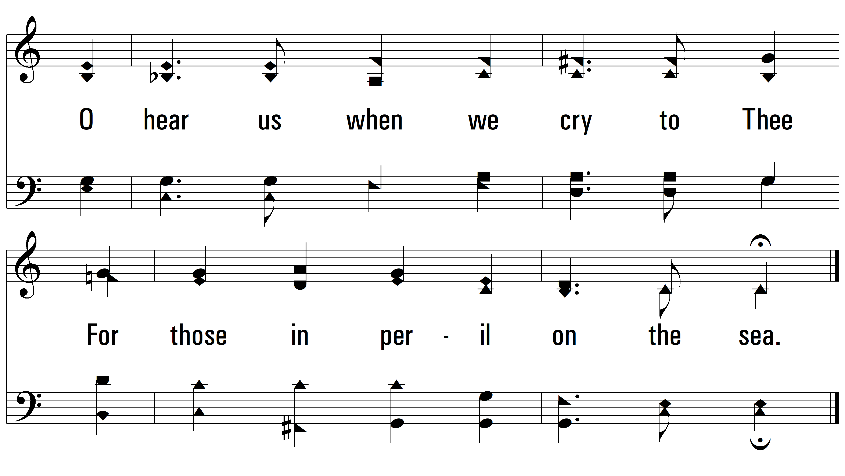
vs. 2

Slide 8
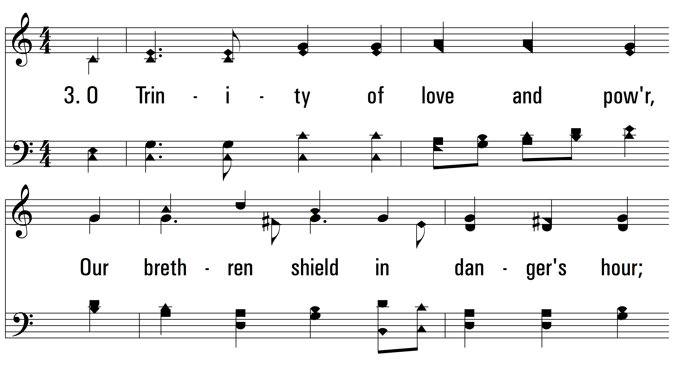
vs. 3 ~ Eternal Father, Strong To Save

Slide 9
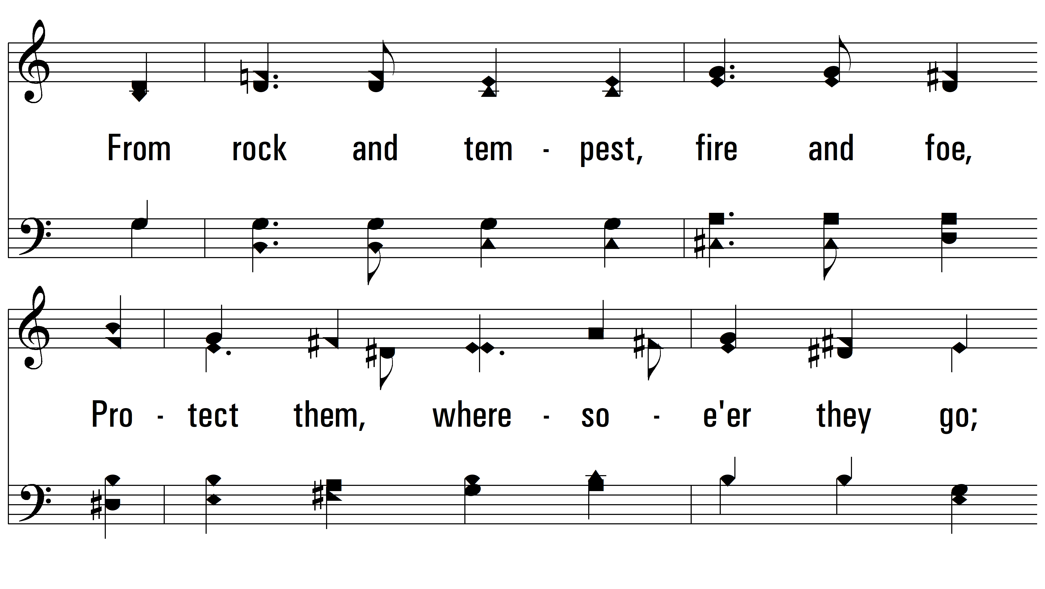
vs. 3

Slide 10
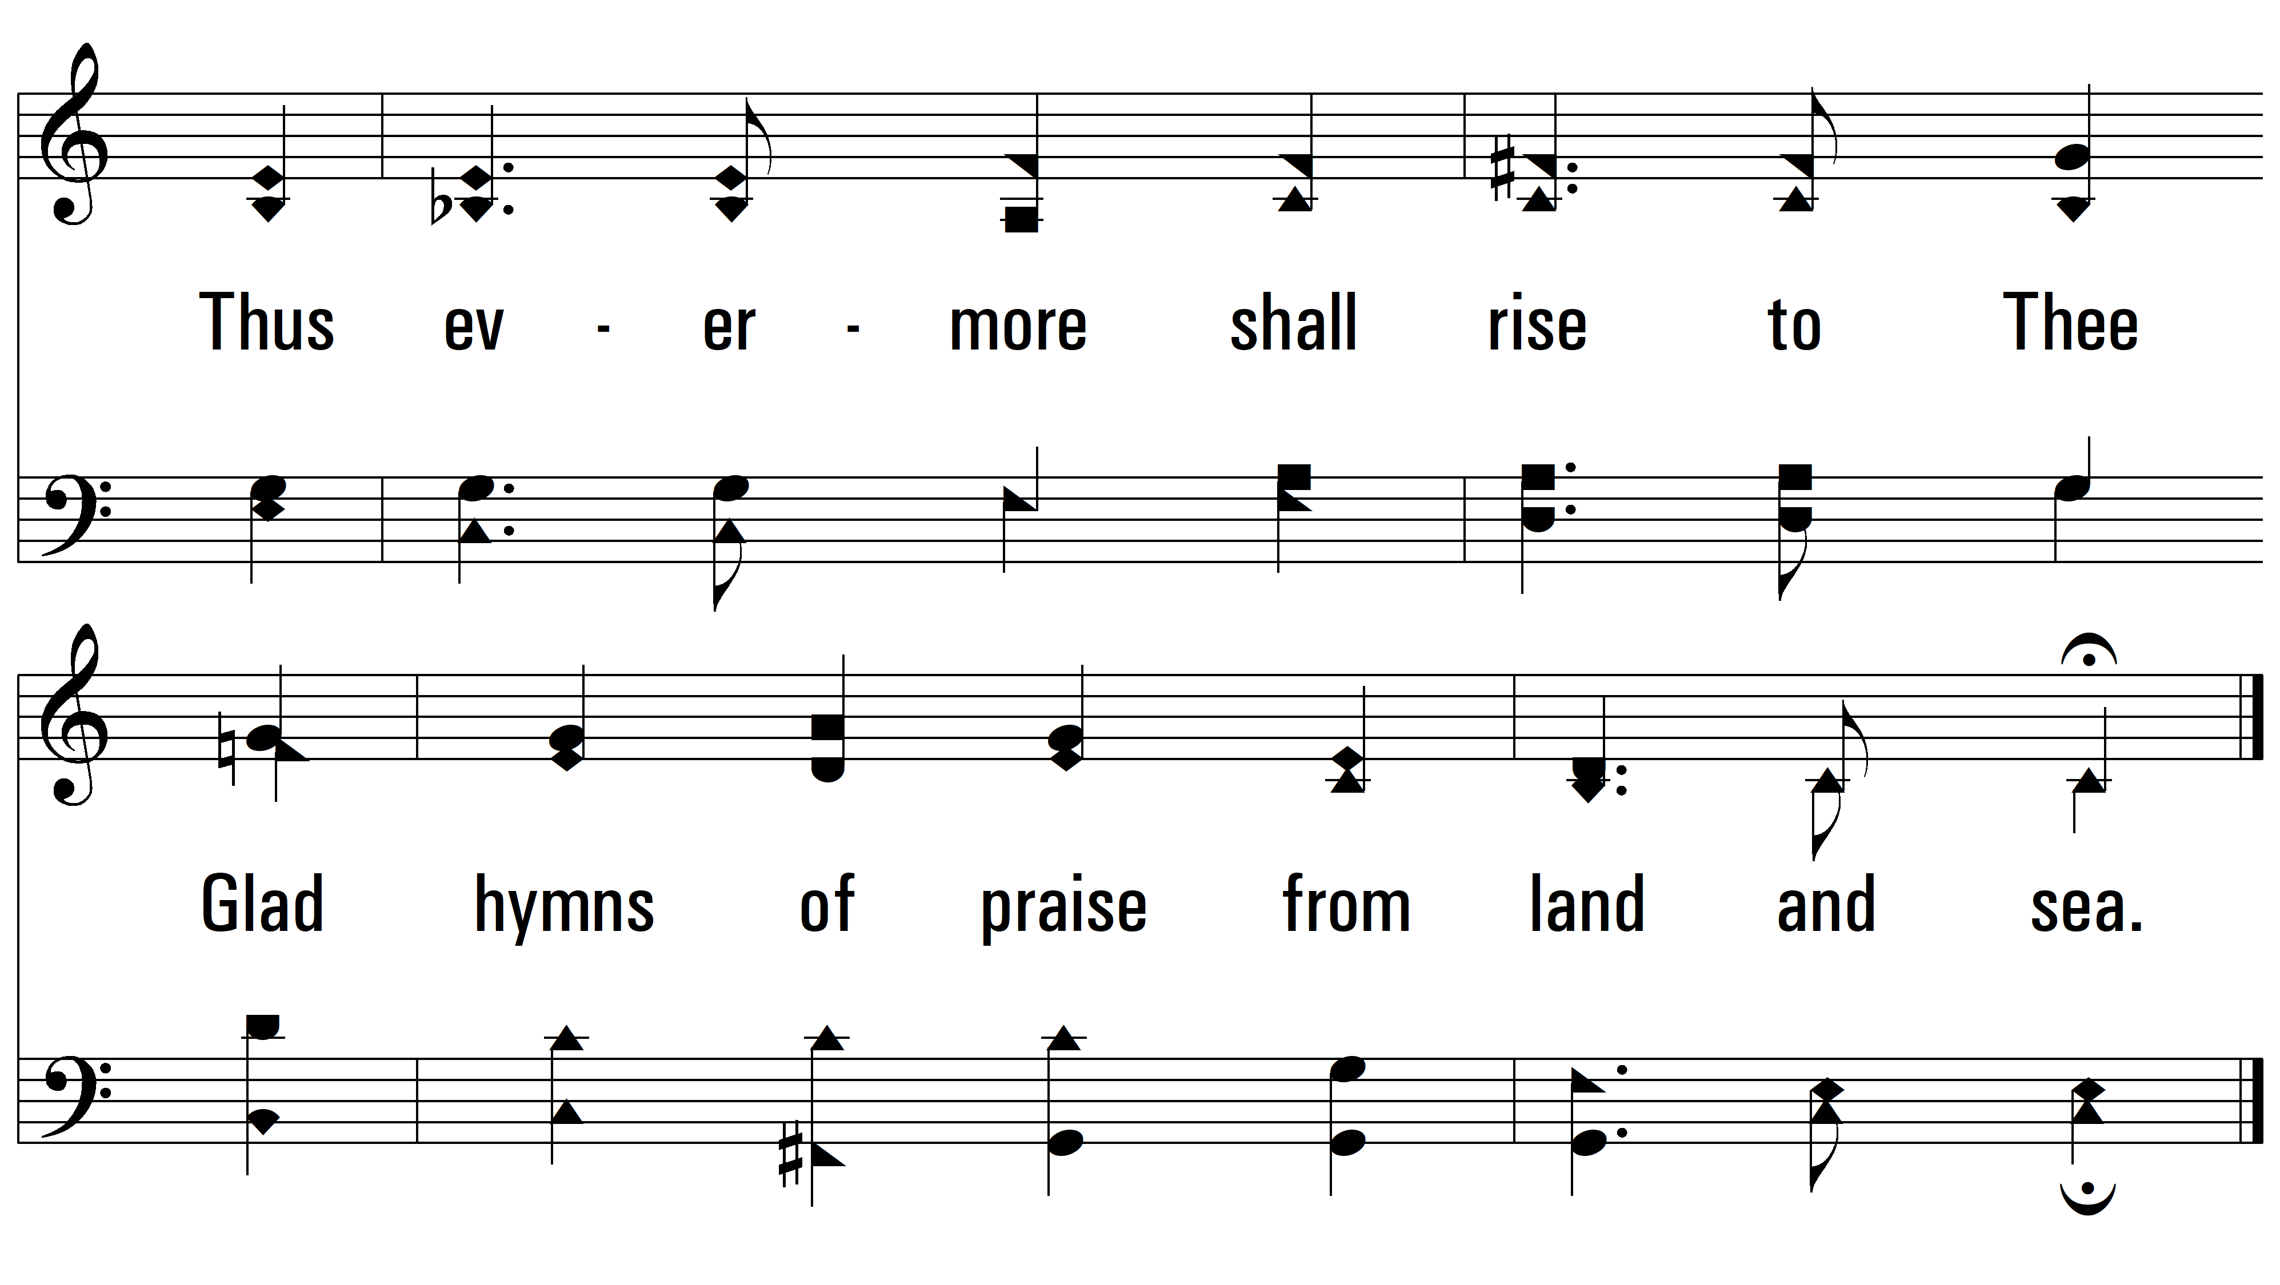
vs. 3
PDHymns.com
END

