Slide 1
Doxology
OLD HUNDRETH
8.8.8.8
Words: | Thomas Ken (1673 & 1709)
Music: | Bourgeois’s Genevan Psalter (1551)
4/4
A/A - DO
Verses: 1
Lead - | DO
Alto - | SOL
Tenor - | MI
Bass - | DO
PDHymns.com

Slide 2
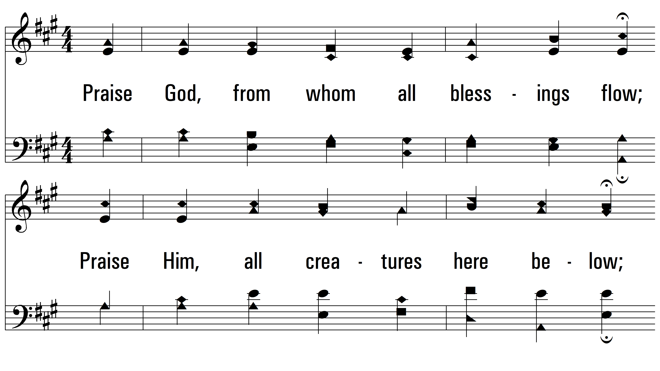
vs. 1 ~ Doxology

Slide 3
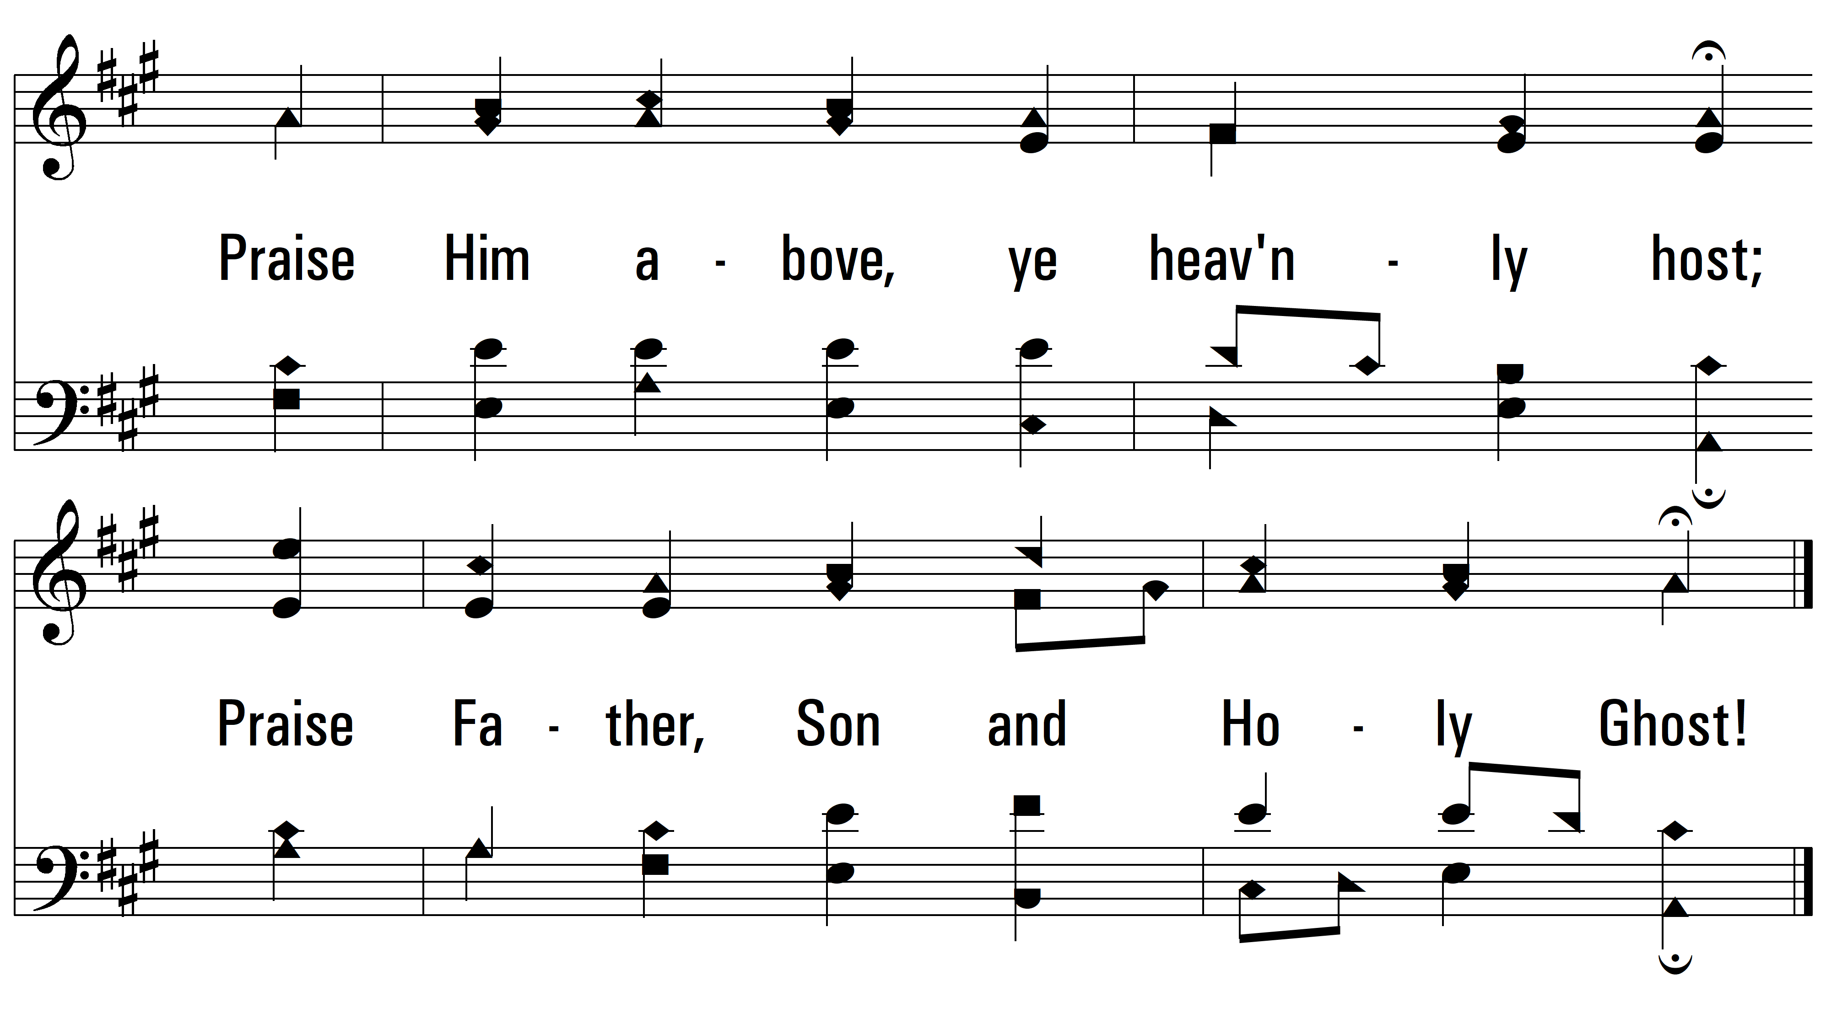
vs. 1
PDHymns.com
END

