Slide 1
Down In My Heart
Words: | Traditional
Music: | Traditional
4/4
C/G - SOL
Verses: 3
Lead - | SOL
Alto - | MI
Tenor - | DO
Bass - | DO
PDHymns.com

Slide 2
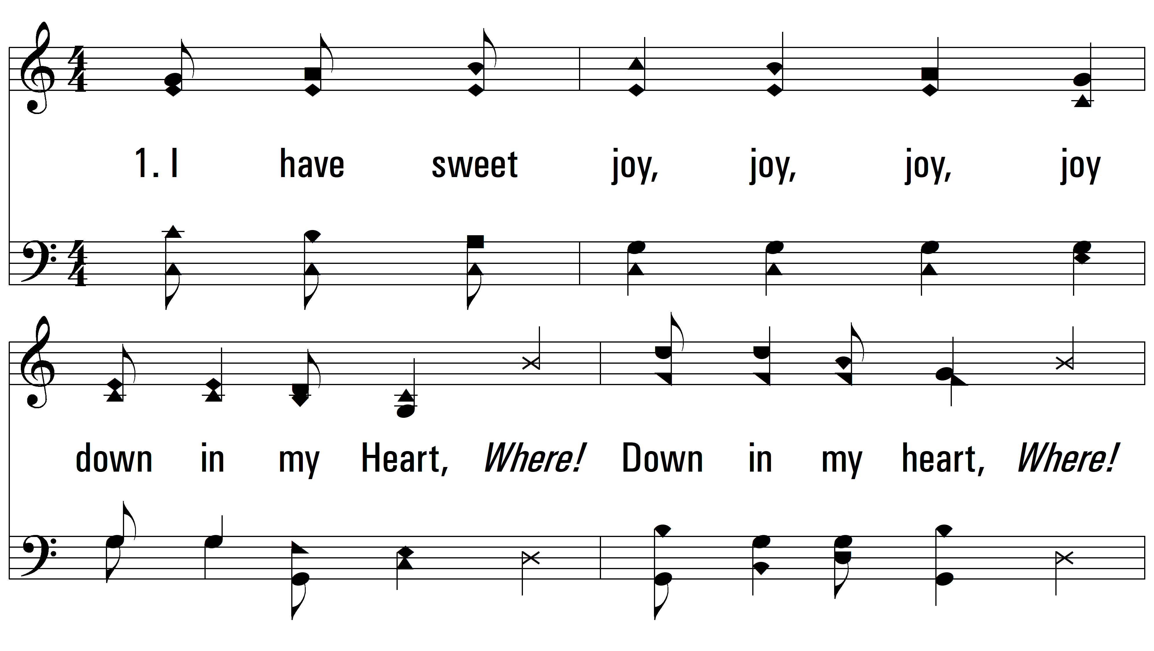
vs. 1 ~ Down In My Heart

Slide 3
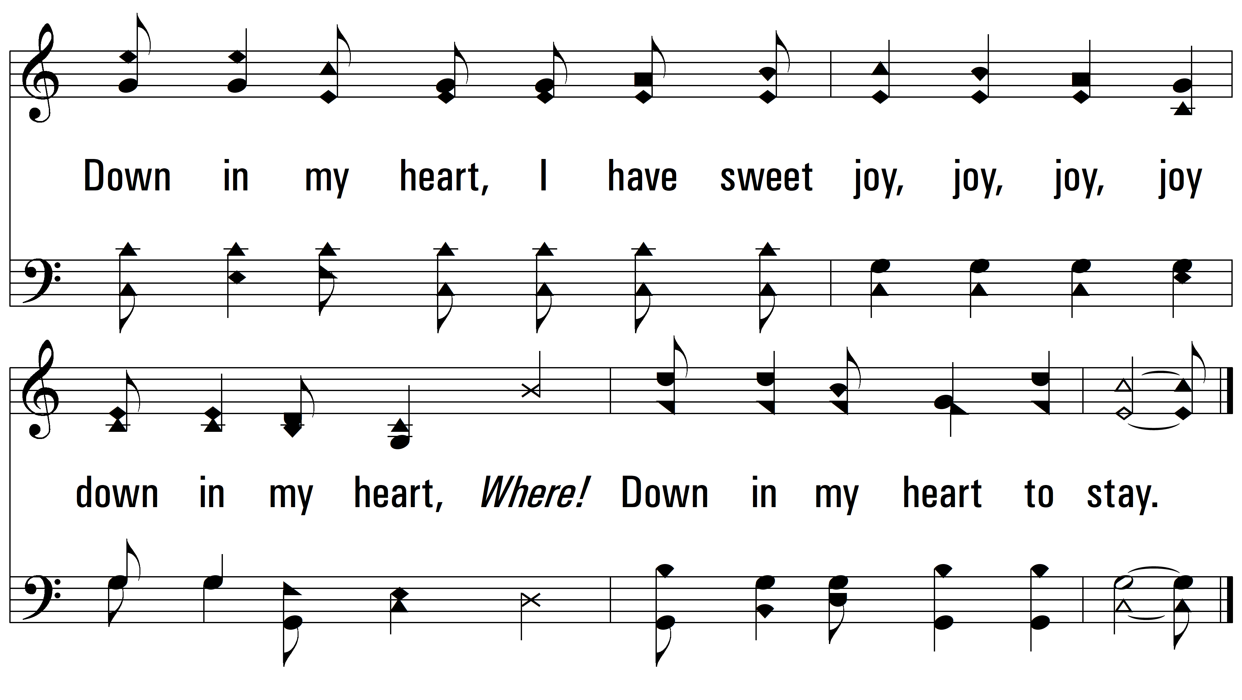
vs. 1

Slide 4
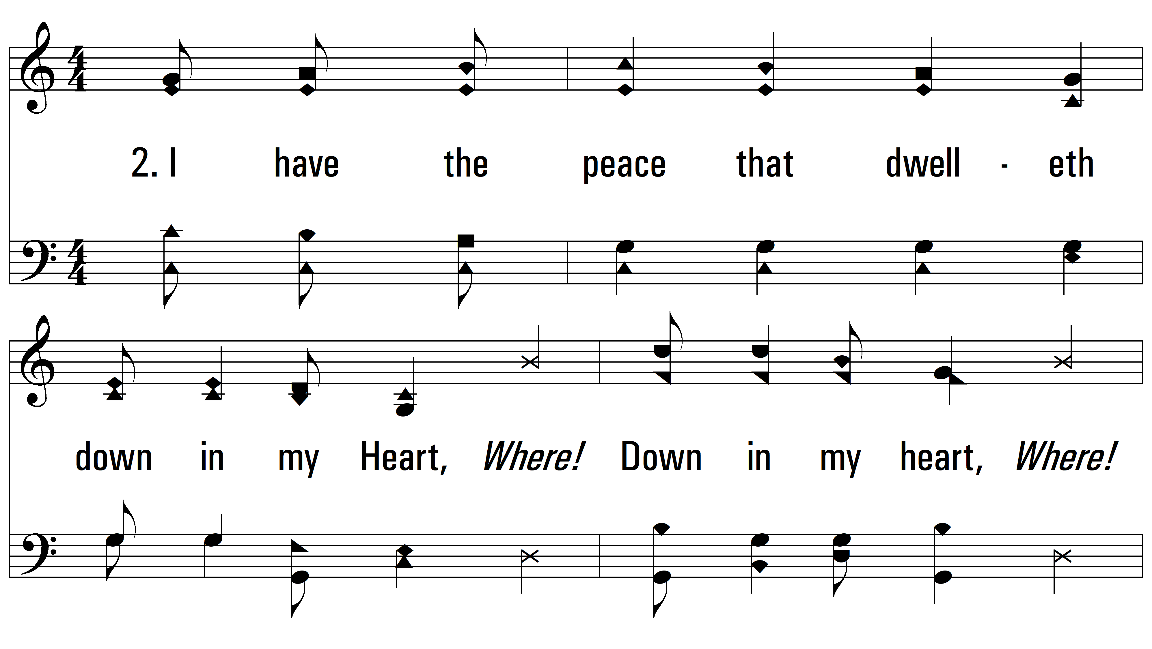
vs. 2 ~ Down In My Heart

Slide 5
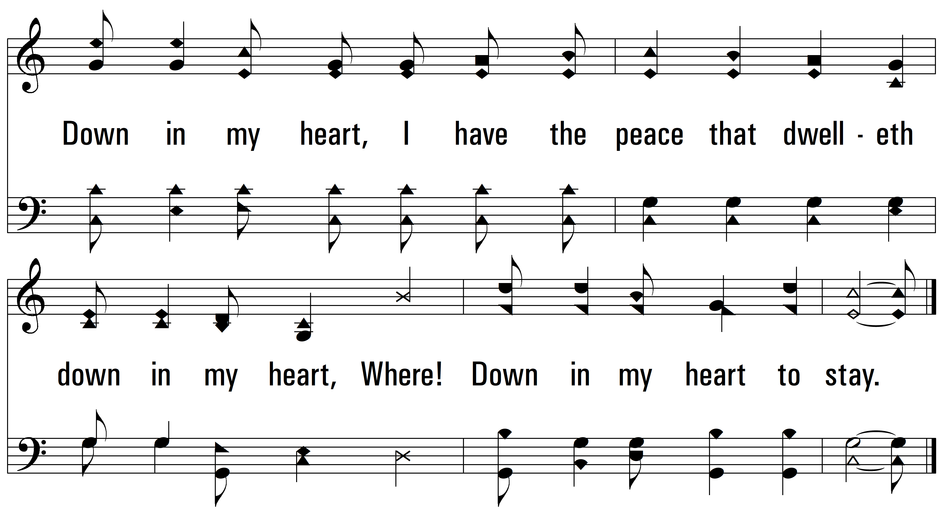
vs. 2

Slide 6
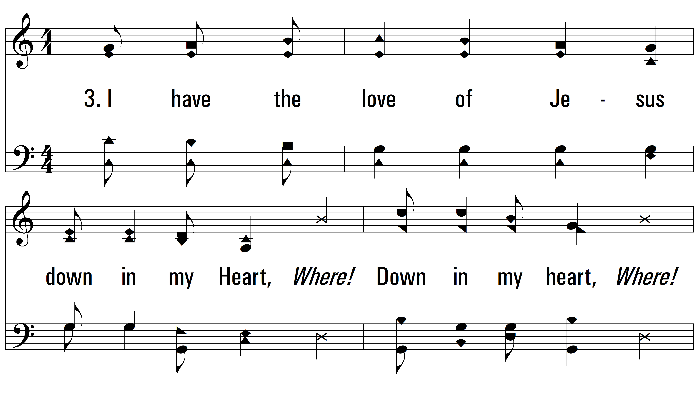
vs. 3 ~ Down In My Heart

Slide 7
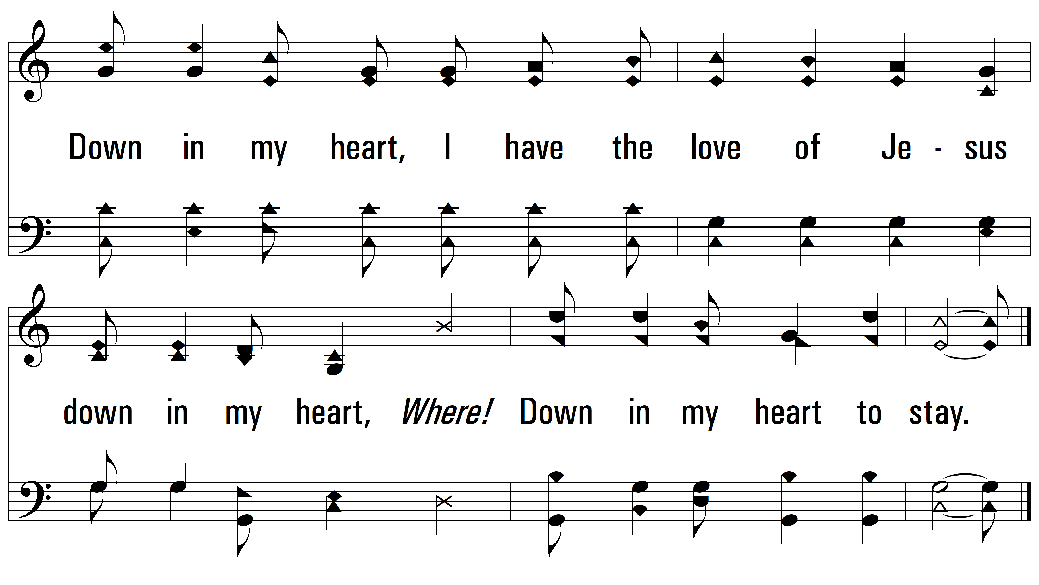
vs. 3
PDHymns.com
END

