Slide 1
Did You Think To Pray?
Words: | Mrs. M. A. Kidder (1875)
Music: | W. O. Perkins (1875)
4/4
F/A - MI
Verses: 3/Chorus
Lead - | MI
Alto - | DO
Tenor - | SOL
Bass - | DO
PDHymns.com

Slide 2
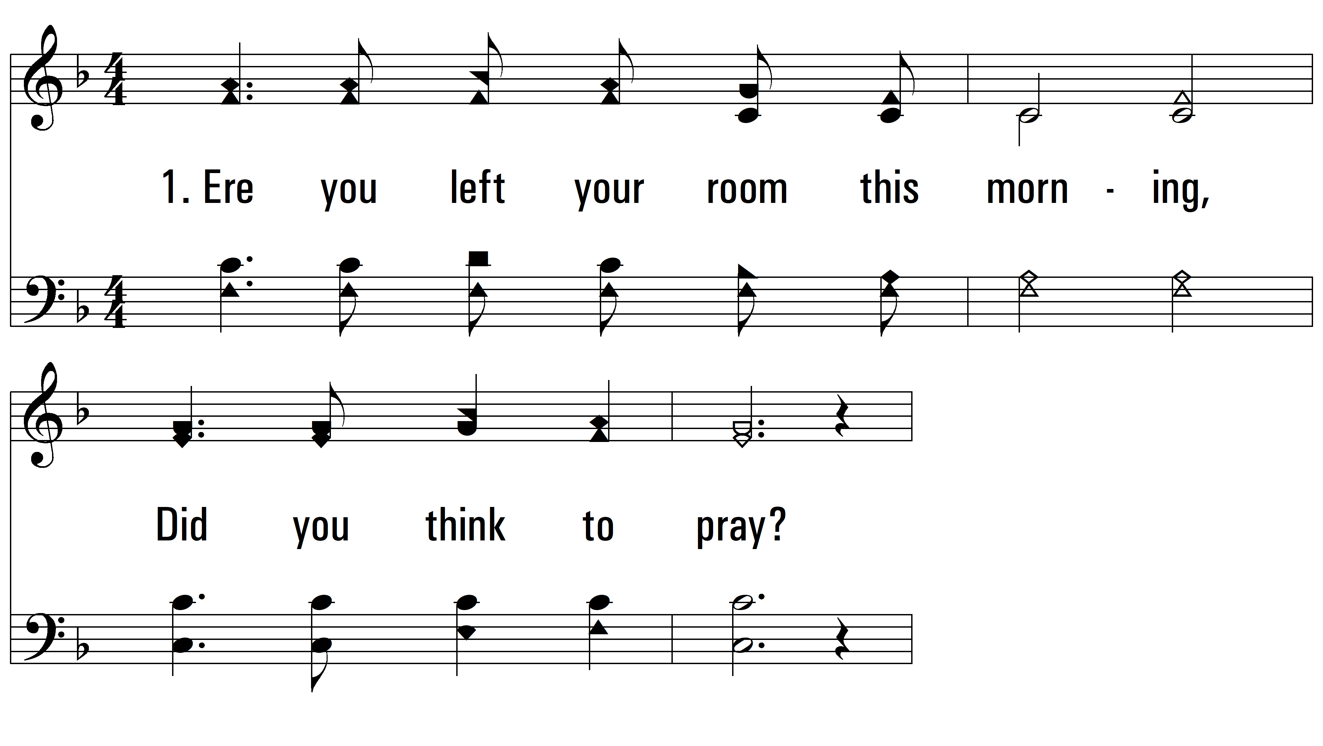
vs. 1 ~ Did You Think To Pray?

Slide 3
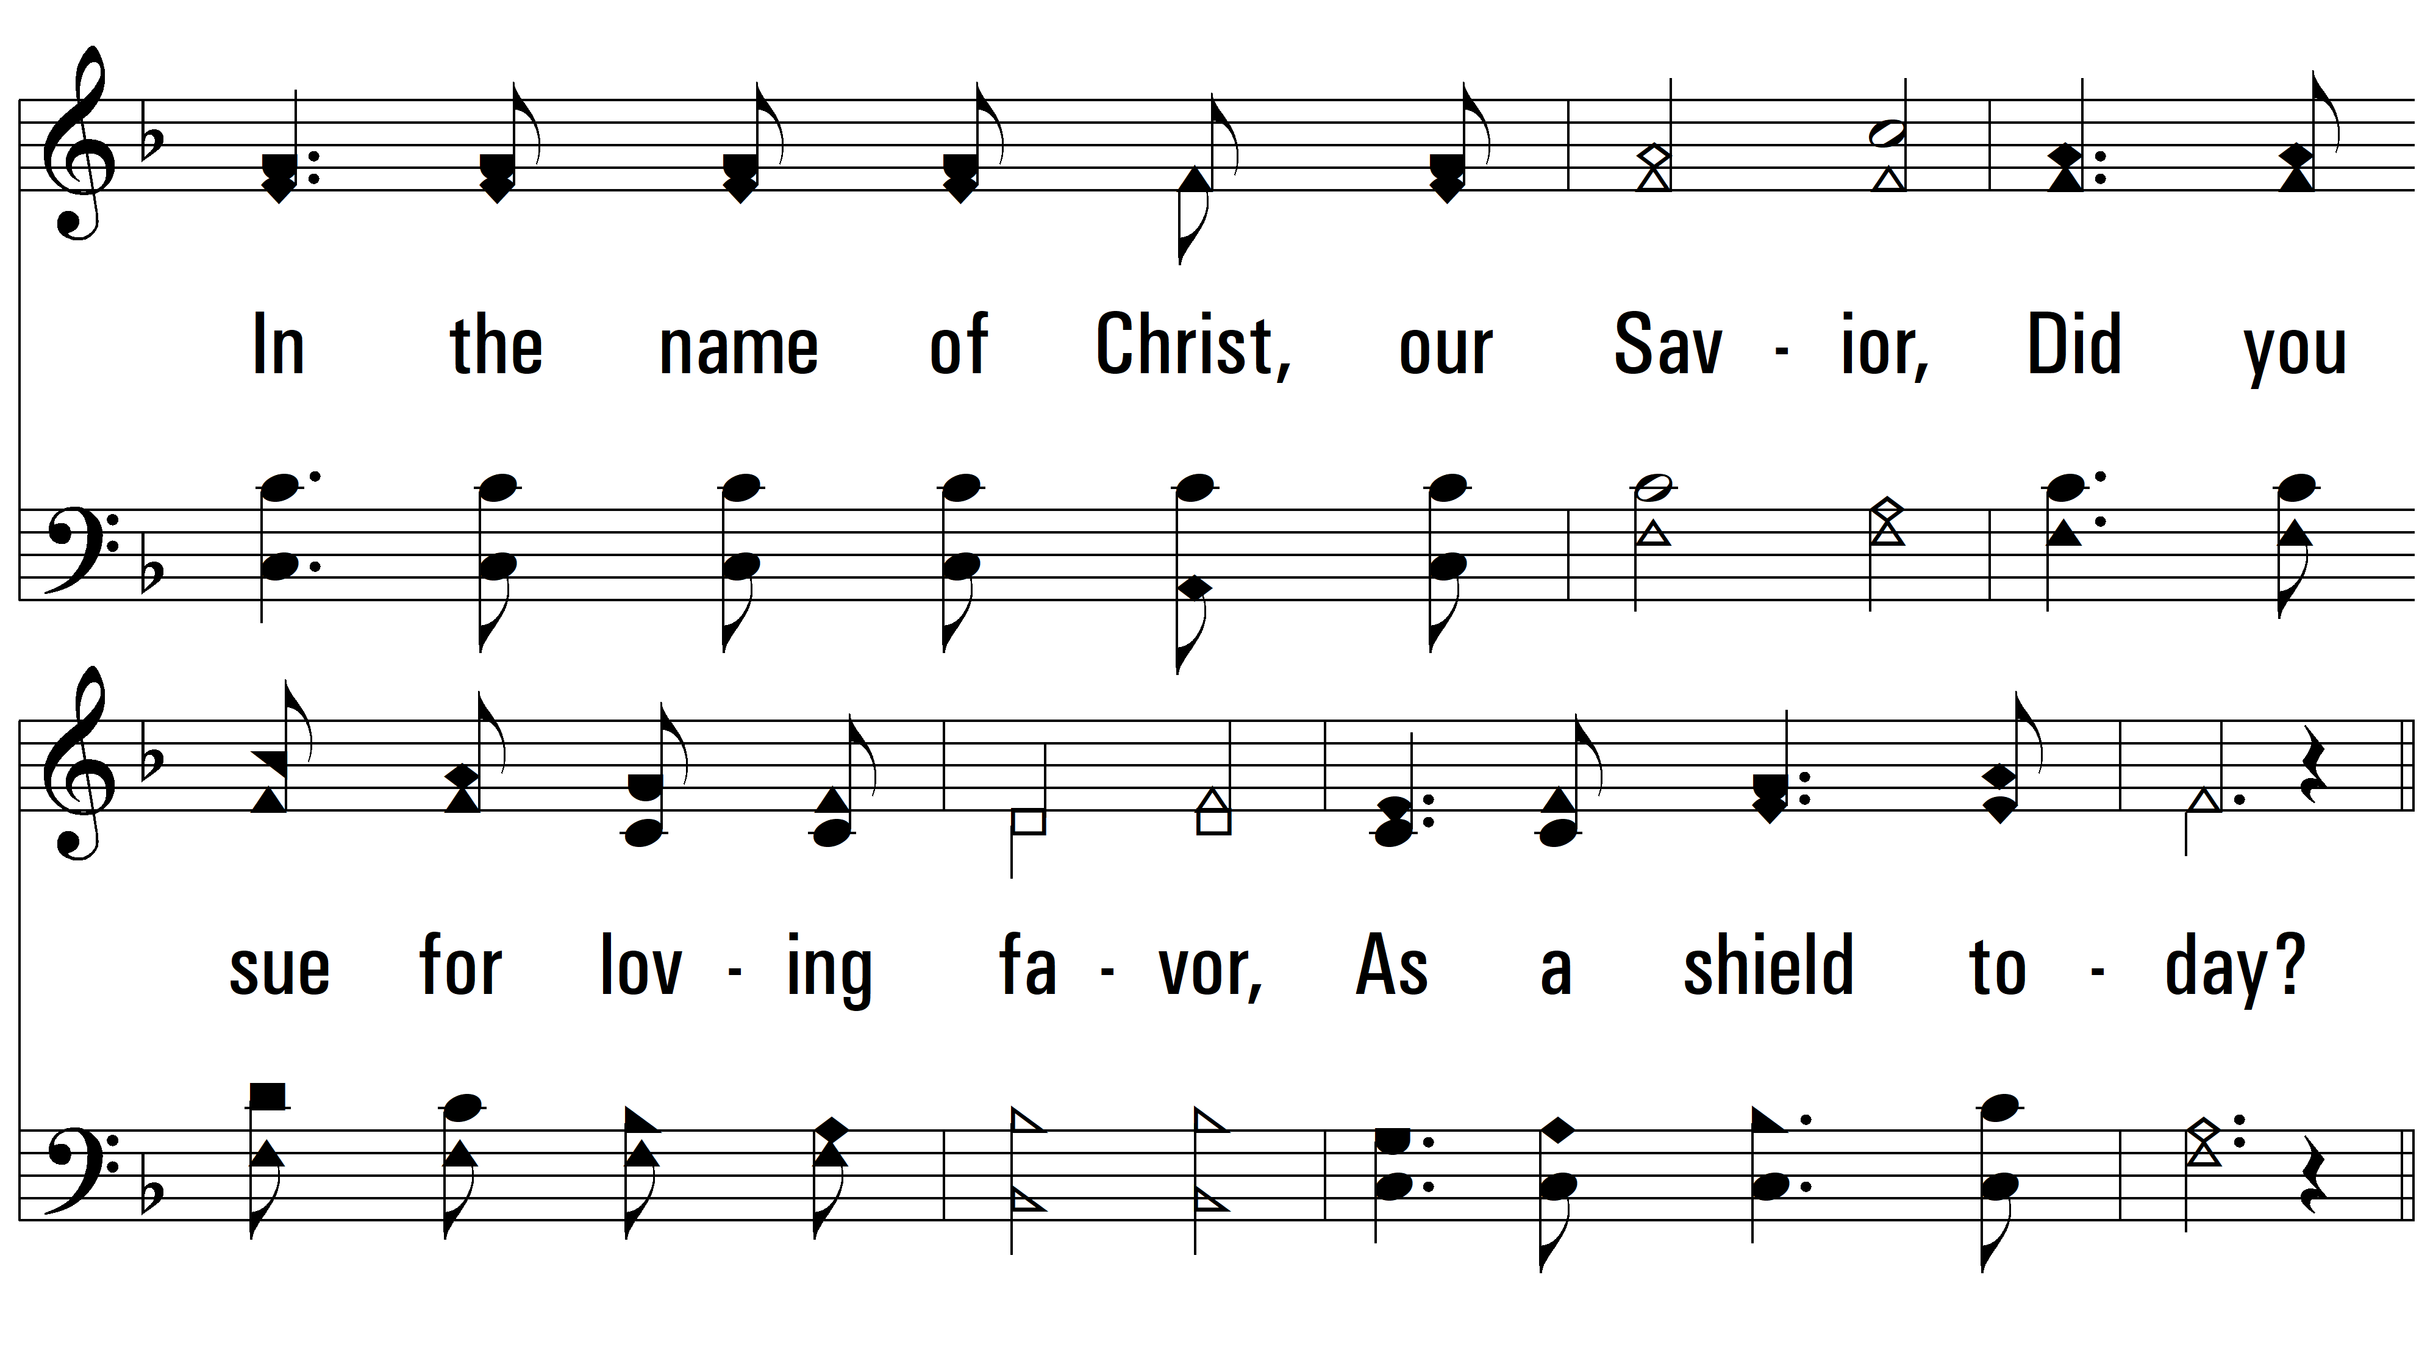
vs. 1

Slide 4
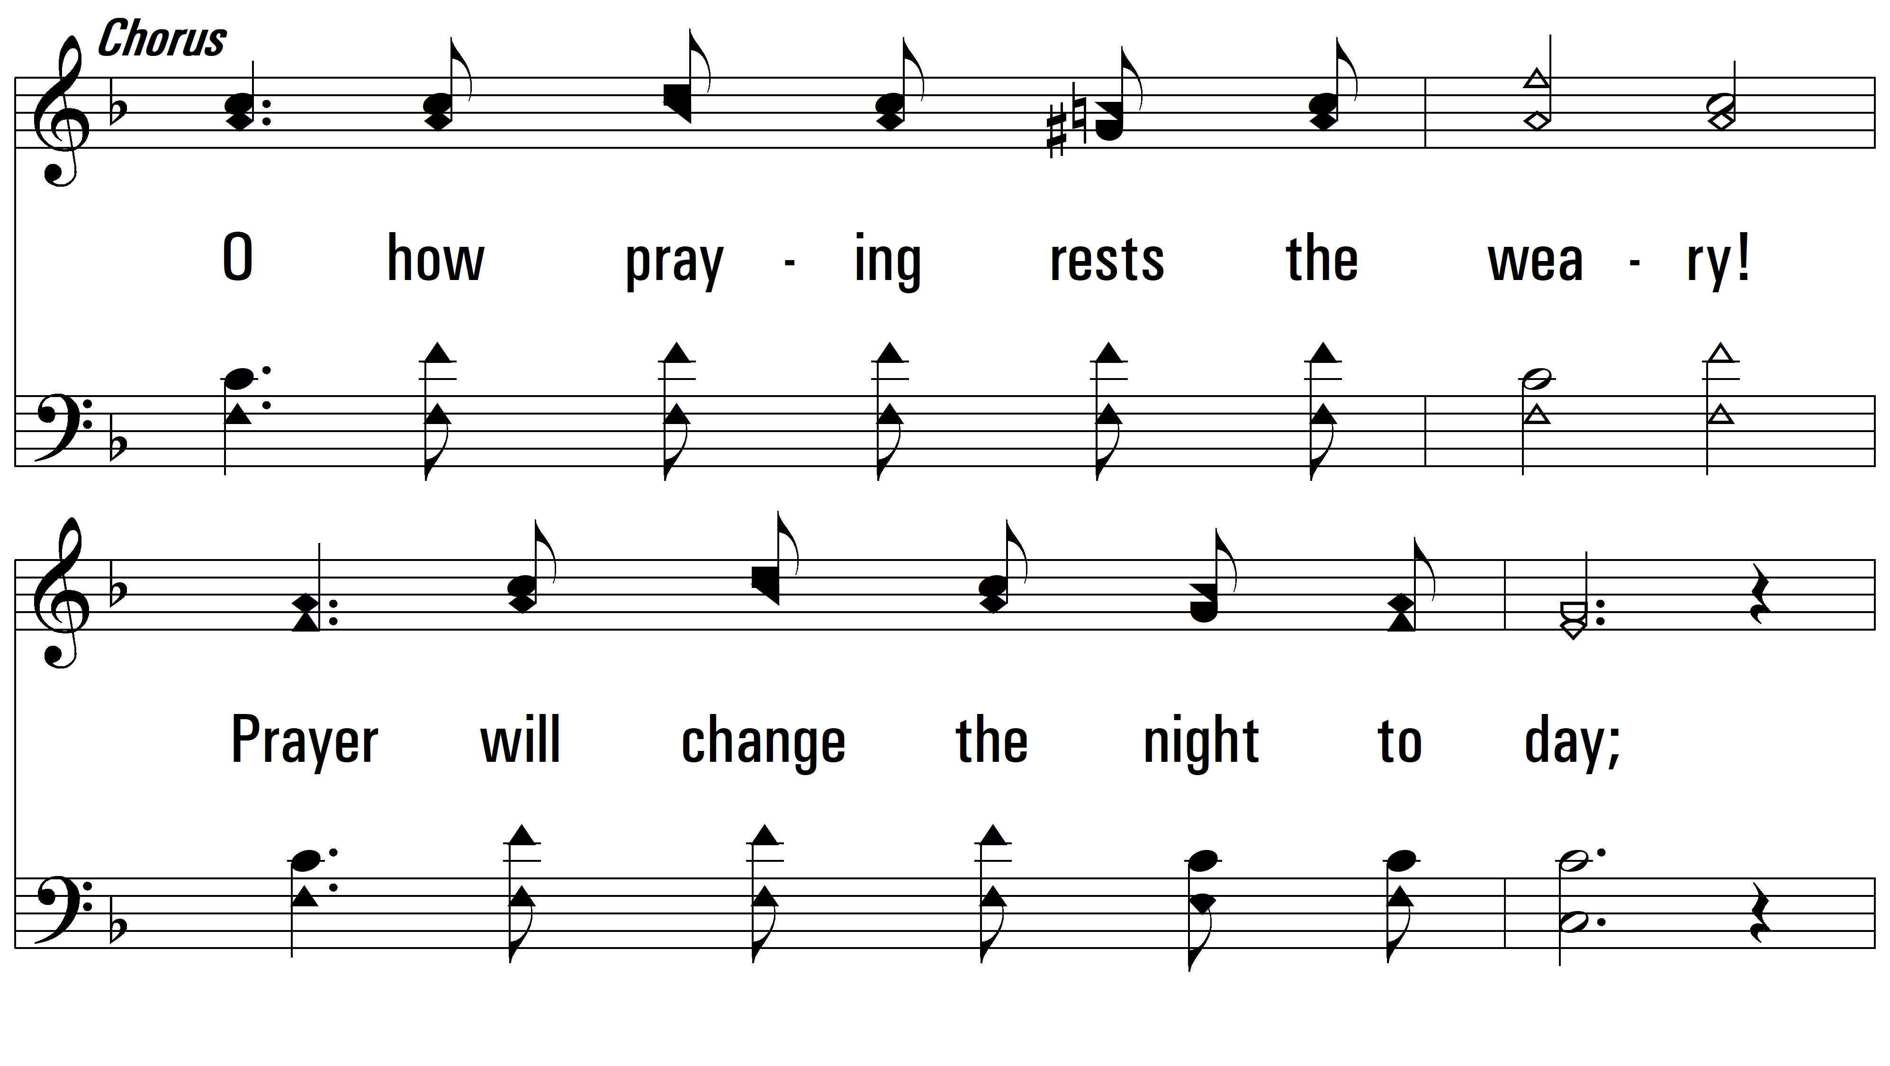
vs. 1

Slide 5
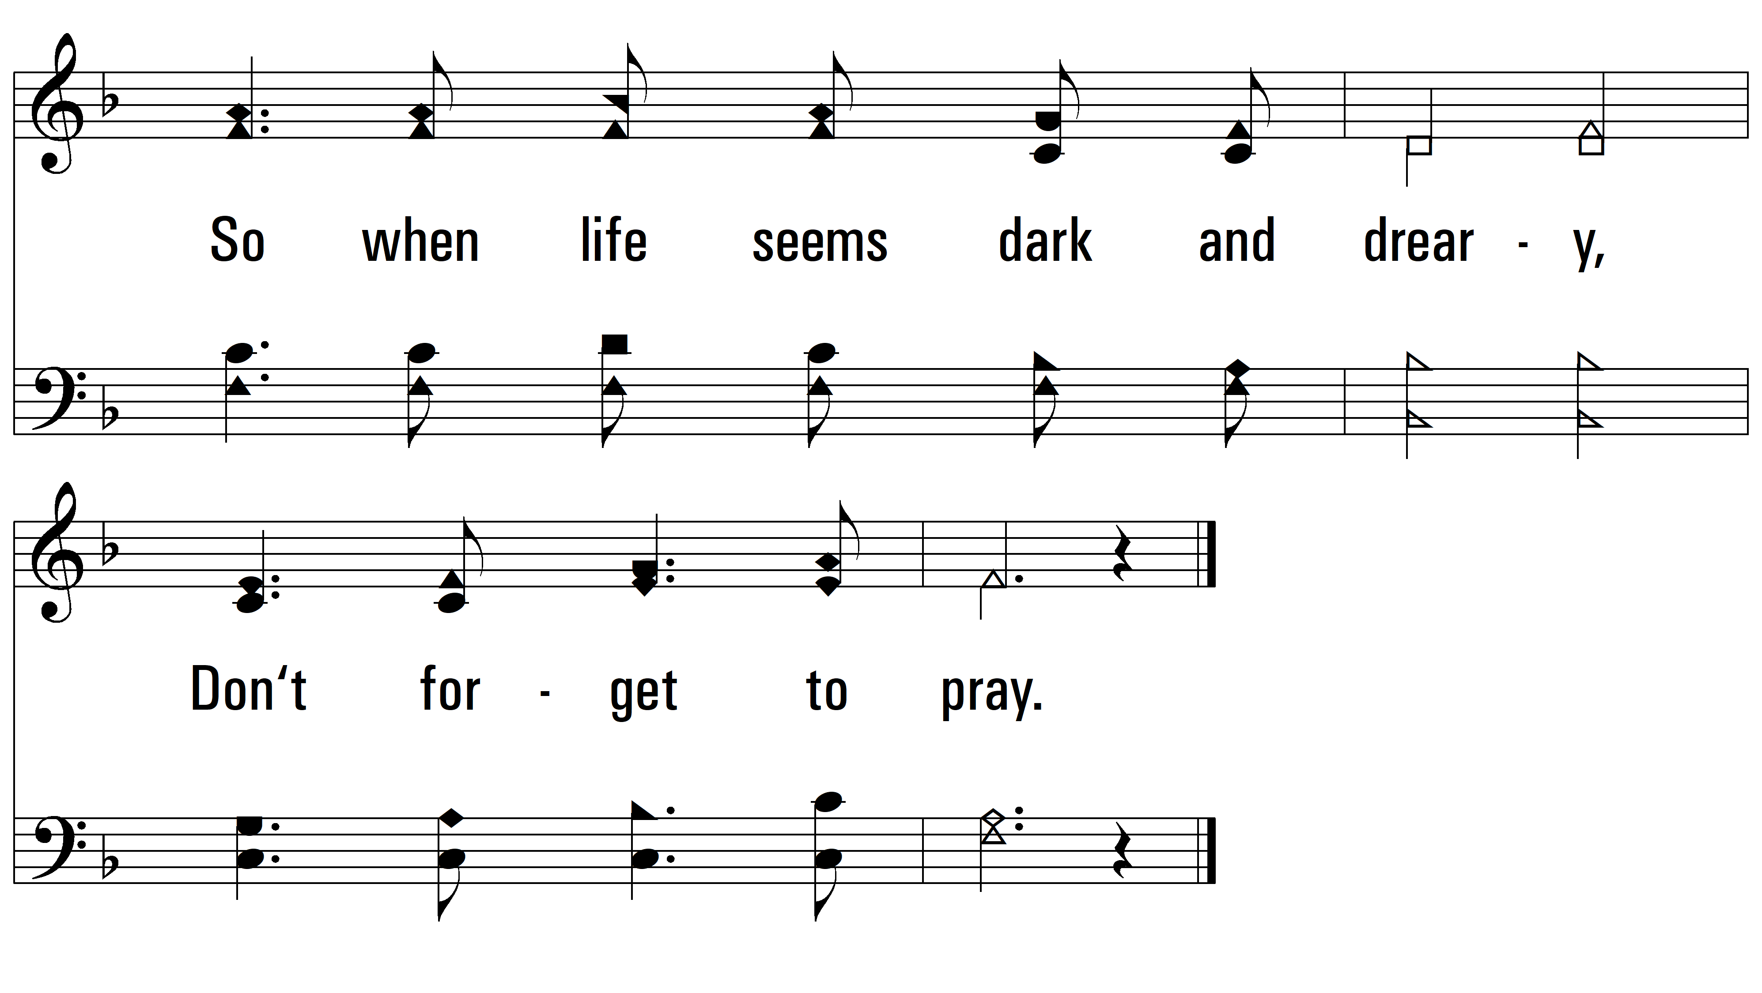
vs. 1

Slide 6
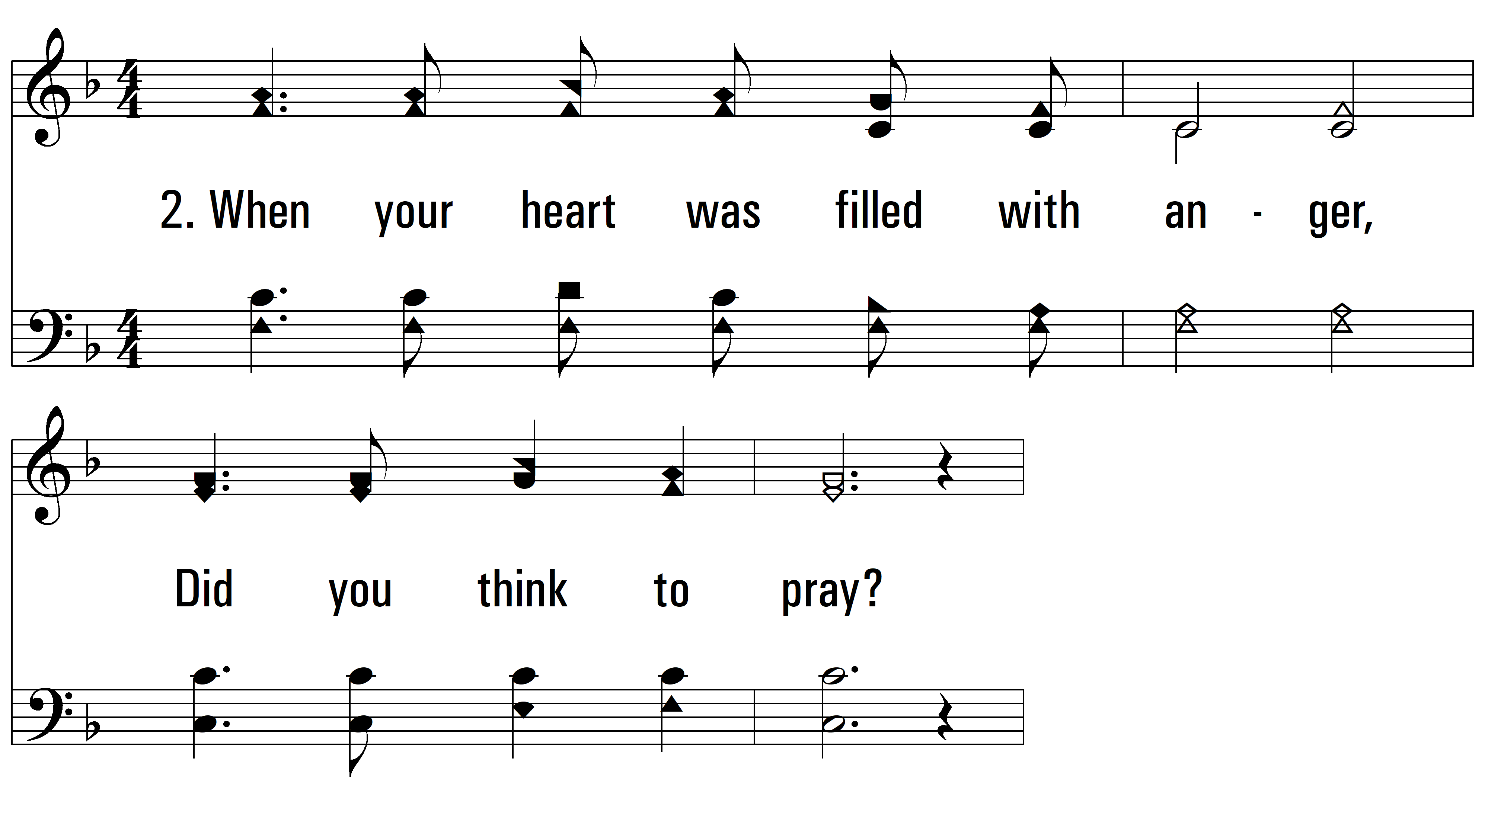
vs. 2 ~ Did You Think To Pray?

Slide 7
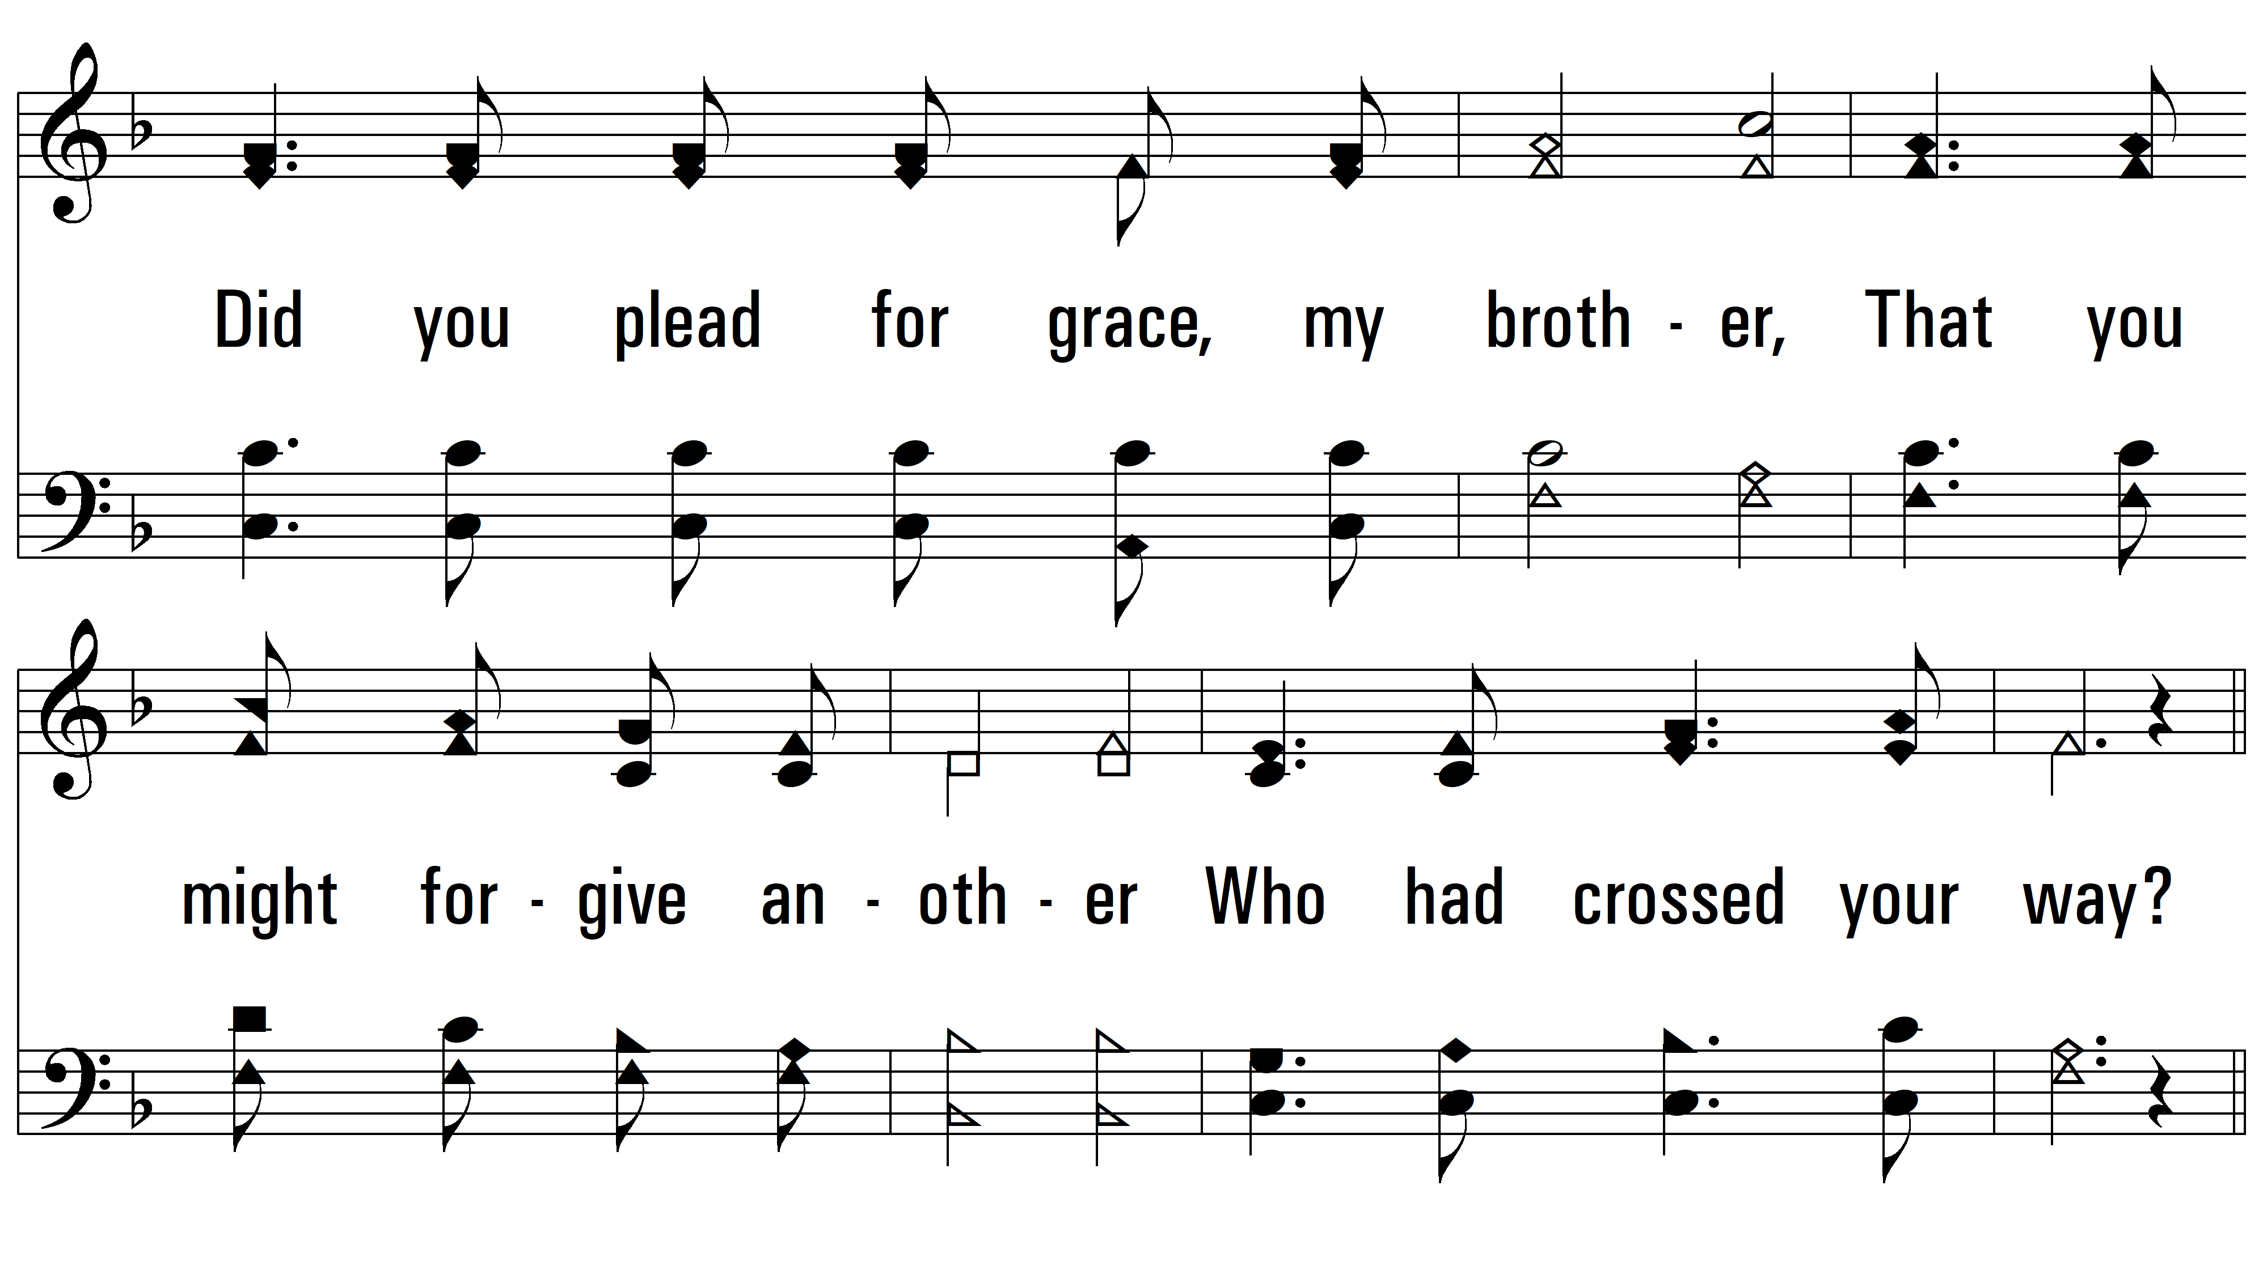
vs. 2

Slide 8
vs. 2

Slide 9
vs. 2

Slide 10
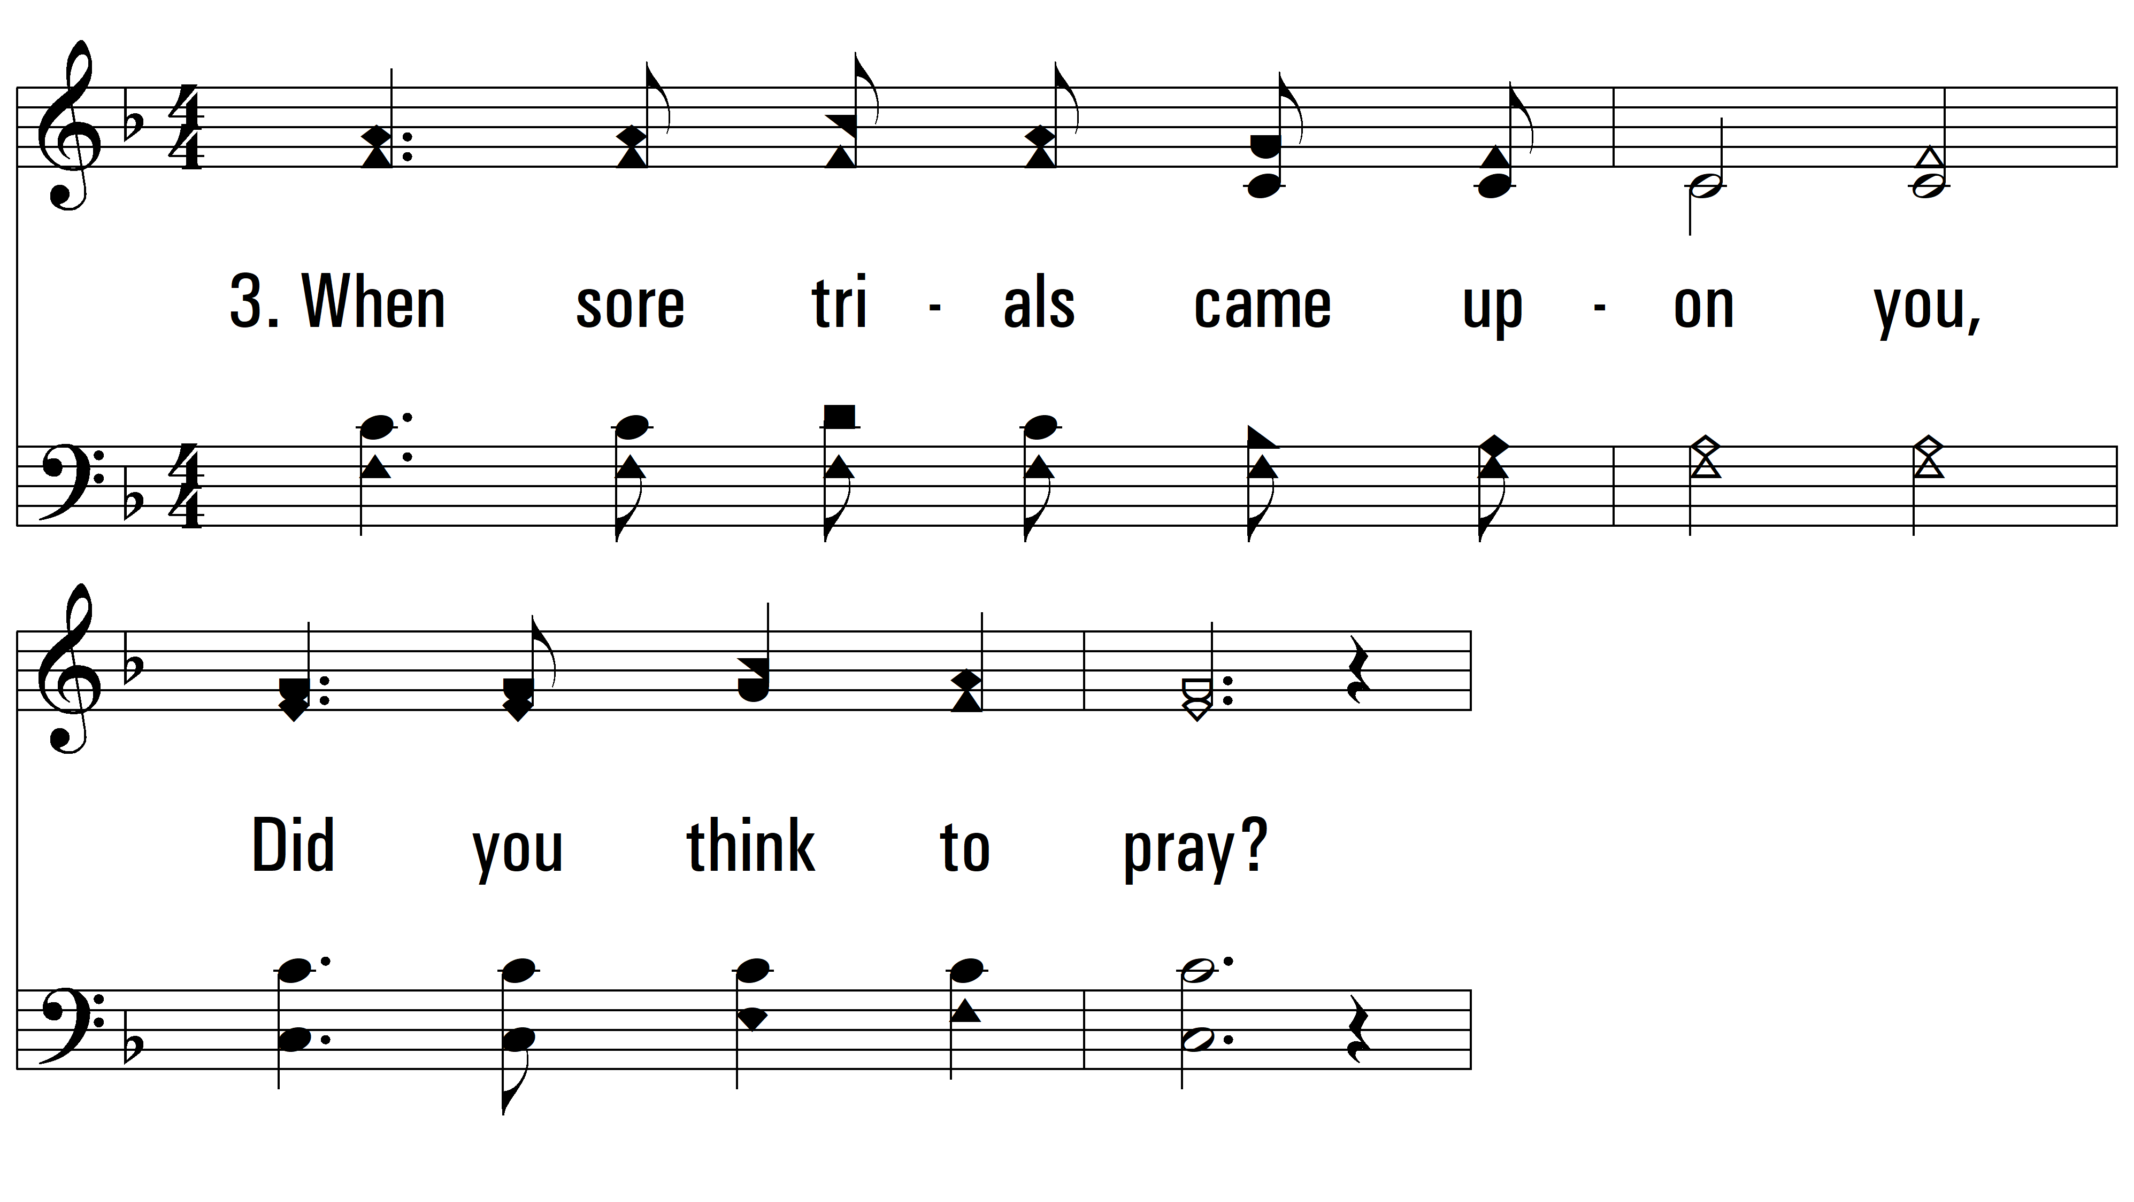
vs. 3 ~ Did You Think To Pray?

Slide 11
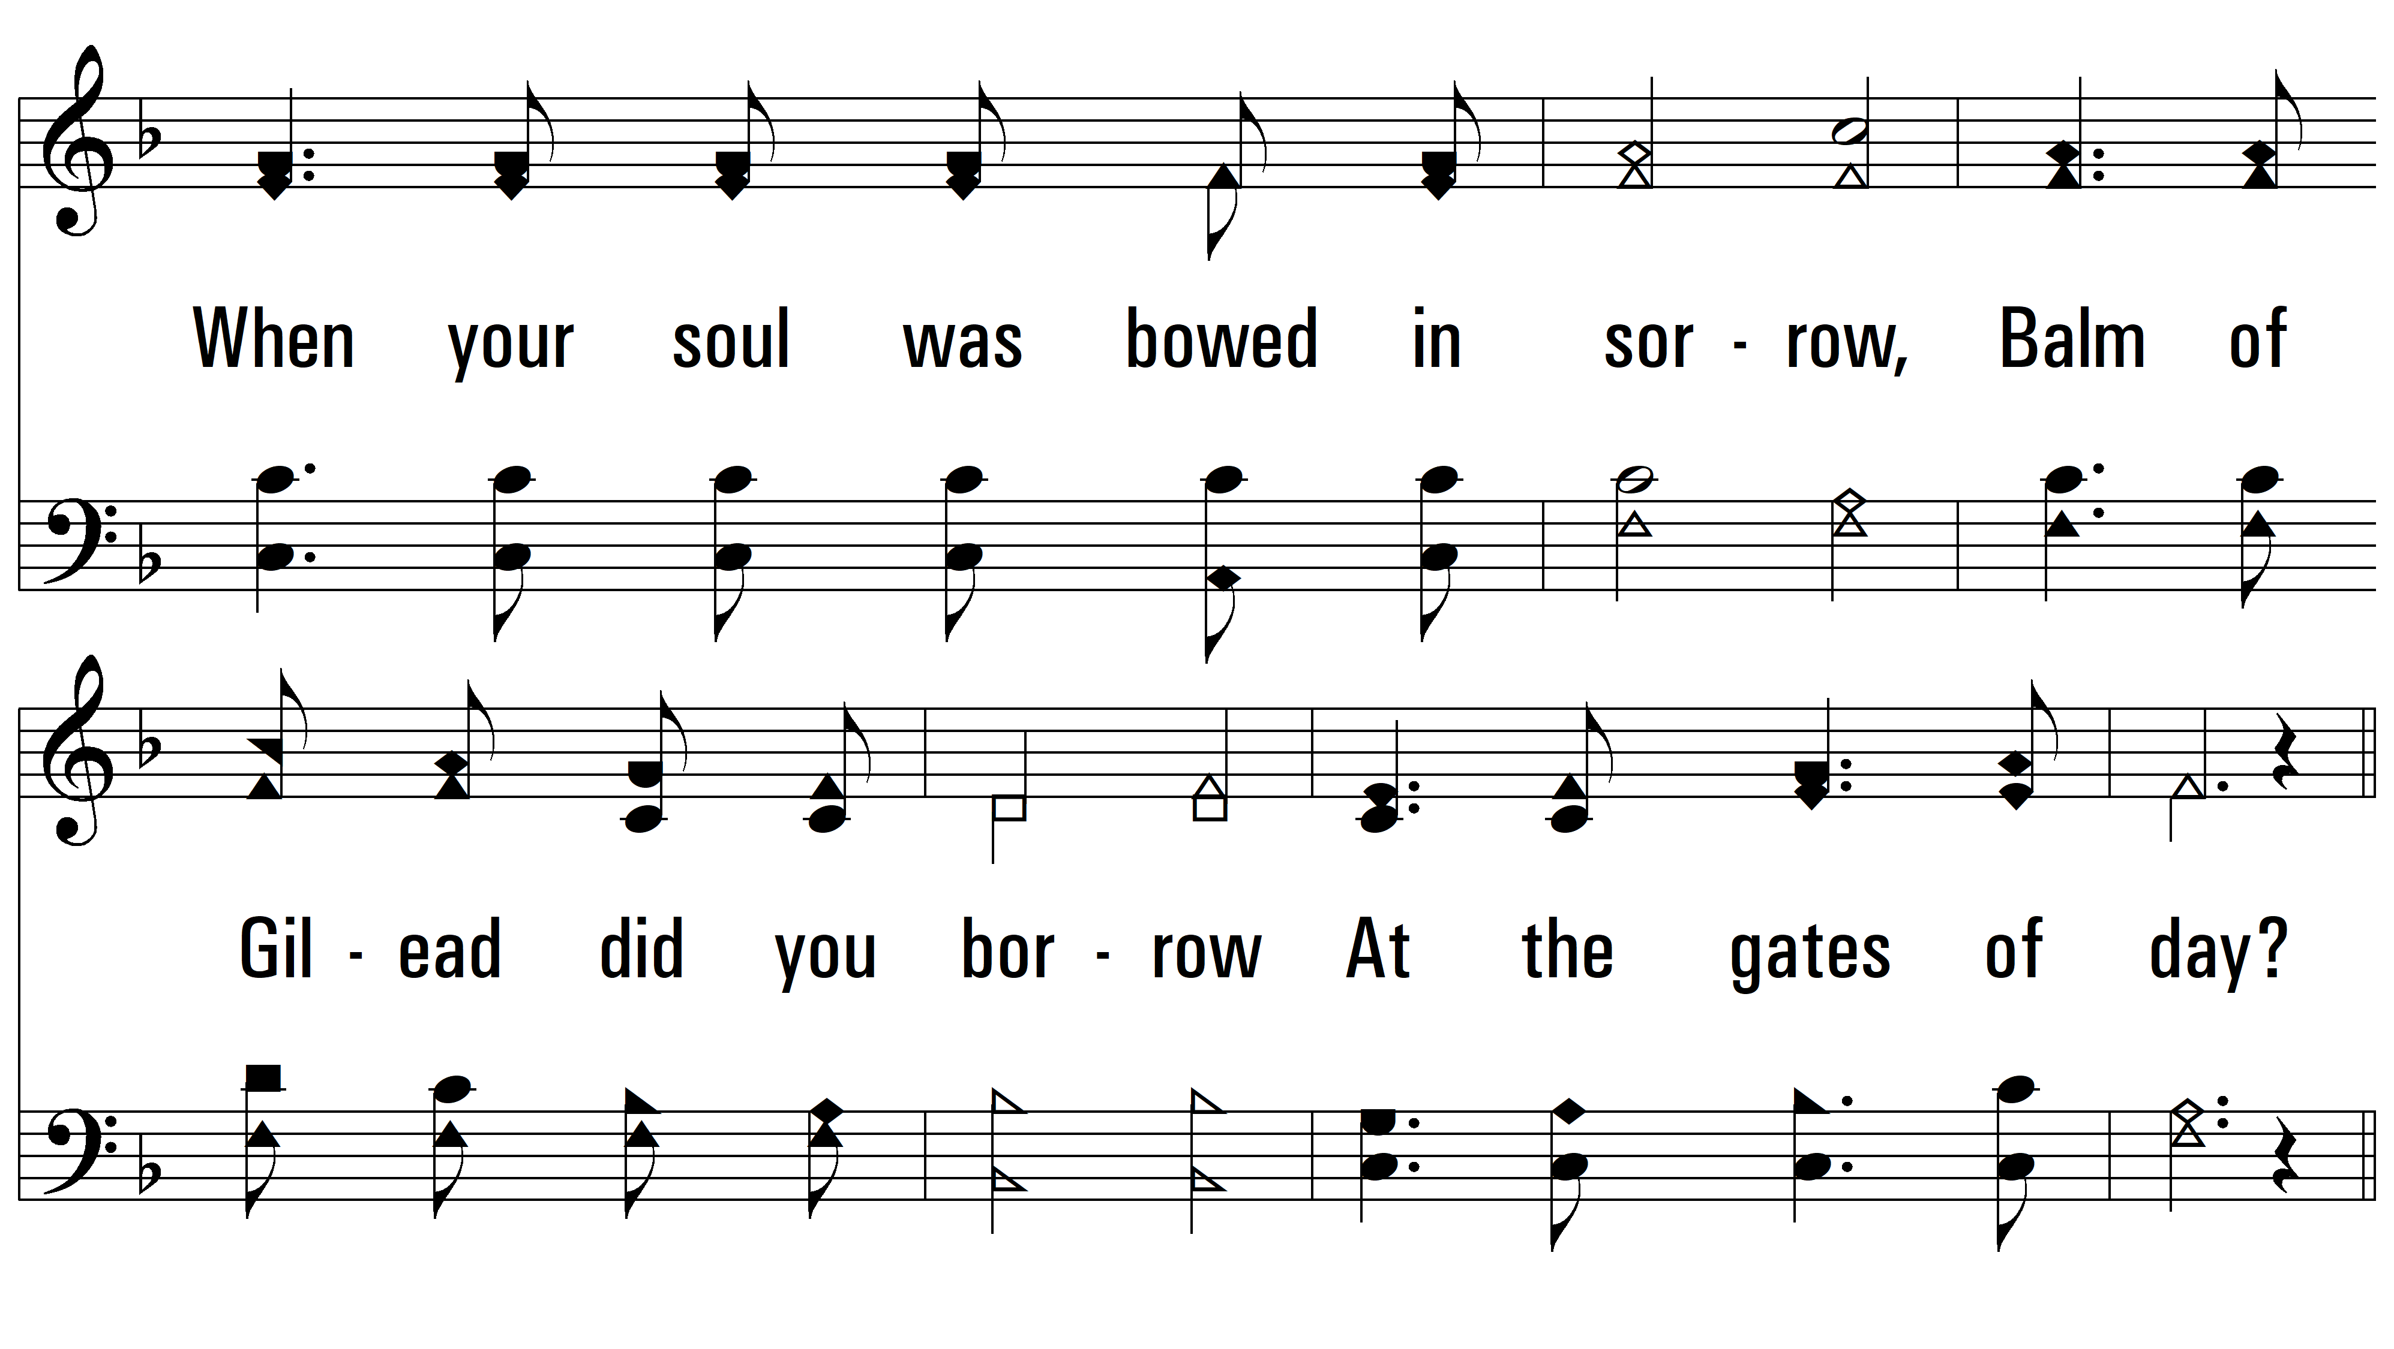
vs. 3

Slide 12
vs. 3

Slide 13
vs. 3
PDHymns.com
END

