Slide 1
Dear Lord And Father Of Mankind
ELTON
8.6.8.8.6
Words: | John G. Whittier (1872)
Music: | Frederick C. Maker (1887)
4/4
D/F# - MI
Verses: 6
Lead - | MI
Alto - | DO
Tenor - | SOL
Bass - | DO
PDHymns.com

Slide 2
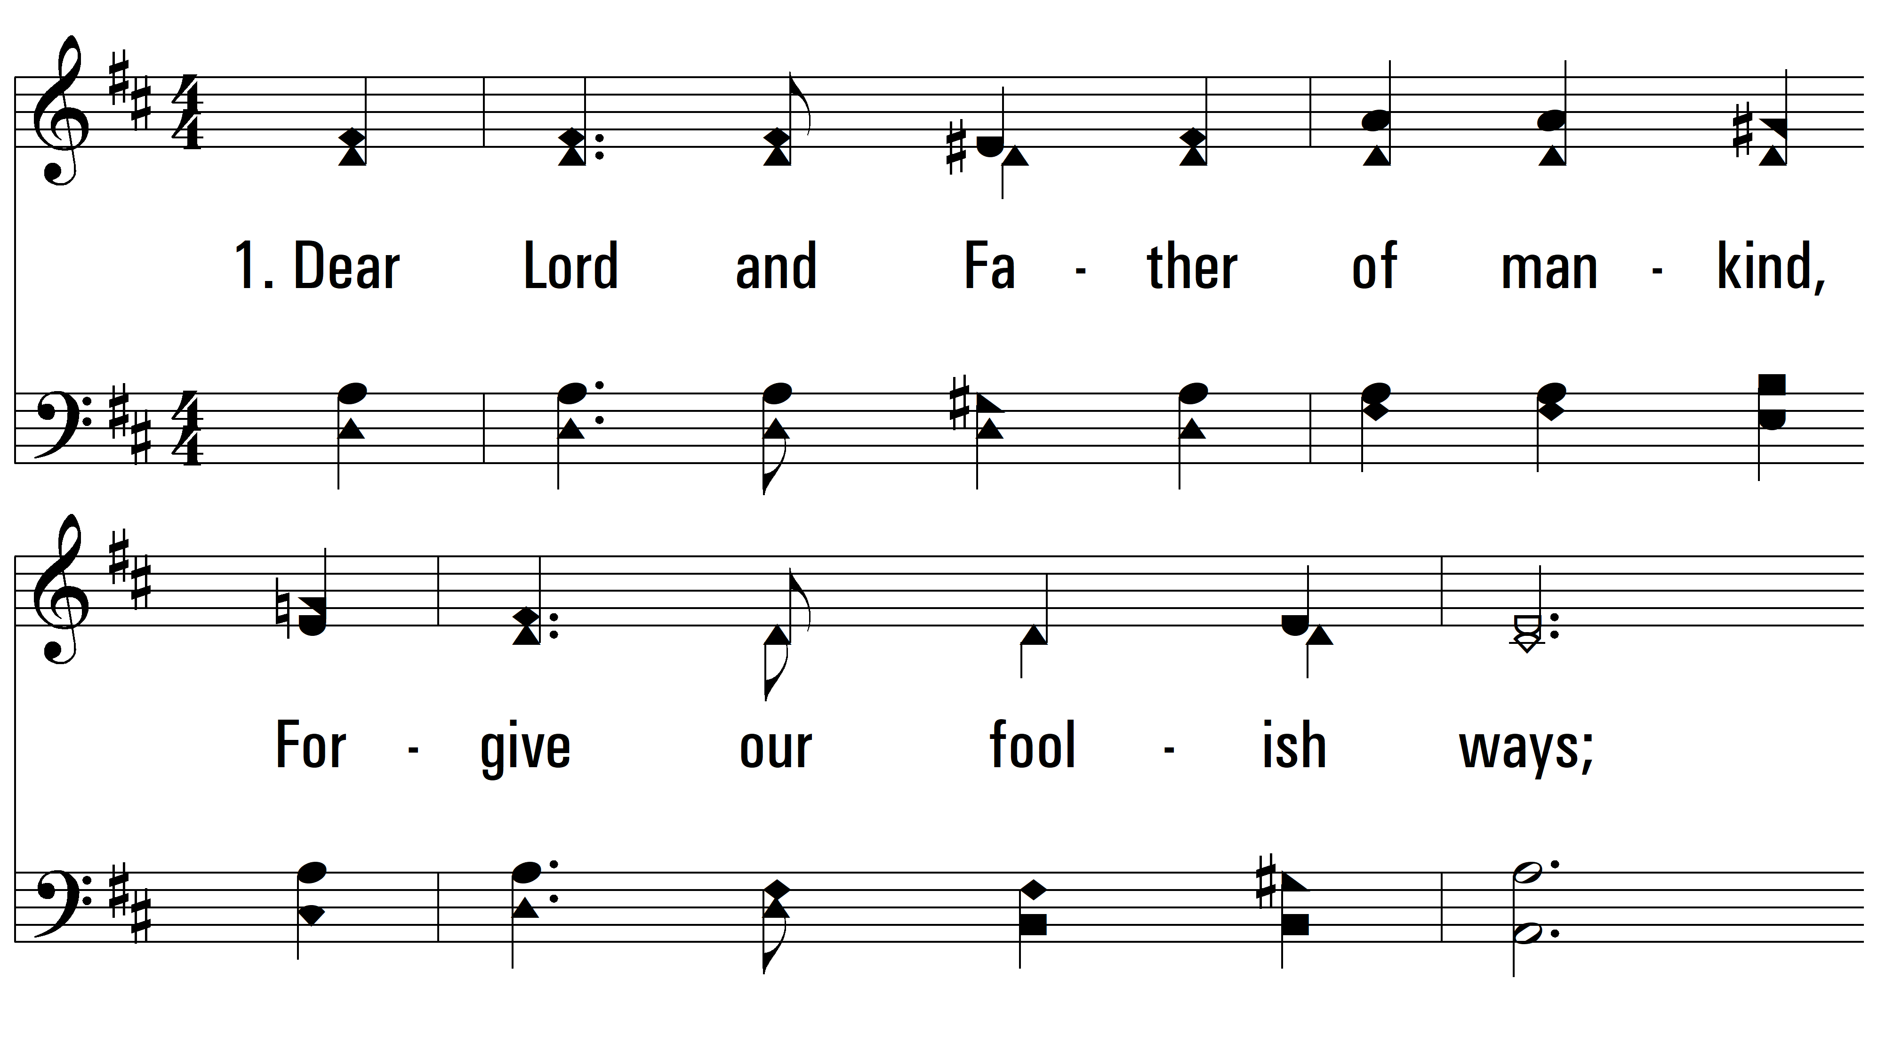
vs. 1 ~ Dear Lord And Father Of Mankind

Slide 3
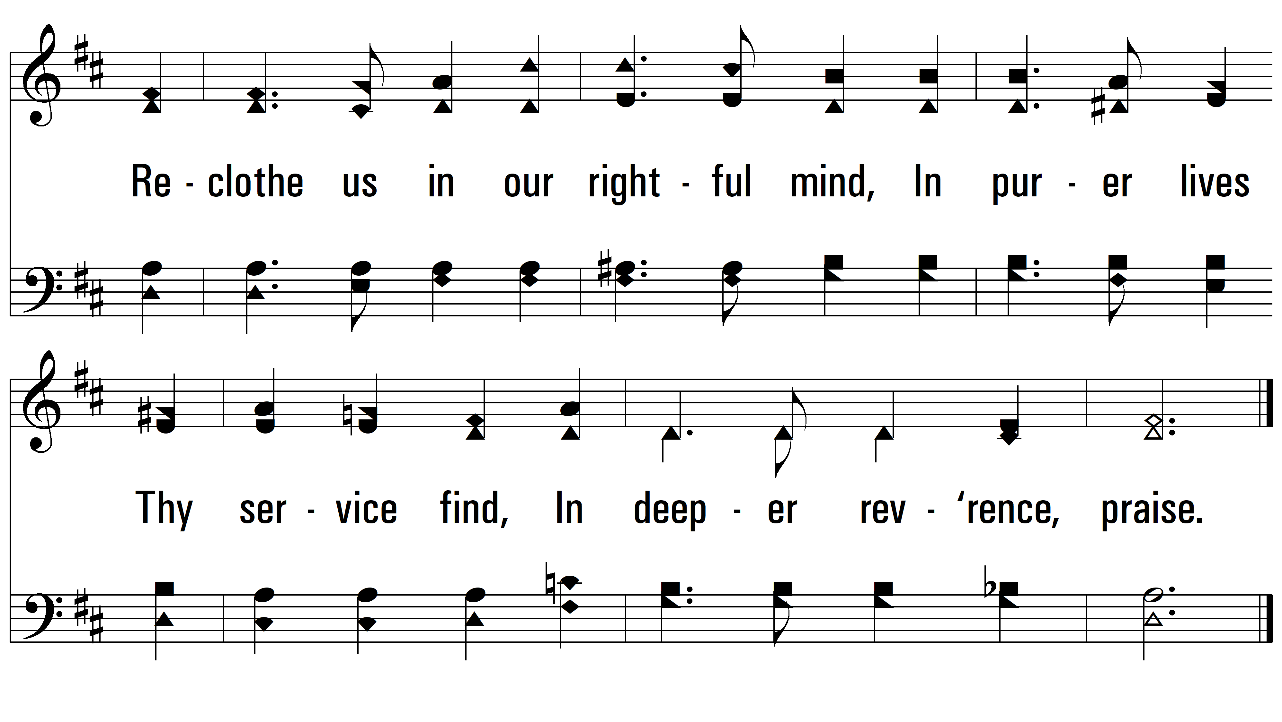
vs. 1

Slide 4
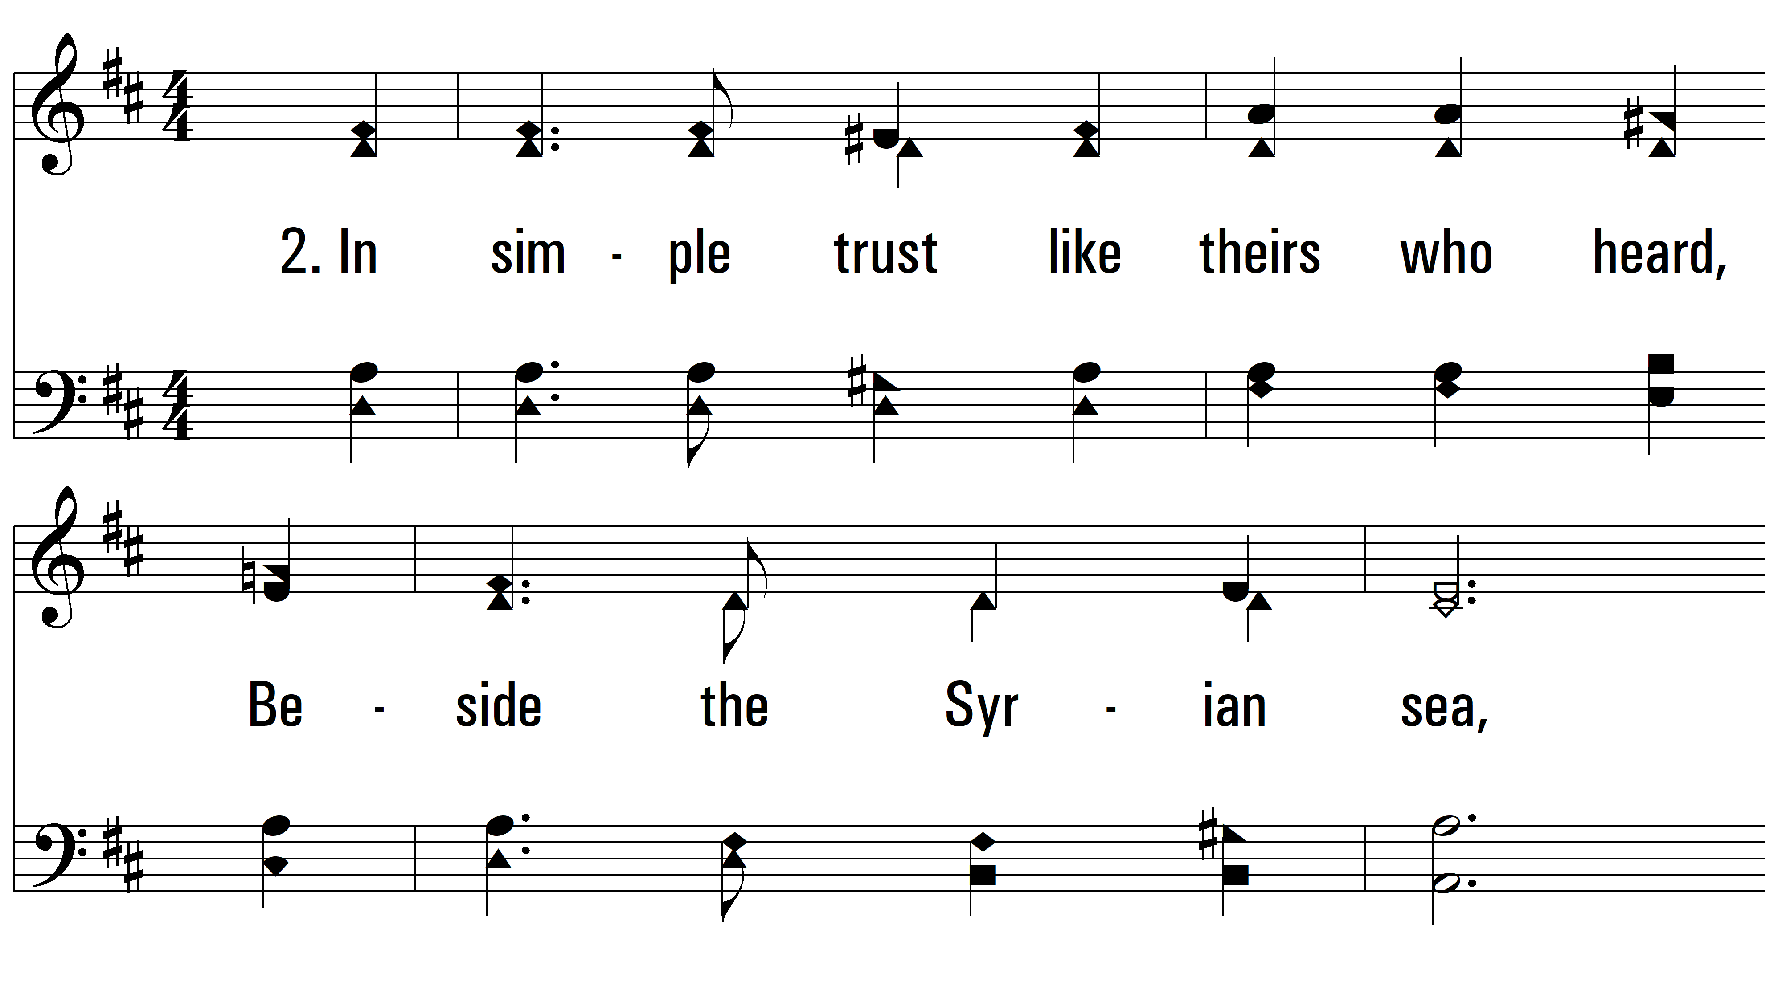
vs. 2 ~ Dear Lord And Father Of Mankind

Slide 5
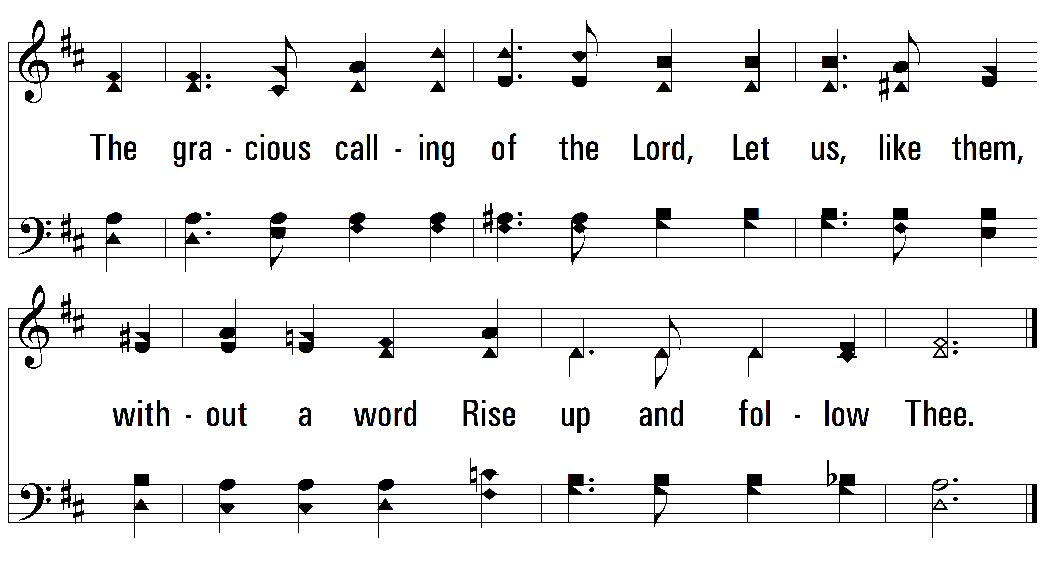
vs. 2

Slide 6
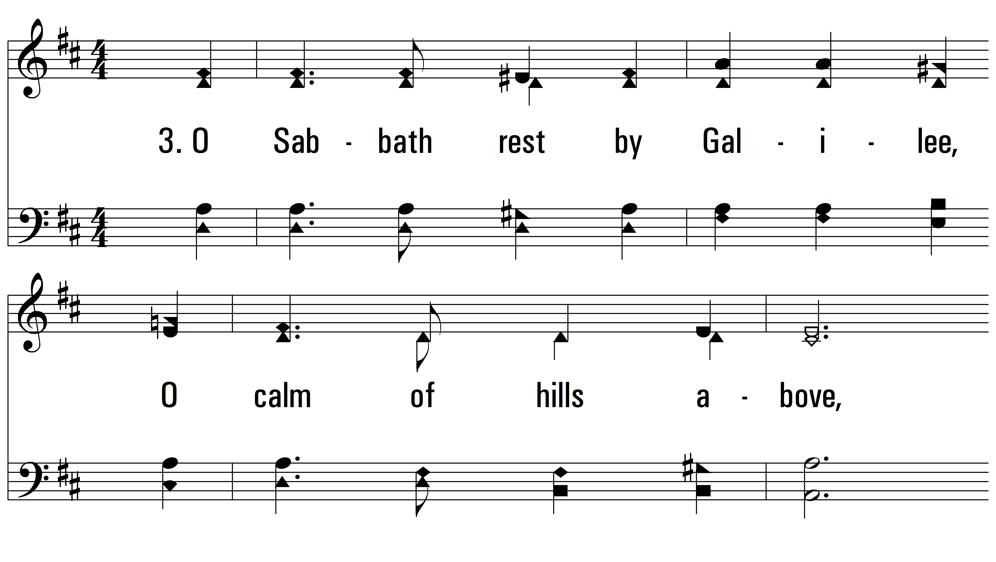
vs. 3 ~ Dear Lord And Father Of Mankind

Slide 7
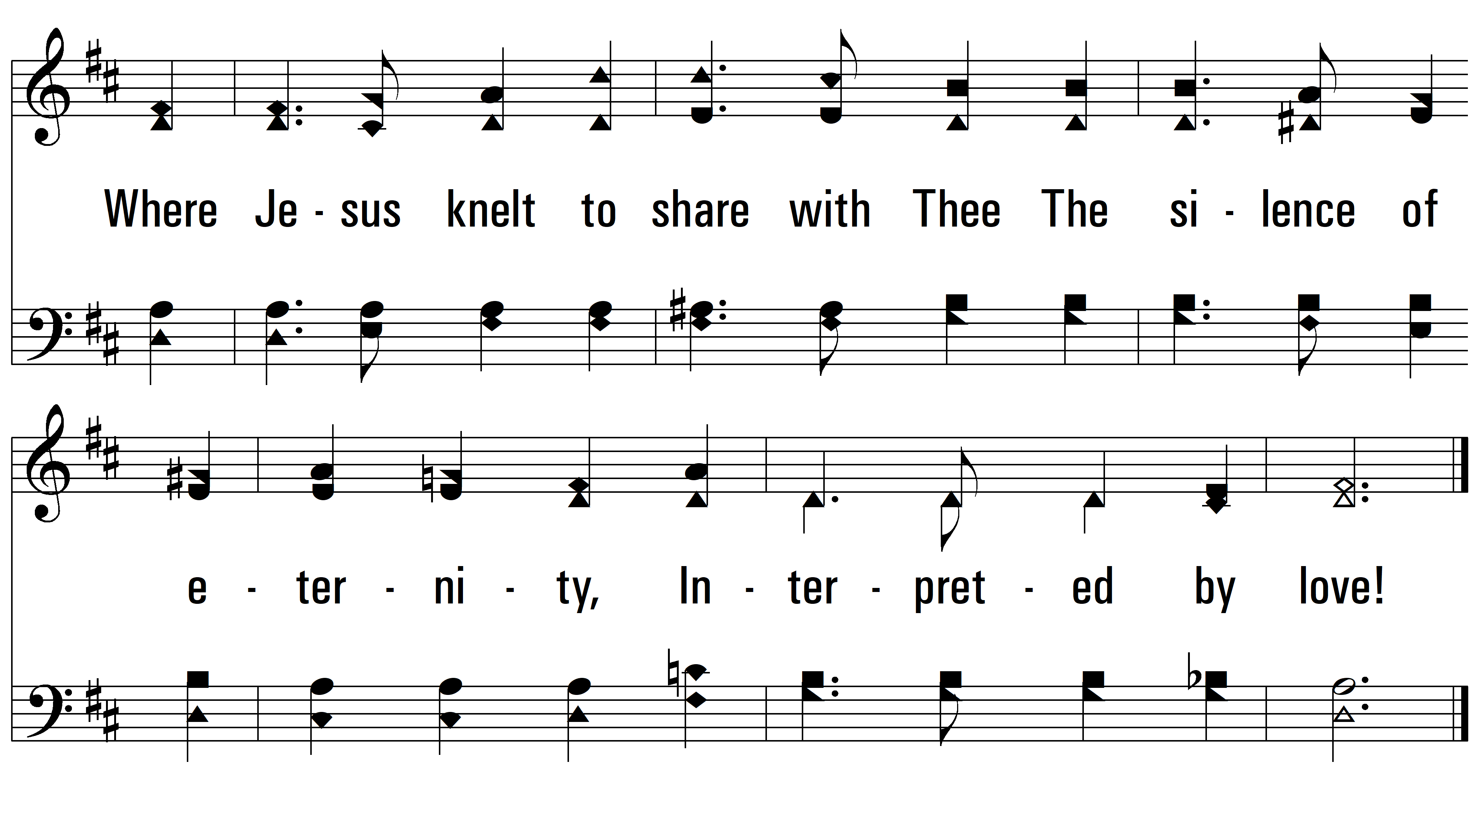
vs. 3

Slide 8
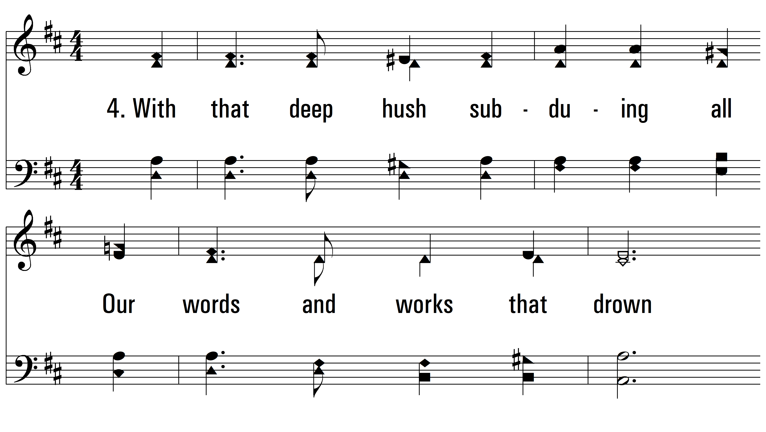
vs. 4 ~ Dear Lord And Father Of Mankind

Slide 9
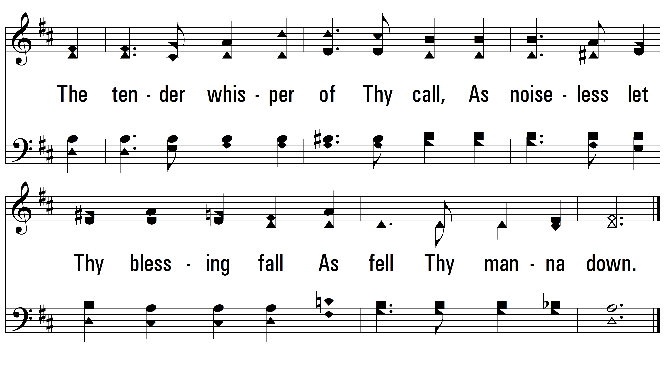
vs. 4

Slide 10
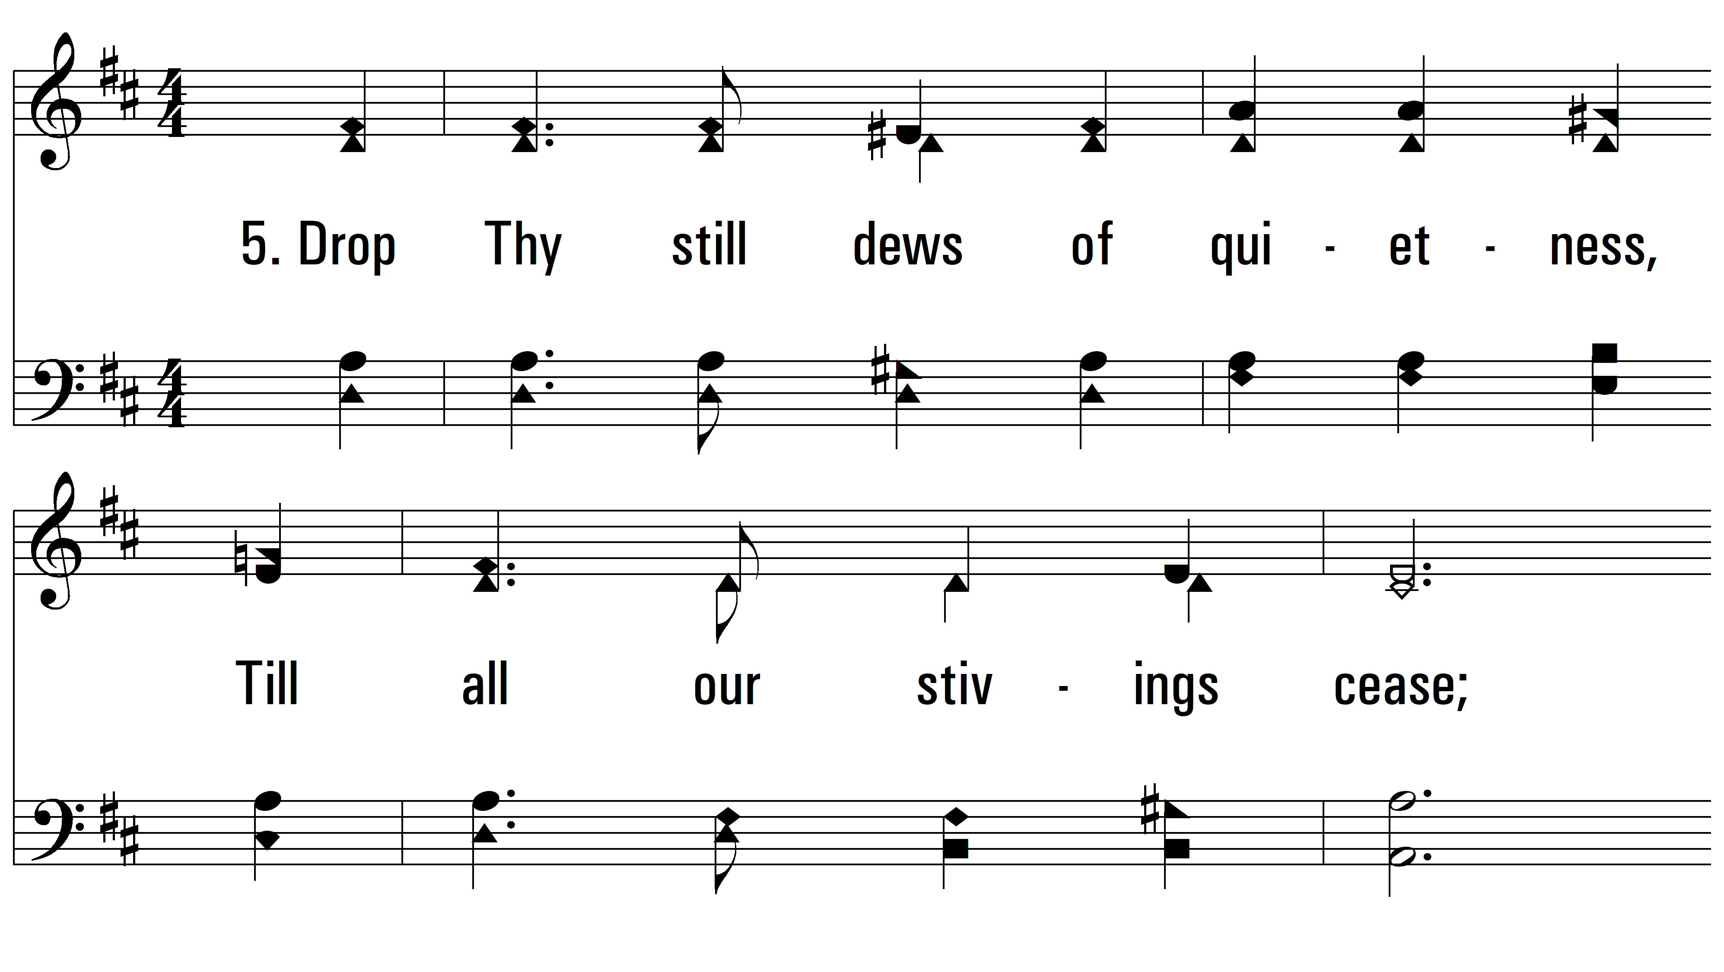
vs. 5 ~ Dear Lord And Father Of Mankind

Slide 11
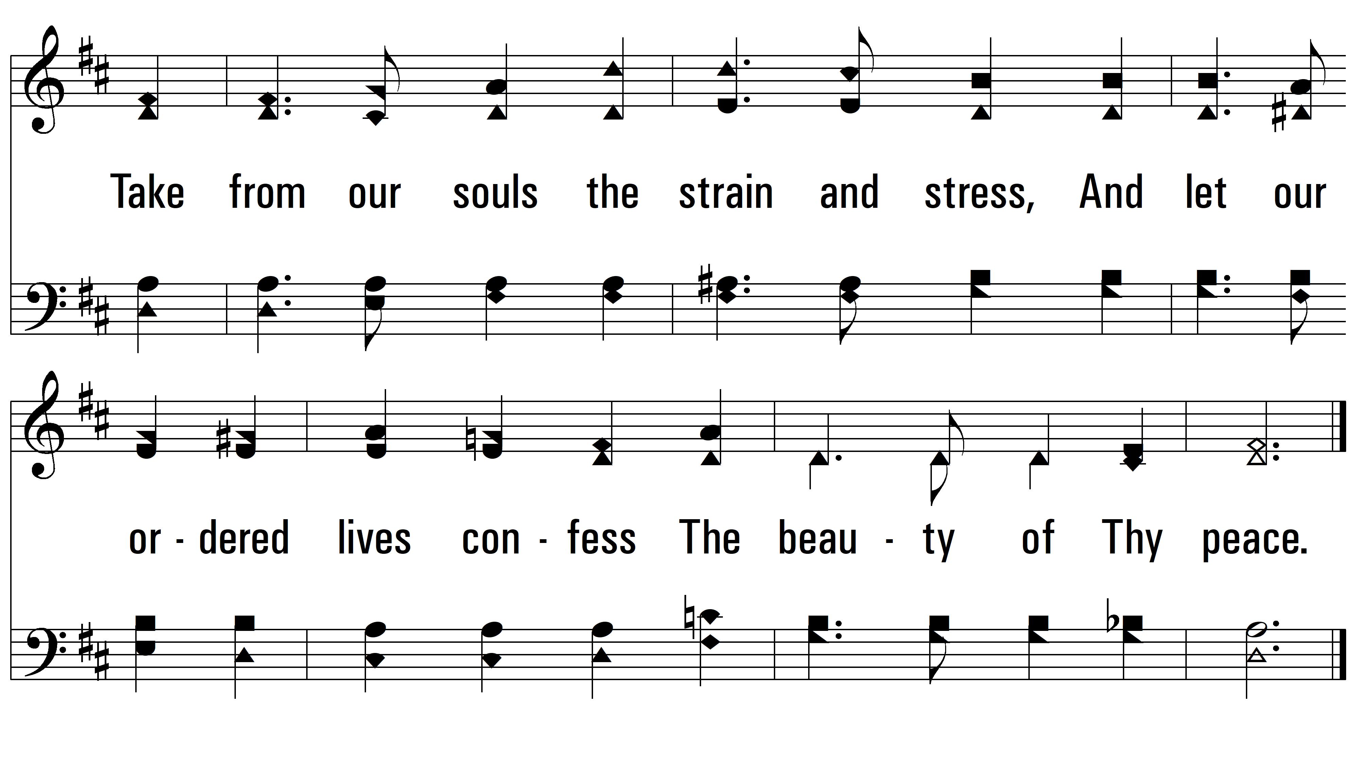
vs. 5

Slide 12
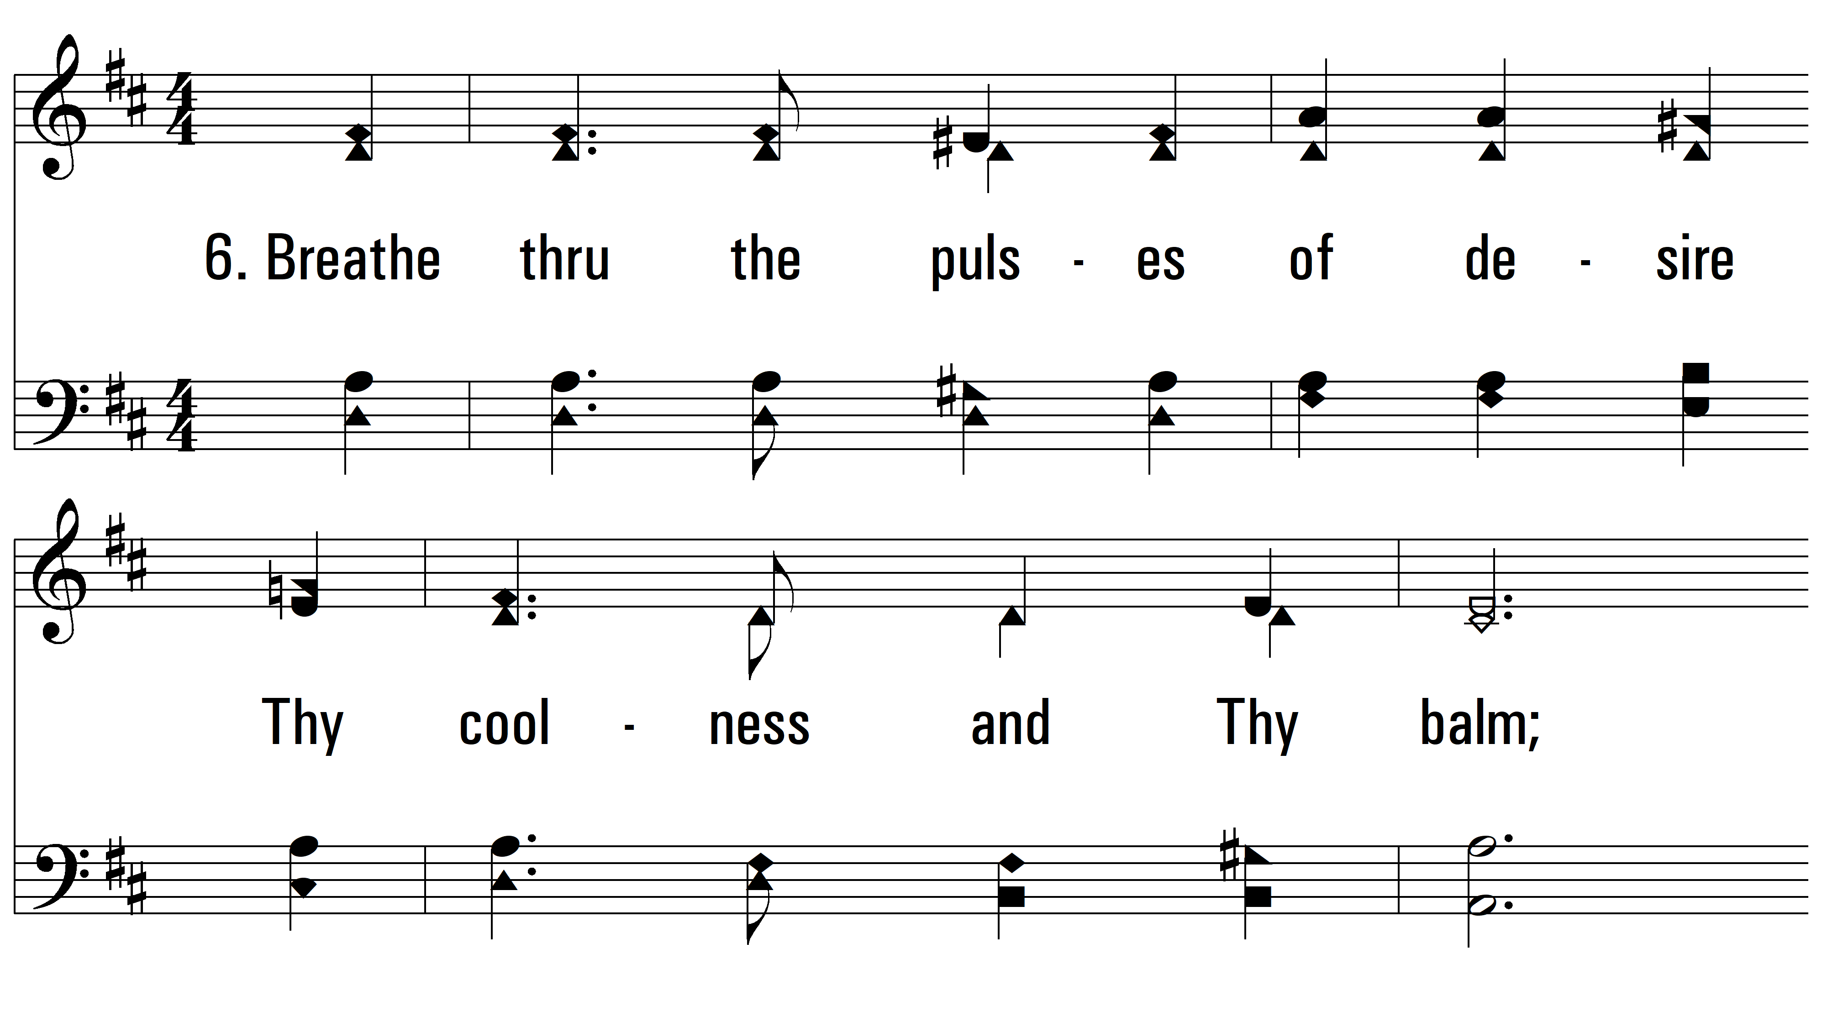
vs. 6 ~ Dear Lord And Father Of Mankind

Slide 13
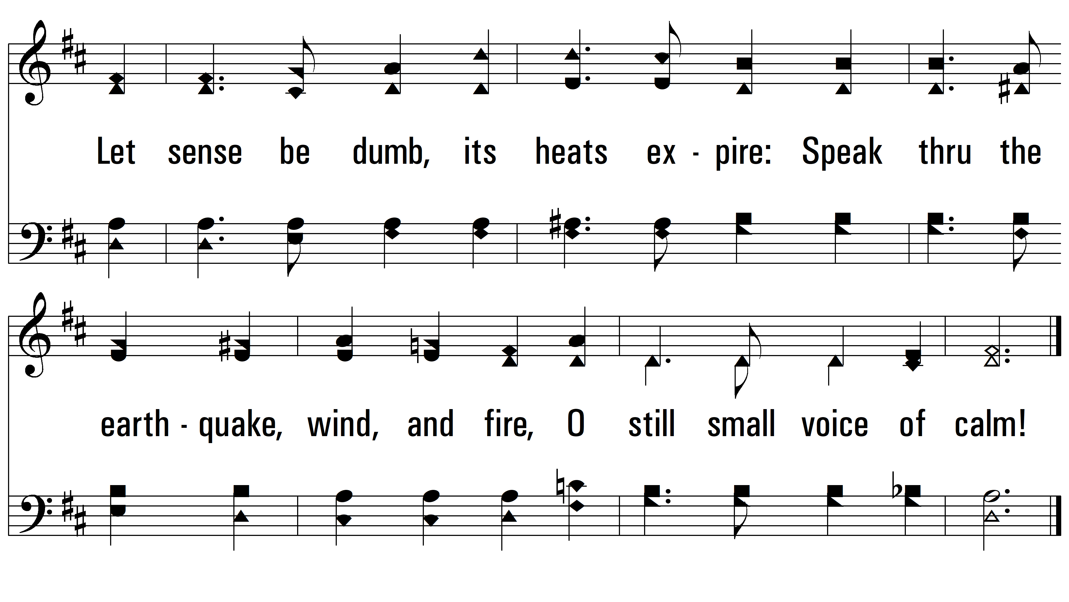
vs. 6
PDHymns.com
END

