Slide 1
Crown Him With Many Crowns
DIADEMATA
SMD
Words: | Matthew Bridges (1851), vs. 2 Godfrey Trhing (1874)
Music: | George J. Elvey (1868)
4/4
E^{b}/E^{b} - DO
Verses: 4
Lead - | DO
Alto - | SOL
Tenor - | MI
Bass - | DO
PDHymns.com

Slide 2
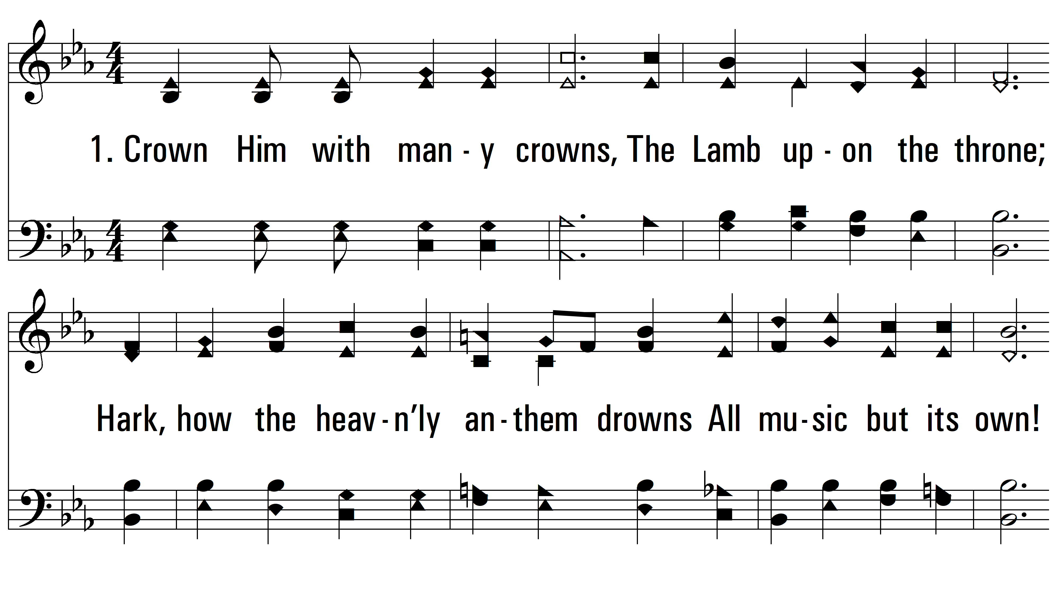
vs. 1 ~ Crown Him With Many Crowns

Slide 3
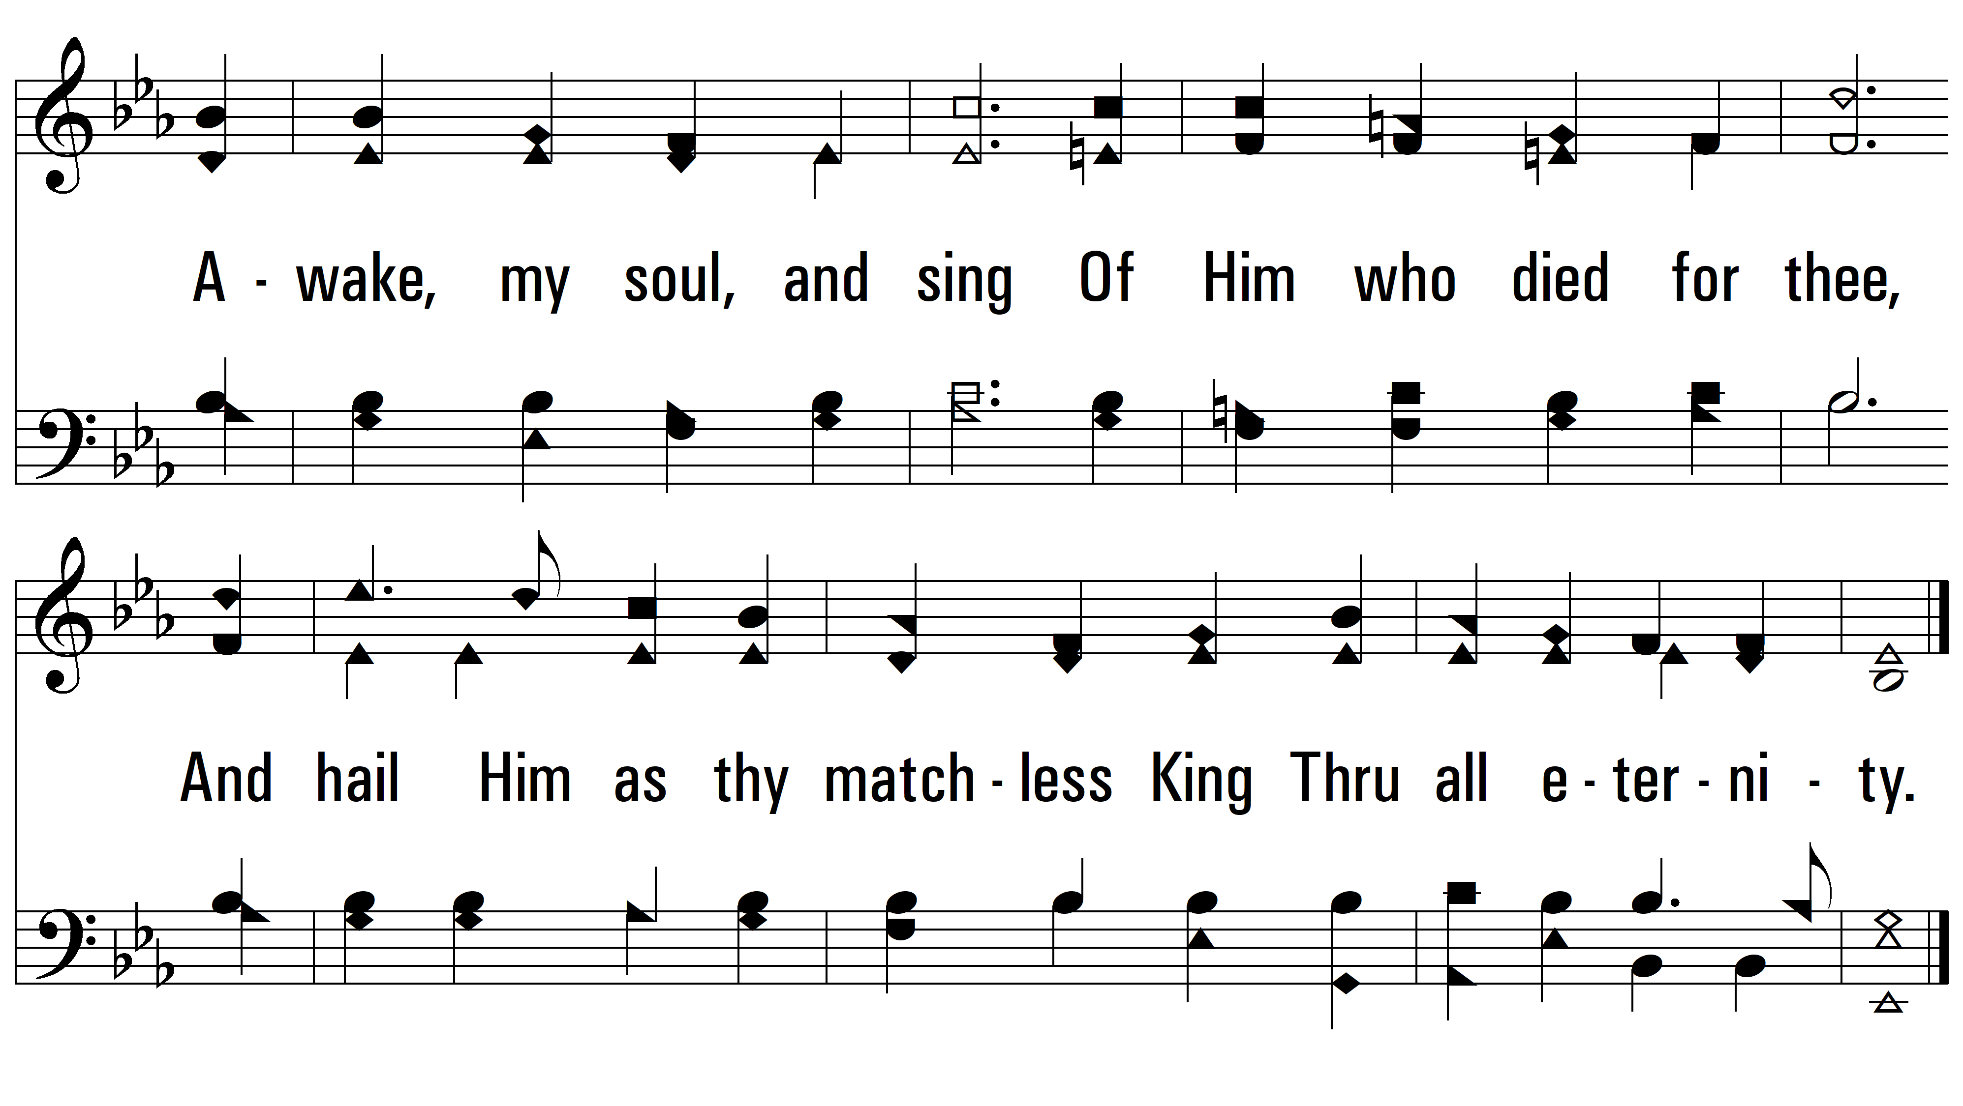
vs. 1

Slide 4
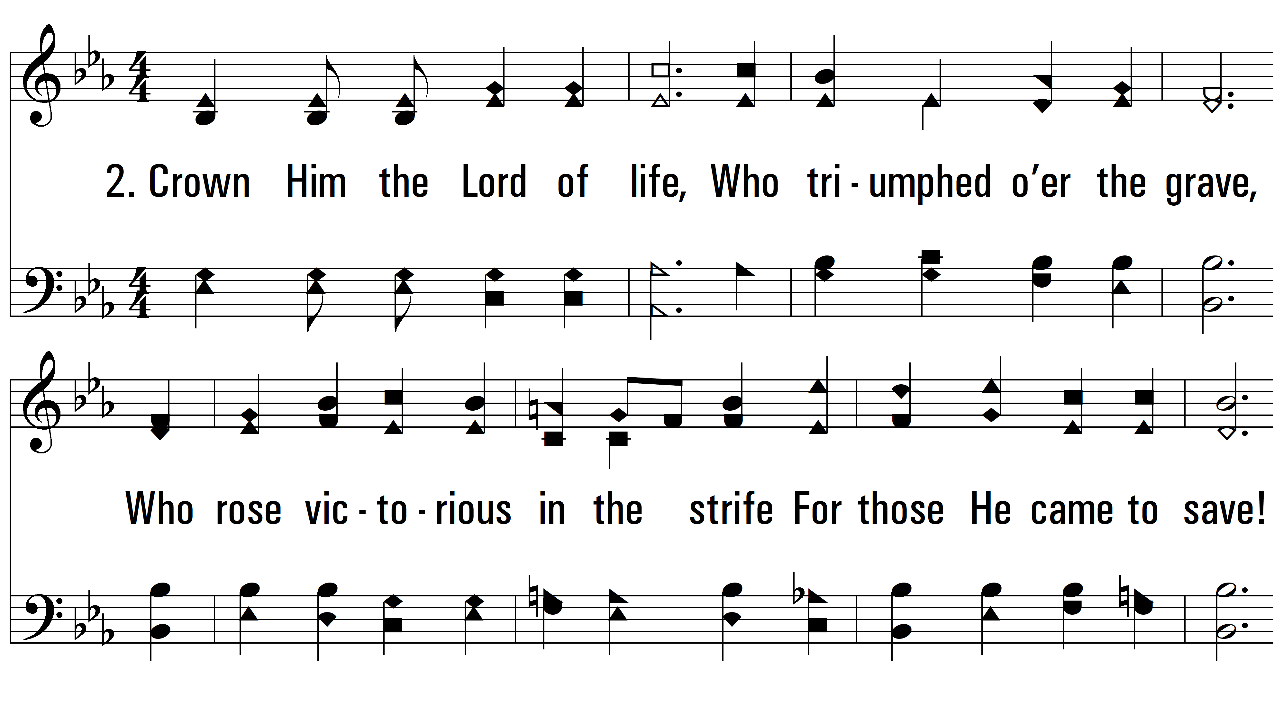
vs. 2 ~ Crown Him With Many Crowns

Slide 5
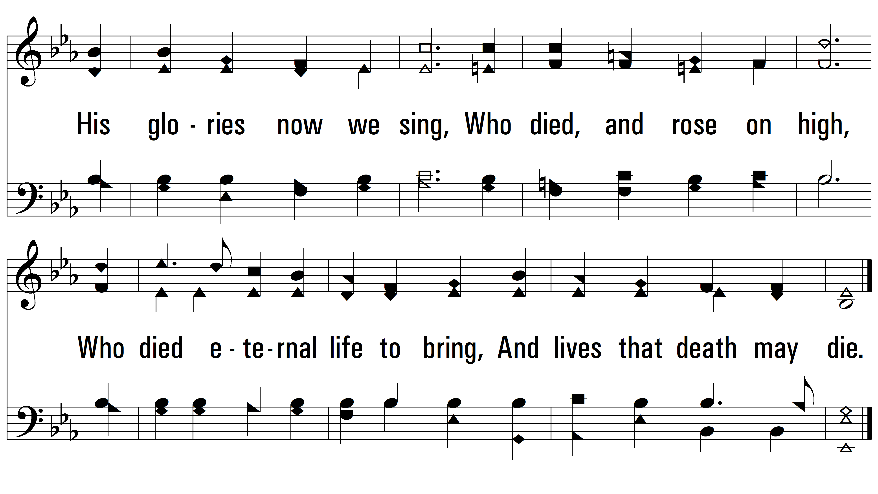
vs. 2

Slide 6
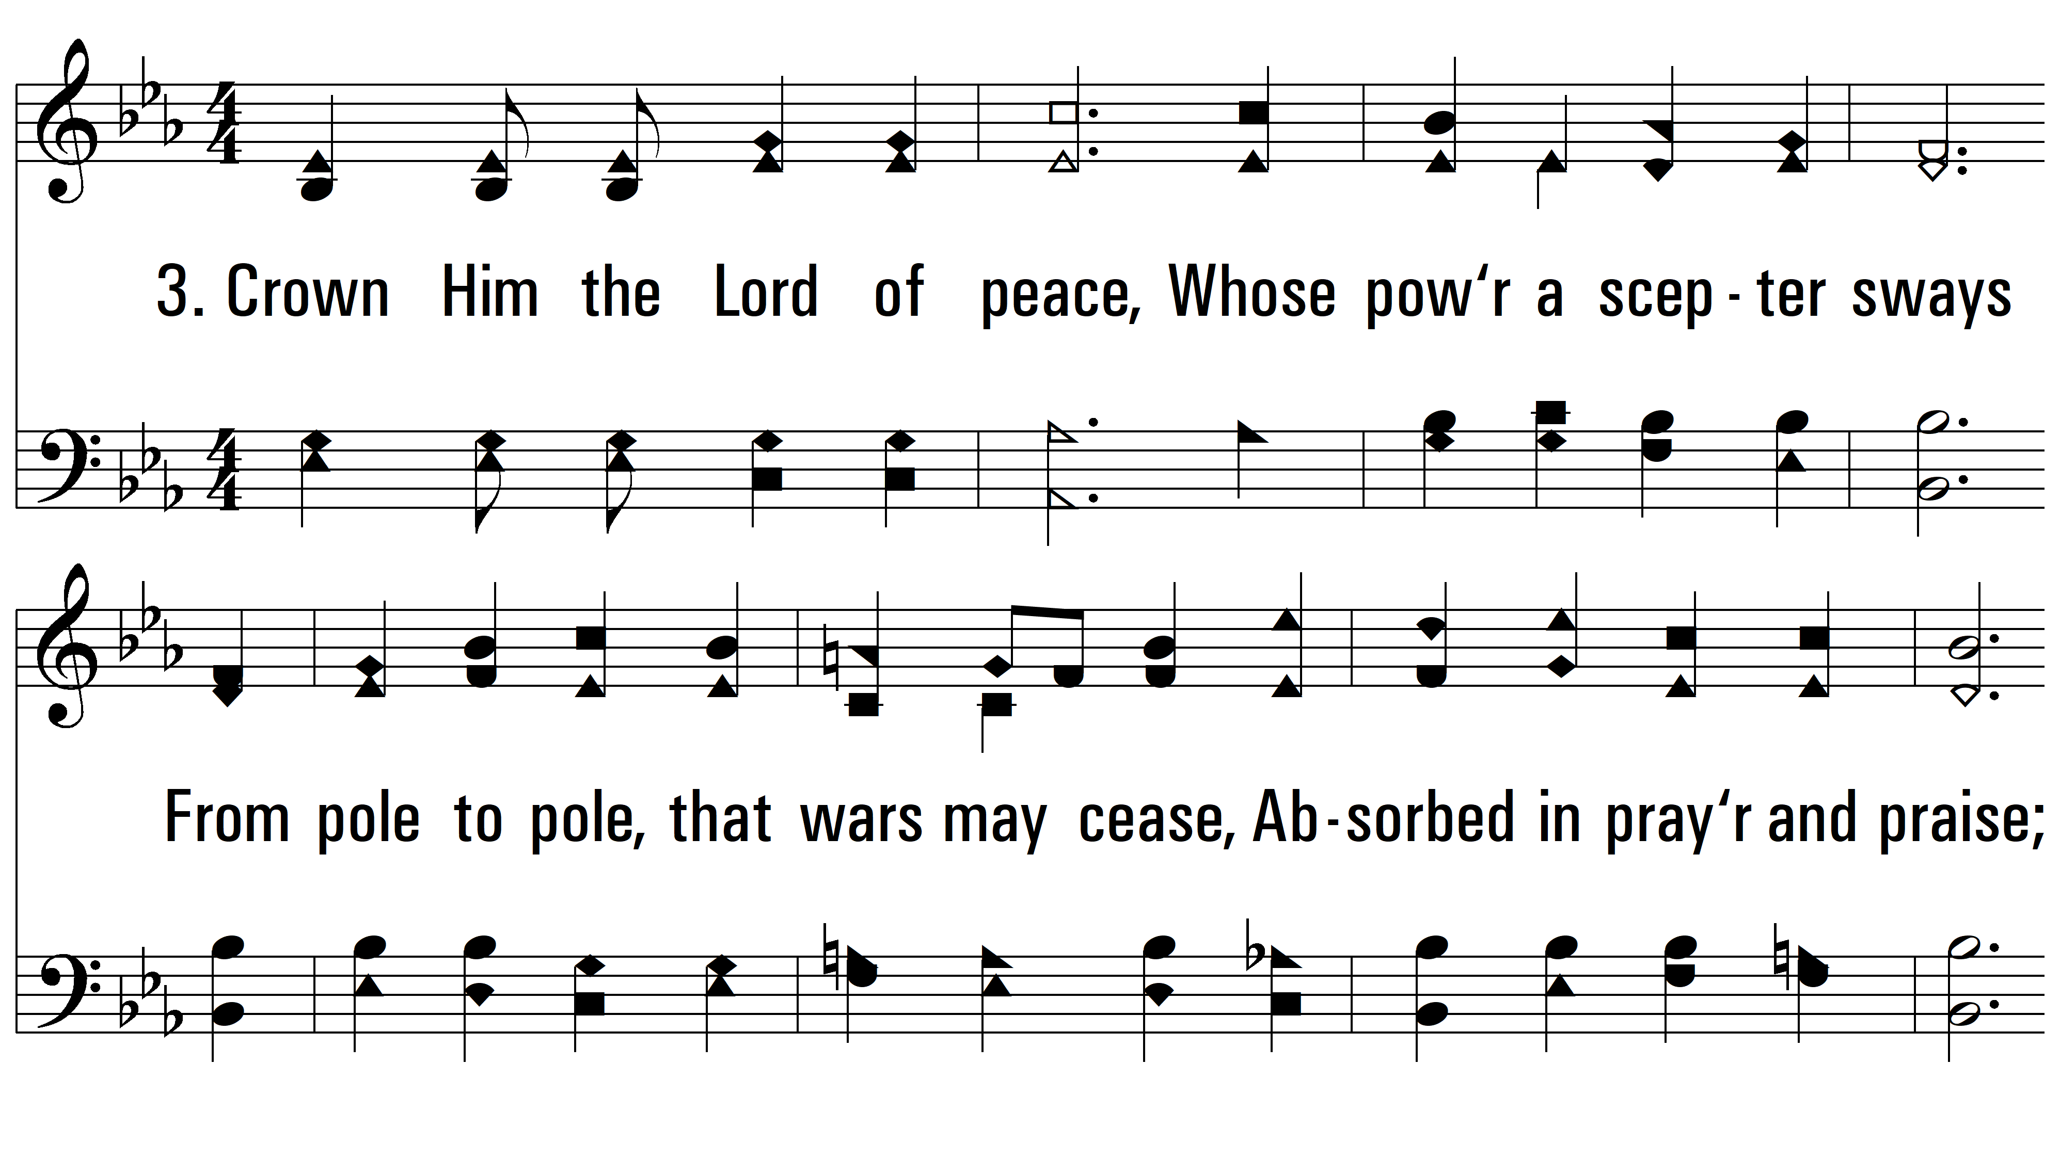
vs. 3 ~ Crown Him With Many Crowns

Slide 7
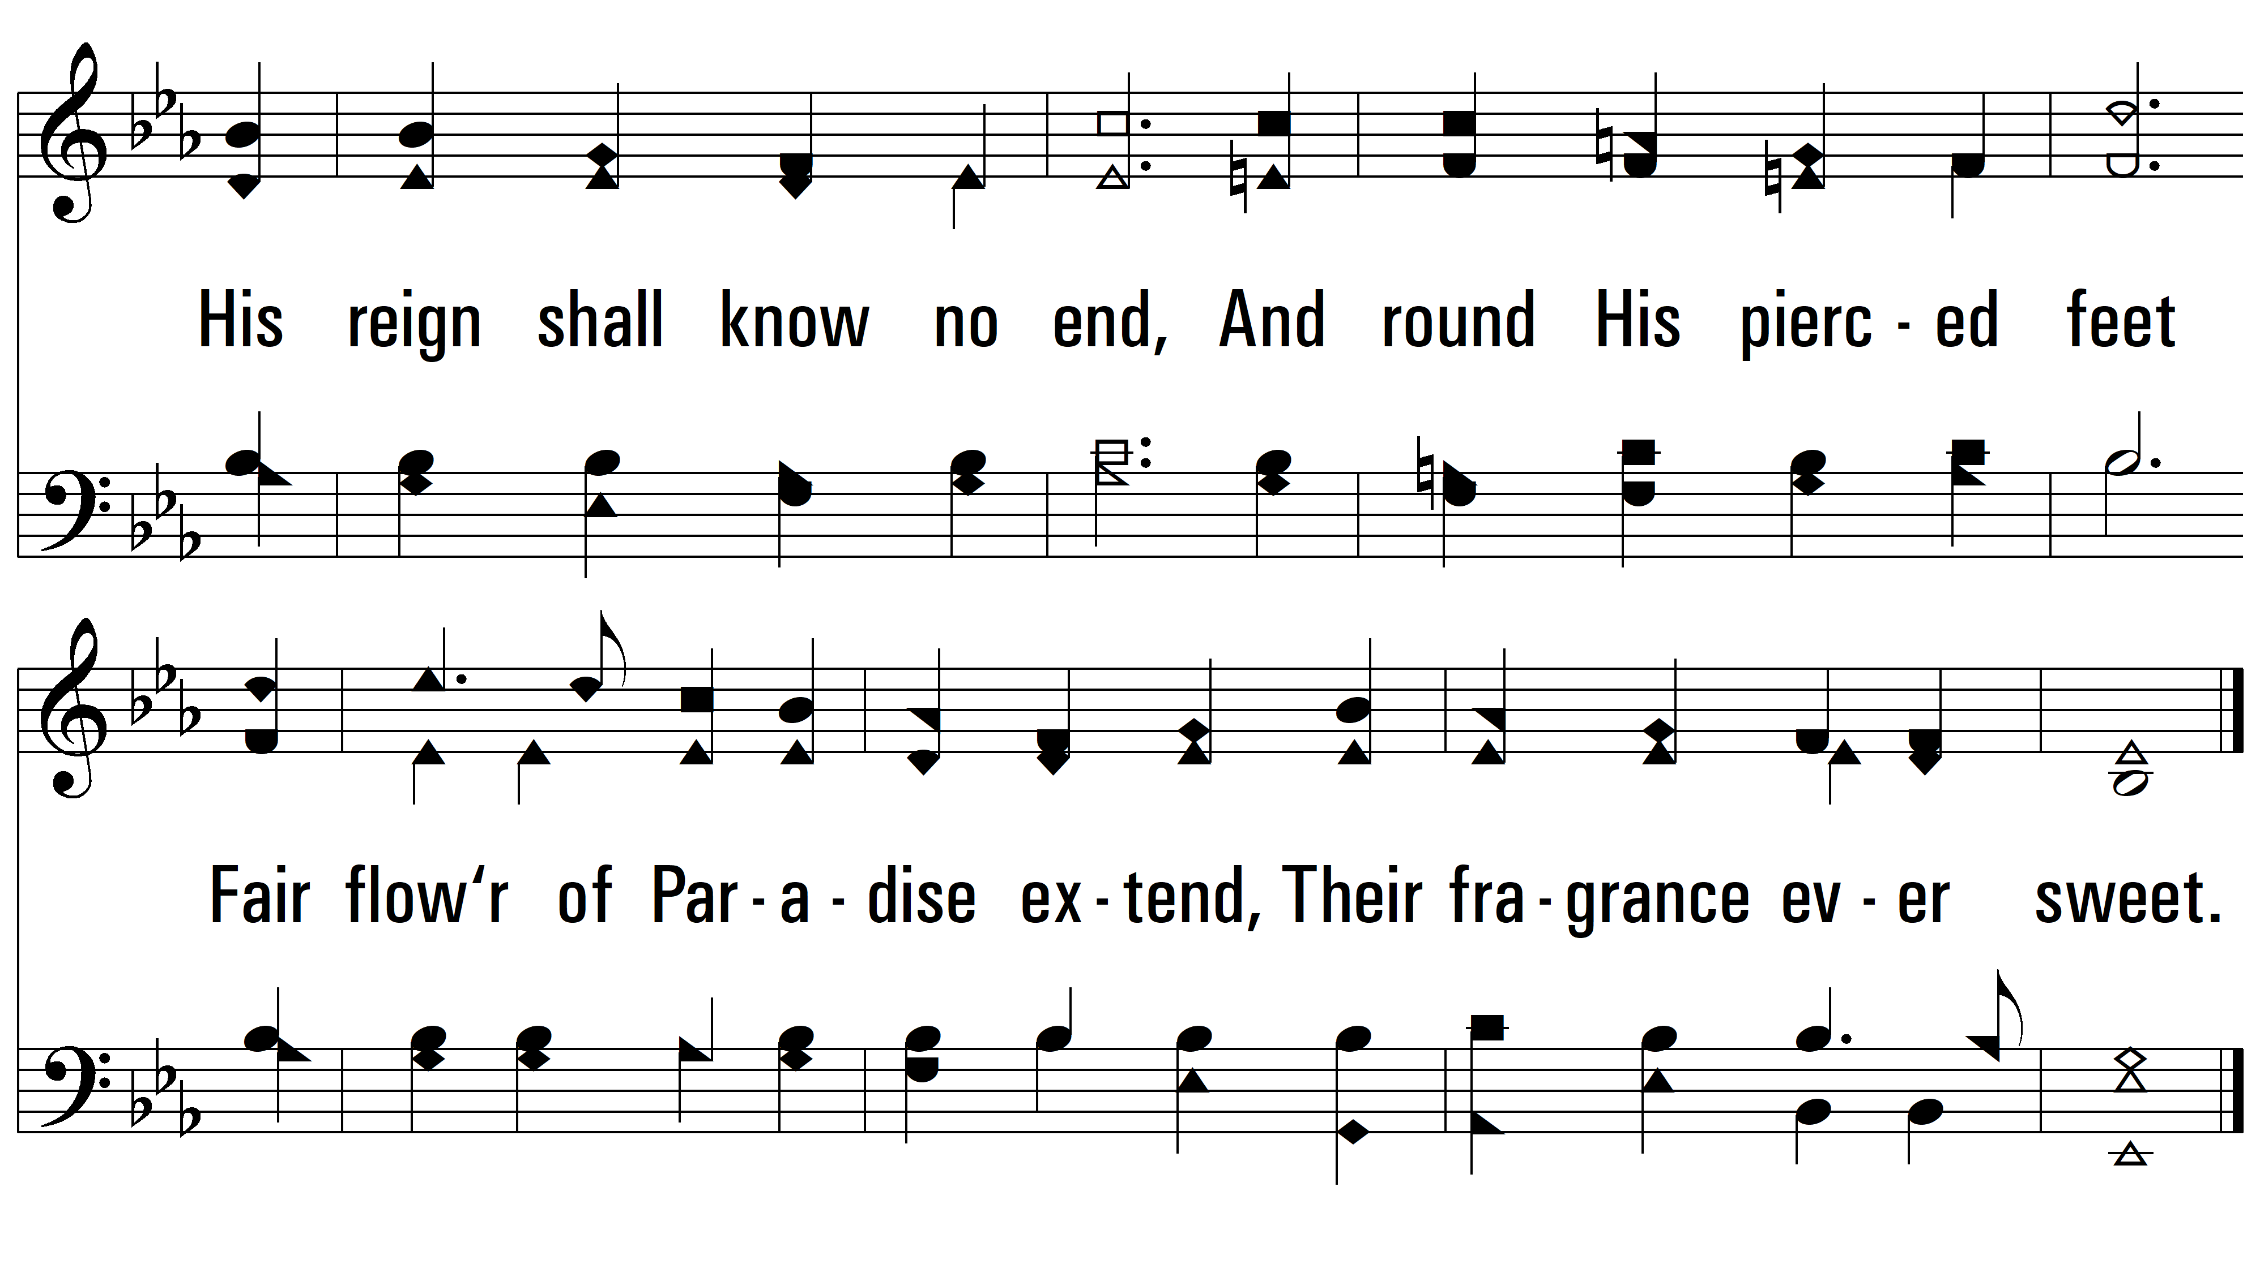
vs. 3

Slide 8
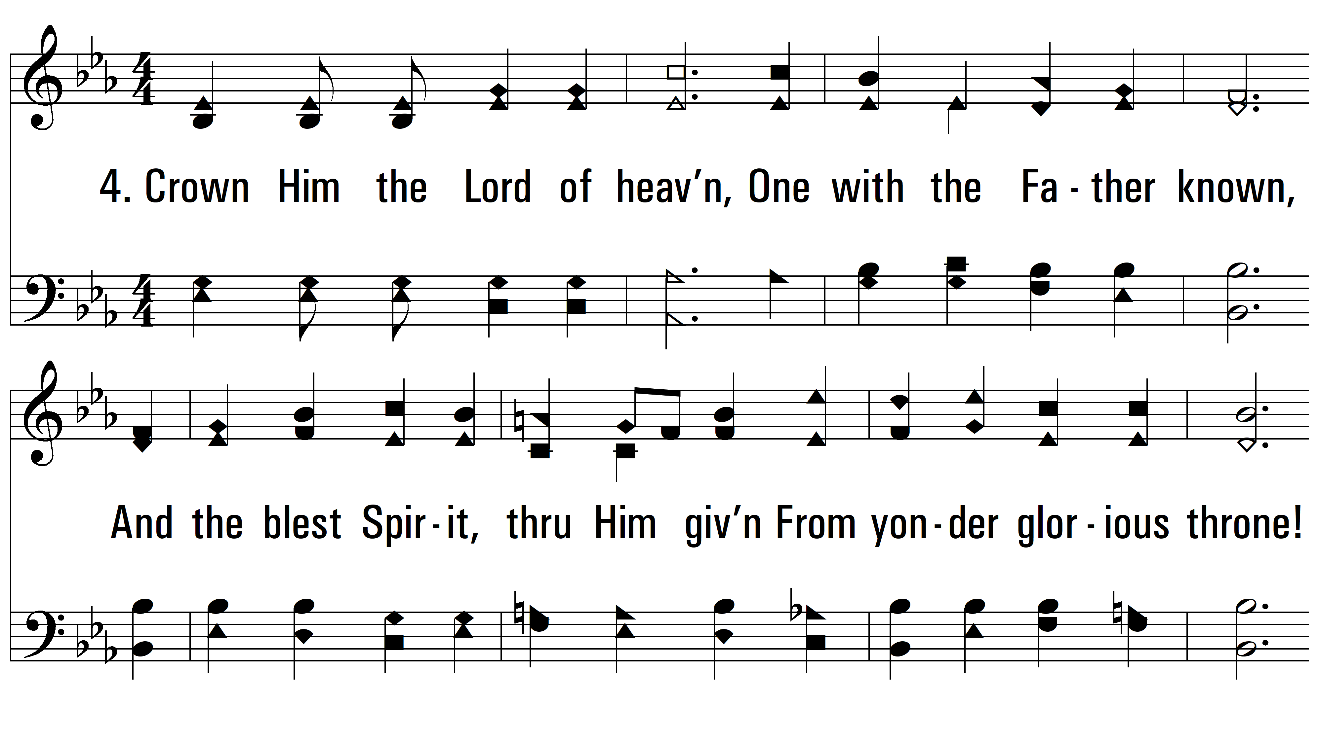
vs. 4 ~ Crown Him With Many Crowns

Slide 9
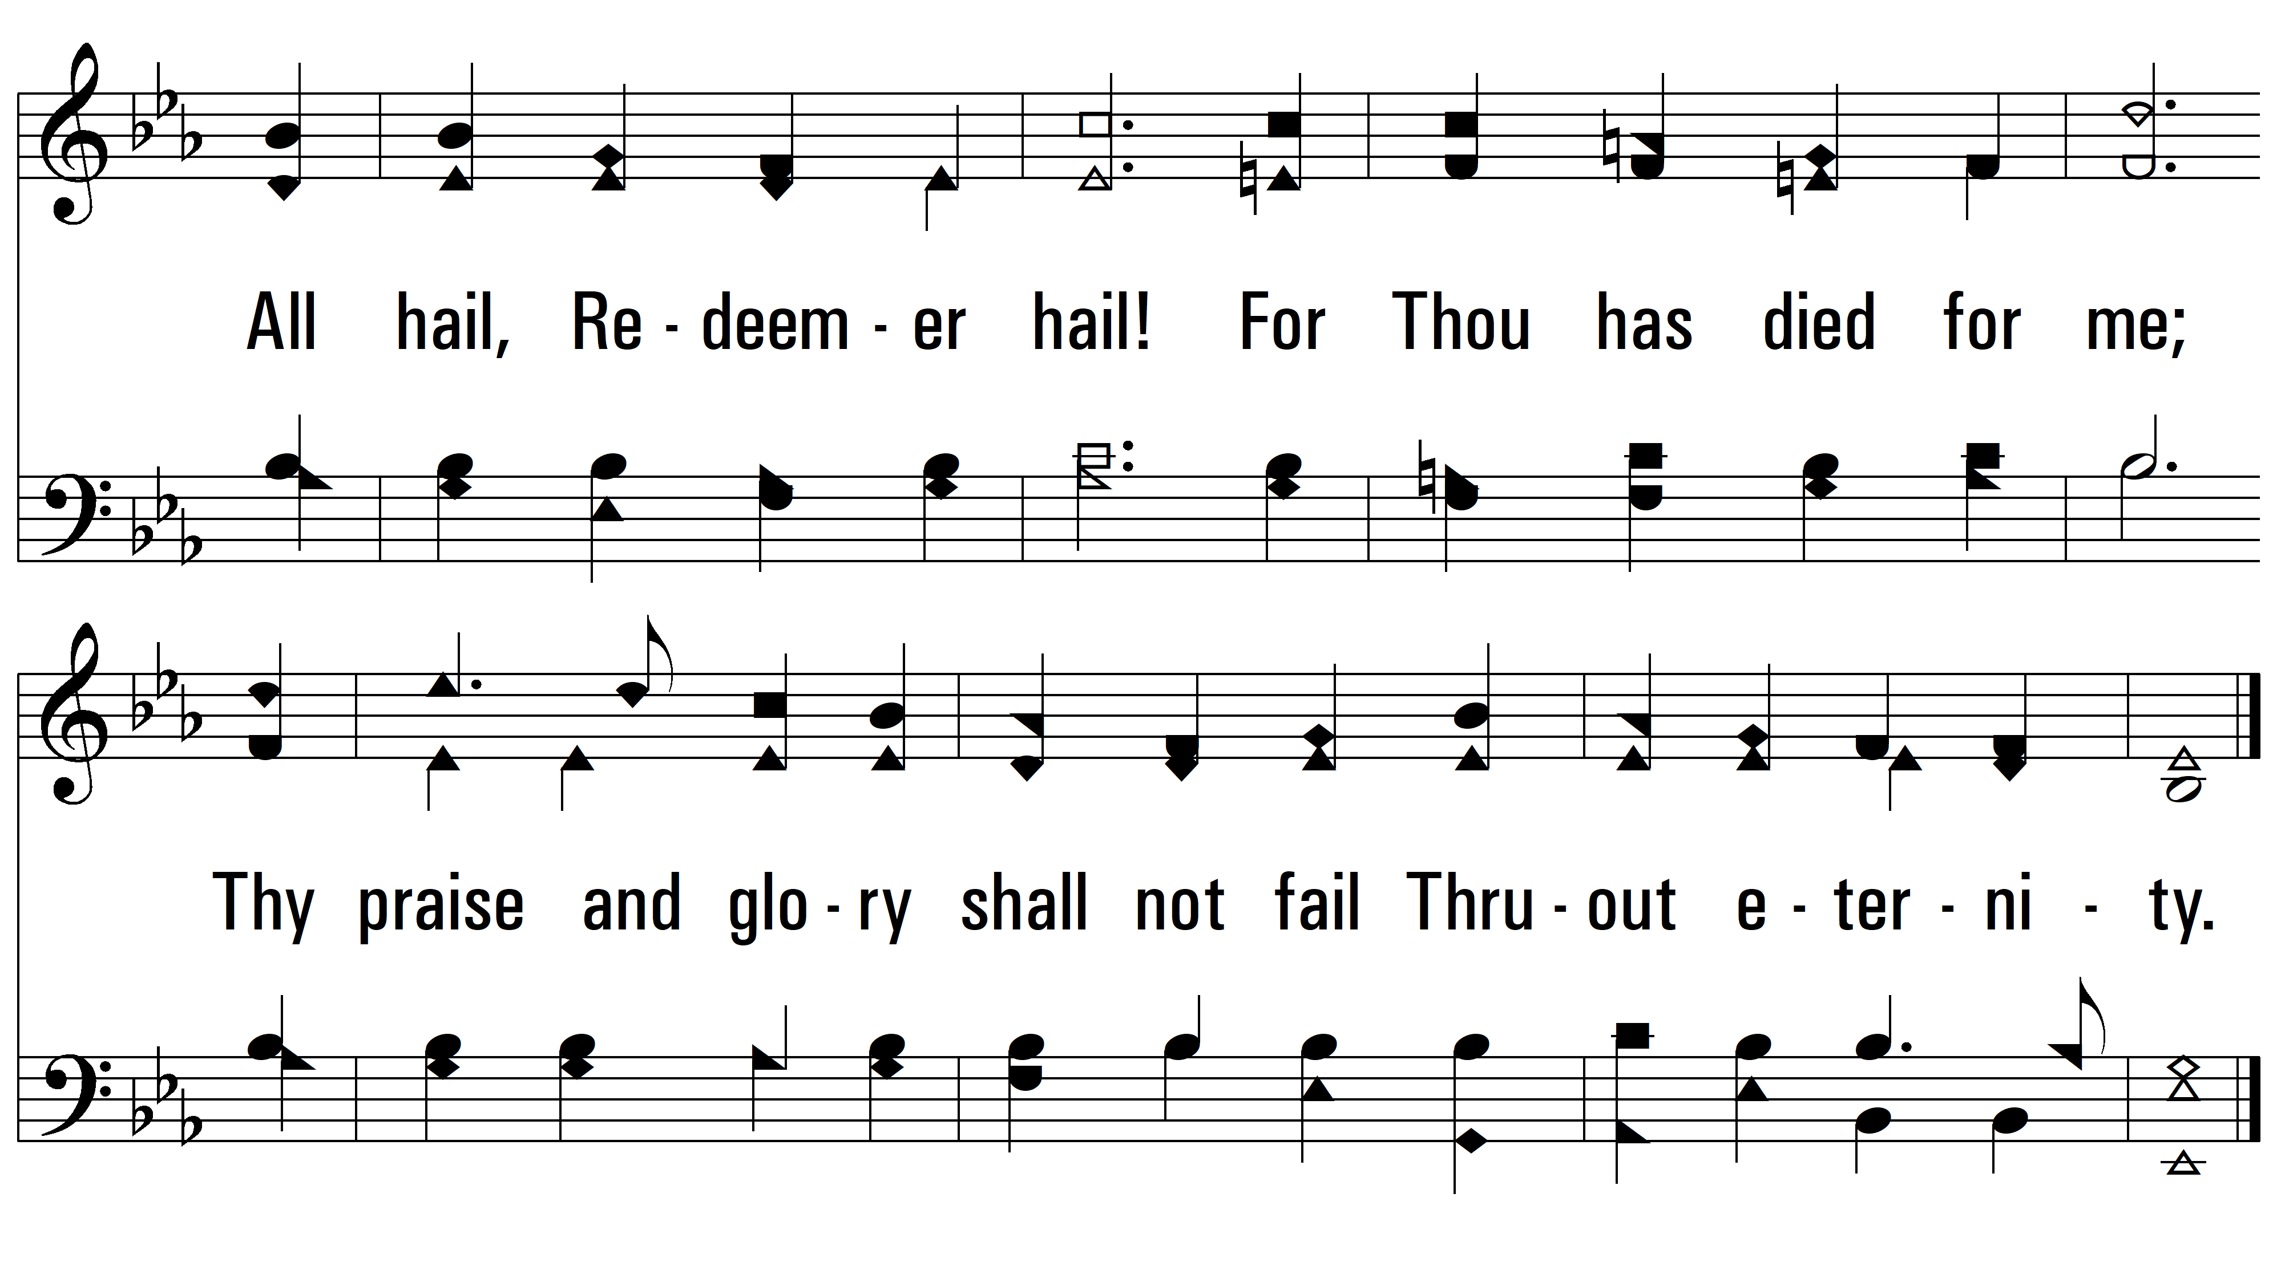
vs. 4
PDHymns.com
END

