Slide 1
Come, Ye Thankful People, Come
ST. GEORGE’S WINDSOR
7.7.7.7.D
Words: | Henry Alford (1844)
Music: | George J. Elvey (1858)
4/4
G/B - MI
Verses: 4
Lead - | MI
Alto - | SOL
Tenor - | DO
Bass - | DO
PDHymns.com

Slide 2
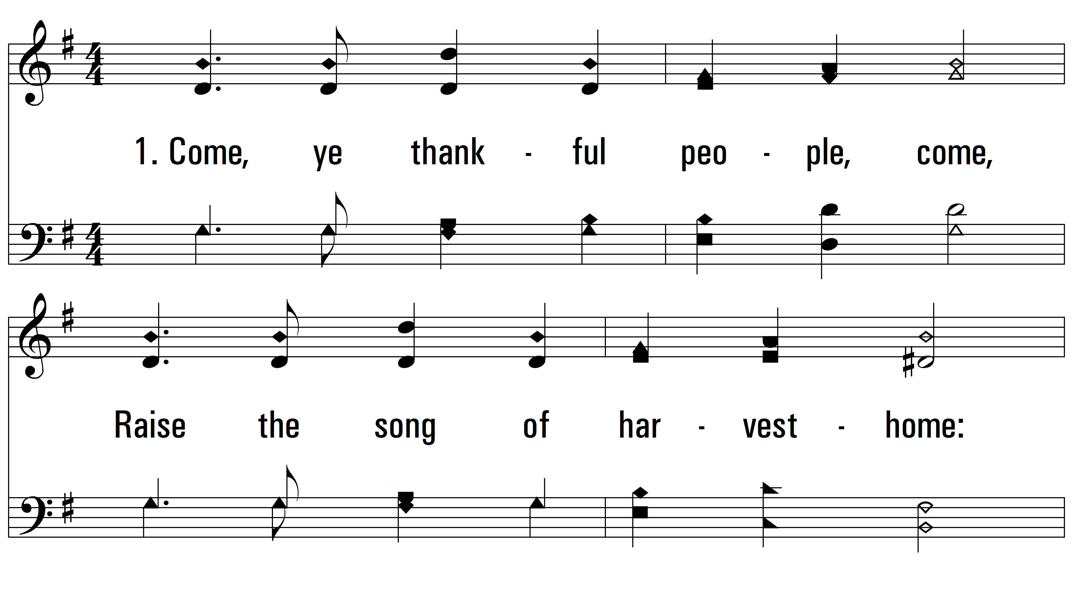
vs. 1 ~ Come, Ye Thankful People, Come

Slide 3
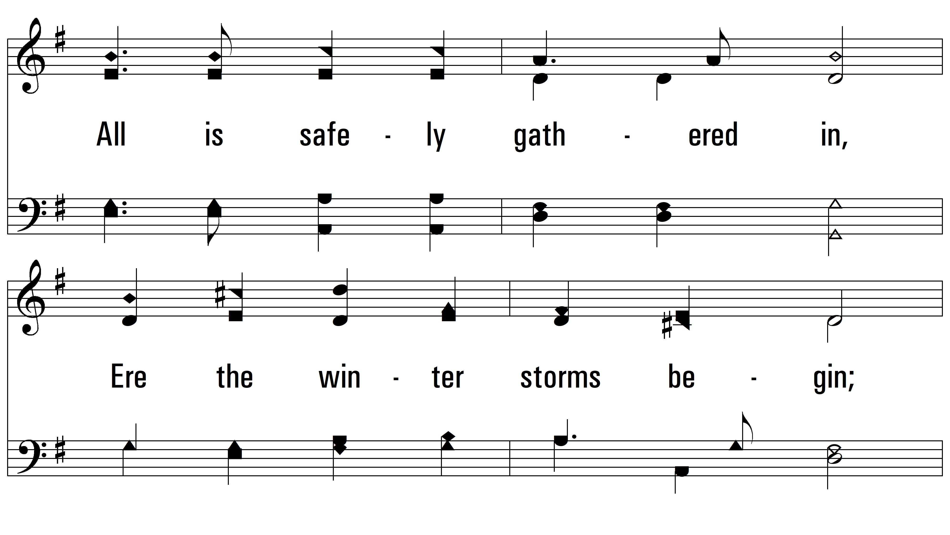
vs. 1

Slide 4
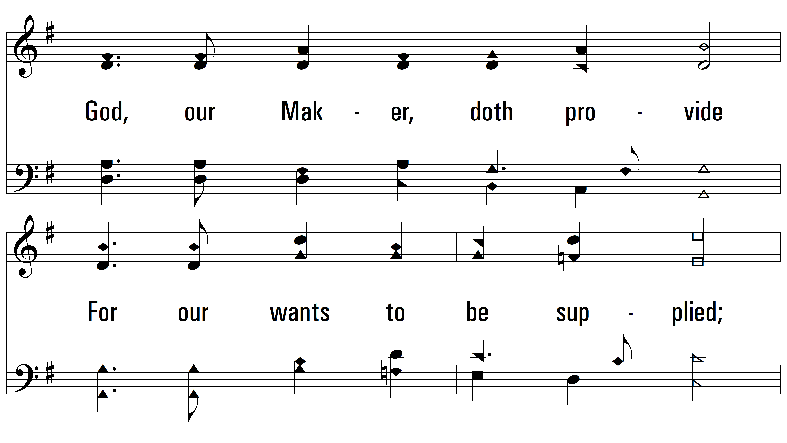
vs. 1

Slide 5
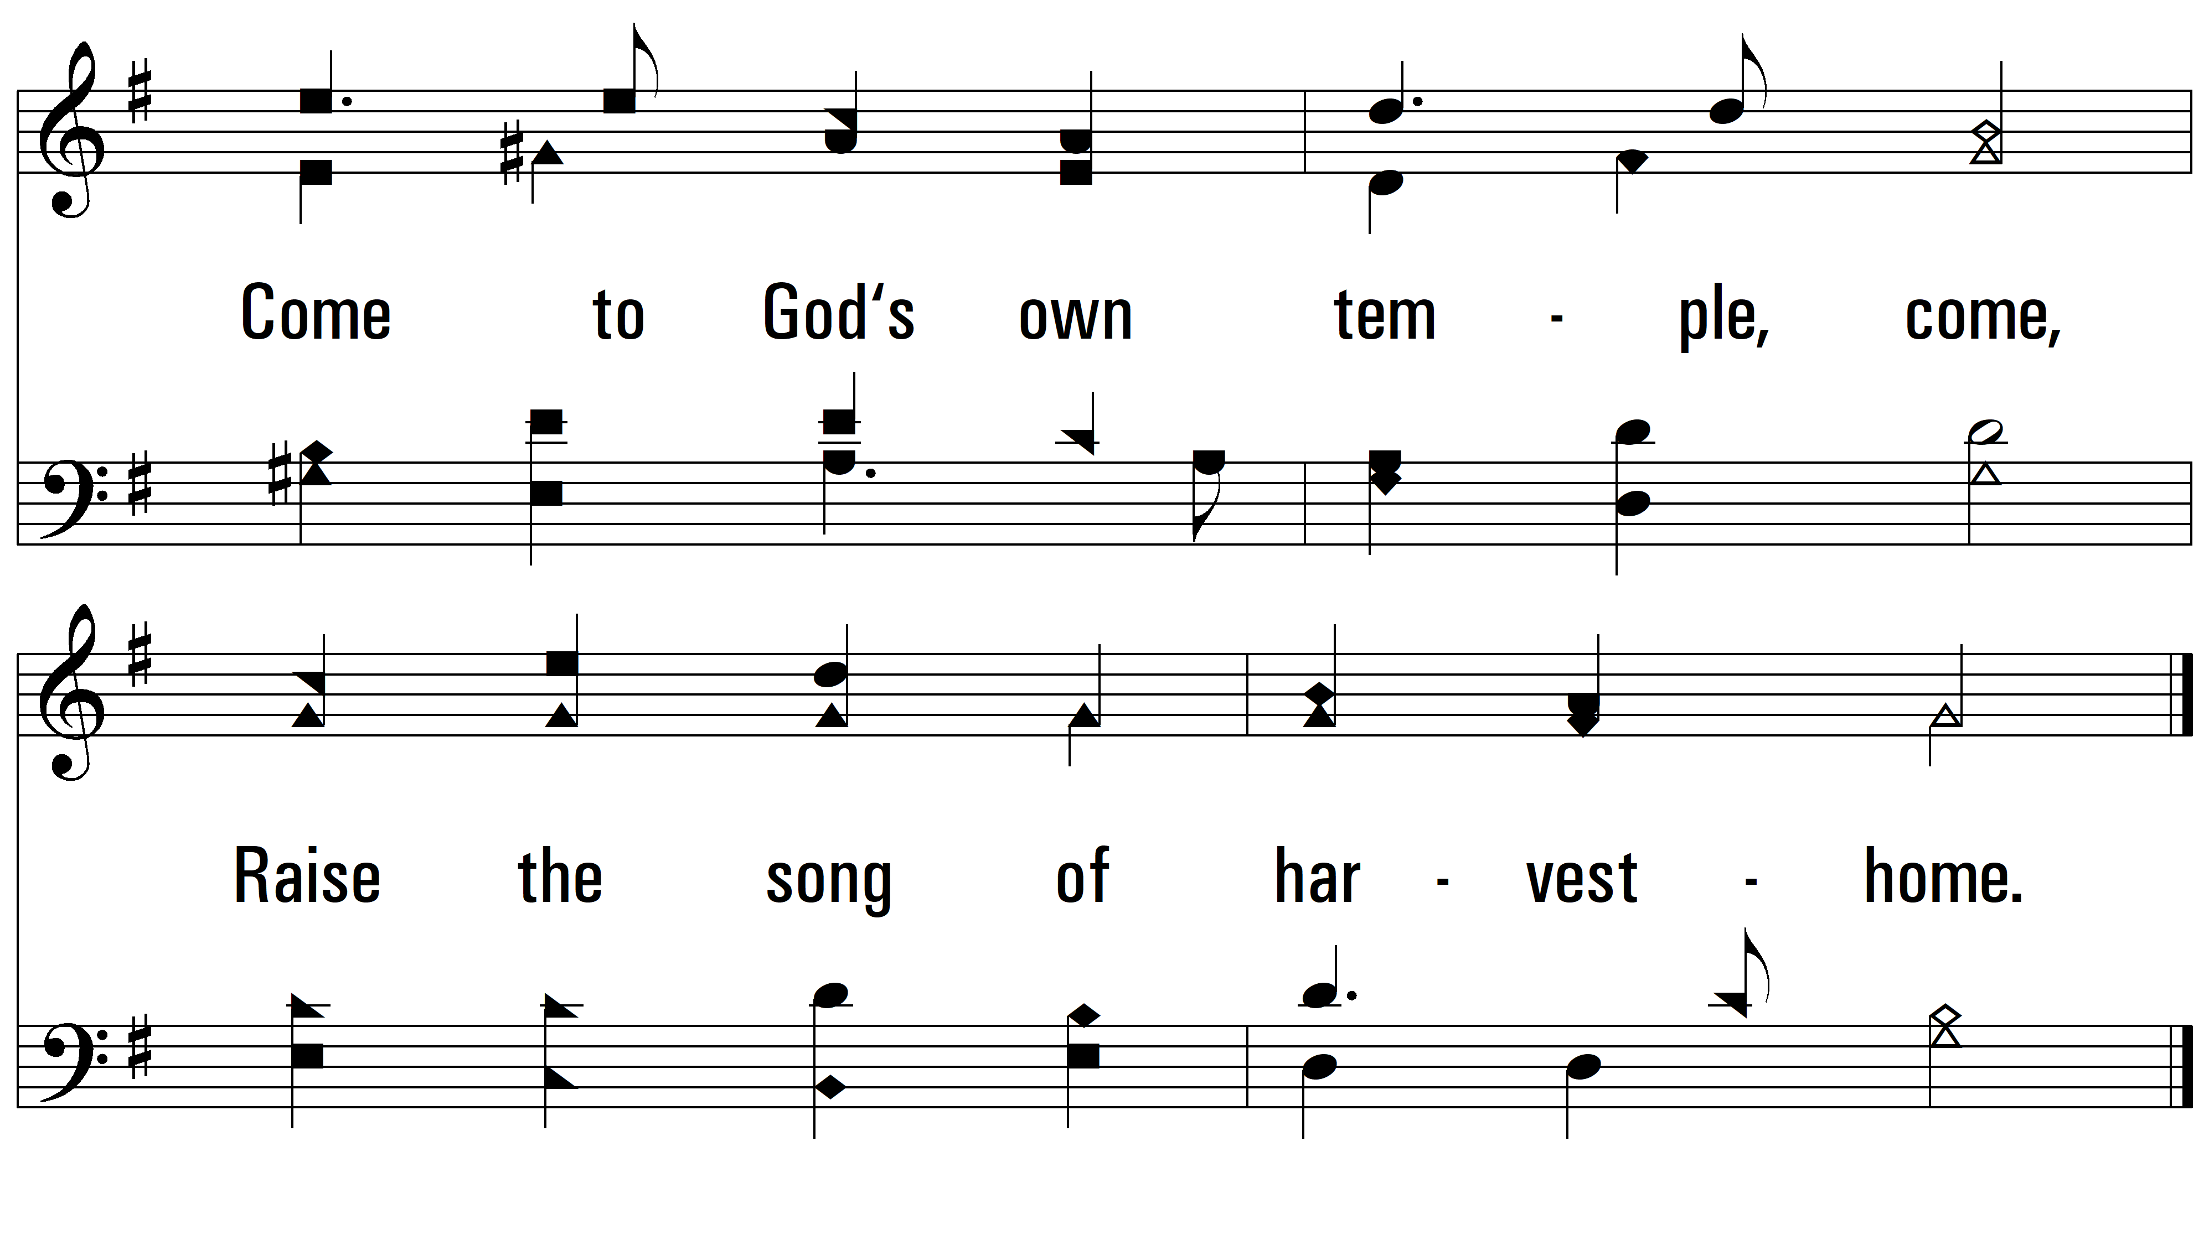
vs. 1

Slide 6
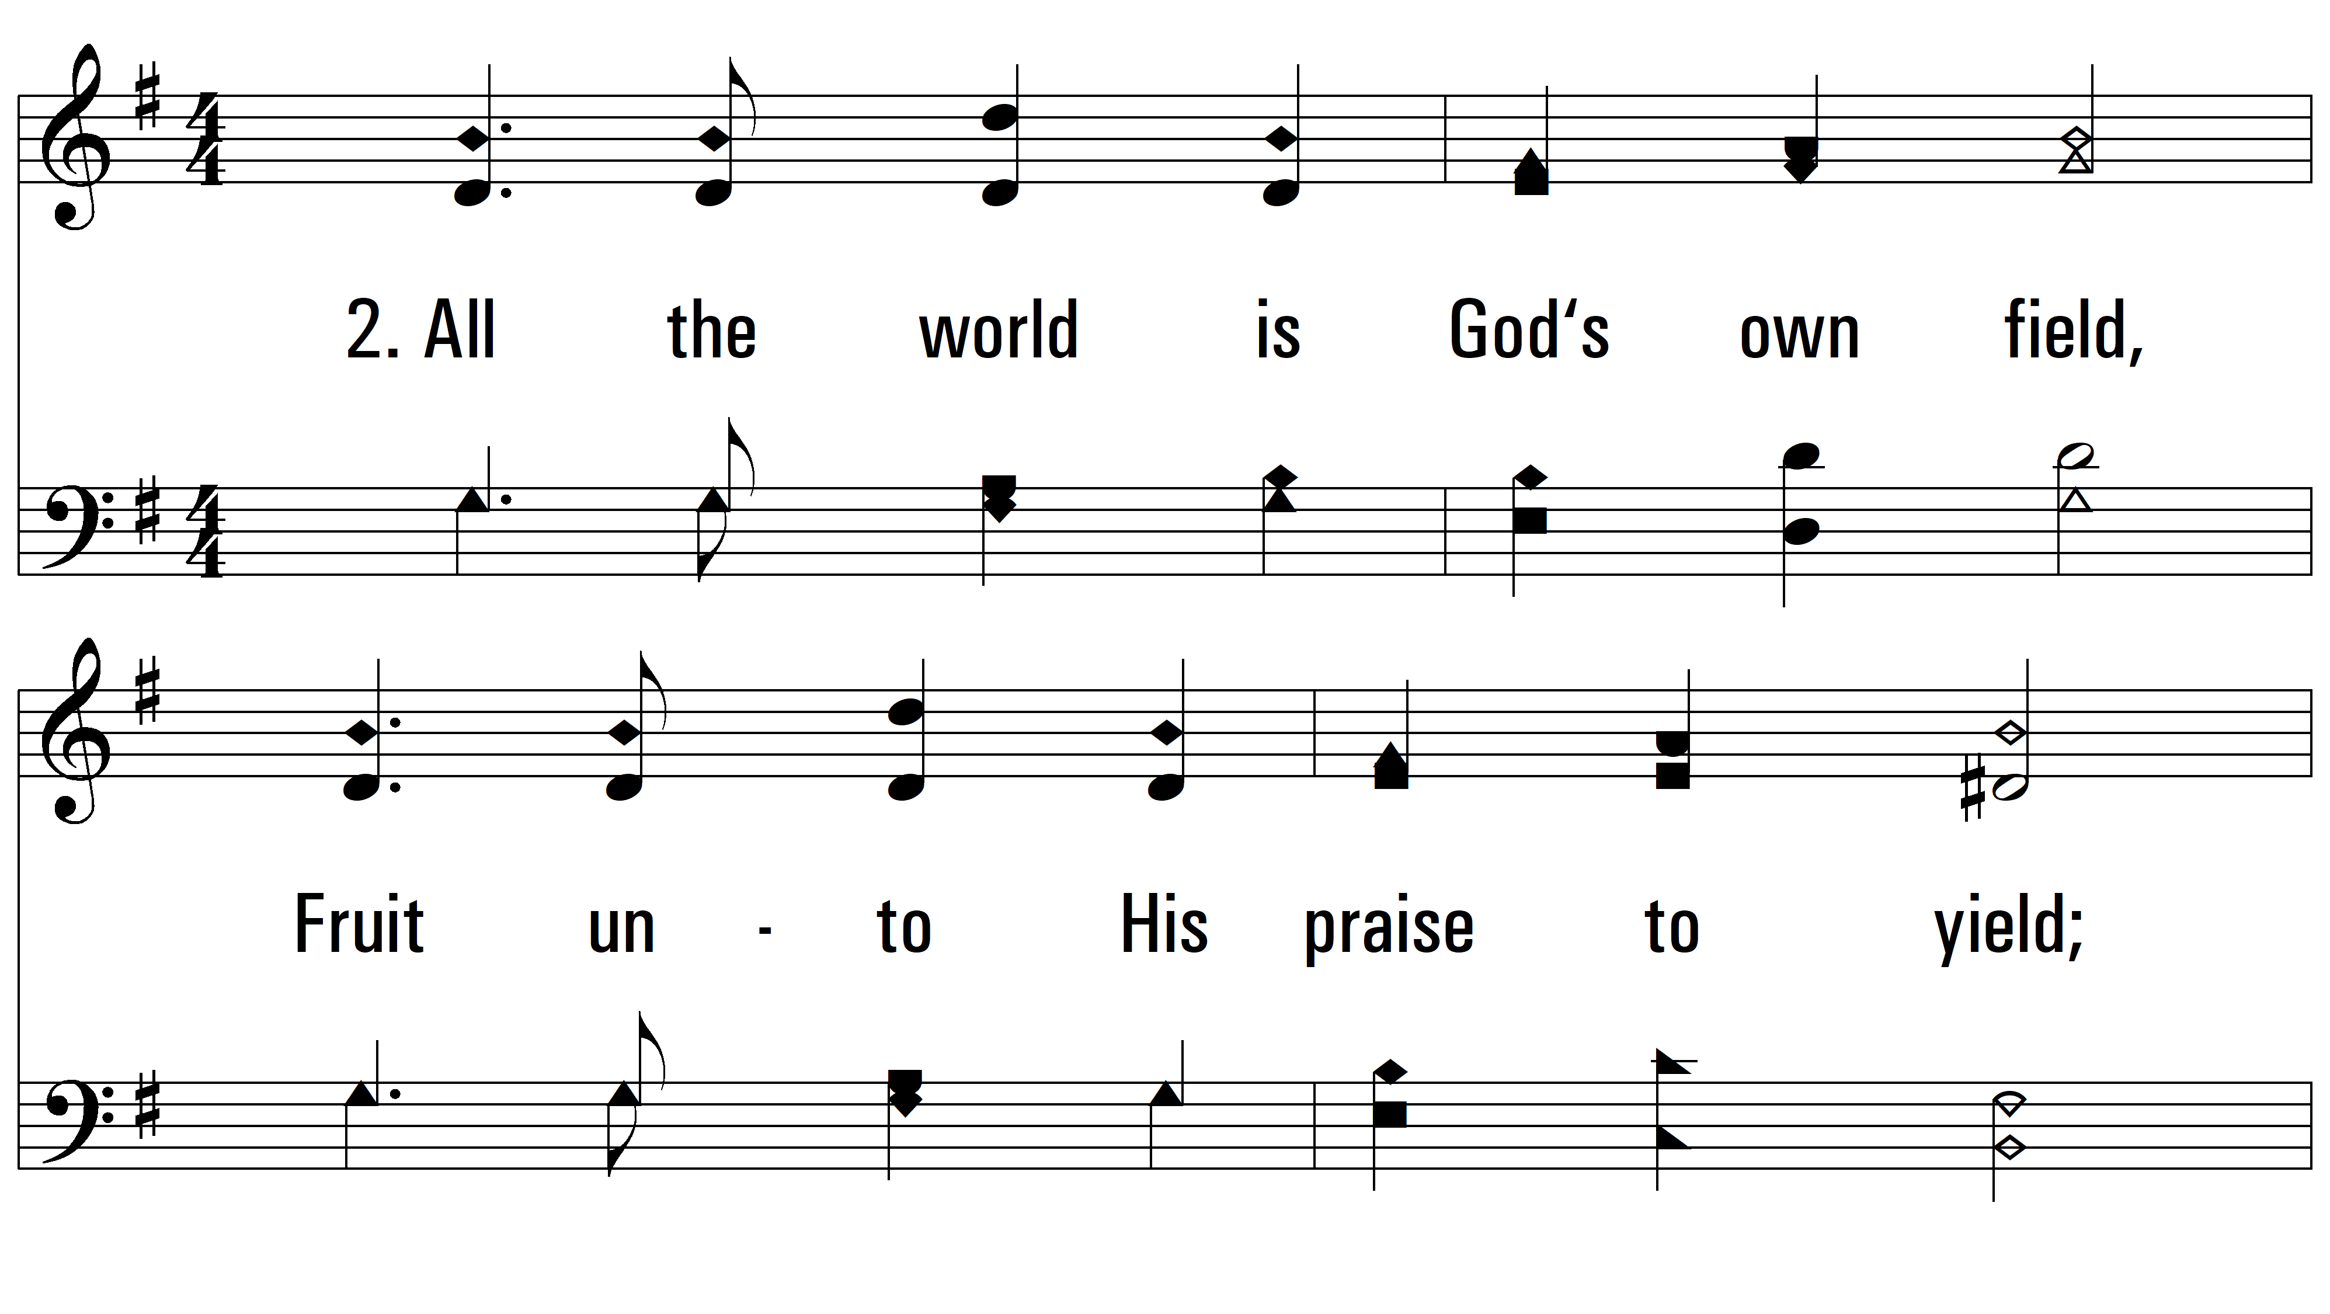
vs. 2 ~ Come, Ye Thankful People, Come

Slide 7
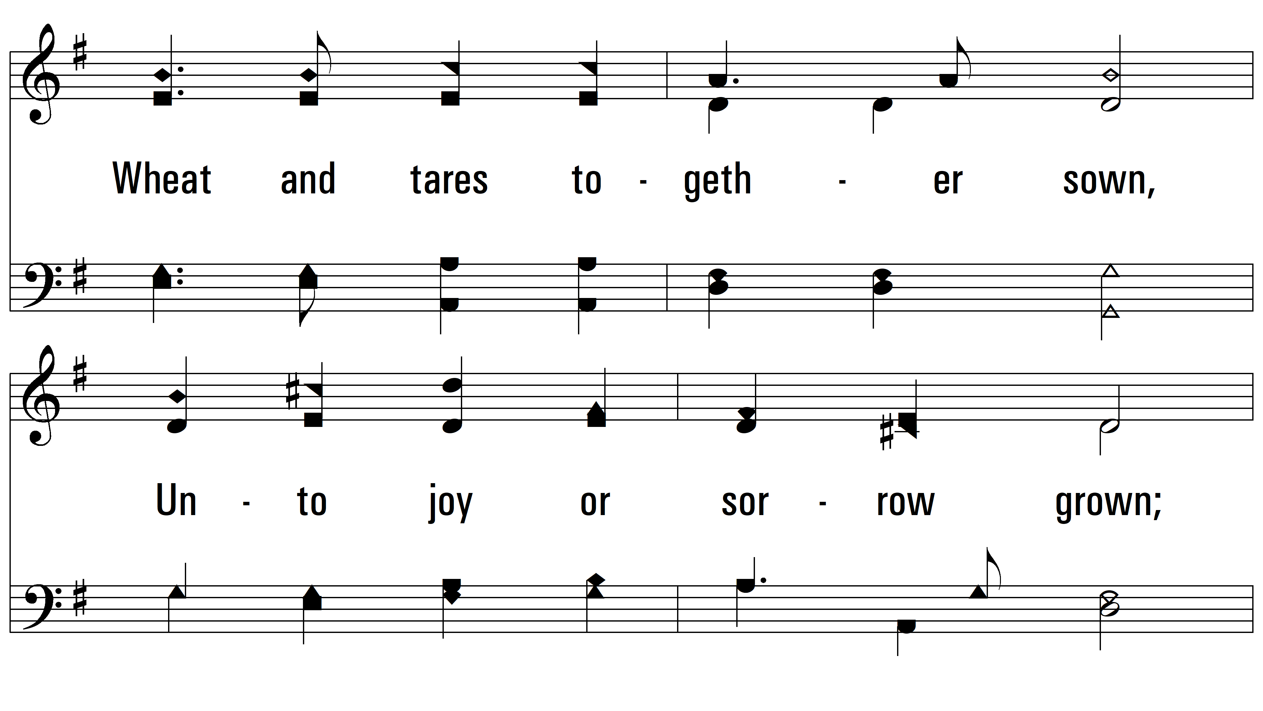
vs. 2

Slide 8
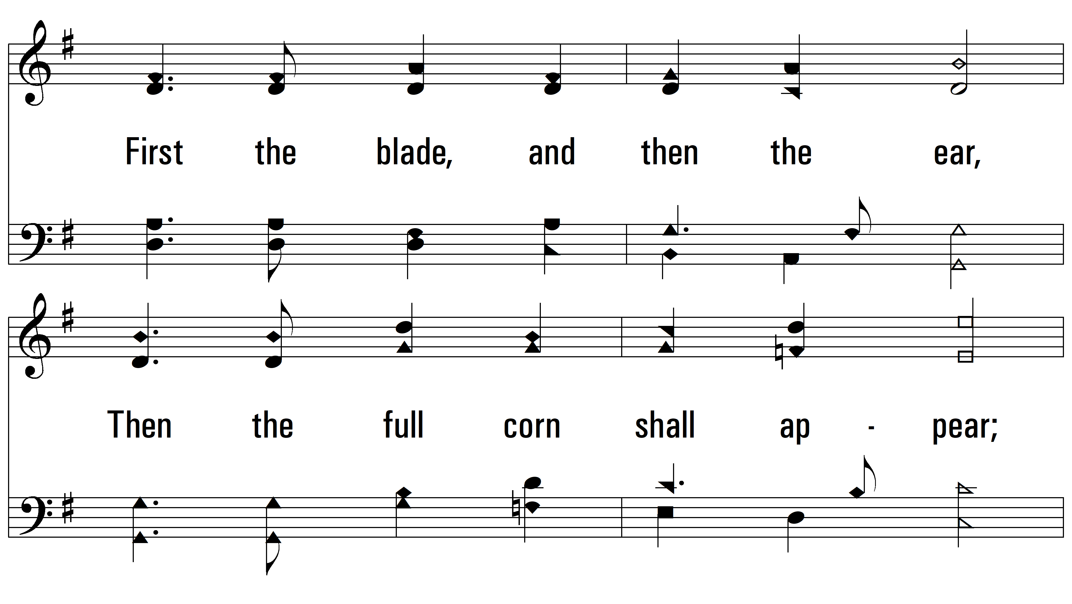
vs. 2

Slide 9
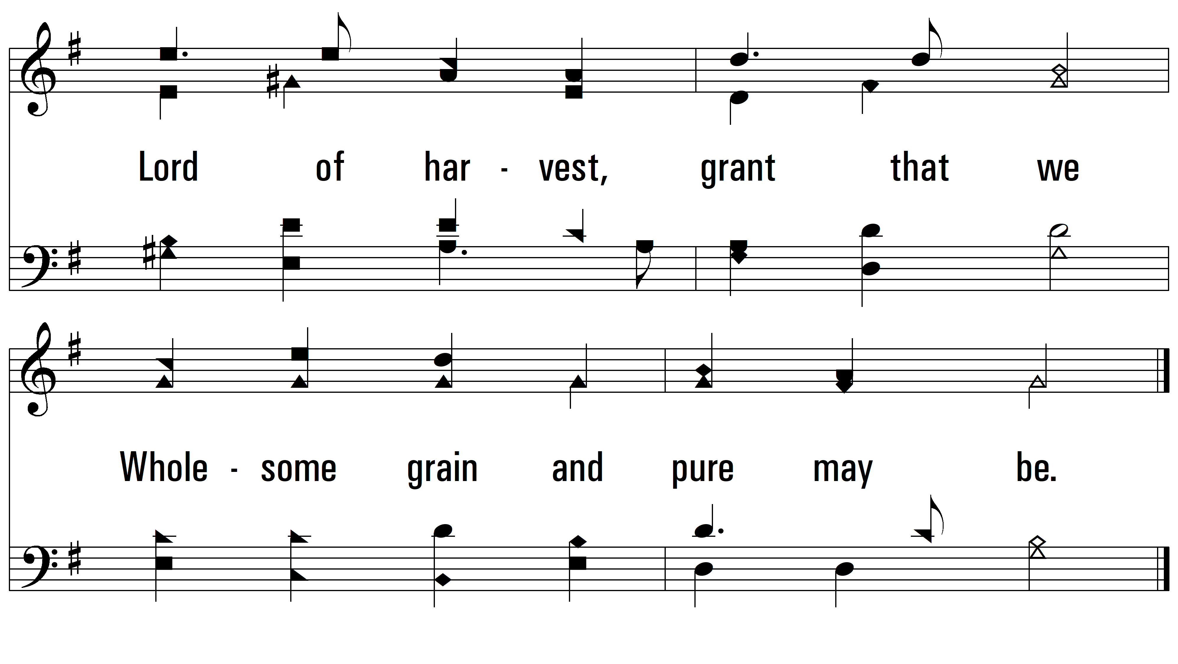
vs. 2

Slide 10
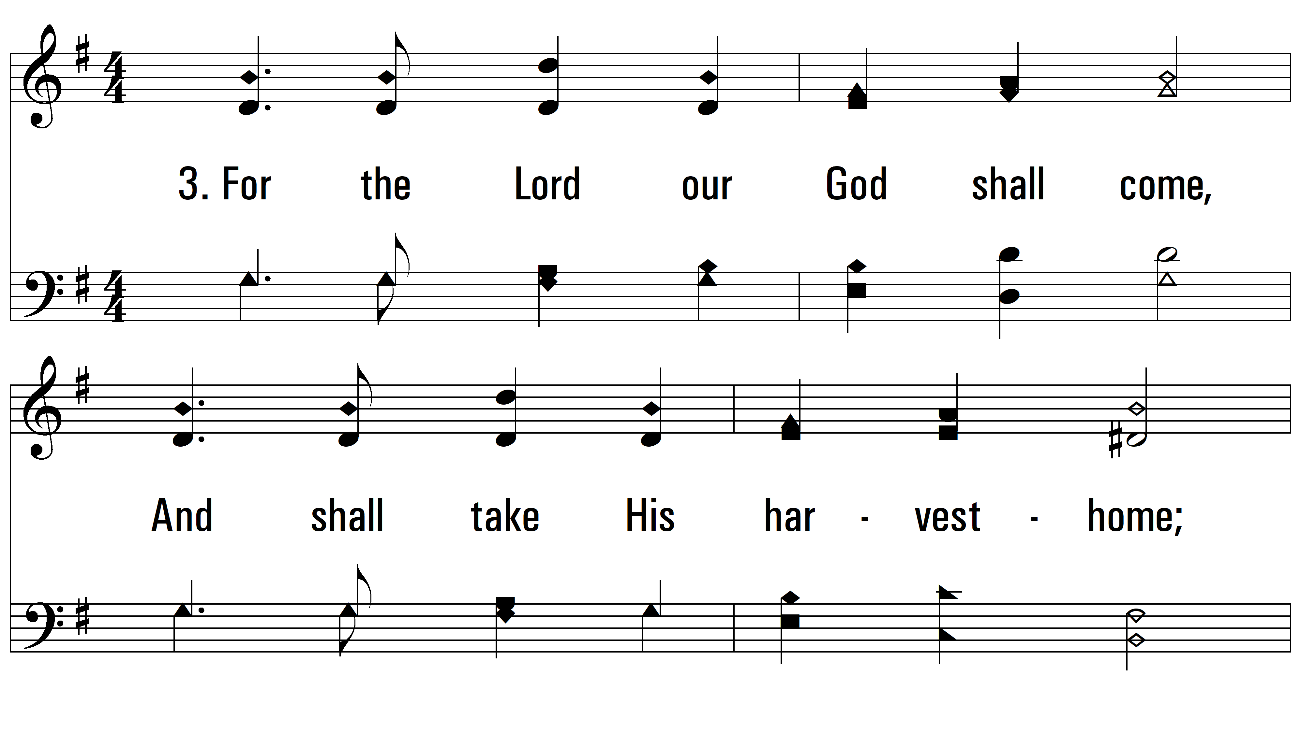
vs. 3 ~ Come, Ye Thankful People, Come

Slide 11
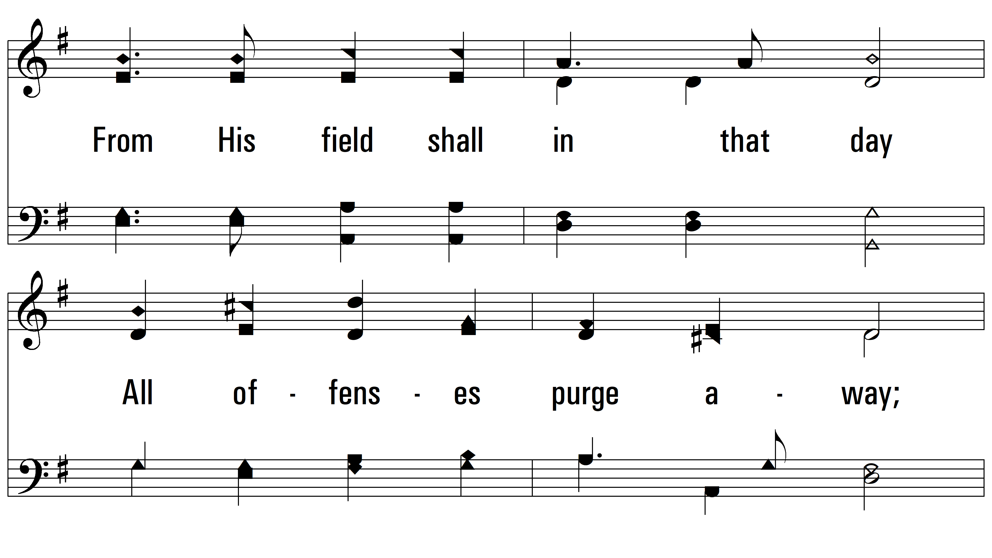
vs. 3

Slide 12
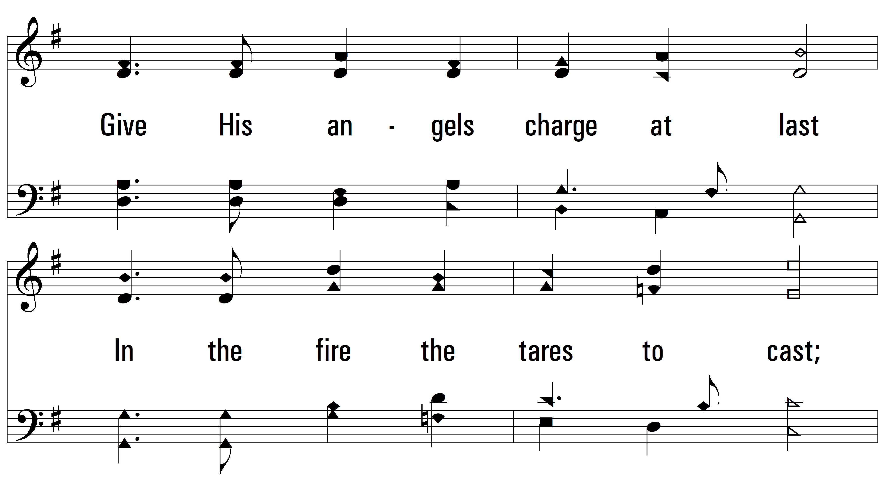
vs. 3

Slide 13
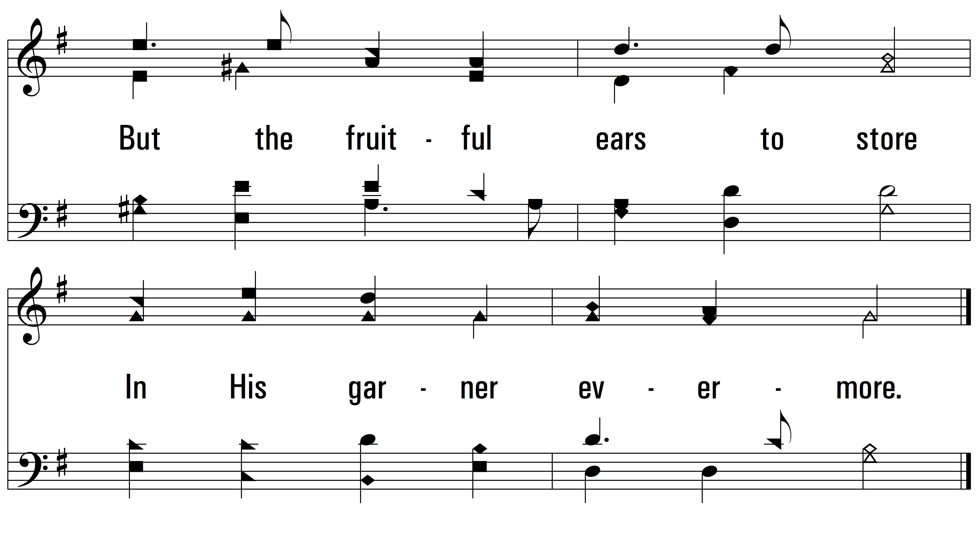
vs. 3

Slide 14
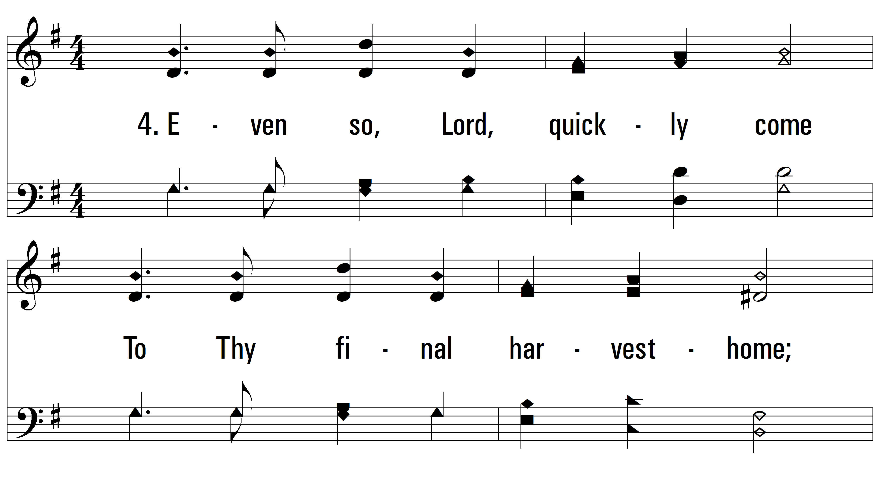
vs. 4 ~ Come, Ye Thankful People, Come

Slide 15
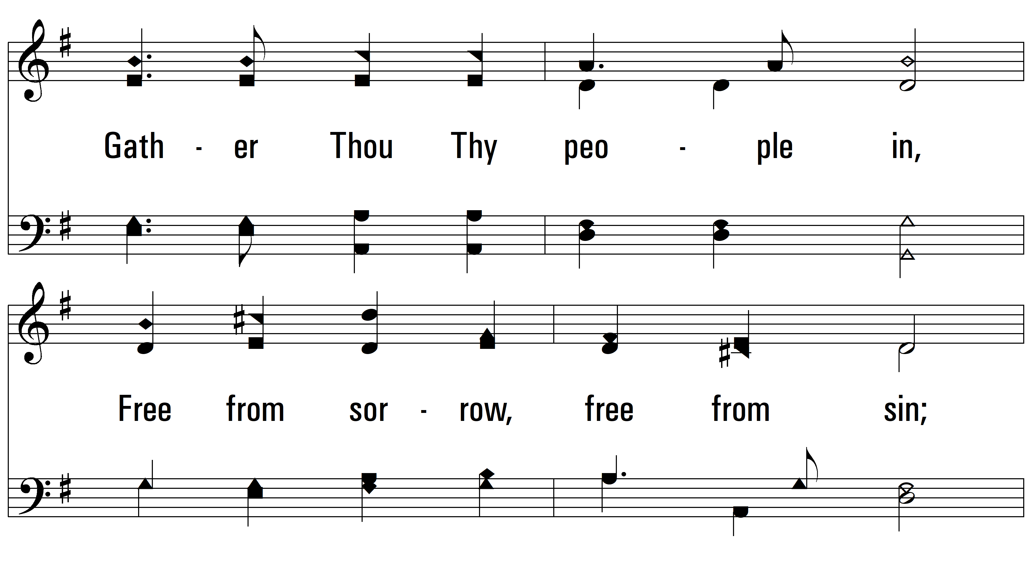
vs. 4

Slide 16
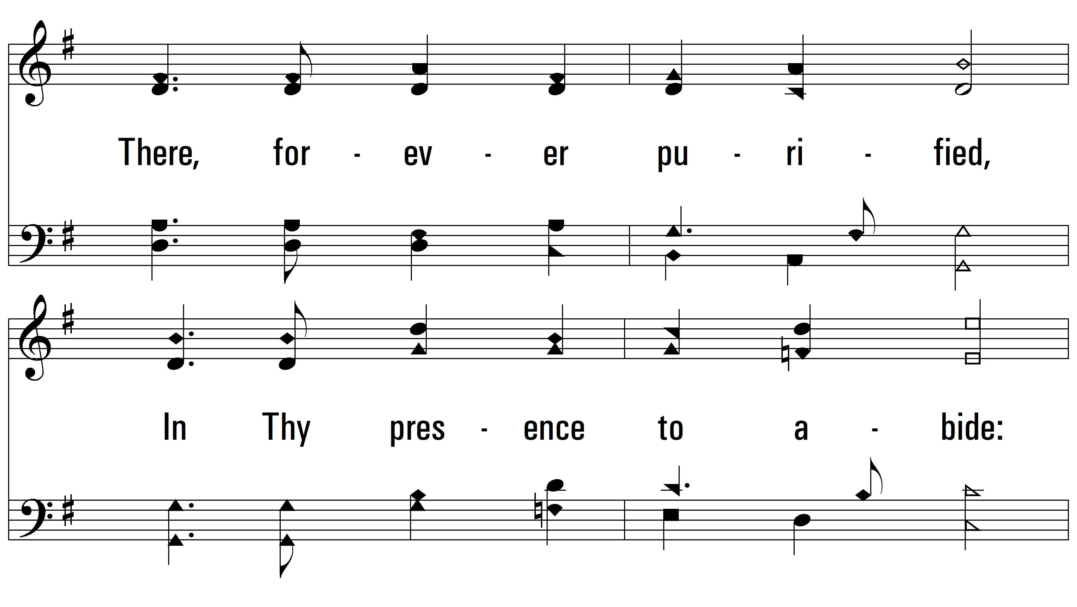
vs. 4

Slide 17
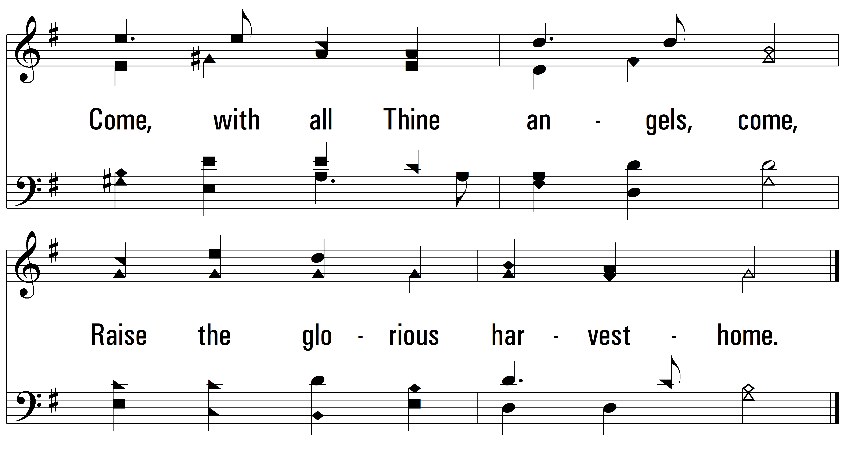
vs. 4
PDHymns.com
END

