Slide 1
Come, Sinner, Come
(While Jesus Whispers To You)
Words: | W. E. Witter (1877)
Music: | H. R. Palmer (1879)
6/8
F/A - MI
Verses: 5
Lead - | MI
Alto - | DO
Tenor - | SOL
Bass - | DO
PDHymns.com

Slide 2
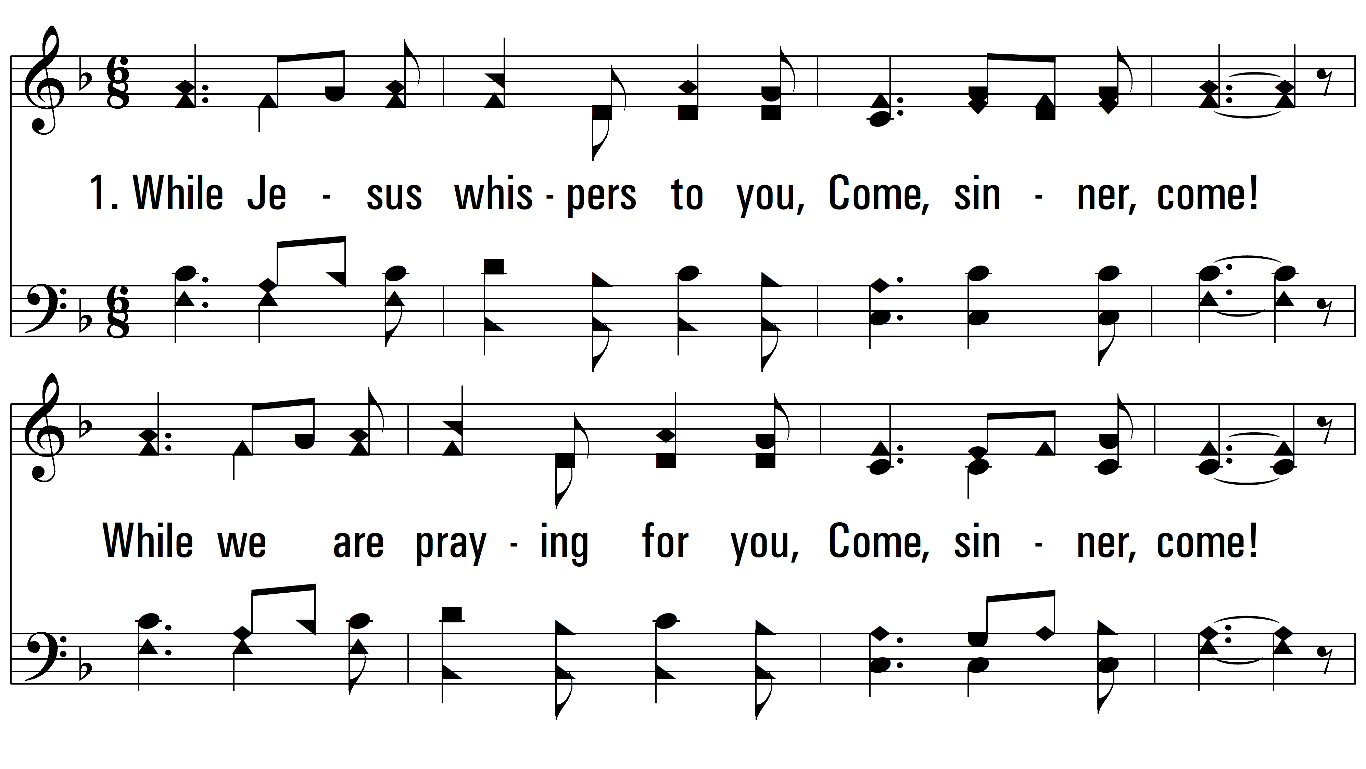
vs. 1 ~ Come, Sinner, Come

Slide 3
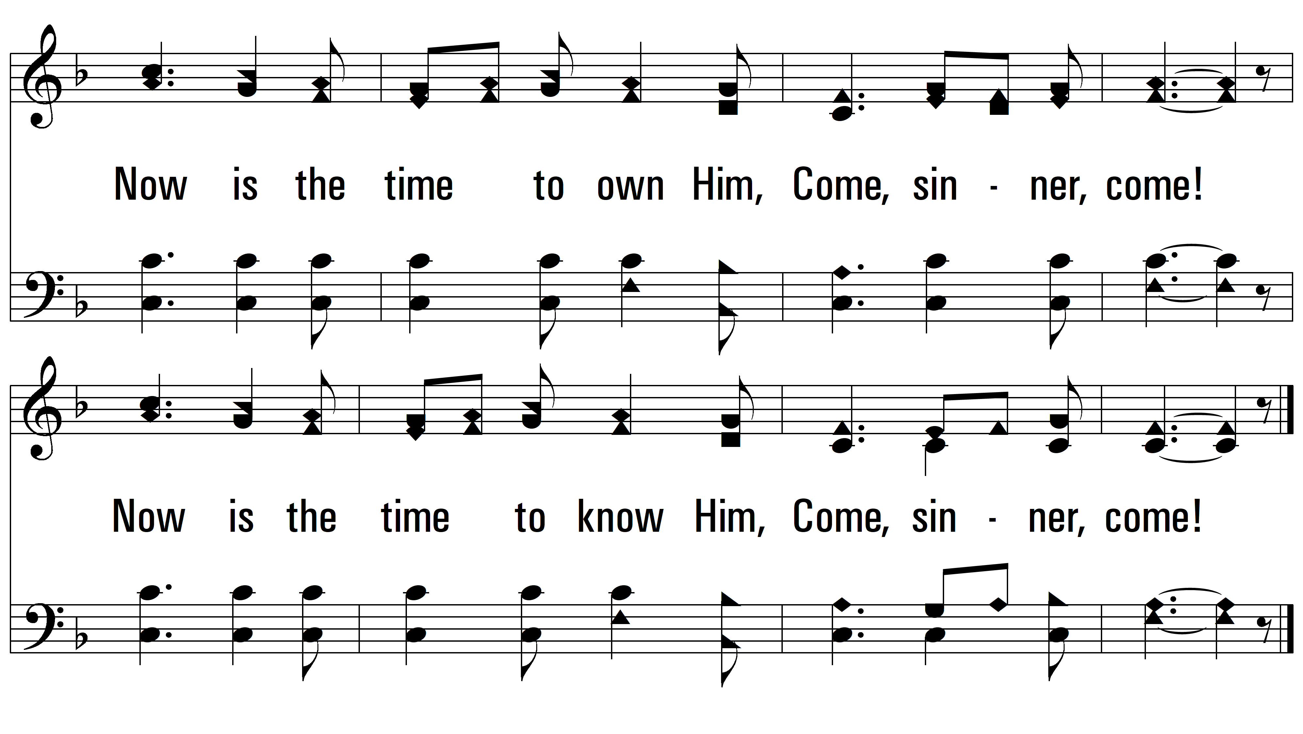
vs. 1

Slide 4
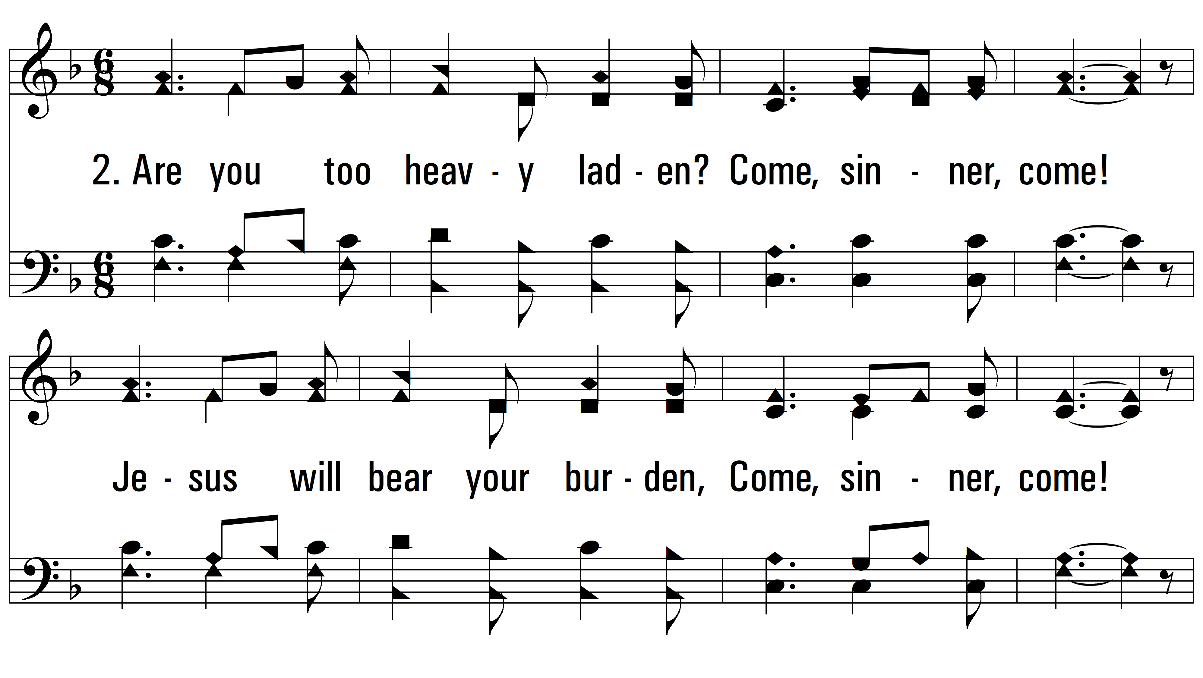
vs. 2 ~ Come, Sinner, Come

Slide 5
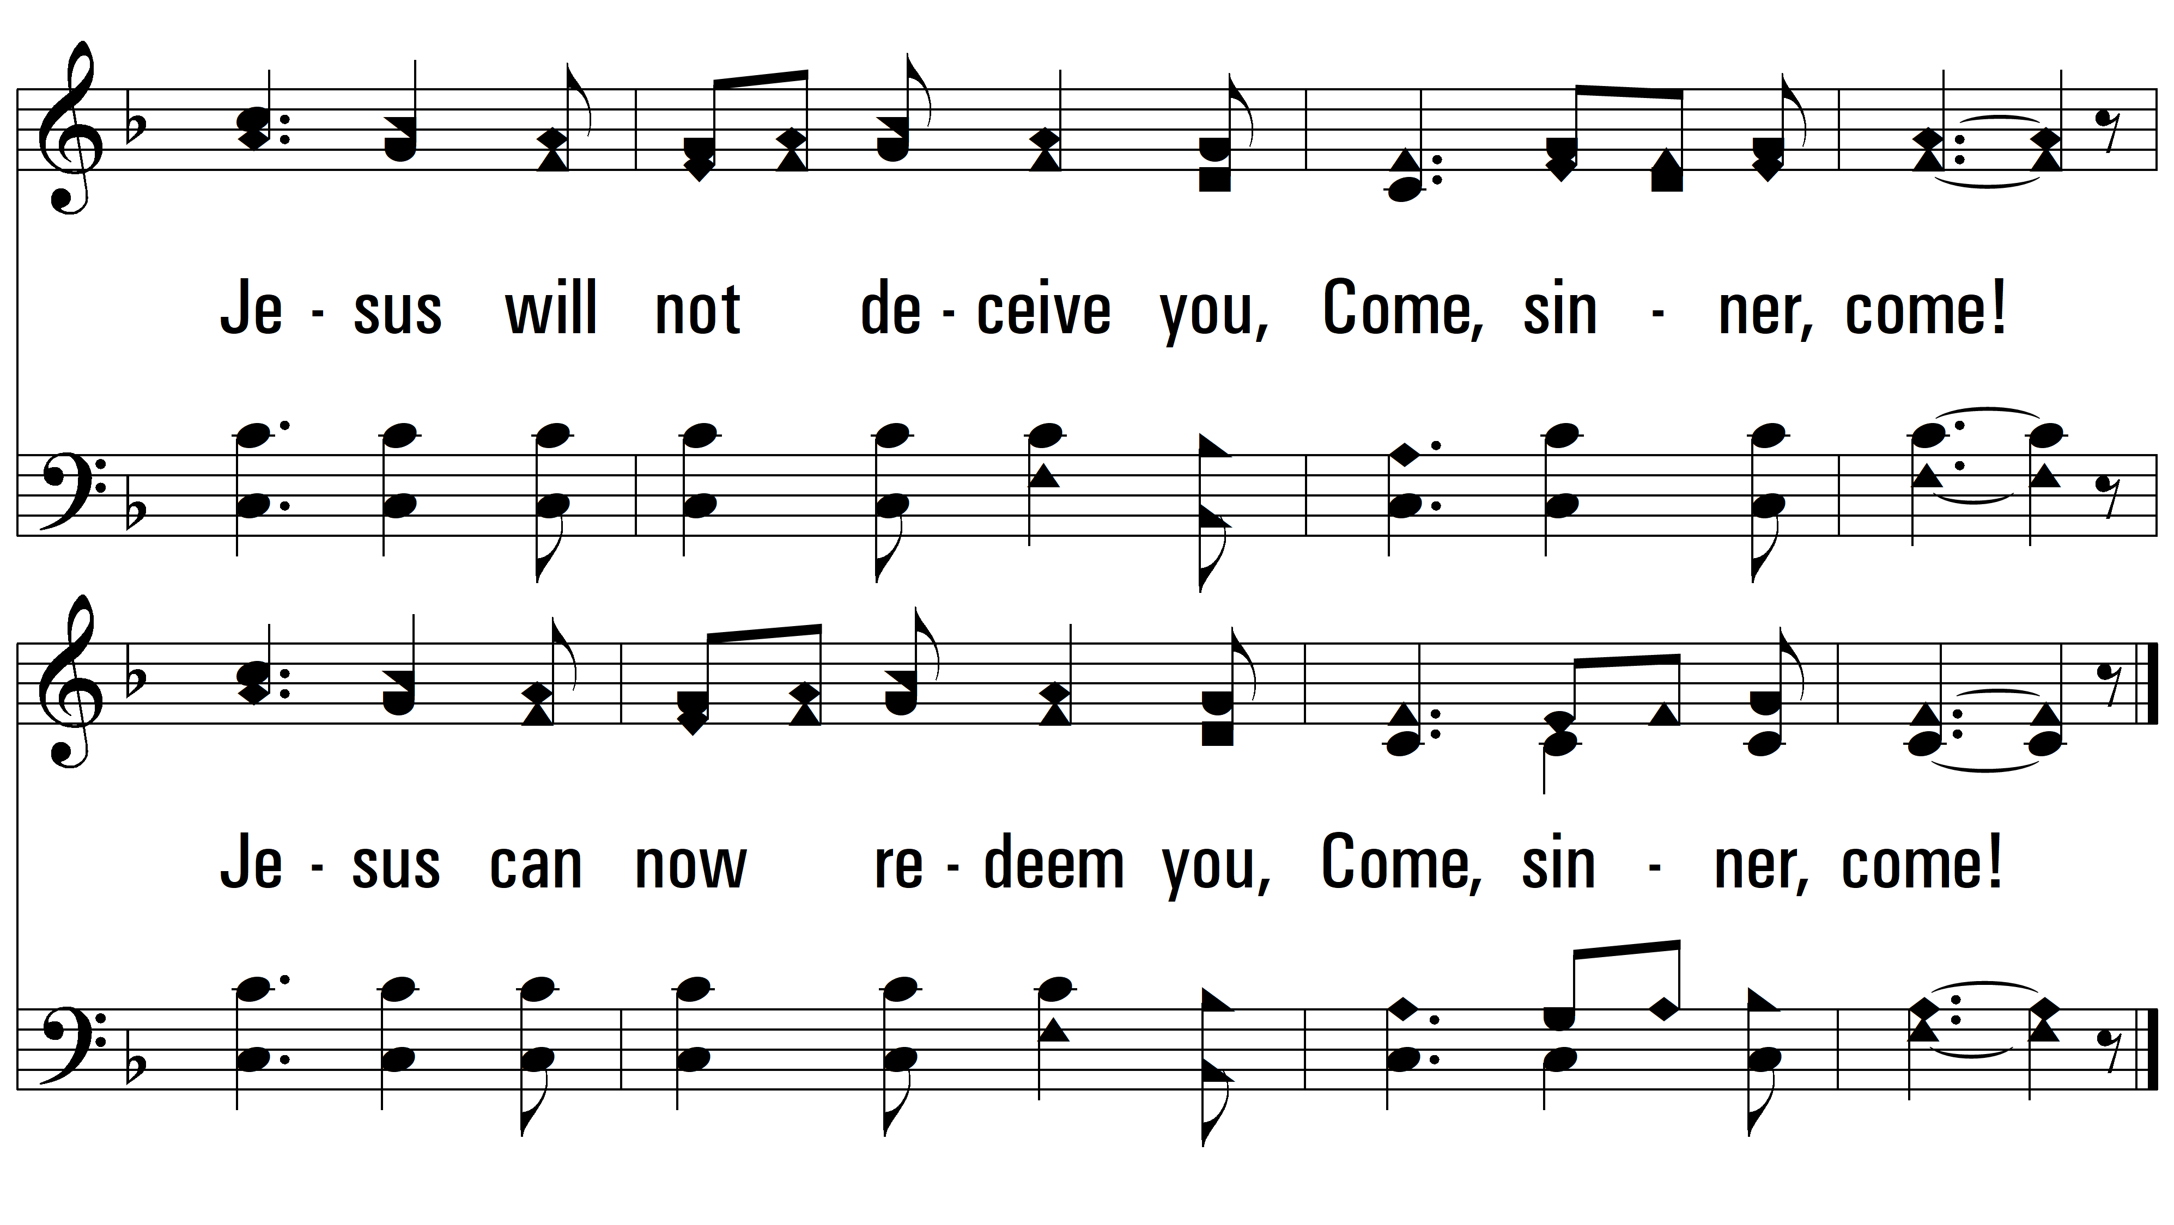
vs. 2

Slide 6
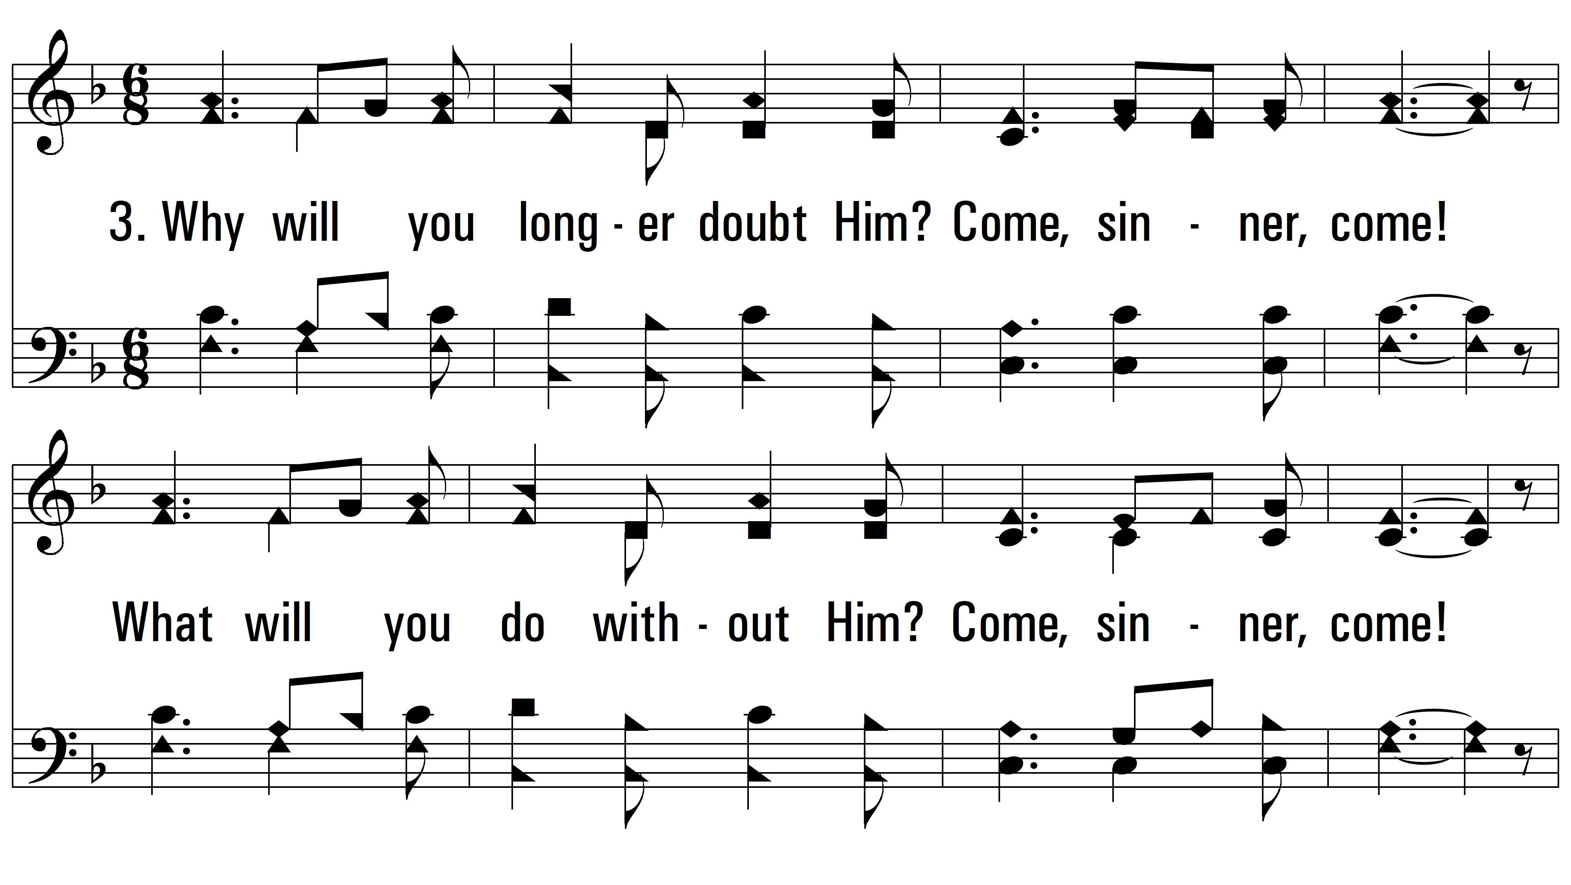
vs. 3 ~ Come, Sinner, Come

Slide 7
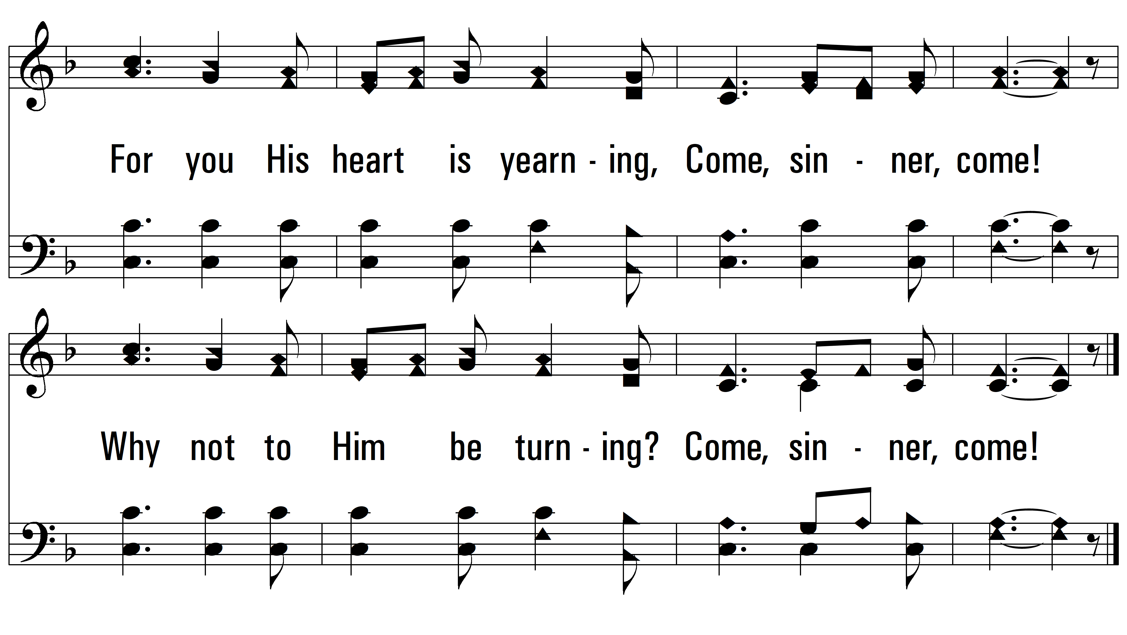
vs. 3

Slide 8
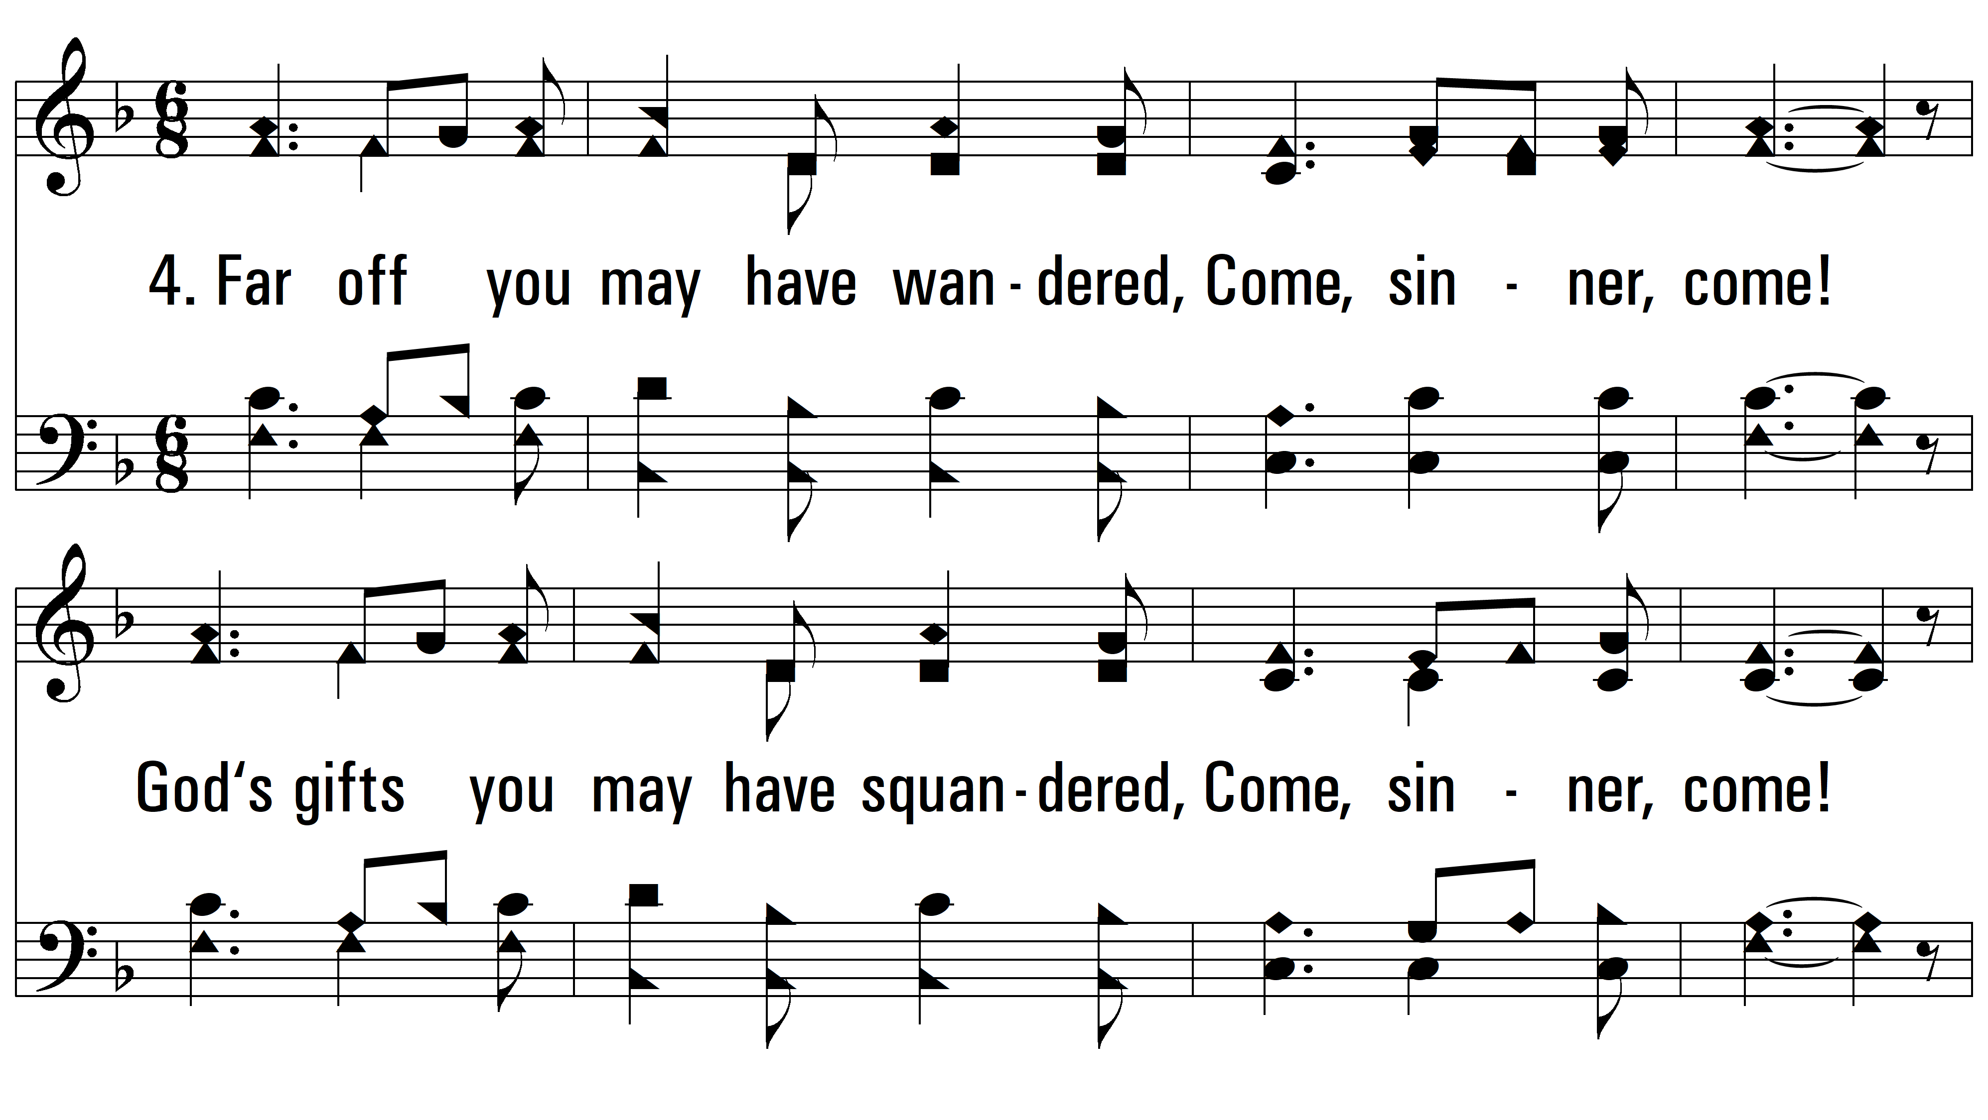
vs. 4 ~ Come, Sinner, Come

Slide 9
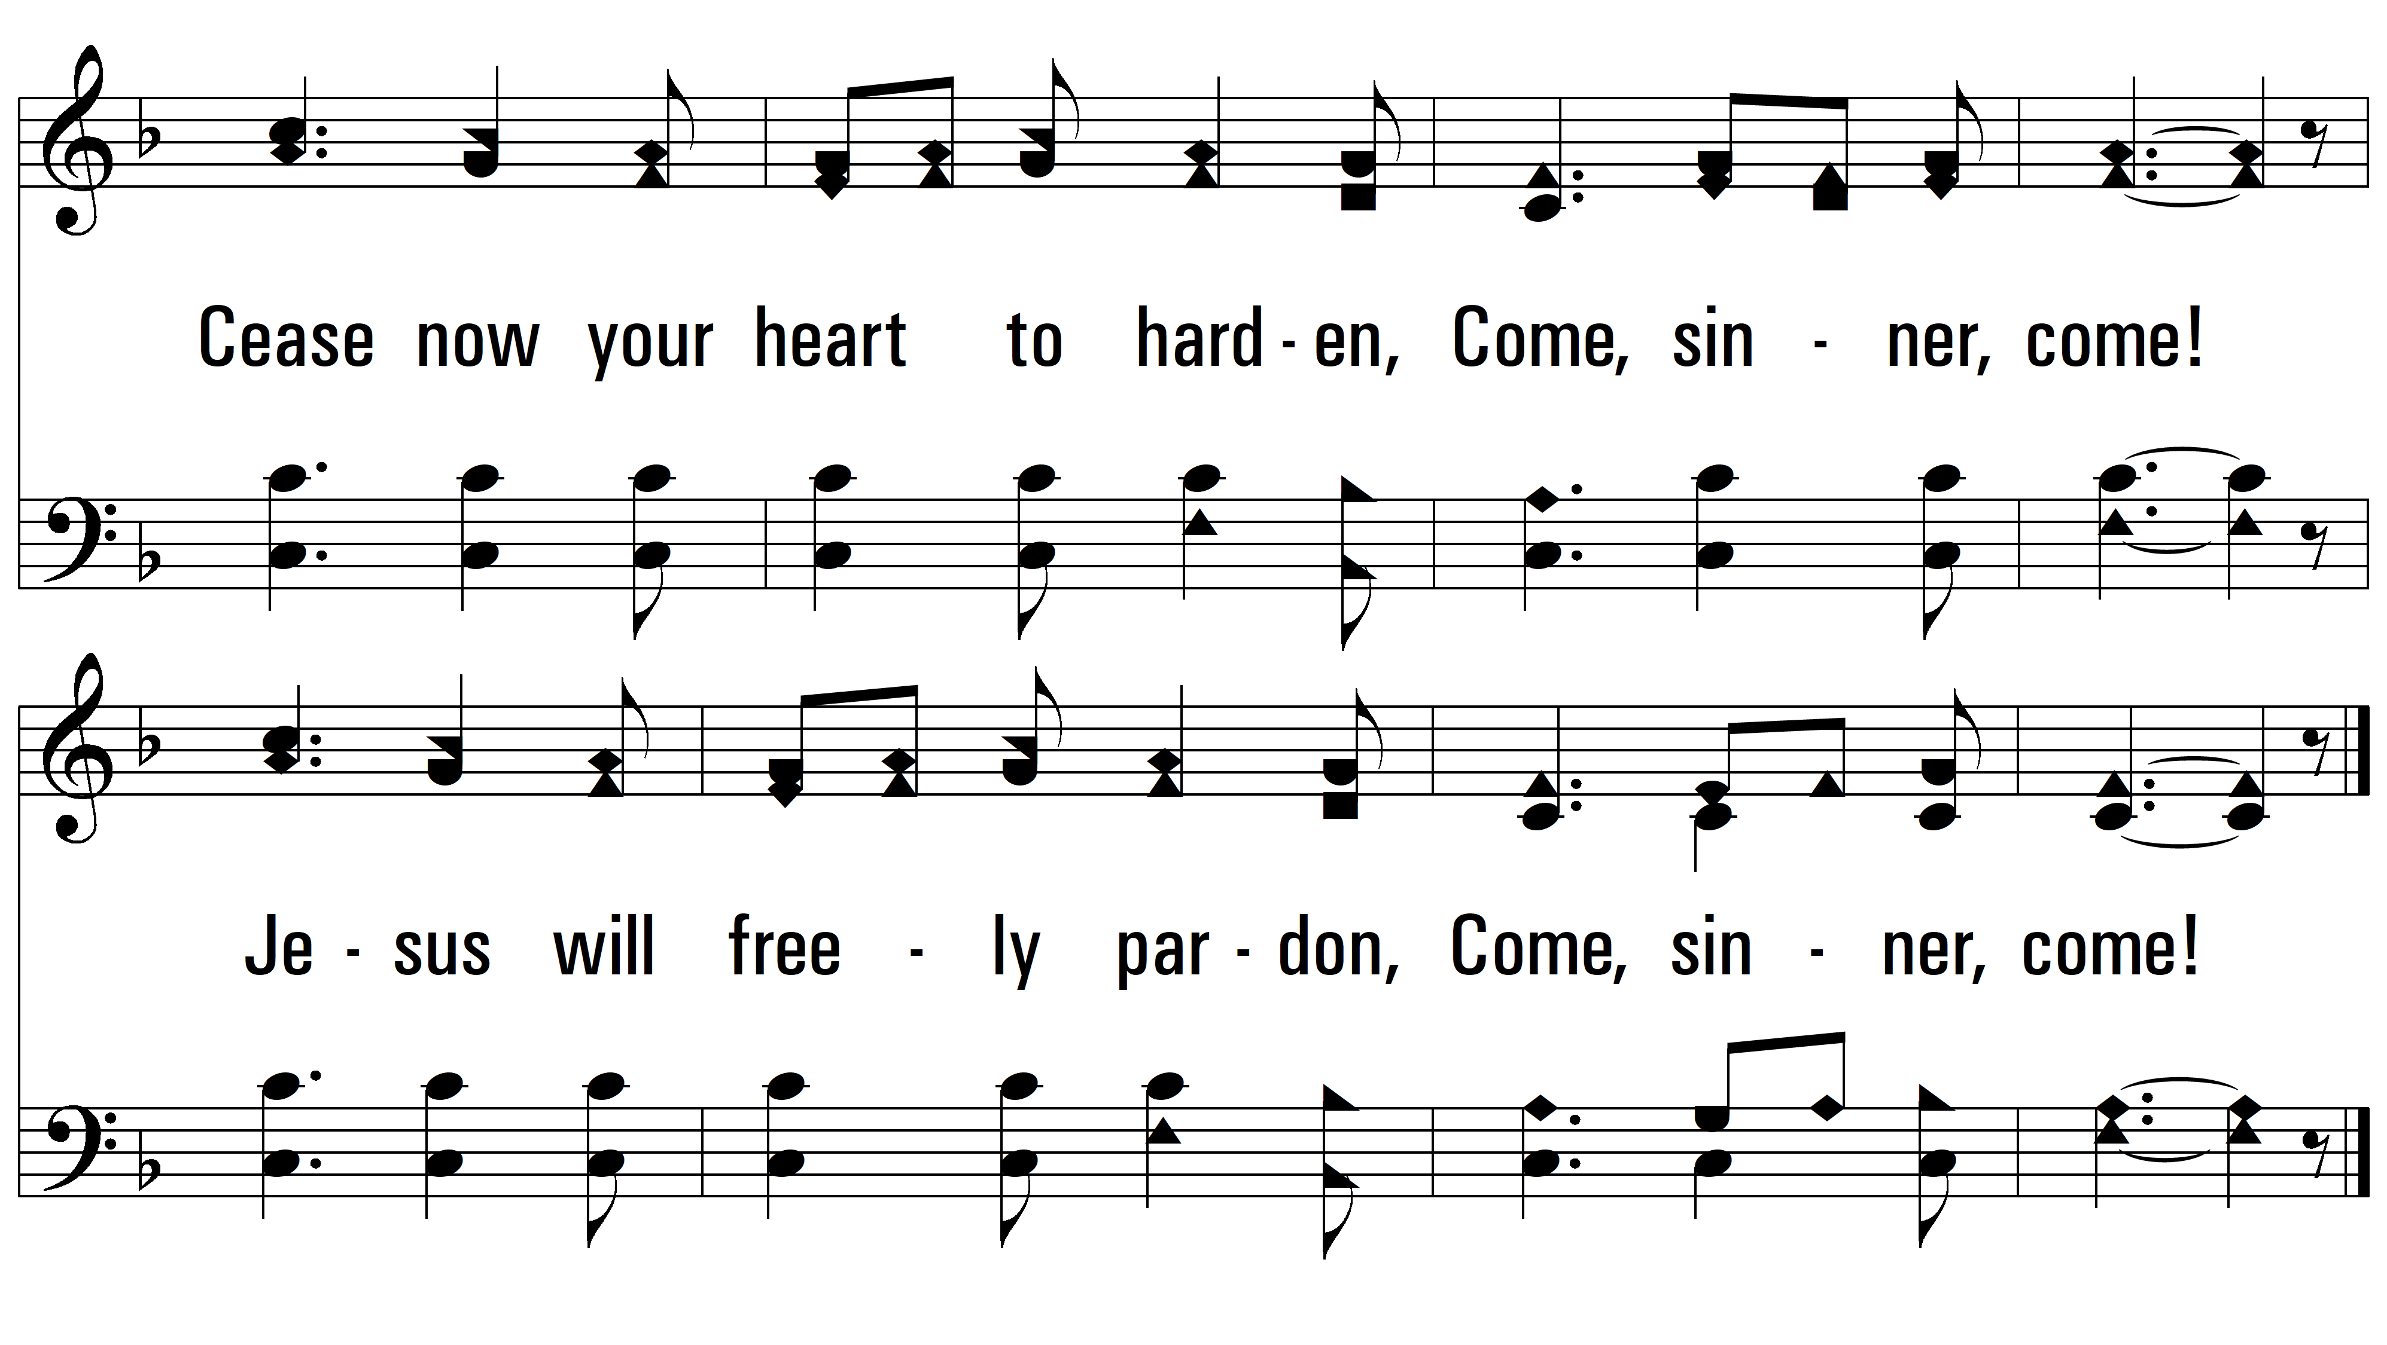
vs. 4

Slide 10
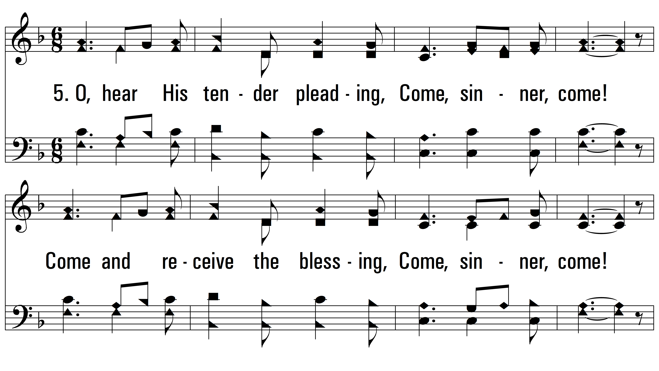
vs. 5 ~ Come, Sinner, Come

Slide 11
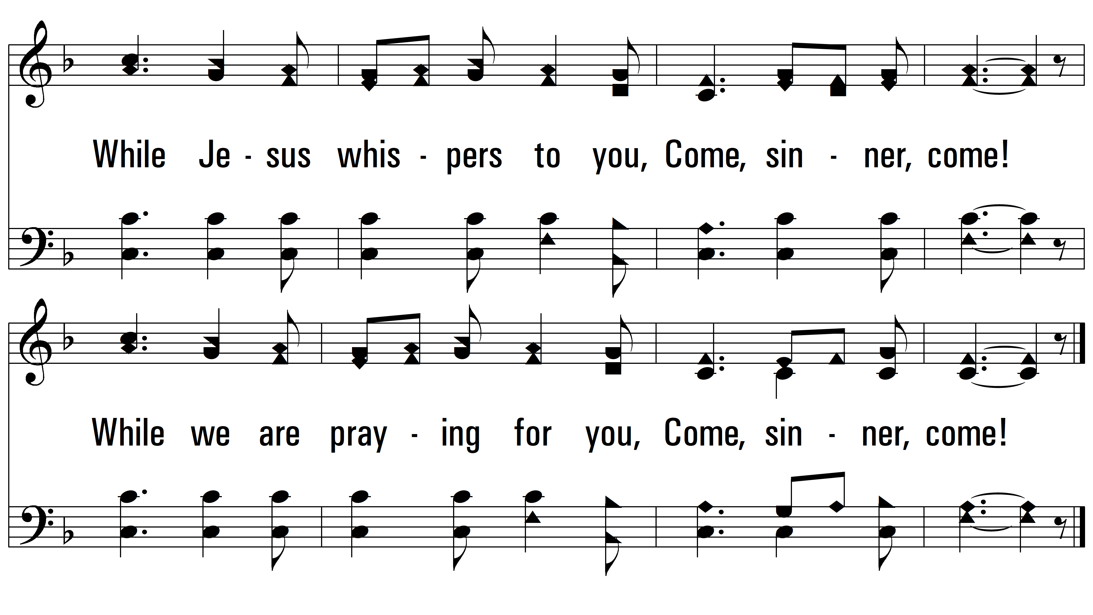
vs. 5
PDHymns.com
END

