Slide 1
Come, Let Us Join Our Cheerful Songs
RICHMOND
CM
Words: | Isaac Watts (1707)
Music: | Thomas Haweis (1792)
3/4
G/D - SOL
Verses: 3
Lead - | SOL
Alto - | SOL
Tenor - | MI
Bass - | DO
PDHymns.com

Slide 2
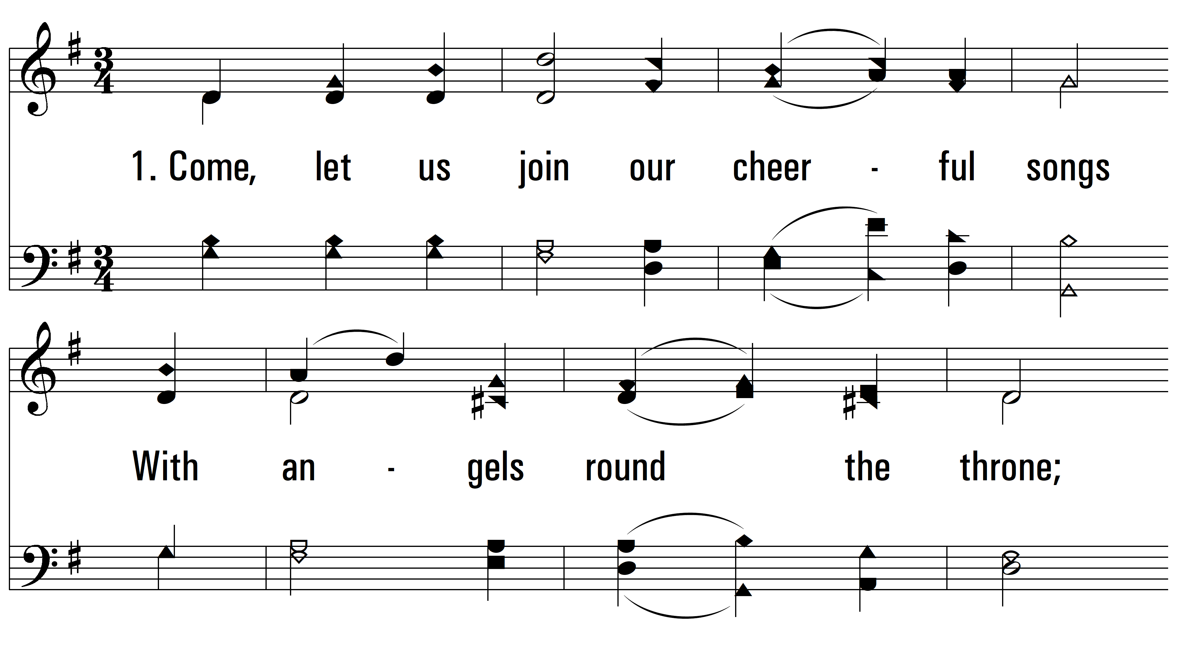
vs. 1 ~ Come, Let Us Join Our Cheerful Songs

Slide 3
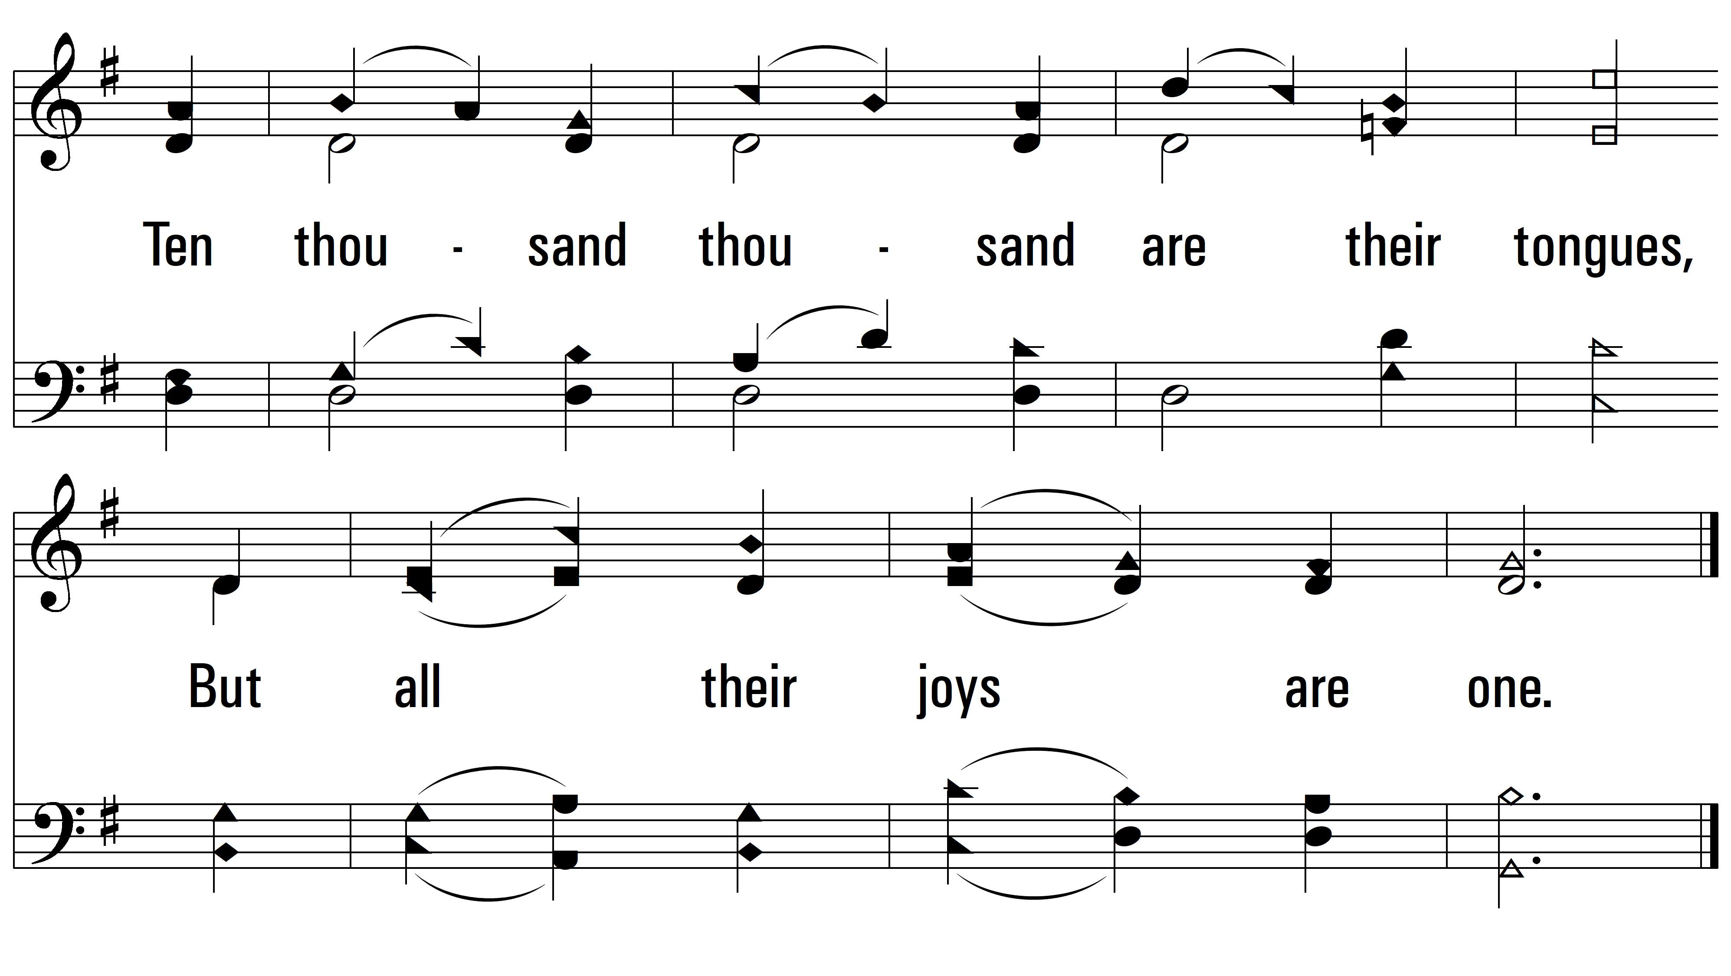
vs. 1

Slide 4
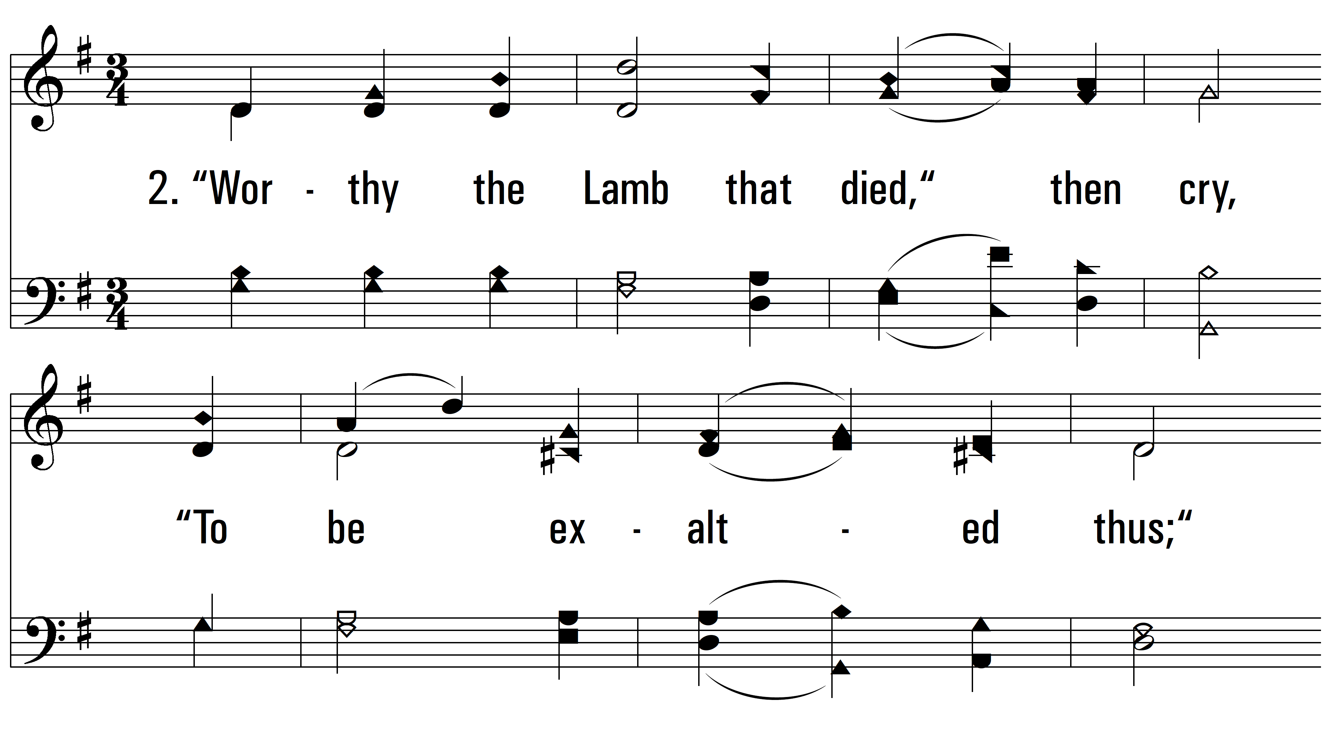
vs. 2 ~ Come, Let Us Join Our Cheerful Songs

Slide 5
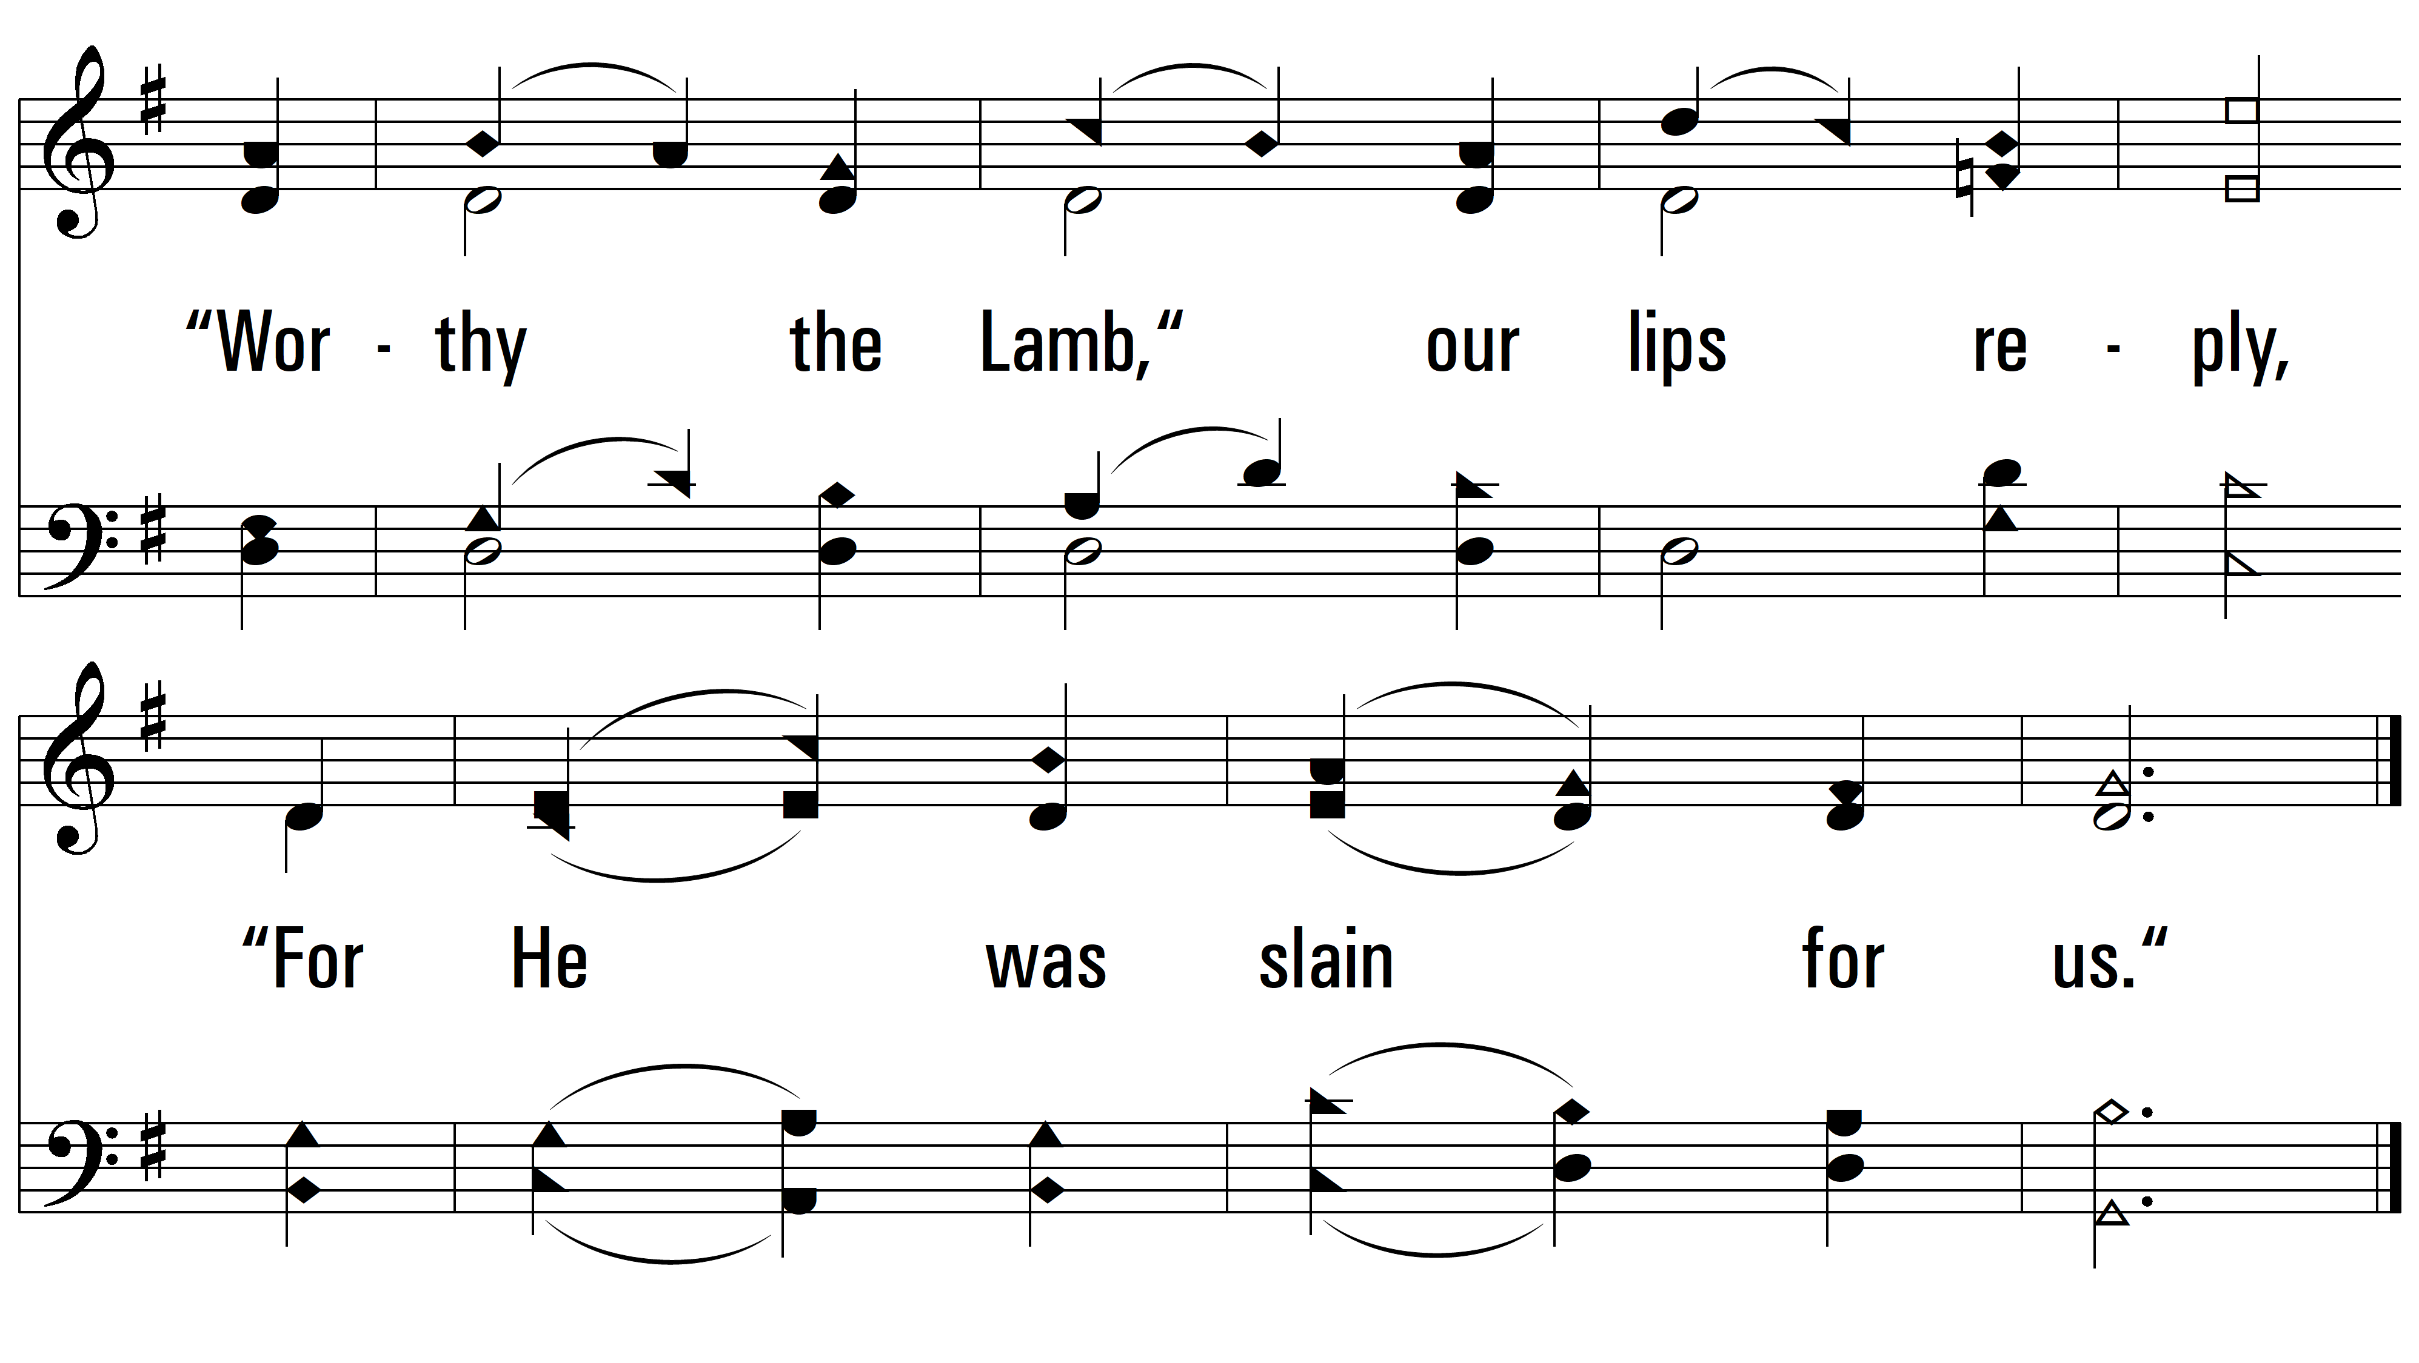
vs. 2

Slide 6
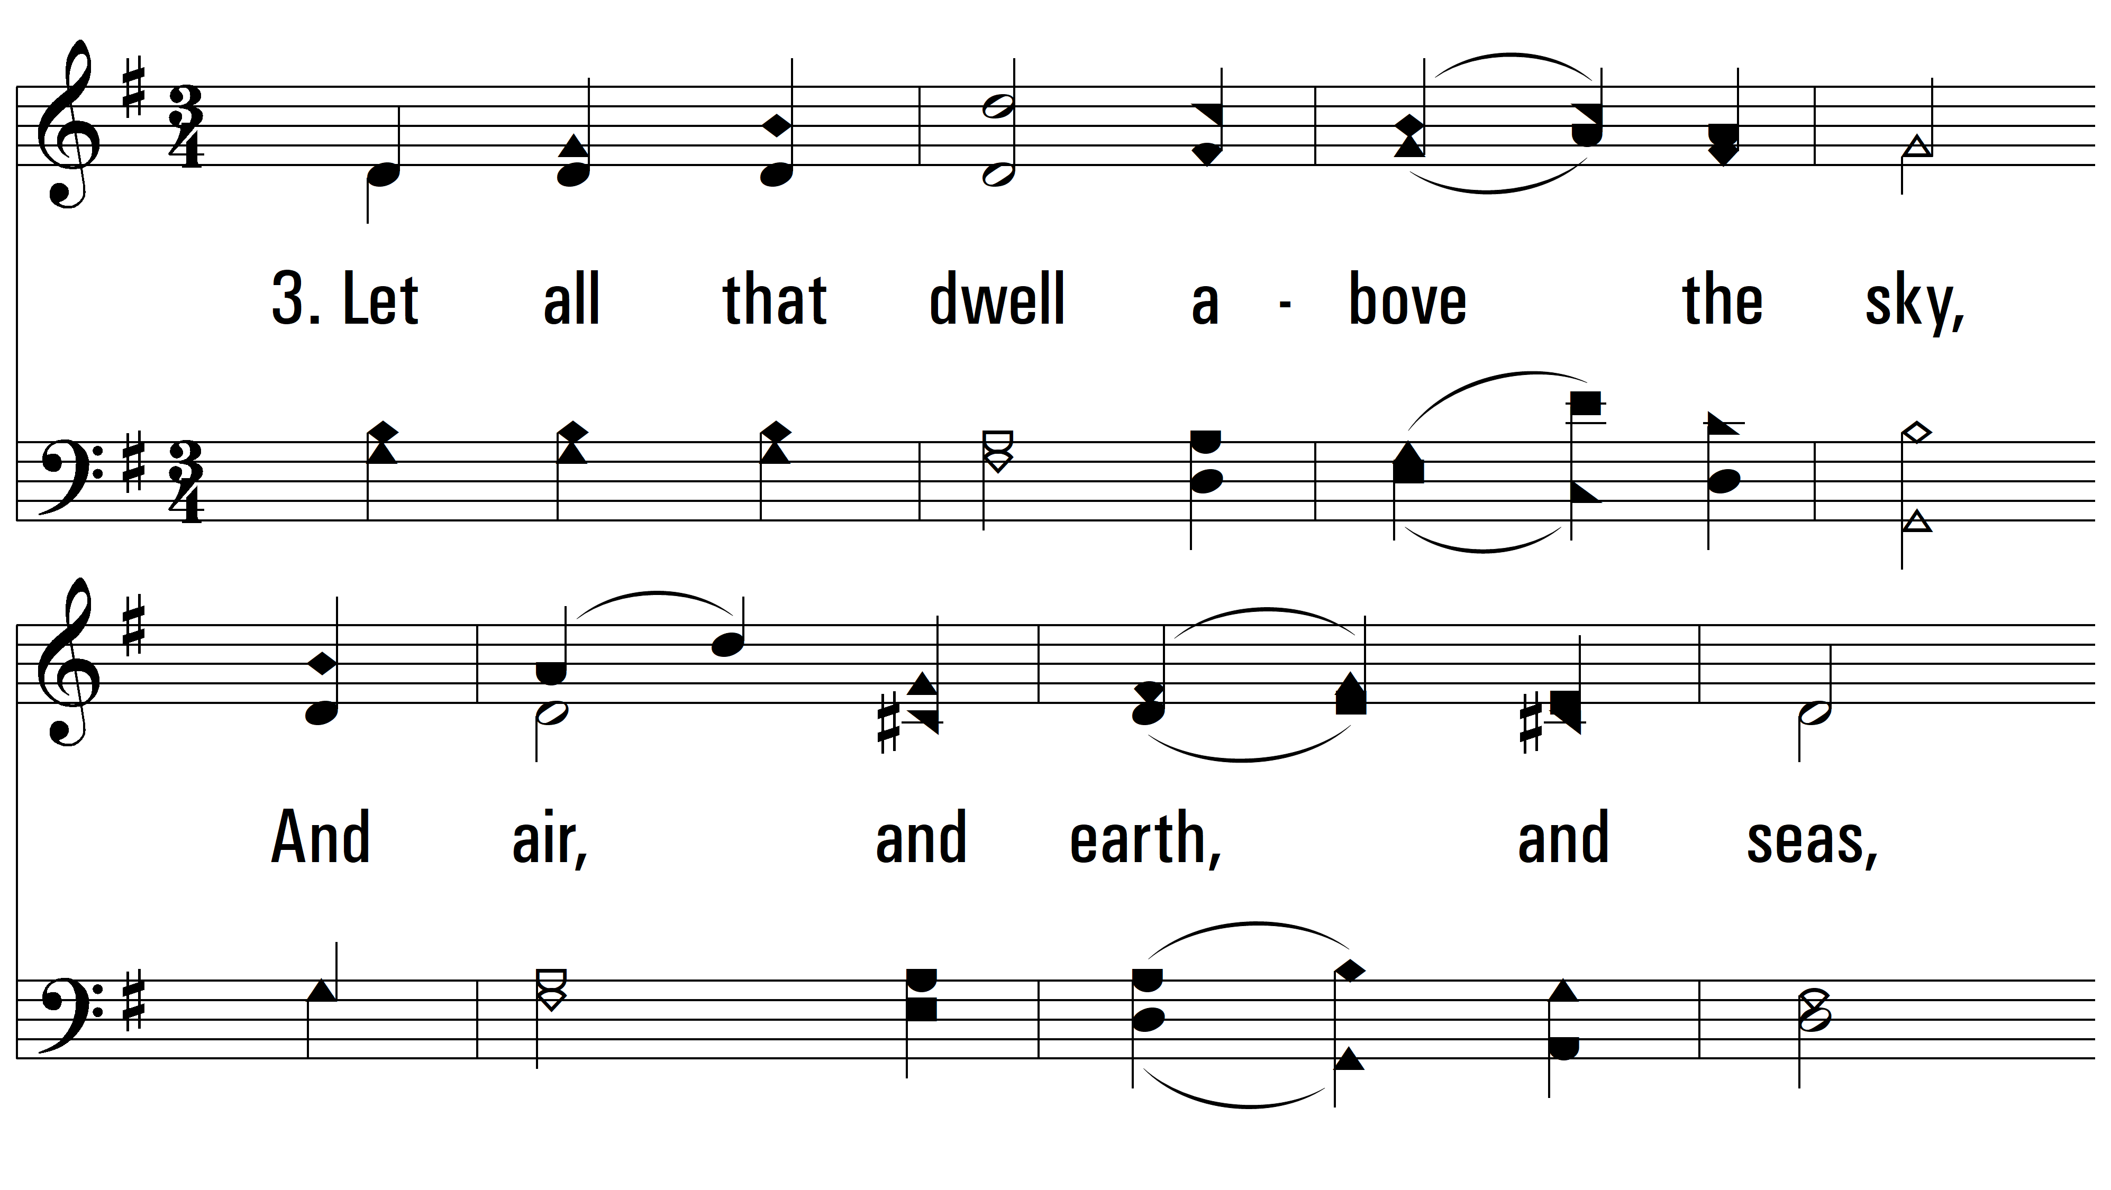
vs. 3 ~ Come, Let Us Join Our Cheerful Songs

Slide 7
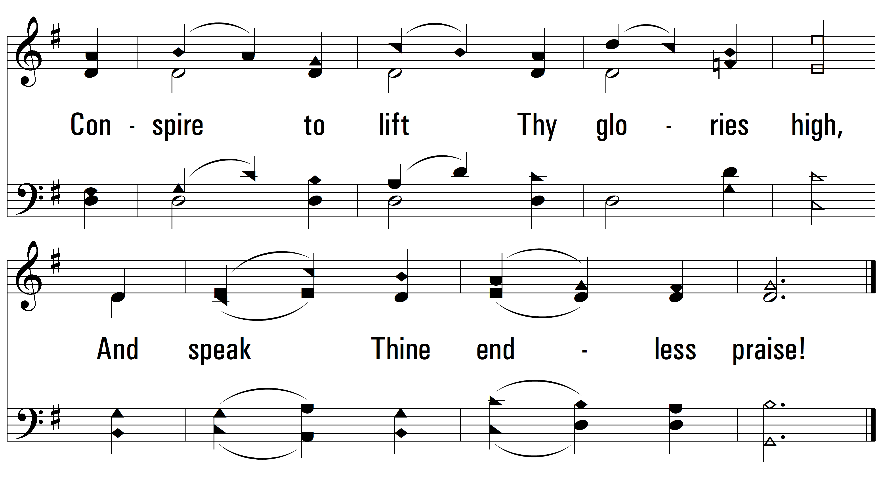
vs. 3
PDHymns.com
END

