Slide 1
Close To Thee
Words: | Fanny J. Crosby (1874)
Music: | Silas J. Vail (1874)
3/4
G/D - SOL
Verses: 3
Lead - | SOL
Alto - | SOL
Tenor - | MI
Bass - | DO
PDHymns.com

Slide 2
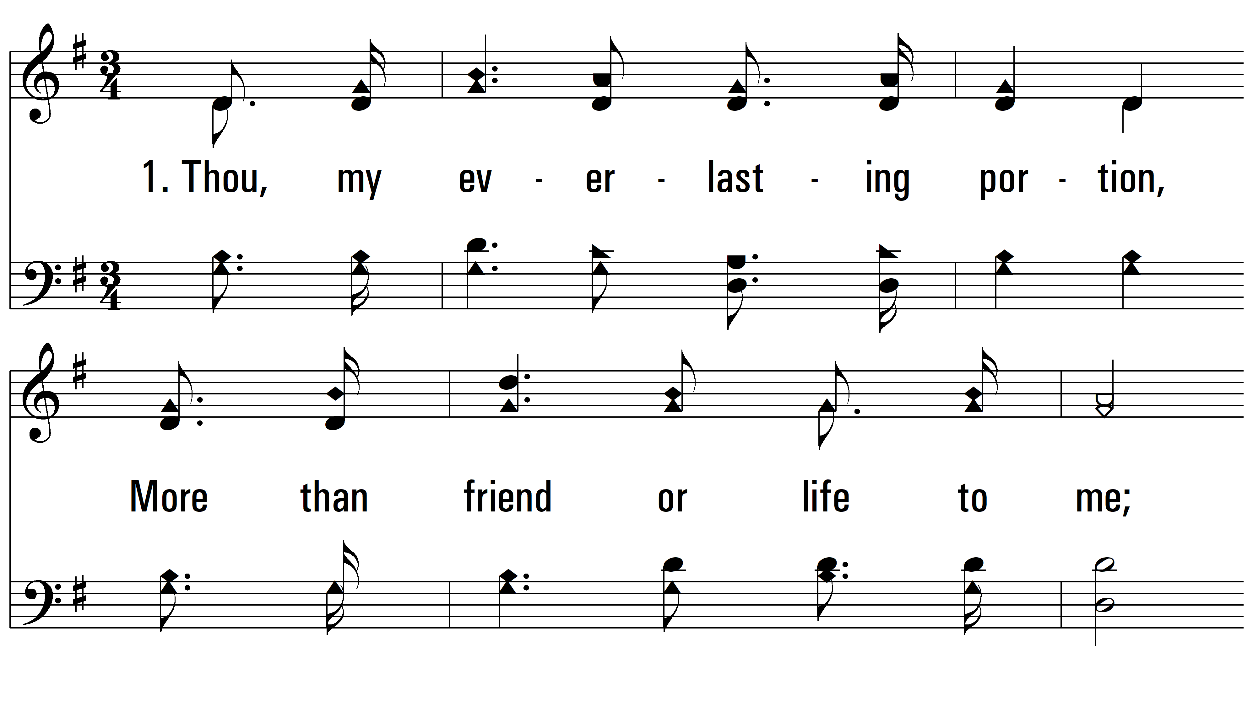
vs. 1 ~ Close To Thee

Slide 3
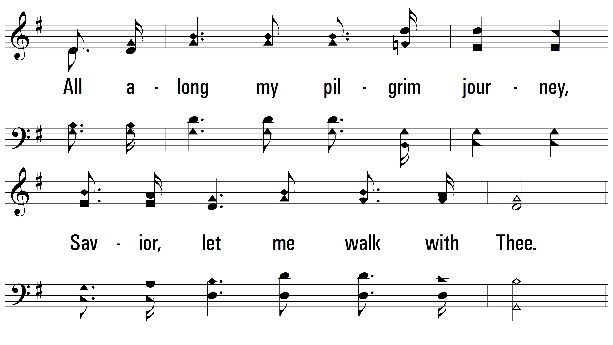
vs. 1

Slide 4
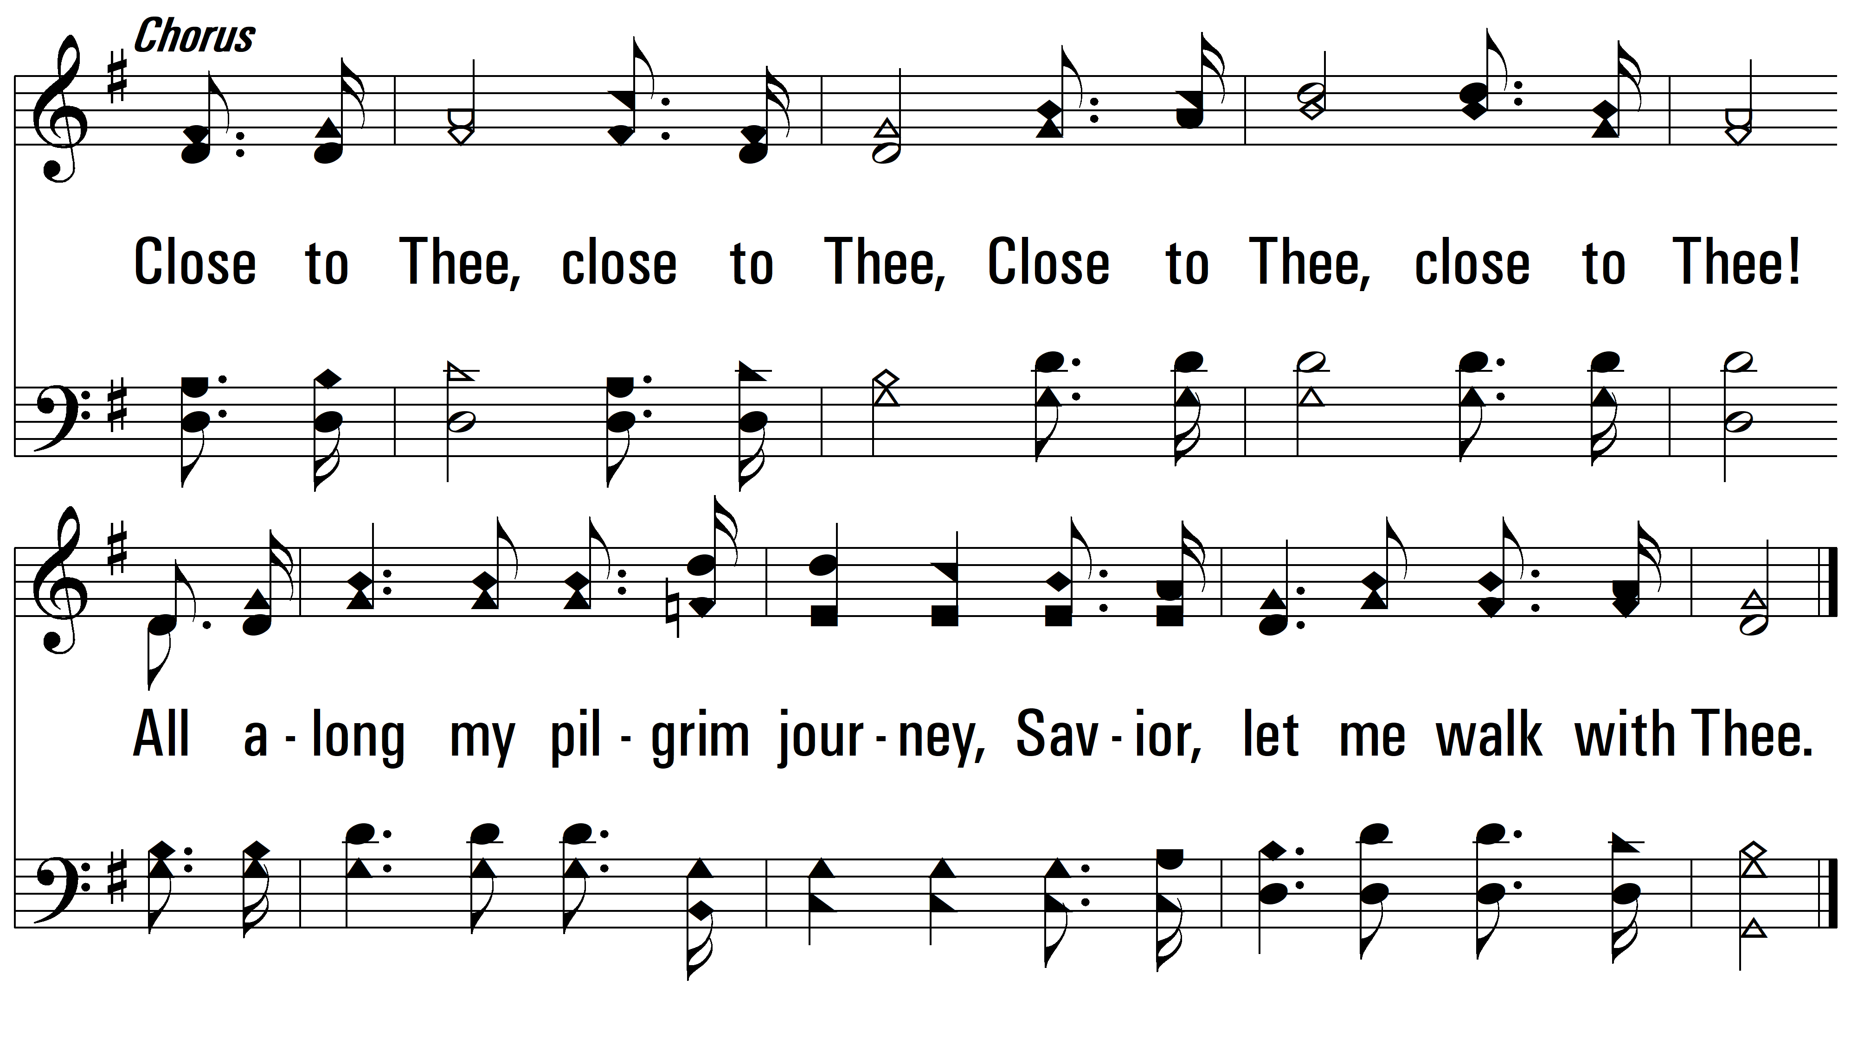
vs. 1

Slide 5
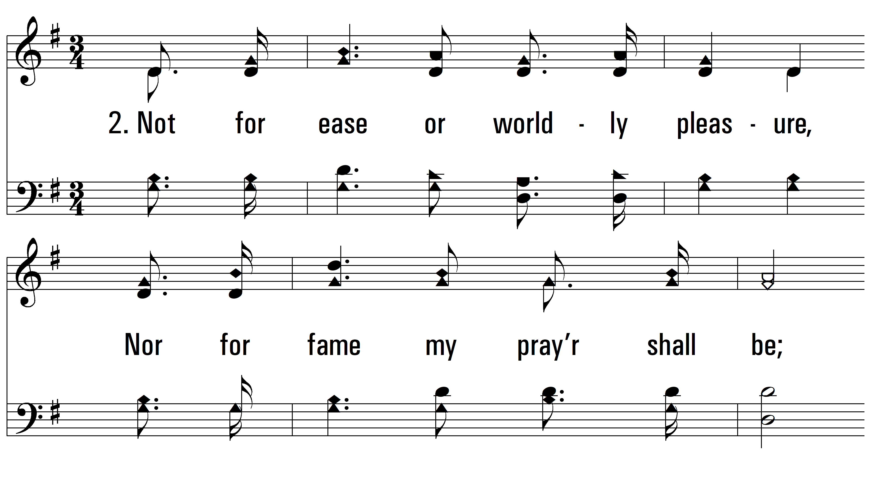
vs. 2 ~ Close To Thee

Slide 6
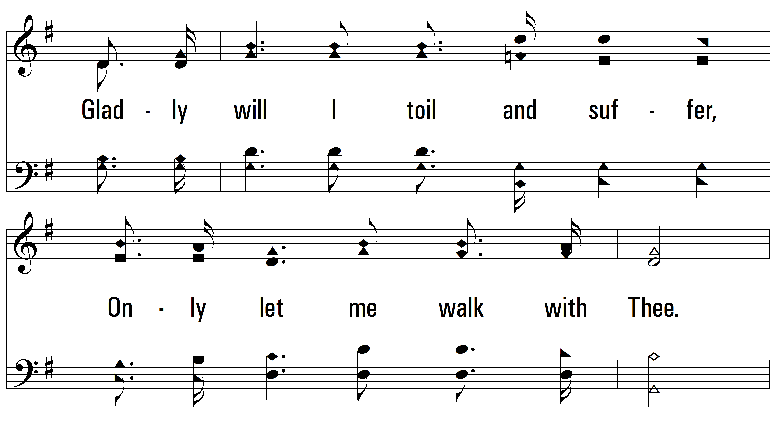
vs. 2

Slide 7
vs. 2

Slide 8
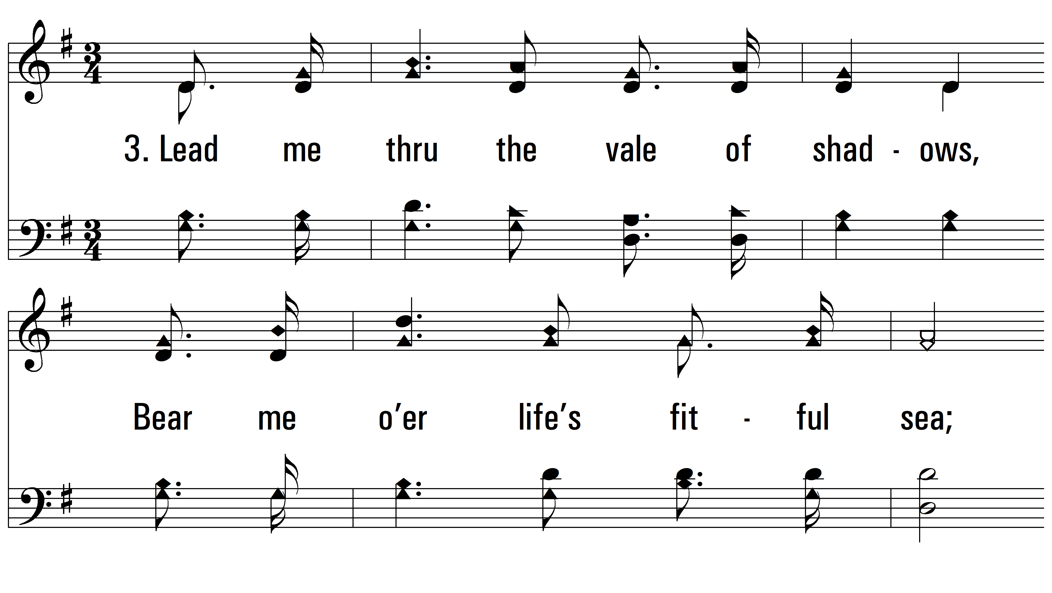
vs. 3 ~ Close To Thee

Slide 9
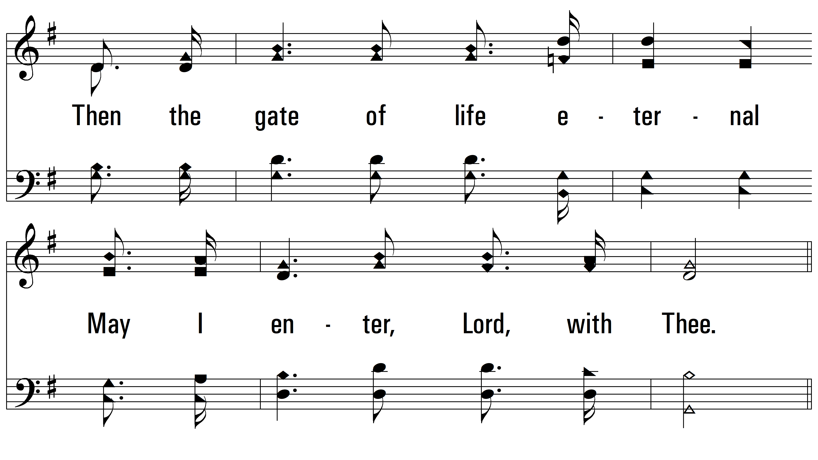
vs. 3

Slide 10
vs. 3
PDHymns.com
END

