Slide 1
Christ, We Do All Adore Thee
Words: | Theodore Baker (1899)
Music: | Theodore Dubois (1867)
4/4
C/C - DO
Verses: 1
Lead - | DO
Alto - | MI
Tenor - | SOL
Bass - | DO
PDHymns.com

Slide 2
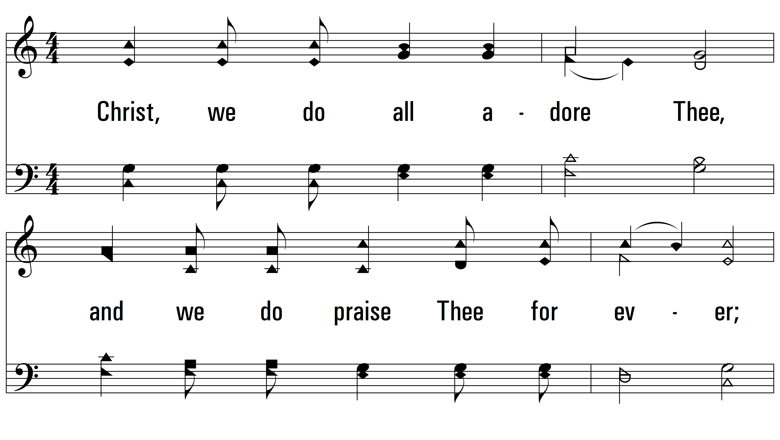
vs. 1 ~ Christ, We Do All Adore Thee

Slide 3
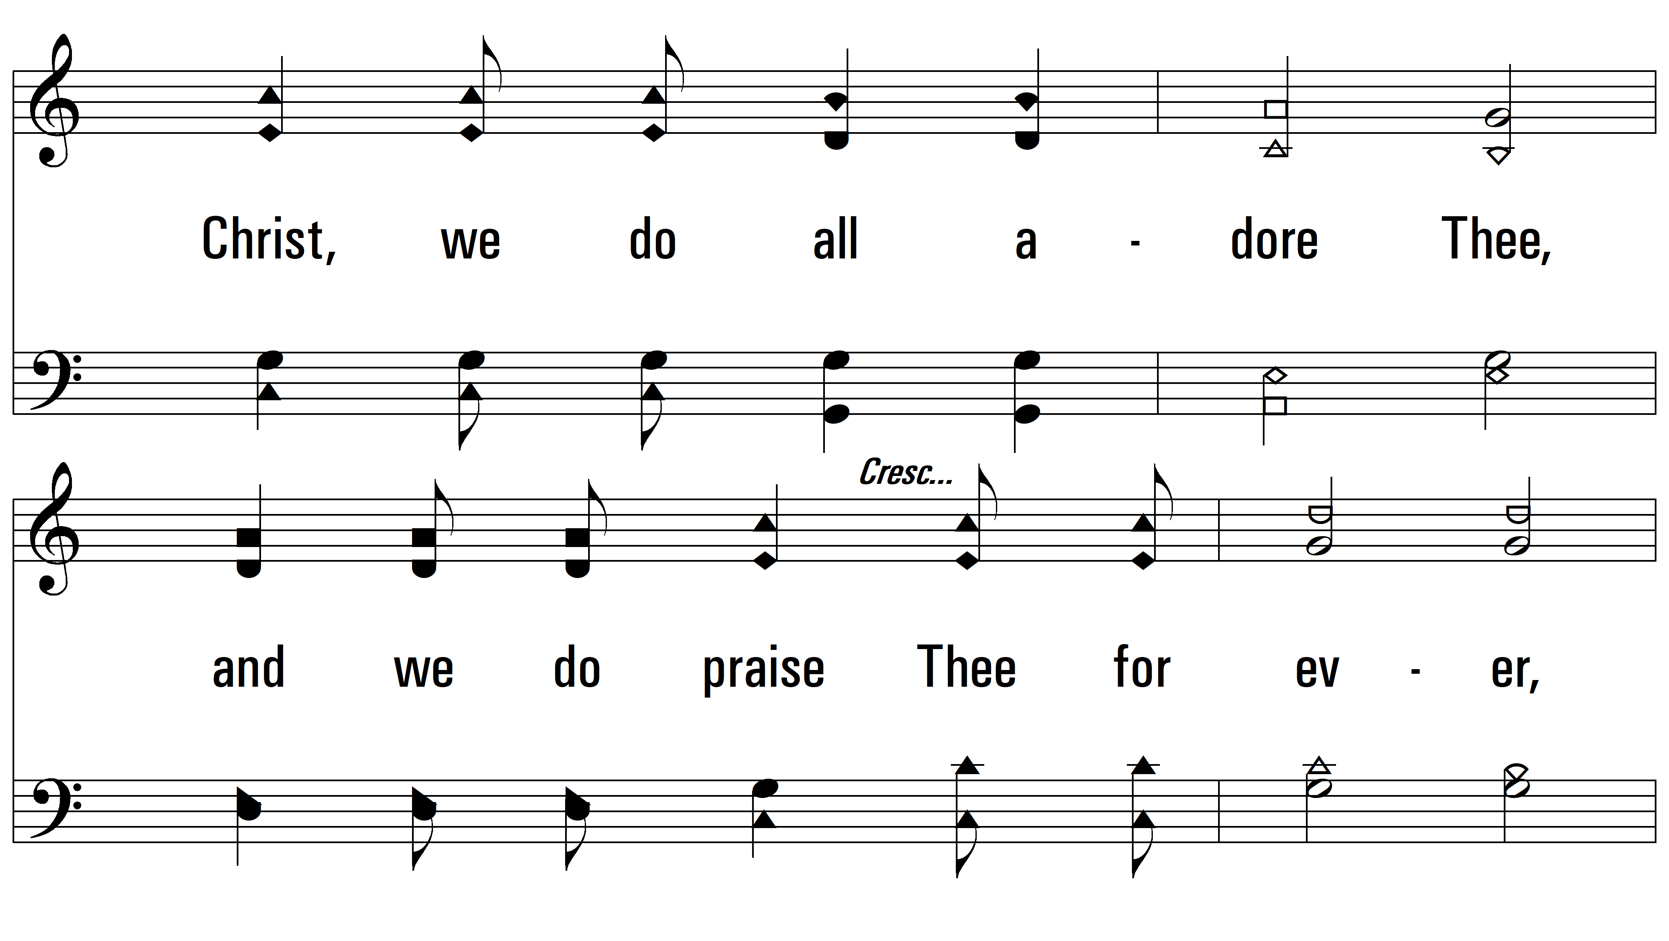
vs. 1

Slide 4
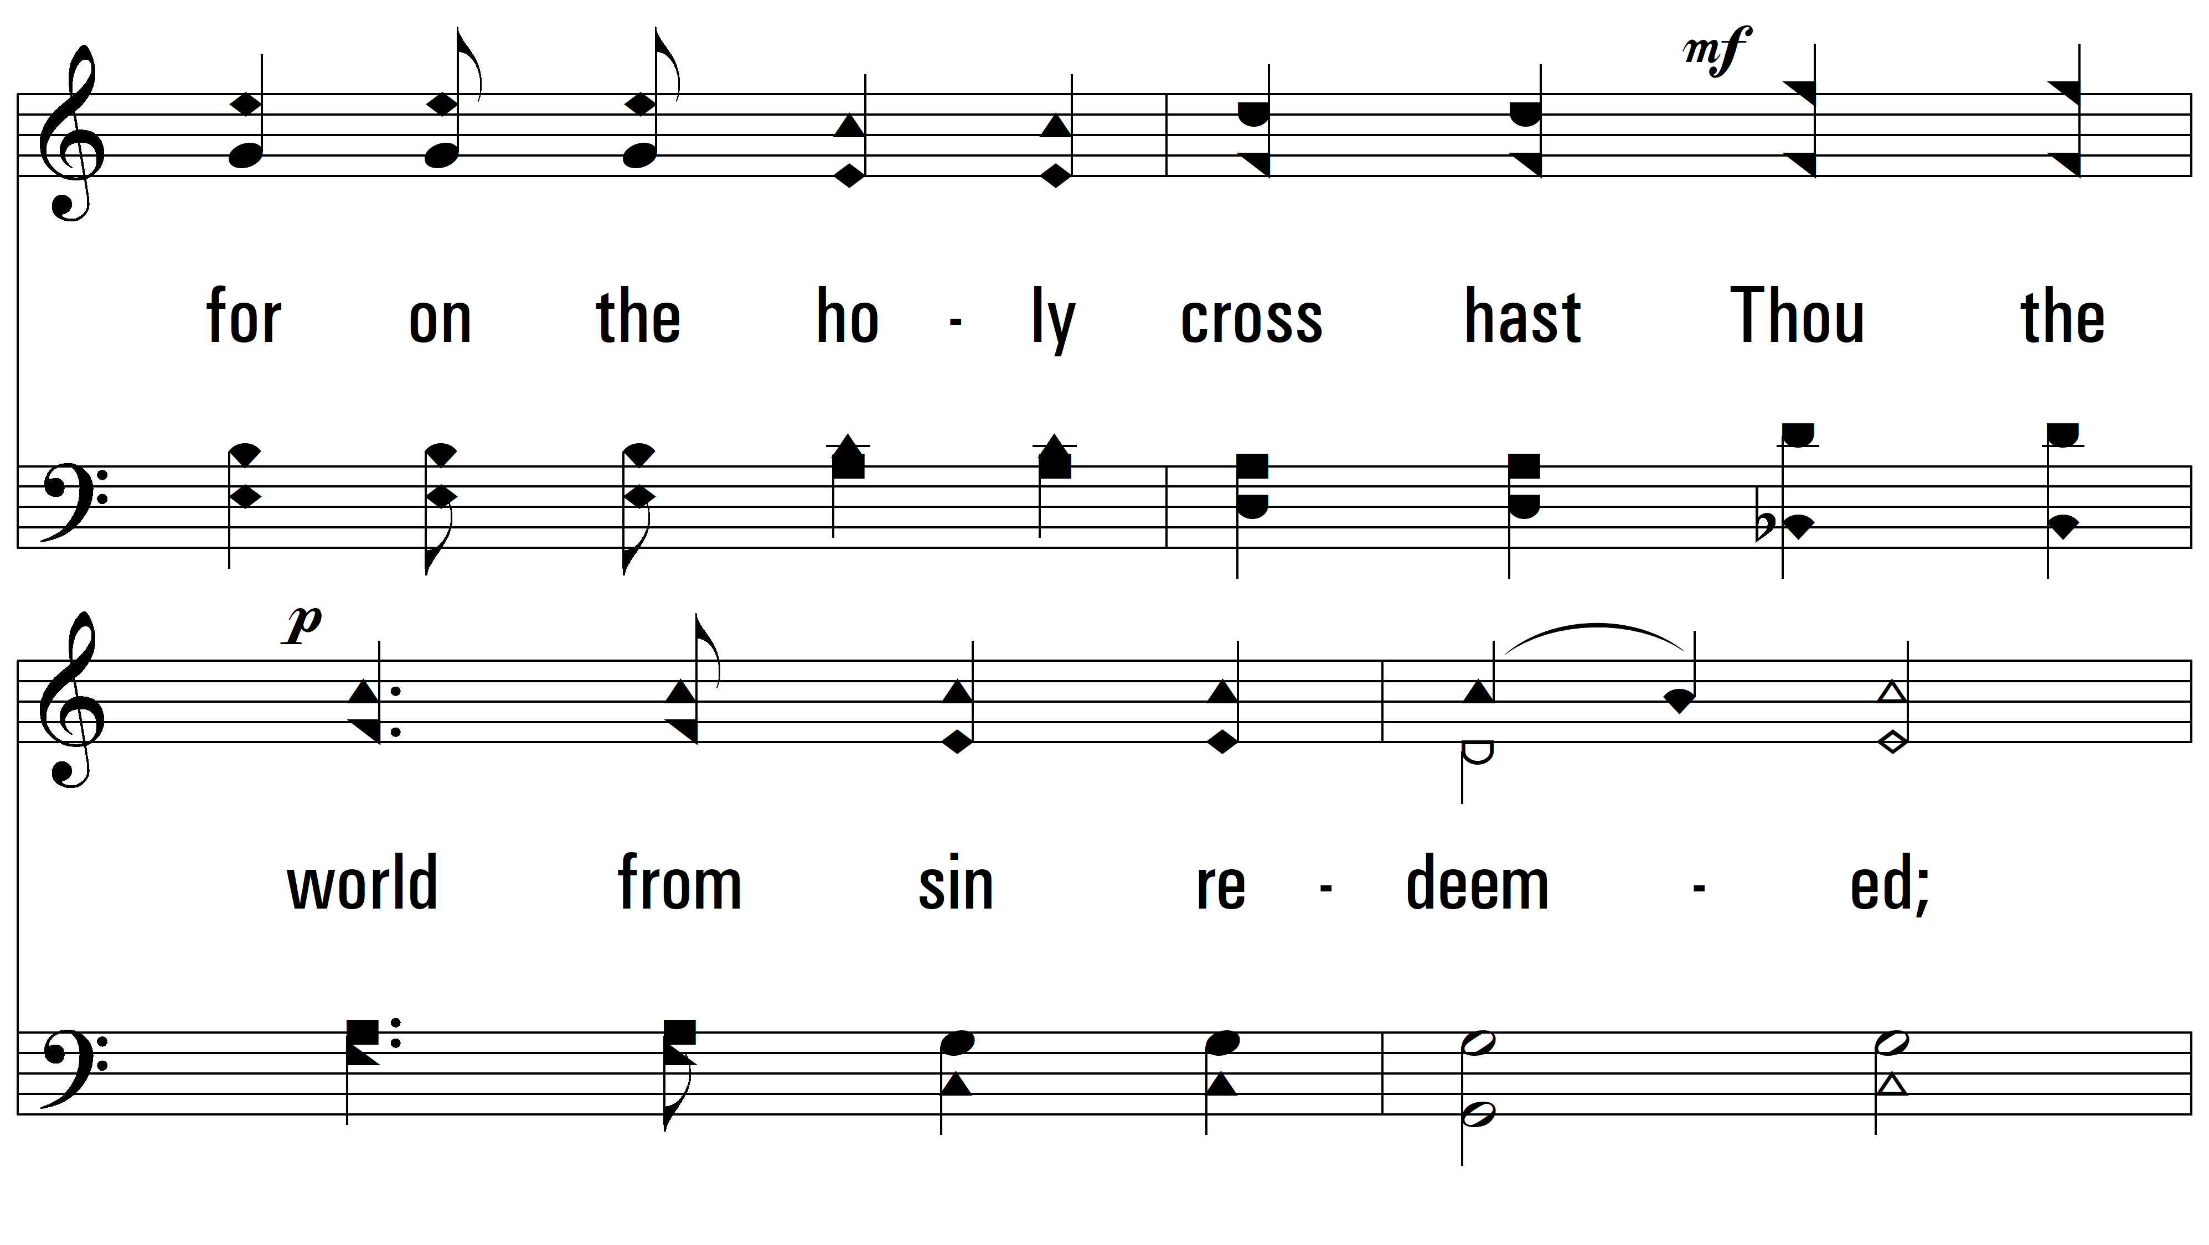
vs. 1

Slide 5
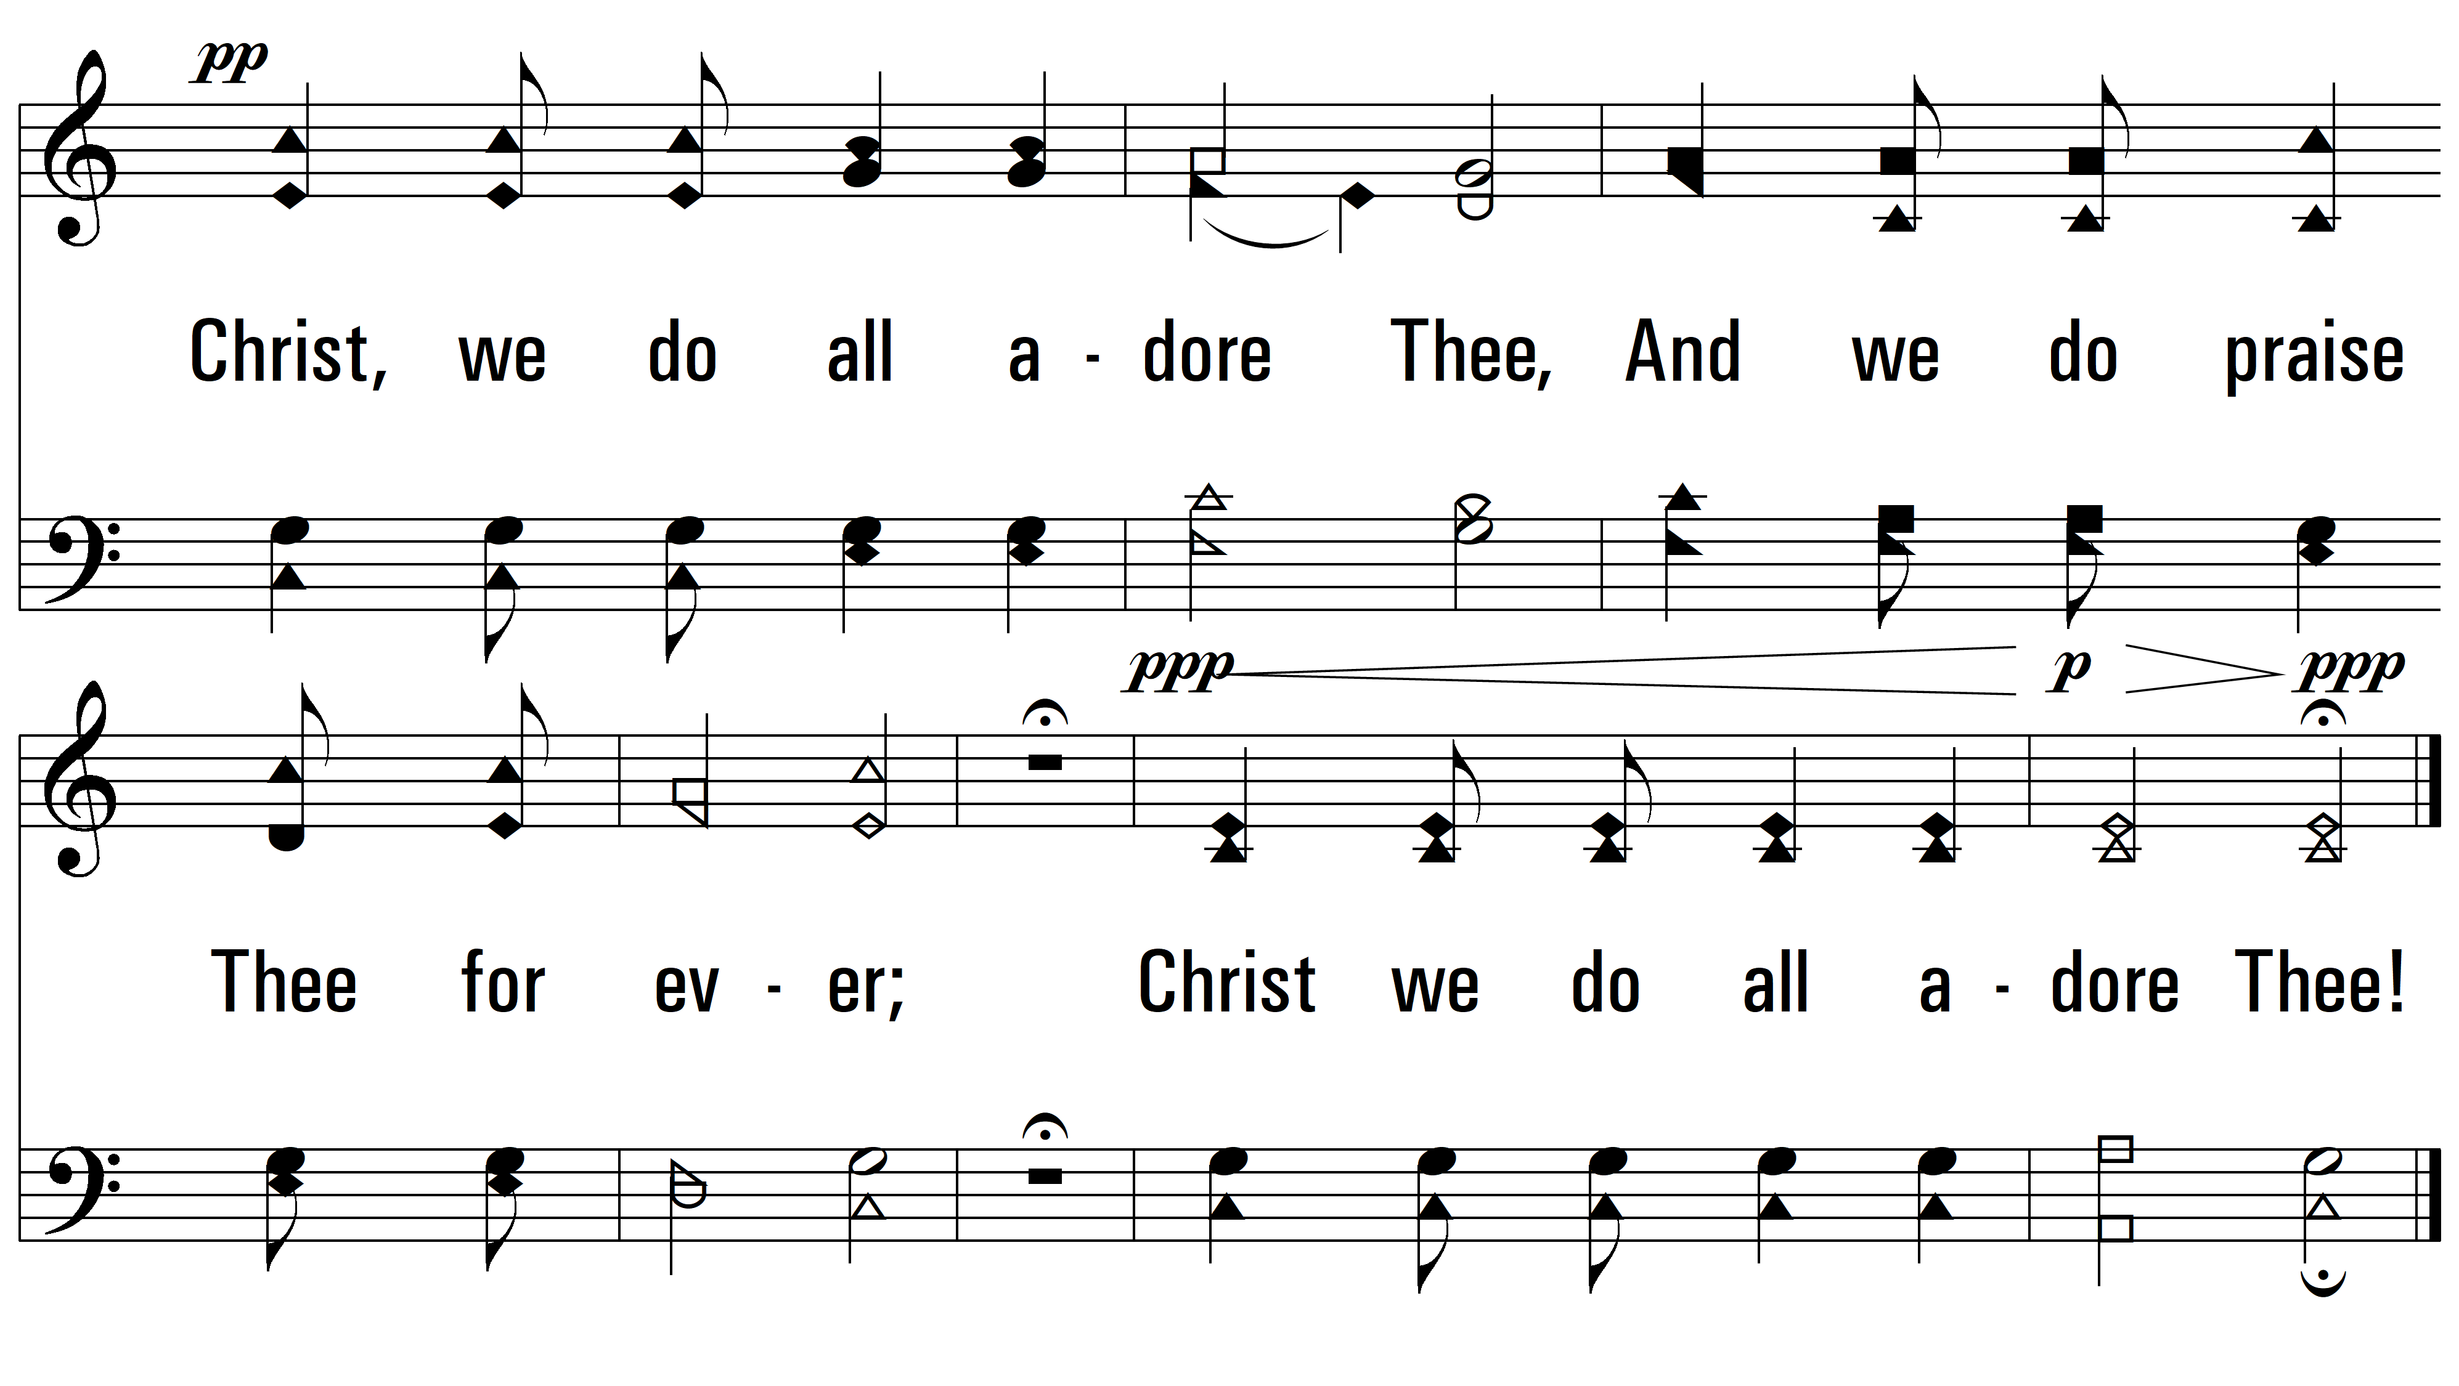
vs. 1
PDHymns.com
END

