Slide 1
Christ For The World We Sing
ITALIAN HYMN
6.6.4.6.6.6.4
Words: | Samuel Wolcott (1869)
Music: | Felice De Giardini (1769)
3/4
G/D - SOL
Verses: 3
Lead - | SOL
Alto - | DO
Tenor - | MI
Bass - | DO
PDHymns.com

Slide 2
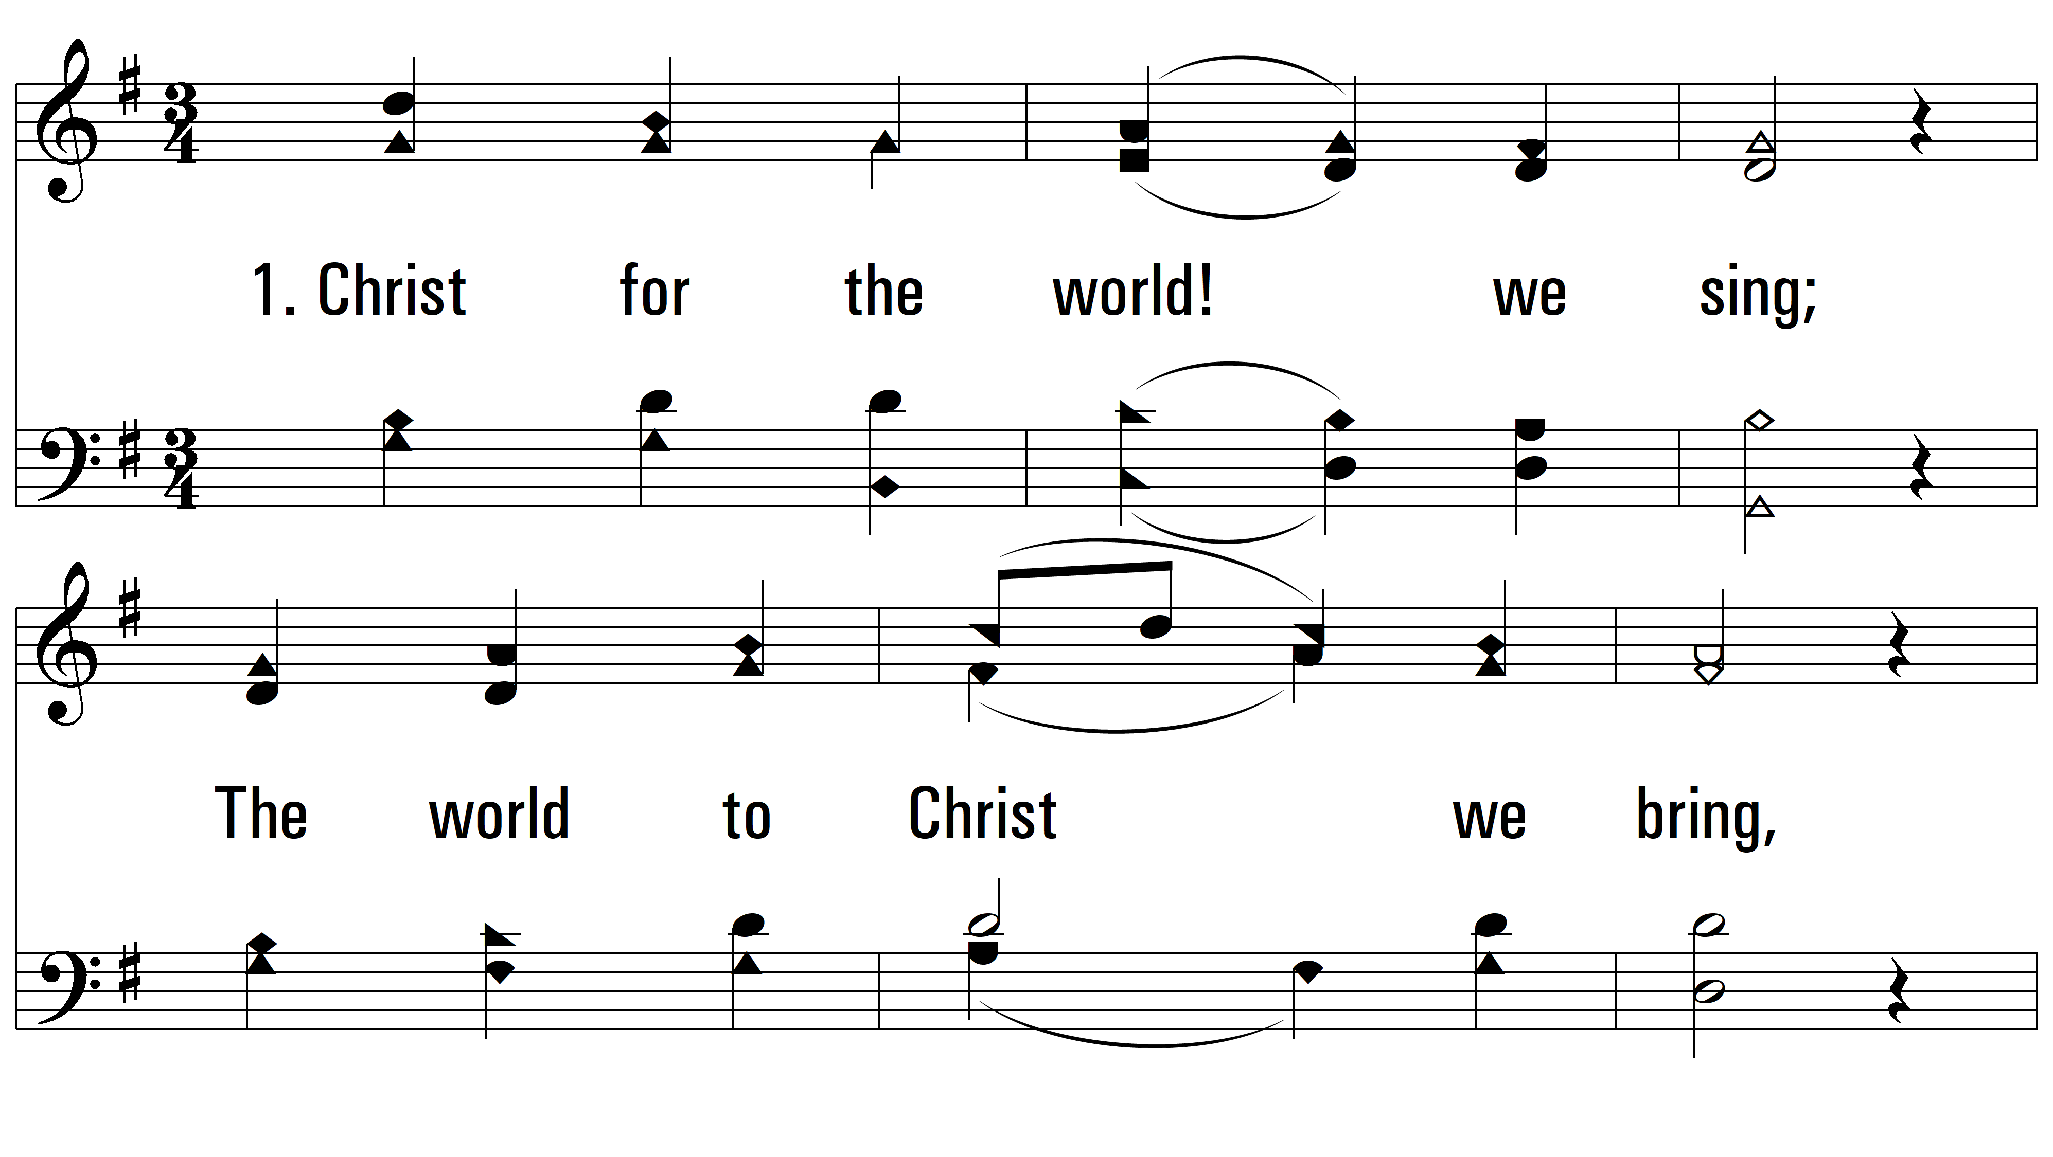
vs. 1 ~ Christ For The World We Sing

Slide 3
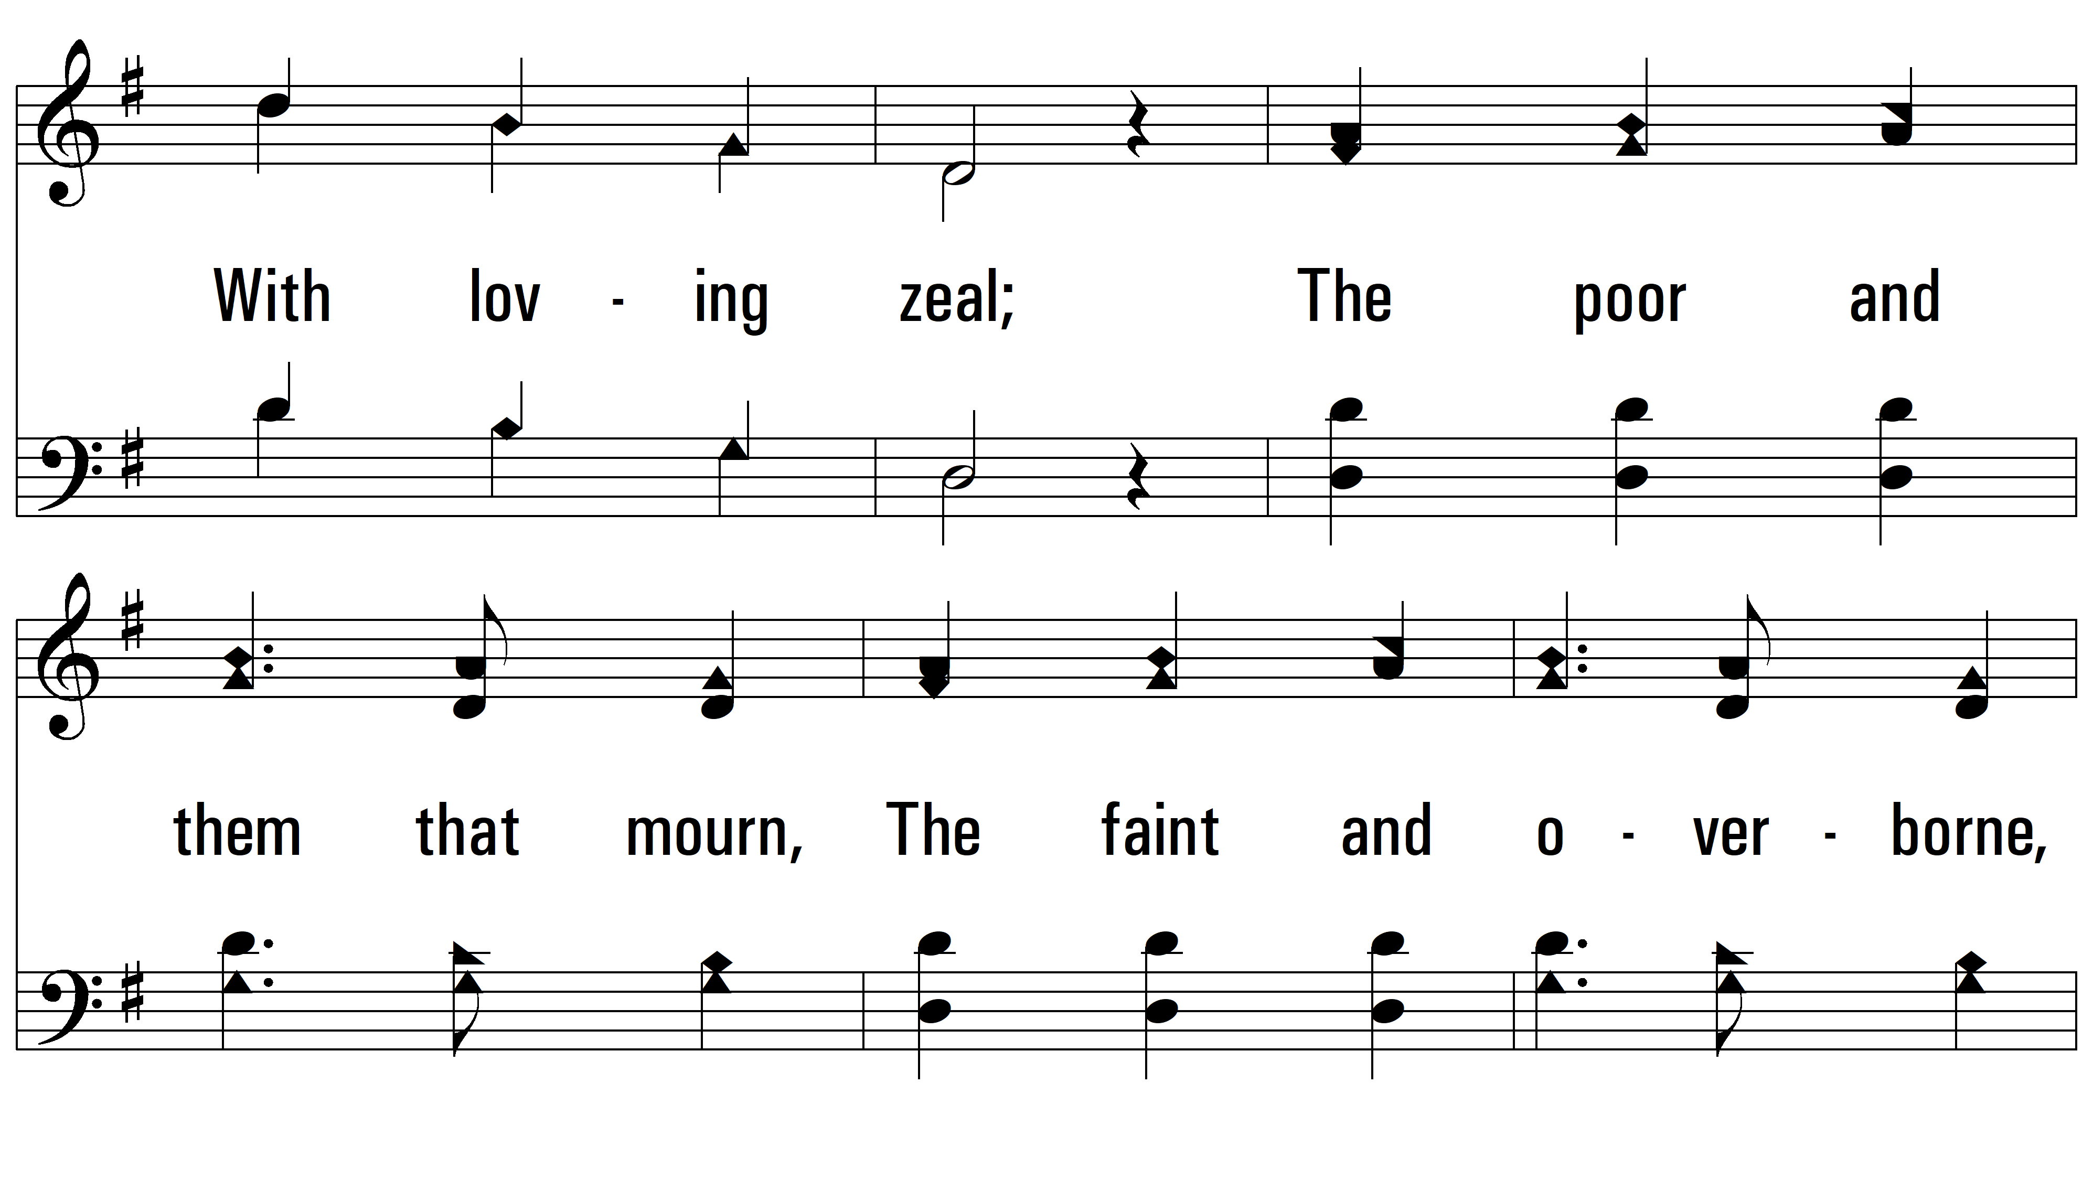
vs. 1

Slide 4
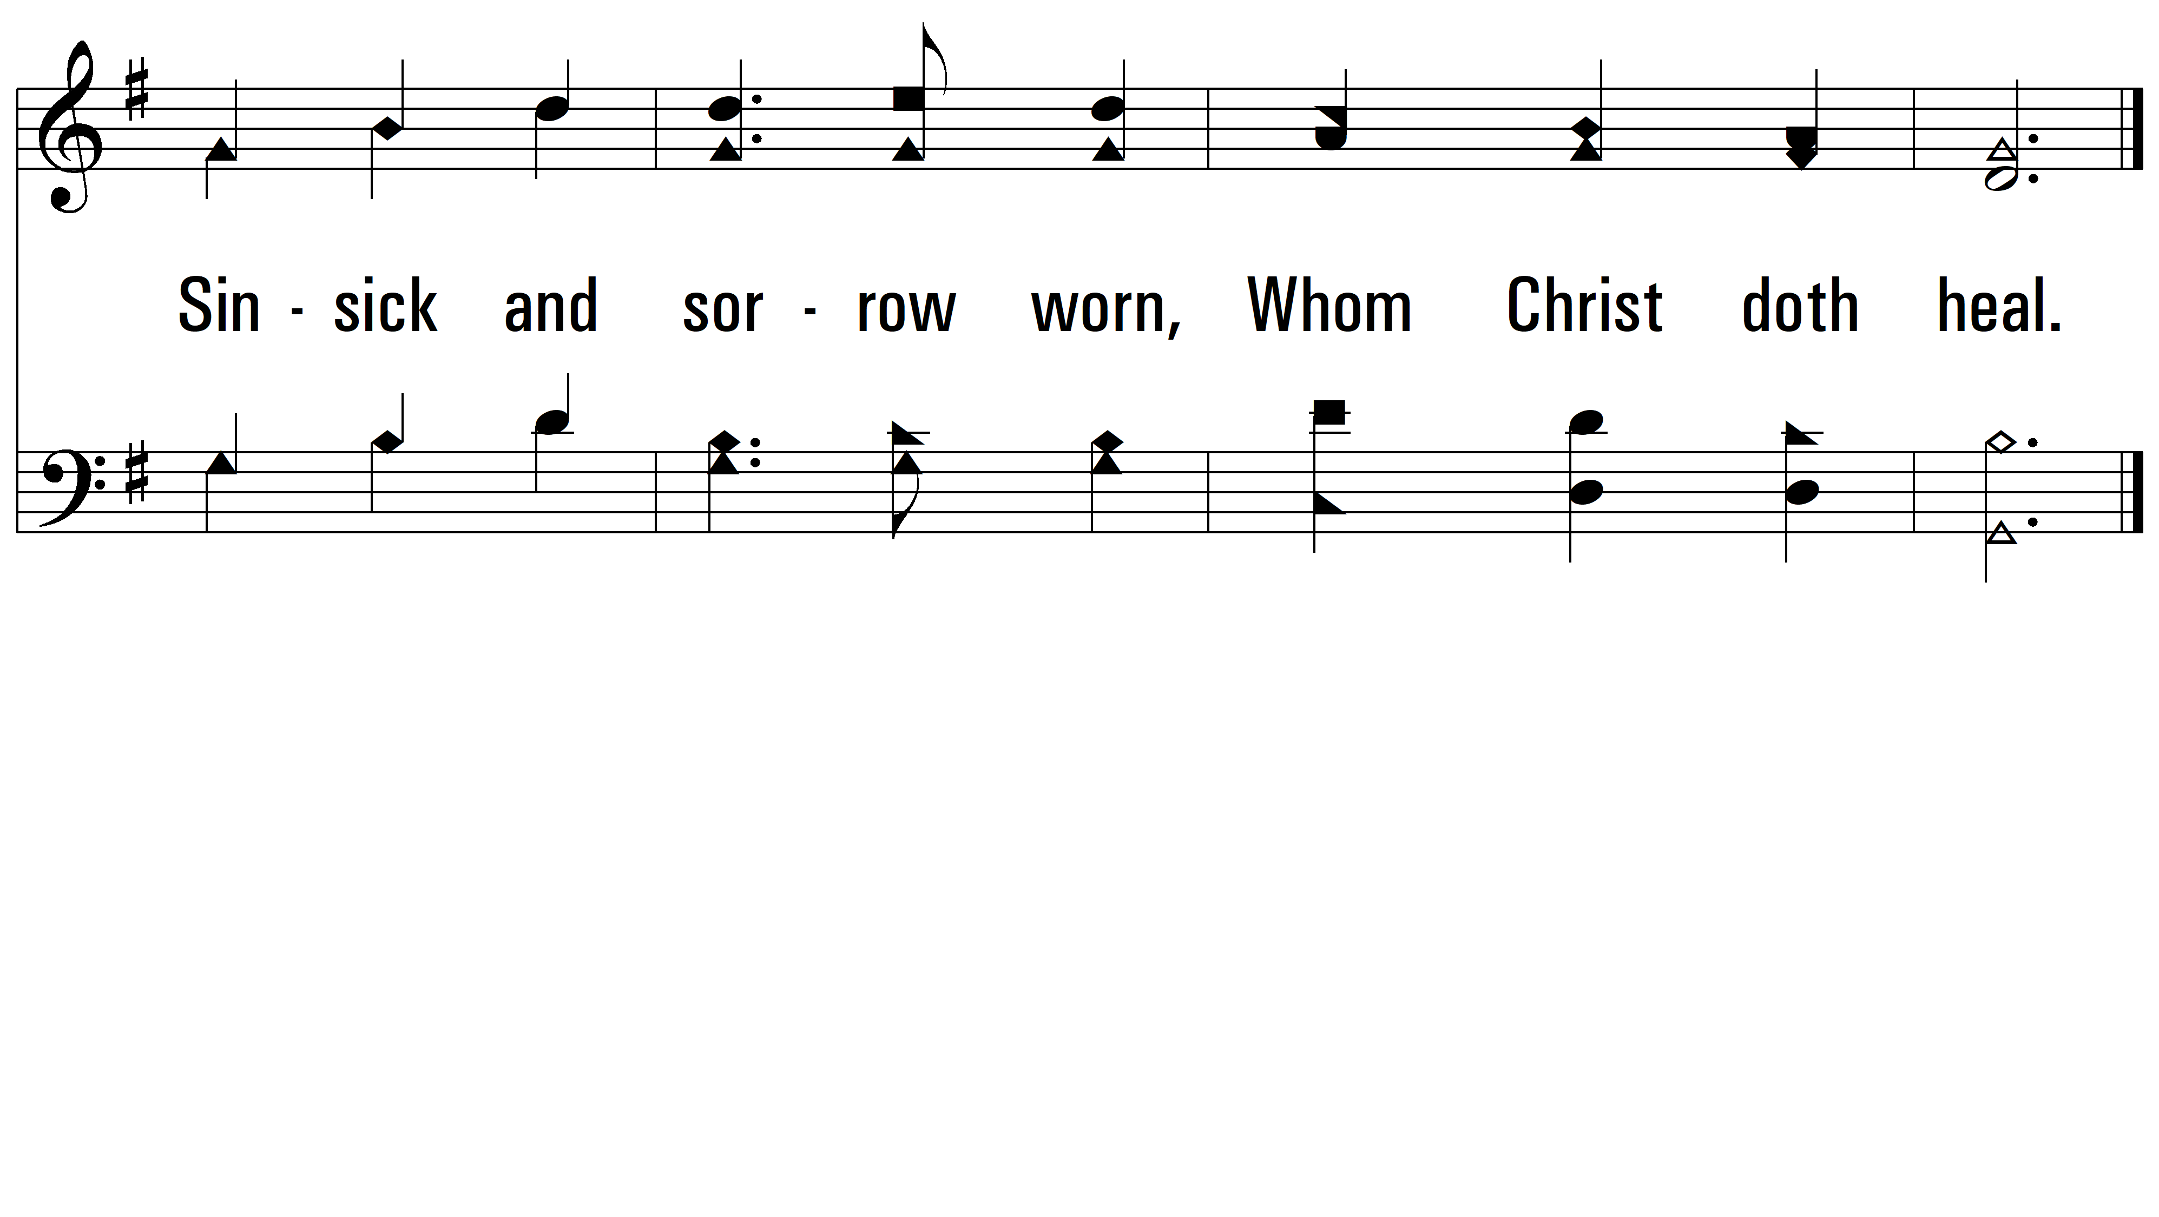
vs. 1

Slide 5

vs. 2 ~ Christ For The World We Sing

Slide 6
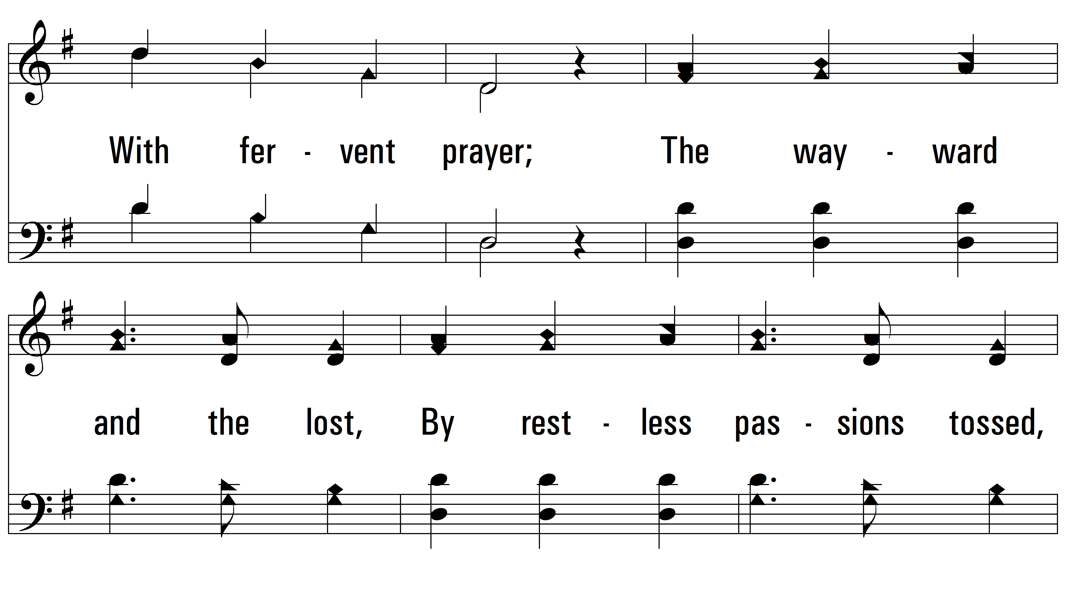
vs. 2

Slide 7
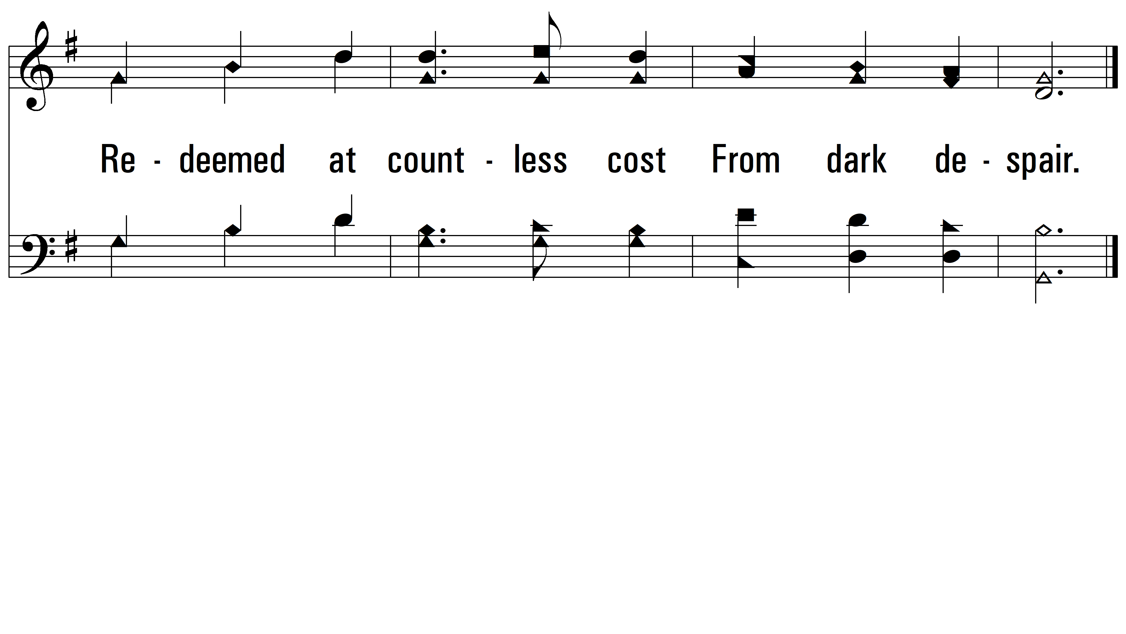
vs. 2

Slide 8

vs. 3 ~ Christ For The World We Sing

Slide 9
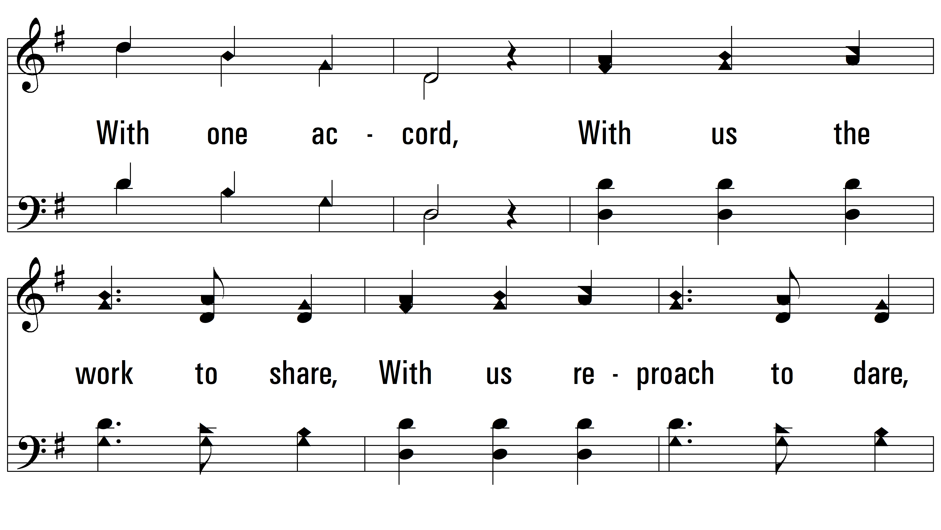
vs. 3

Slide 10
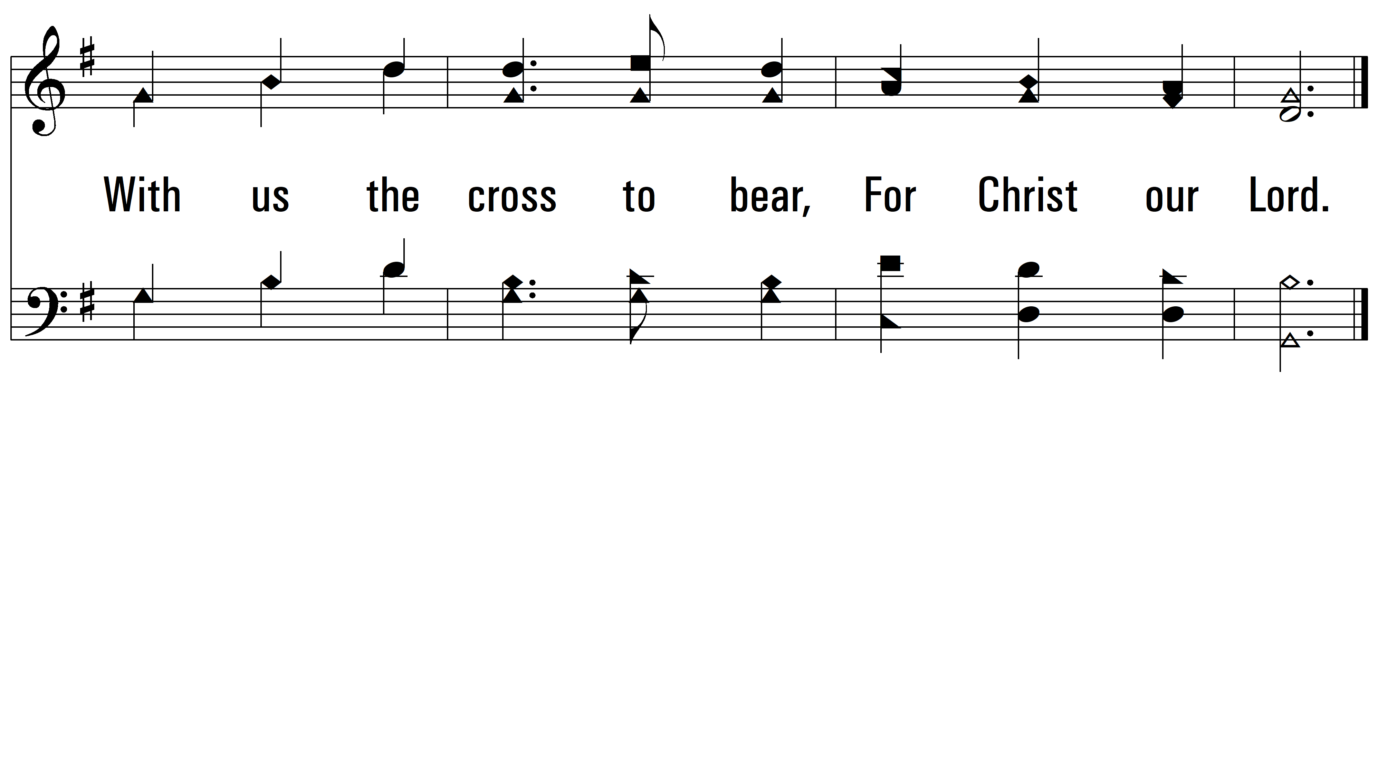
vs. 3
PDHymns.com
END

