Slide 1
Can You Count The Stars?
STERNENZHL
8.7.8.7.8.8.7
Words: | Johann Hey (1837), Tr. by Elmer L. Jorgeneon (1921)
Music: | German Folk Tune (c. 1550)
3/4
F/F - DO
Verses: 3
Lead - | DO
Alto - | DO
Tenor - | MI
Bass - | DO
PDHymns.com

Slide 2
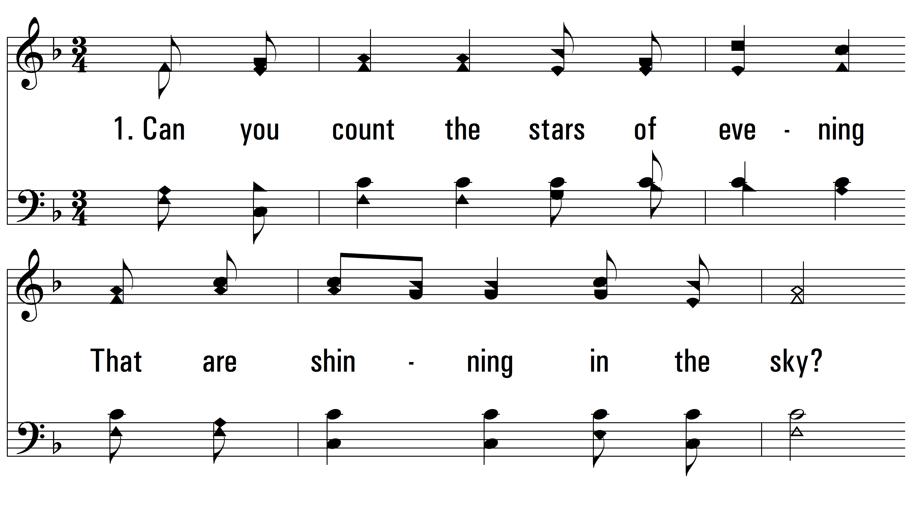
vs. 1 ~ Can You Count The Stars?

Slide 3
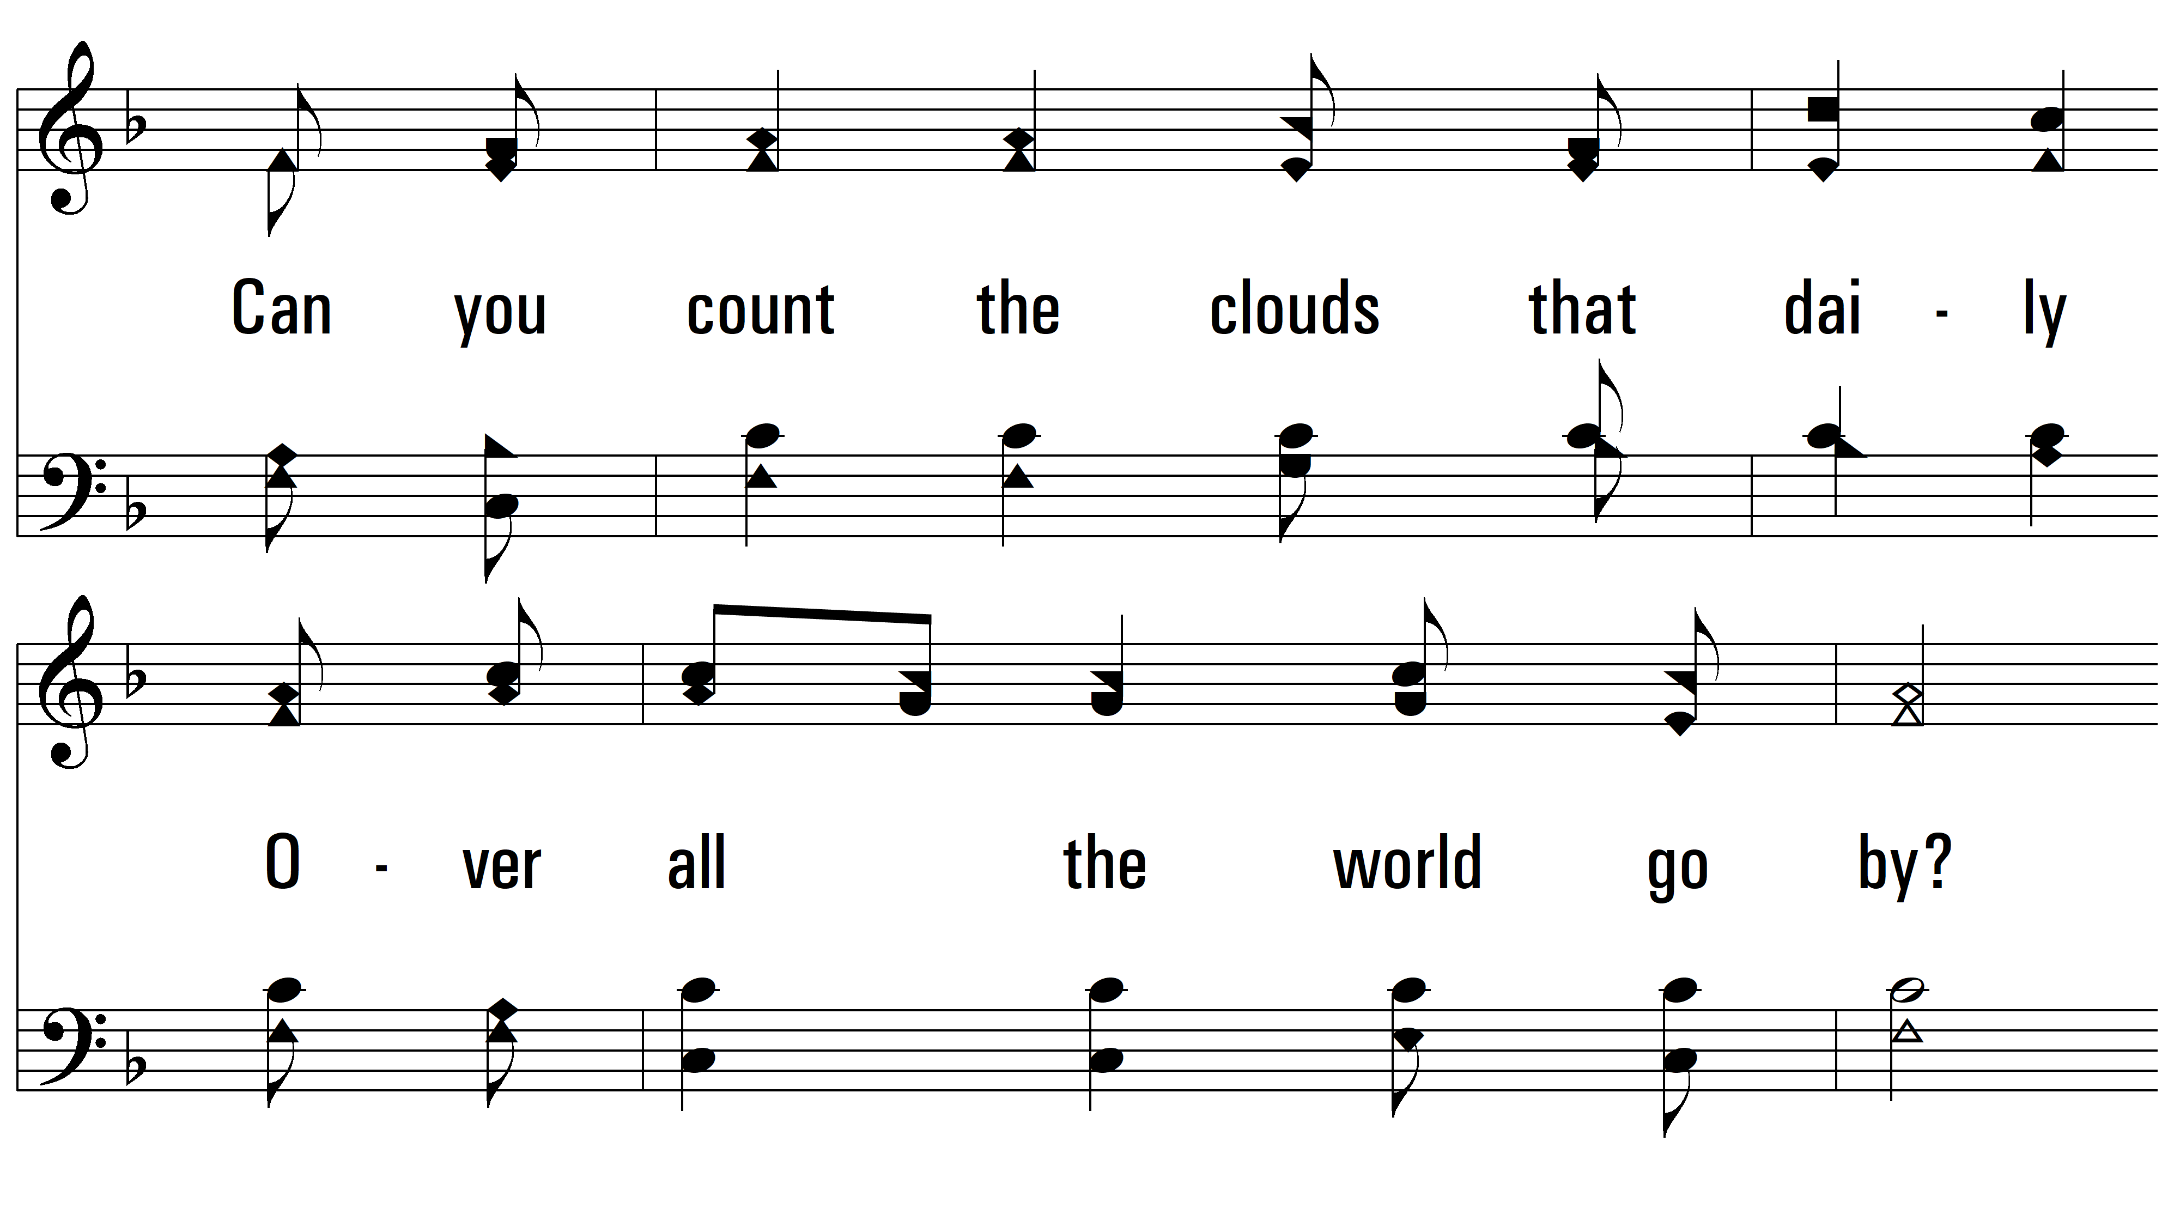
vs. 1

Slide 4
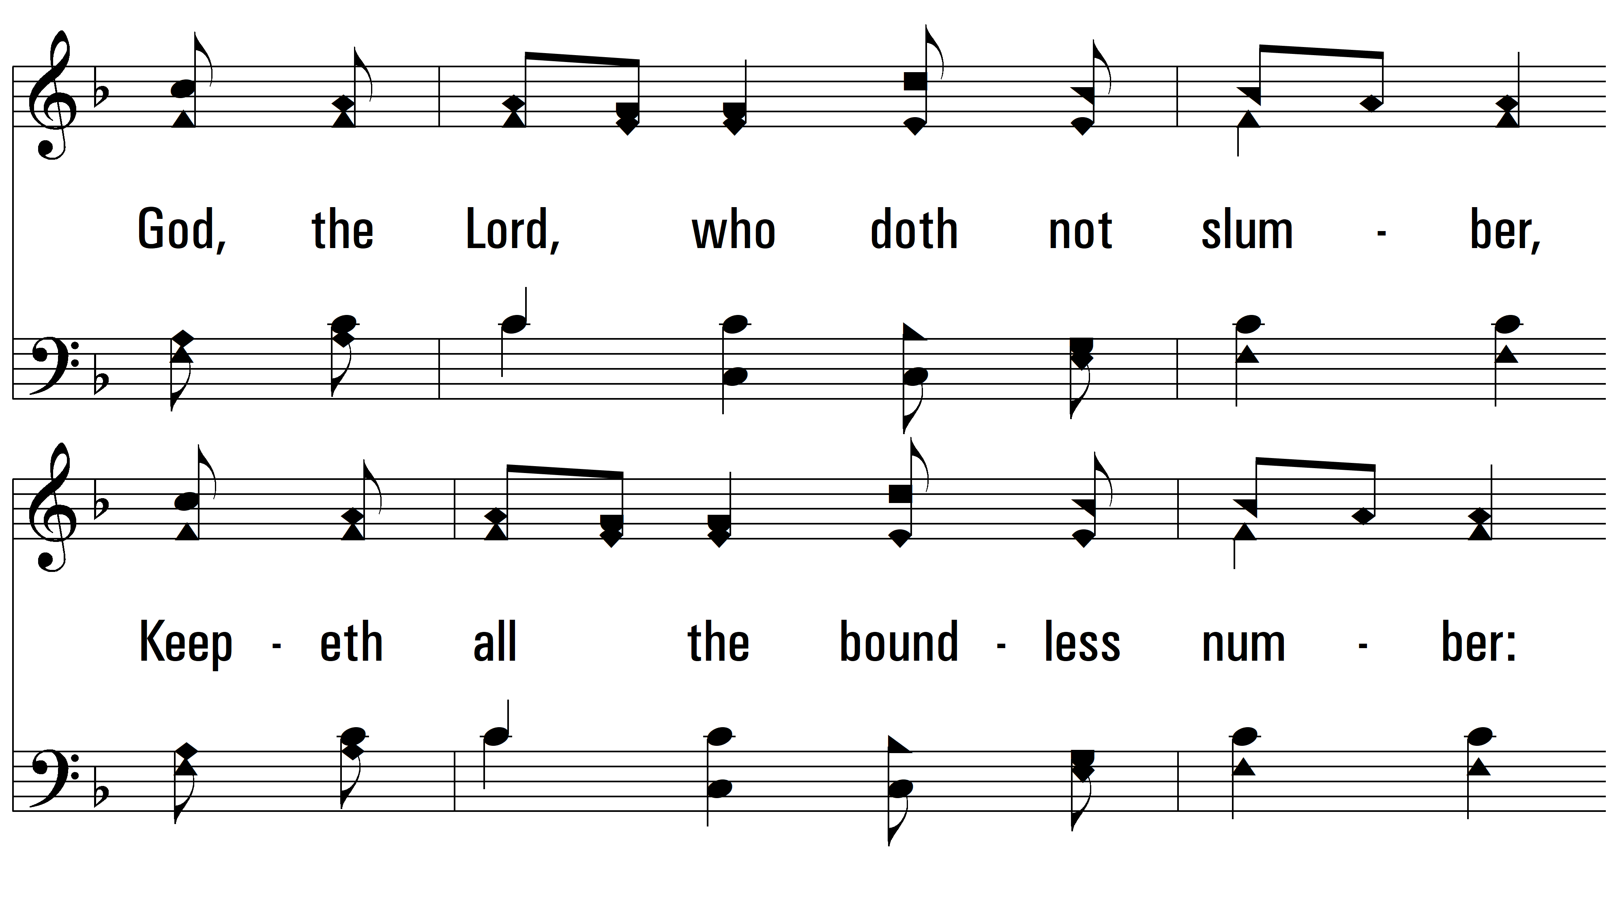
vs. 1

Slide 5
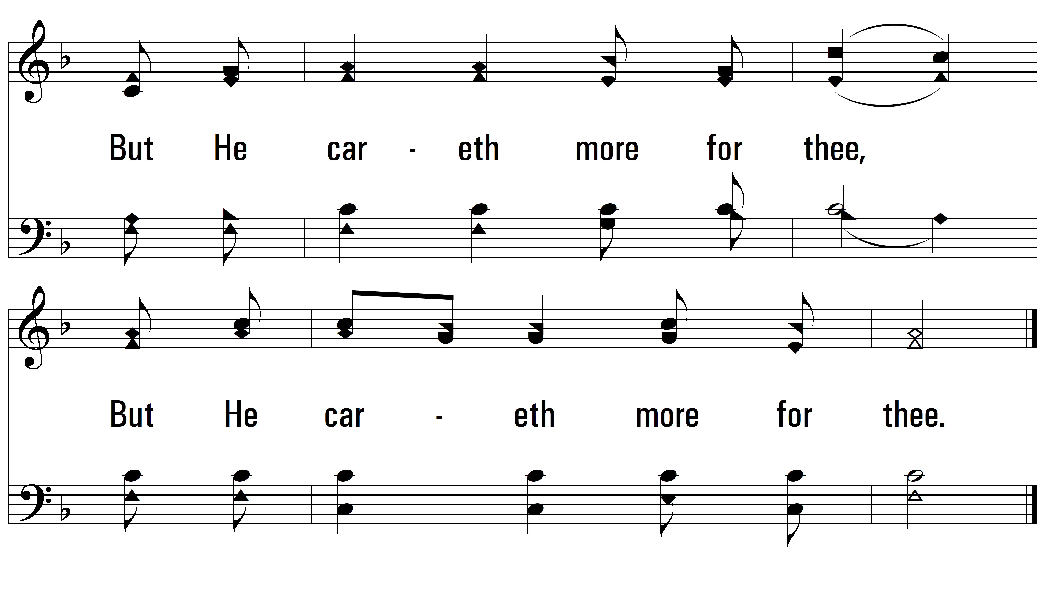
vs. 1

Slide 6
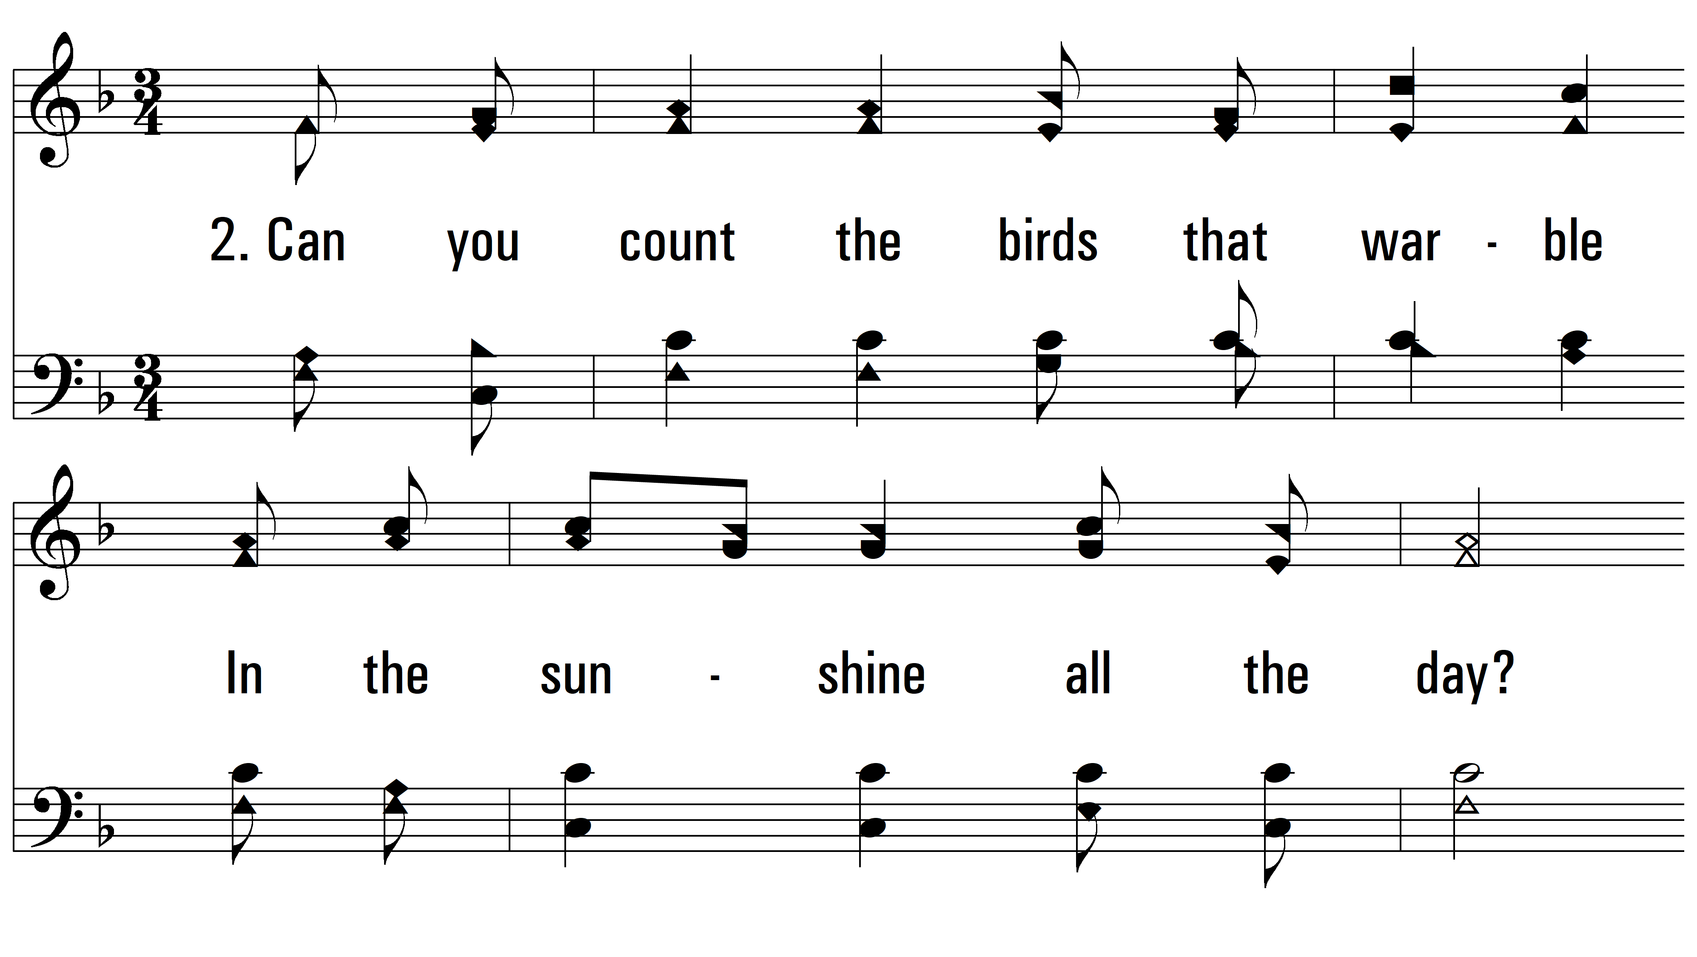
vs. 2 ~ Can You Count The Stars?

Slide 7
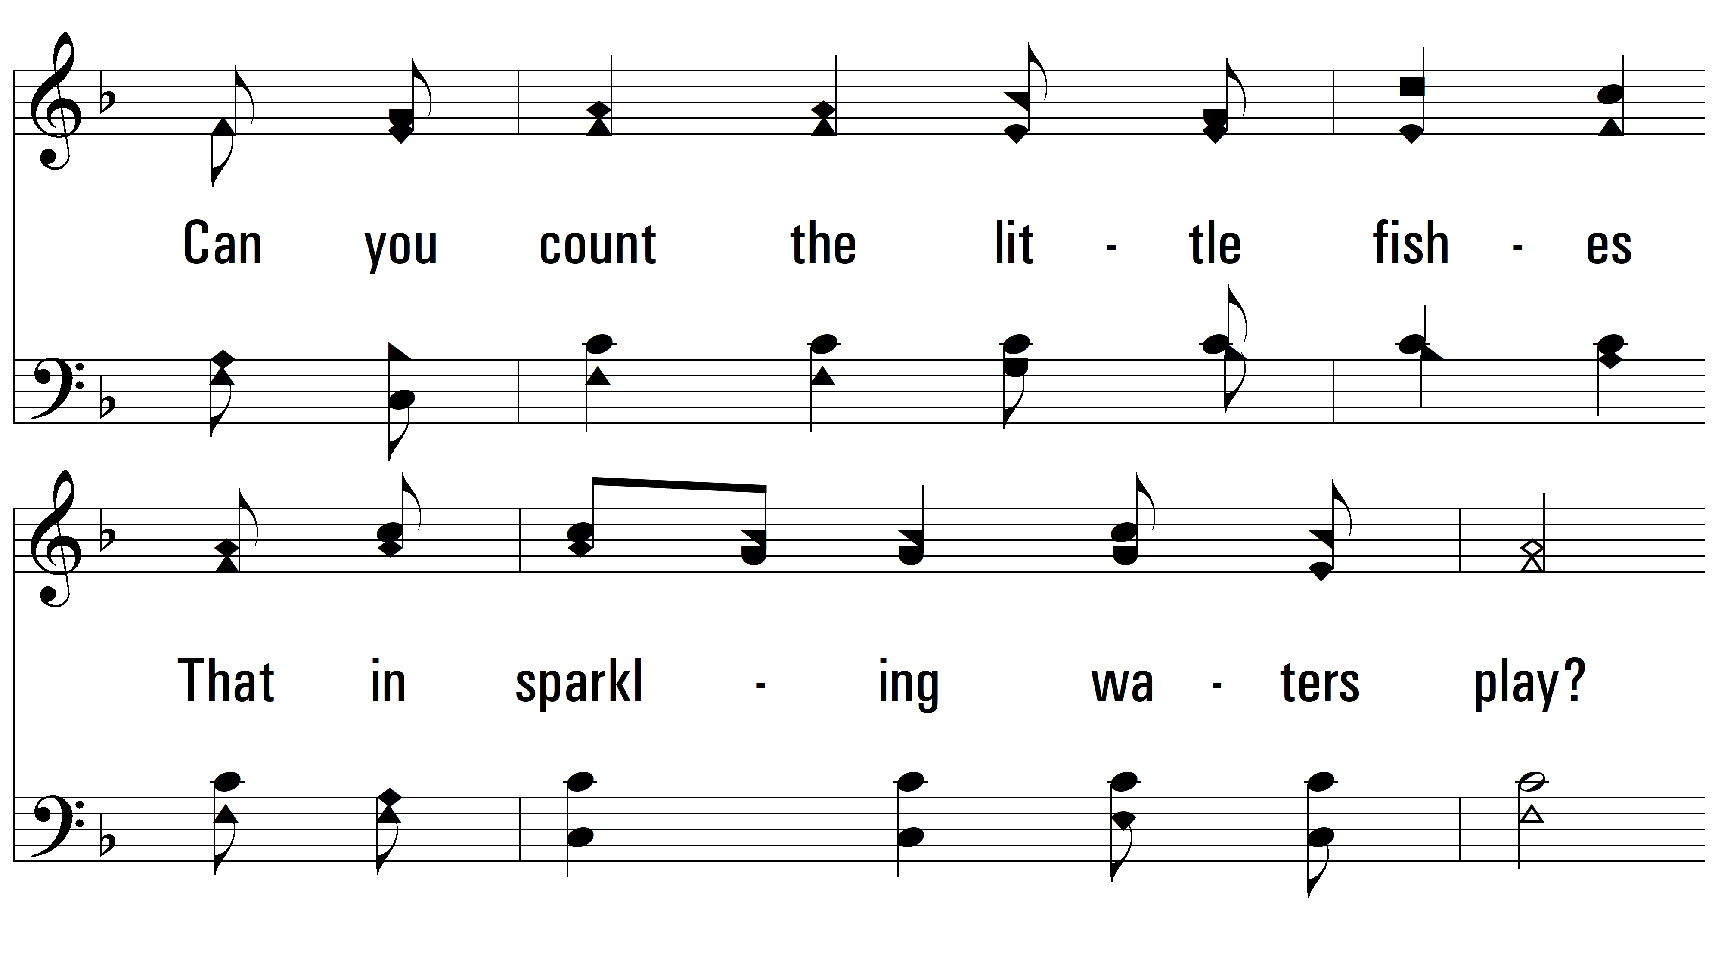
vs. 2

Slide 8
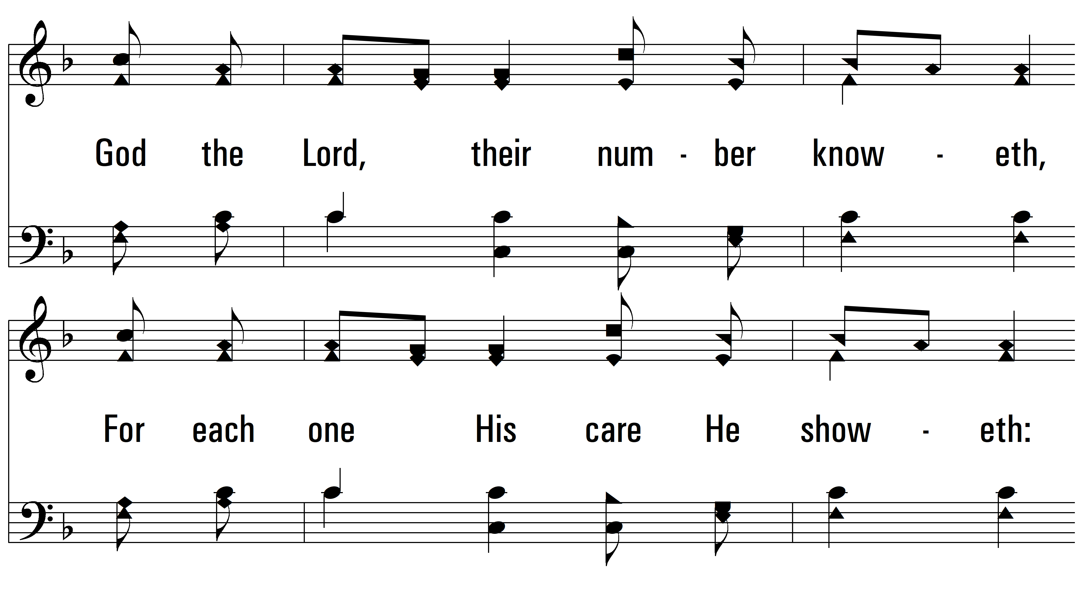
vs. 2

Slide 9
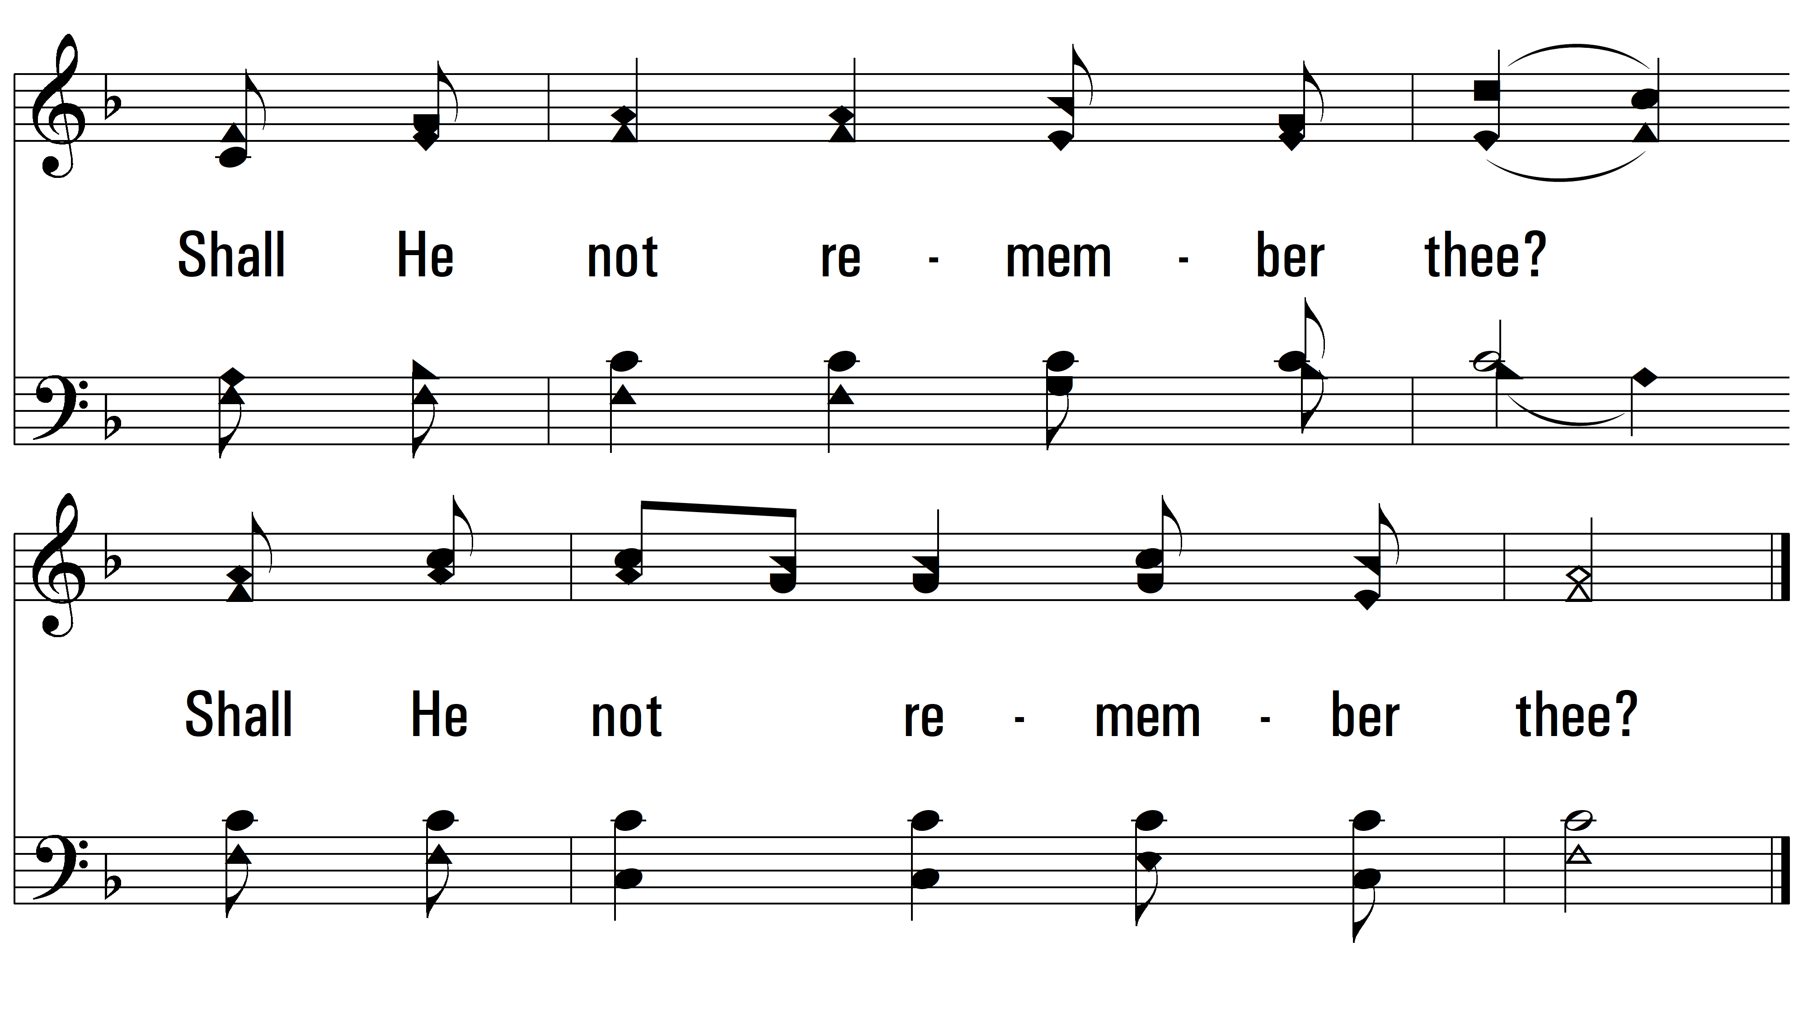
vs. 2

Slide 10
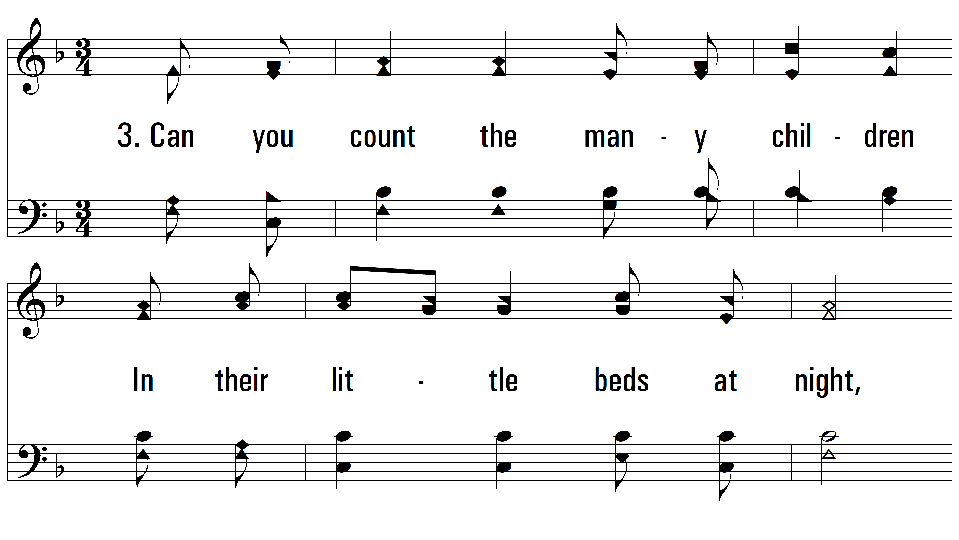
vs. 3 ~ Can You Count The Stars?

Slide 11
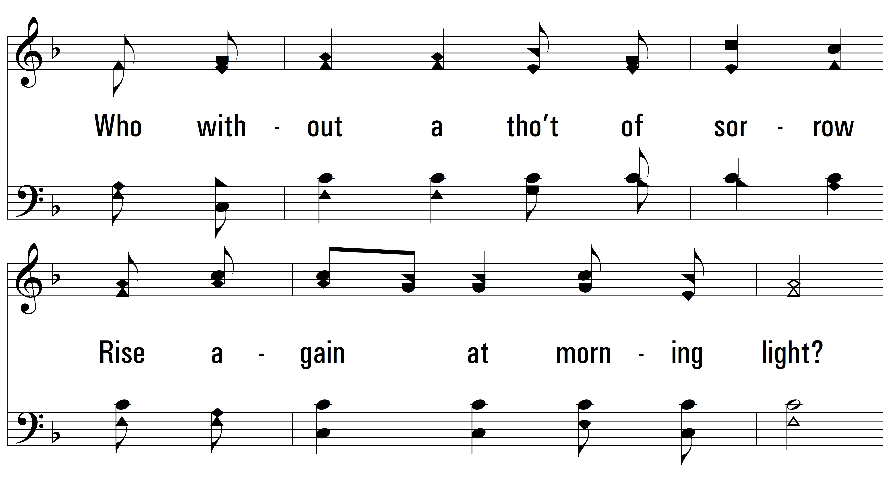
vs. 3

Slide 12
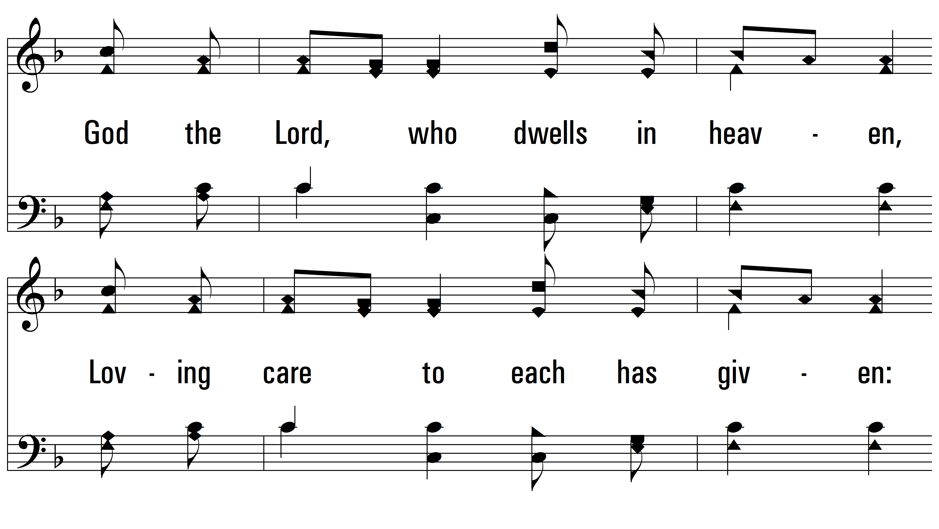
vs. 3

Slide 13
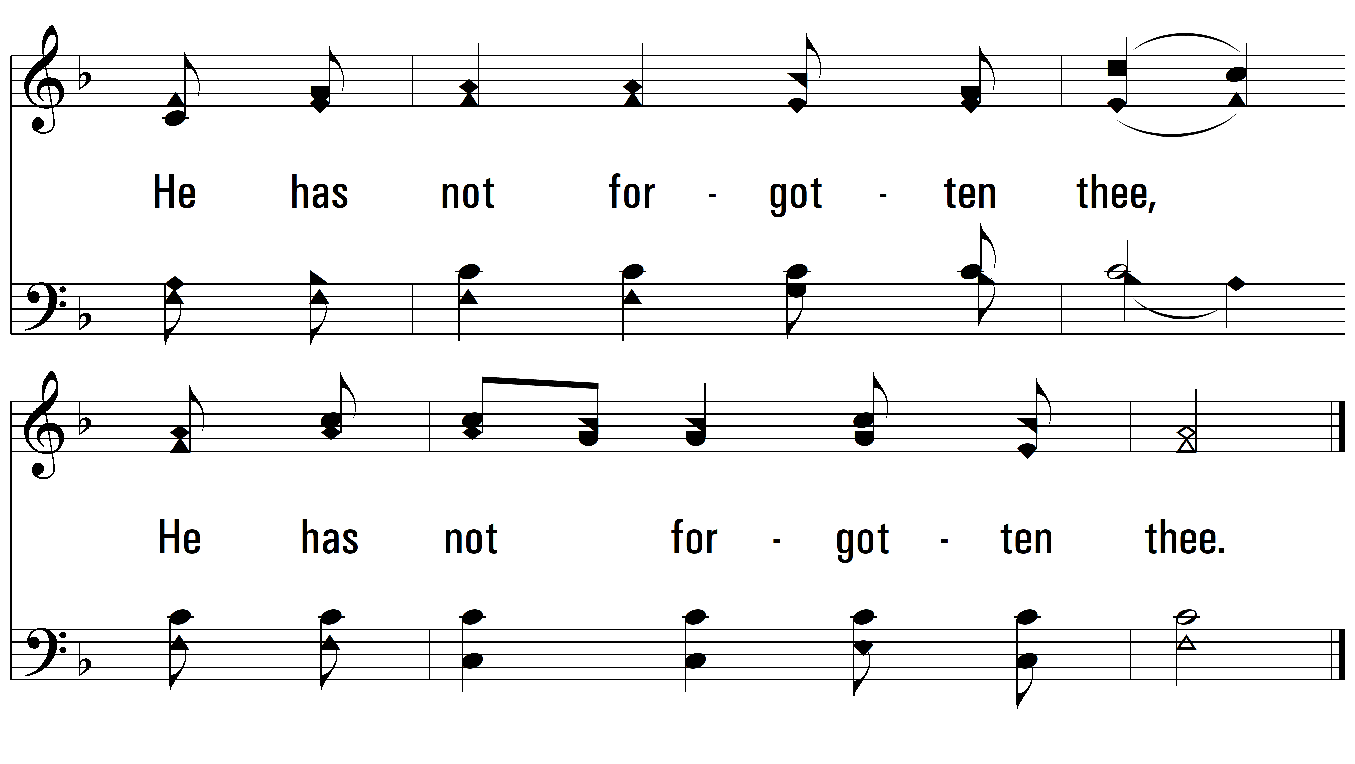
vs. 3
PDHymns.com
END

