Slide 1
By Christ Redeemed
TROYTE’S CHANT
8.8.8.4
Words: | George Rawson (1858)
Music: | A. H. Troyte’s (1860)
4/4
E^{b}/G - MI
Verses: 3
Lead - | MI
Alto - | DO
Tenor - | SOL
Bass - | DO
PDHymns.com

Slide 2
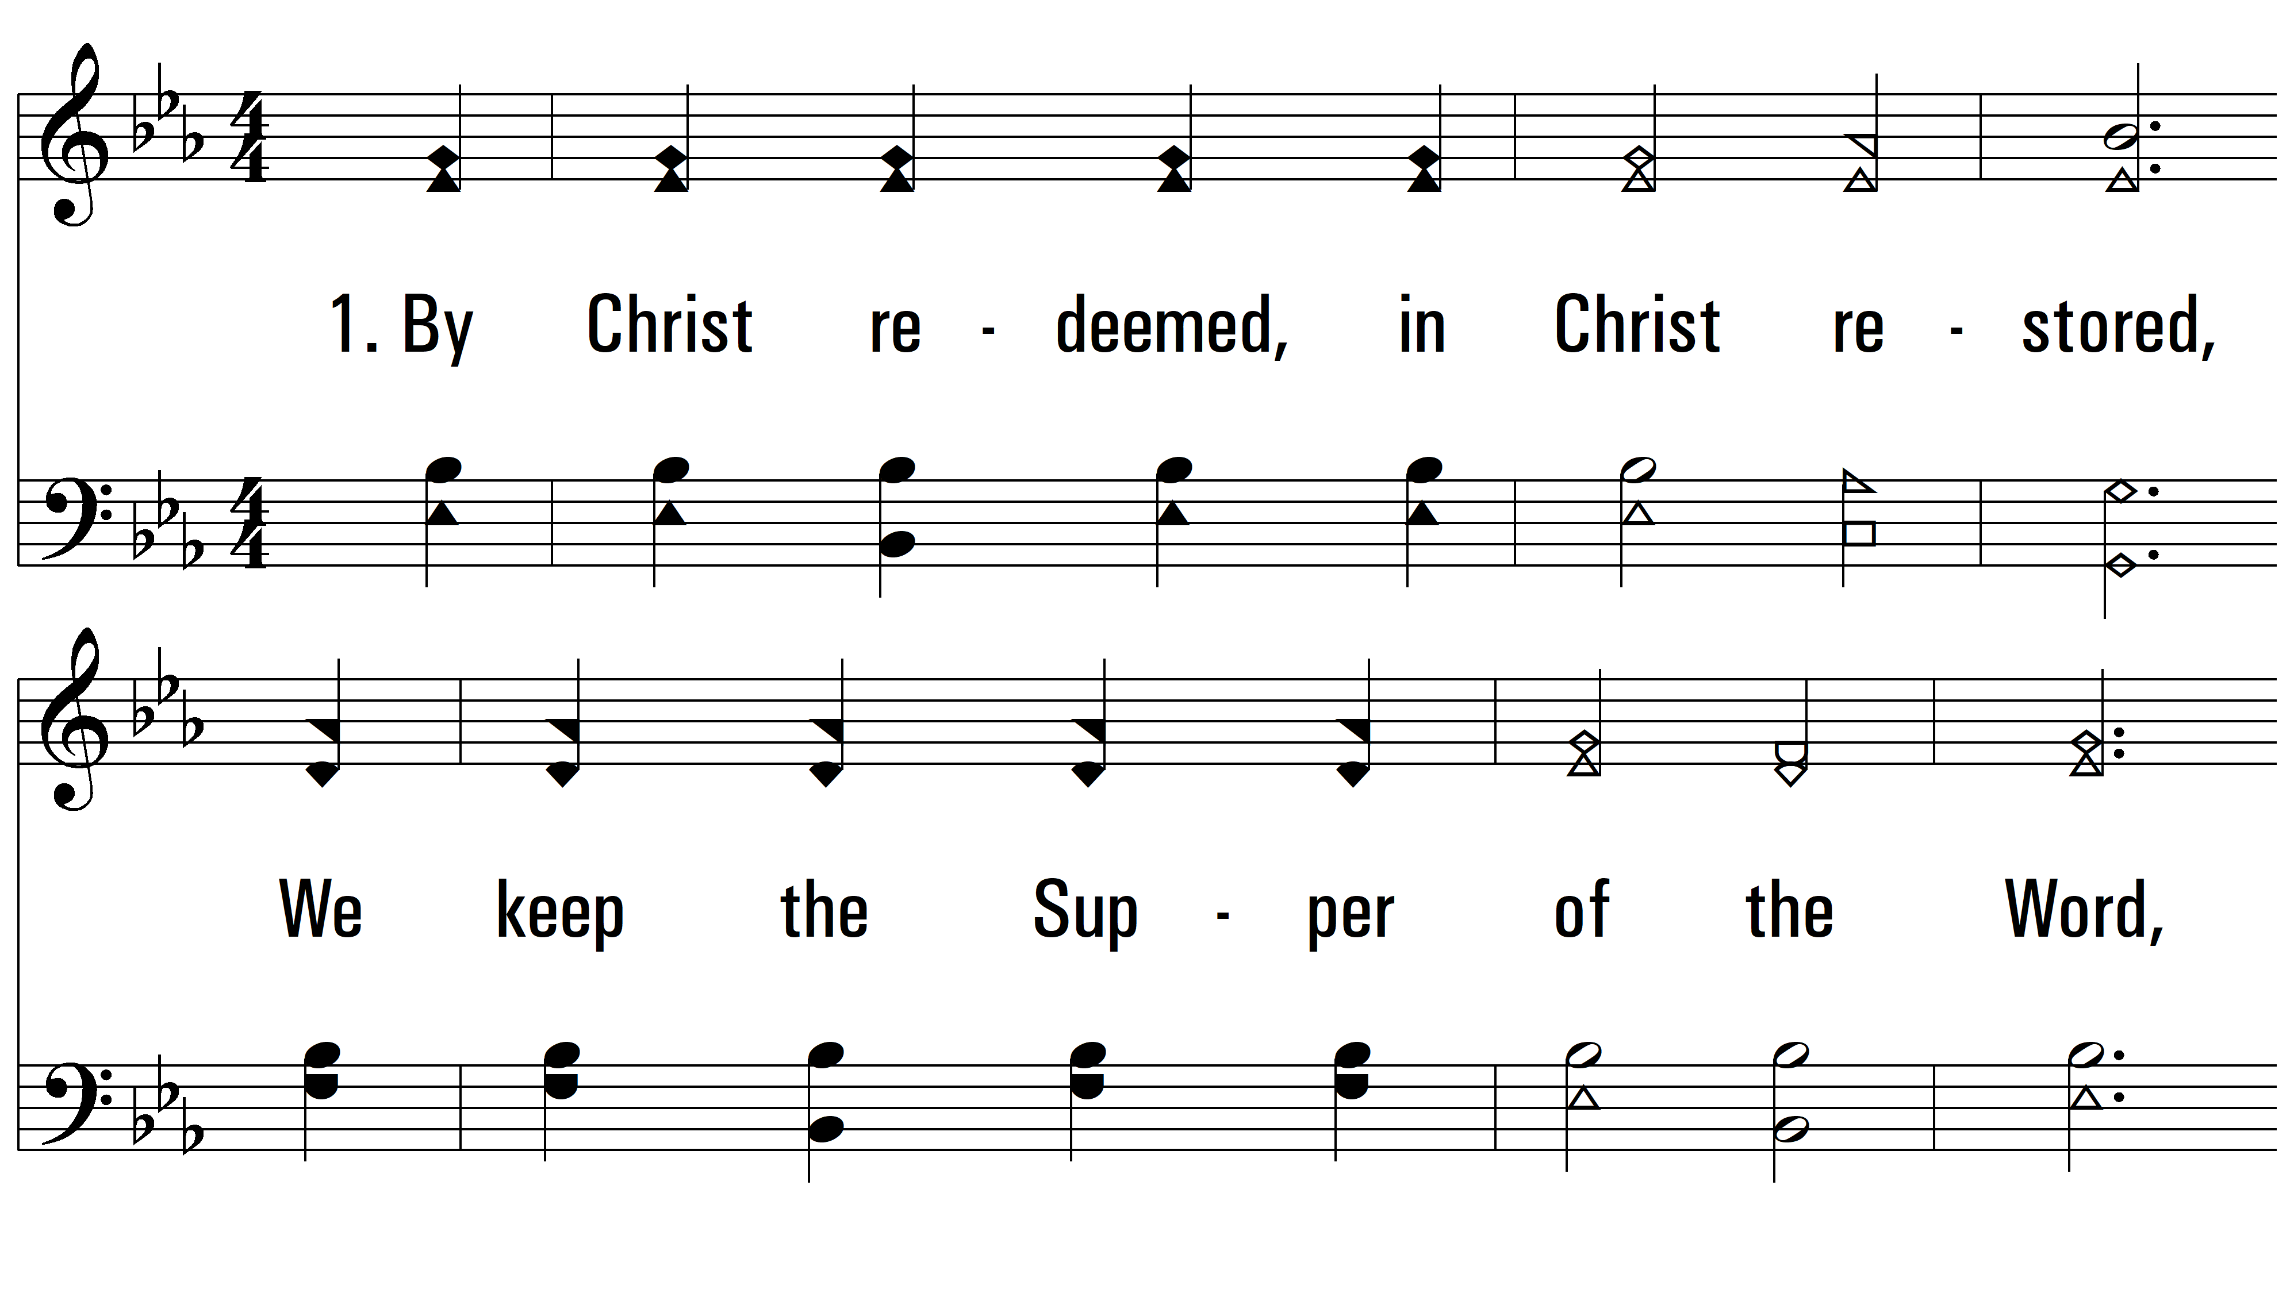
vs. 1 ~ By Christ Redeemed

Slide 3
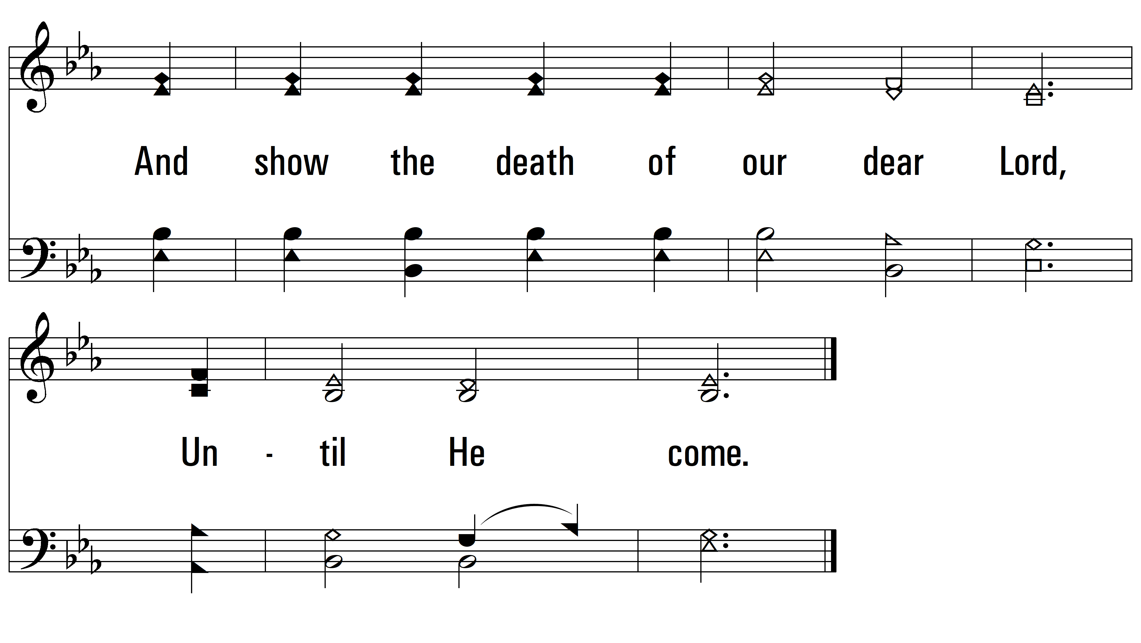
vs. 1

Slide 4
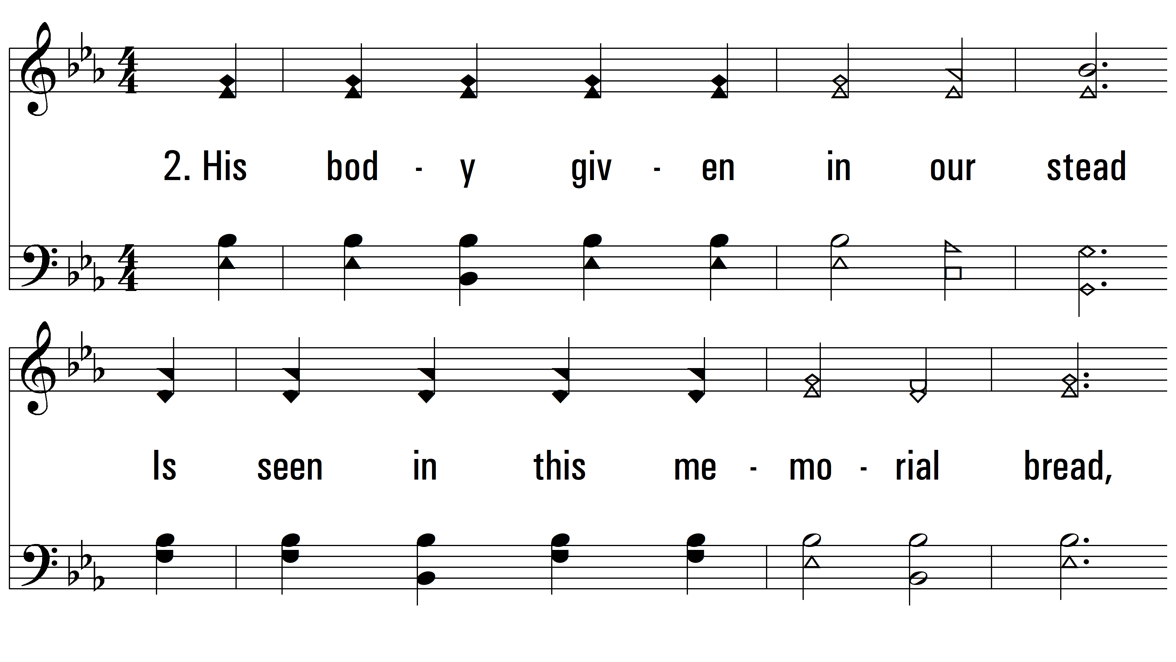
vs. 2 ~ By Christ Redeemed

Slide 5
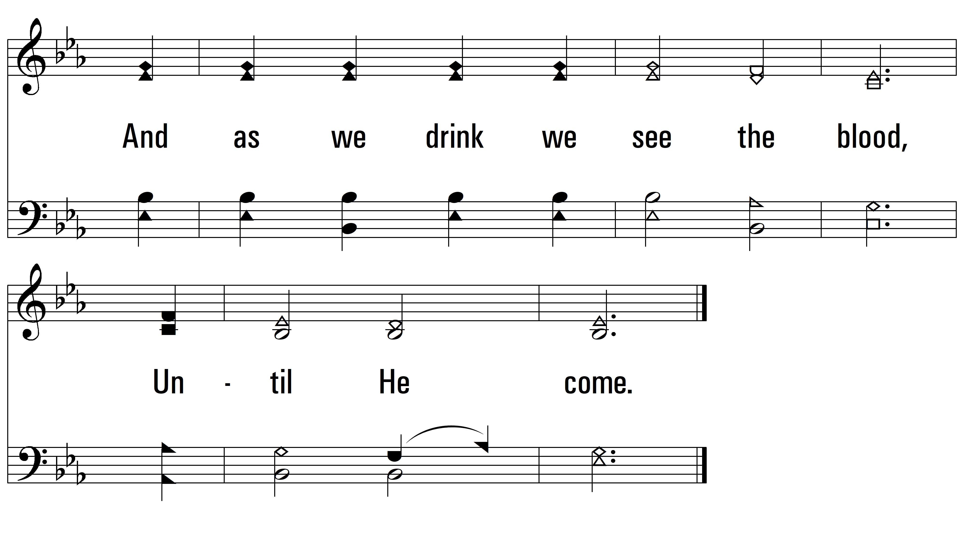
vs. 2

Slide 6
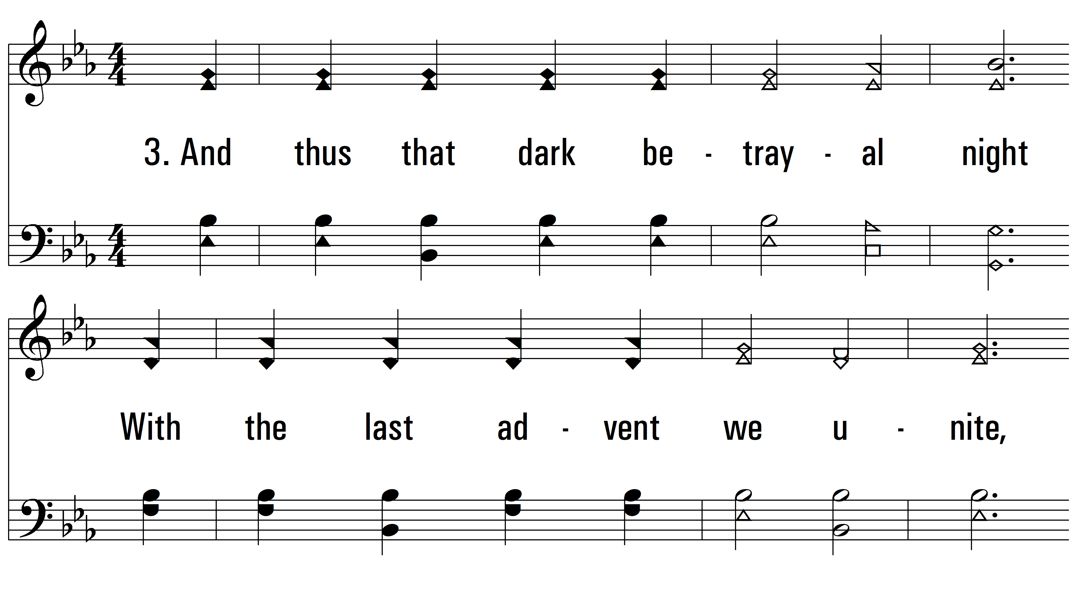
vs. 3 ~ By Christ Redeemed

Slide 7
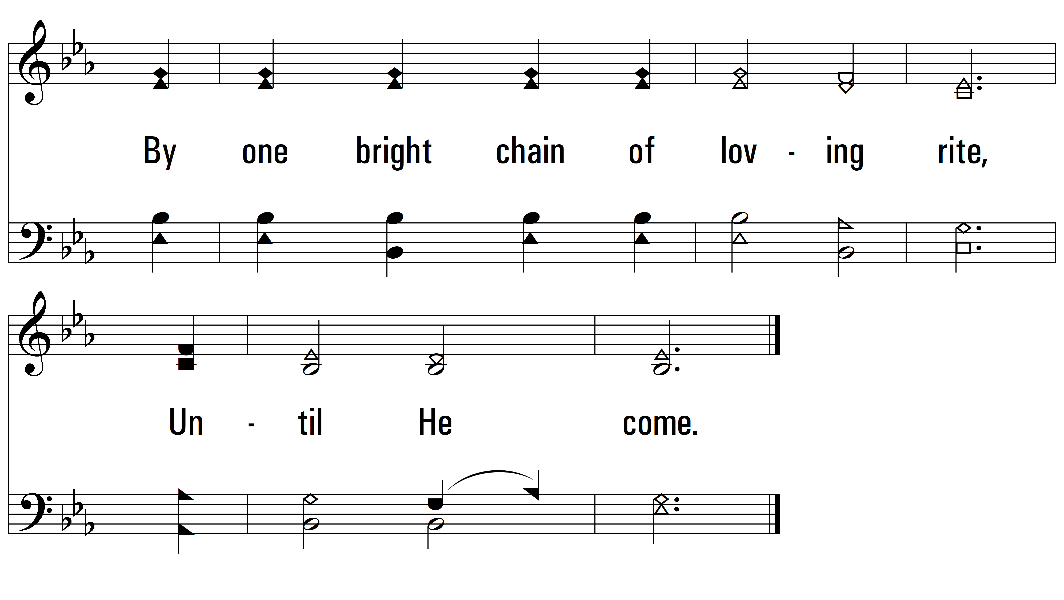
vs. 3
PDHymns.com
END

