Slide 1
Buried With Christ
Words: | Thomas Ryder (1875)
Music: | William J. Kirkpatrick
9/8
A/E - SOL
Verses: 4/Chorus
Lead - | SOL
Alto - | MI
Tenor - | DO
Bass - | DO
PDHymns.com

Slide 2
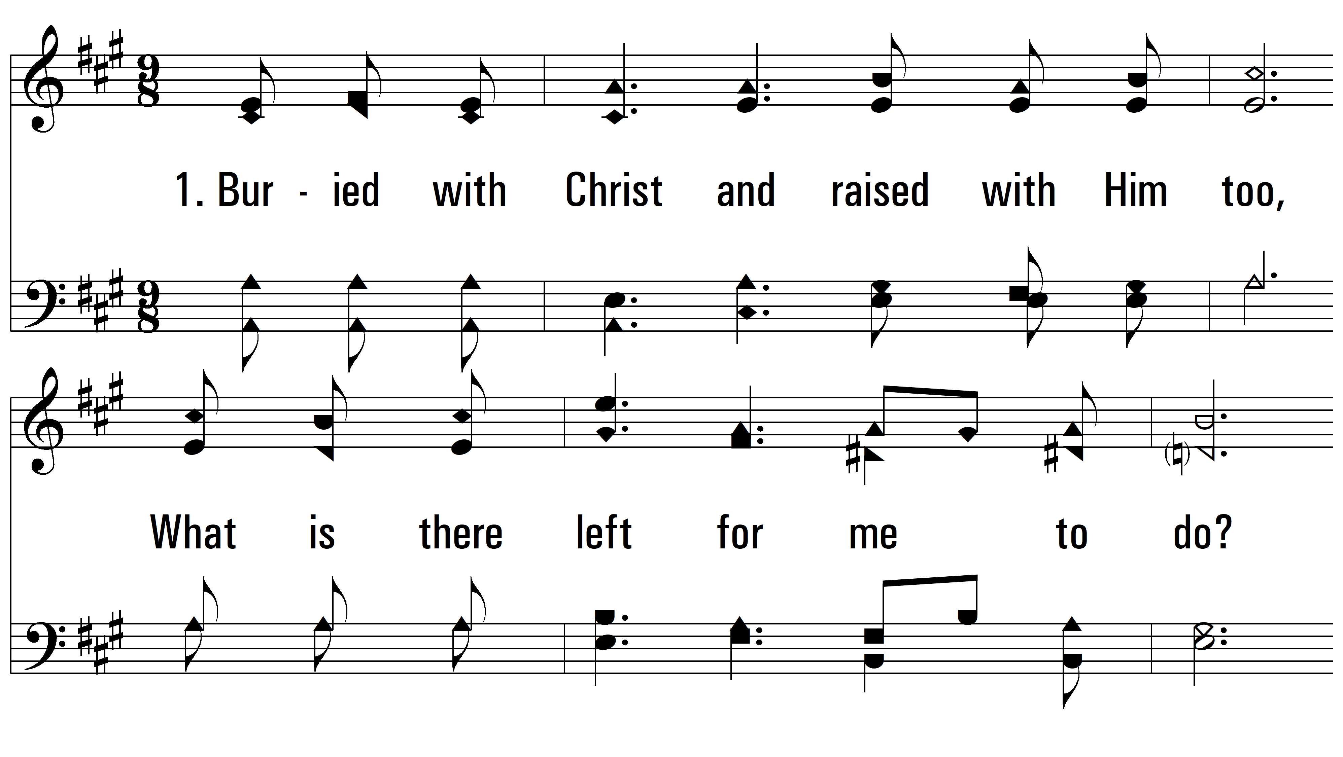
vs. 1 ~ Buried With Christ

Slide 3
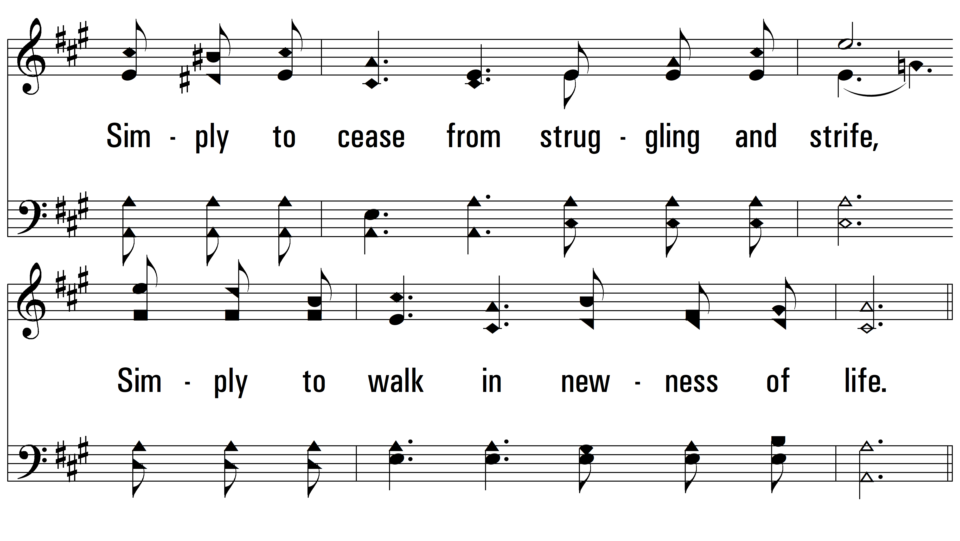
vs. 1

Slide 4
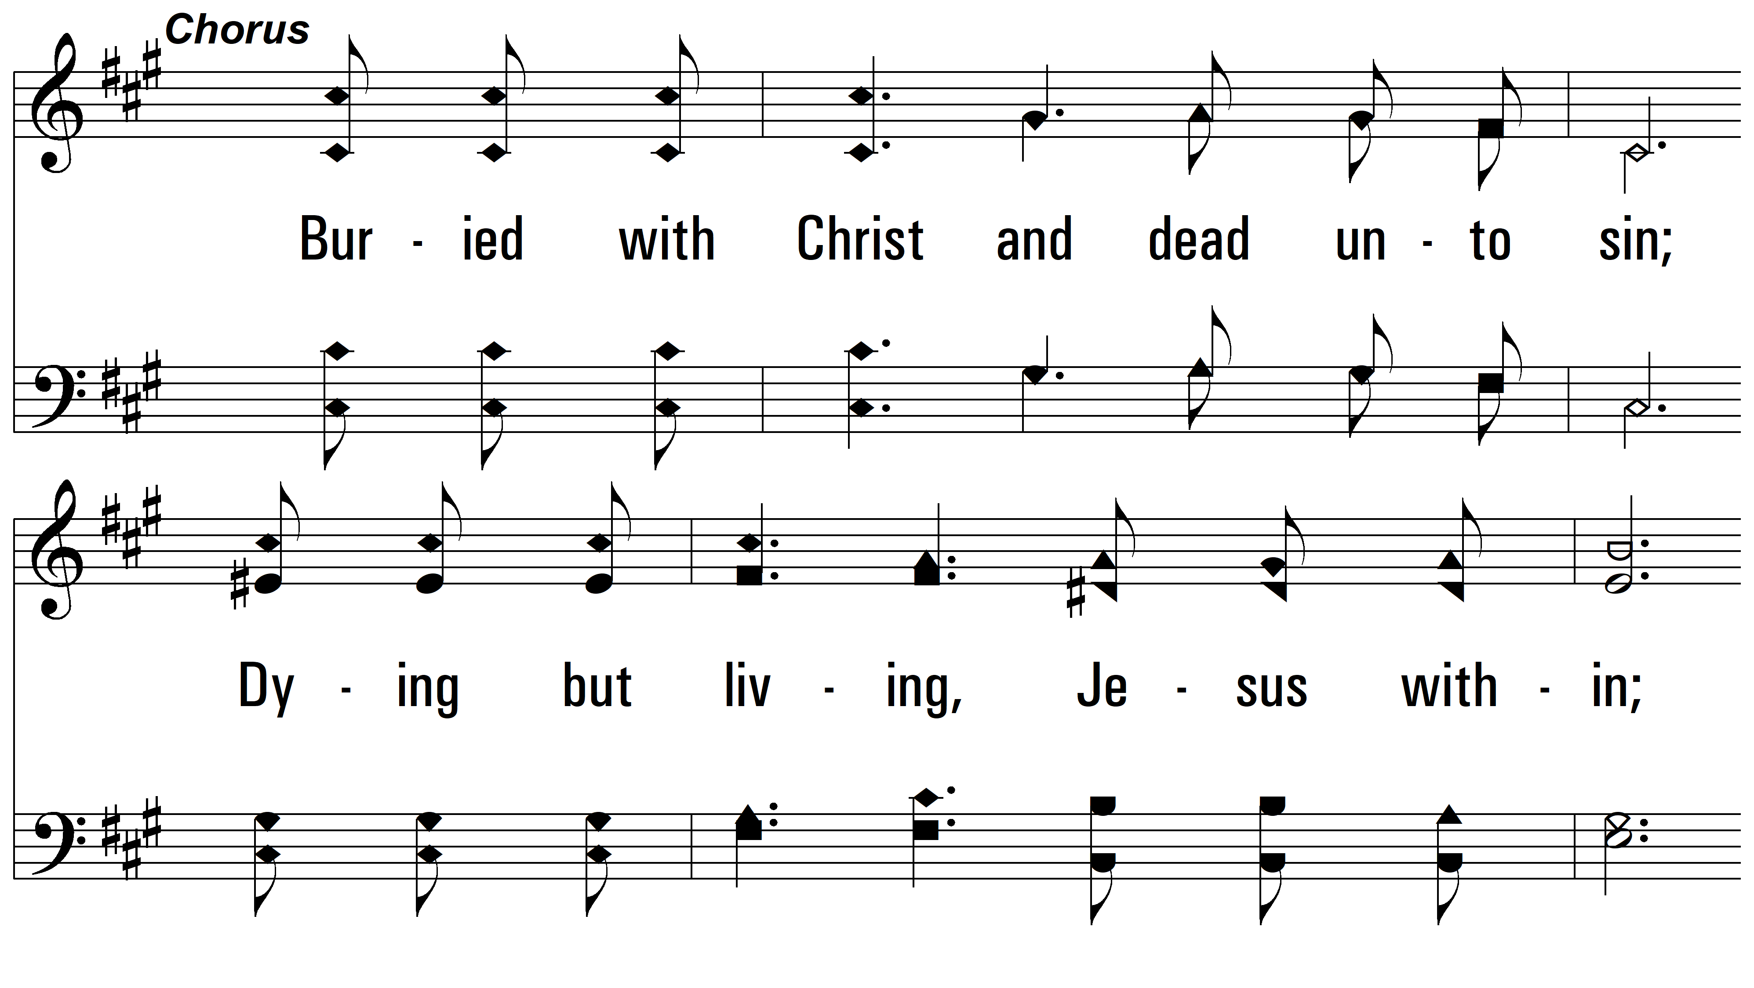
vs. 1

Slide 5
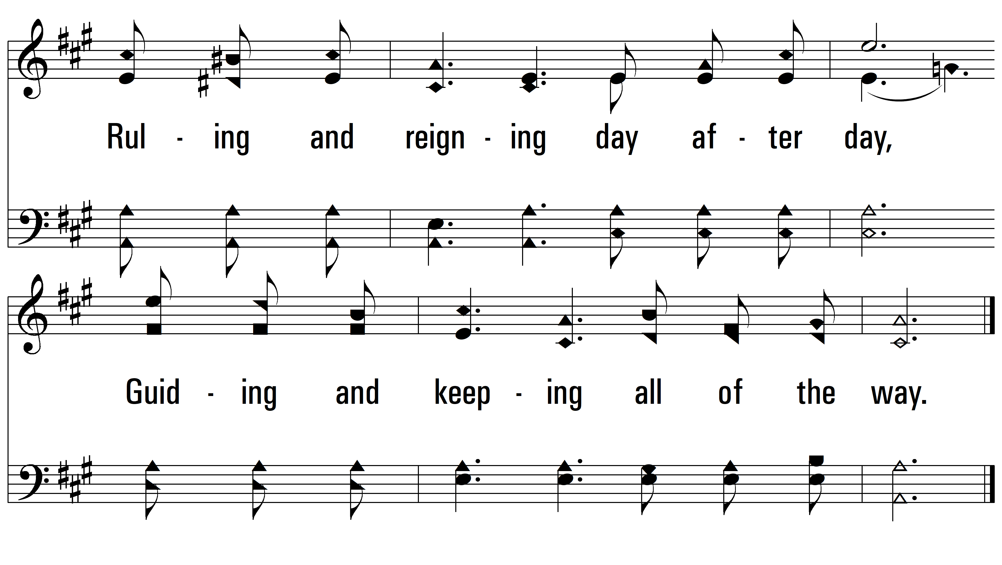
vs. 1

Slide 6
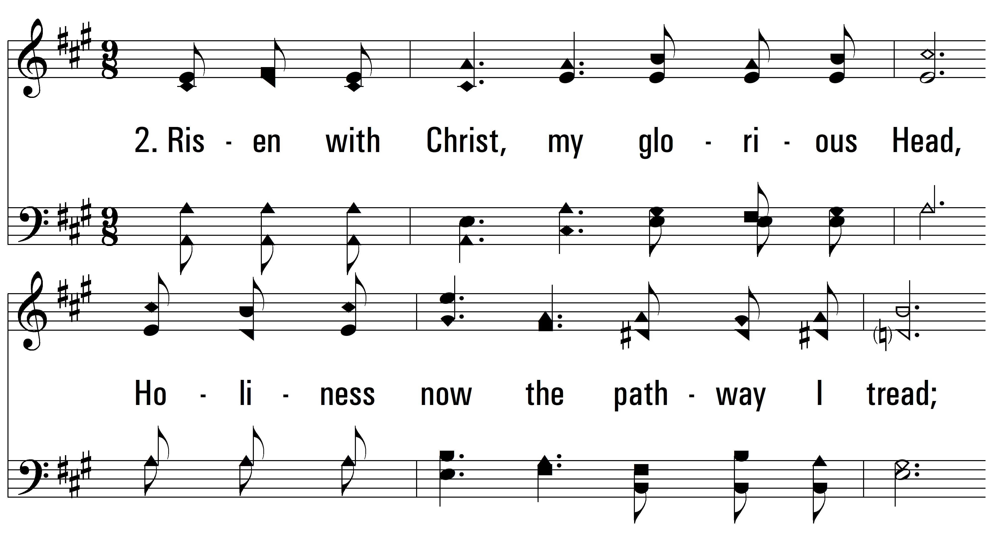
vs. 2 ~ Buried With Christ

Slide 7
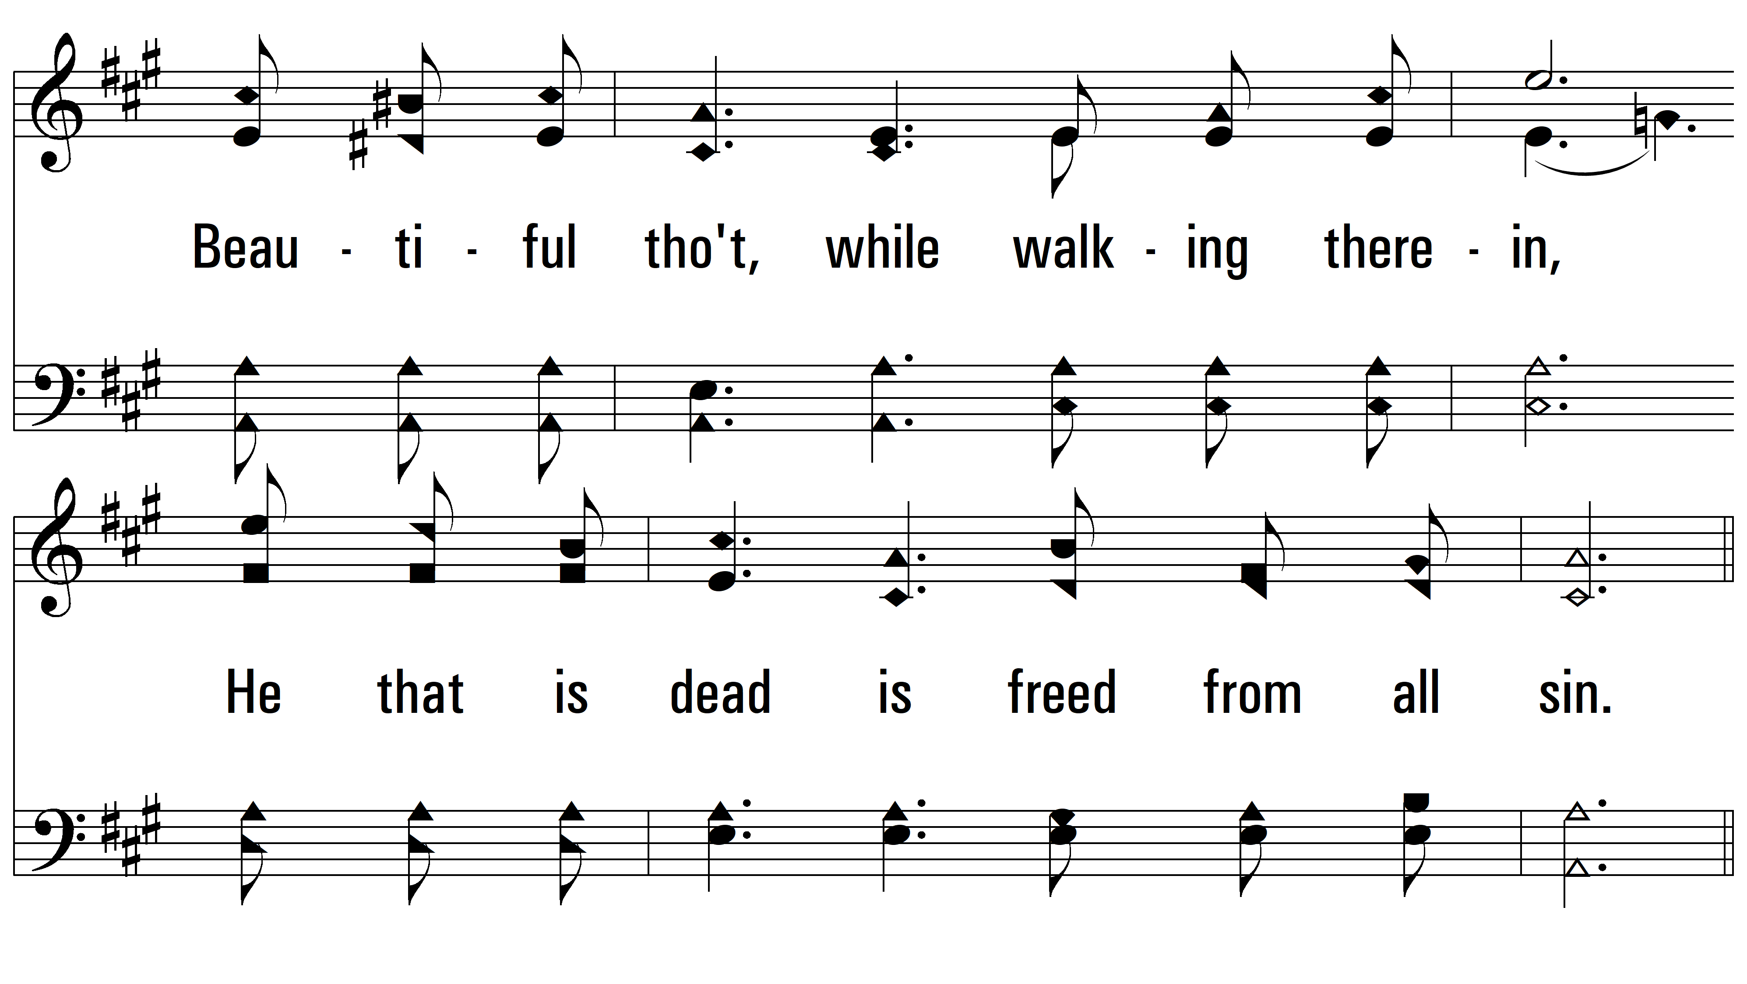
vs. 2

Slide 8
vs. 2

Slide 9
vs. 2

Slide 10
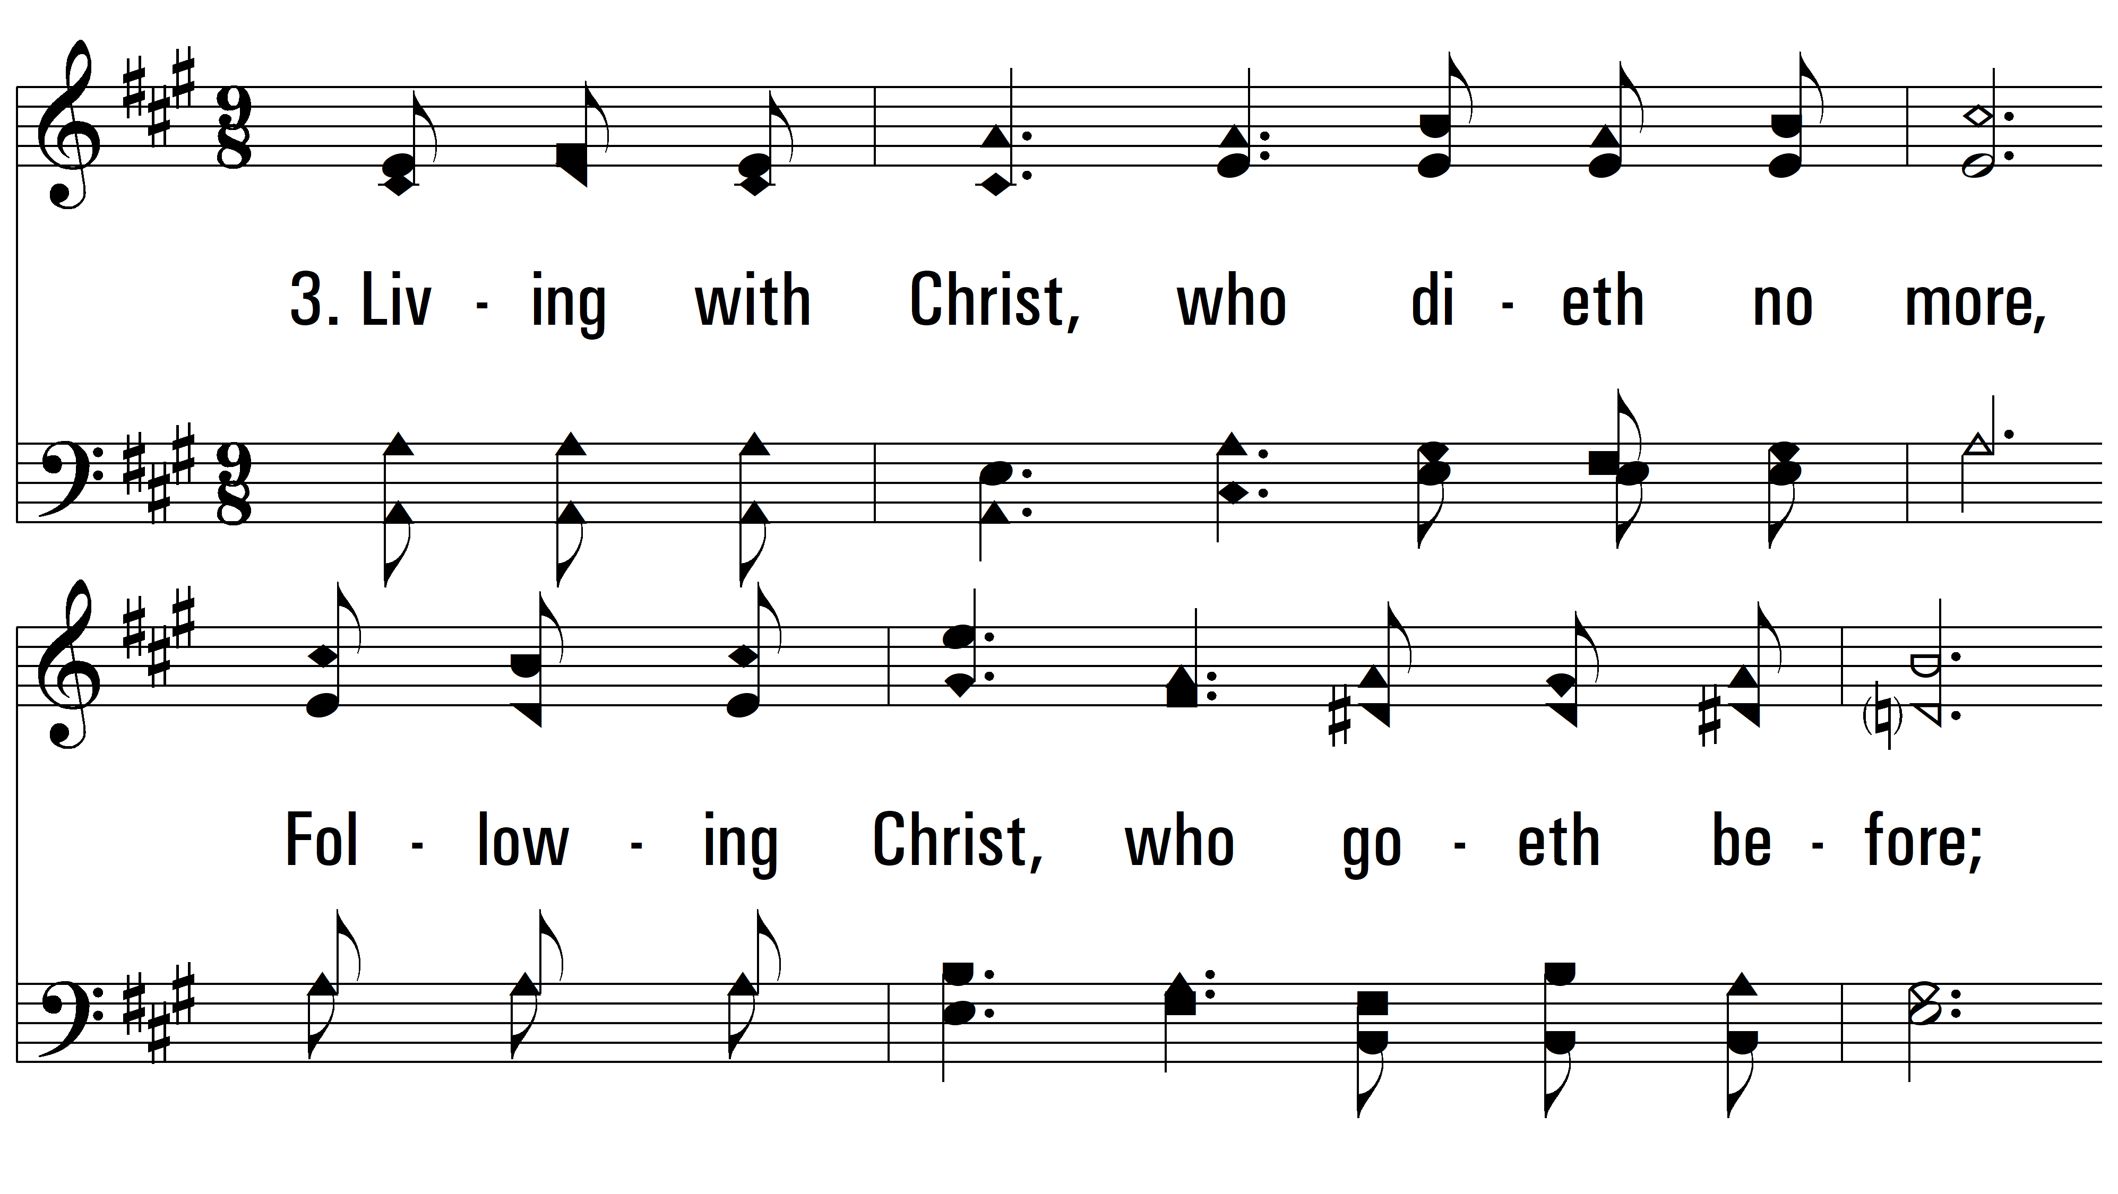
vs. 3 ~ Buried With Christ

Slide 11
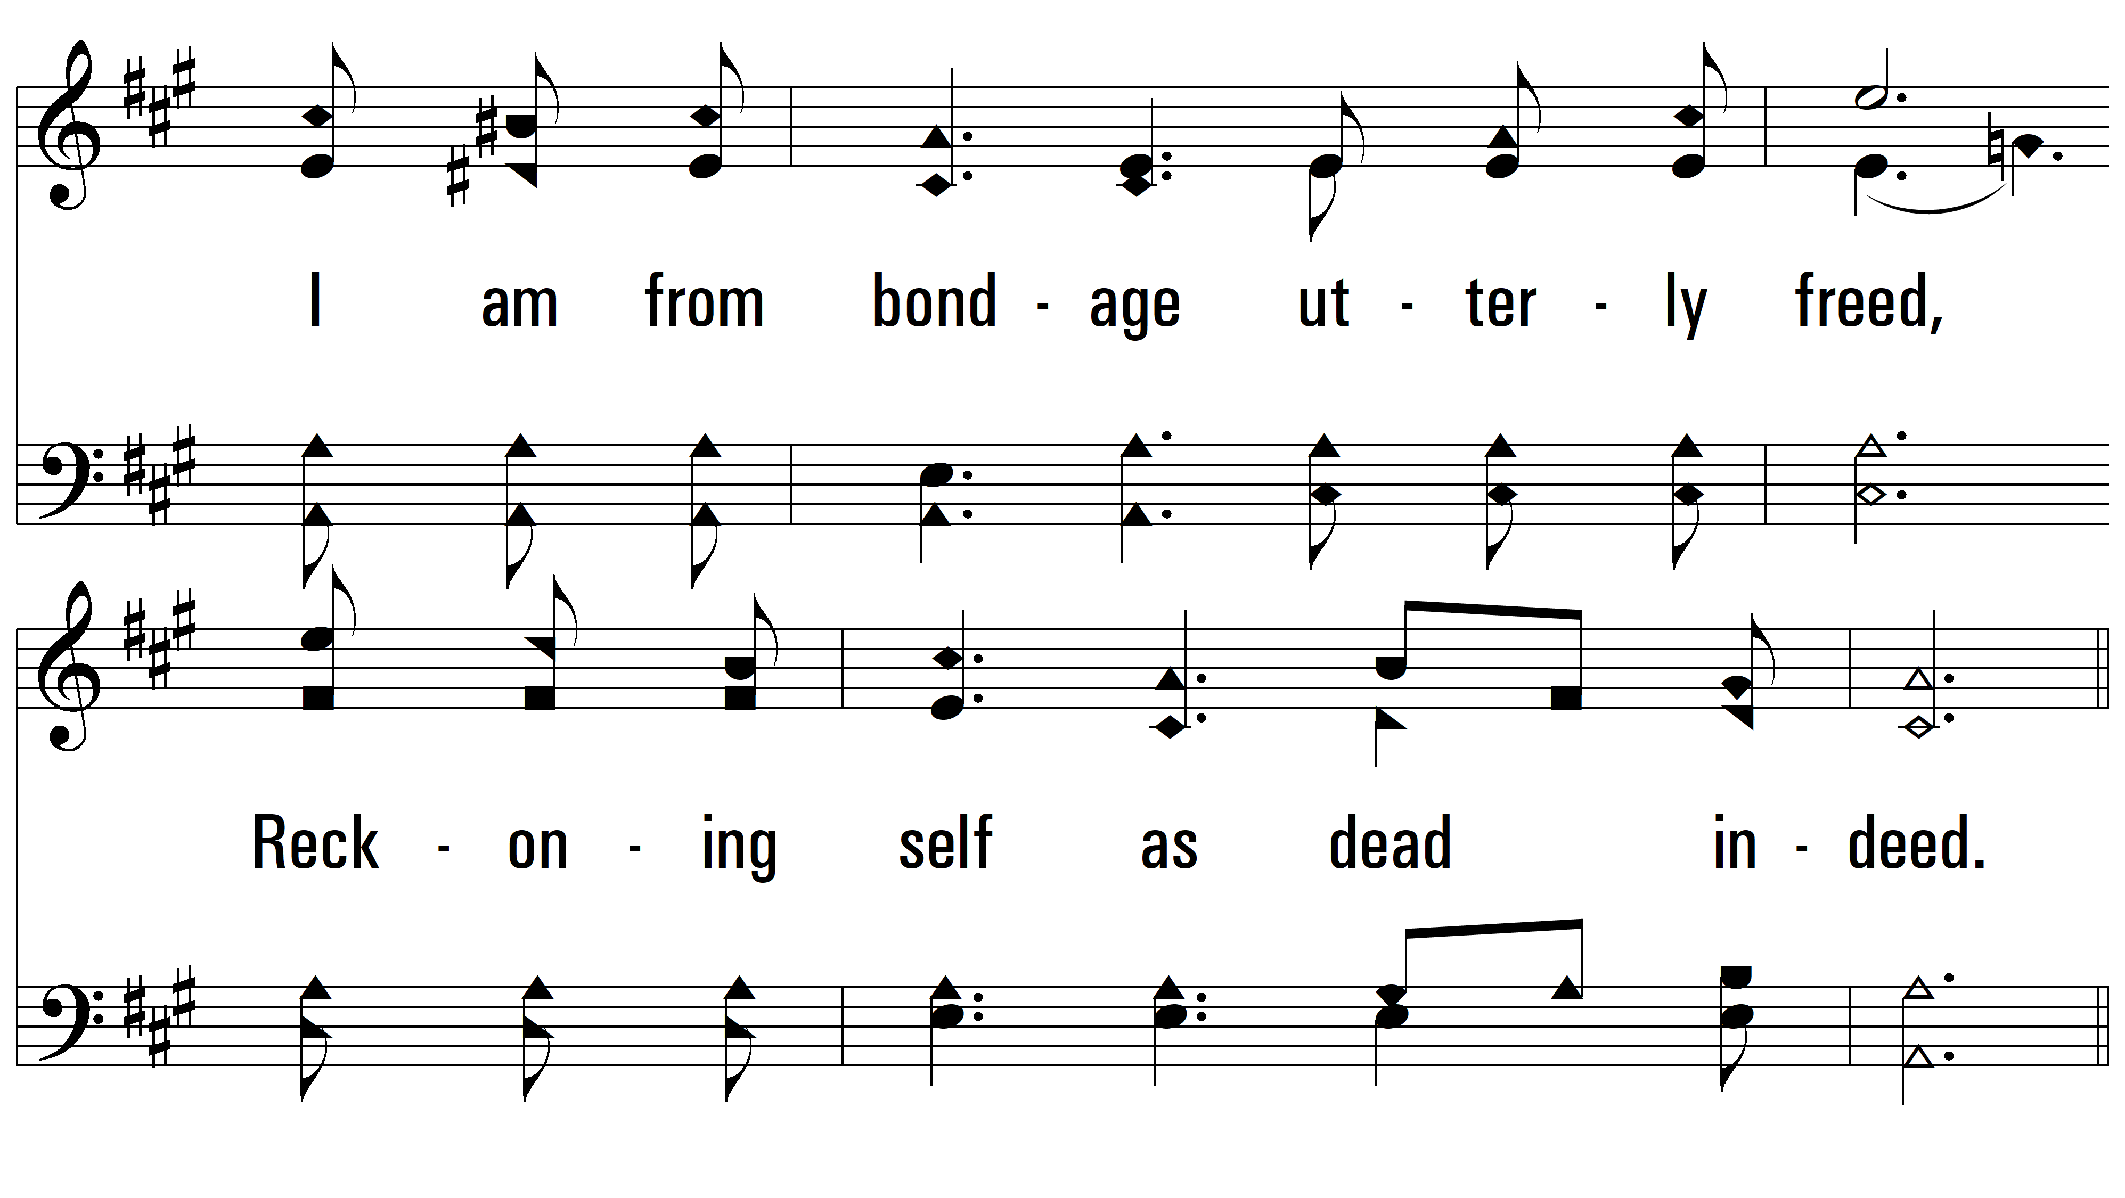
vs. 3

Slide 12
vs. 3

Slide 13
vs. 3

Slide 14
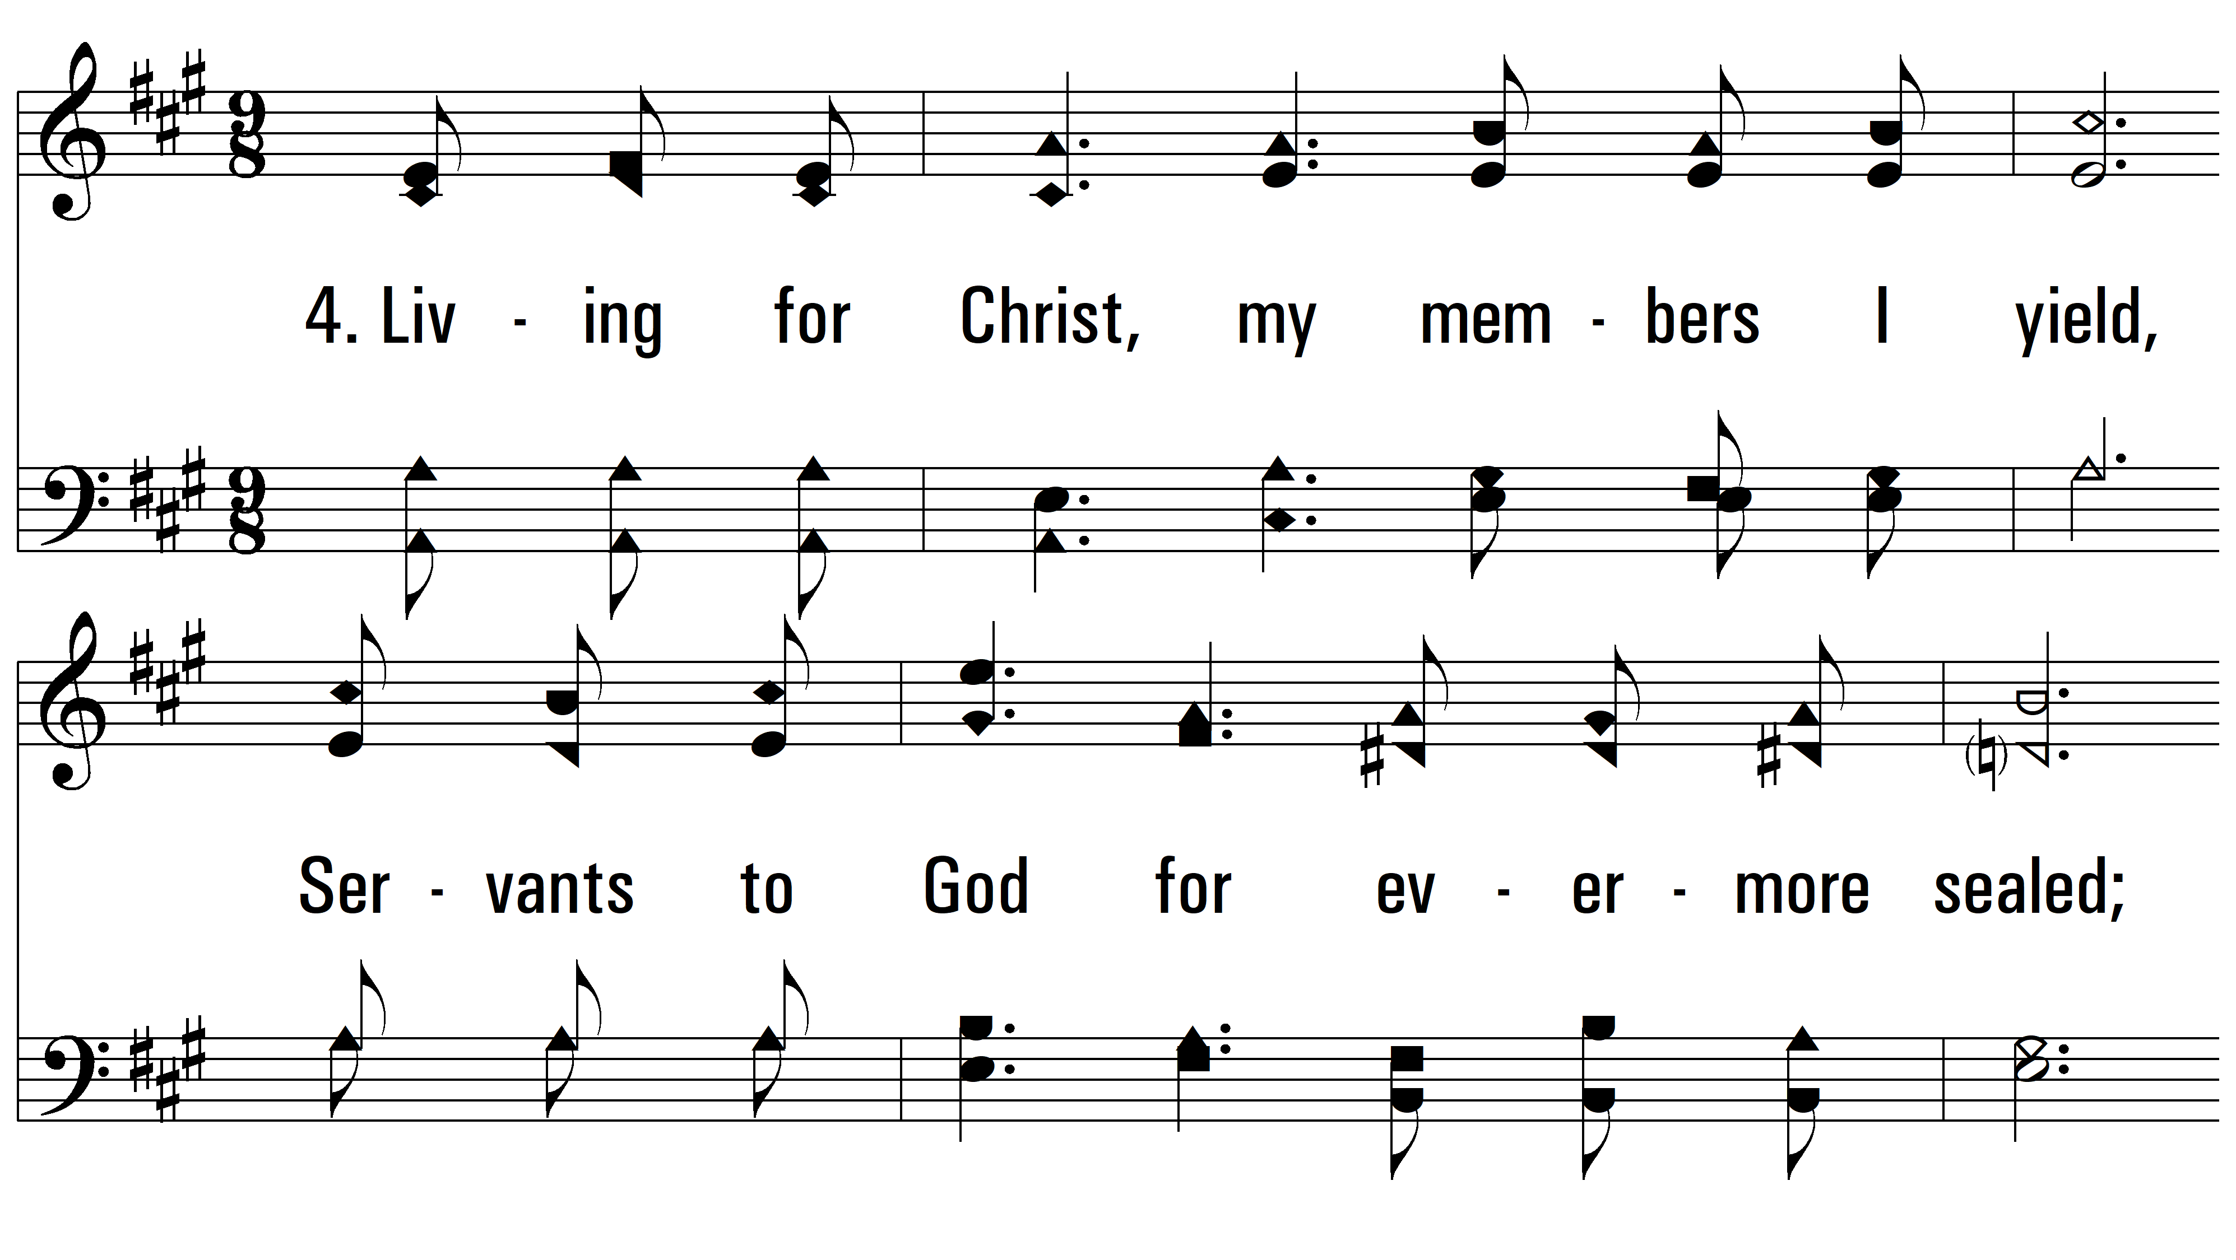
vs. 4 ~ Buried With Christ

Slide 15
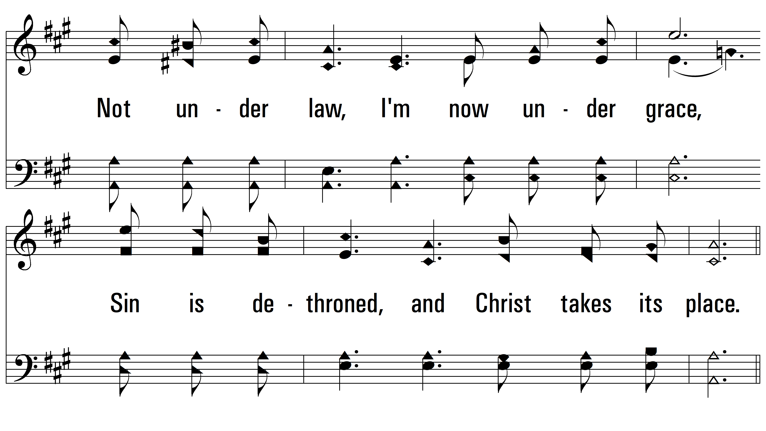
vs. 4

Slide 16
vs. 4

Slide 17
vs. 4
PDHymns.com
END

