Slide 1
Built On A Rock
KIRKEN
8.8.8.8.8.8.8
Words: | Nikolai F. S. Grundtvig (1837), Tr. by Carl Doving (1909)
Music: | Ludvig M. Lindeman (1840)
3/4
Dm(F)/D - LA
Verses: 4
Lead - | LA
Alto - | LA
Tenor - | DO
Bass - | LA
PDHymns.com

Slide 2
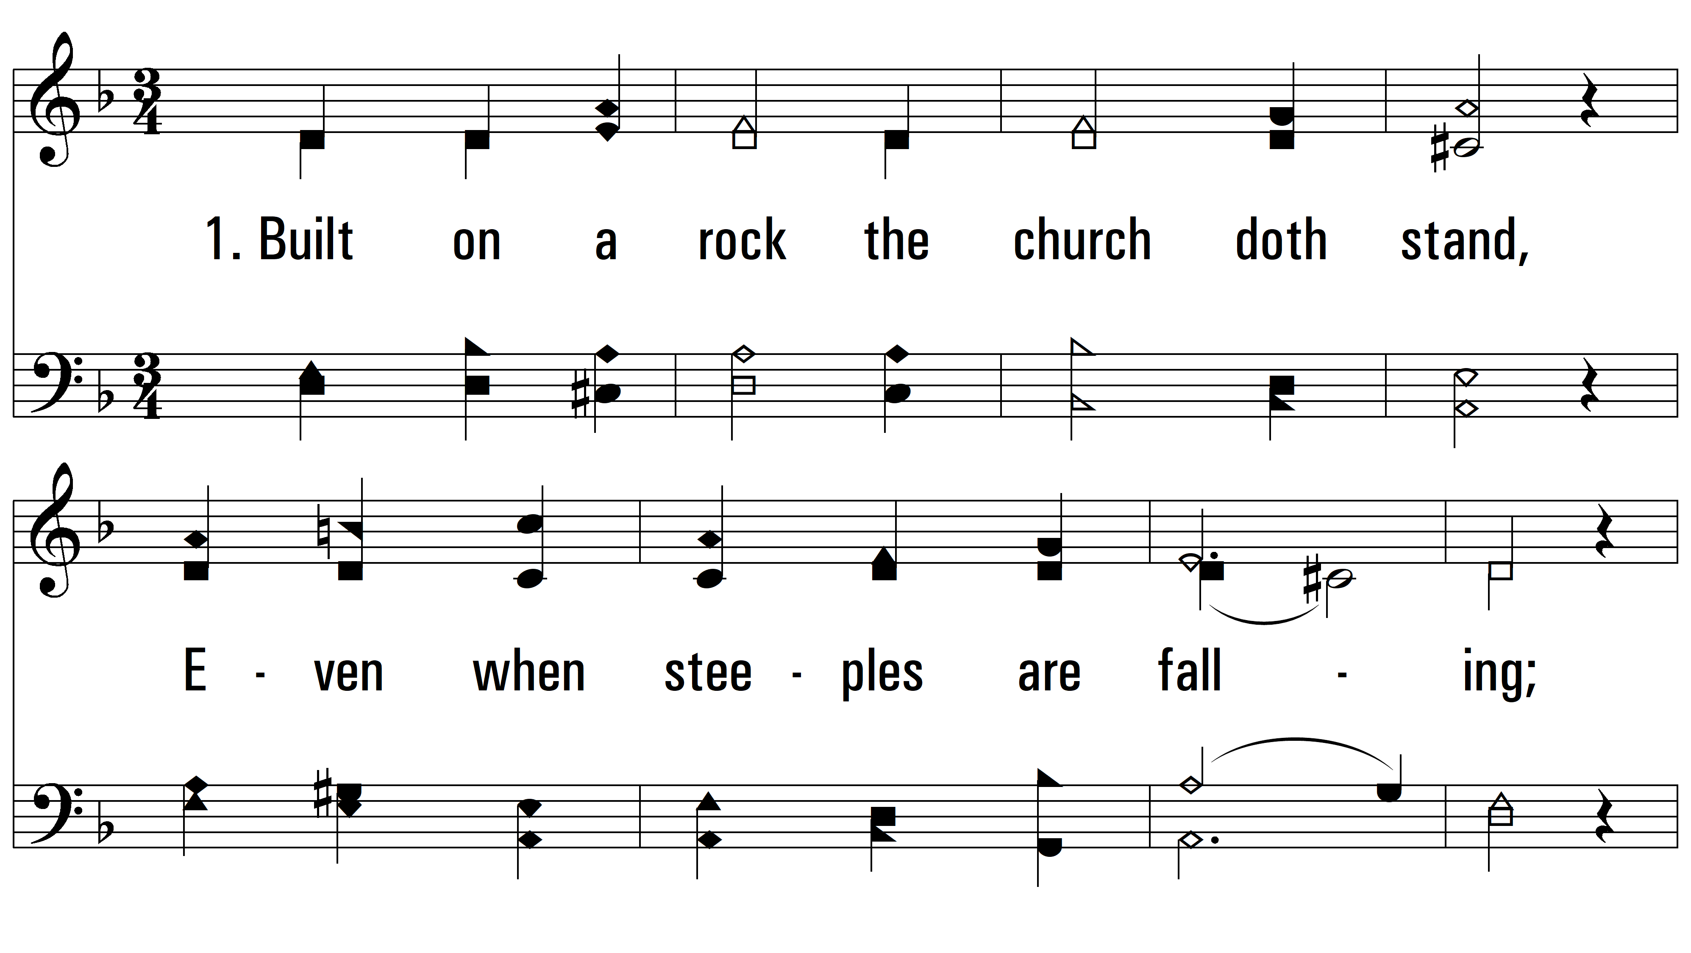
vs. 1 ~ Built On A Rock

Slide 3
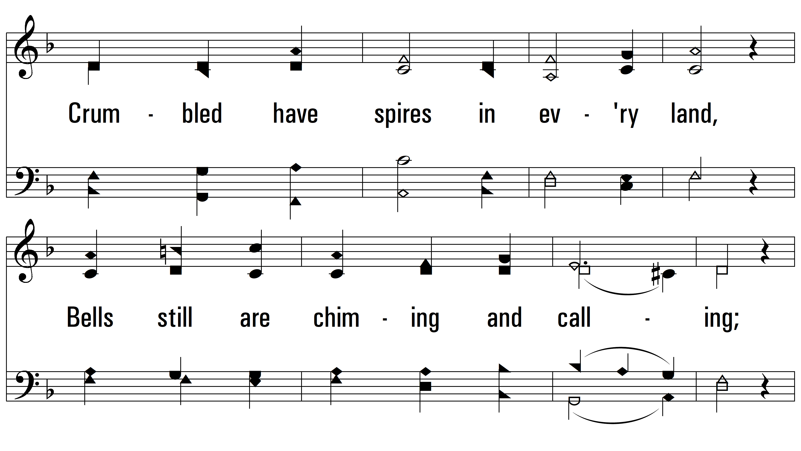
vs. 1

Slide 4
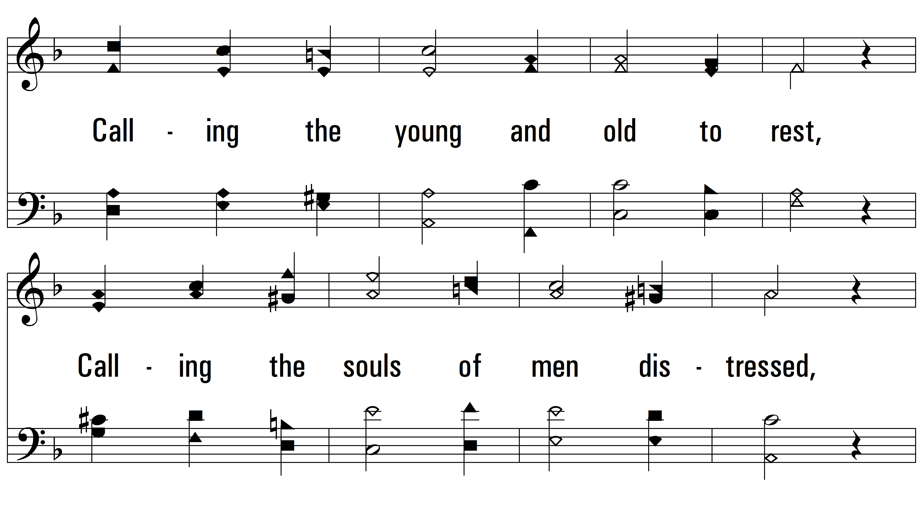
vs. 1

Slide 5
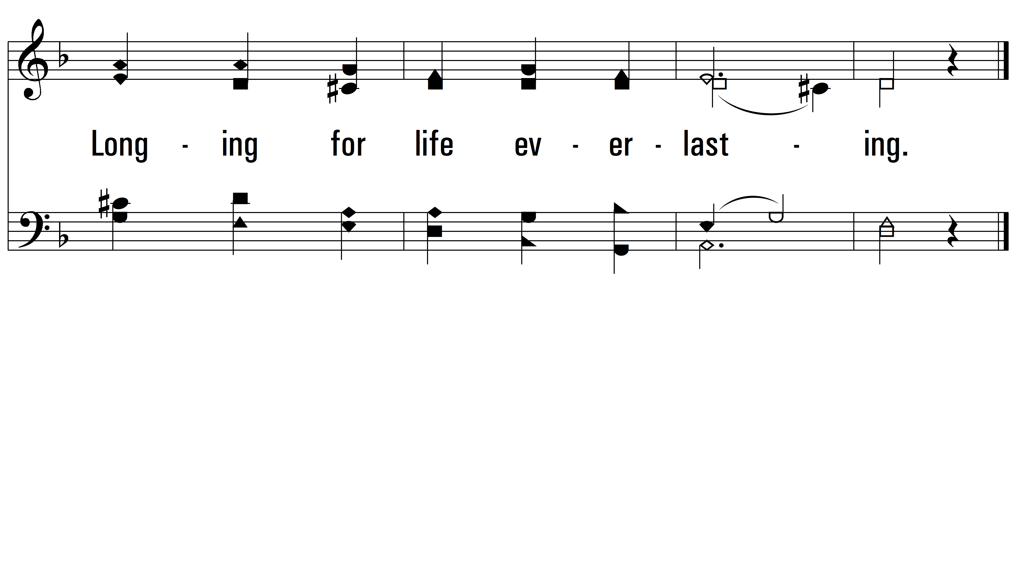
vs. 1

Slide 6
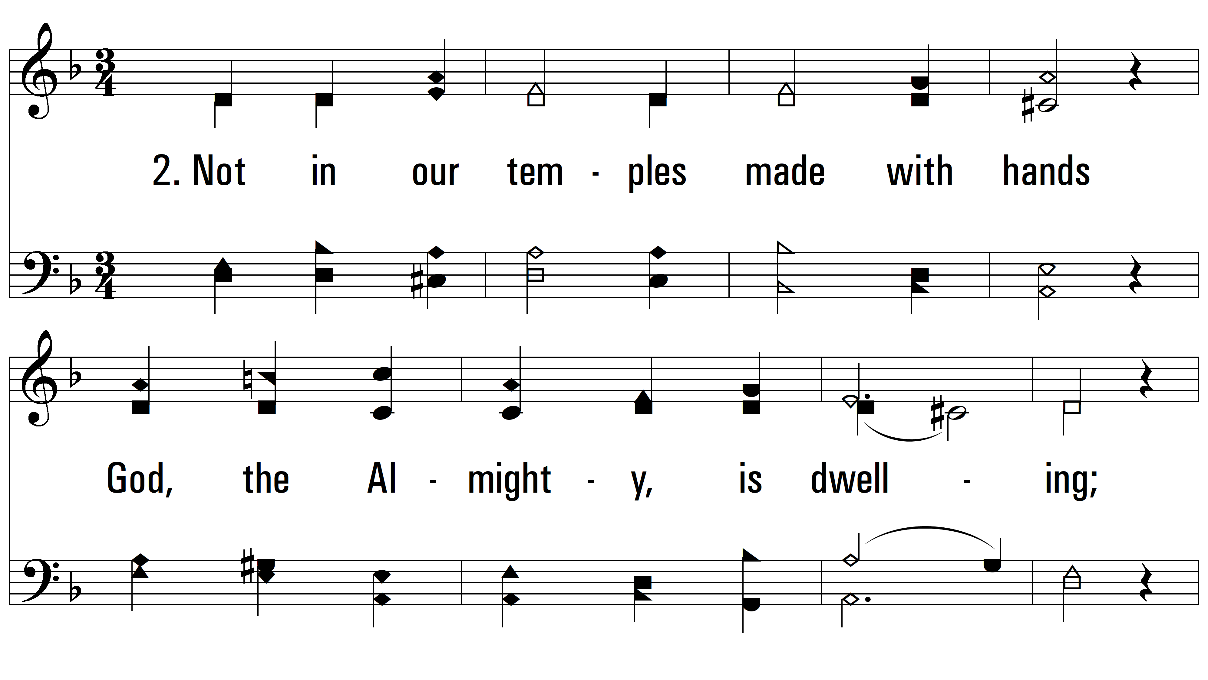
vs. 2 ~ Built On A Rock

Slide 7
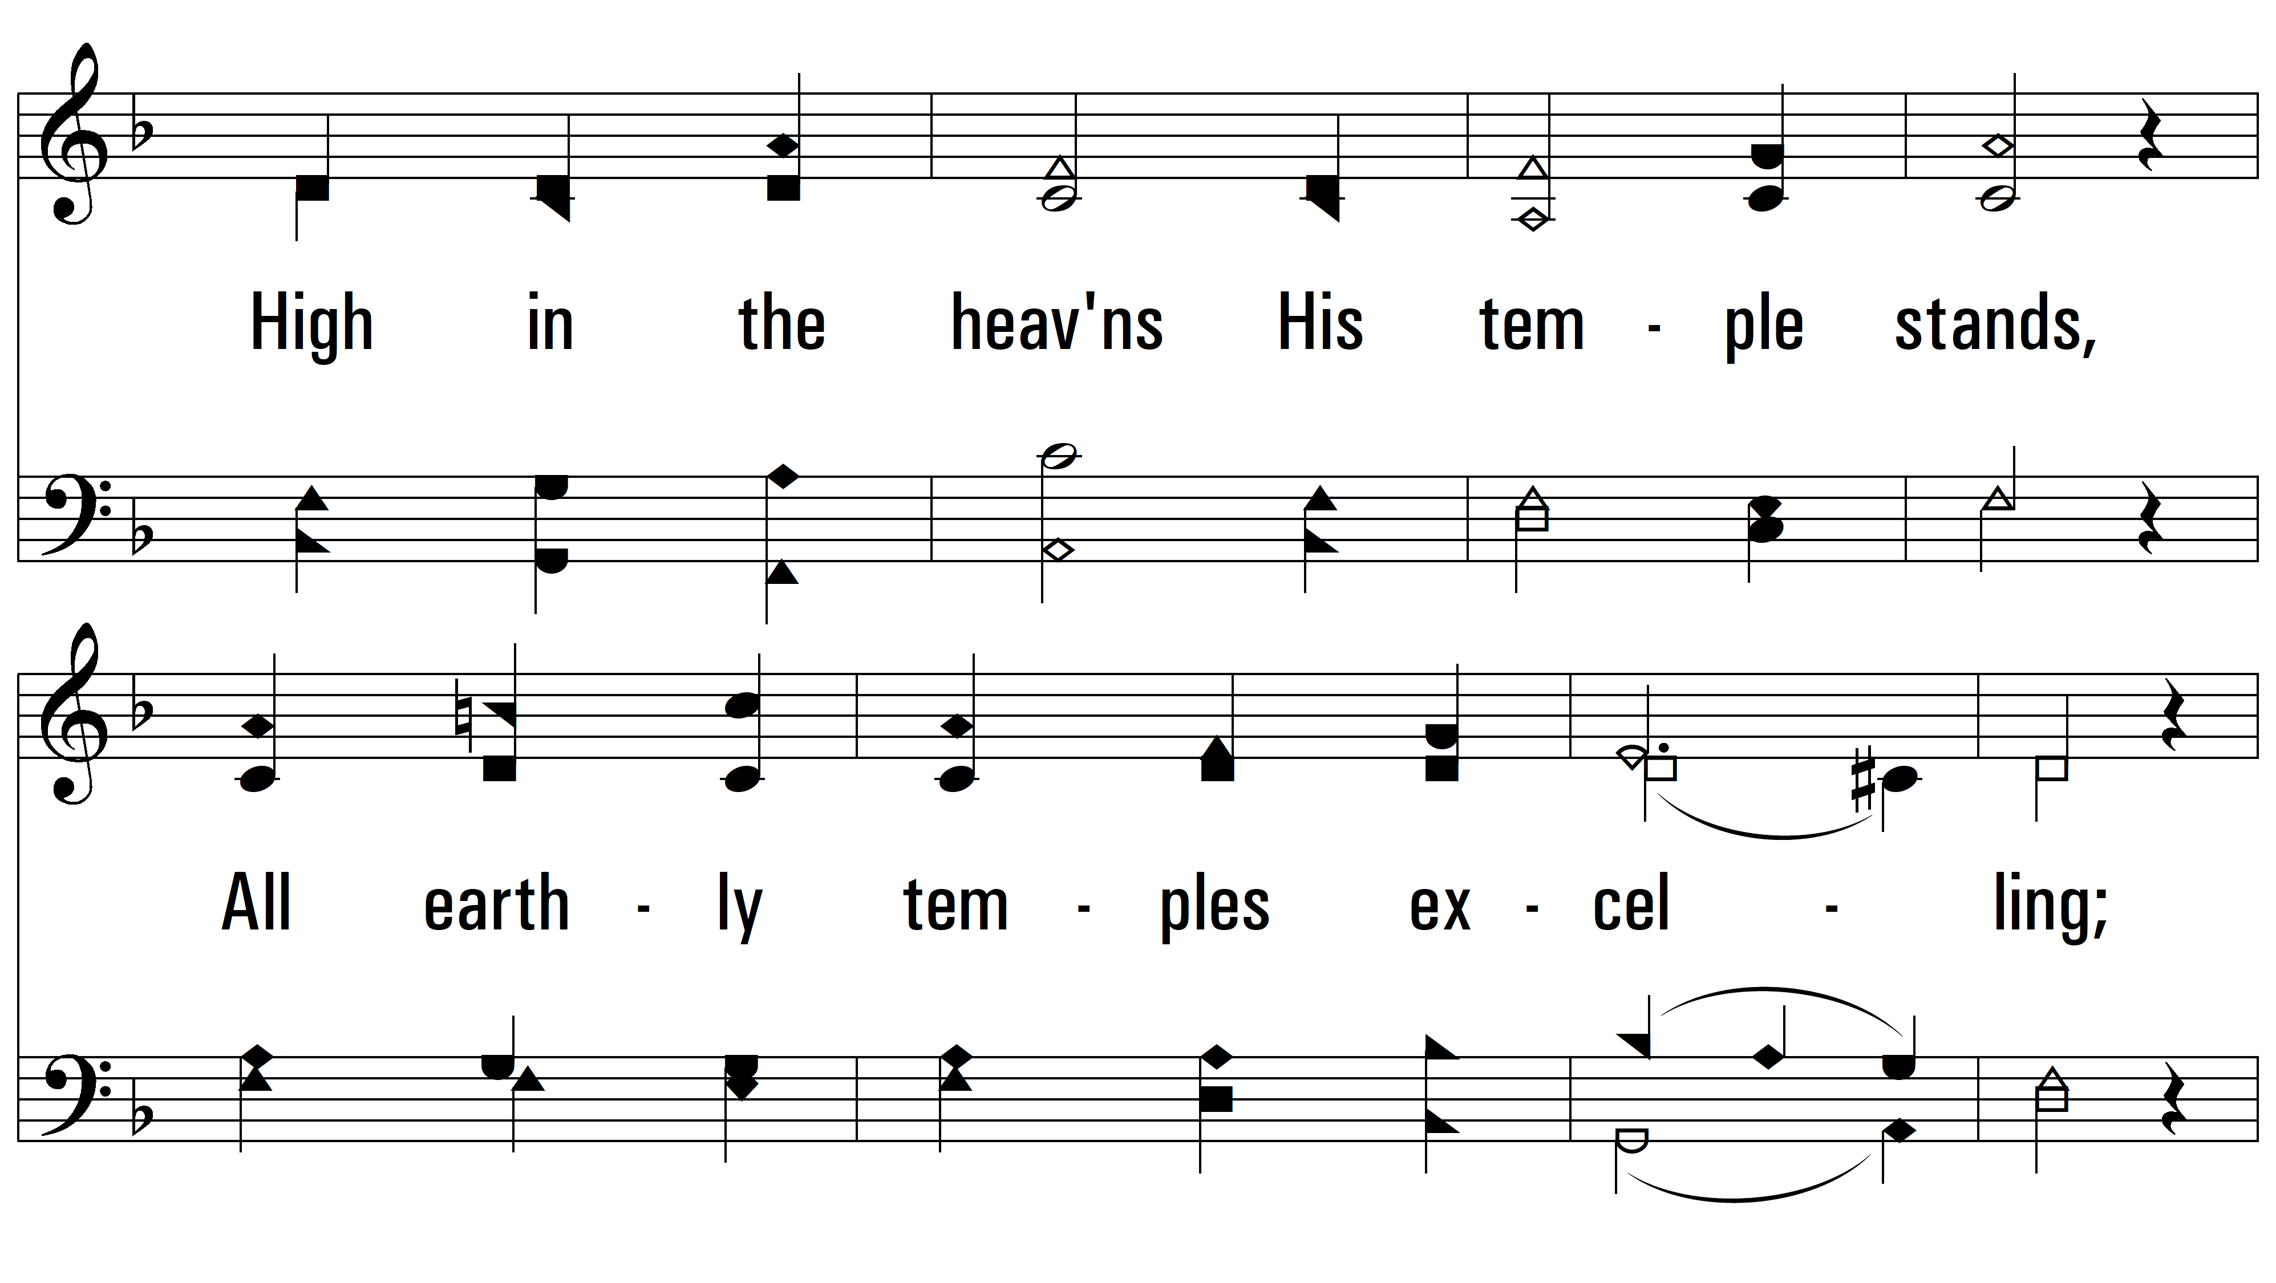
vs. 2

Slide 8
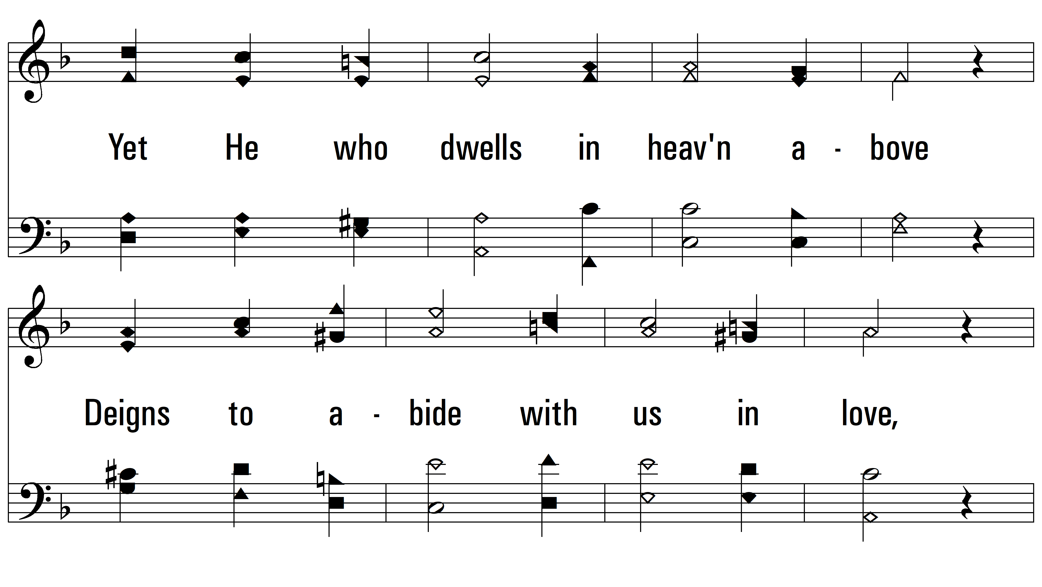
vs. 2

Slide 9
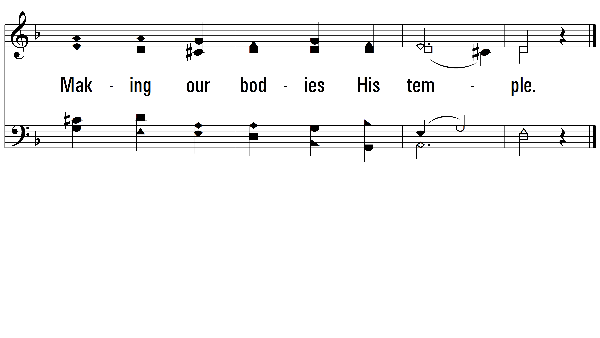
vs. 2

Slide 10
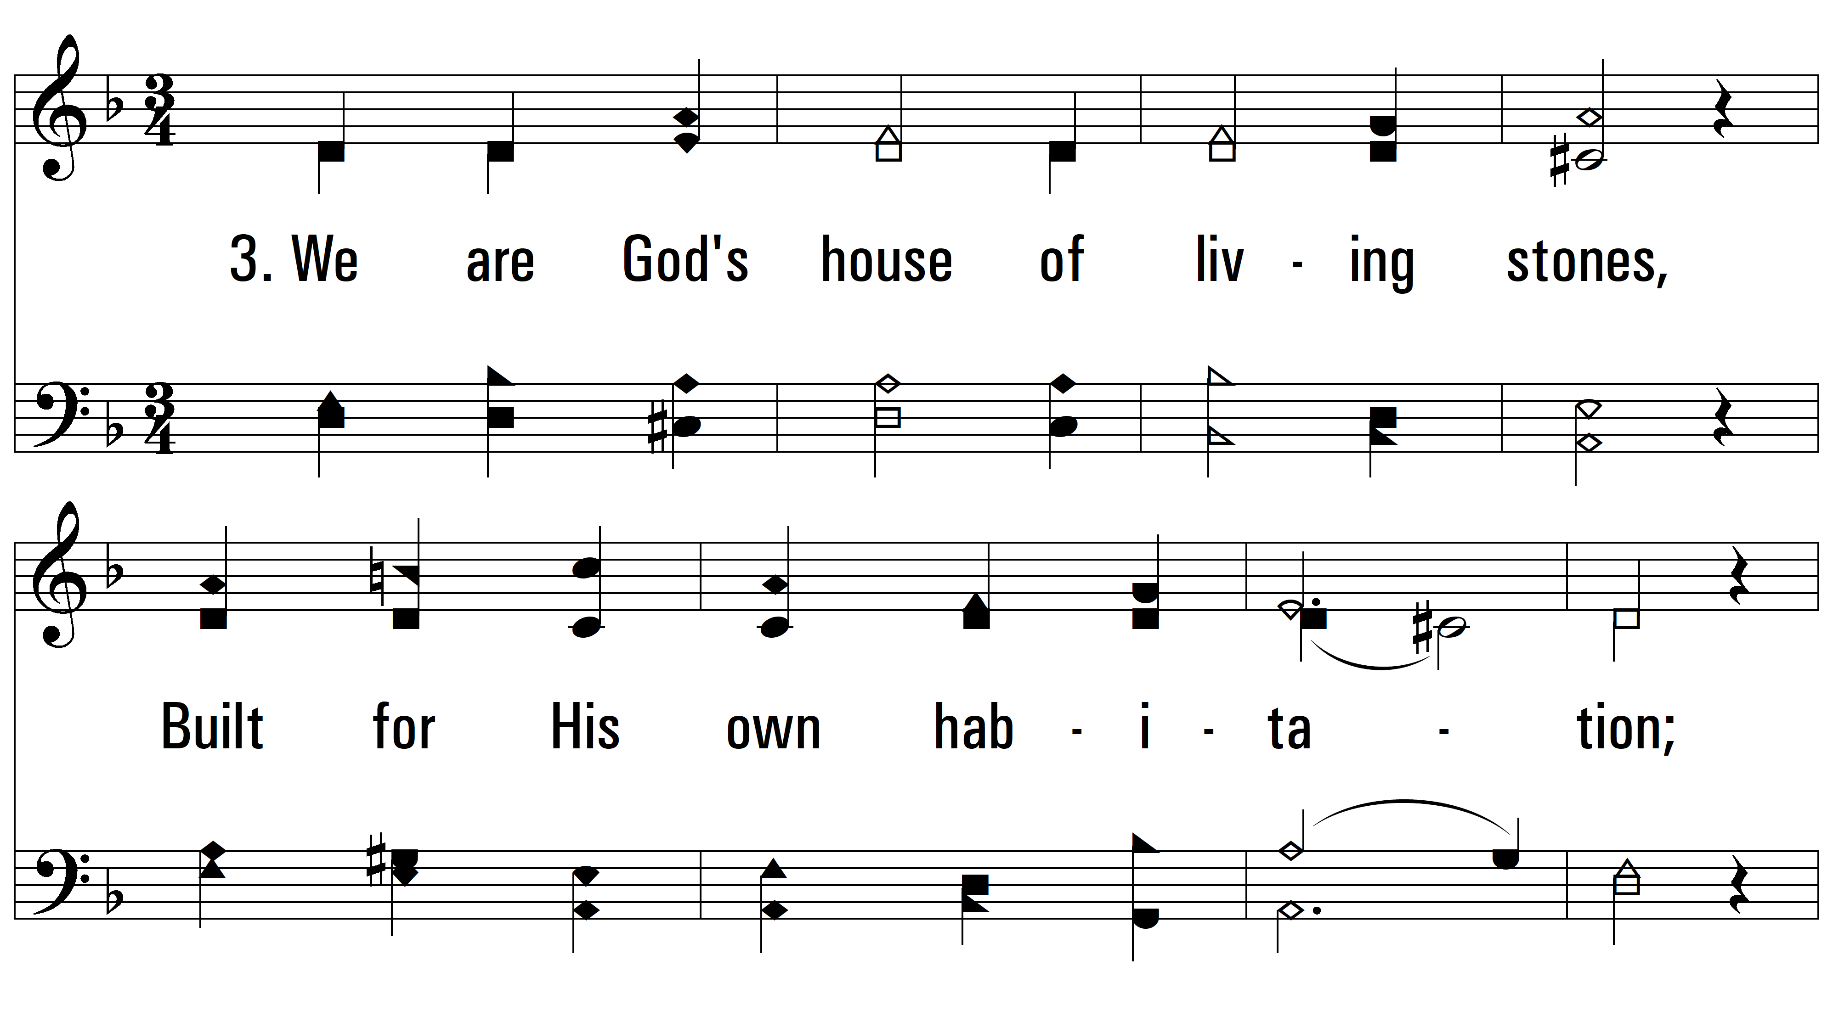
vs. 3 ~ Built On A Rock

Slide 11
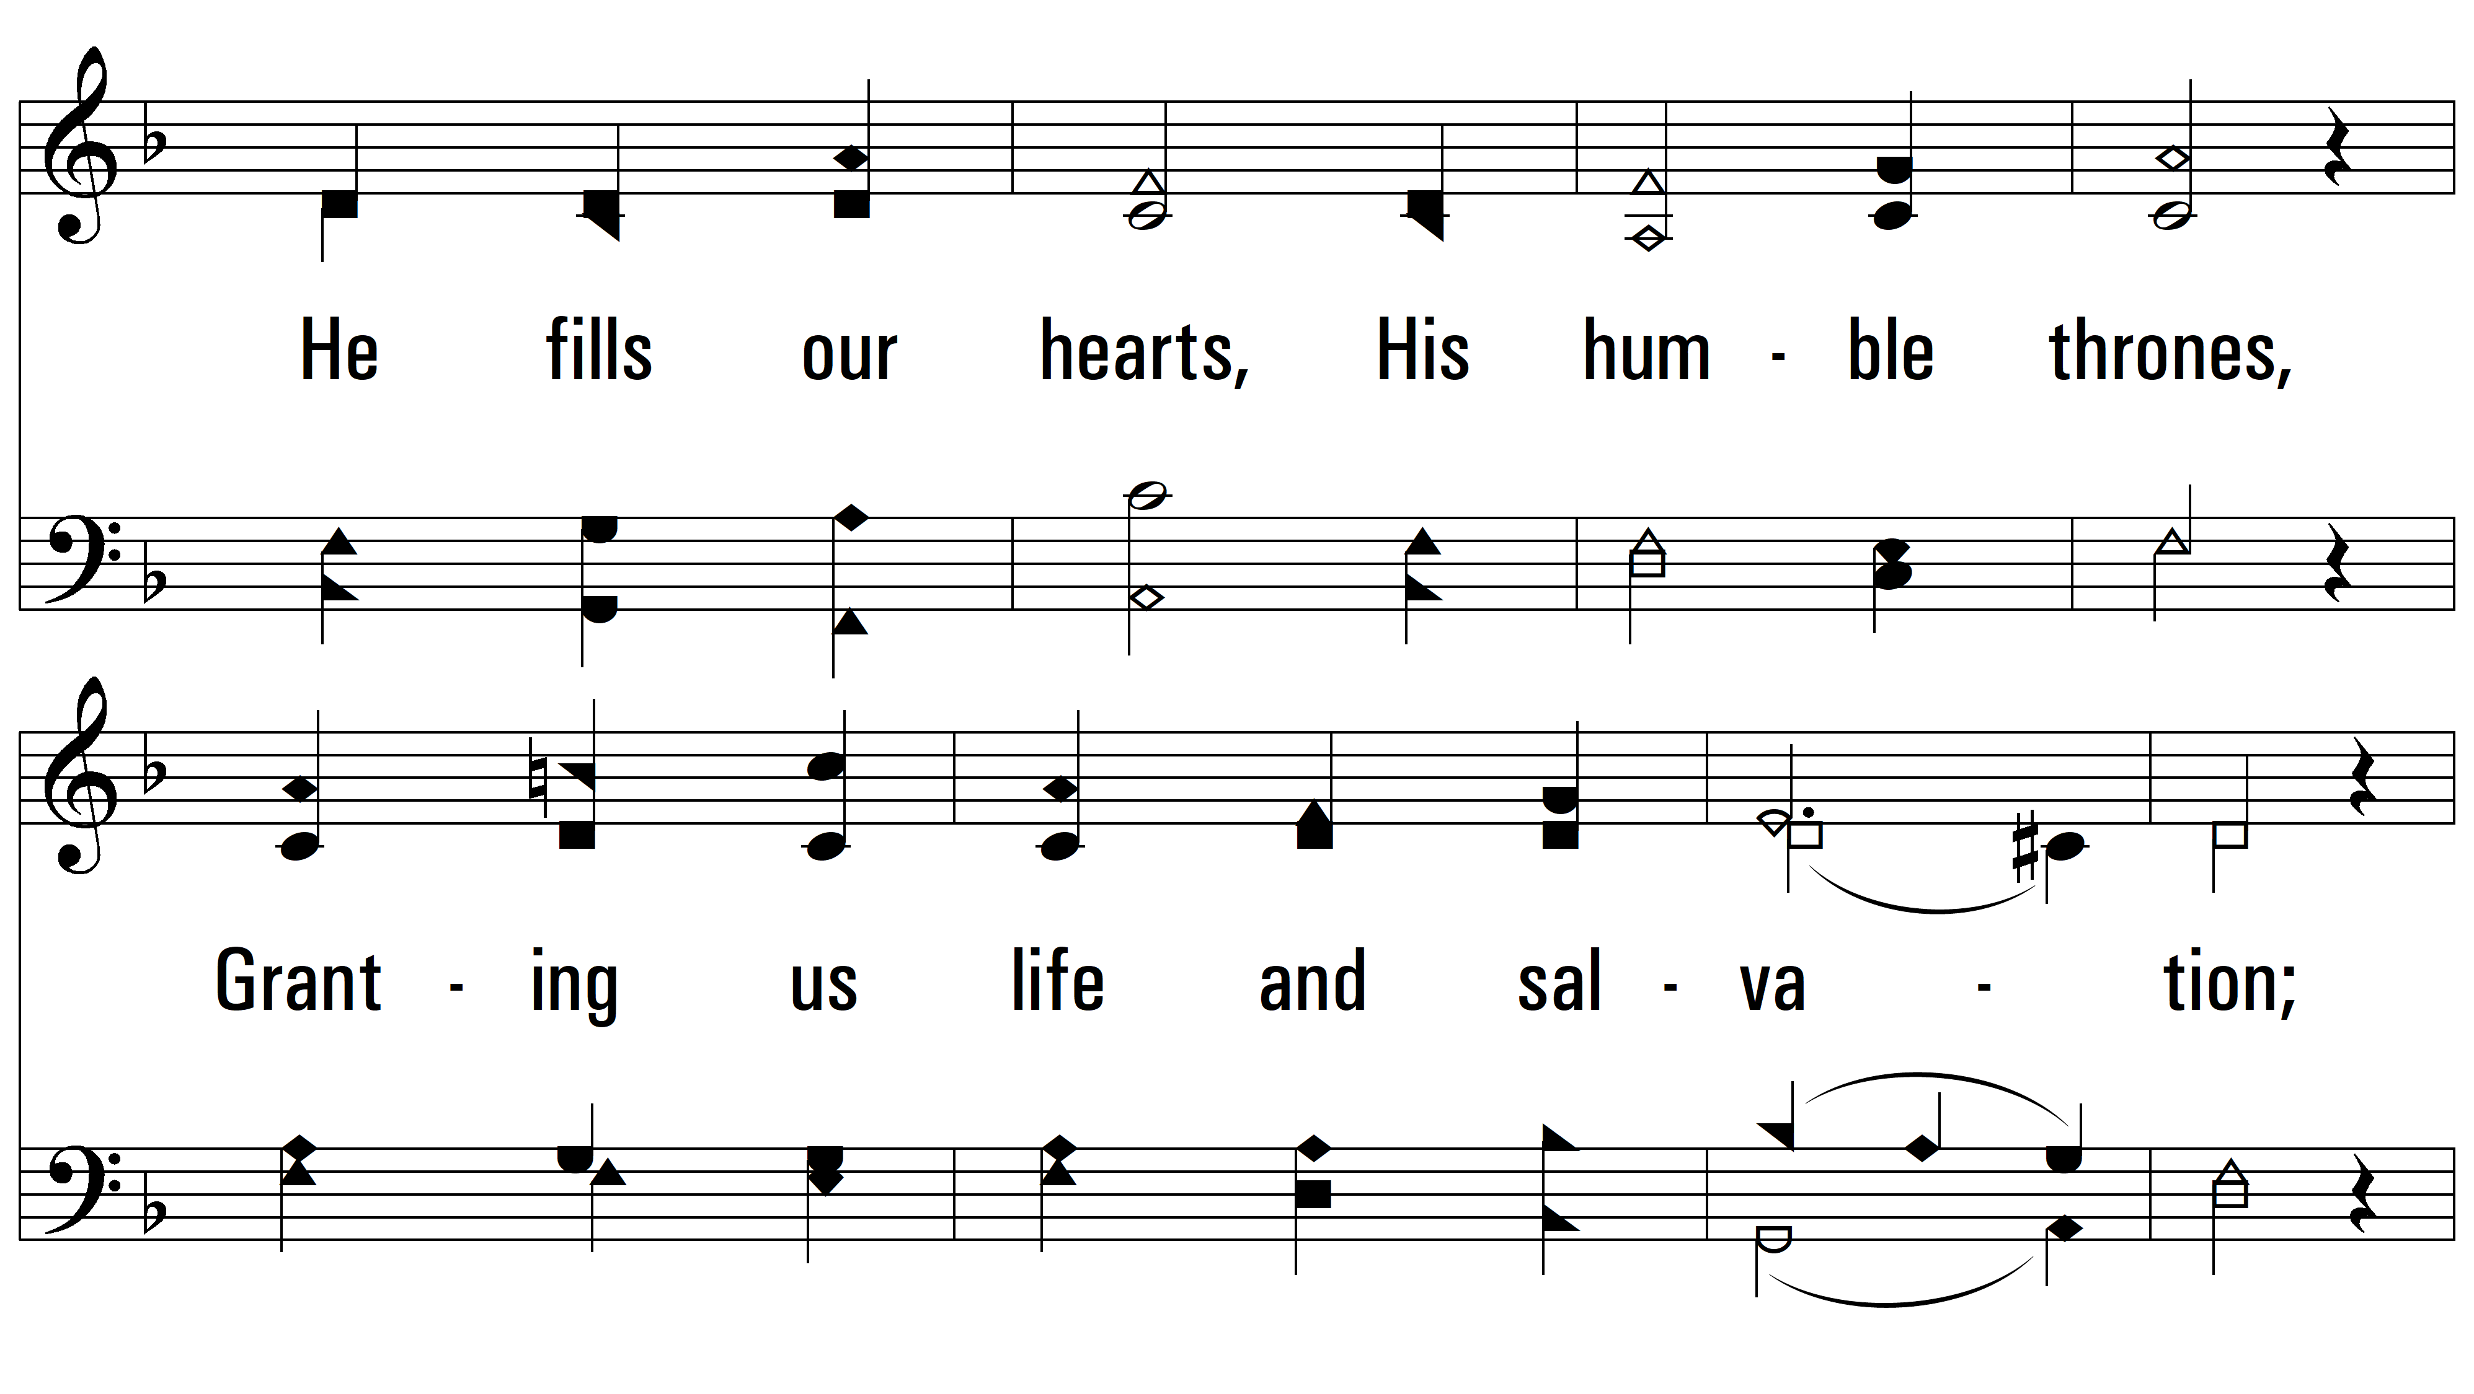
vs. 3

Slide 12
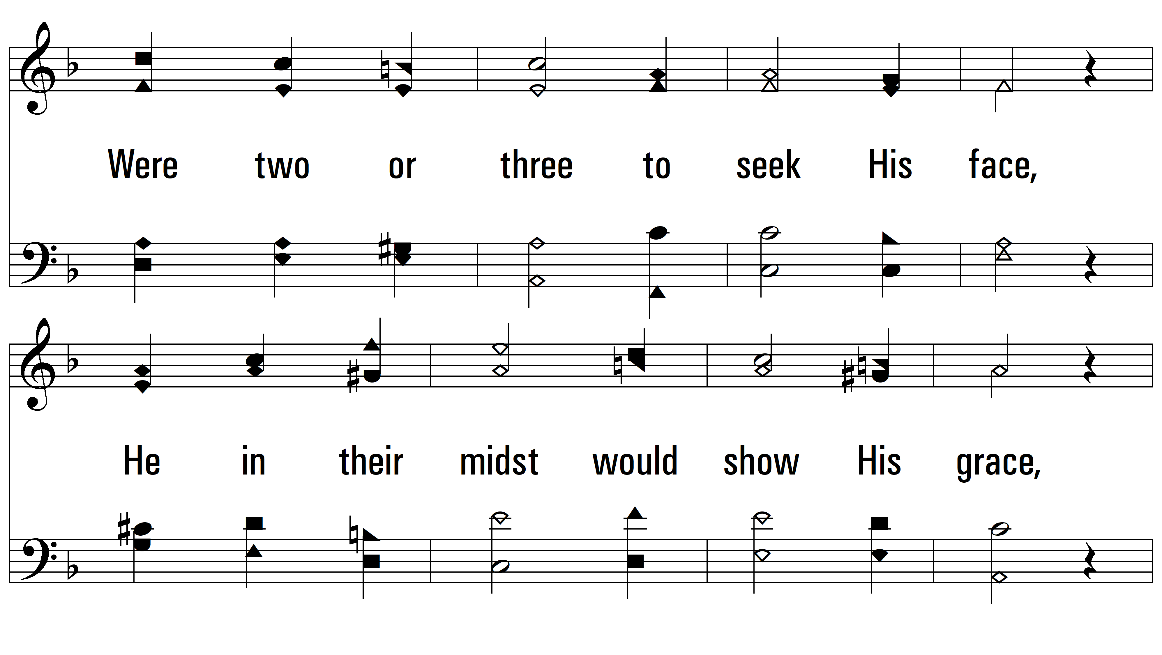
vs. 3

Slide 13
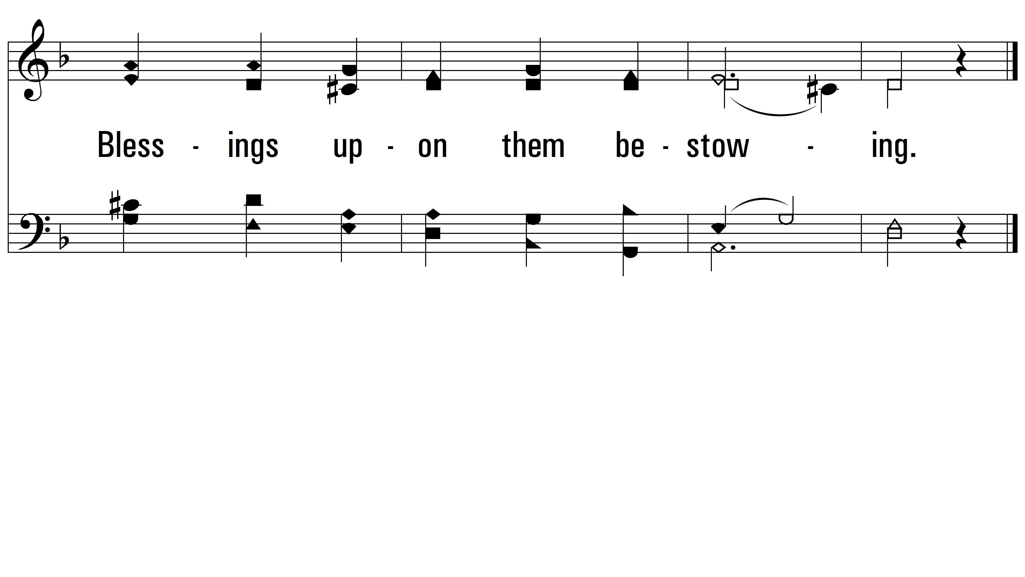
vs. 3

Slide 14
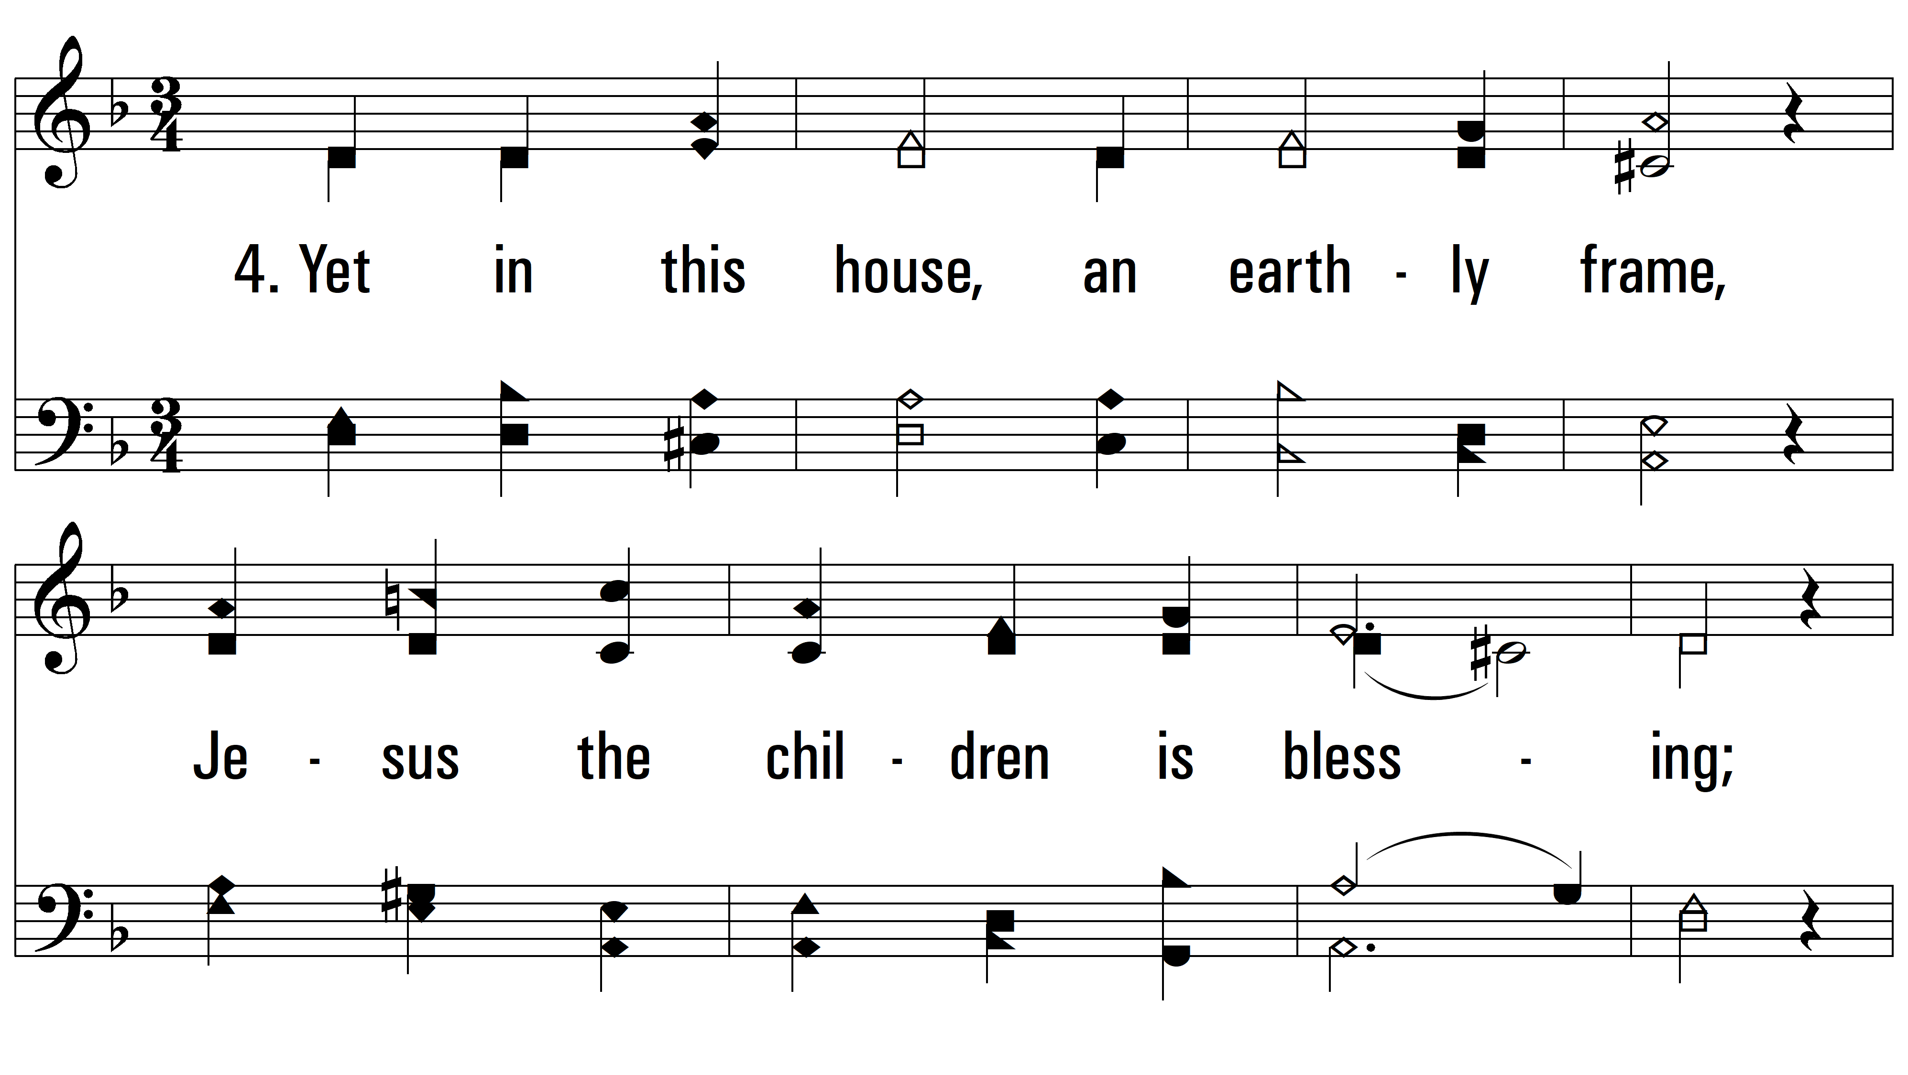
vs. 4 ~ Built On A Rock

Slide 15
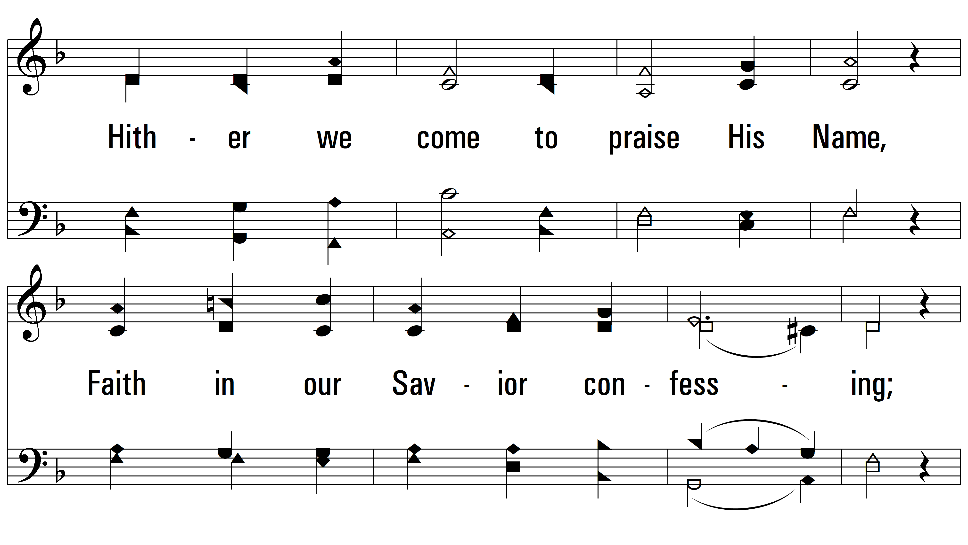
vs. 4

Slide 16
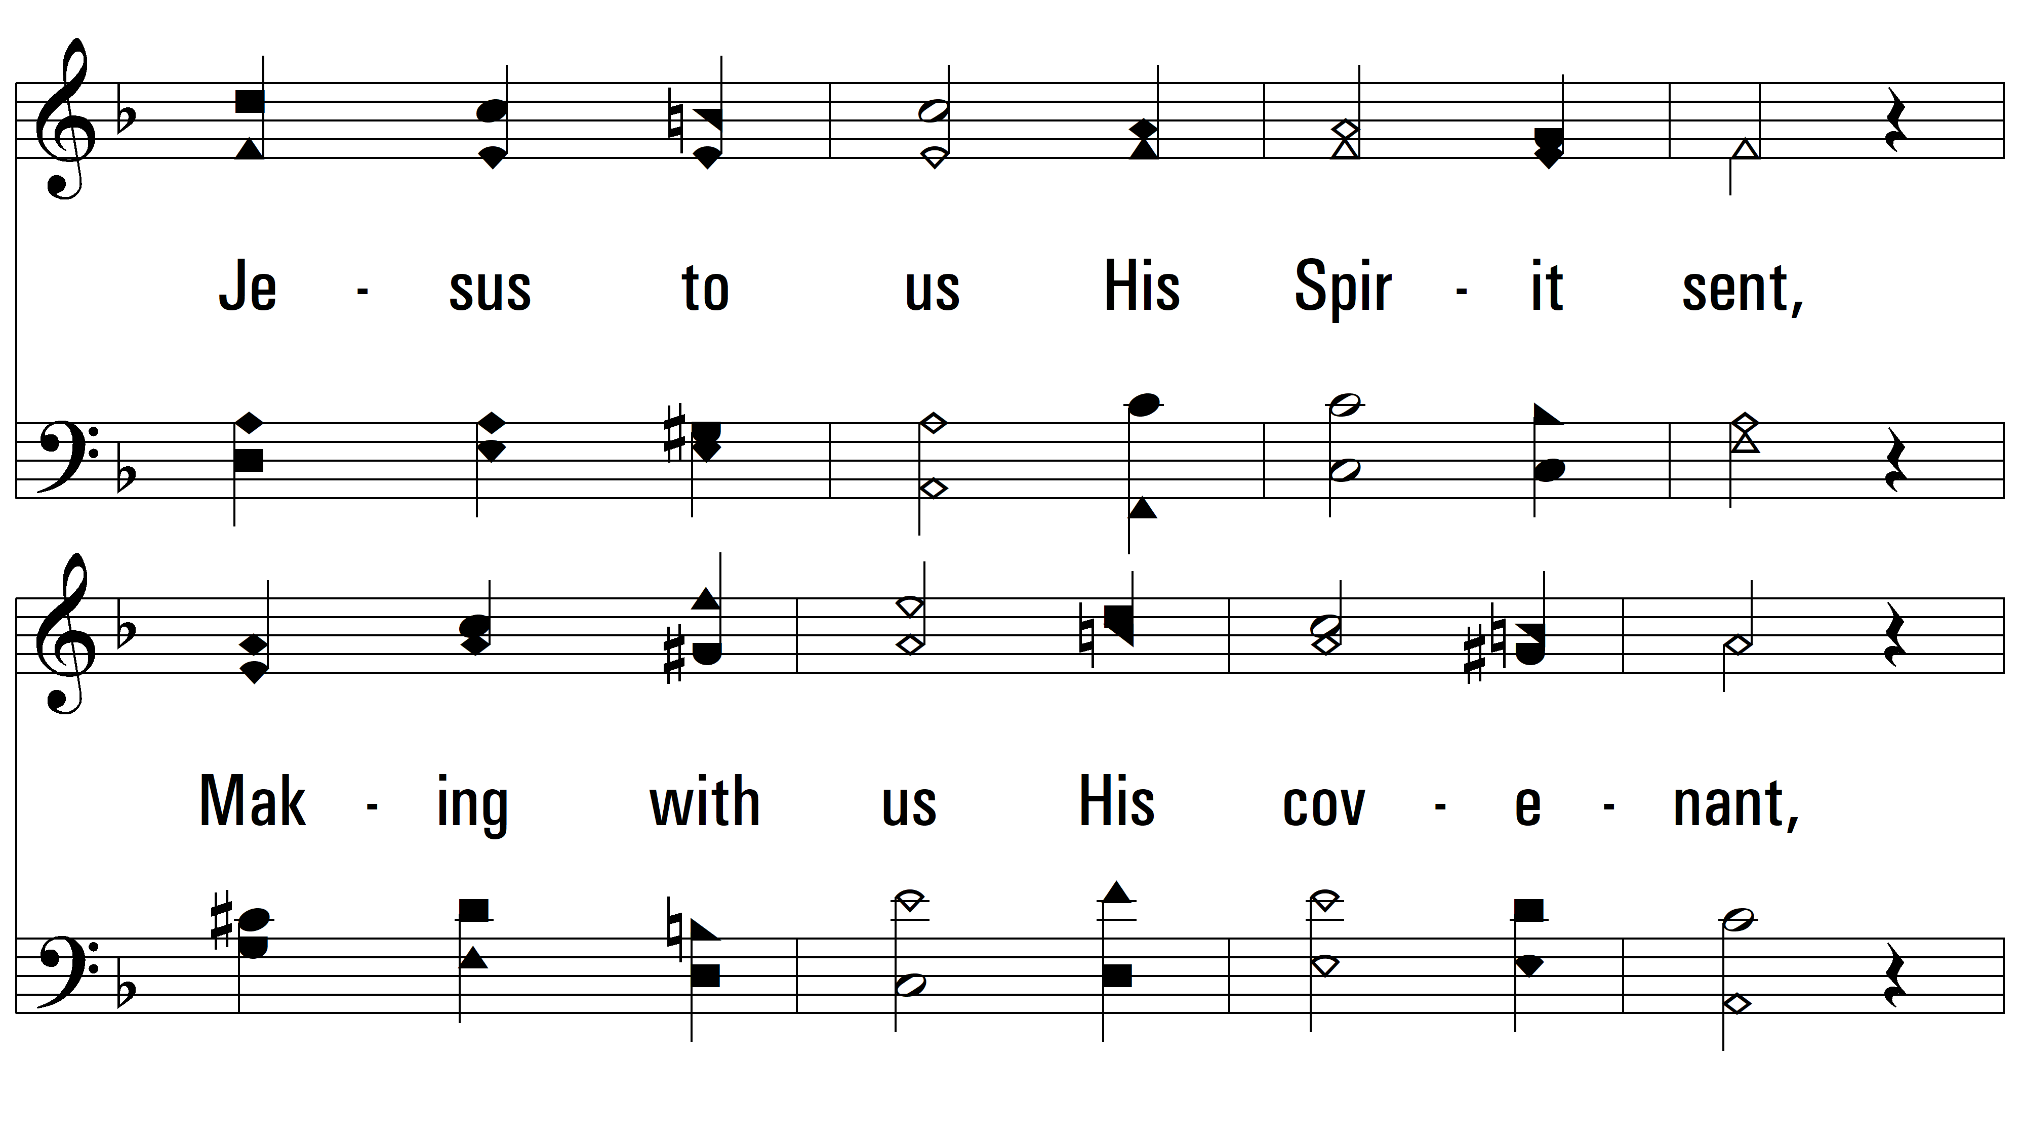
vs. 4

Slide 17
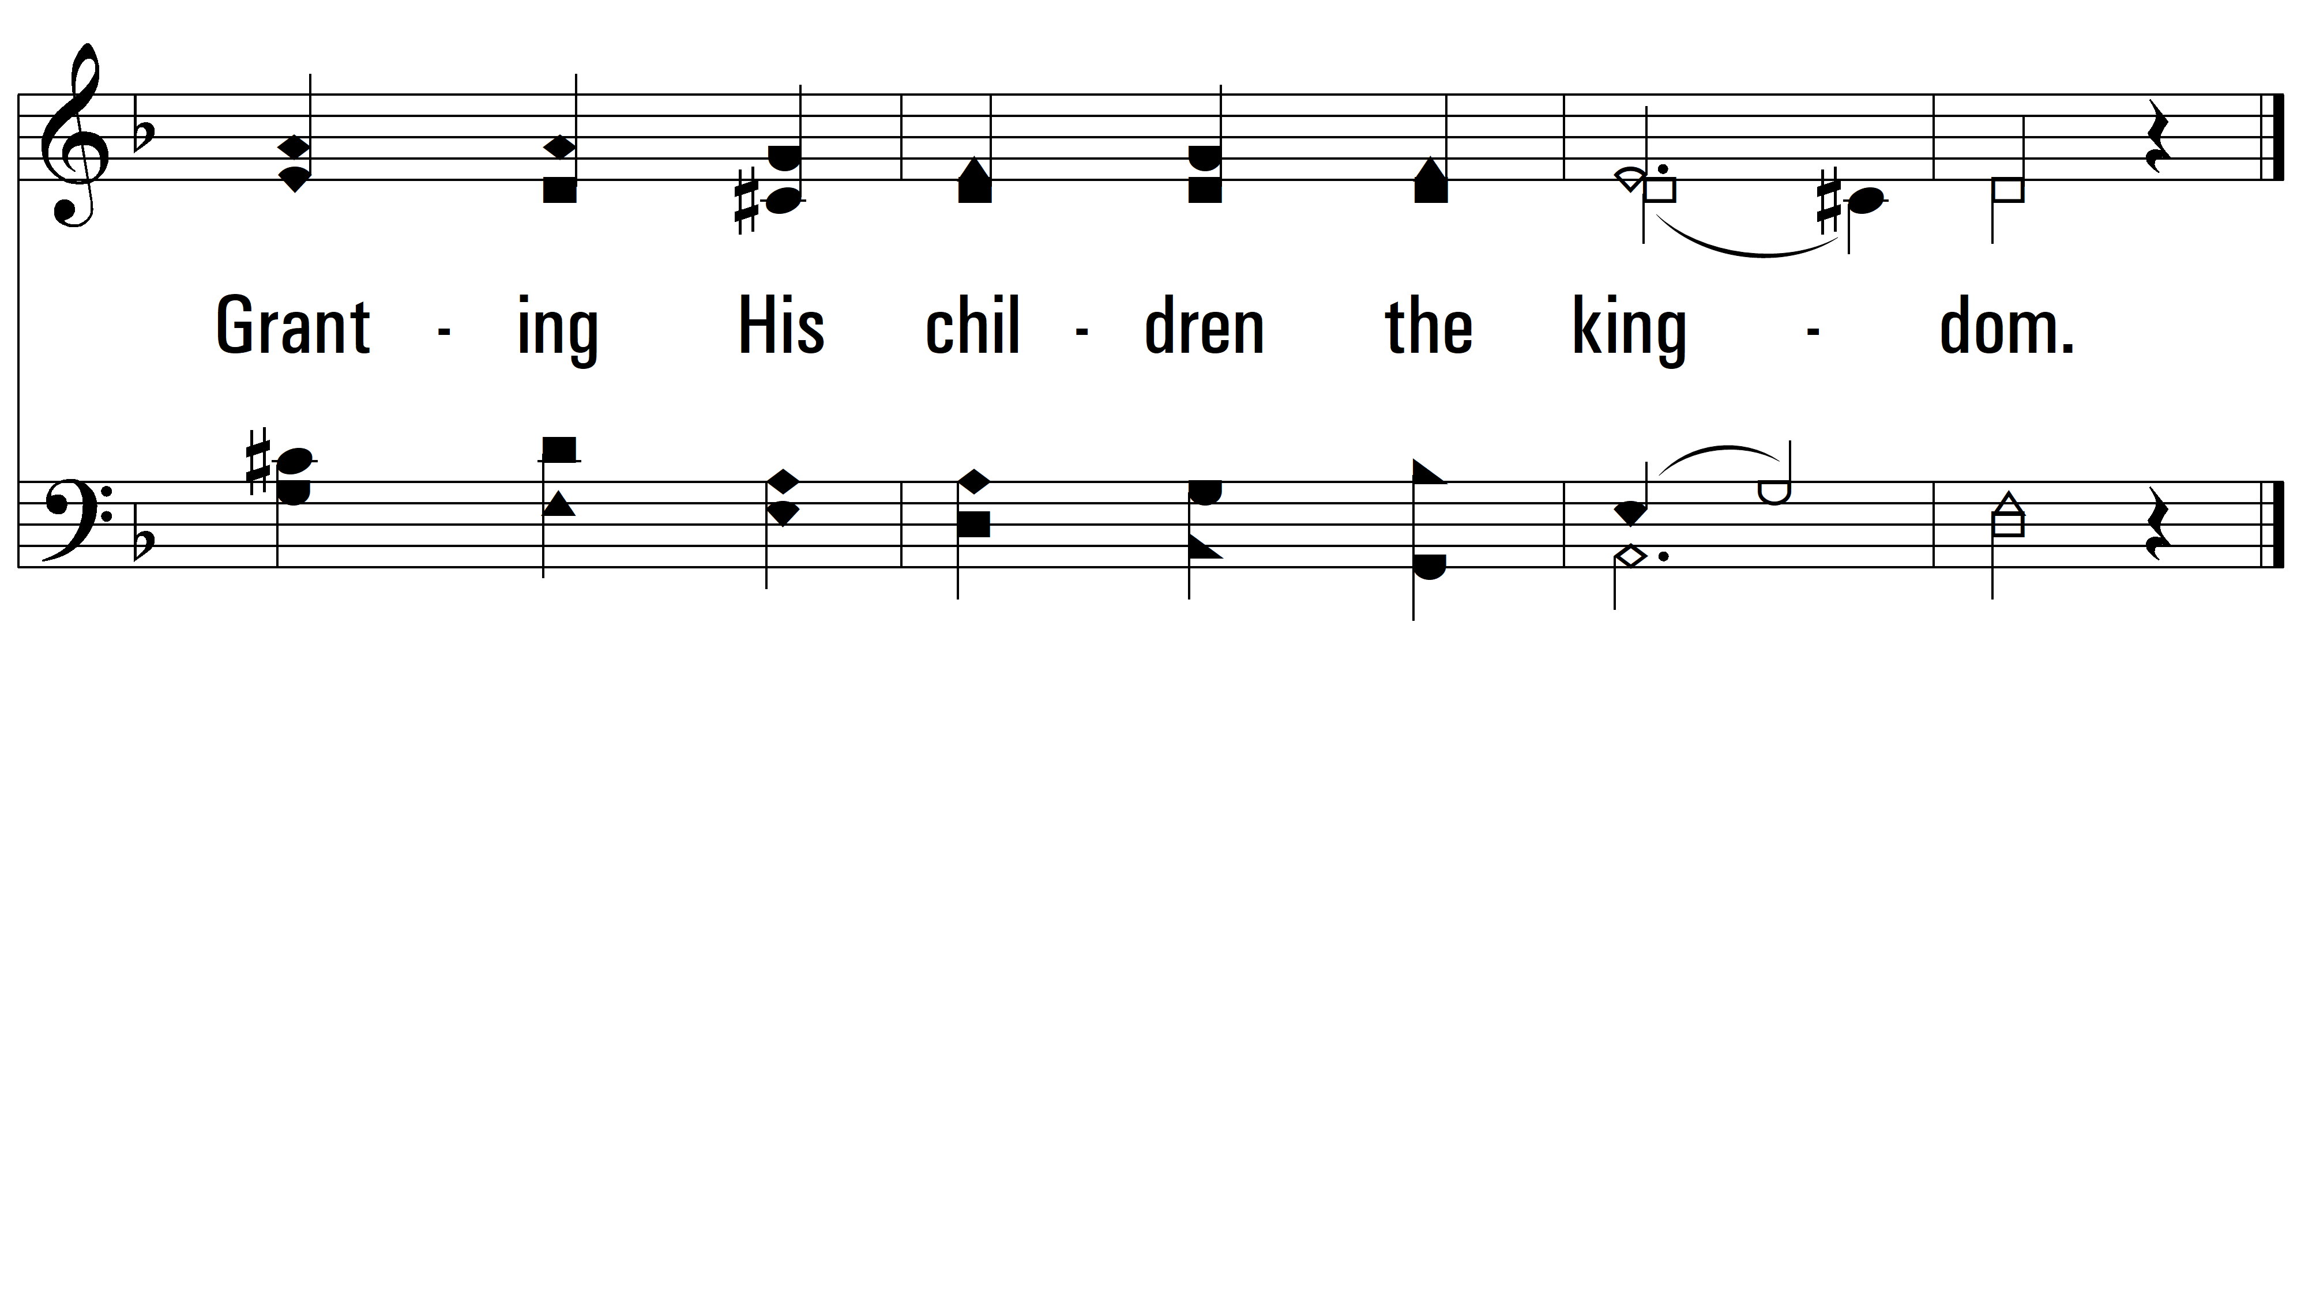
vs. 4
PDHymns.com
END

