Slide 1
Bring Them In
(Hark! ‘Tis The Shepherd’s Voice)
Words: | Alexcenah Thomas (1885)
Music: | William A. Ogden (1885)
4/4
A^{b}/E^{b} - SOL
Verses: 3/Chorus
Lead - | SOL
Alto - | MI
Tenor - | DO
Bass - | DO
PDHymns.com

Slide 2
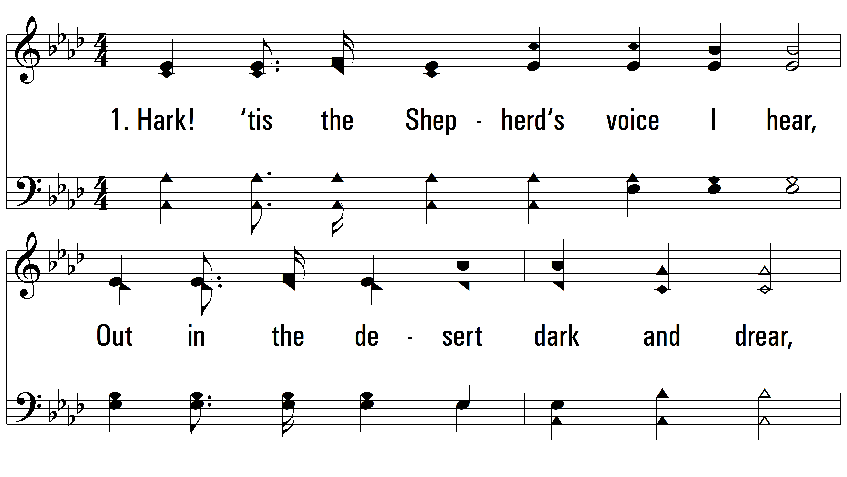
vs. 1 ~ Bring Them In

Slide 3
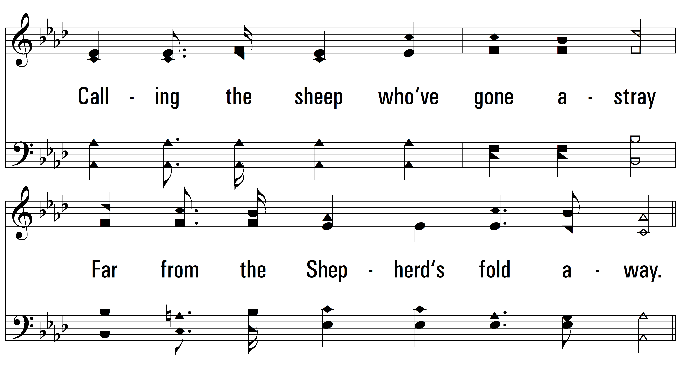
vs. 1

Slide 4
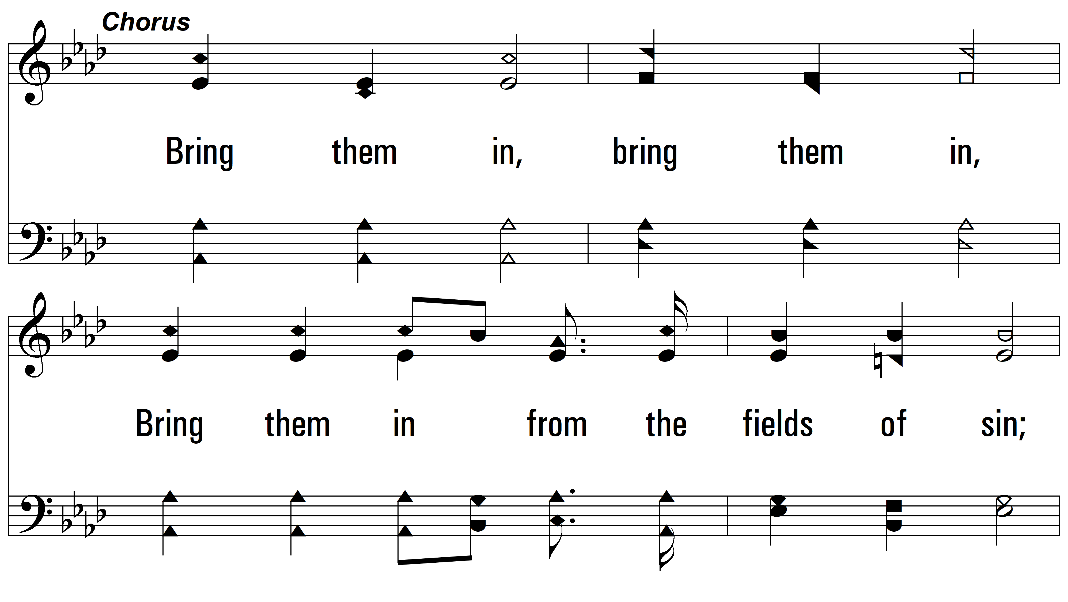
vs. 1

Slide 5
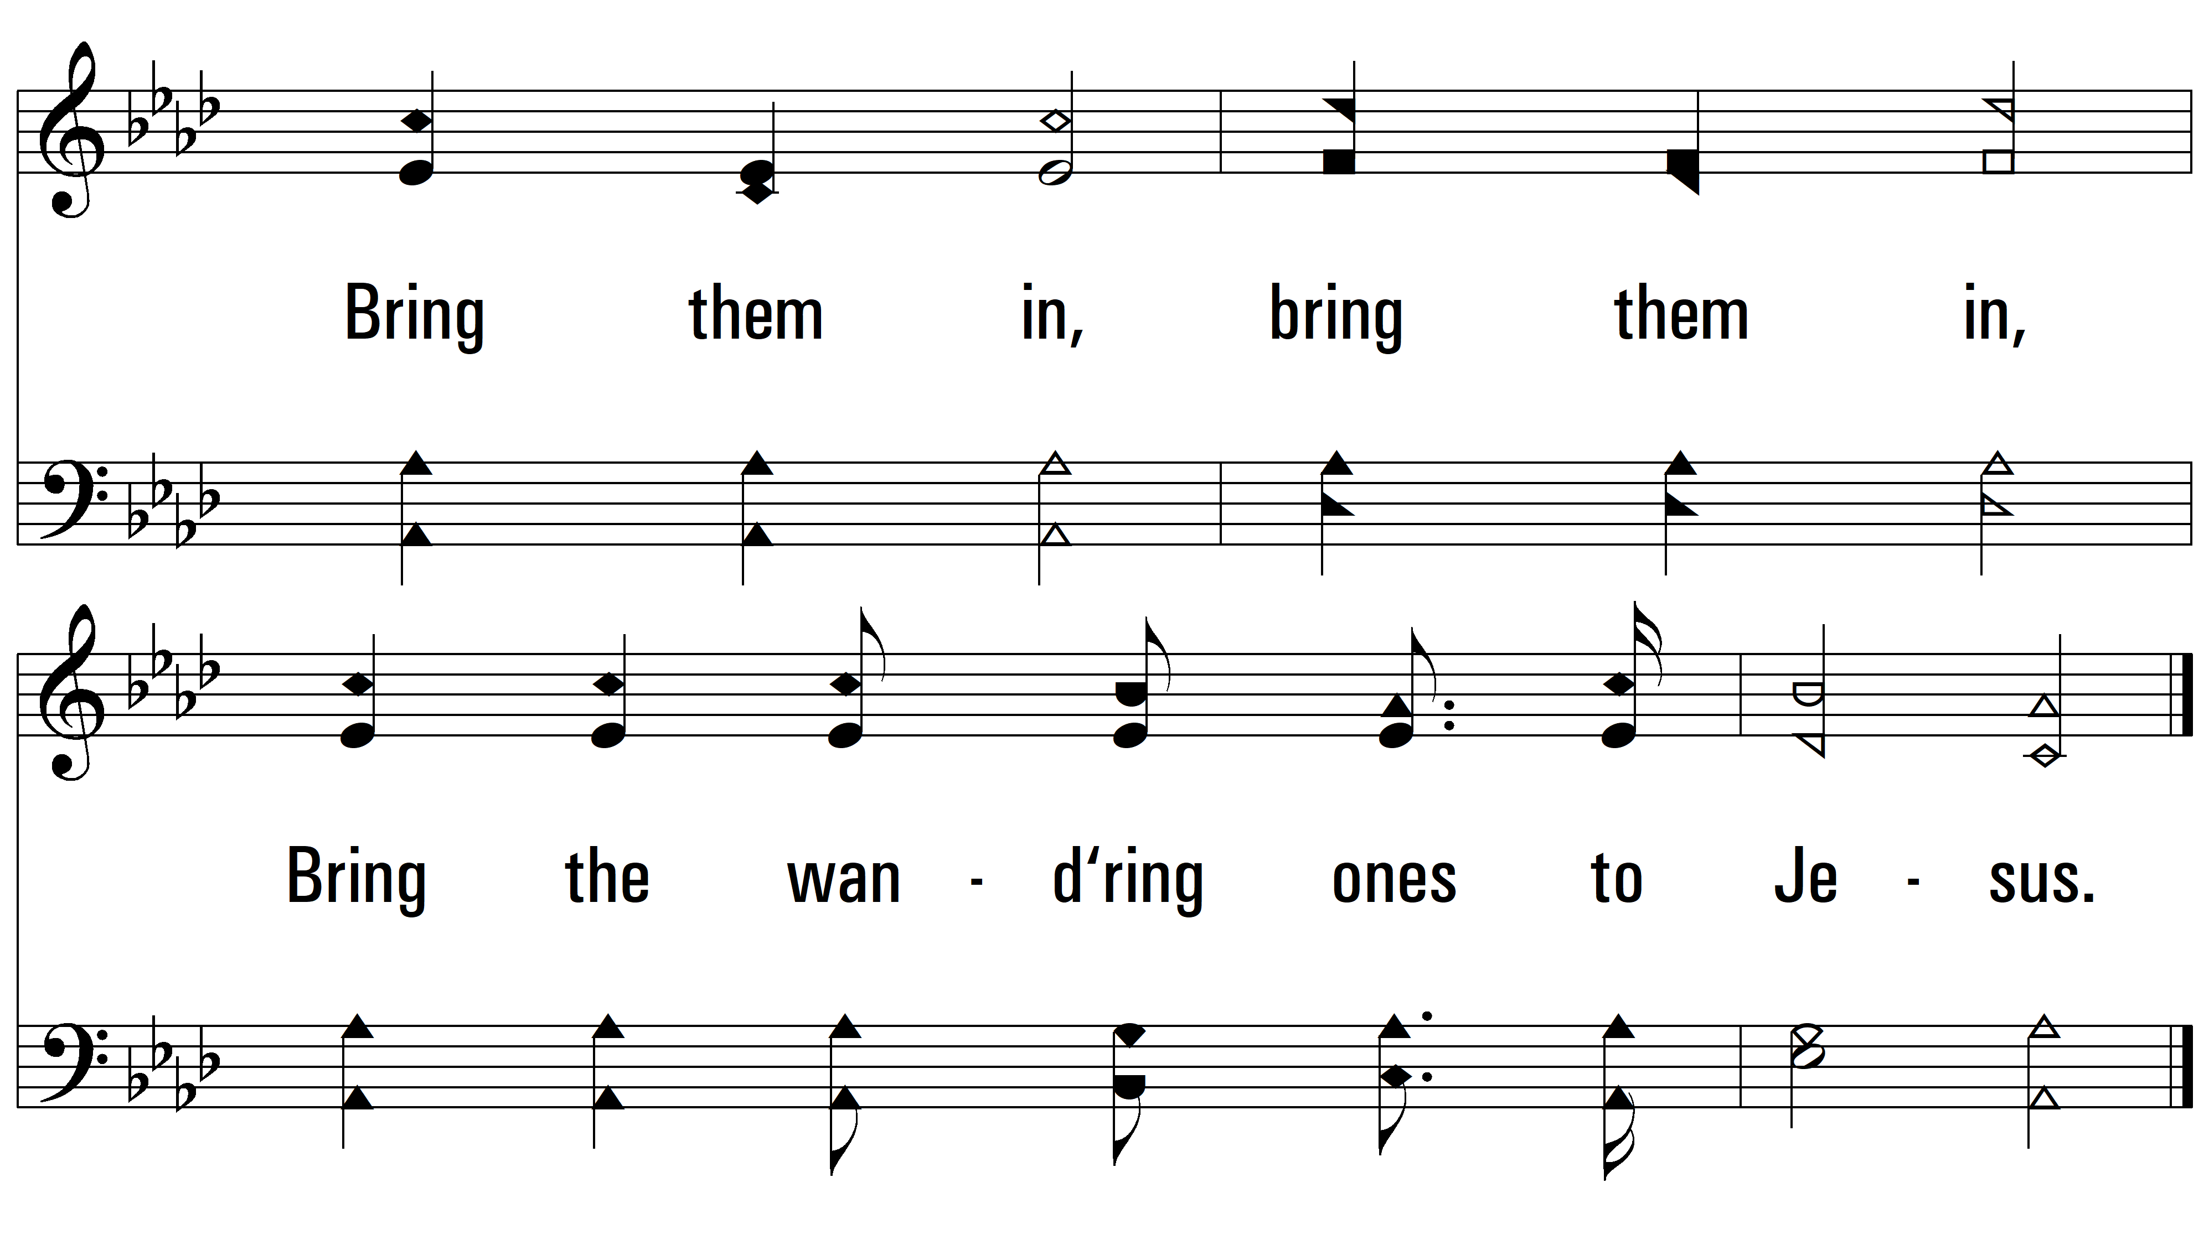
vs. 1

Slide 6
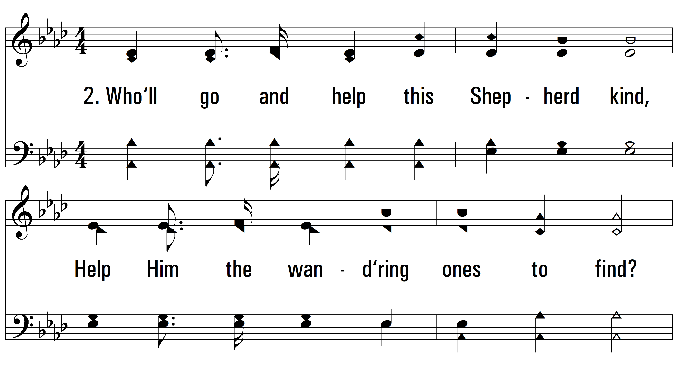
vs. 2 ~ Bring Them In

Slide 7
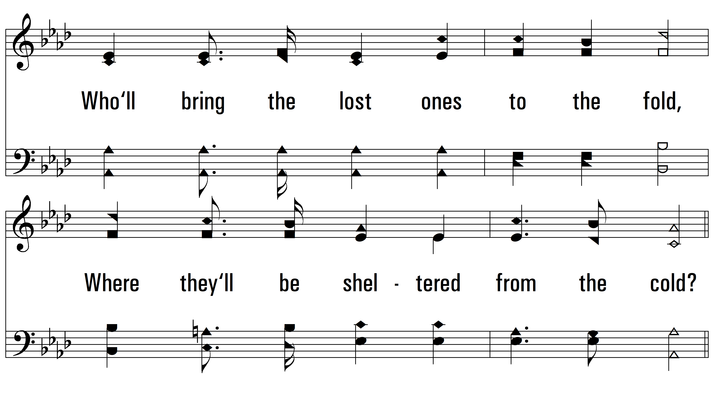
vs. 2

Slide 8
vs. 2

Slide 9
vs. 2

Slide 10
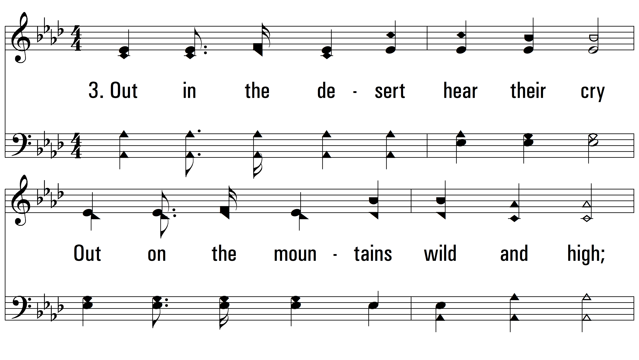
vs. 3 ~ Bring Them In

Slide 11
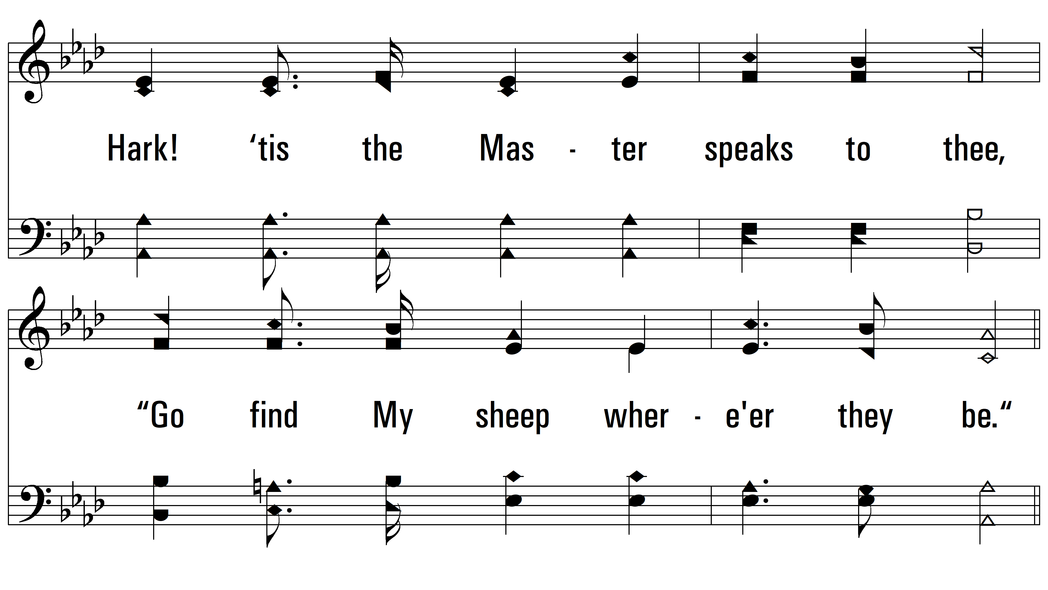
vs. 3

Slide 12
vs. 3

Slide 13
vs. 3
PDHymns.com
END

