Slide 1
Break Thou The Bread Of Life
BREAD OF LIFE
6.4.6.4.D
Words: | Mrs. Annie S. Hawks (1877)
Music: | Robert Lowry (1877)
4/4
E^{b}/G - MI
Verses: 4
Lead - | MI
Alto - | DO
Tenor - | SOL
Bass - | DO
PDHymns.com

Slide 2
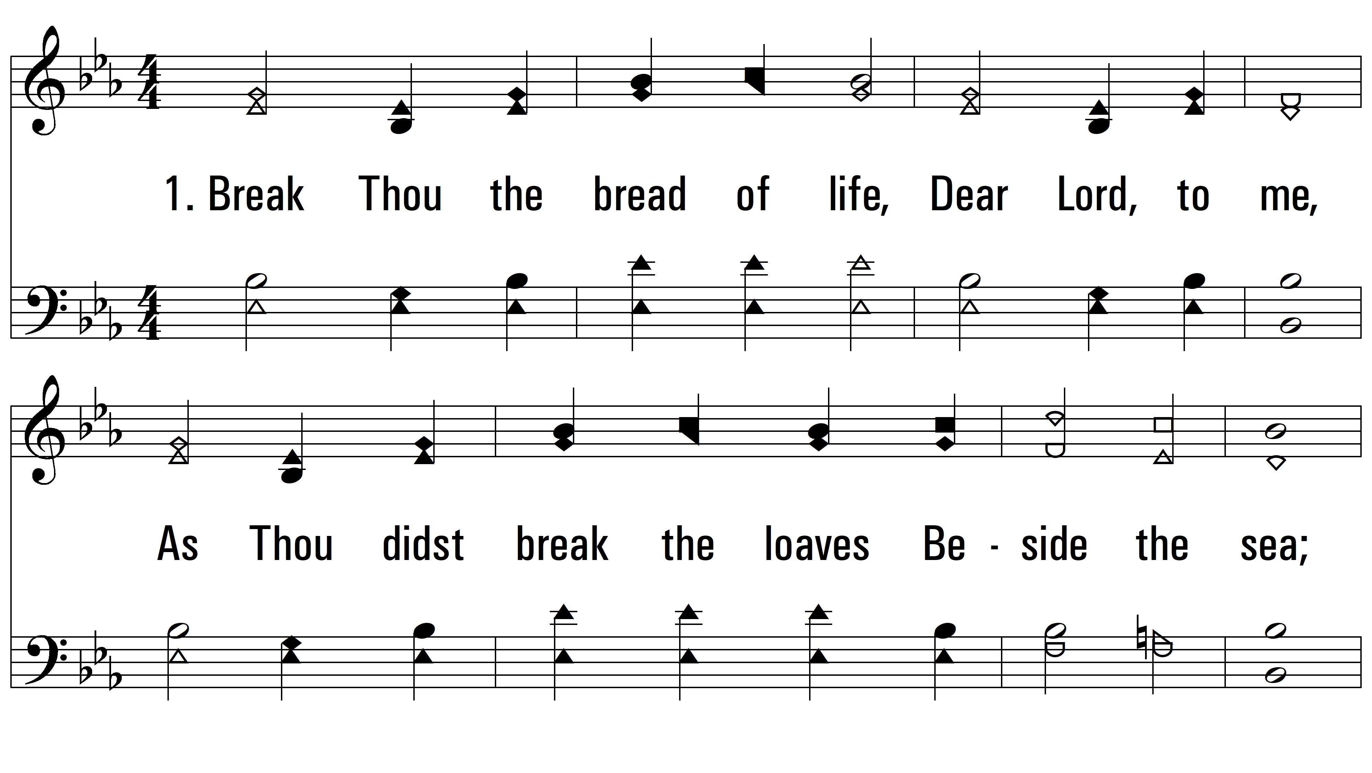
vs. 1 ~ Break Thou The Bread Of Life

Slide 3
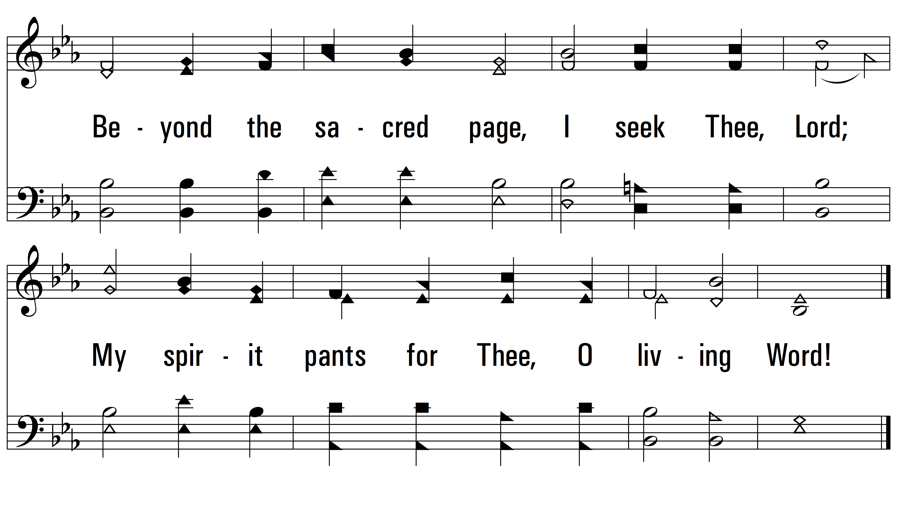
vs. 1

Slide 4
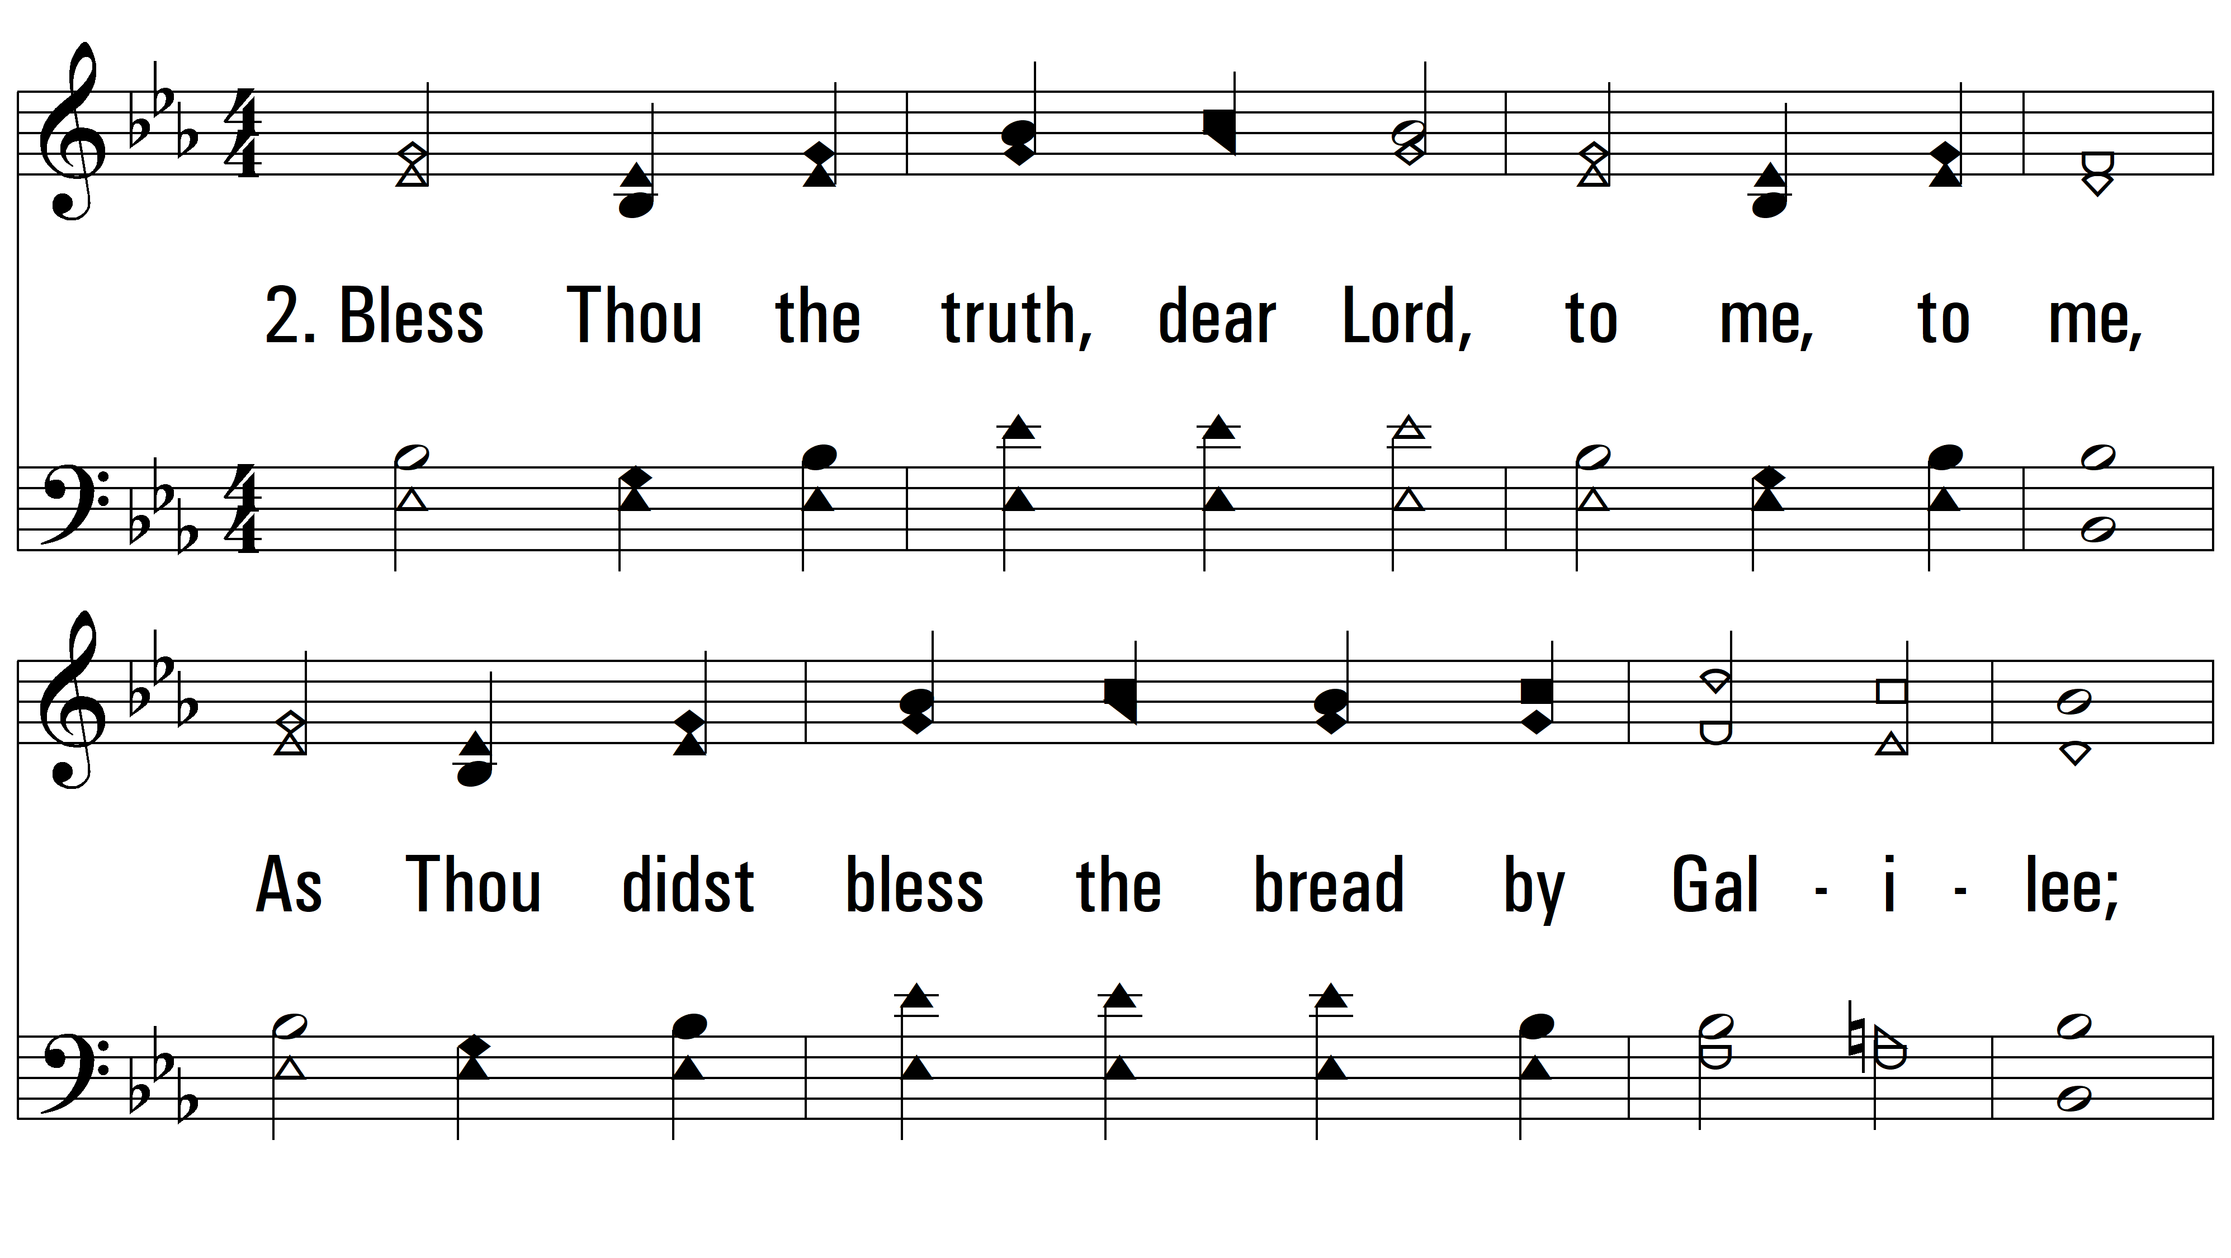
vs. 2 ~ Break Thou The Bread Of Life

Slide 5
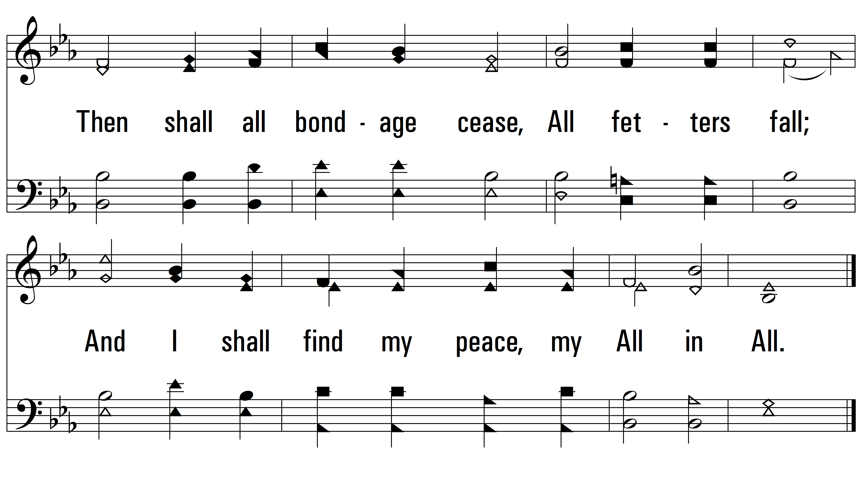
vs. 2

Slide 6
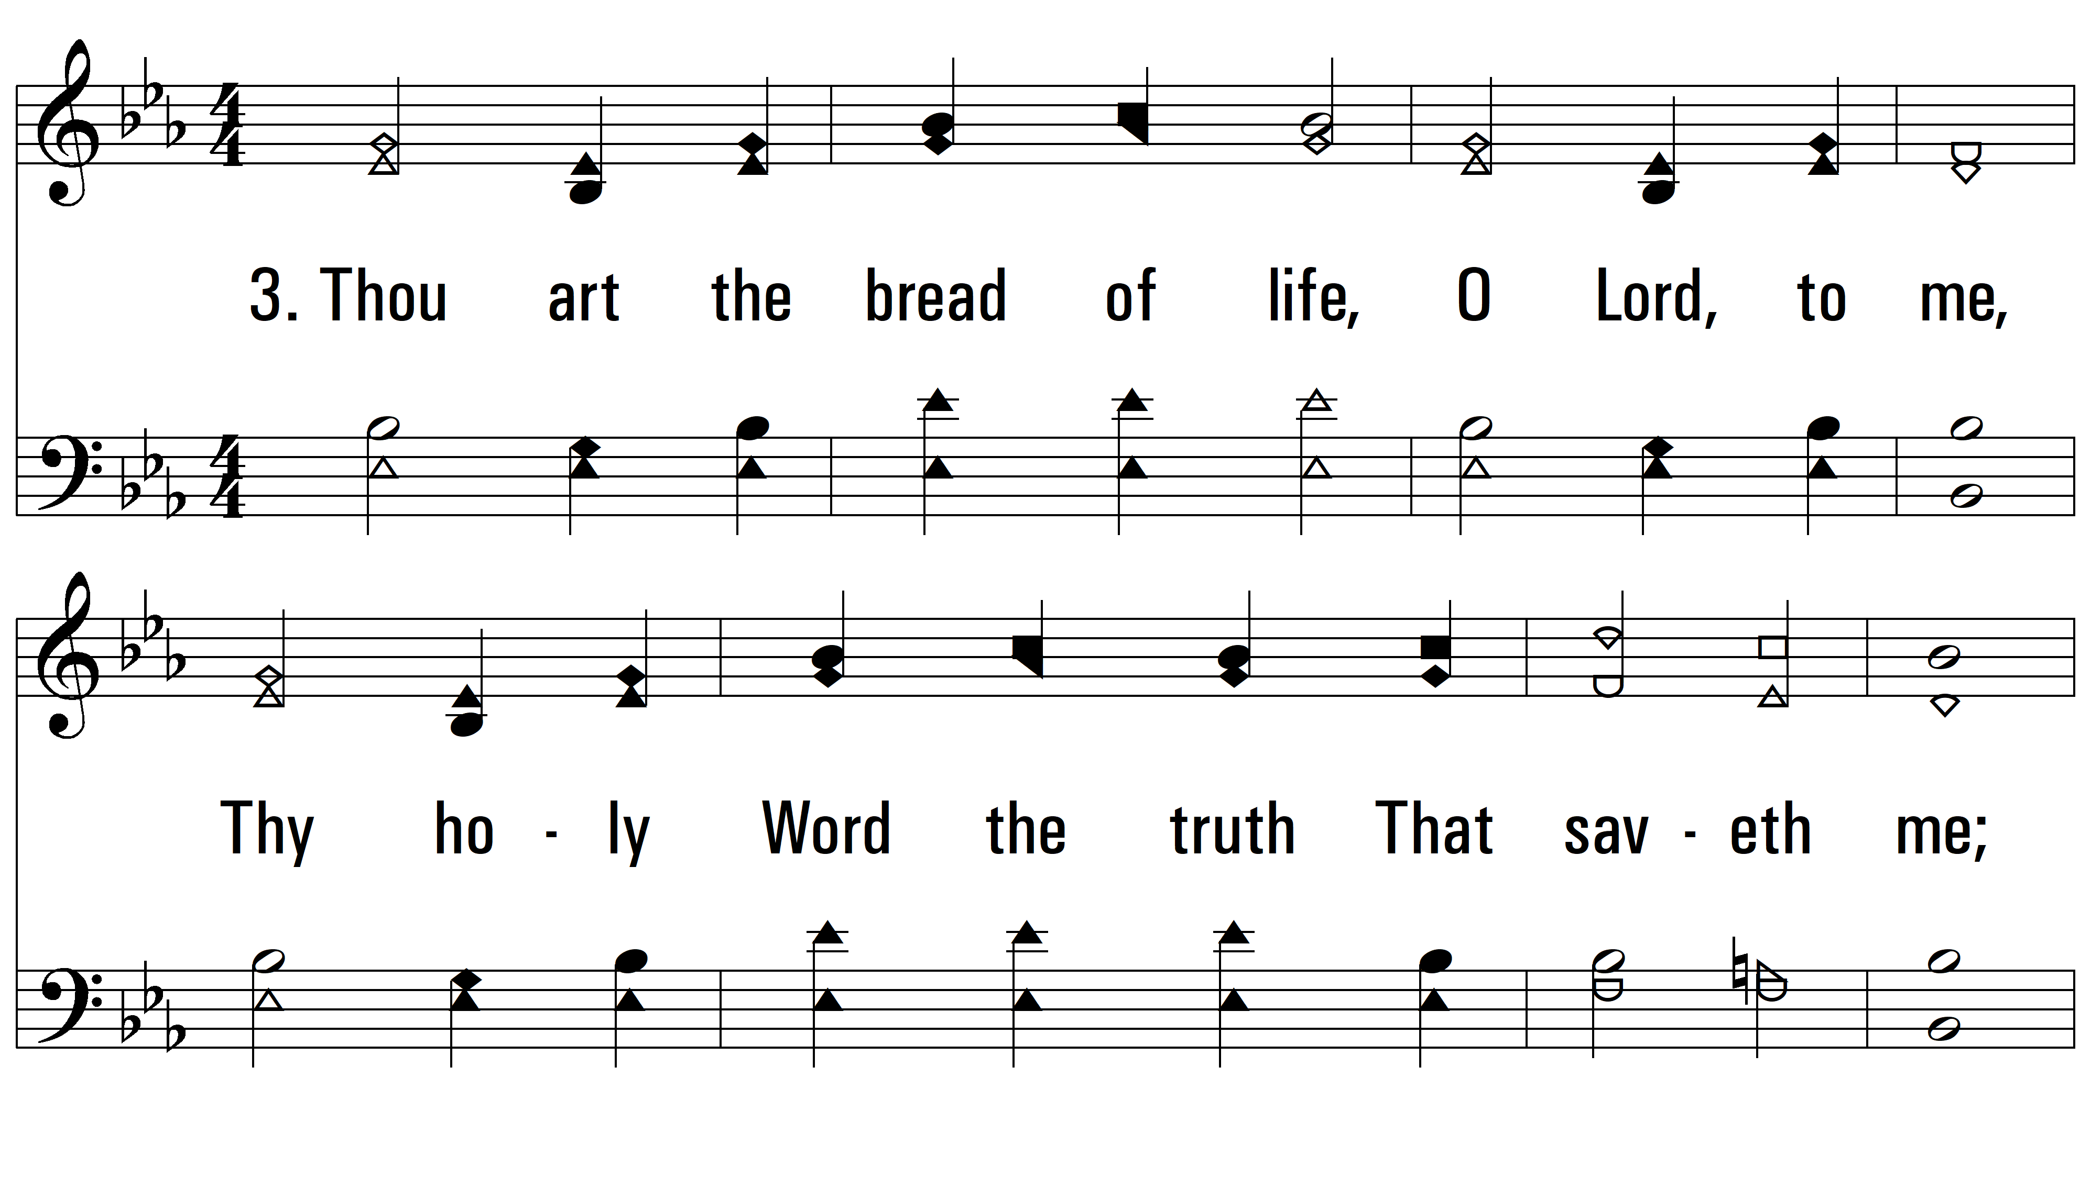
vs. 3 ~ Break Thou The Bread Of Life

Slide 7
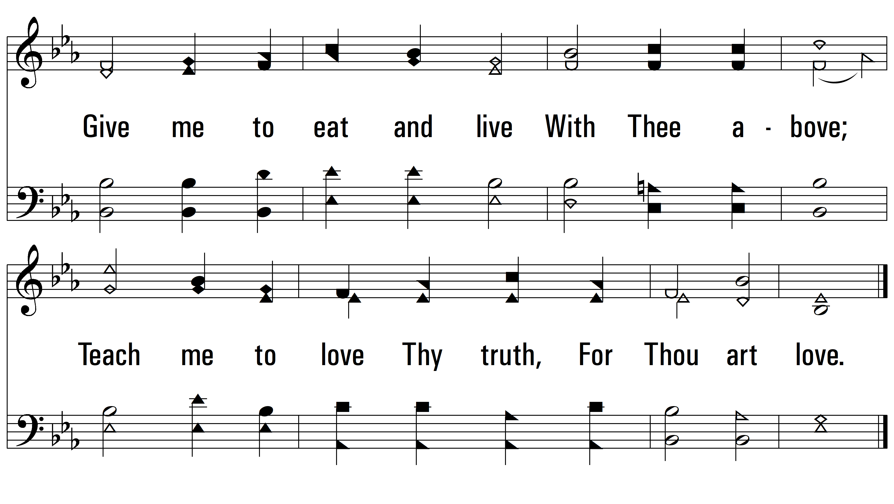
vs. 3

Slide 8
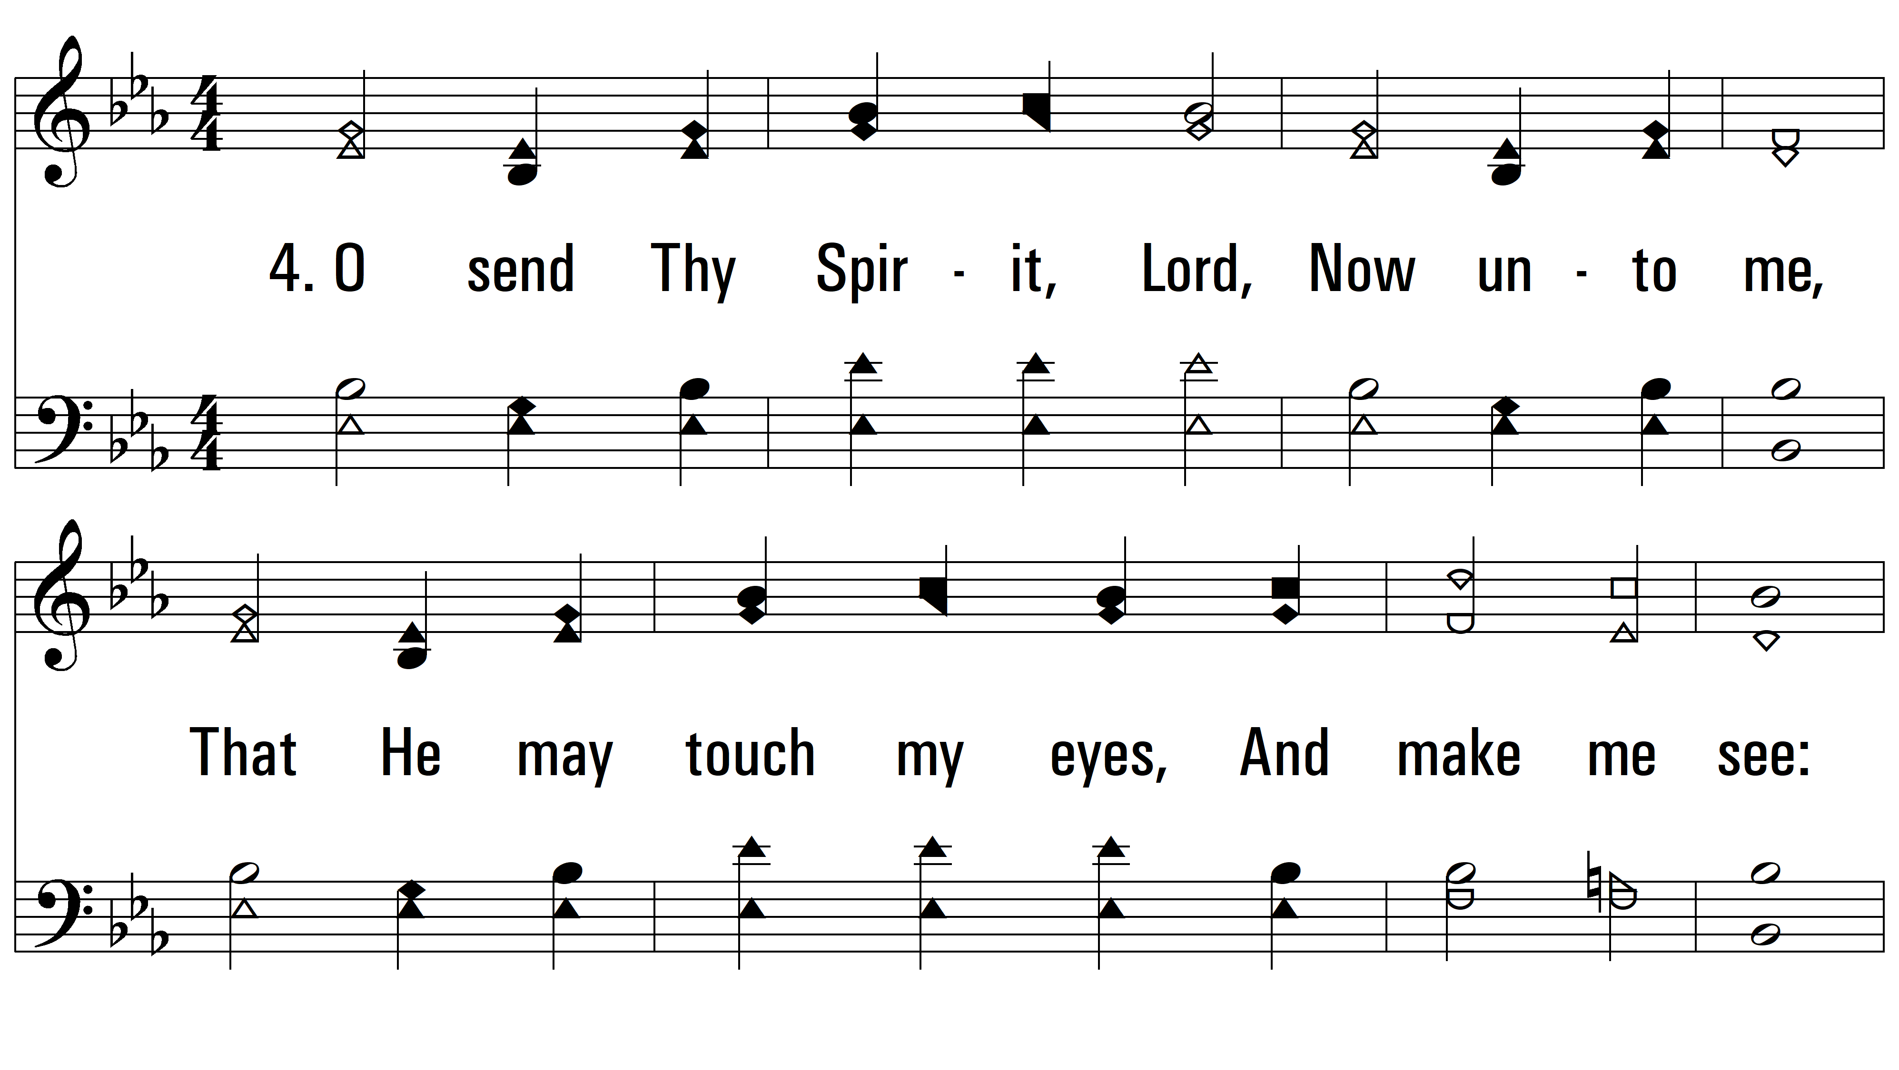
vs. 4 ~ Break Thou The Bread Of Life

Slide 9
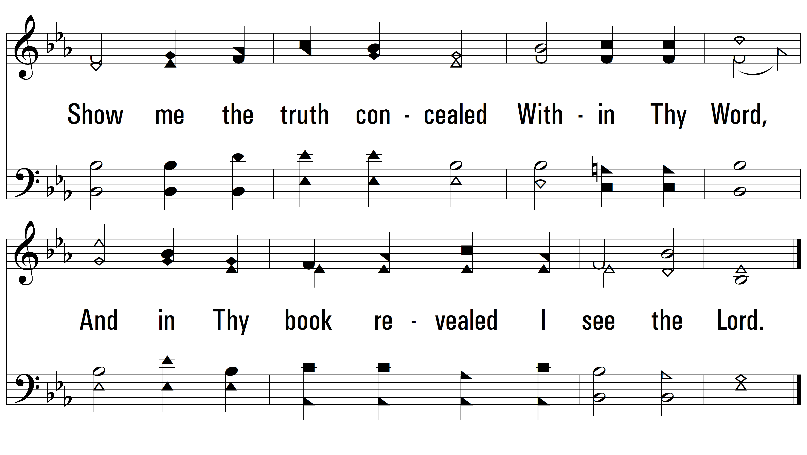
vs. 4
PDHymns.com
END

