Slide 1
Blest Be The Tie That Binds
DENNIS
SM
Words: | John Fawcett (1782)
Music: | Hans G. Naegeli (1832), Arr. by Lowell Mason (1845)
3/4
F/A - MI
Verses: 4
Lead - | MI
Alto - | DO
Tenor - | SOL
Bass - | DO
PDHymns.com

Slide 2
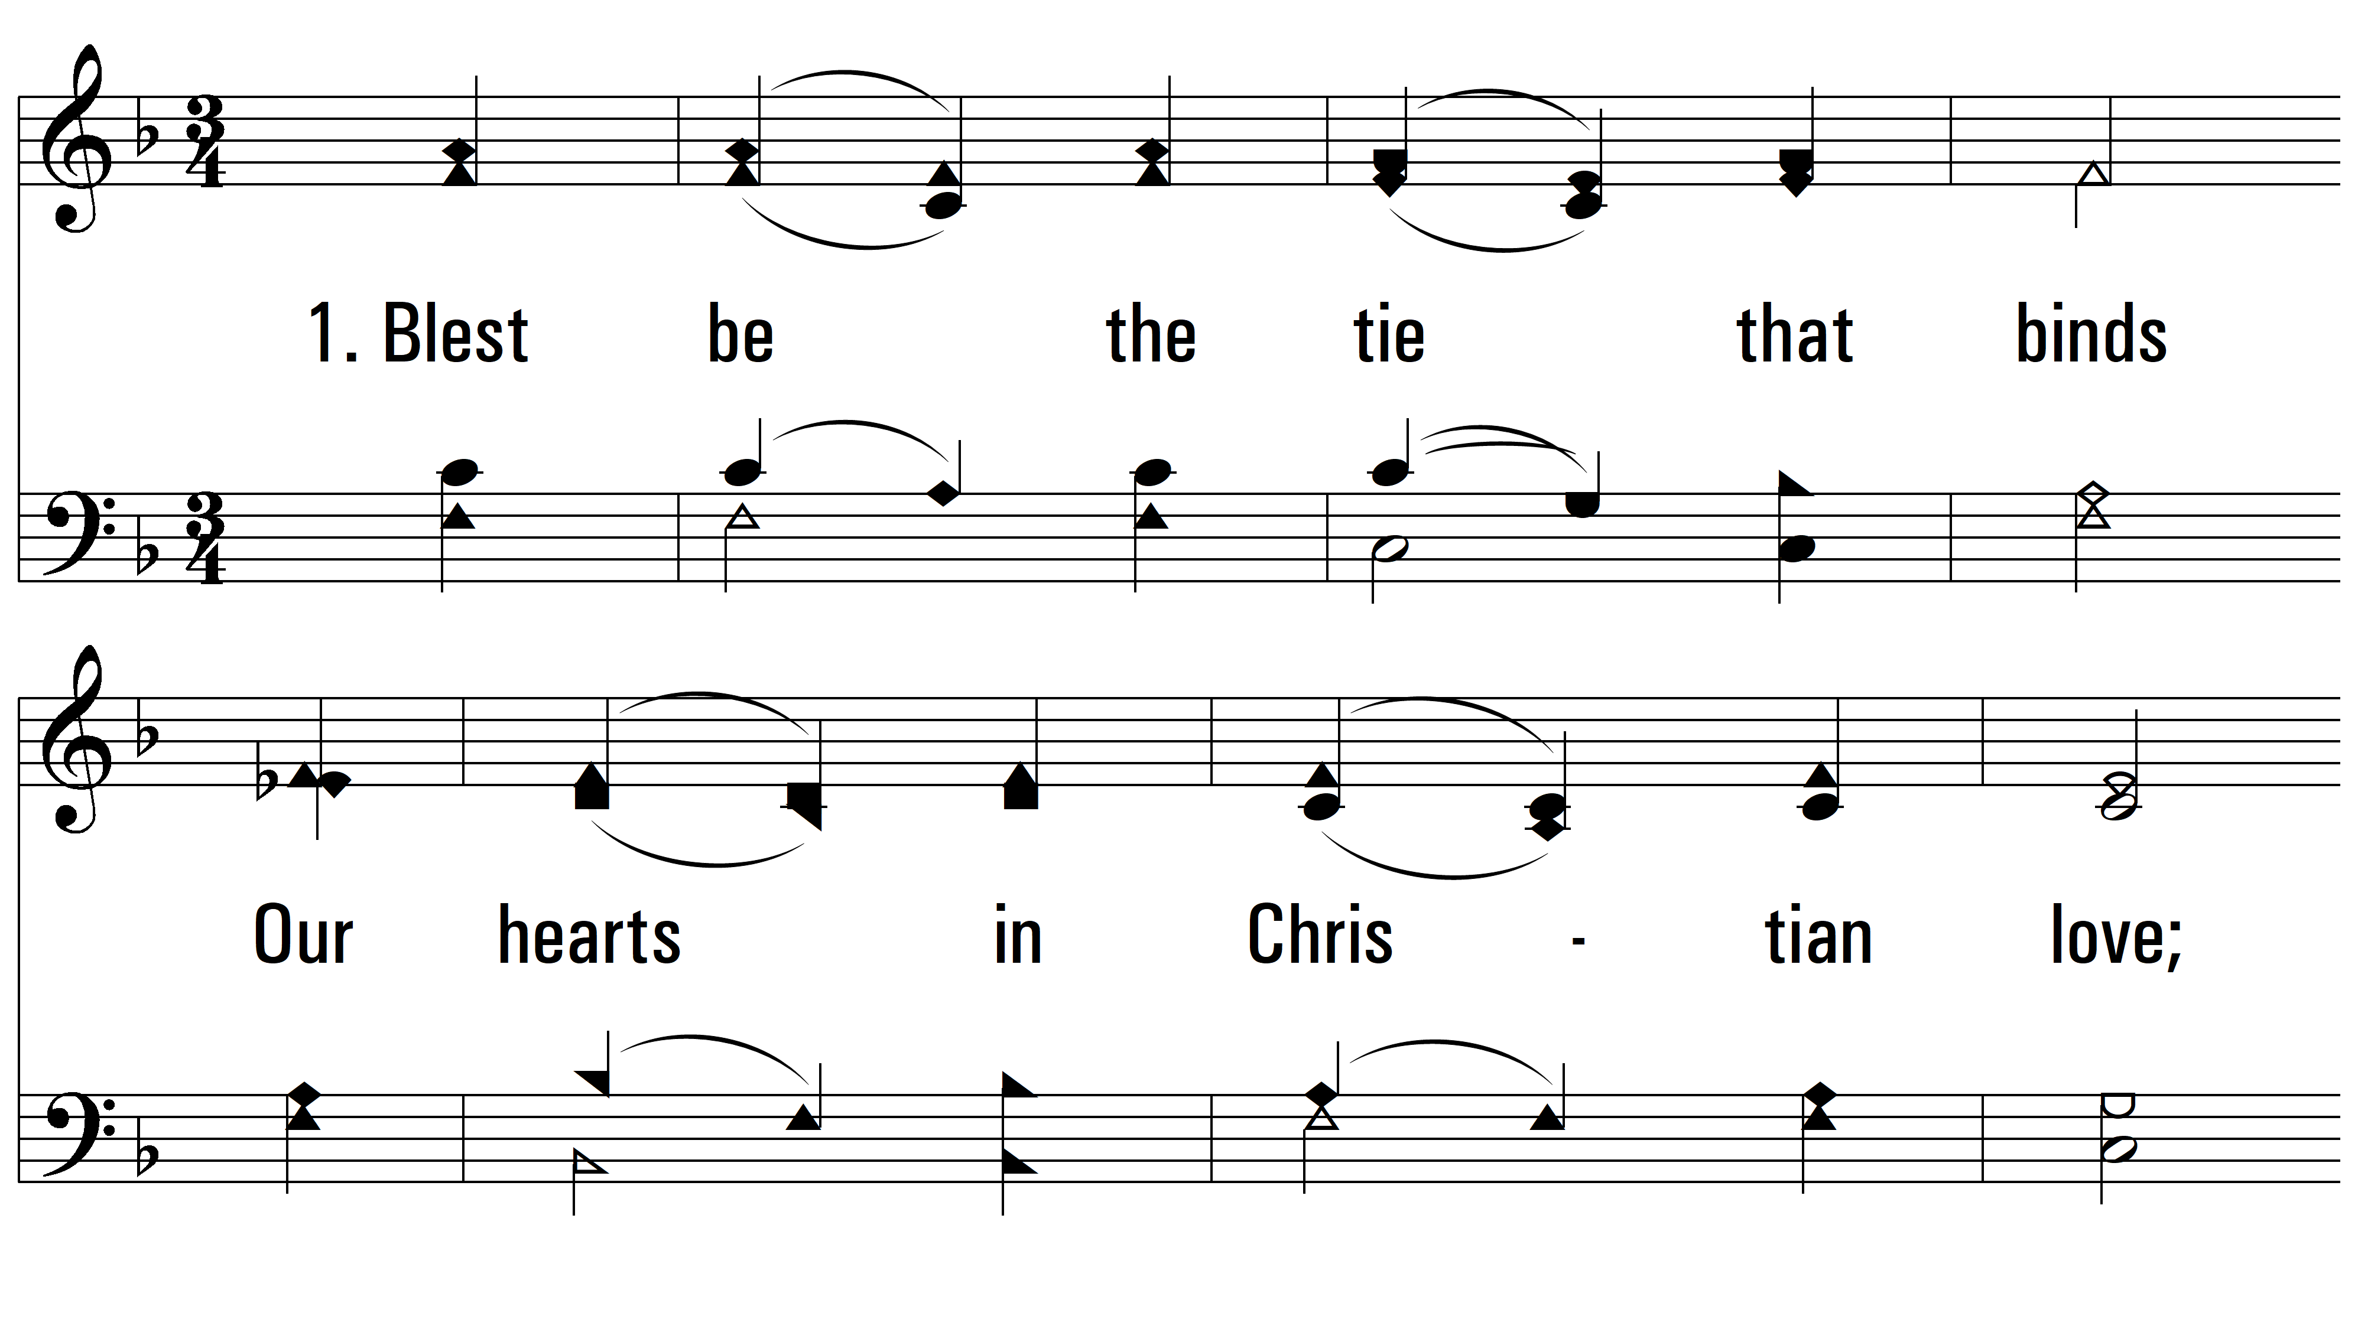
vs. 1 ~ Blest Be The Tie That Binds

Slide 3
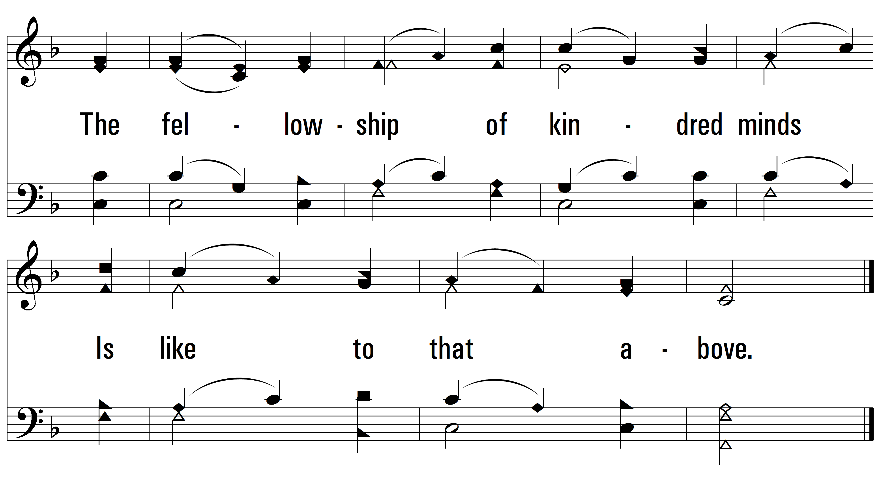
vs. 1

Slide 4
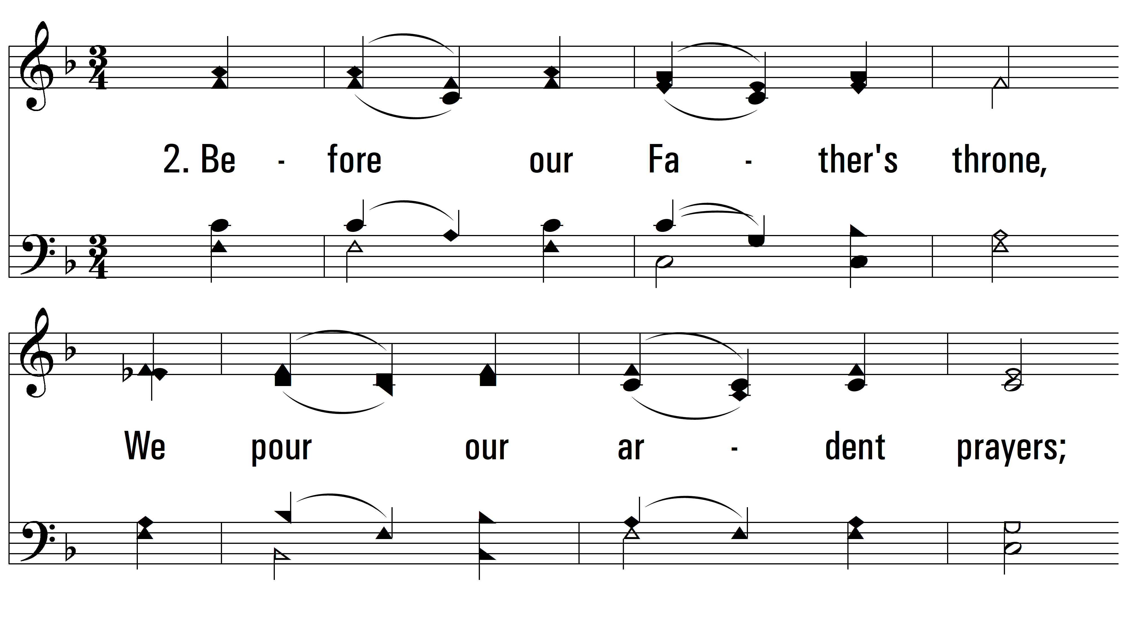
vs. 2 ~ Blest Be The Tie That Binds

Slide 5
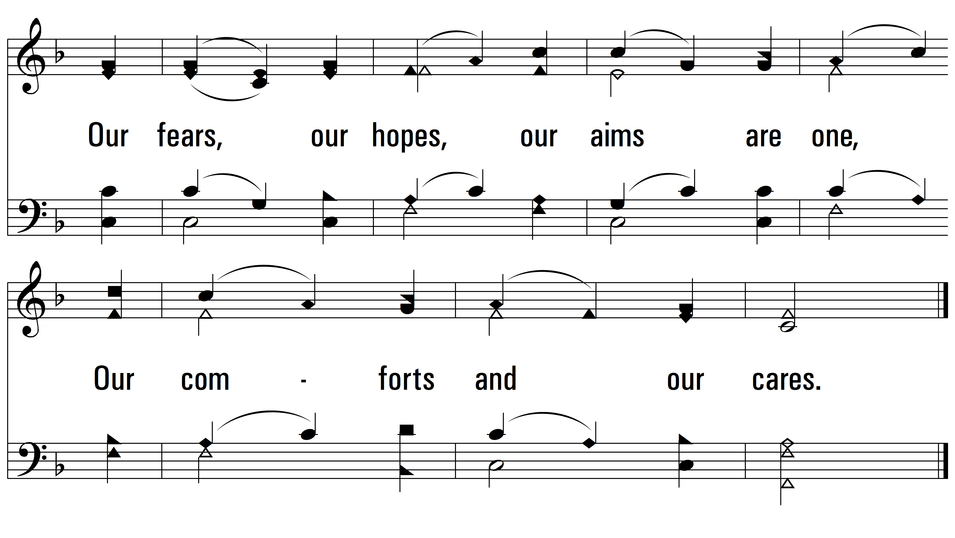
vs. 2

Slide 6
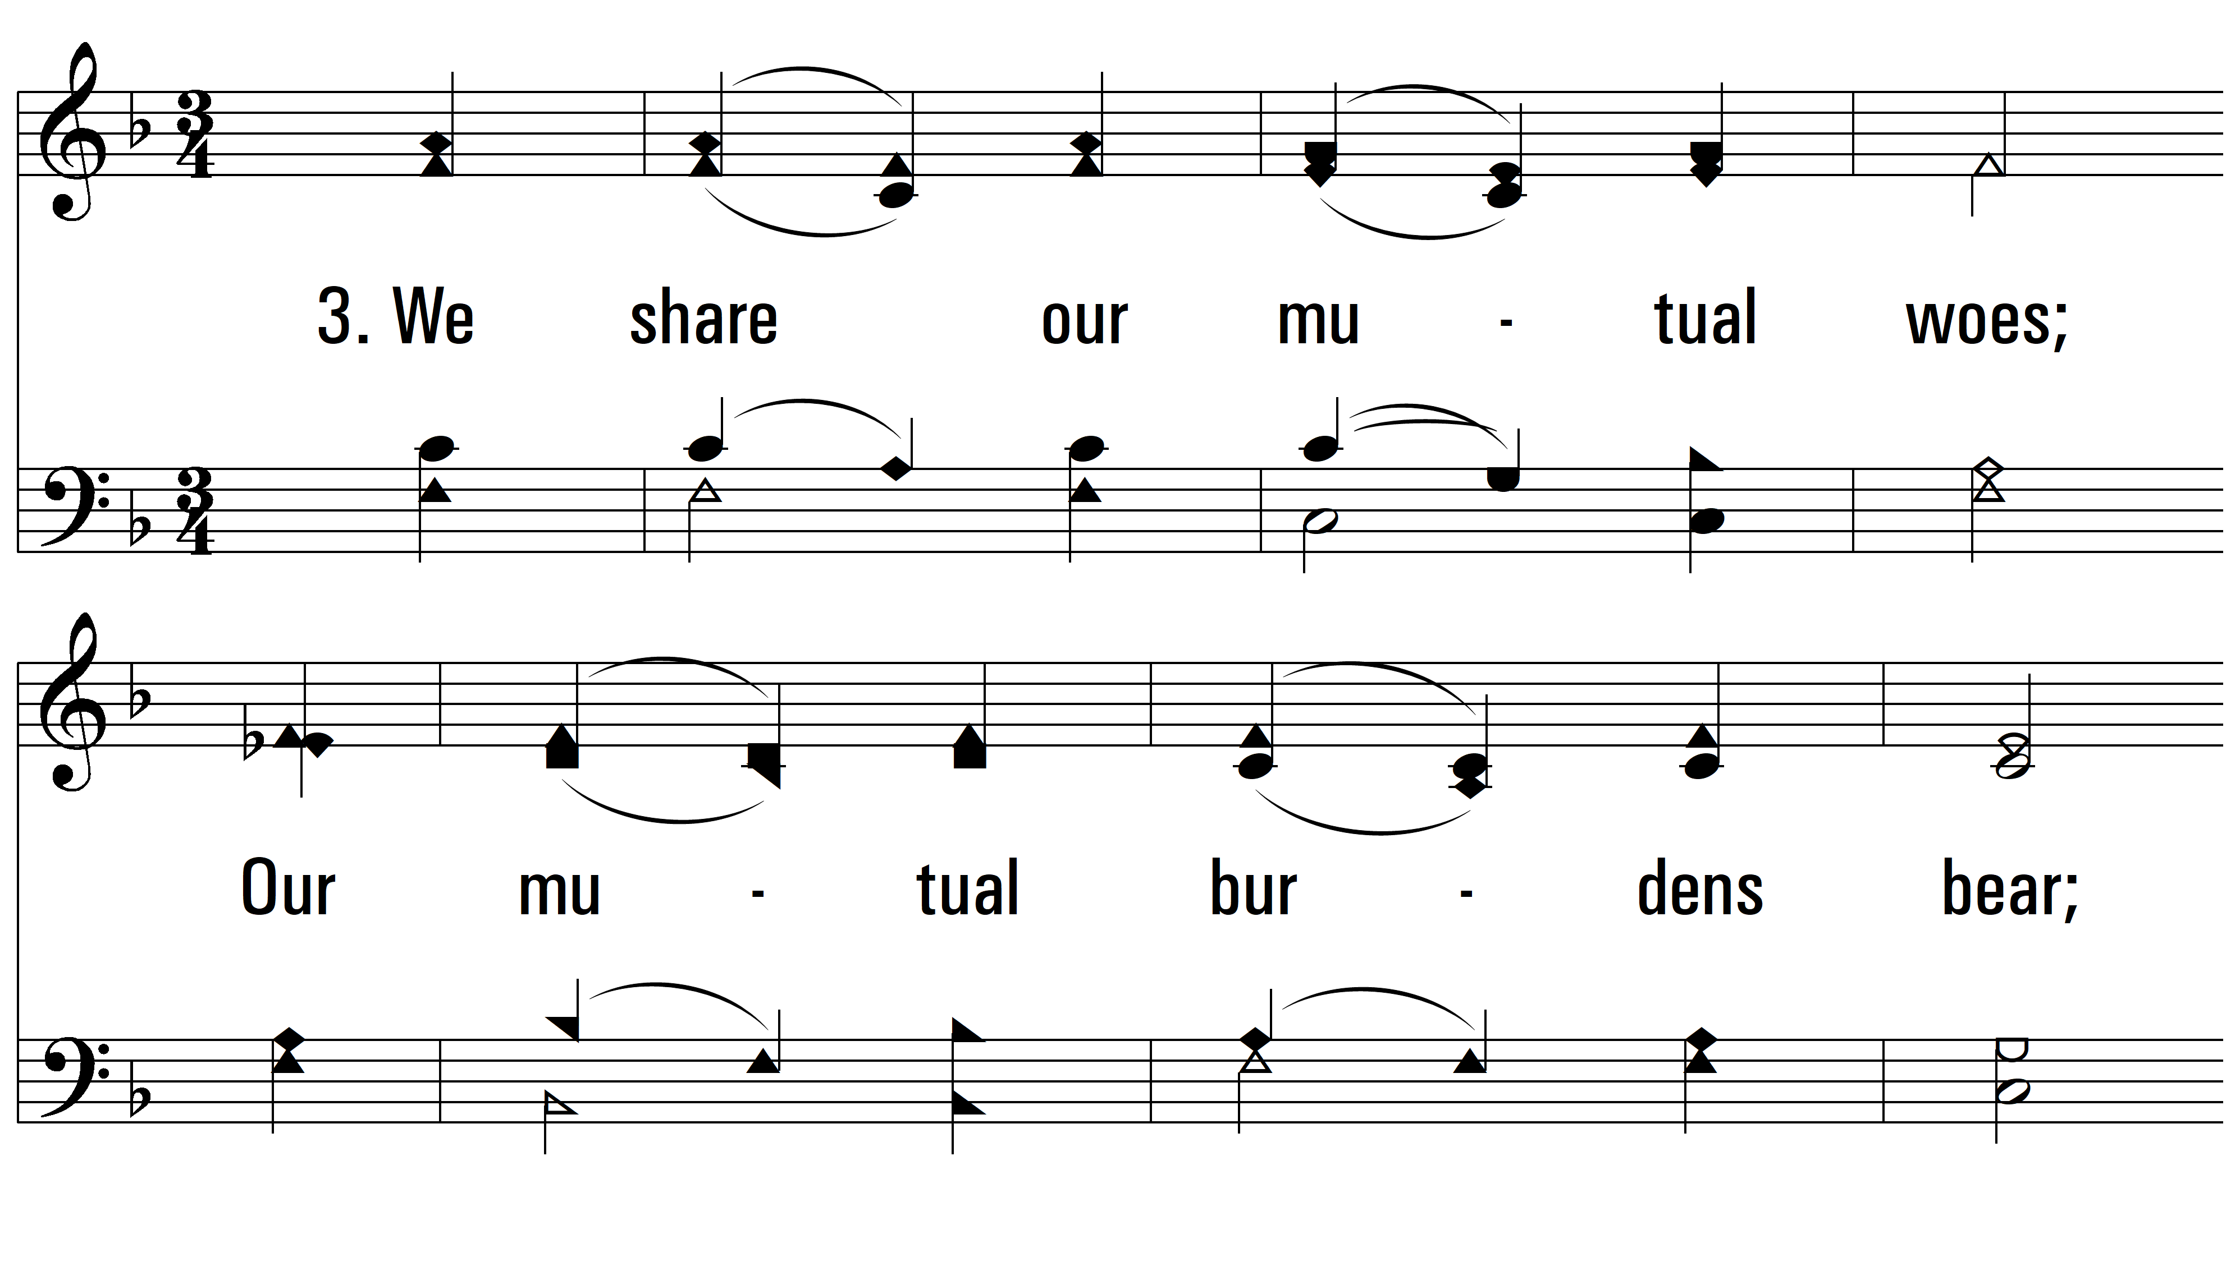
vs. 3 ~ Blest Be The Tie That Binds

Slide 7
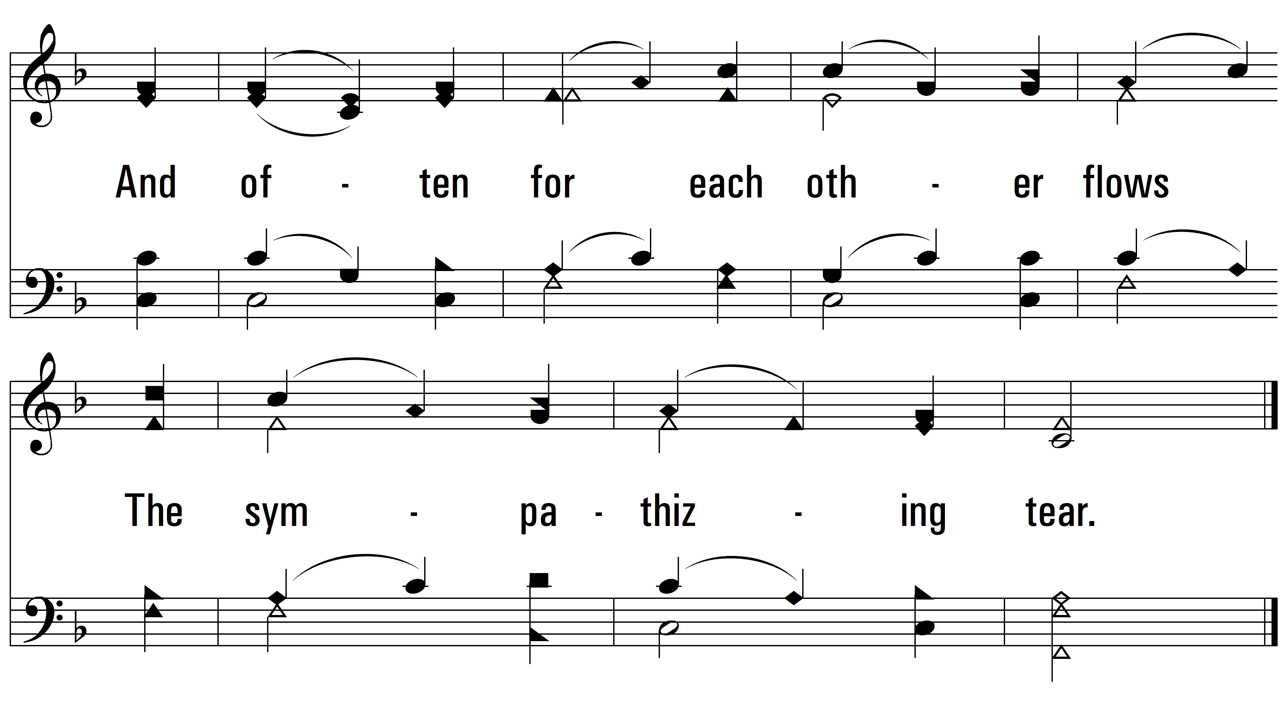
vs. 3

Slide 8
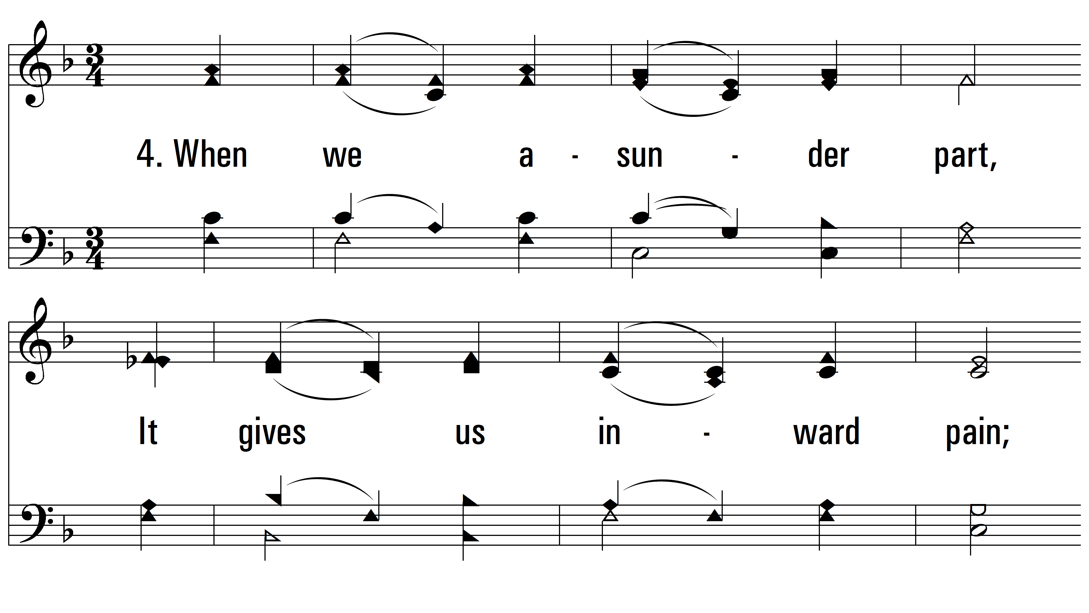
vs. 4 ~ Blest Be The Tie That Binds

Slide 9
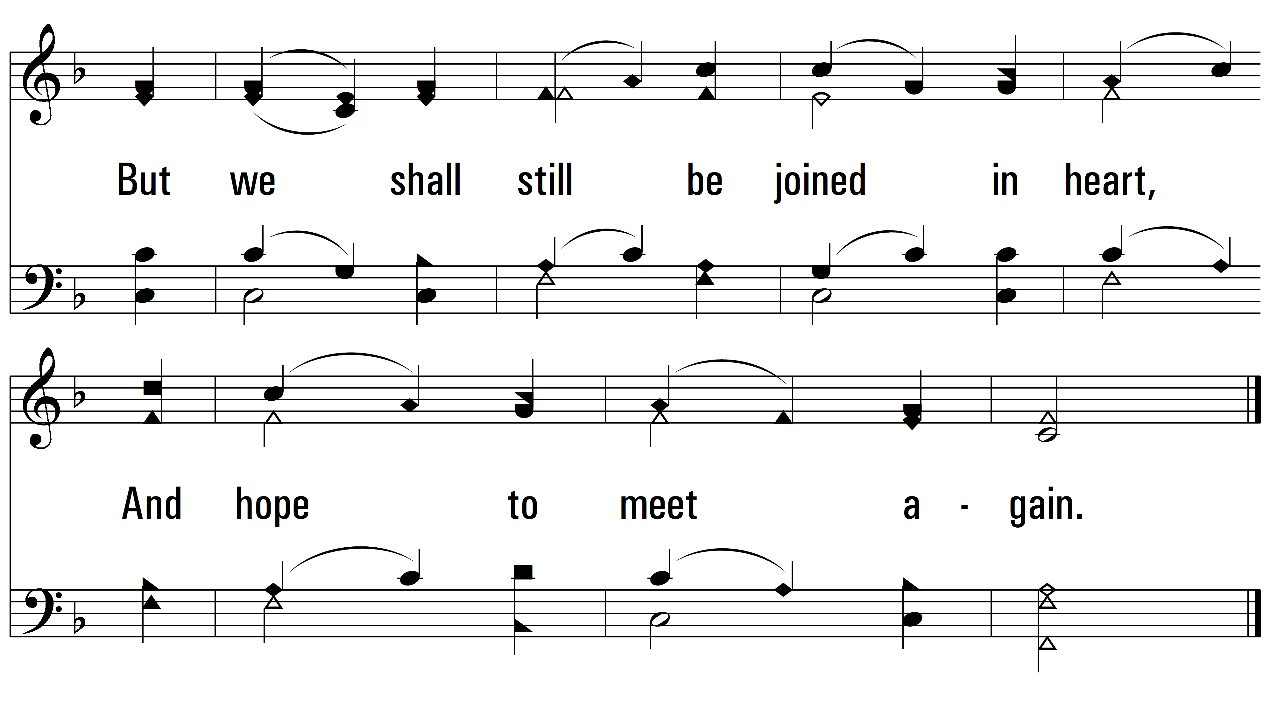
vs. 4
PDHymns.com
END

