Slide 1
Blessed Are They That Do His Commandments
Words: | H. R. Trickett (1884)
Music: | J. H. Fillmore (1884)
4/4
A^{b}/C - MI
Verses: 3/Chorus
Lead - | MI
Alto - | SOL
Tenor - | DO
Bass - | DO
PDHymns.com

Slide 2
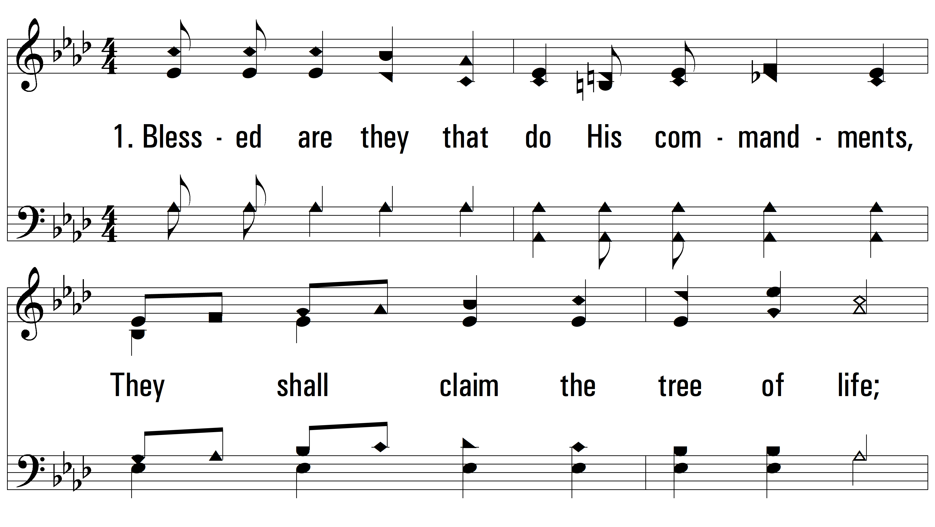
vs. 1 ~ Blessed Are They That Do His Commandments

Slide 3
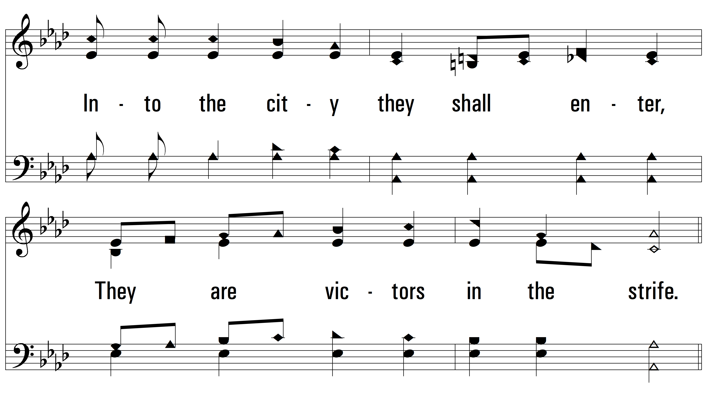
vs. 1

Slide 4
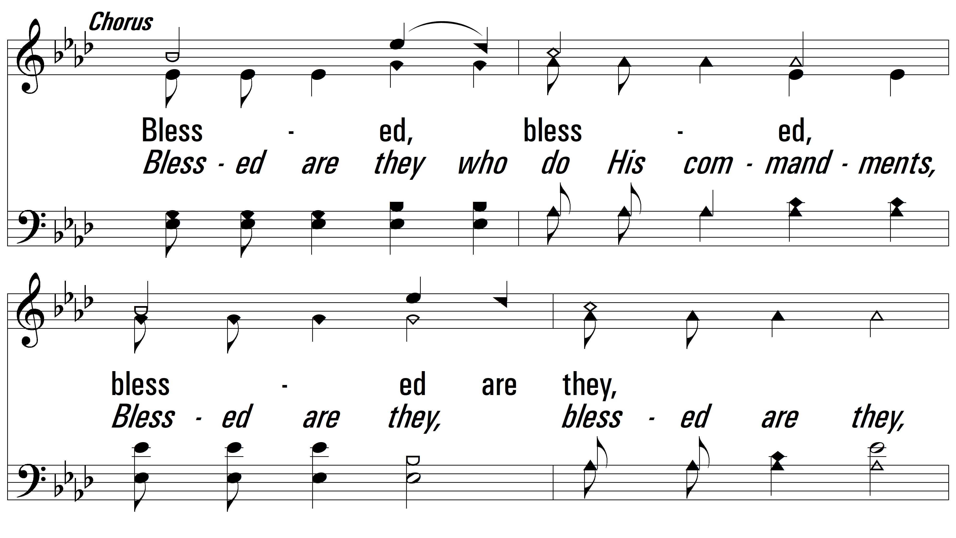
vs. 1

Slide 5
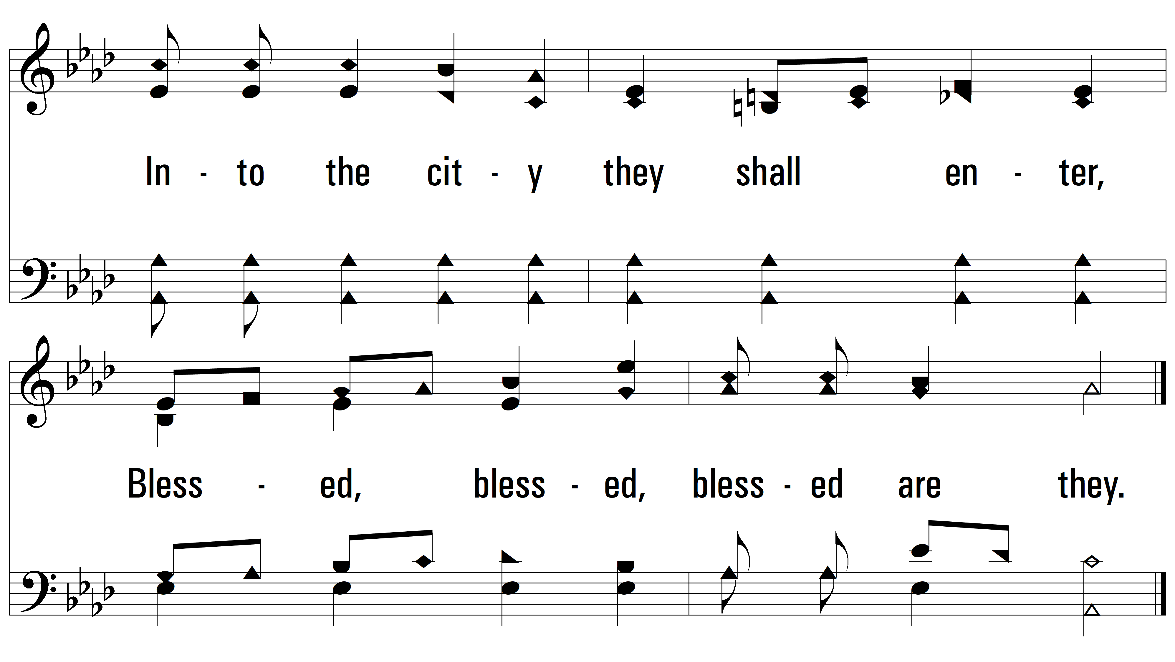
vs. 1

Slide 6
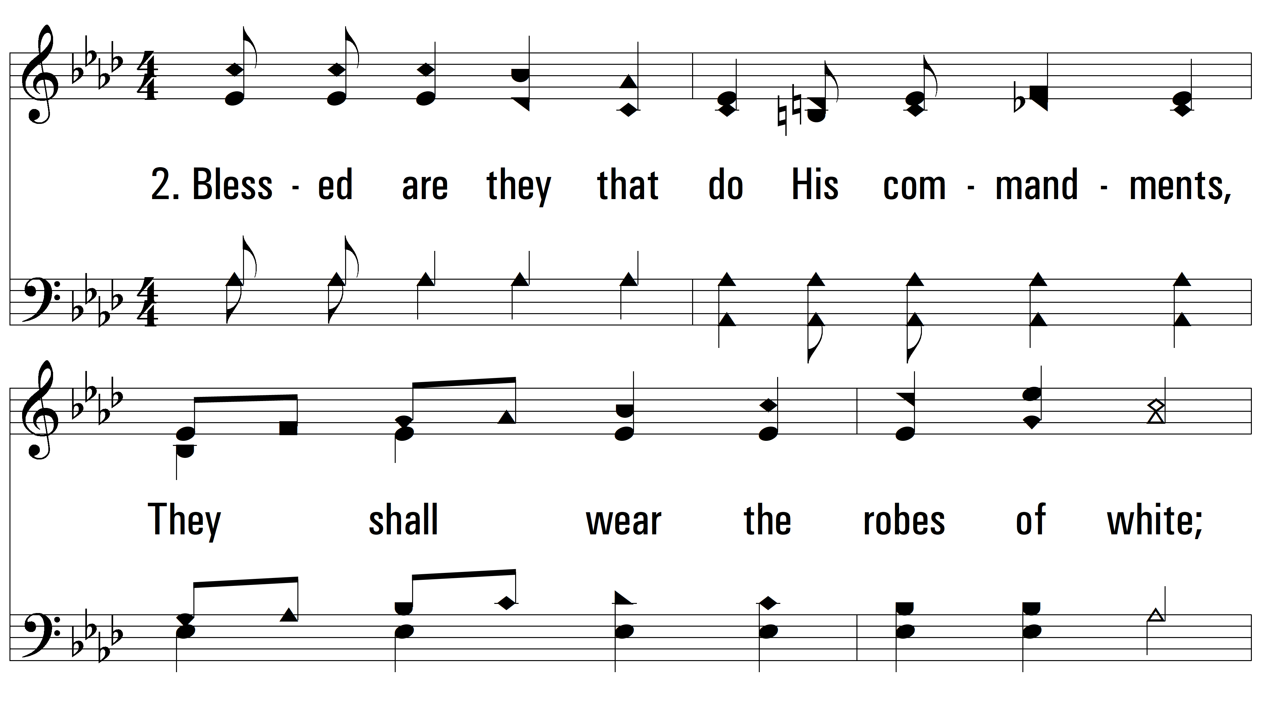
vs. 2 ~ Blessed Are They That Do His Commandments

Slide 7
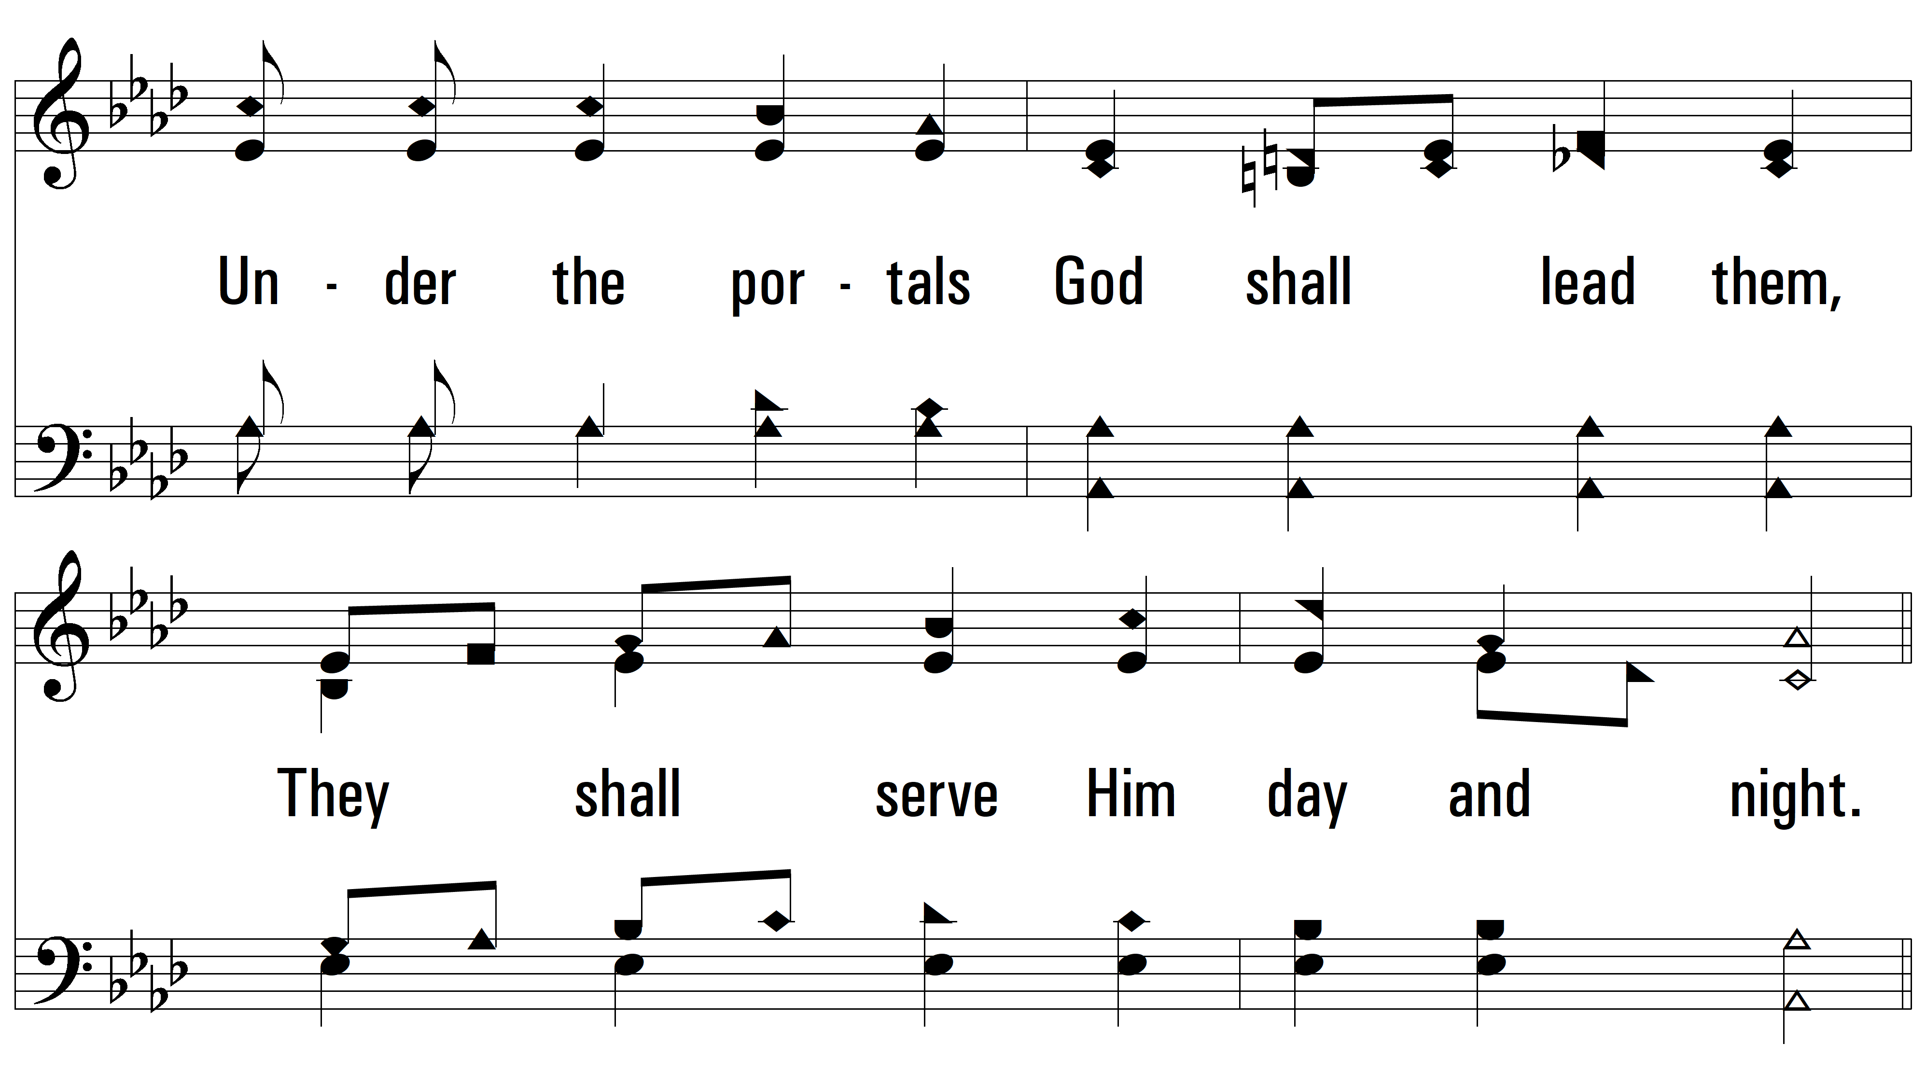
vs. 2

Slide 8
vs. 2

Slide 9
vs. 2

Slide 10
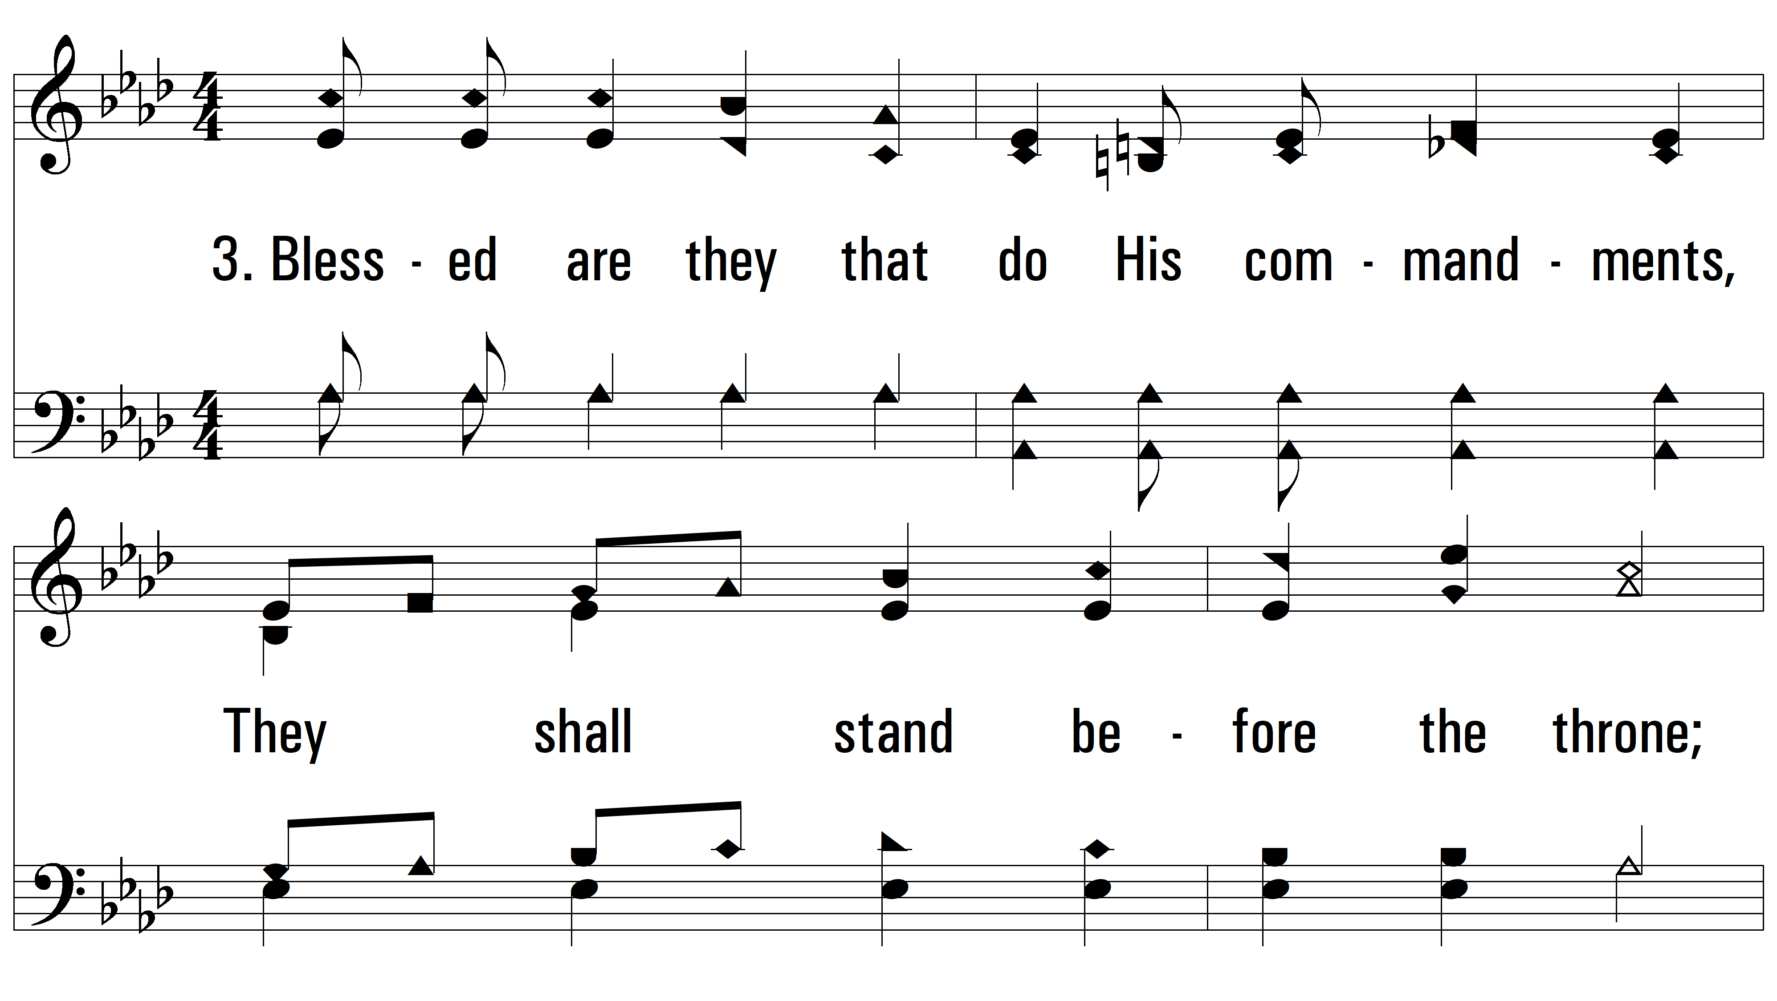
vs. 3 ~ Blessed Are They That Do His Commandments

Slide 11
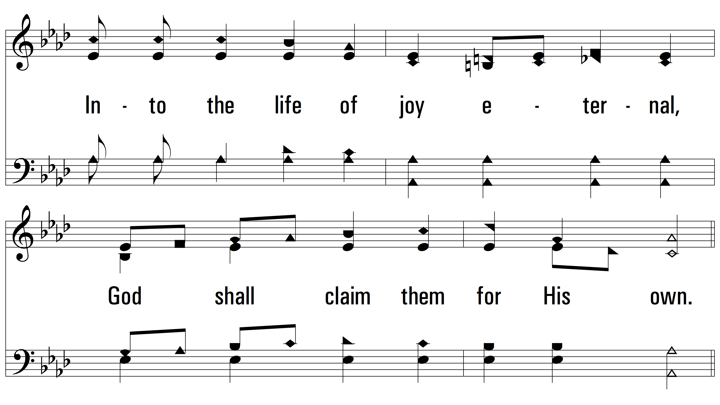
vs. 3

Slide 12
vs. 3

Slide 13
vs. 3
PDHymns.com
END

