Slide 1
Beyond This Land Of Parting
Words: | Mrs. M. B.C. Slade (1876)
Music: | Dr. A. B. Everett (1876)
4/4
G/D - SOL
Verses: 3/Chorus
Lead - | SOL
Alto - | MI
Tenor - | DO
Bass - | DO
PDHymns.com

Slide 2
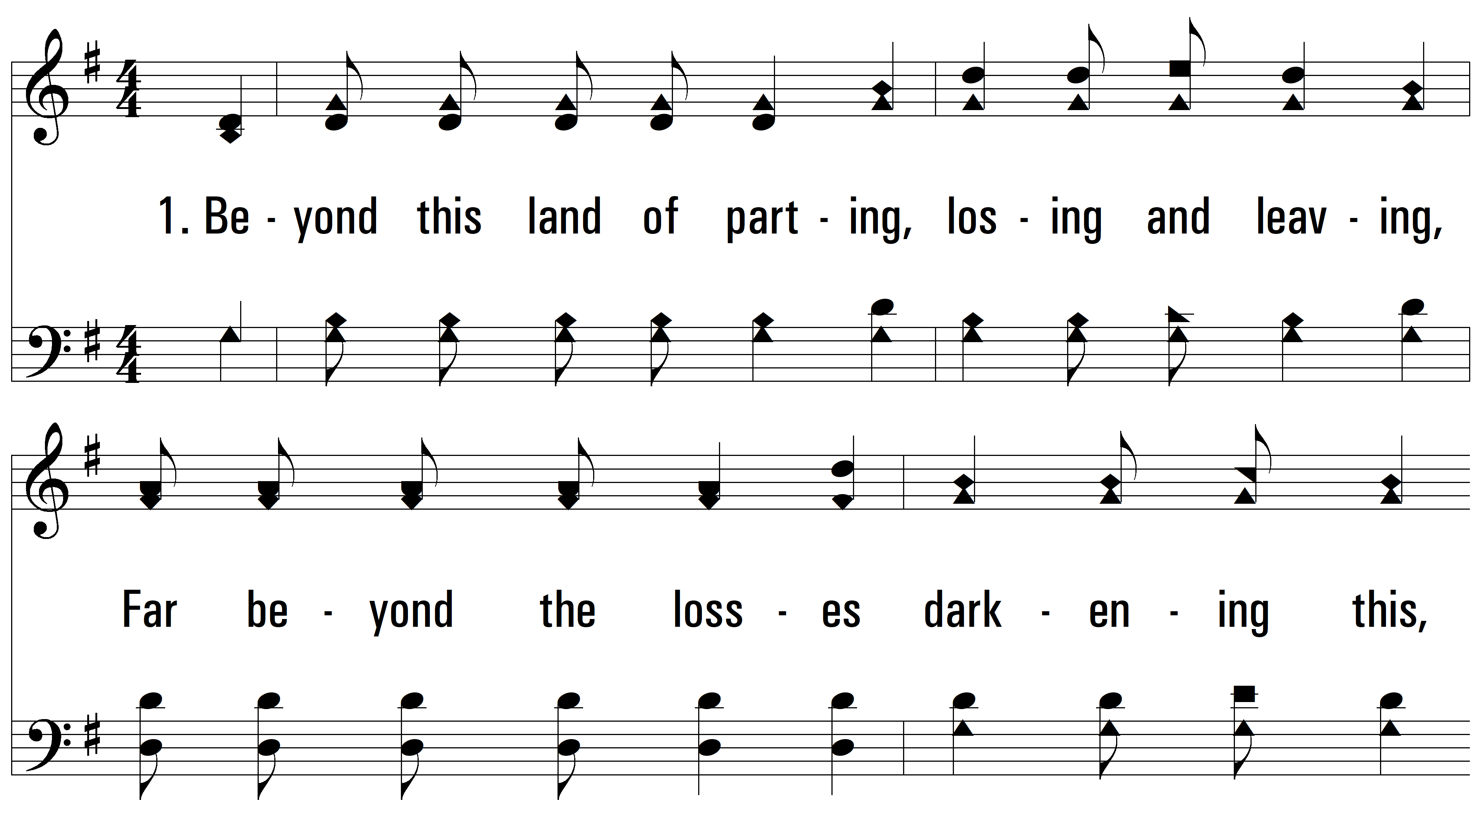
vs. 1 ~ Beyond This Land Of Parting

Slide 3
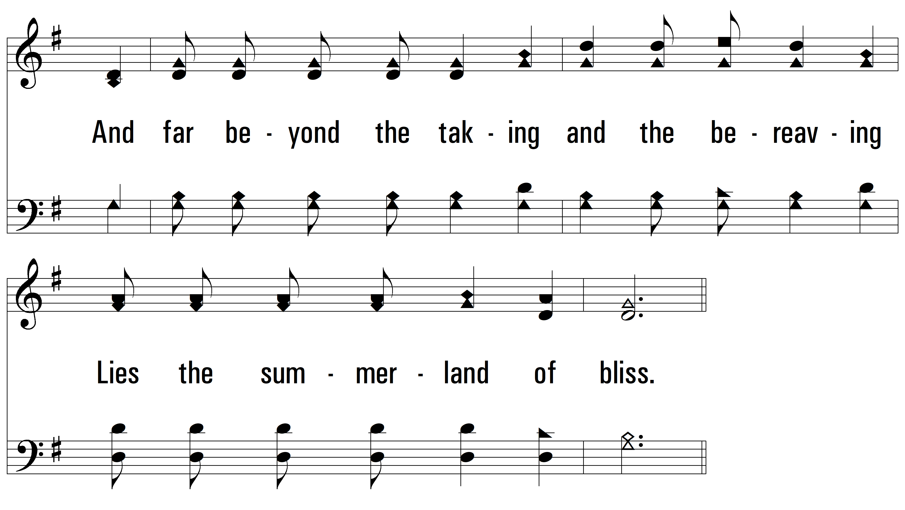
vs. 1

Slide 4
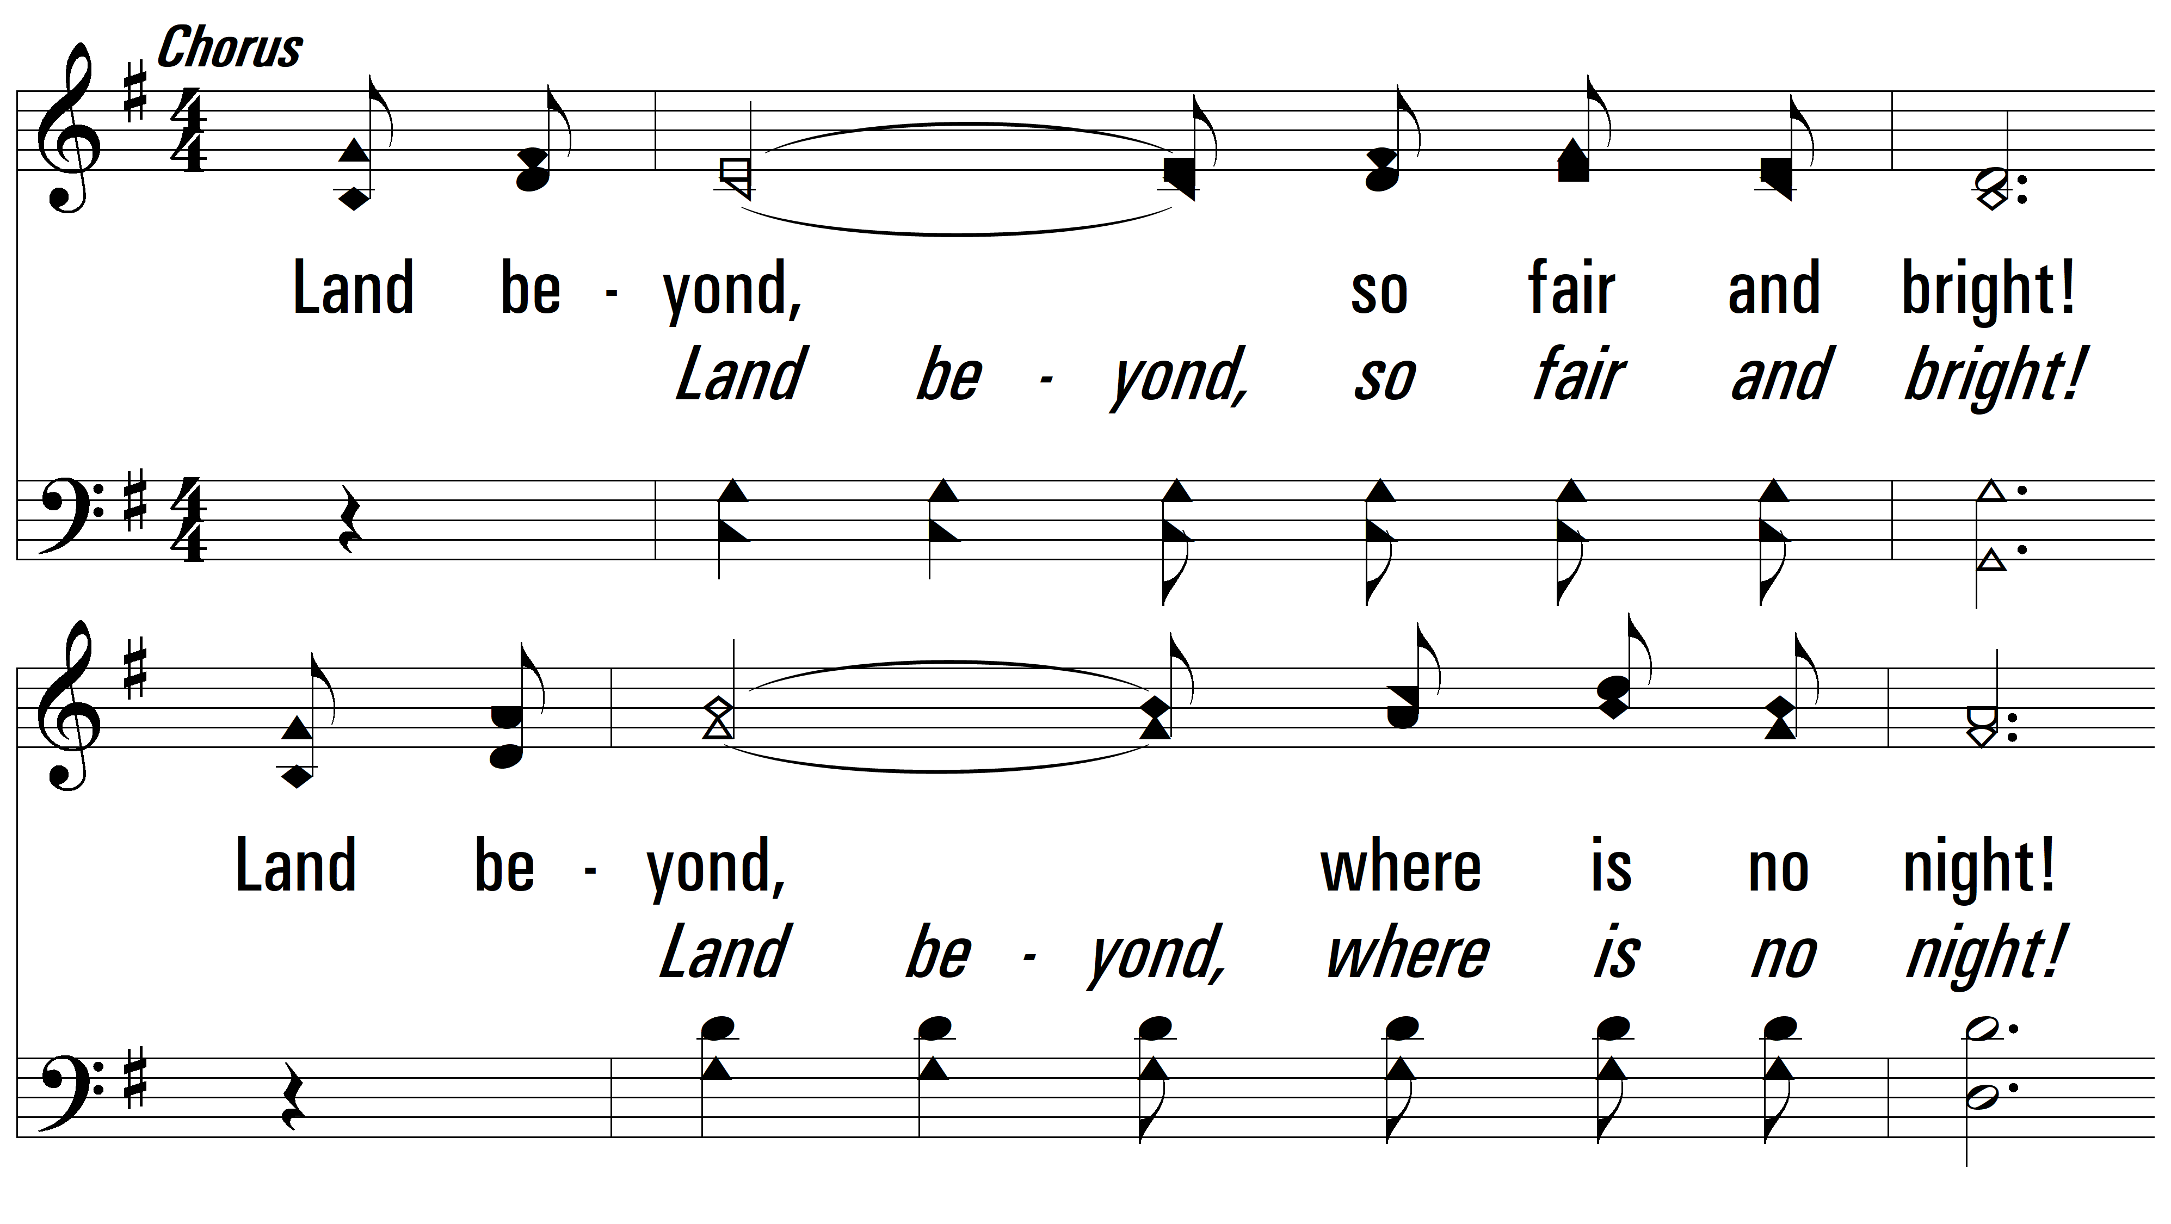
vs. 1

Slide 5
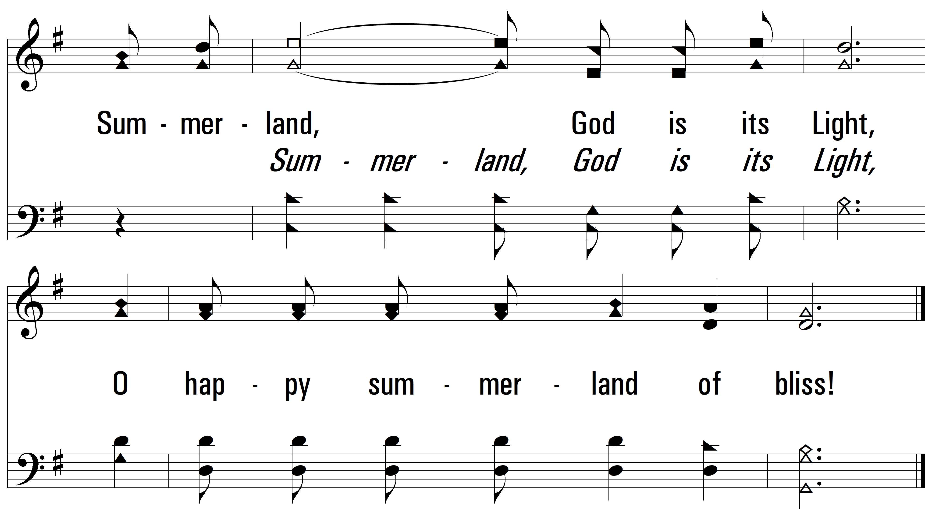
vs. 1

Slide 6
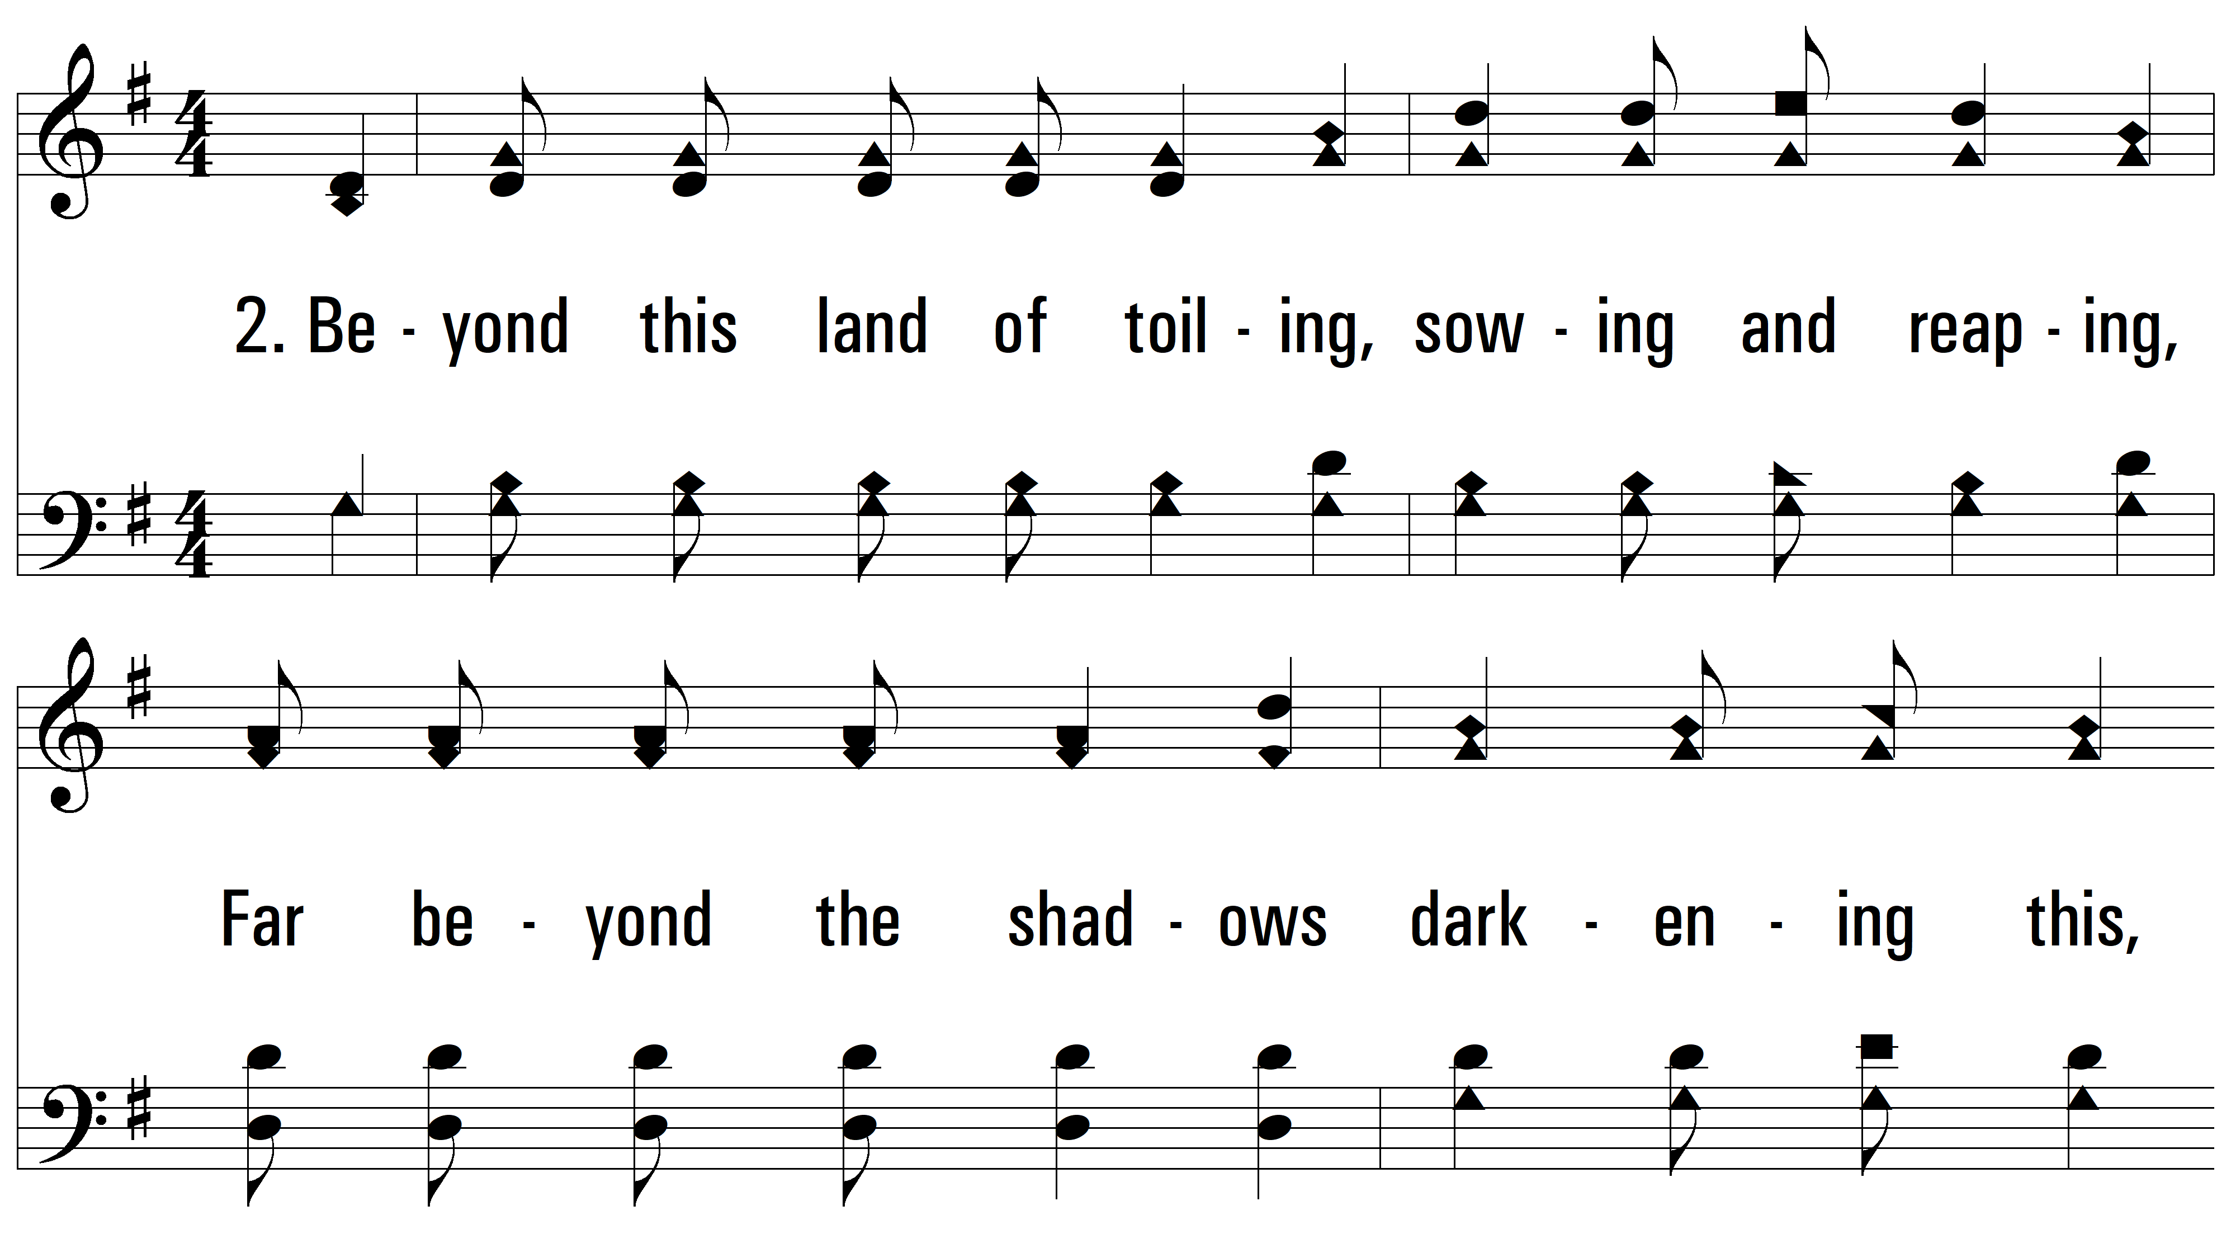
vs. 2 ~ Beyond This Land Of Parting

Slide 7
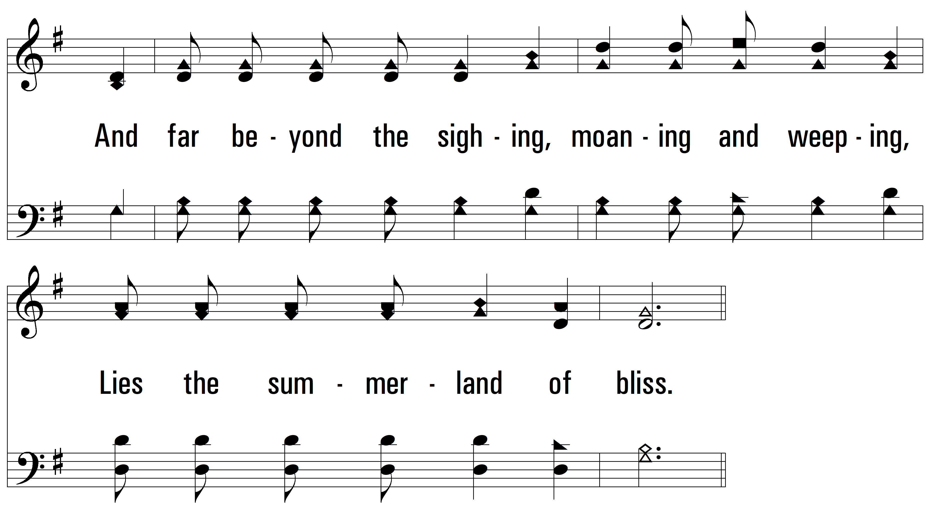
vs. 2

Slide 8
vs. 2

Slide 9
vs. 2

Slide 10
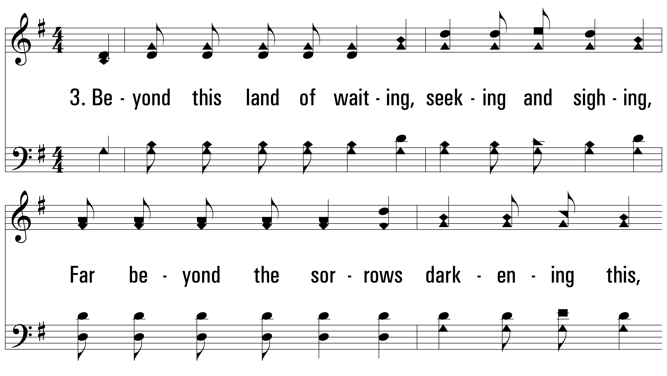
vs. 3 ~ Beyond This Land Of Parting

Slide 11
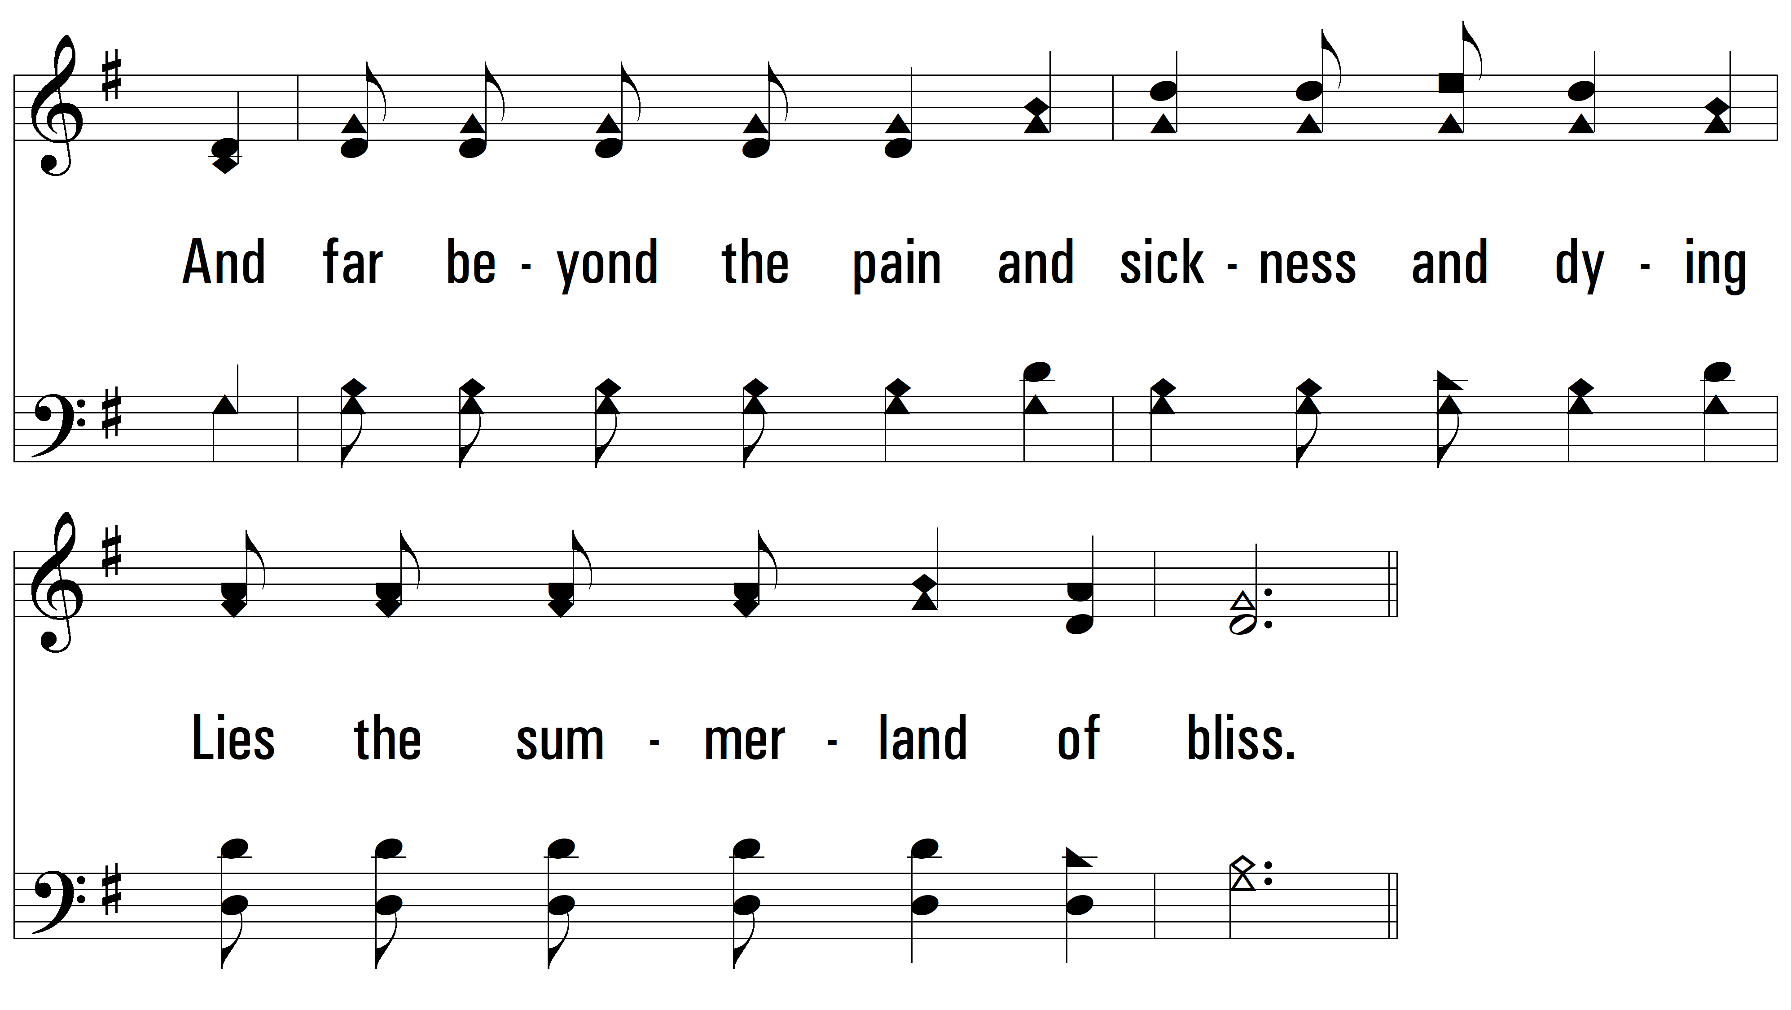
vs. 3

Slide 12
vs. 3

Slide 13
vs. 3
PDHymns.com
END

