Slide 1
Beulah Land
Words: | Edgar Page Stites (1875)
Music: | John R. Sweney (1875)
3/4
G/D - SOL
Verses: 4/Chorus
Lead - | SOL
Alto - | SOL
Tenor - | MI
Bass - | DO
PDHymns.com

Slide 2
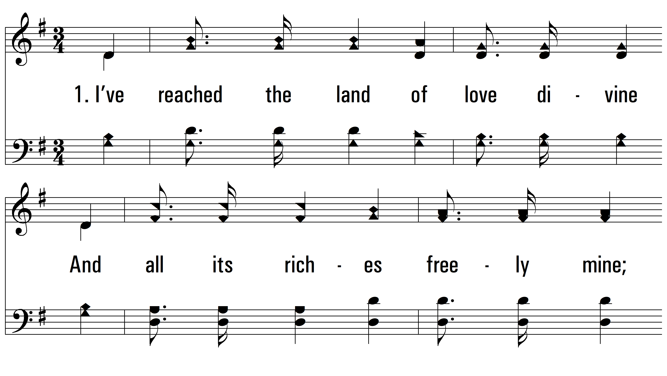
vs. 1 ~ Beulah Land

Slide 3
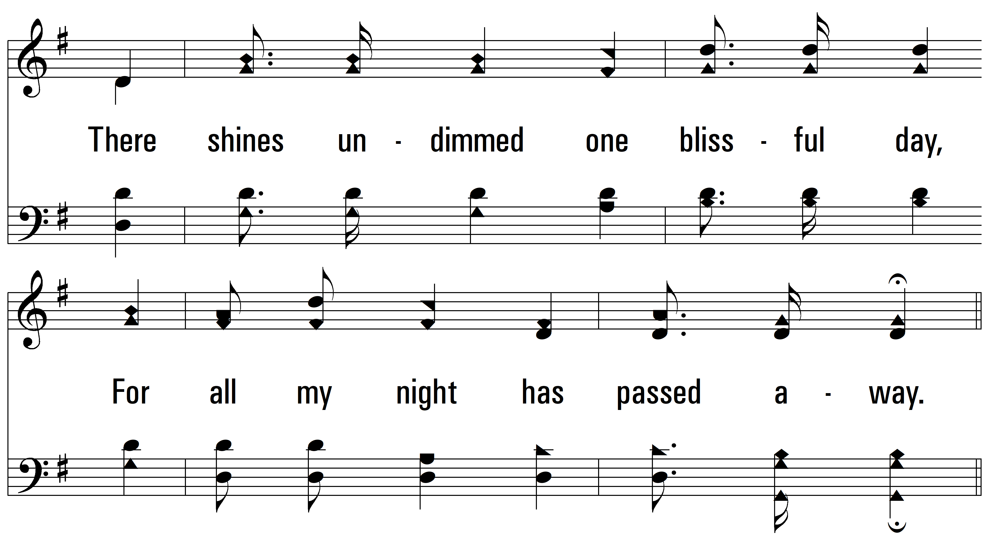
vs. 1

Slide 4
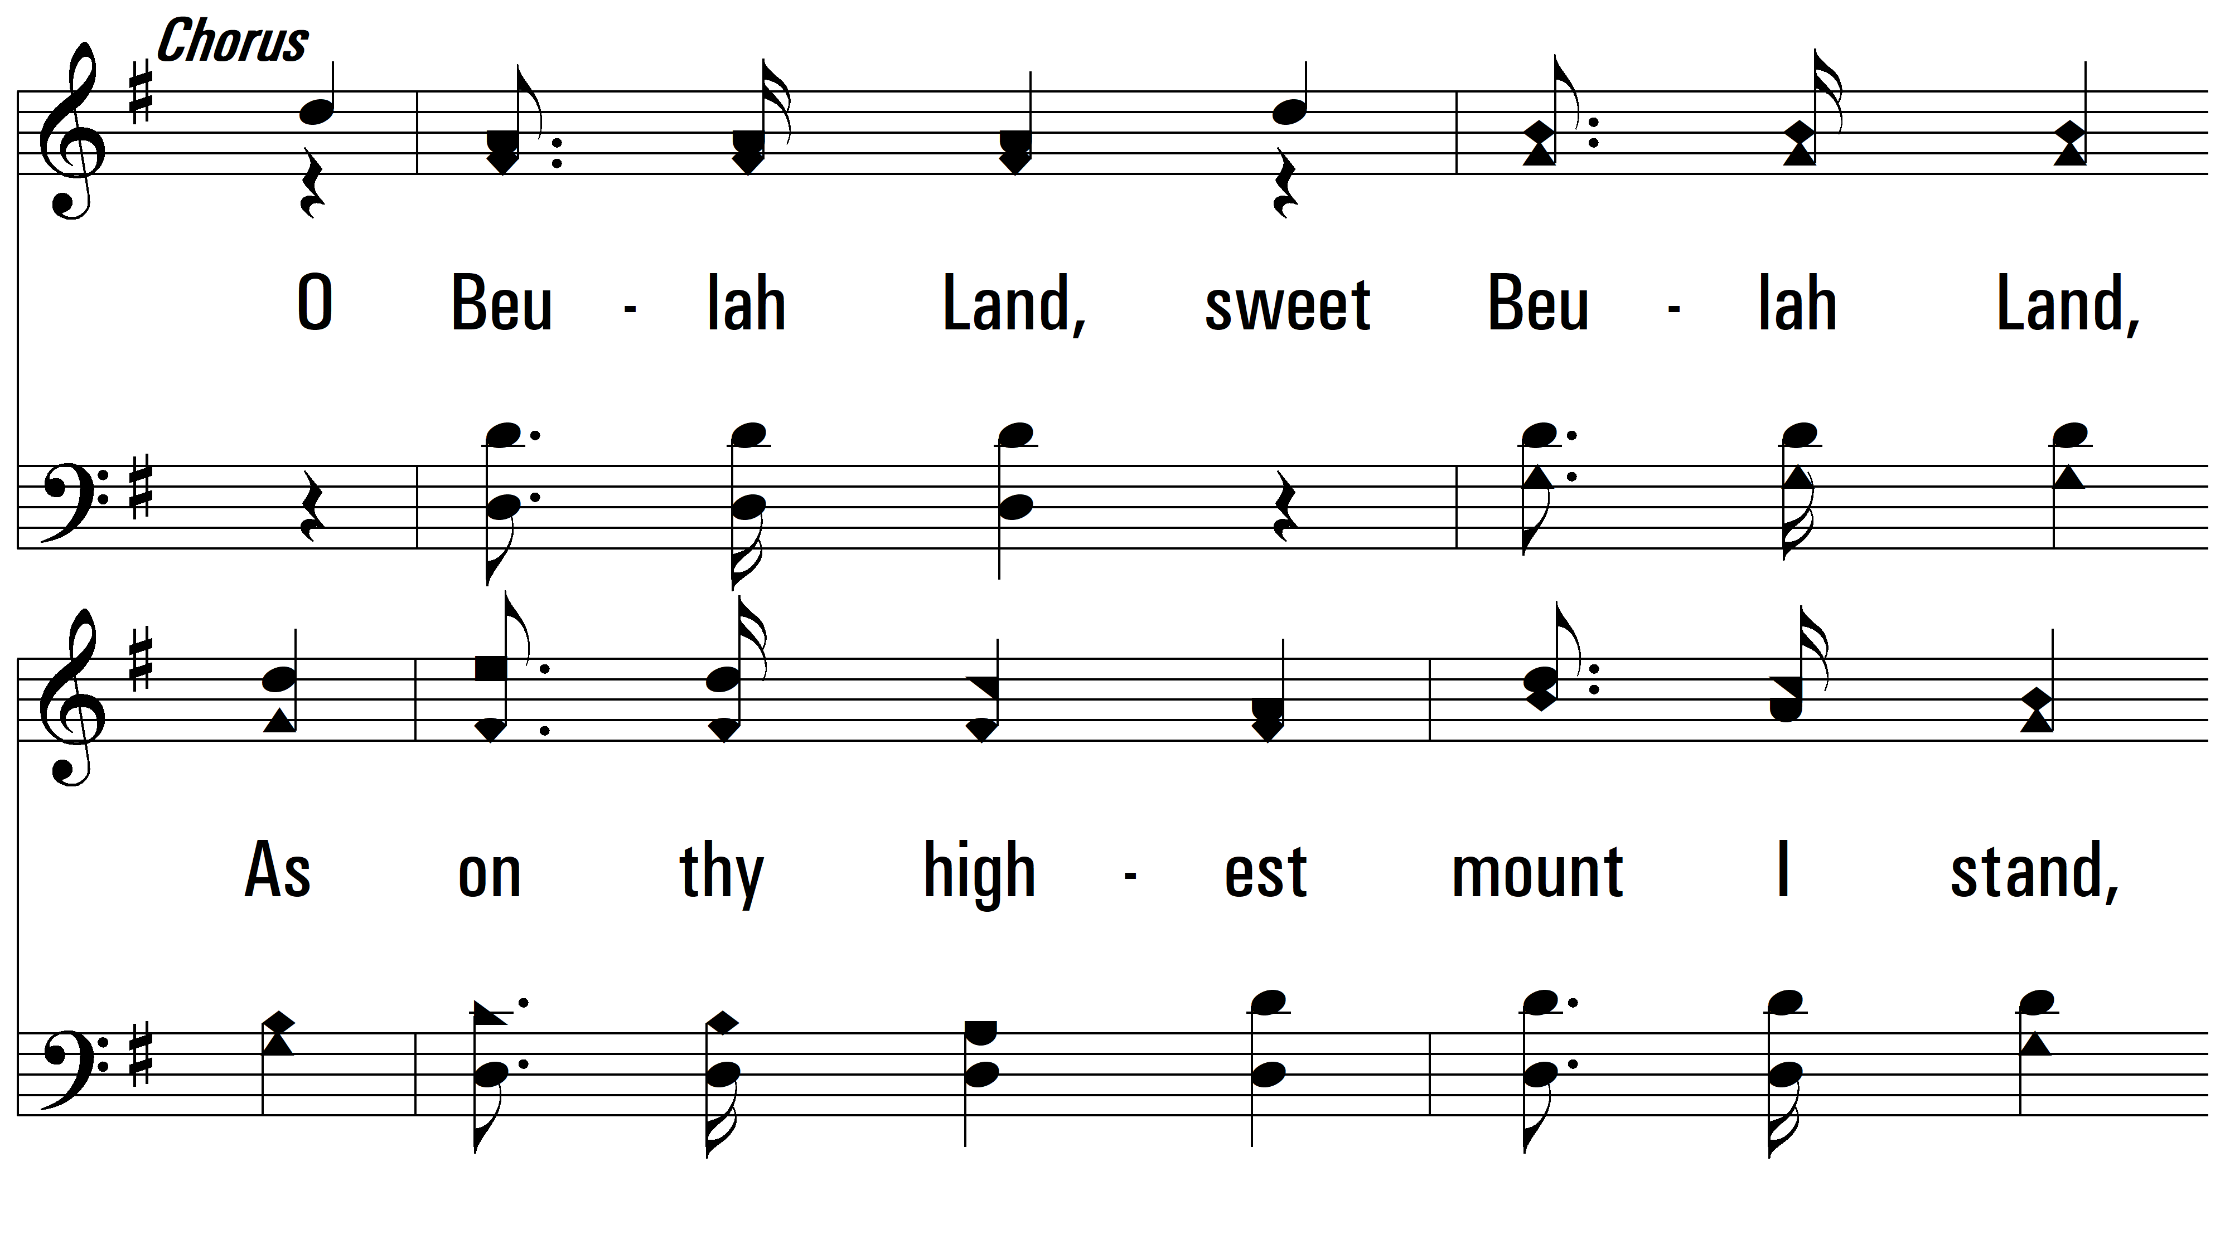
vs. 1

Slide 5
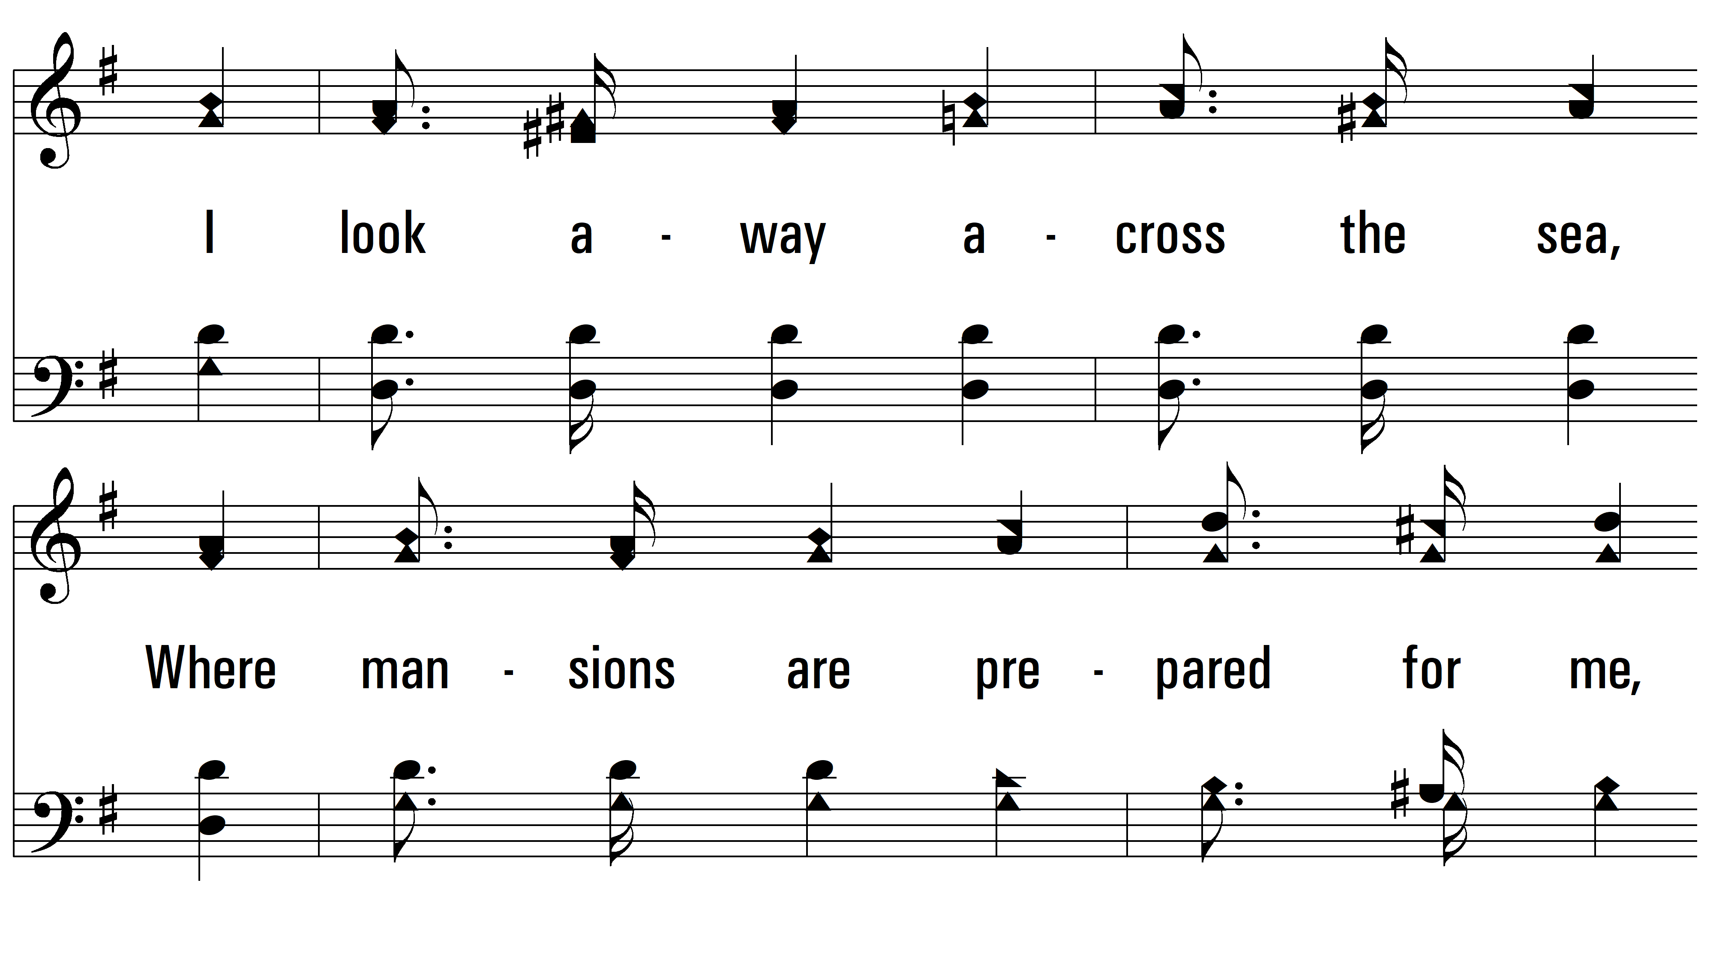
vs. 1

Slide 6
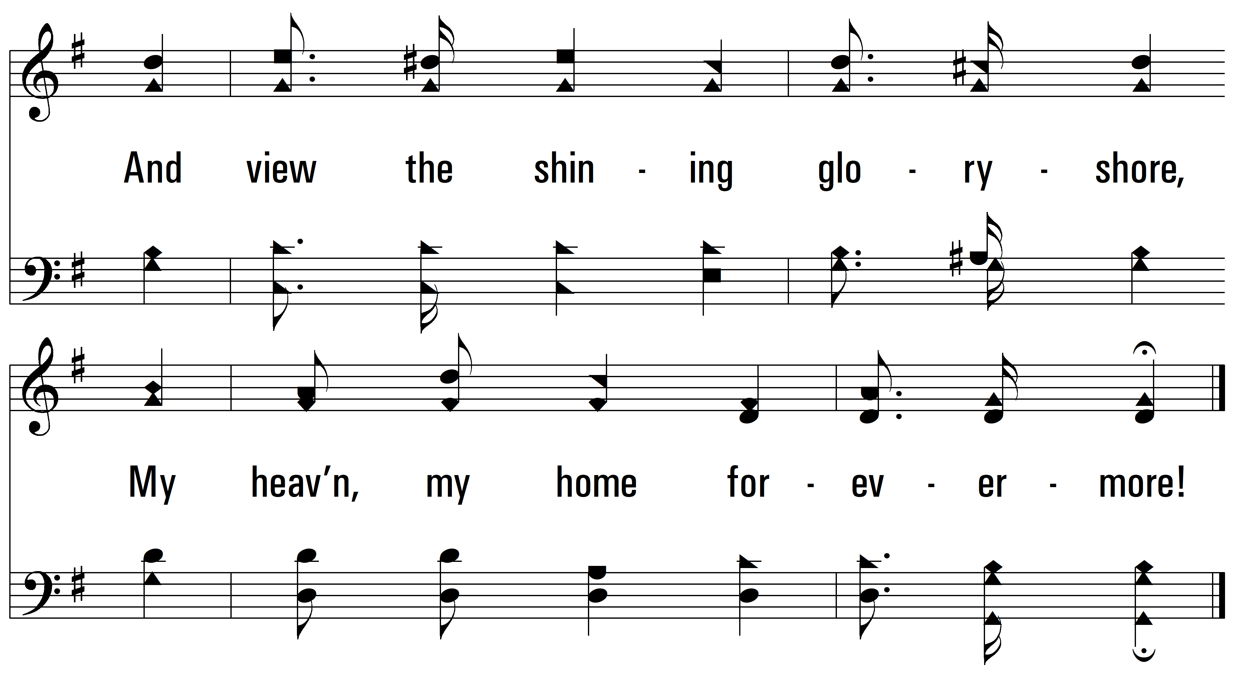
vs. 1

Slide 7
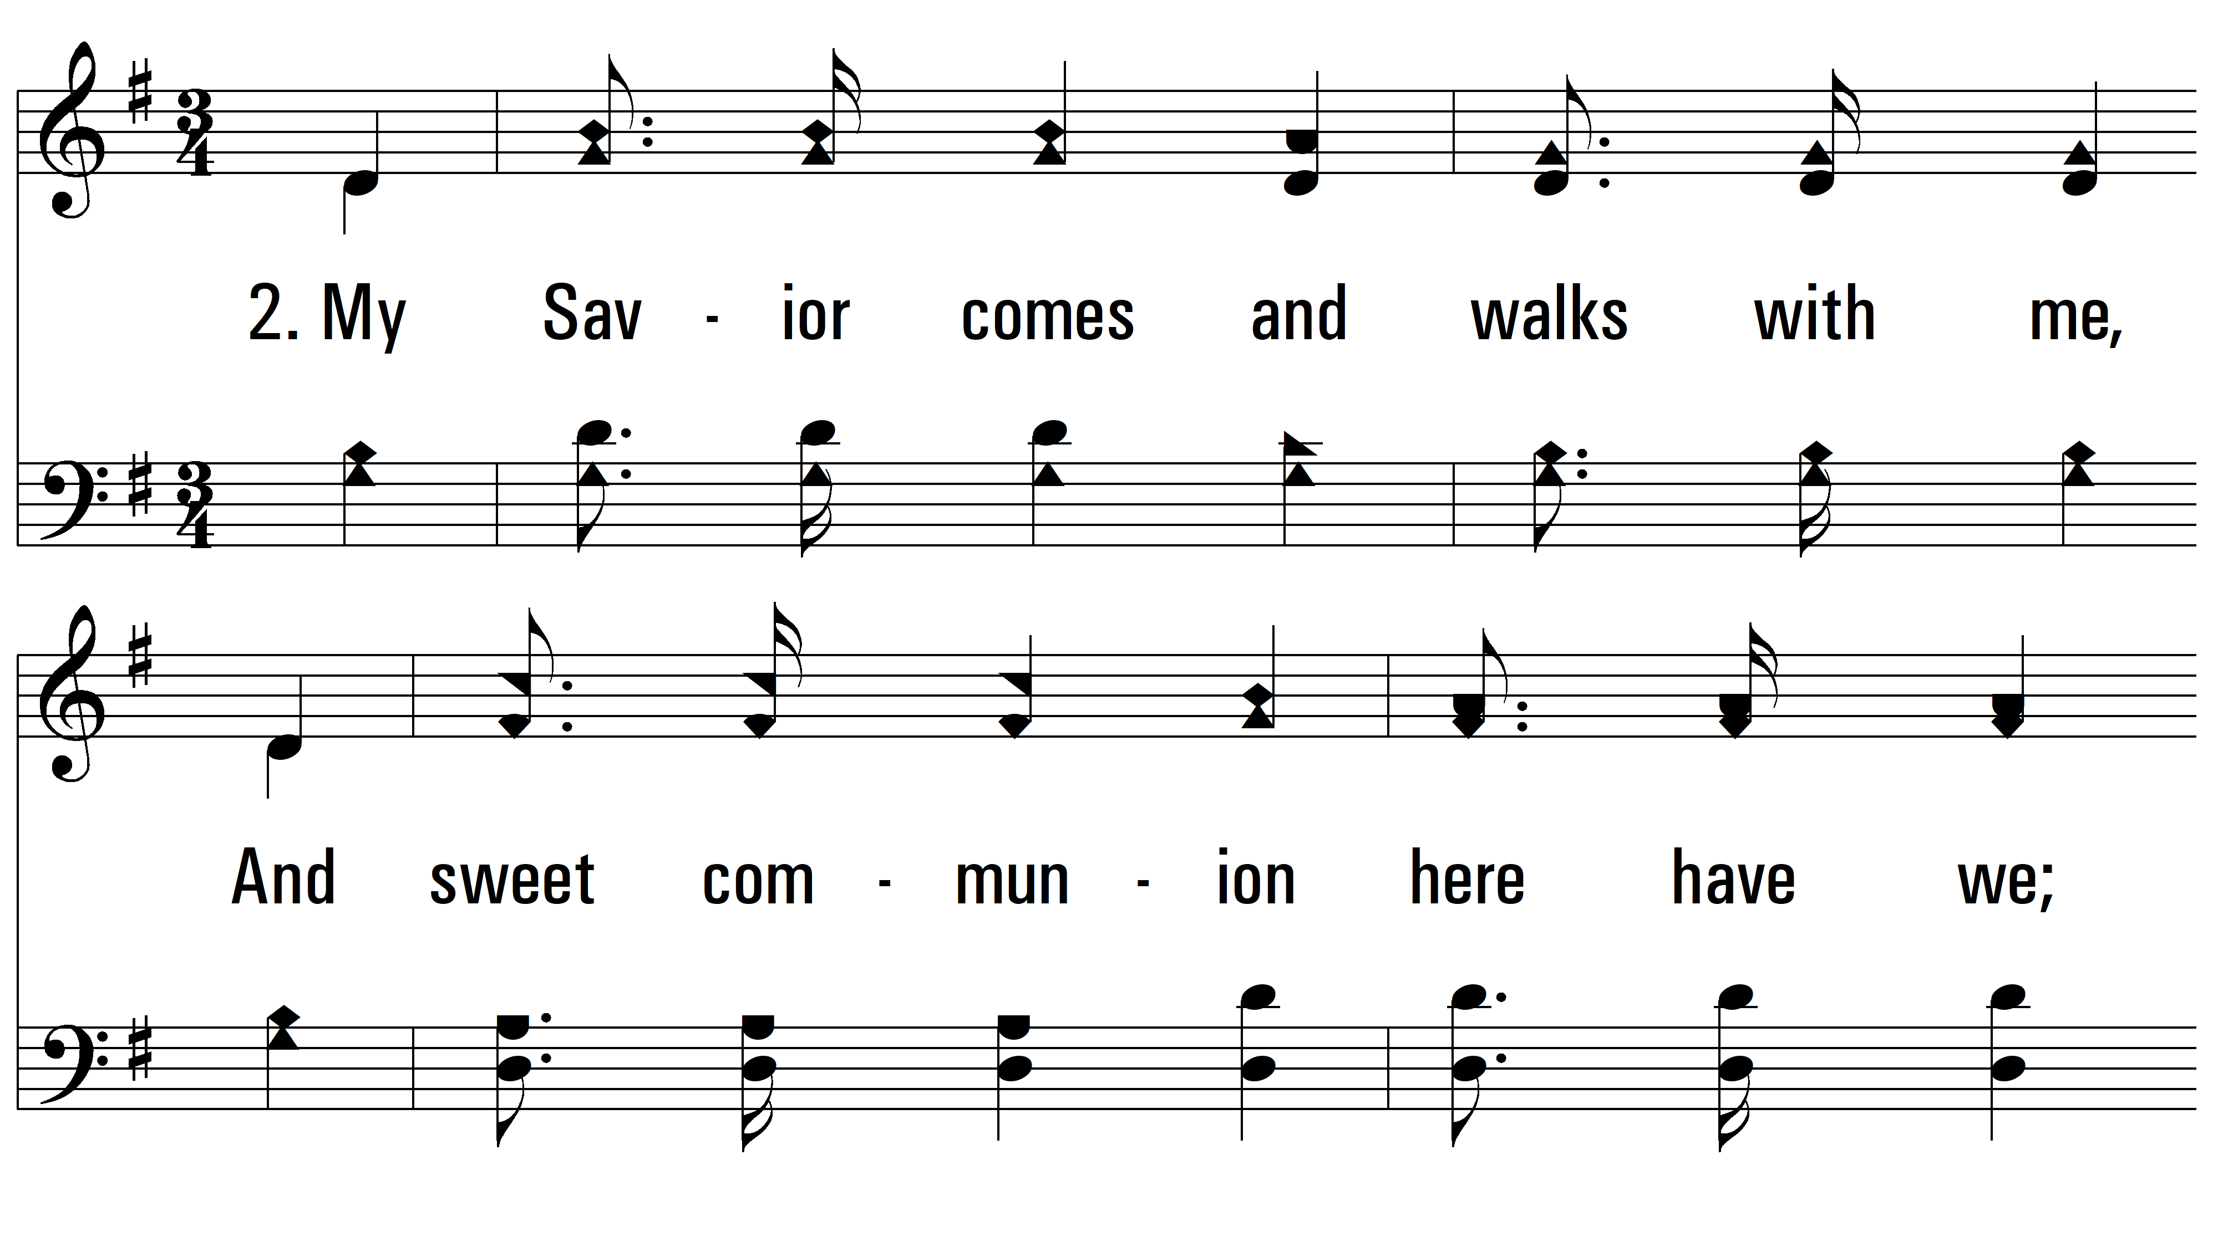
vs. 2 ~ Beulah Land

Slide 8
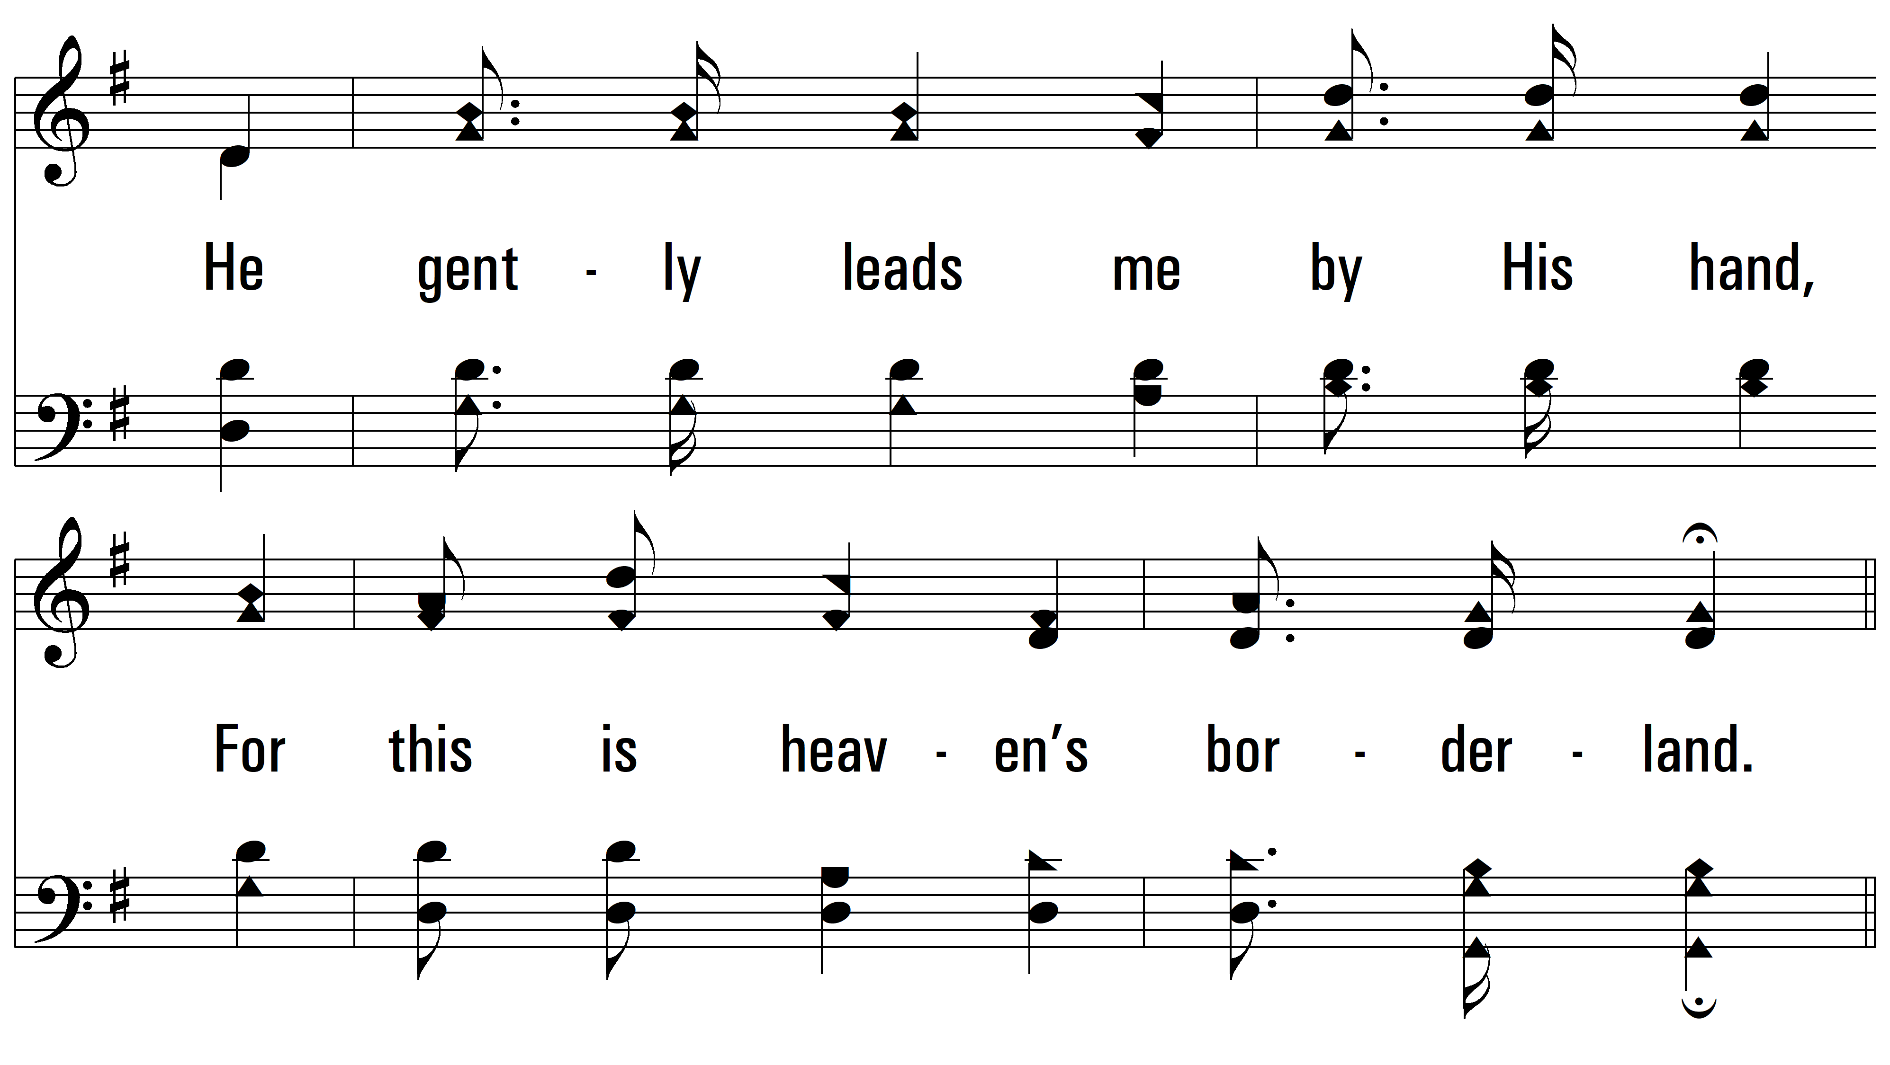
vs. 2

Slide 9
vs. 2

Slide 10
vs. 2

Slide 11
vs. 2

Slide 12
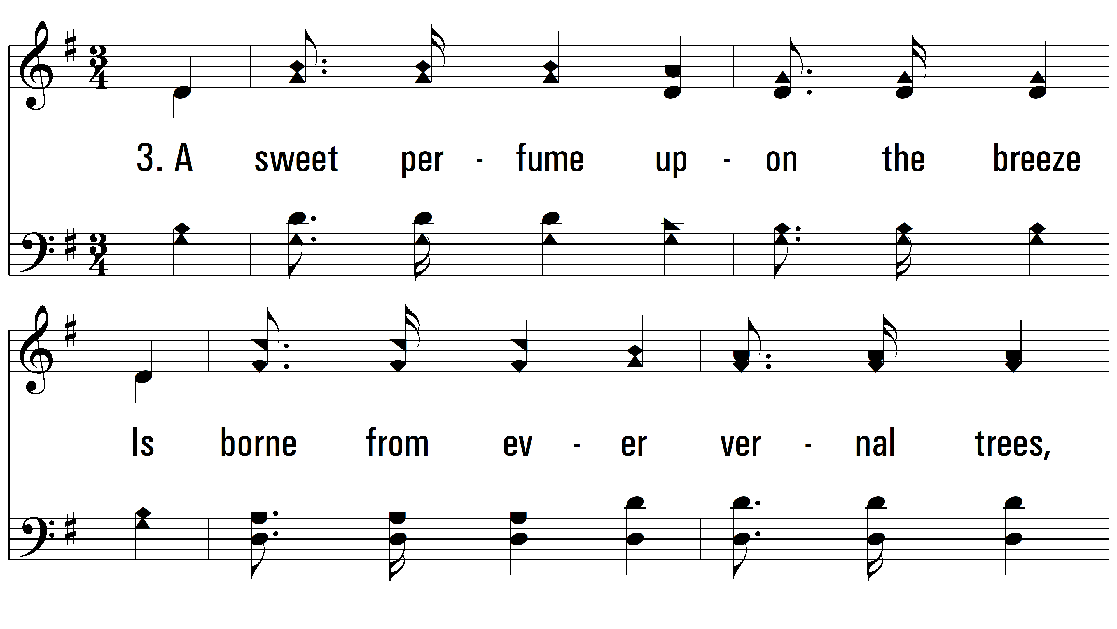
vs. 3 ~ Beulah Land

Slide 13
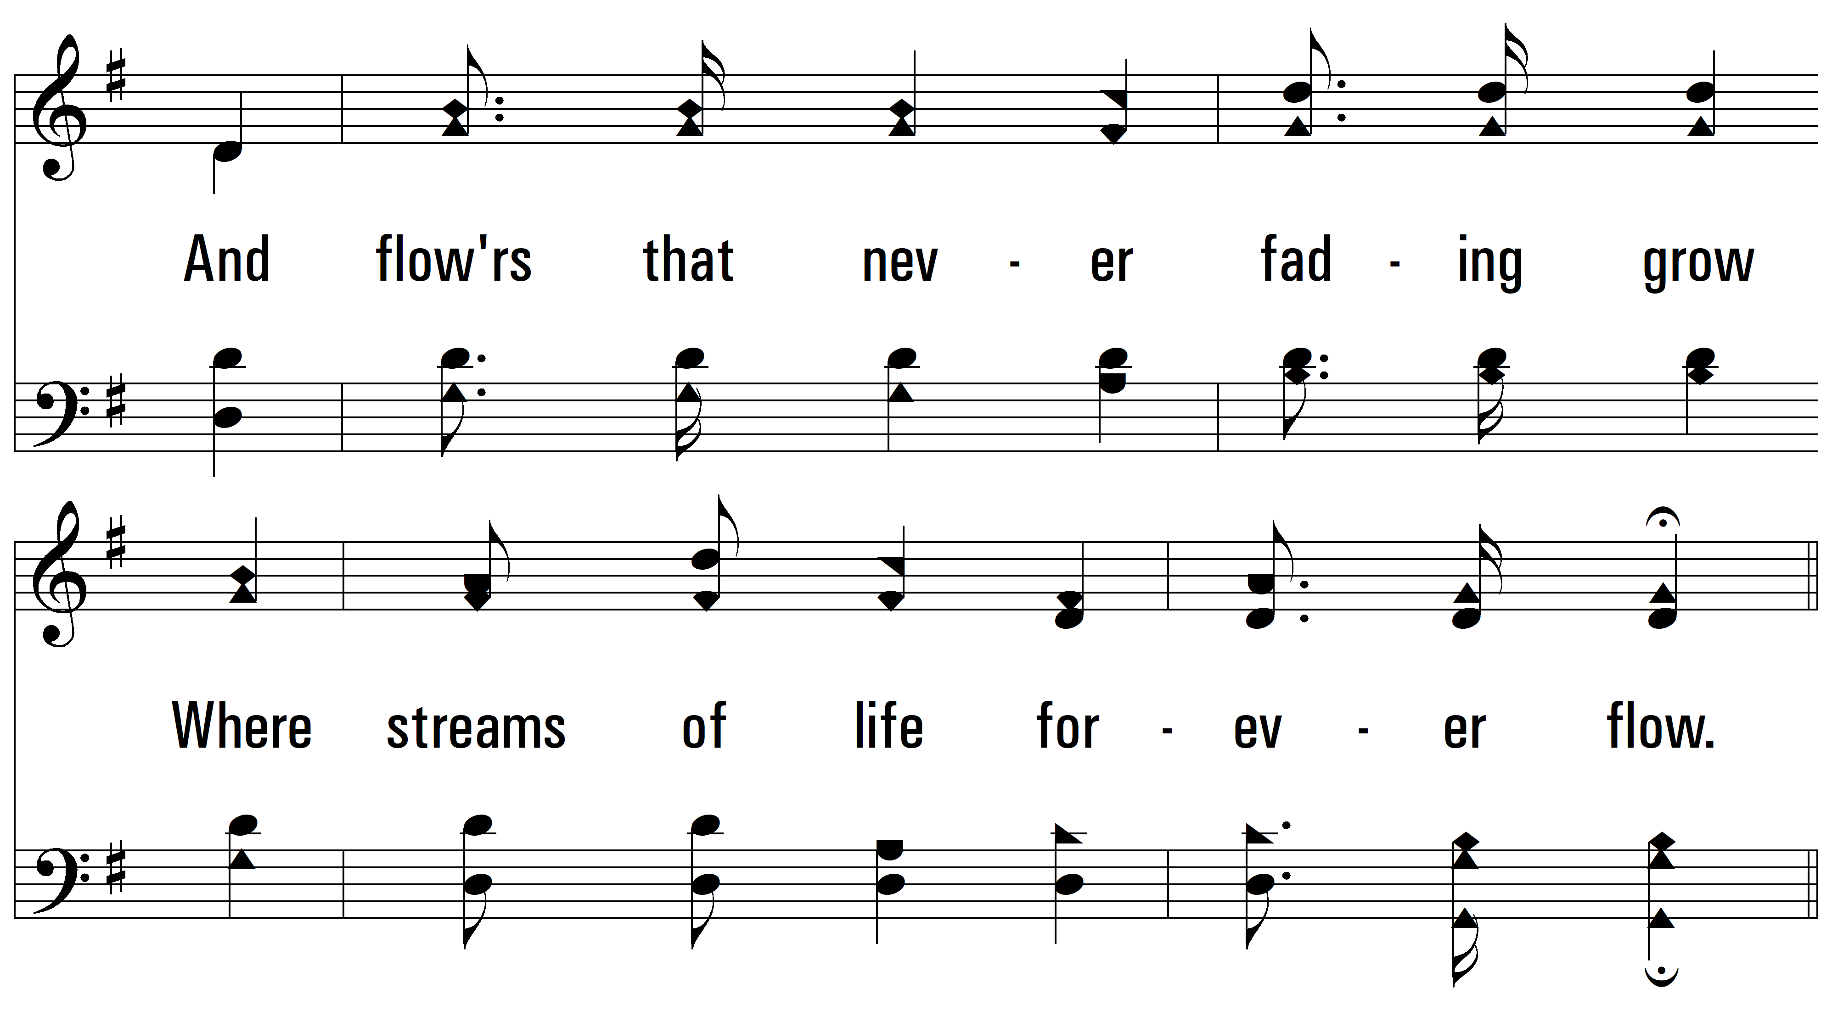
vs. 3

Slide 14
vs. 3

Slide 15
vs. 3

Slide 16
vs. 3

Slide 17
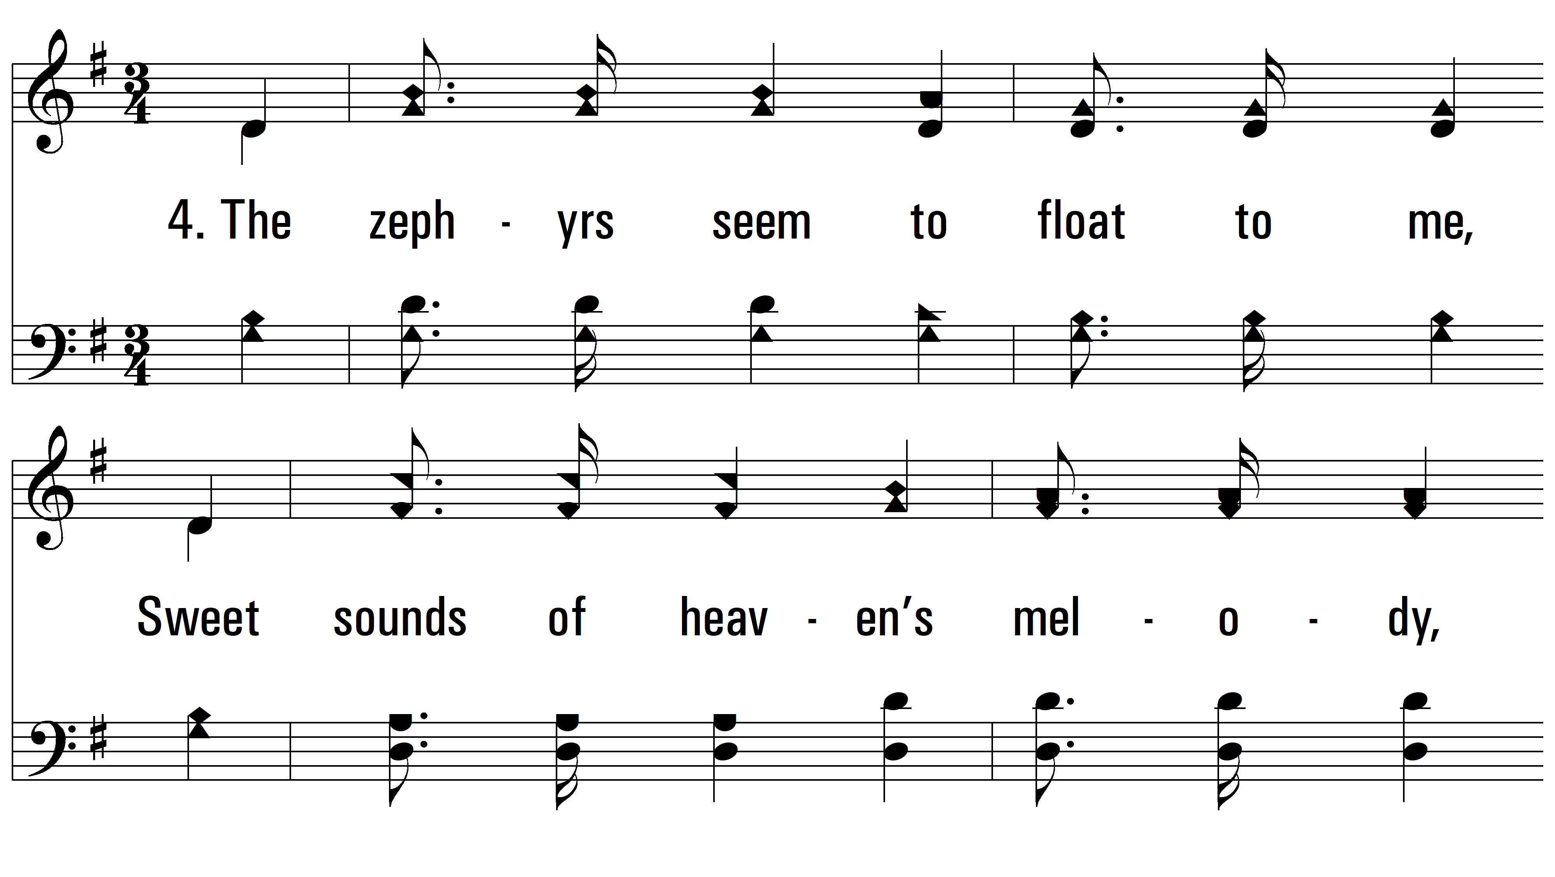
vs. 4 ~ Beulah Land

Slide 18
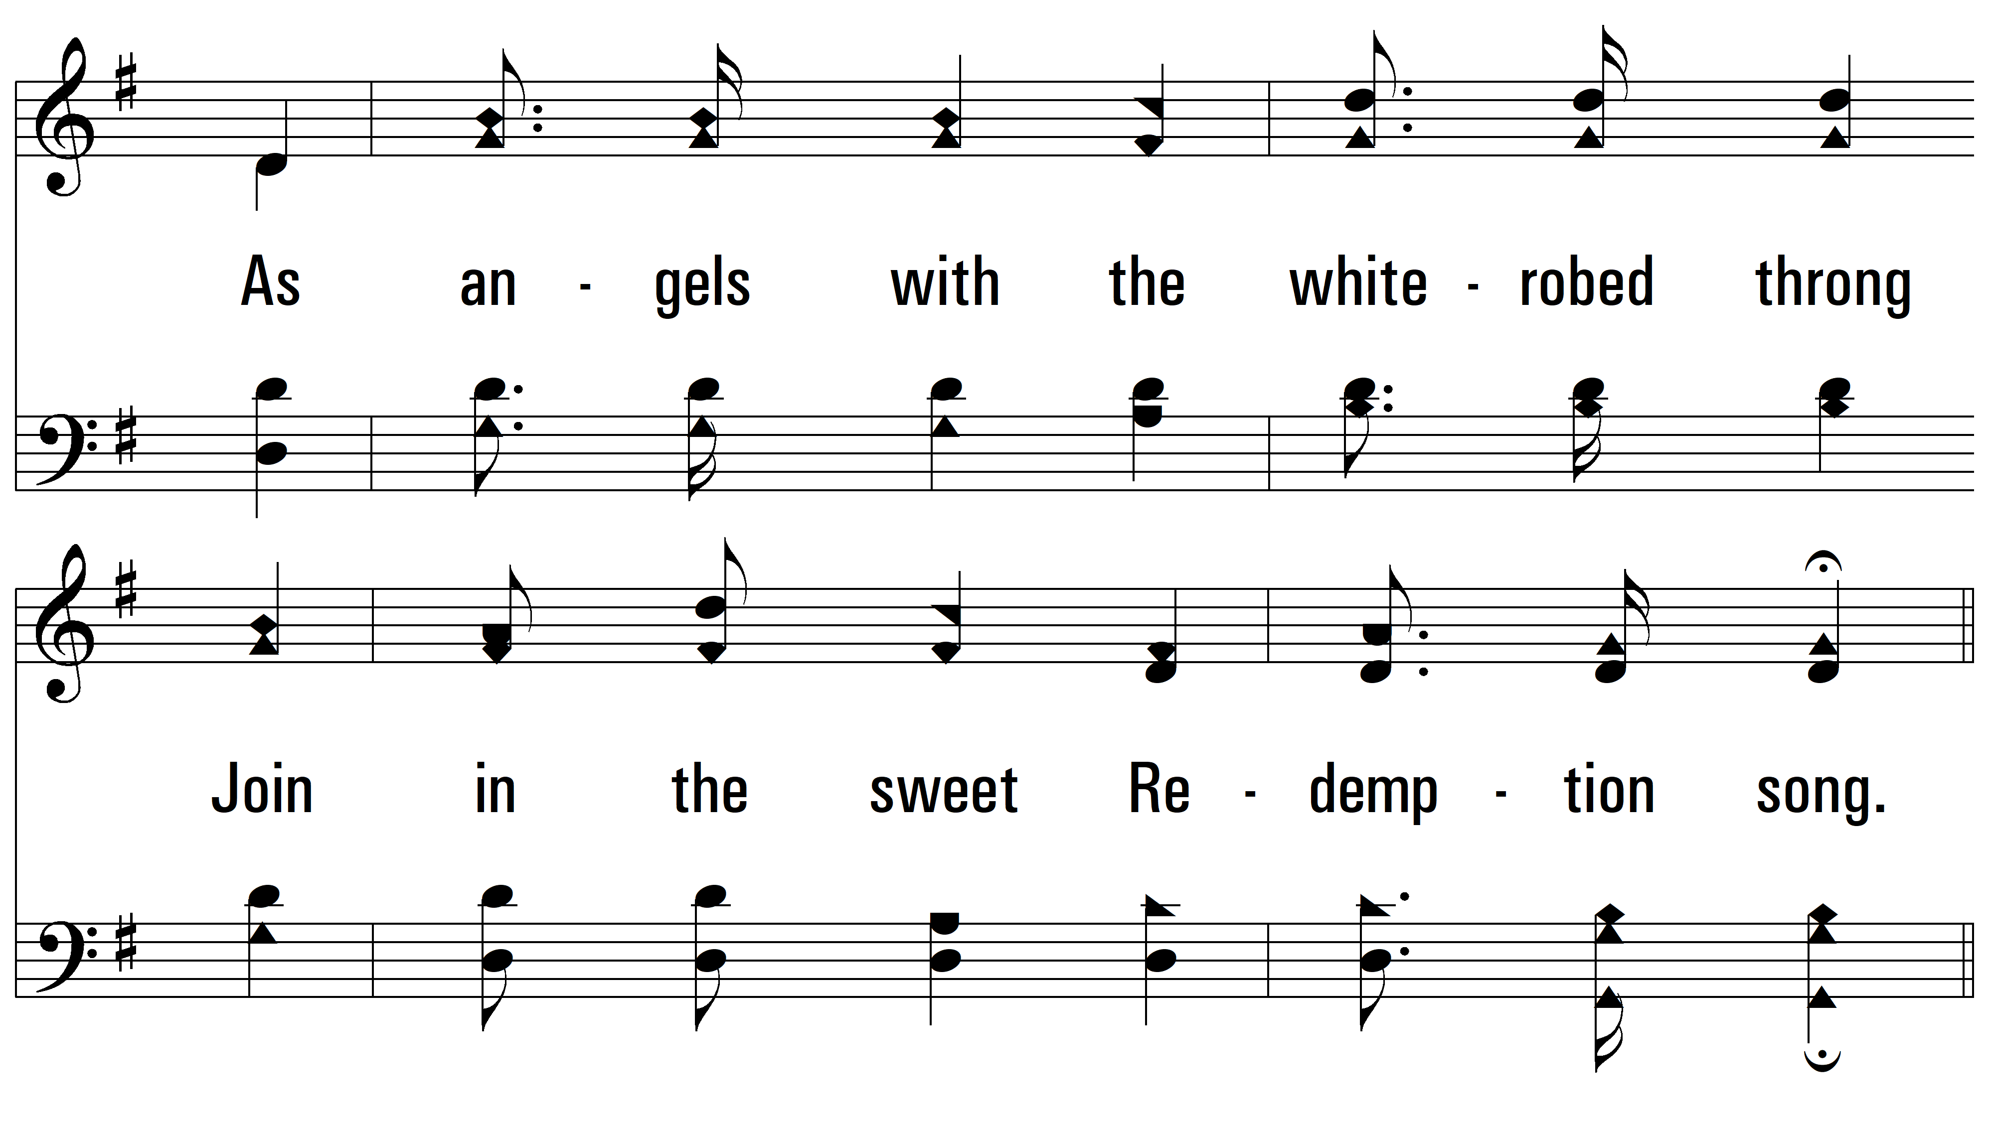
vs. 4

Slide 19
vs. 4

Slide 20
vs. 4

Slide 21
vs. 4
PDHymns.com
END

