Slide 1
Beneath The Cross Of Jesus
ST. CHRISTOPHER
7.6.8.6.8.6.8.6
Words: | Elizabeth C. Clephane (c. 1869)
Music: | Fredrick C. Maker (1881)
4/4
E^{b}/B^{b} - SOL
Verses: 3
Lead - | SOL
Alto - | MI
Tenor - | SOL
Bass - | DO
PDHymns.com

Slide 2
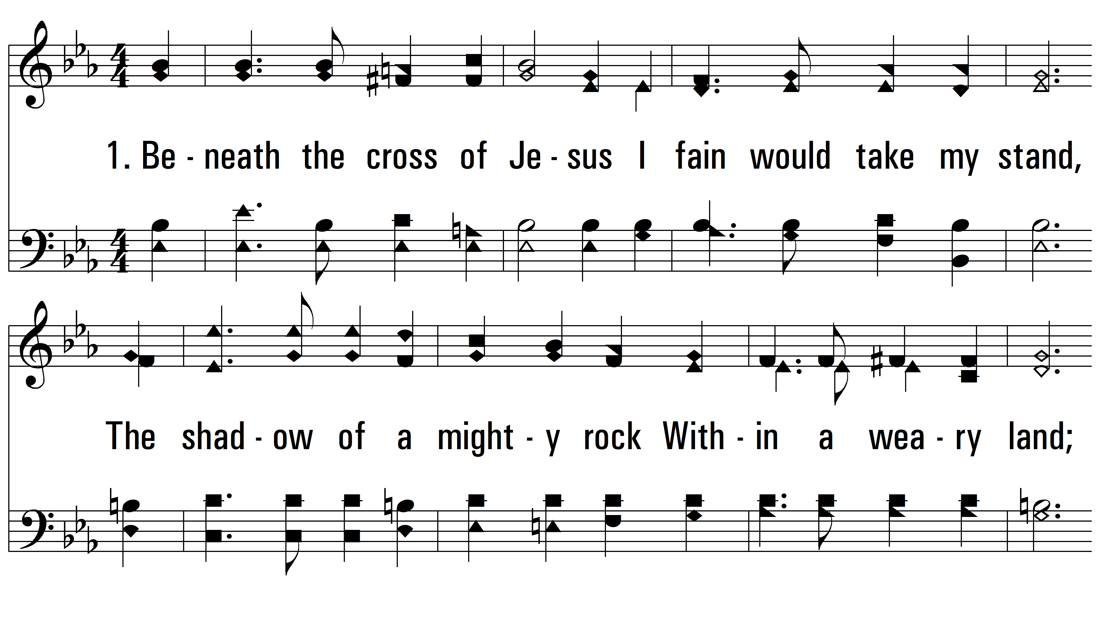
vs. 1 ~ Beneath The Cross Of Jesus

Slide 3
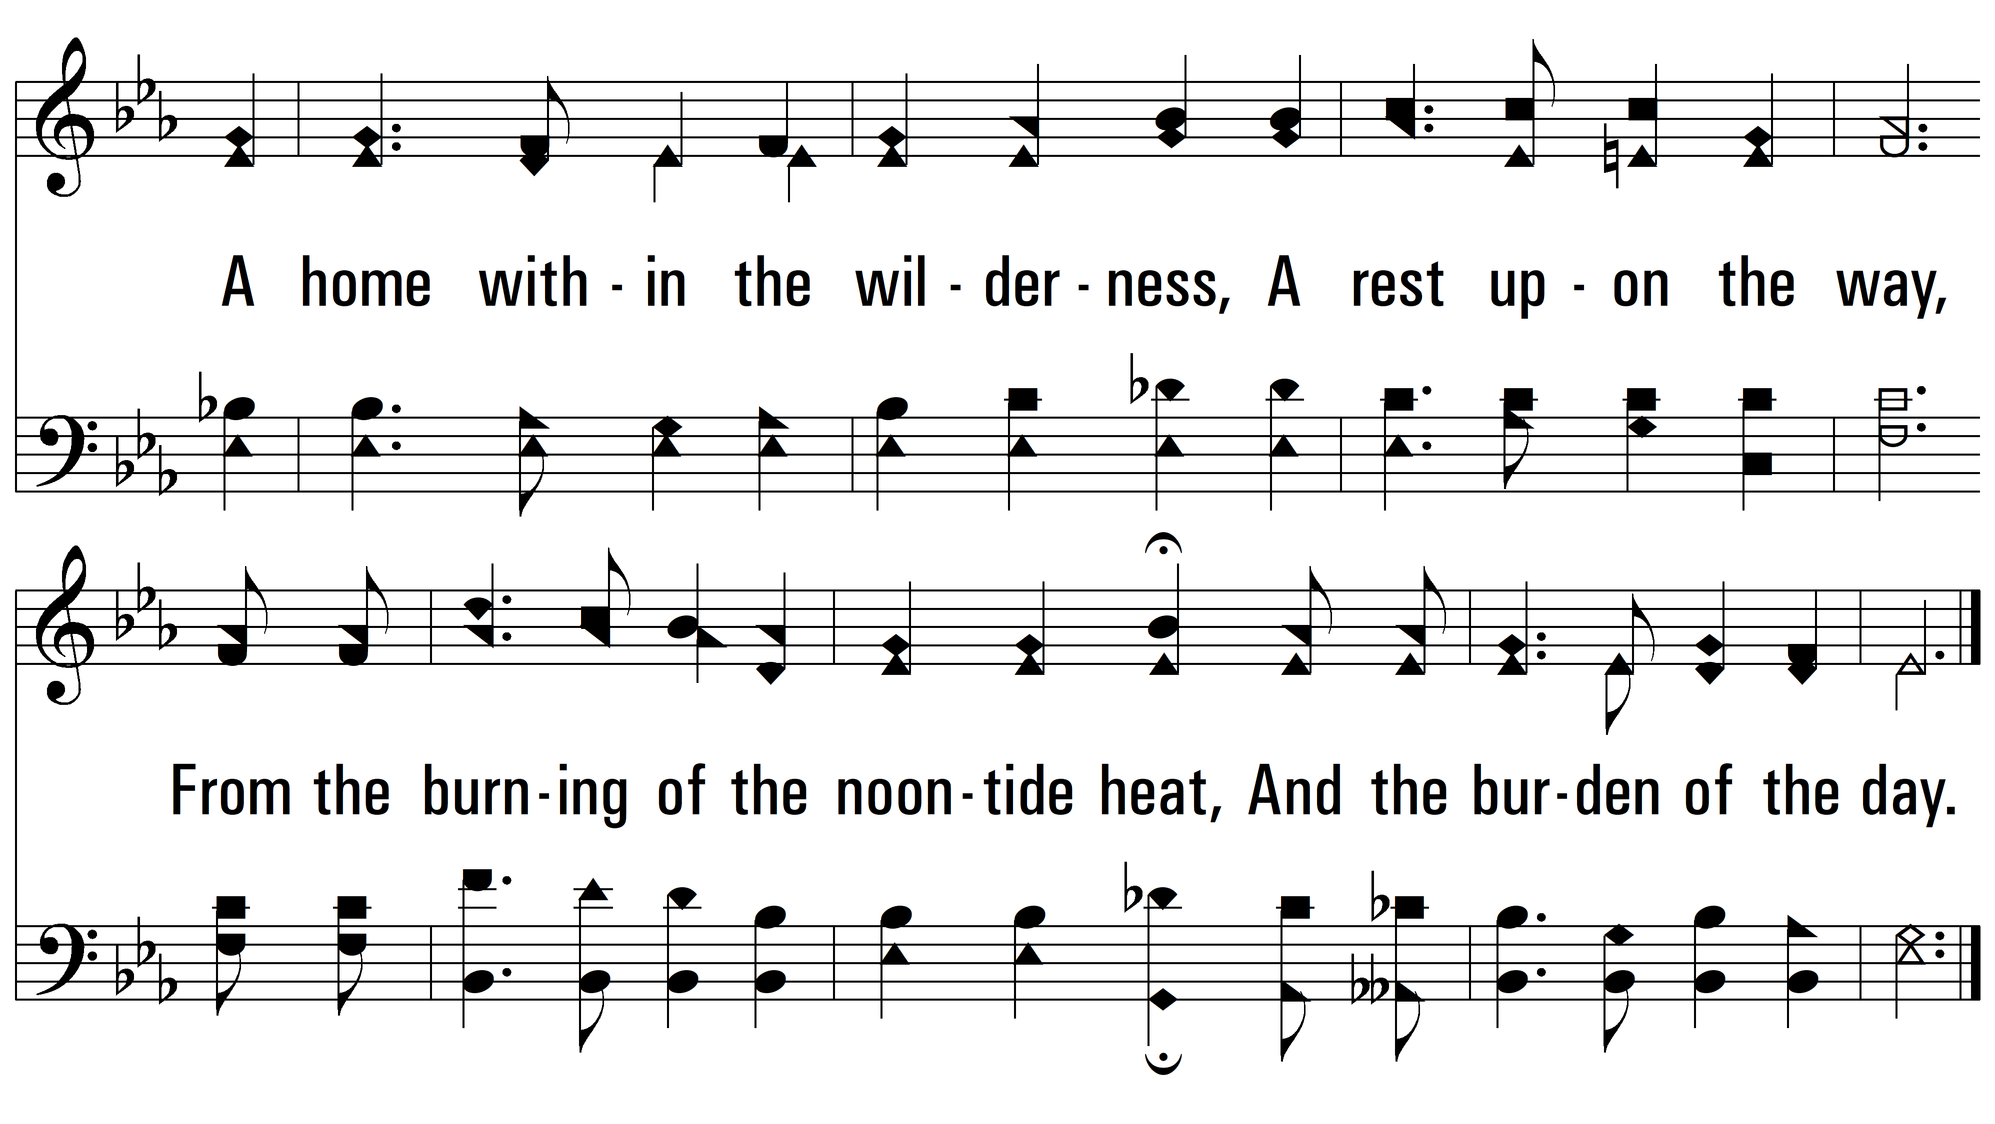
vs. 1

Slide 4
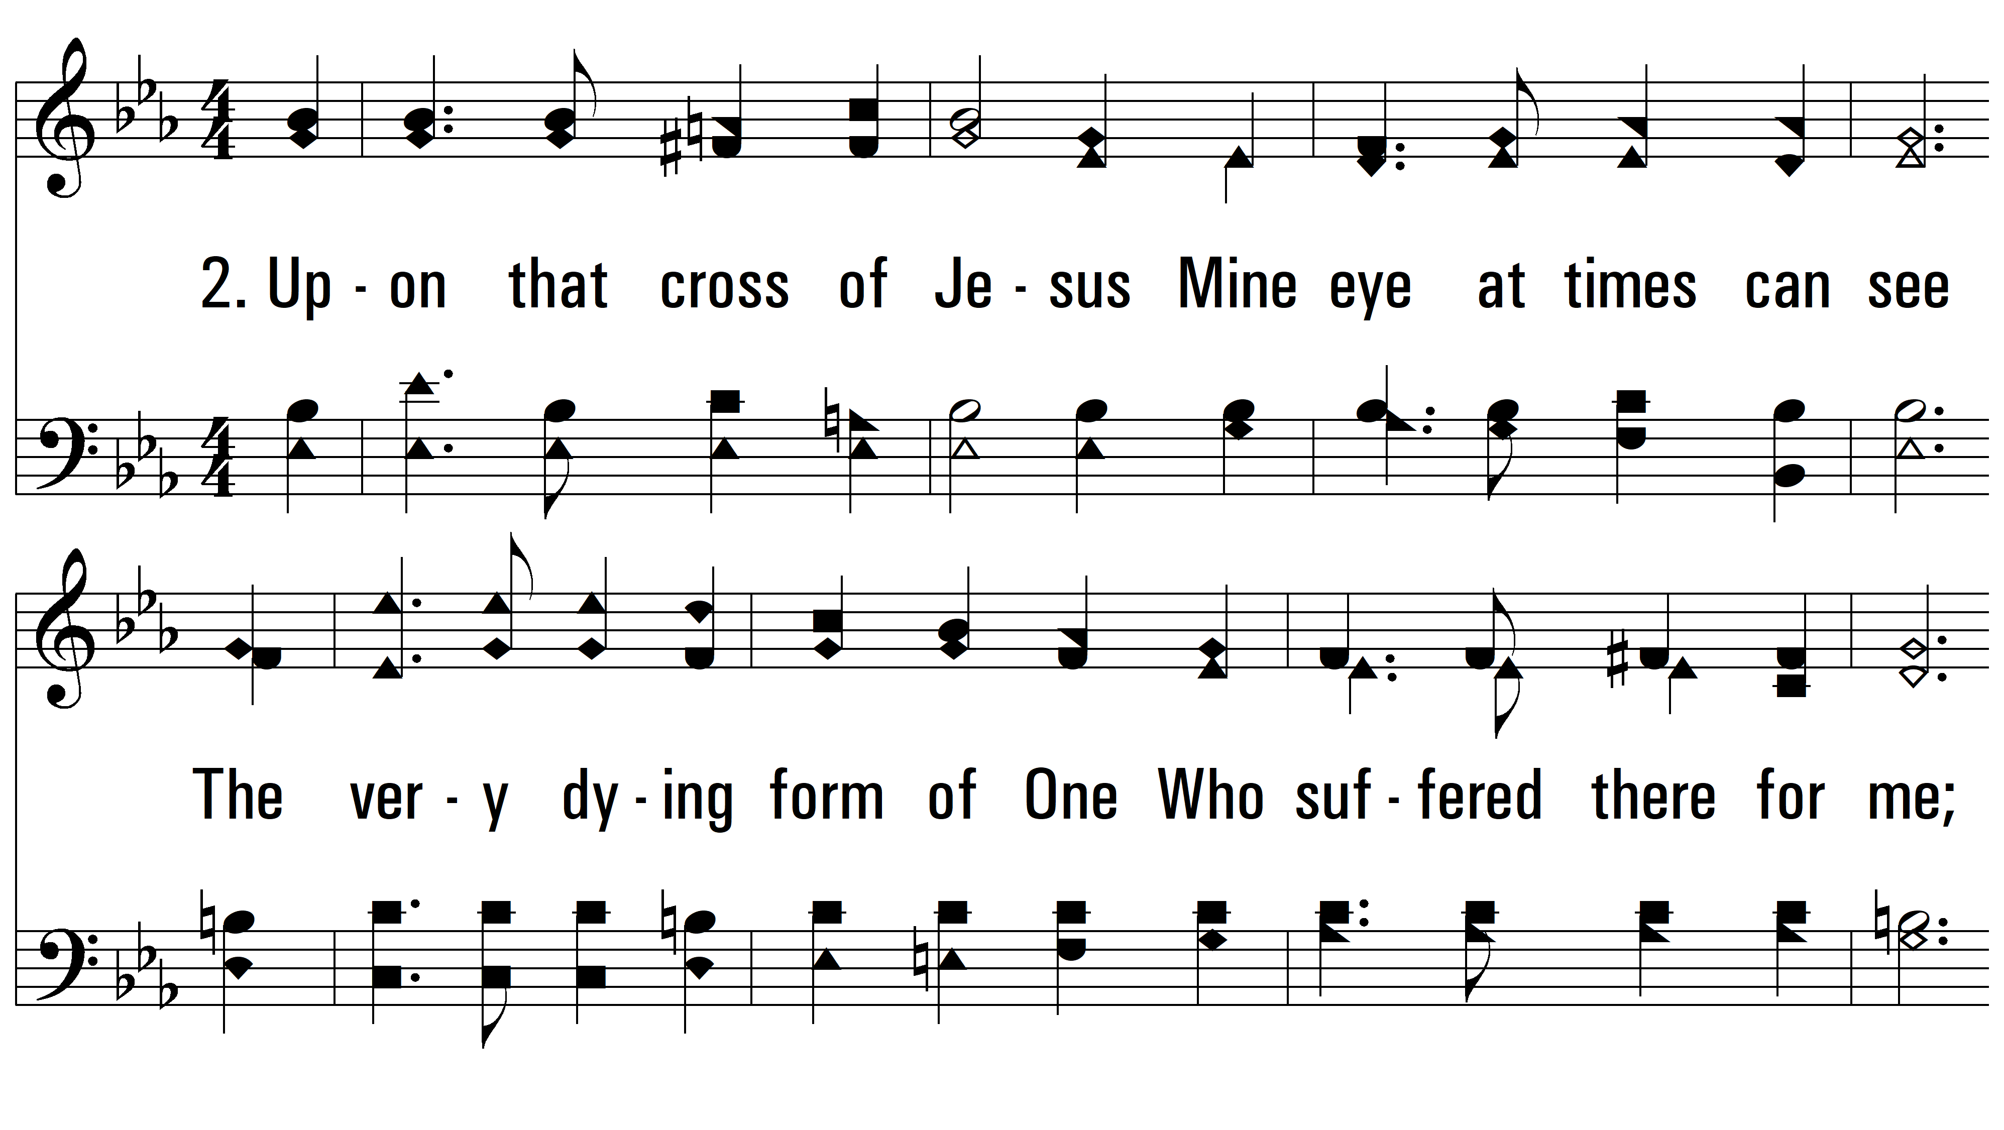
vs. 2 ~ Beneath The Cross Of Jesus

Slide 5
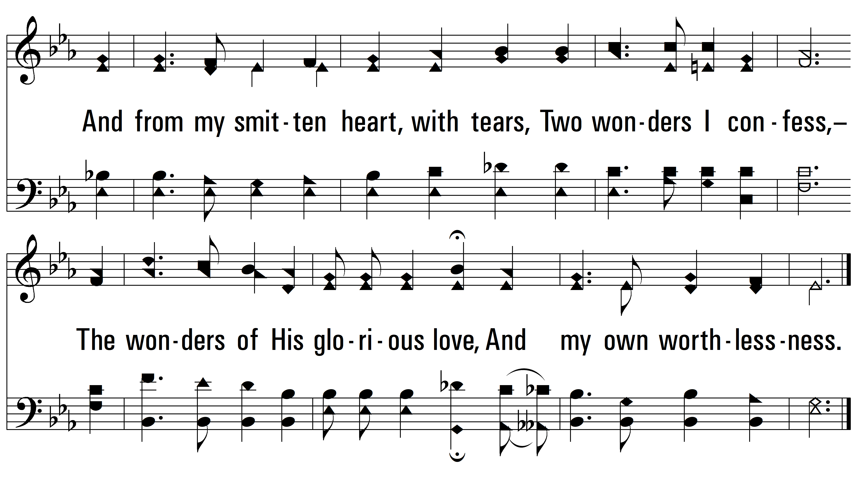
vs. 2

Slide 6
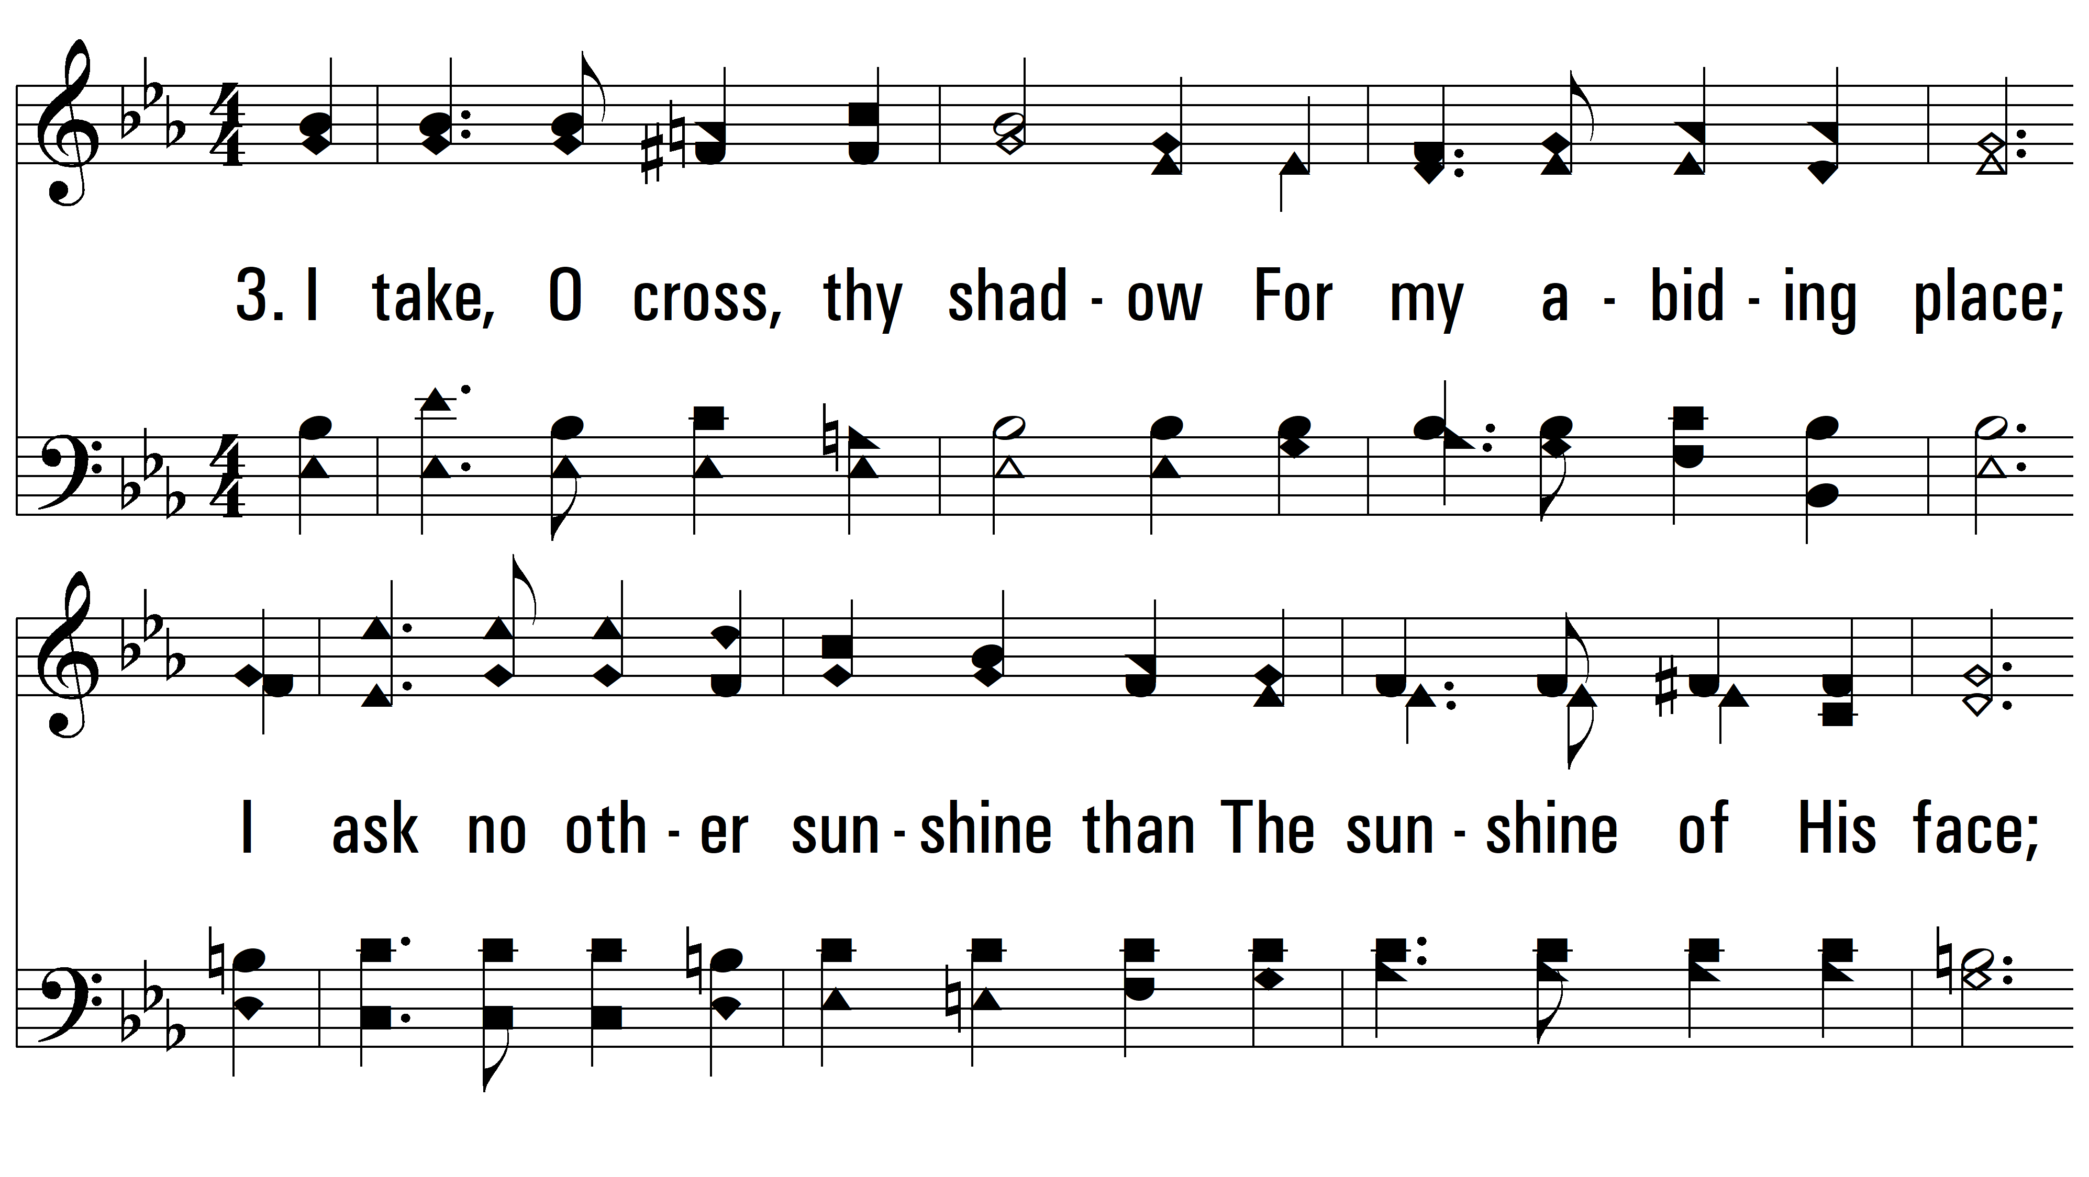
vs. 3 ~ Beneath The Cross Of Jesus

Slide 7
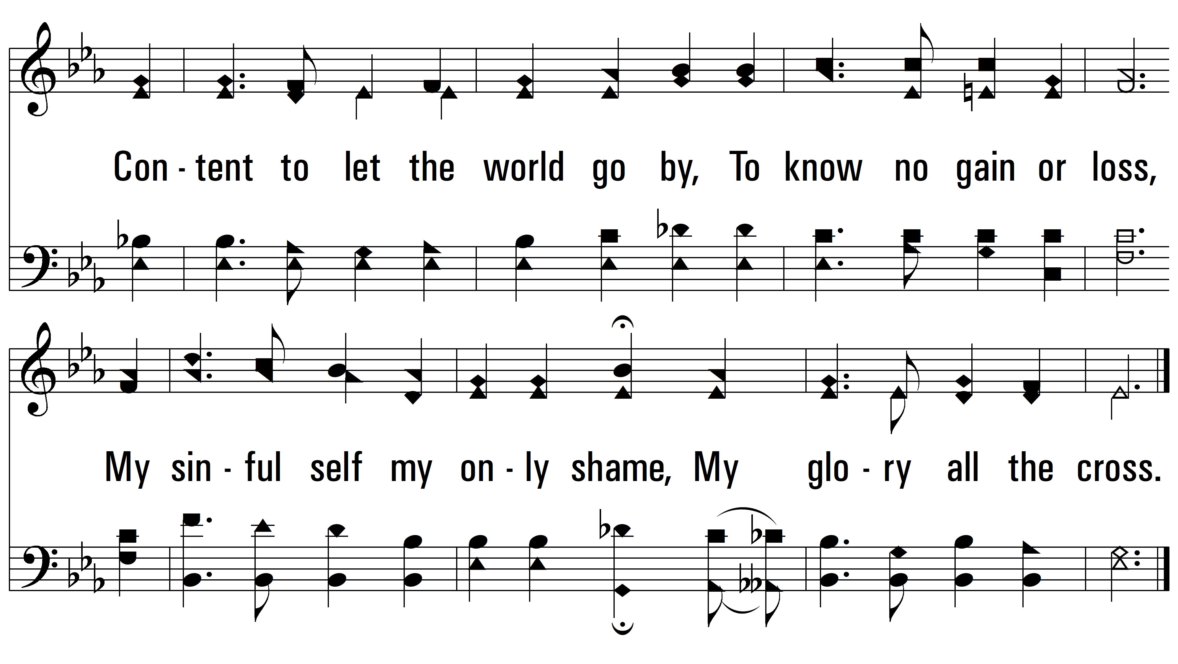
vs. 3
PDHymns.com
END

