Slide 1
Begin, My Tongue, Some Heavenly Theme
MANOAH
CM
Words: | Isaac Watts (1707)
Music: | Henry Wellington Greatorex (1851)
3/4
G/G - DO
Verses: 4
Lead - | DO
Alto - | SOL
Tenor - | MI
Bass - | DO
PDHymns.com

Slide 2
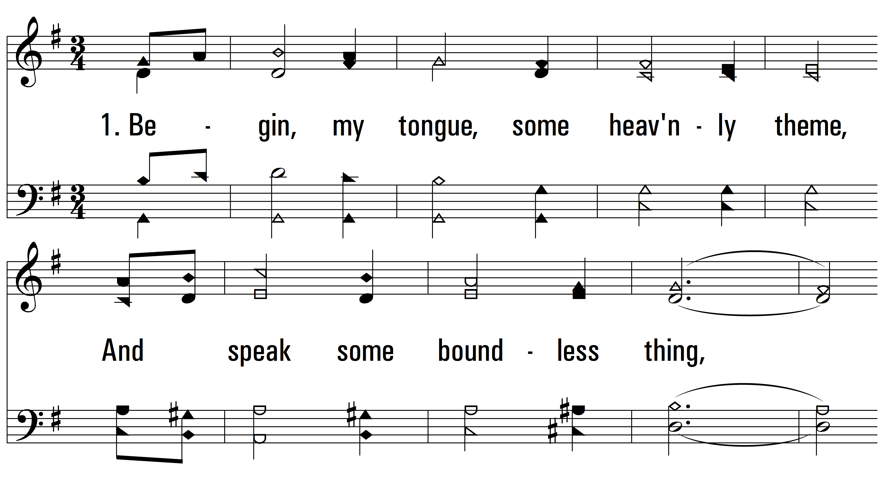
vs. 1 ~ Begin, My Tongue, Some Heavenly Theme
PDHymns.com
END

Slide 3
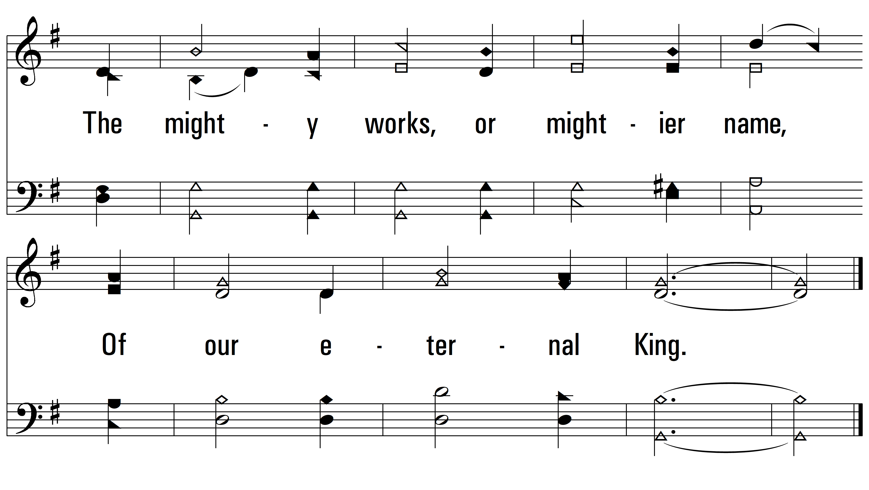
vs. 1

Slide 4
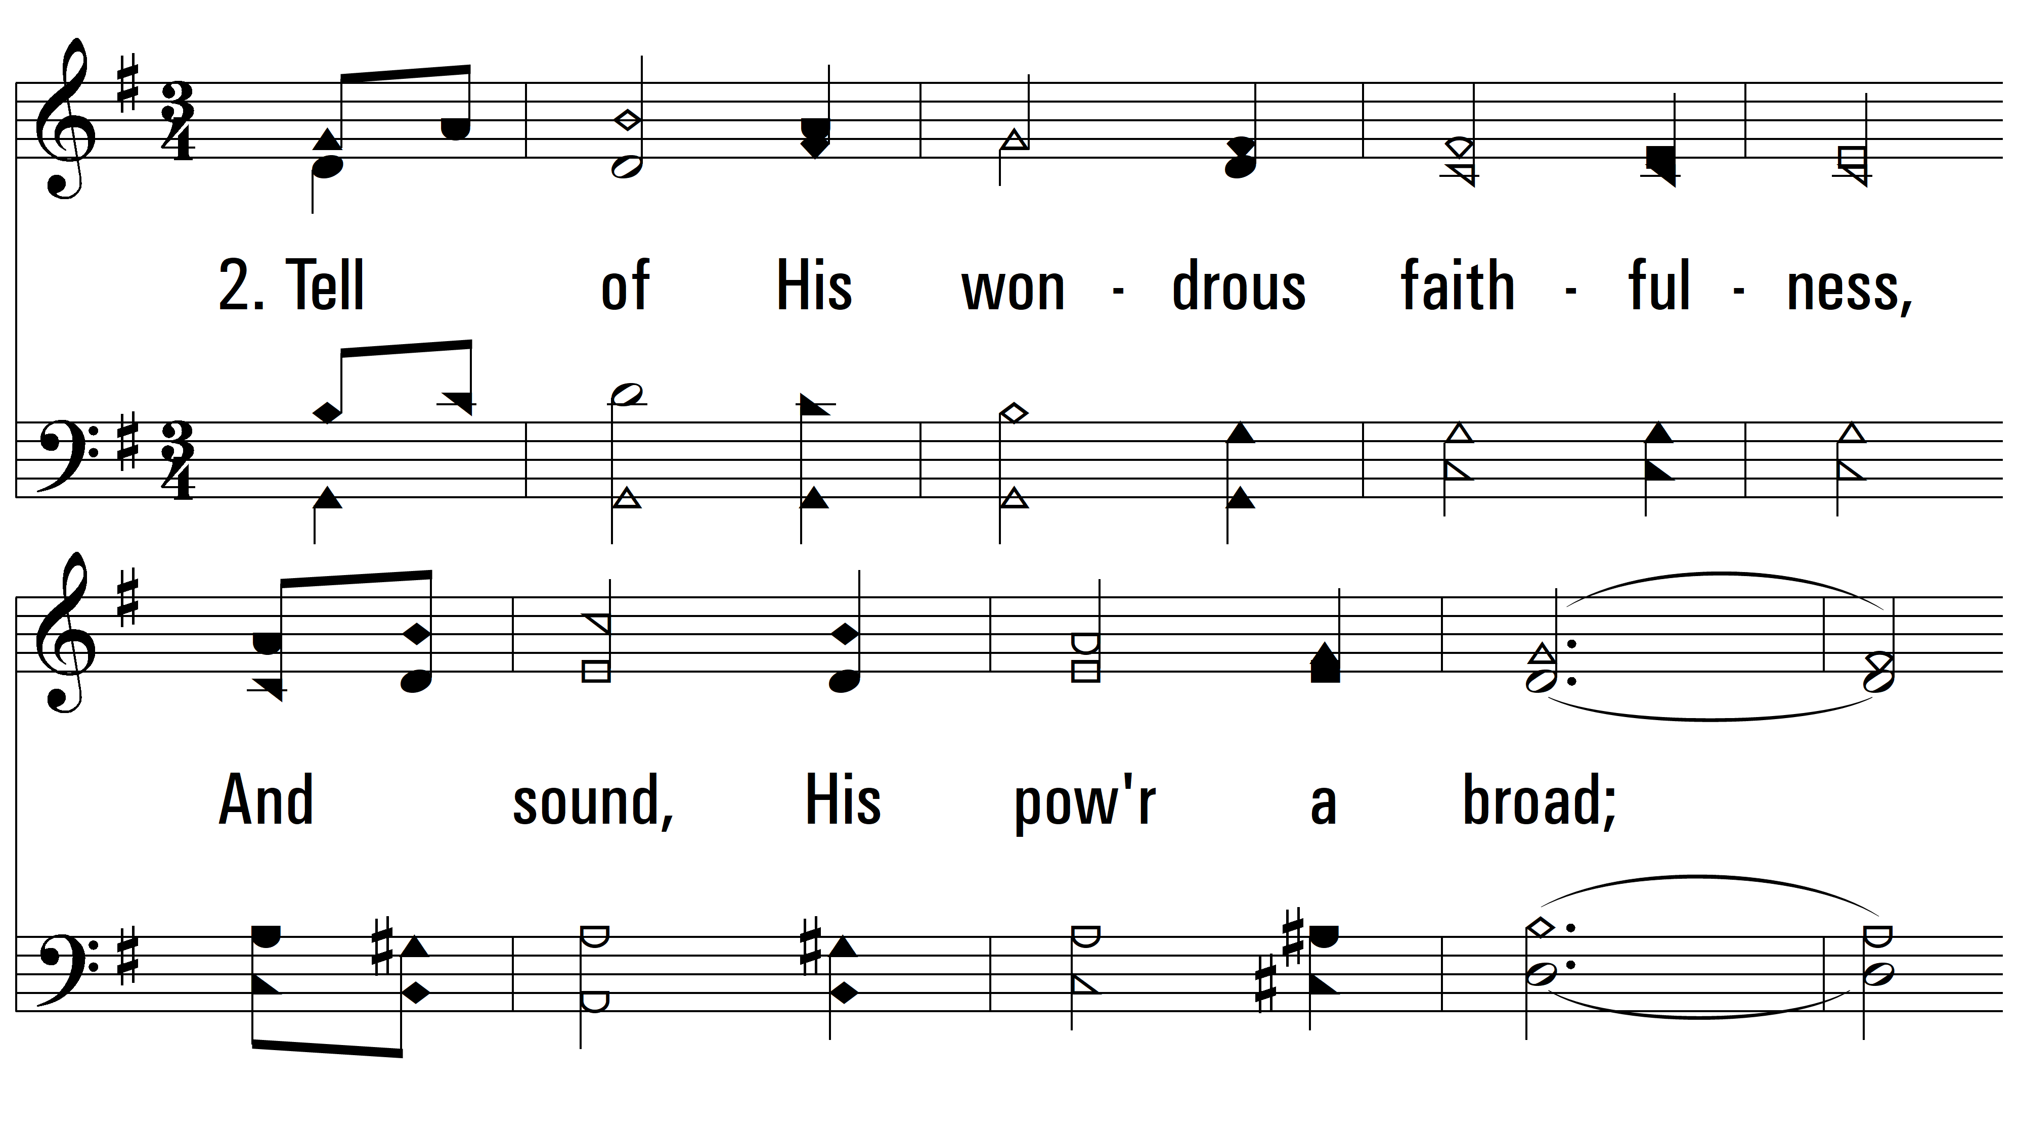
vs. 2 ~ Begin, My Tongue, Some Heavenly Theme

Slide 5
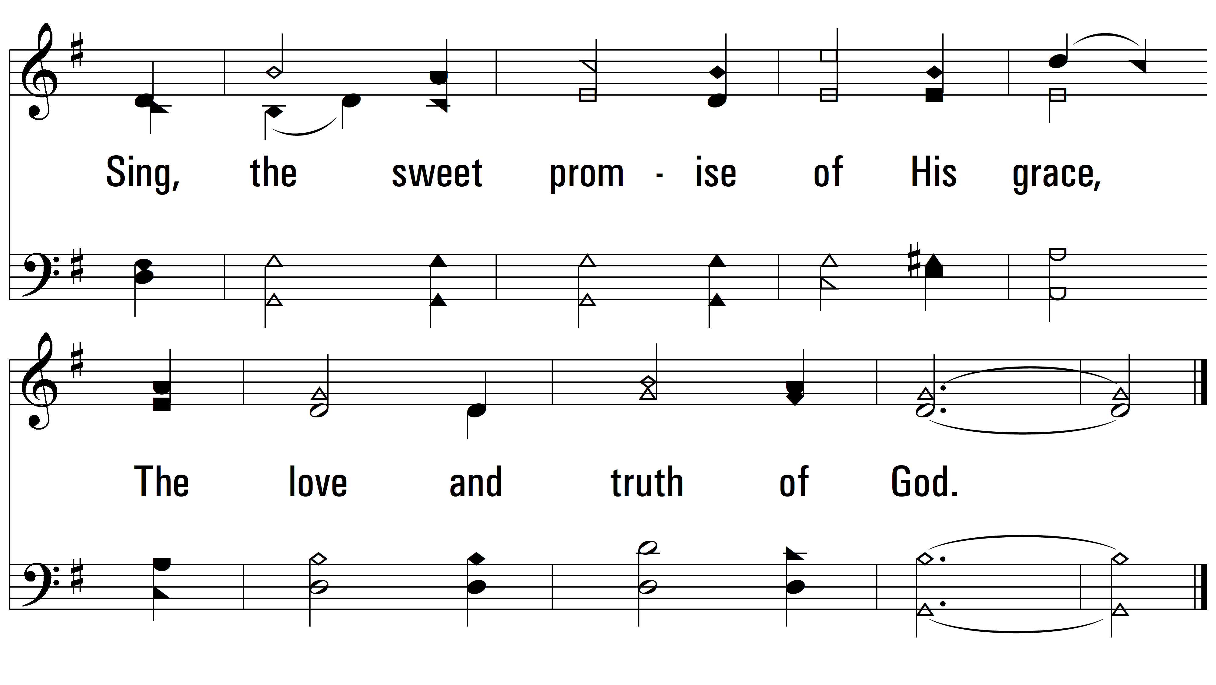
vs. 2

Slide 6
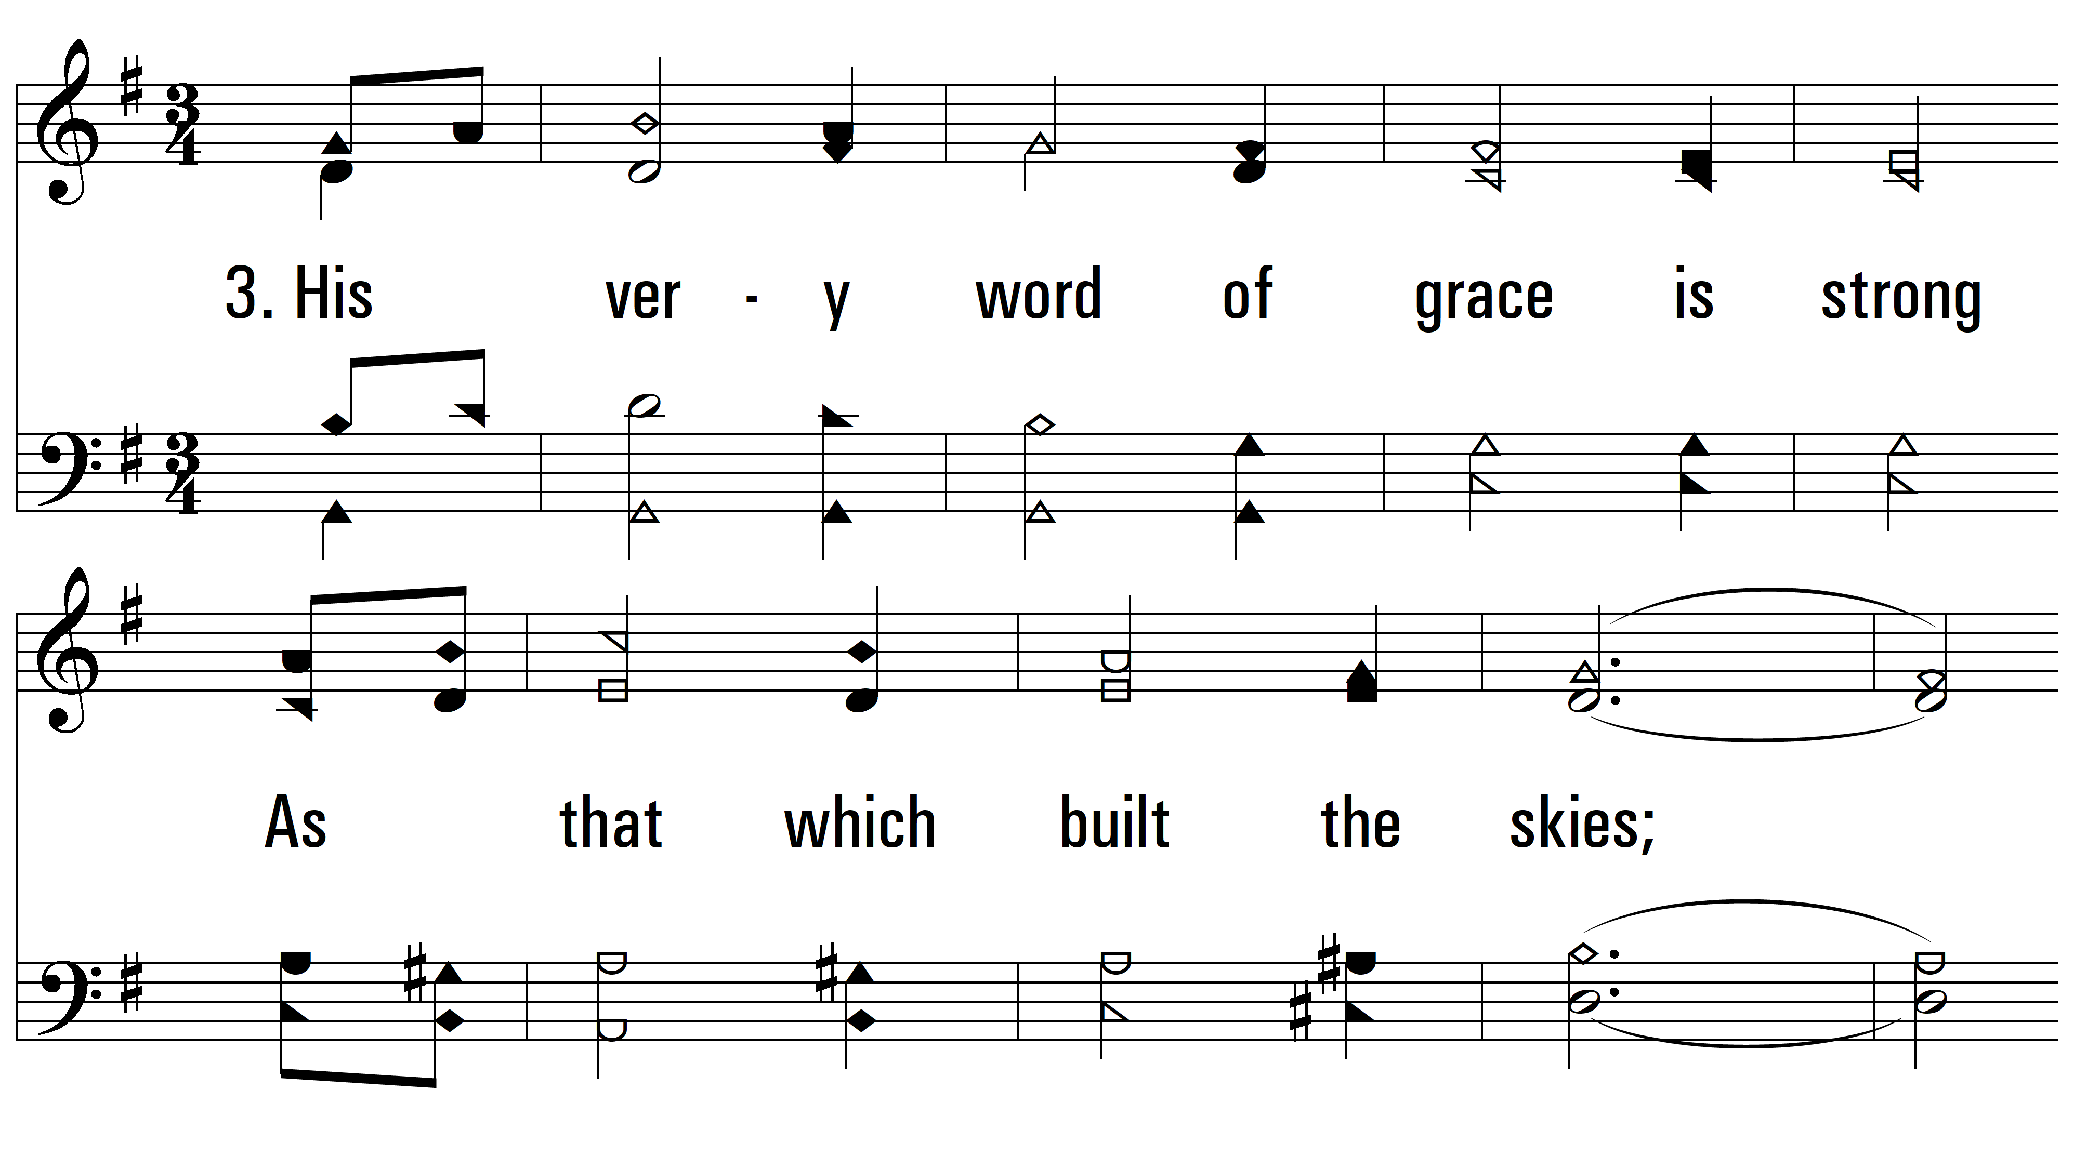
vs. 3 ~ Begin, My Tongue, Some Heavenly Theme

Slide 7
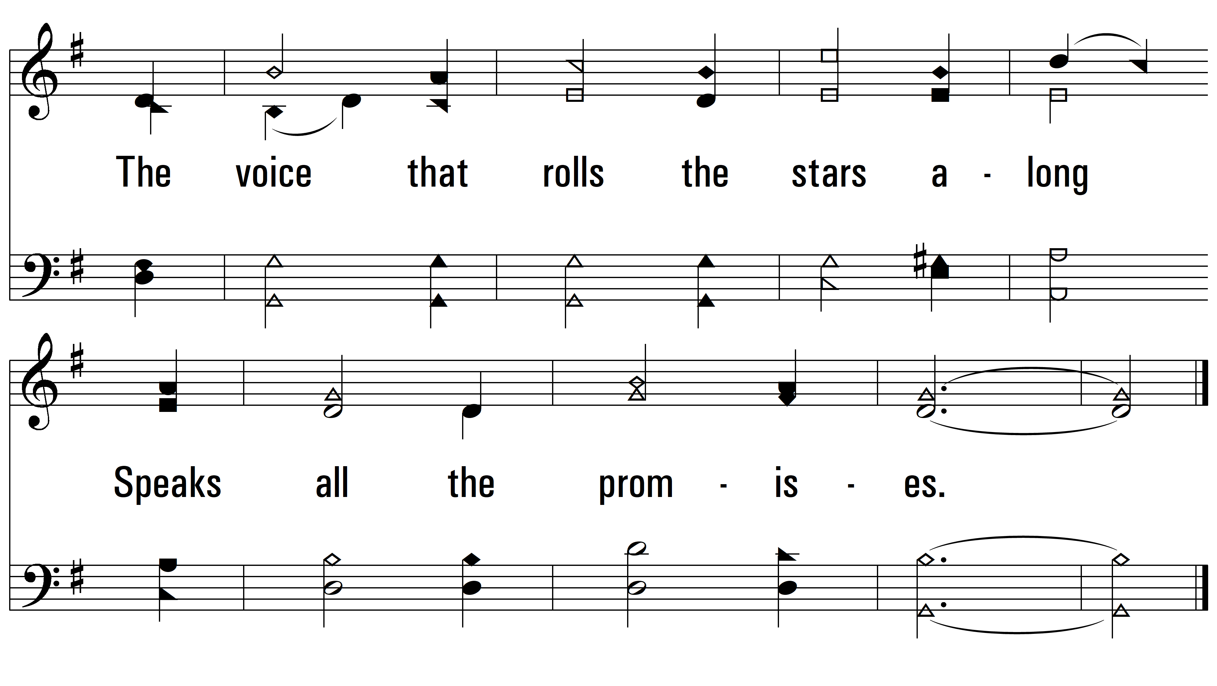
vs. 3

Slide 8
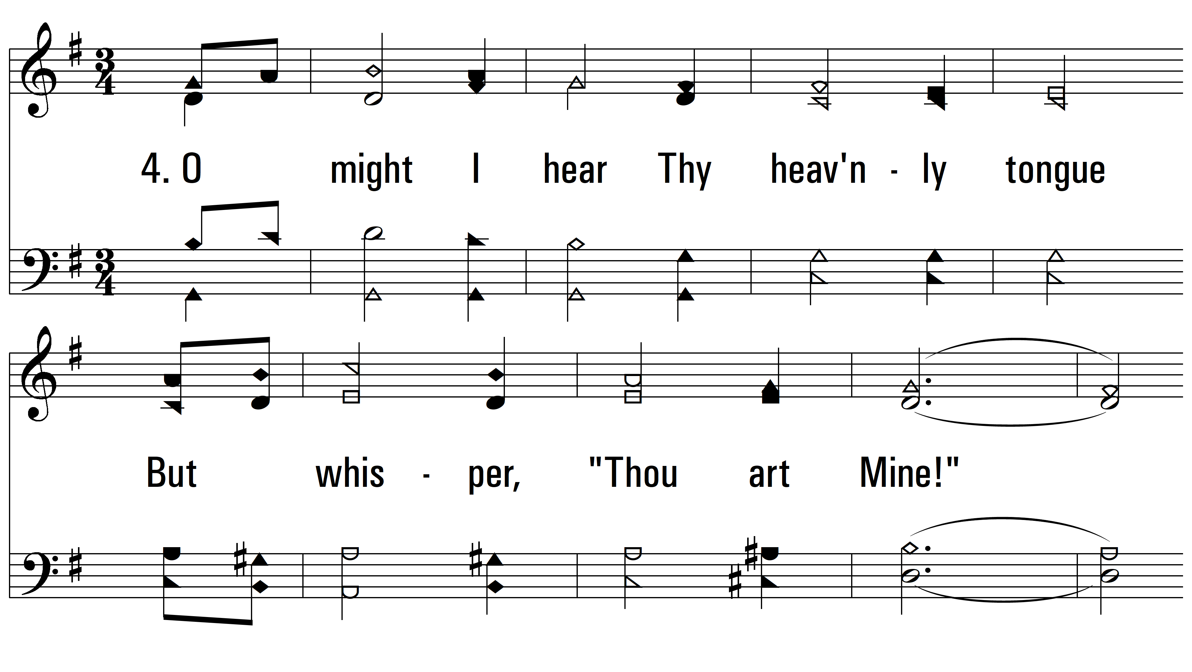
vs. 4 ~ Begin, My Tongue, Some Heavenly Theme

Slide 9
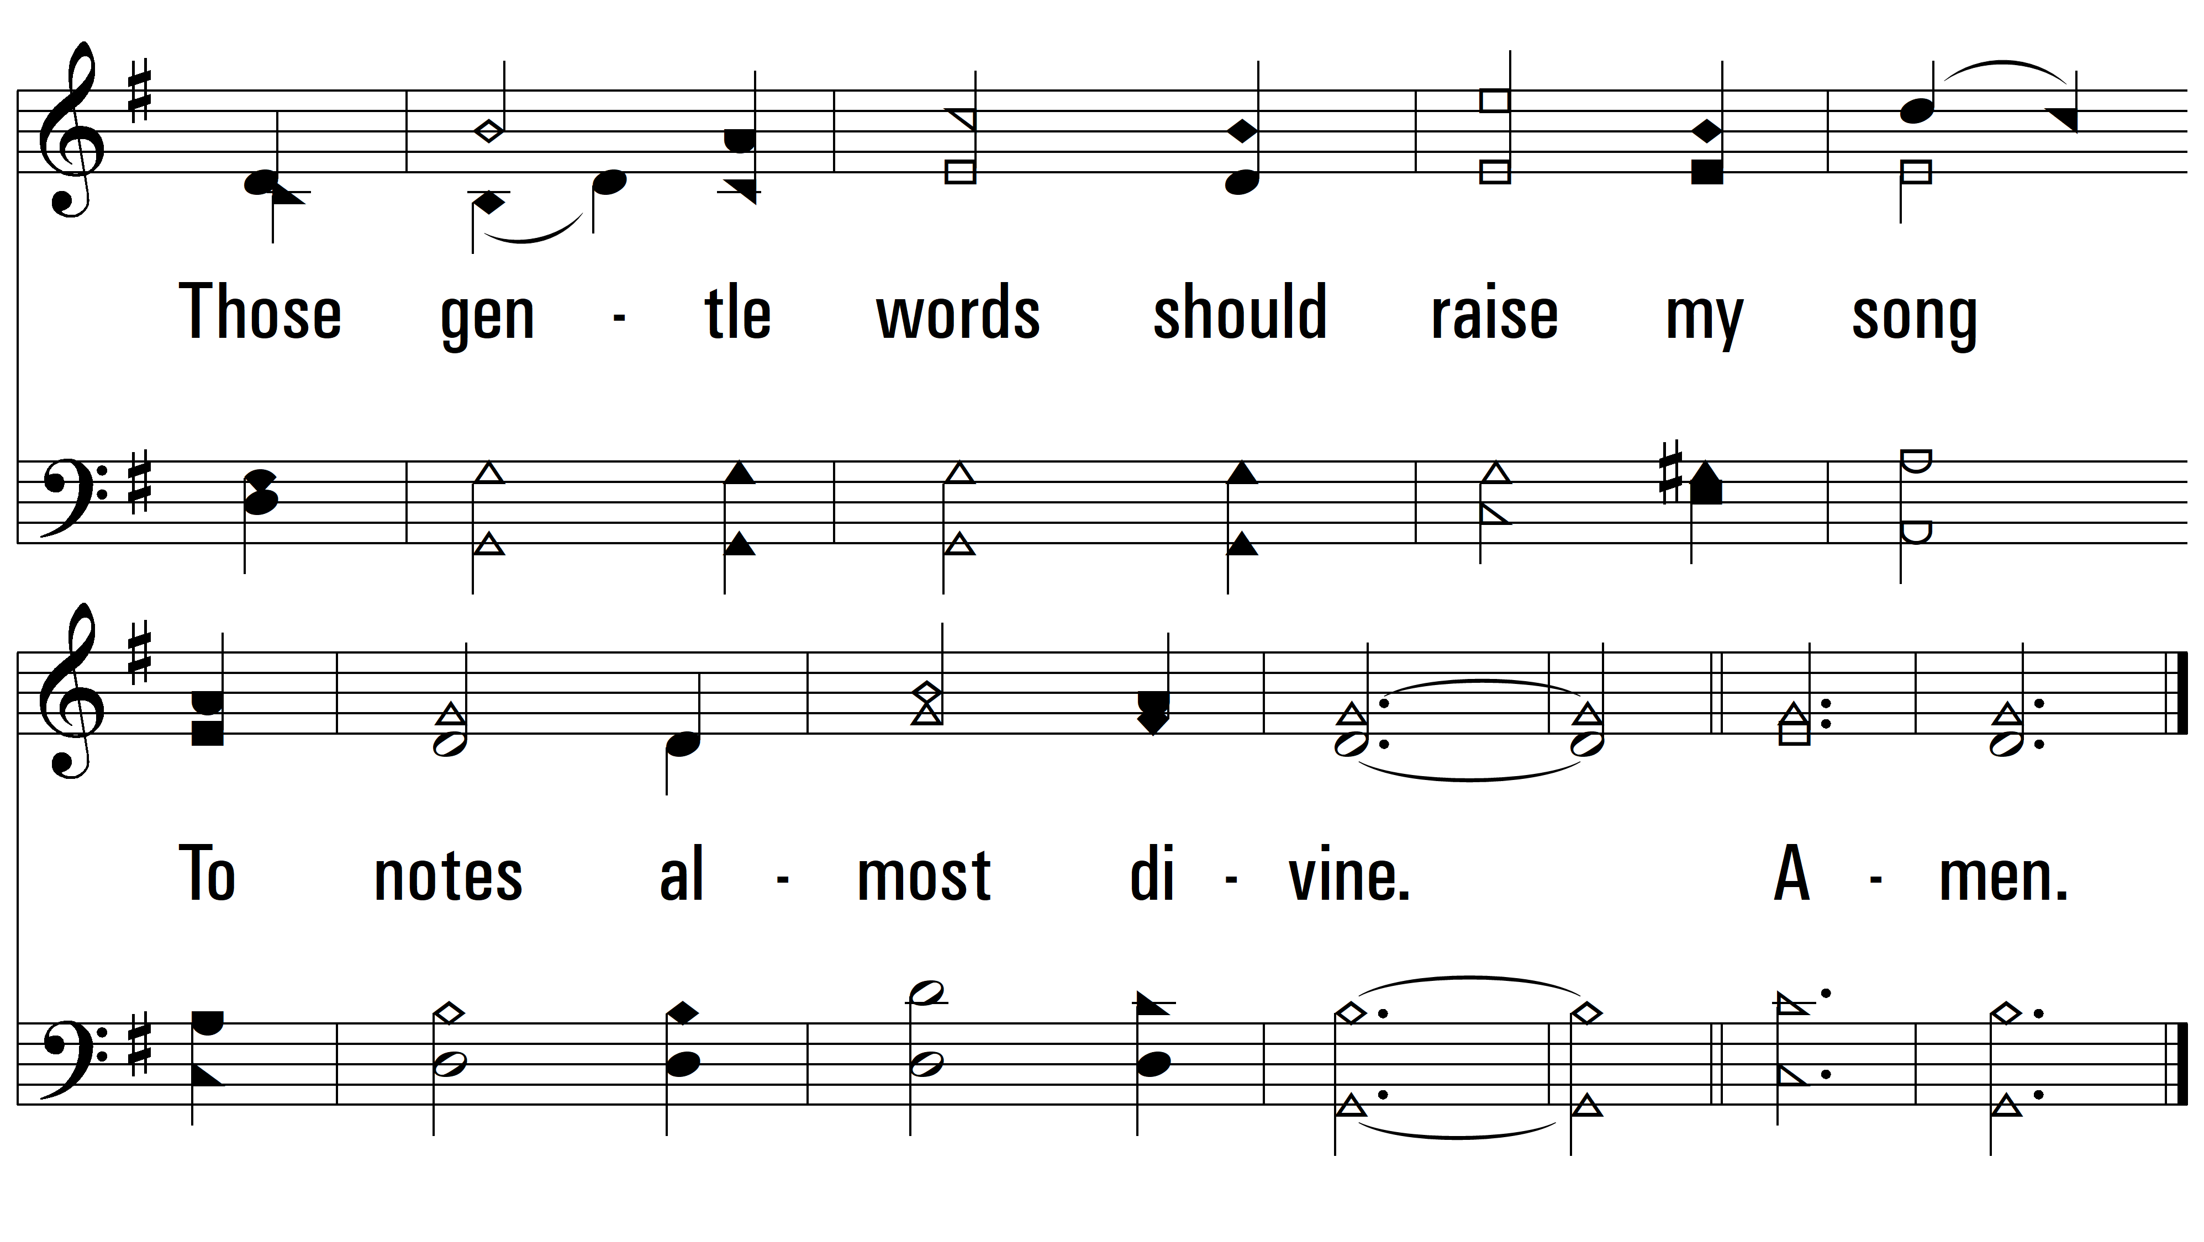
vs. 4

