Slide 1
Beautiful
Words: | B. E. Warren (1911)
Music: | B. E. Warren (1911)
12/8
D^{b}/D^{b} - DOL
Verses: 3/Chorus
Lead - | DO
Alto - | DO
Tenor - | MI
Bass - | DO
PDHymns.com

Slide 2
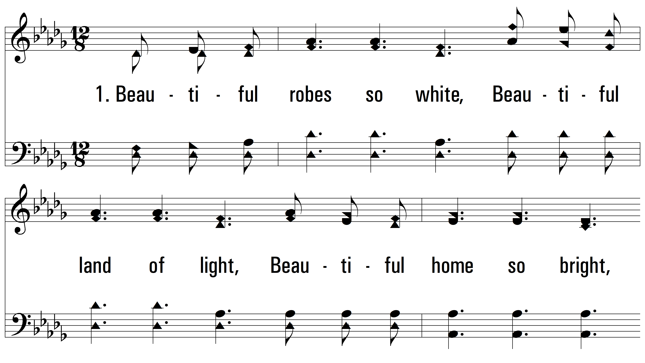
vs. 1 ~ Beautiful

Slide 3
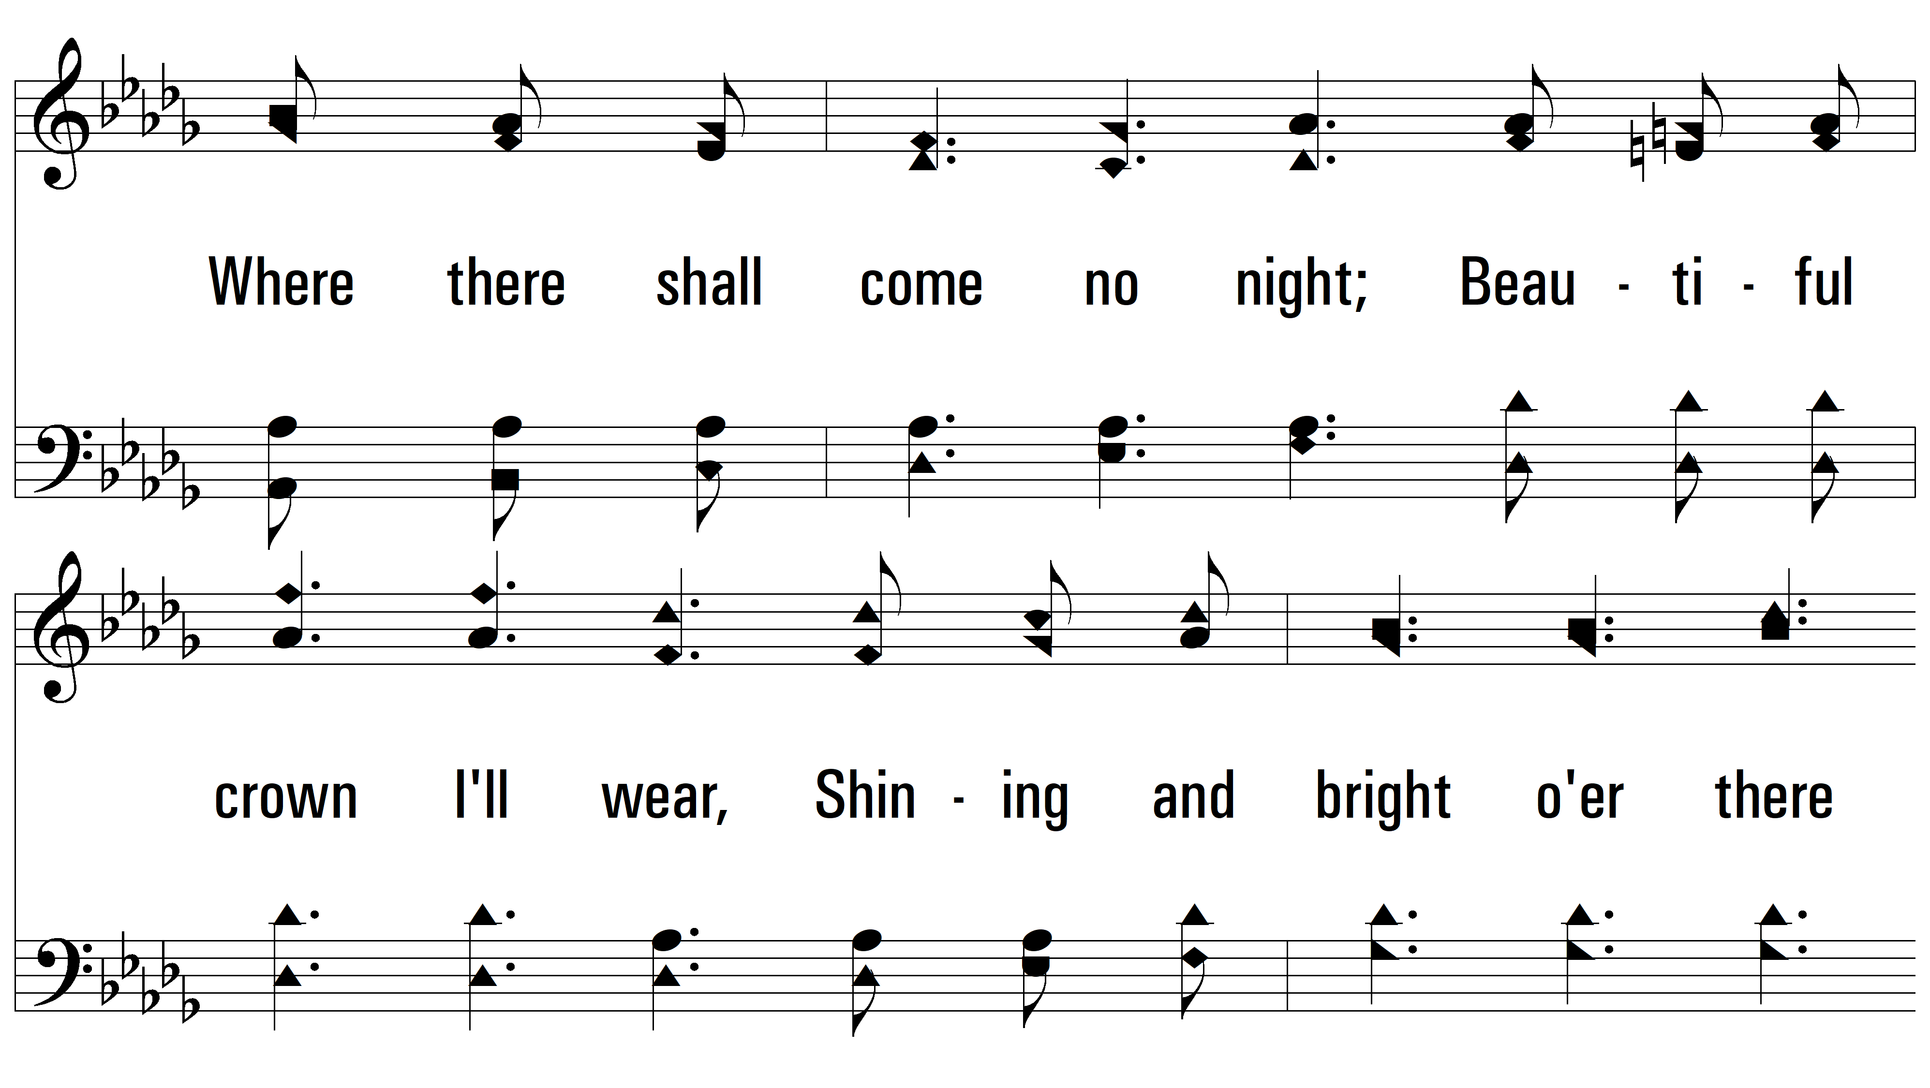
vs. 1

Slide 4
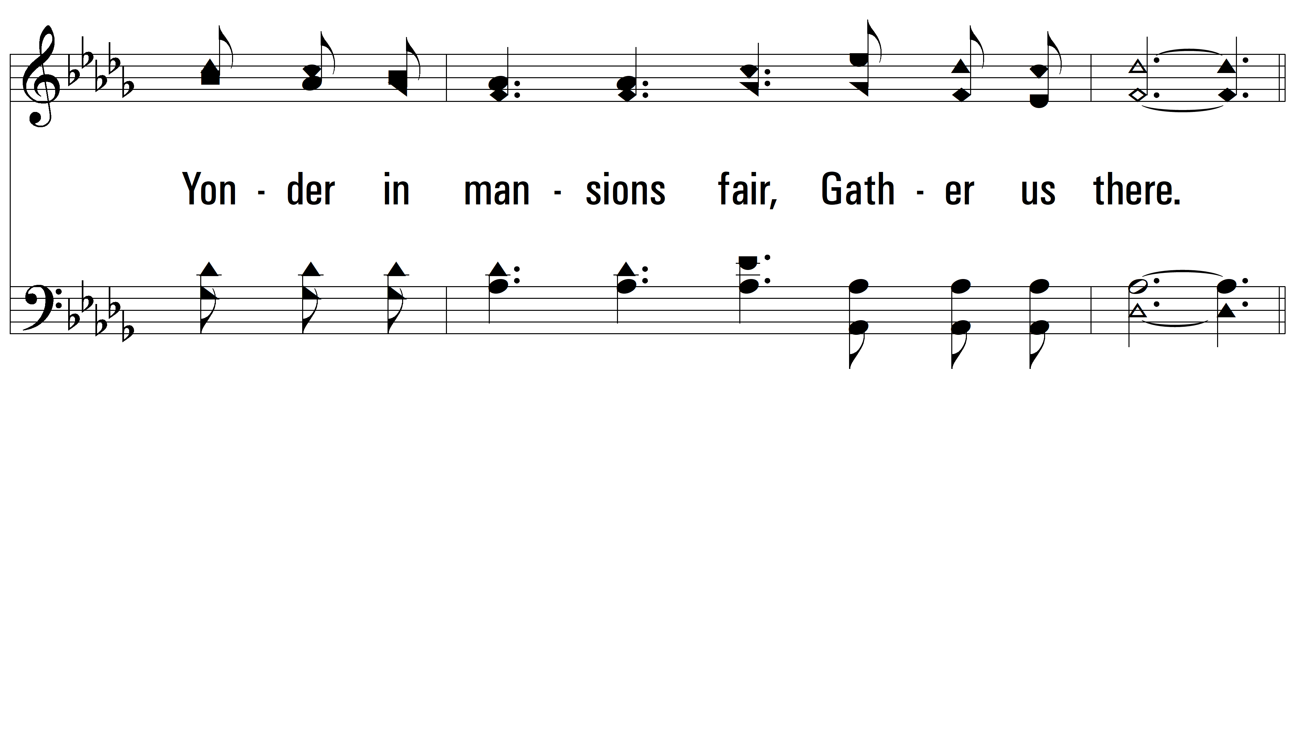
vs. 1

Slide 5
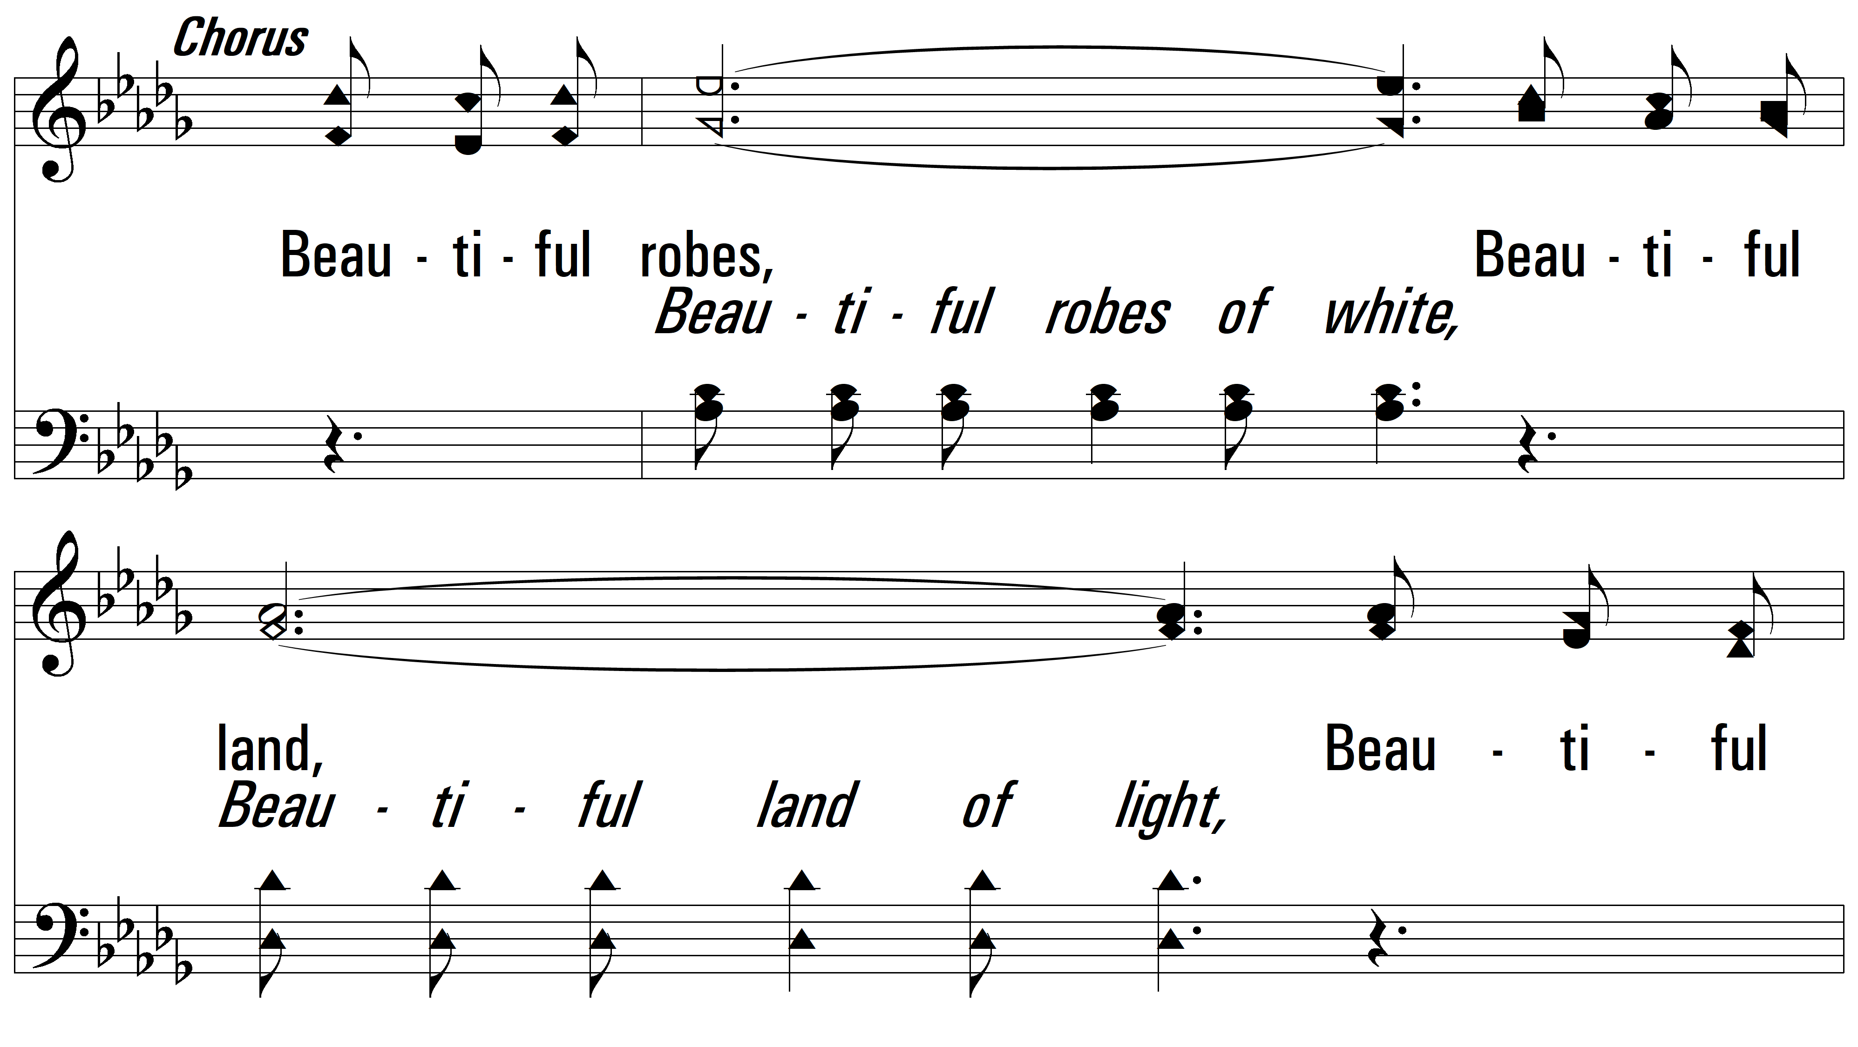
vs. 1

Slide 6
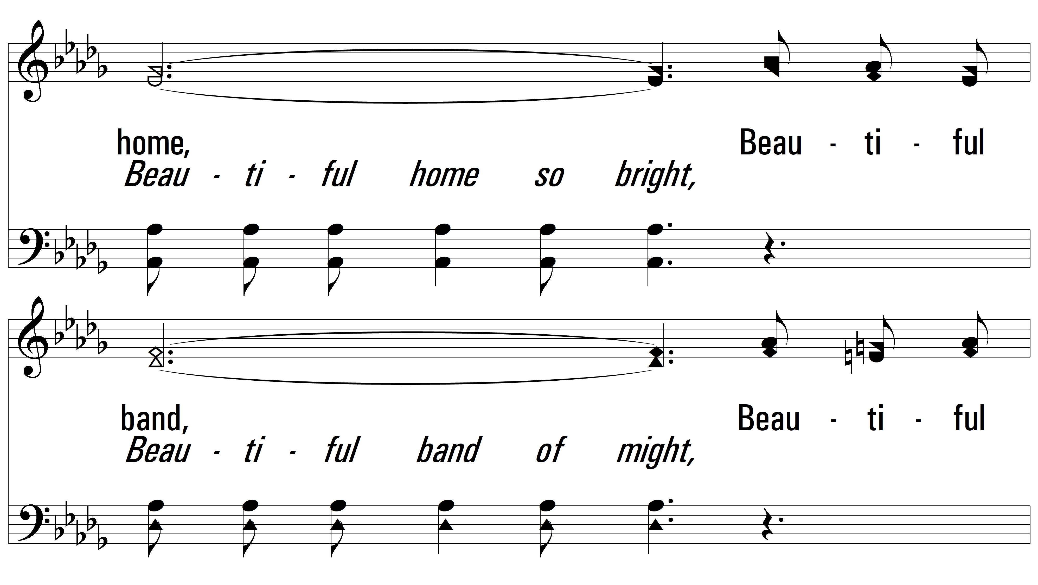
vs. 1

Slide 7
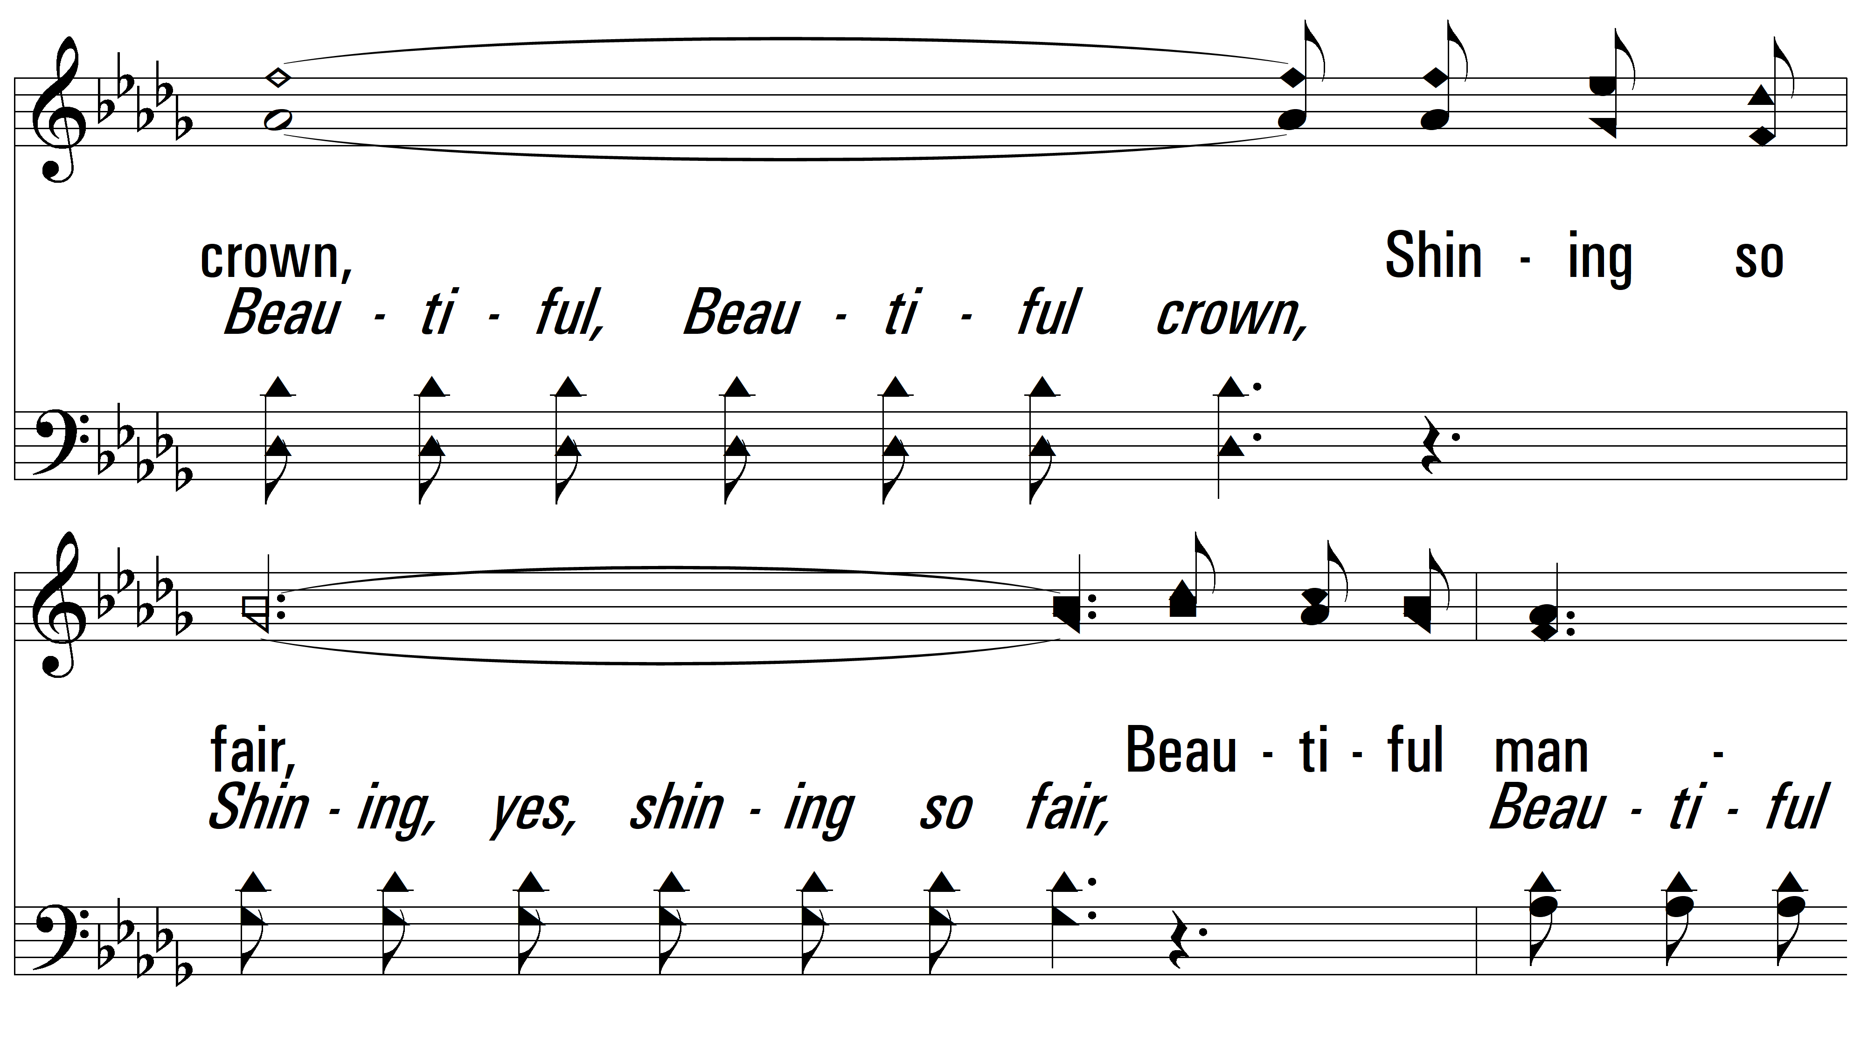
vs. 1

Slide 8
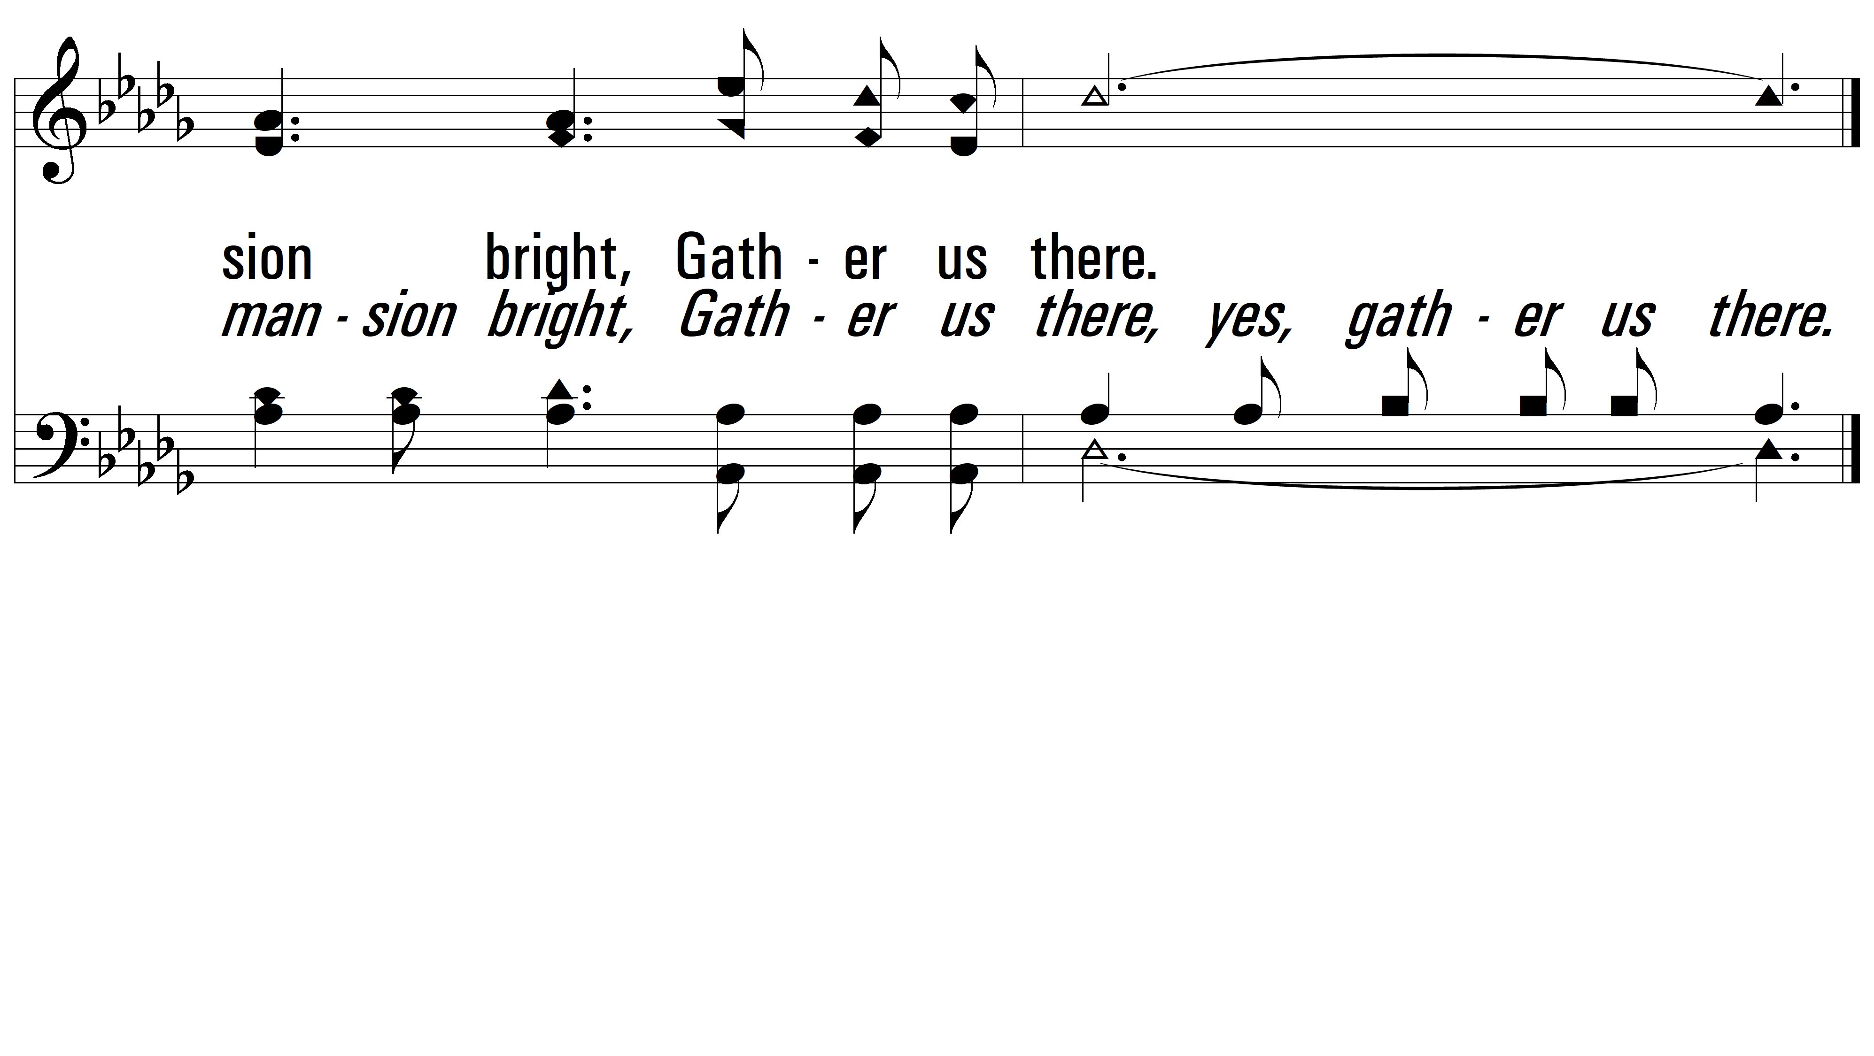
vs. 1

Slide 9
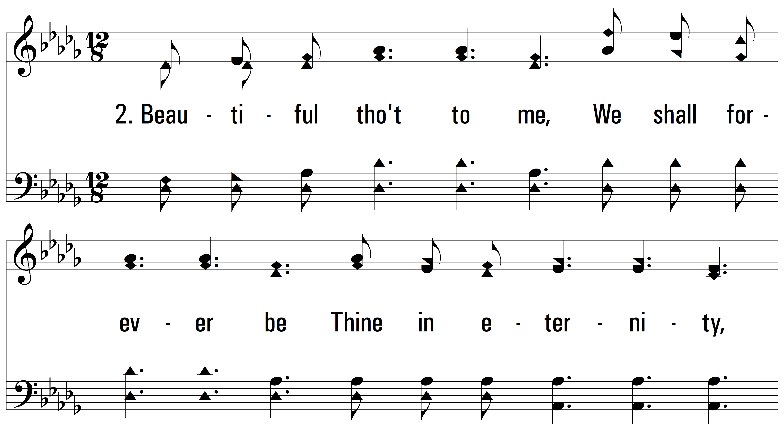
vs. 2 ~ Beautiful

Slide 10
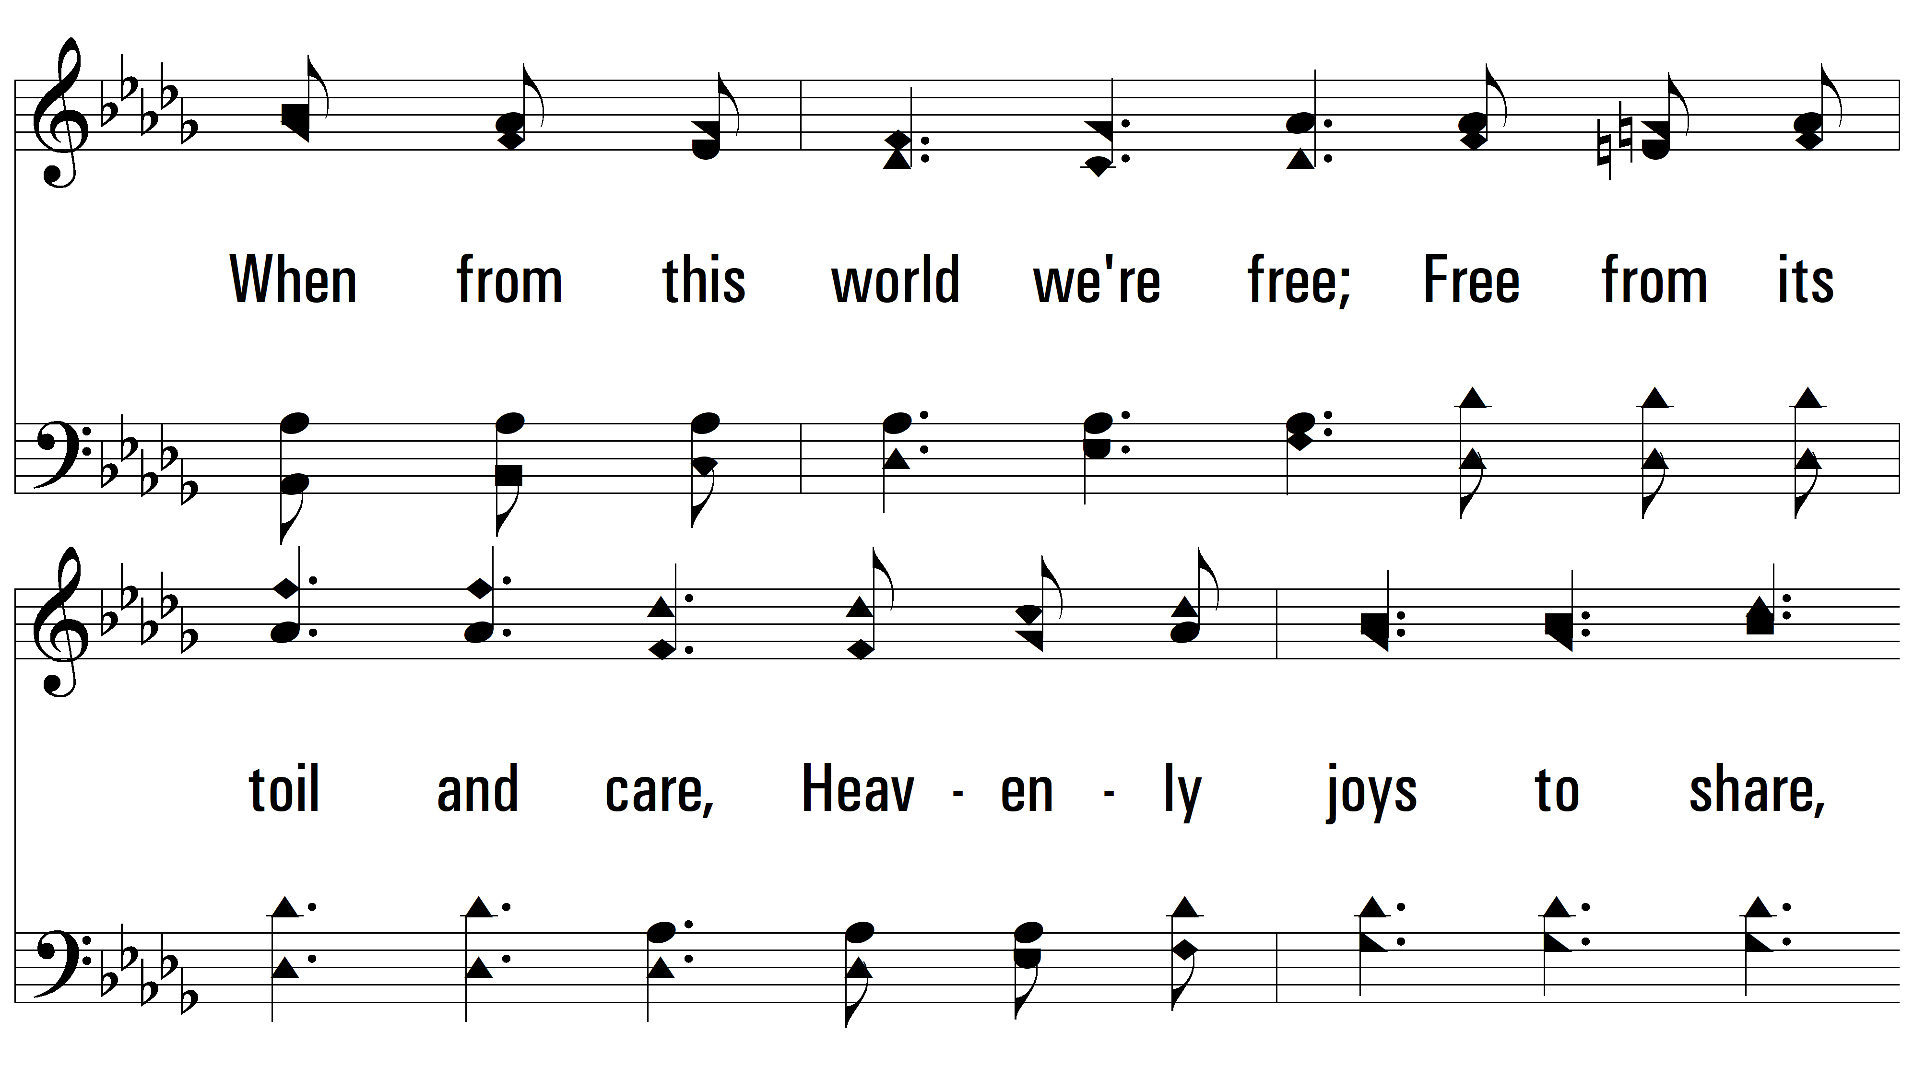
vs. 2

Slide 11
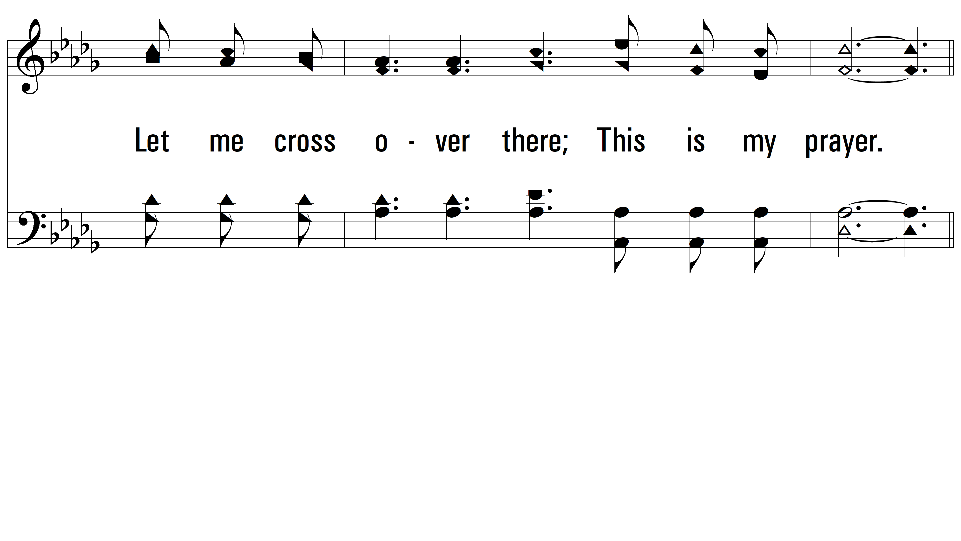
vs. 2

Slide 12
vs. 2

Slide 13
vs. 2

Slide 14
vs. 2

Slide 15
vs. 2

Slide 16
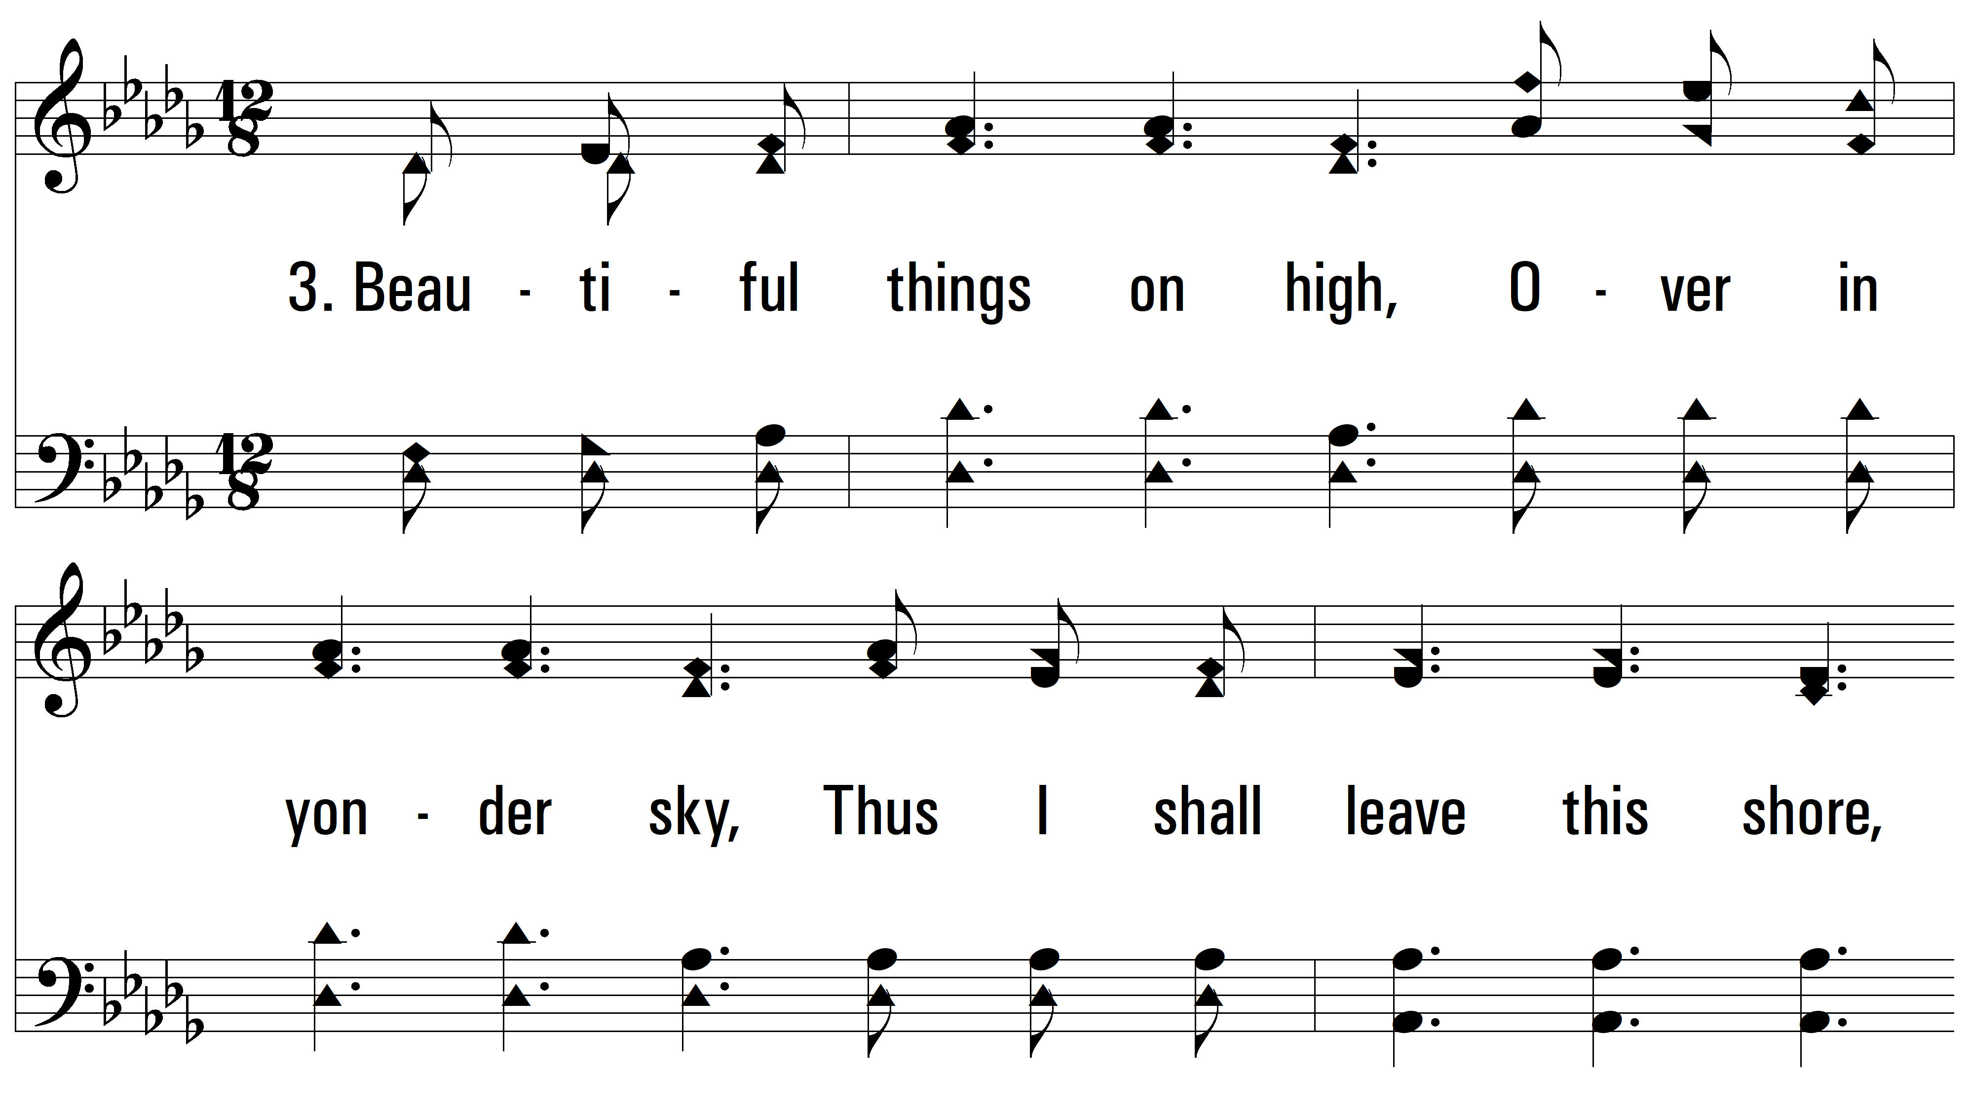
vs. 3 ~ Beautiful

Slide 17
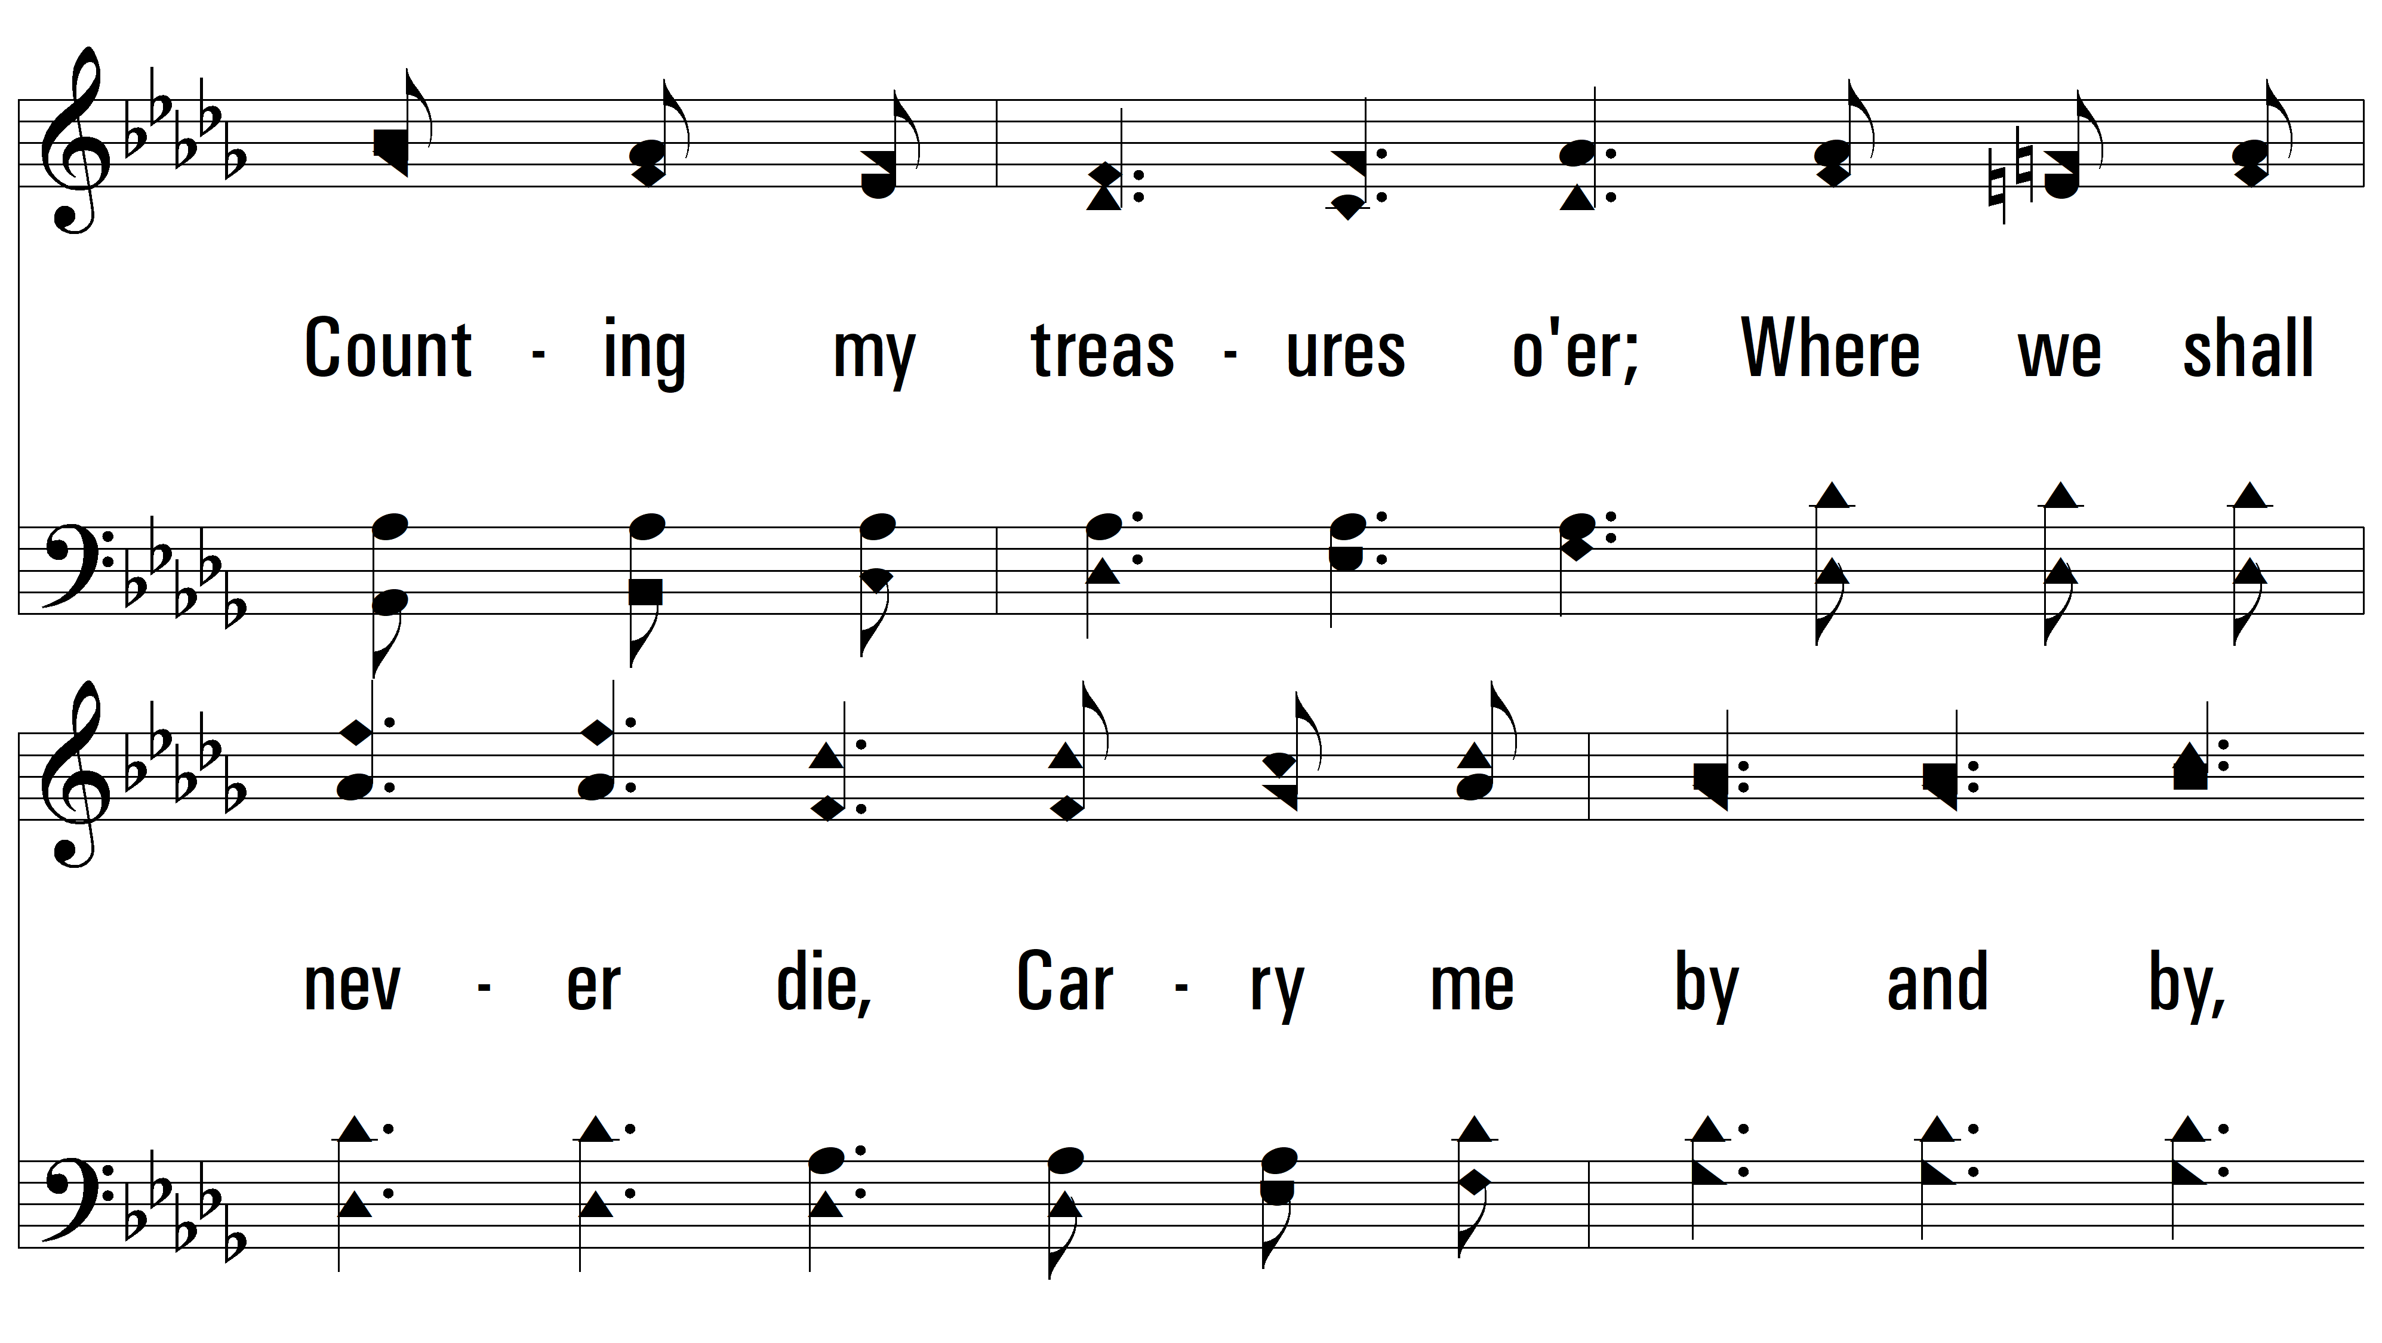
vs. 3

Slide 18
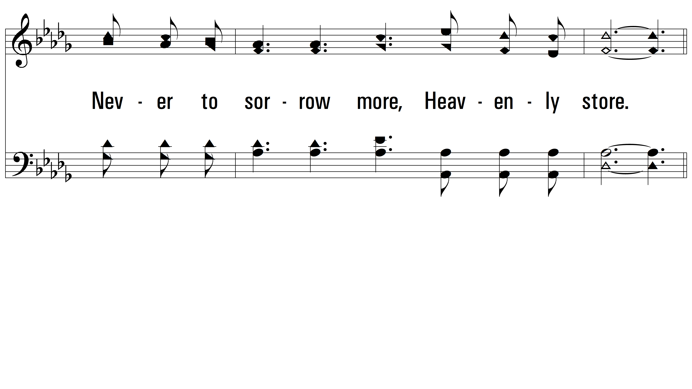
vs. 3

Slide 19
vs. 3

Slide 20
vs. 3

Slide 21
vs. 3

Slide 22
vs. 3
PDHymns.com
END

