Slide 1
Be Thou My Vision
SLANE
10.10.10.10
Words: | 8th cent. hymn (750); tr. by Mary Elizabeth Byrne (1905); Alt. Eleanor Hull (1912)
Music: | Irish Folk Melody
3/4
E^{b}/E^{b} - DO
Verses: 5
Lead - | DO
Alto - | SOL
Tenor - | MI
Bass - | DO
PDHymns.com

Slide 2
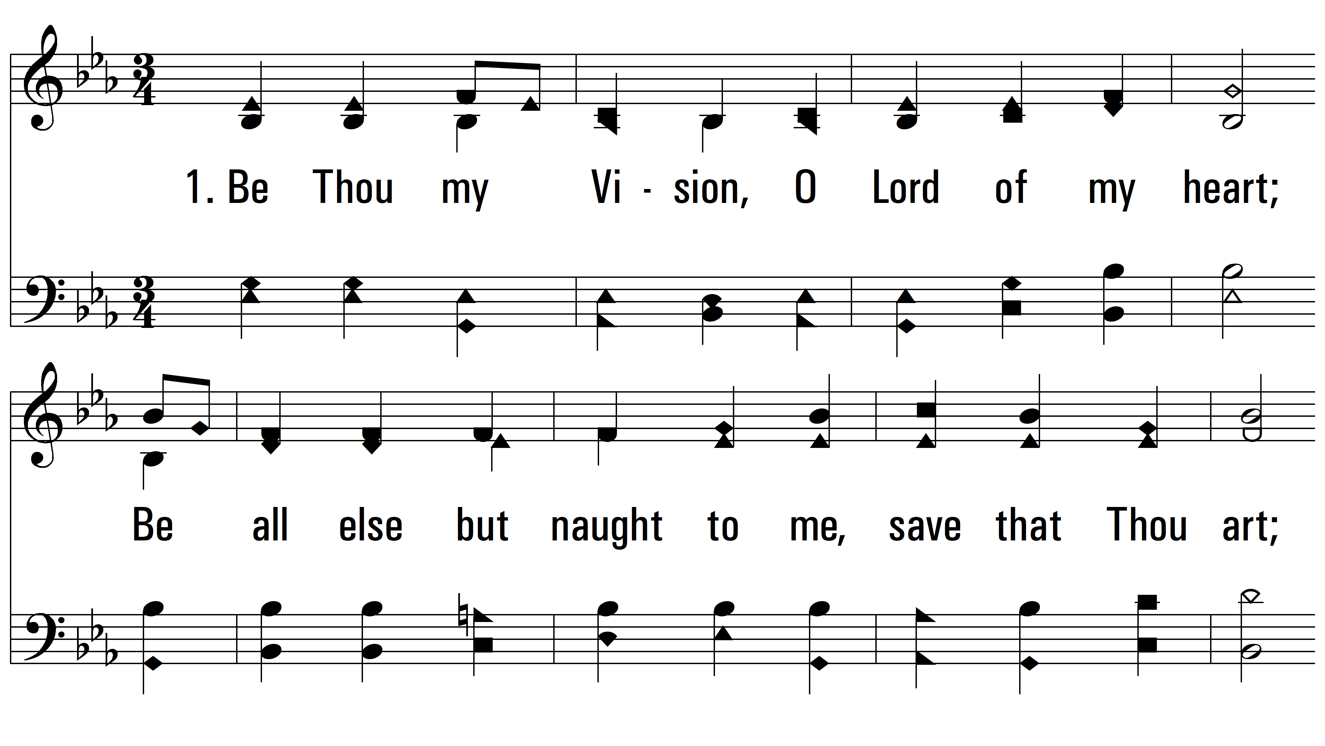
vs. 1 ~ Be Thou My Vision

Slide 3
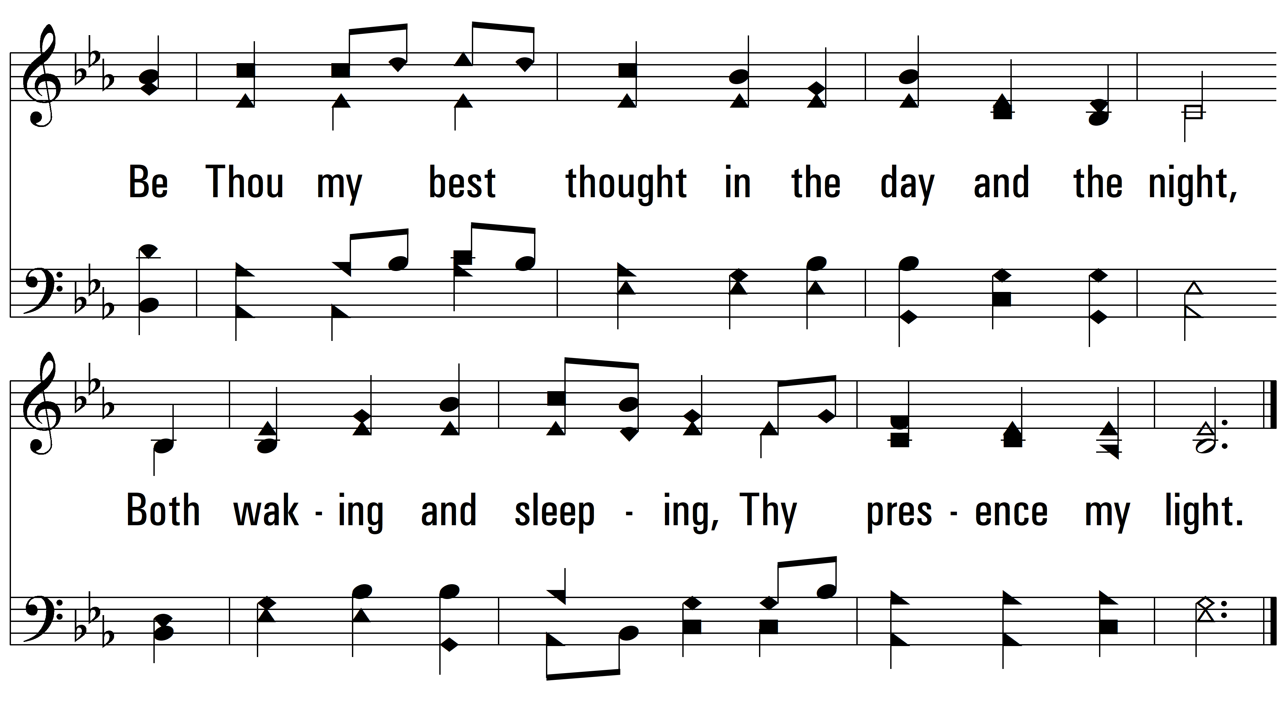
vs. 1

Slide 4
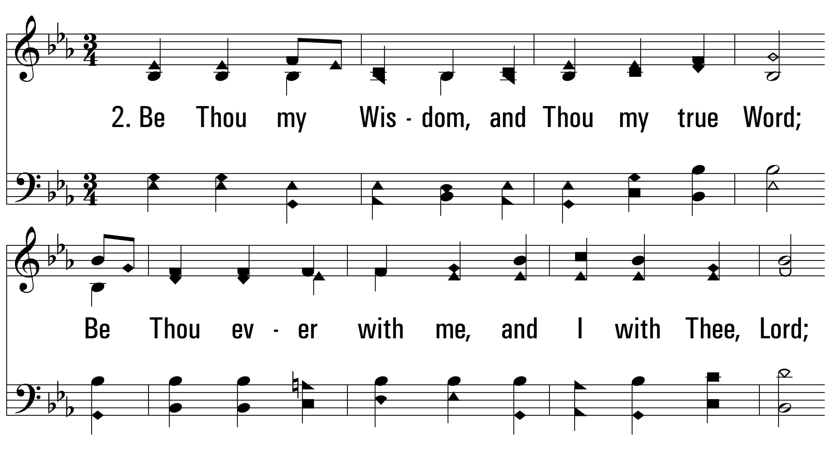
vs. 2 ~ Be Thou My Vision

Slide 5
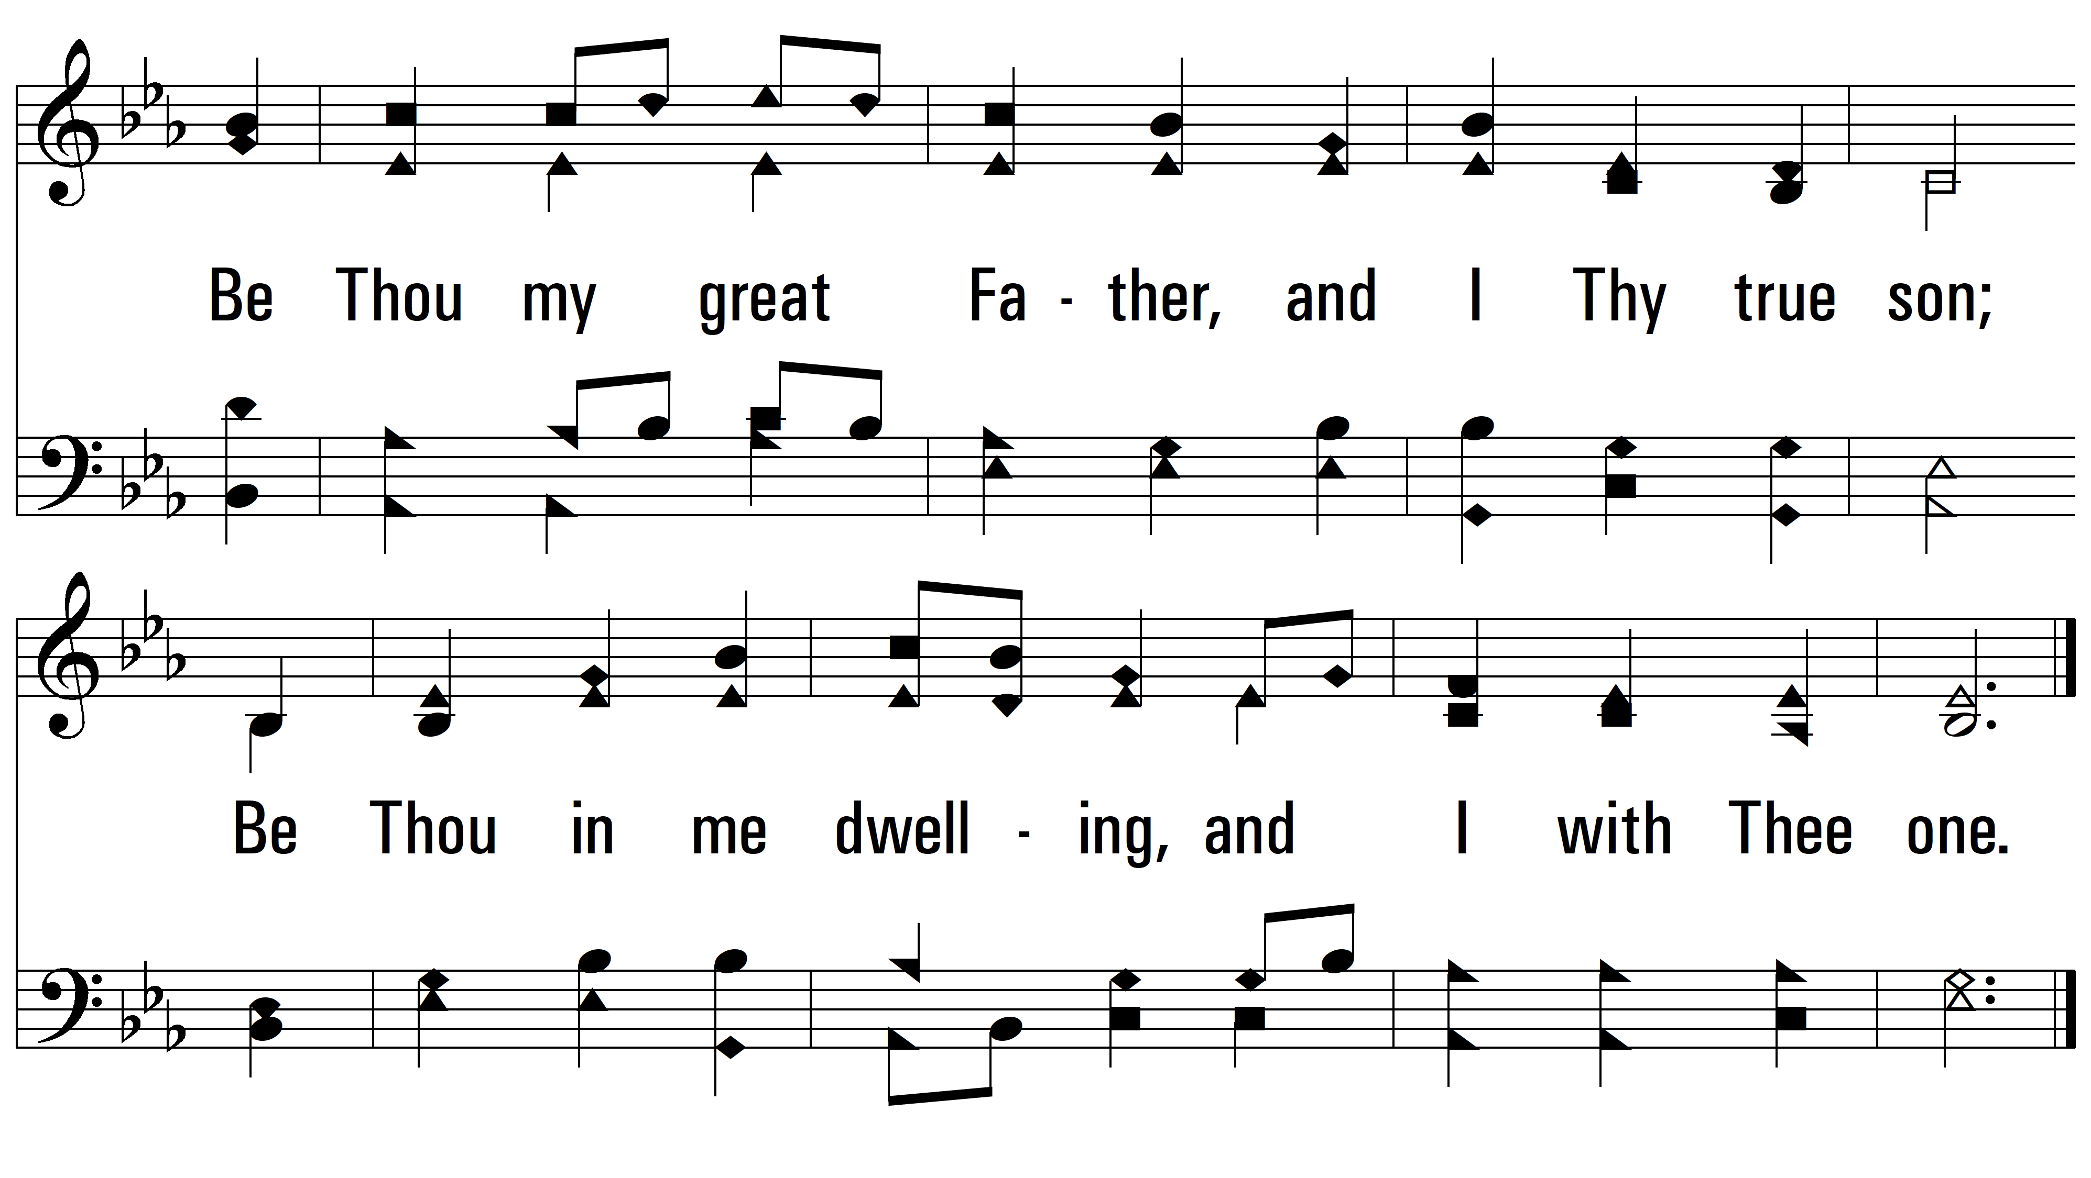
vs. 2

Slide 6
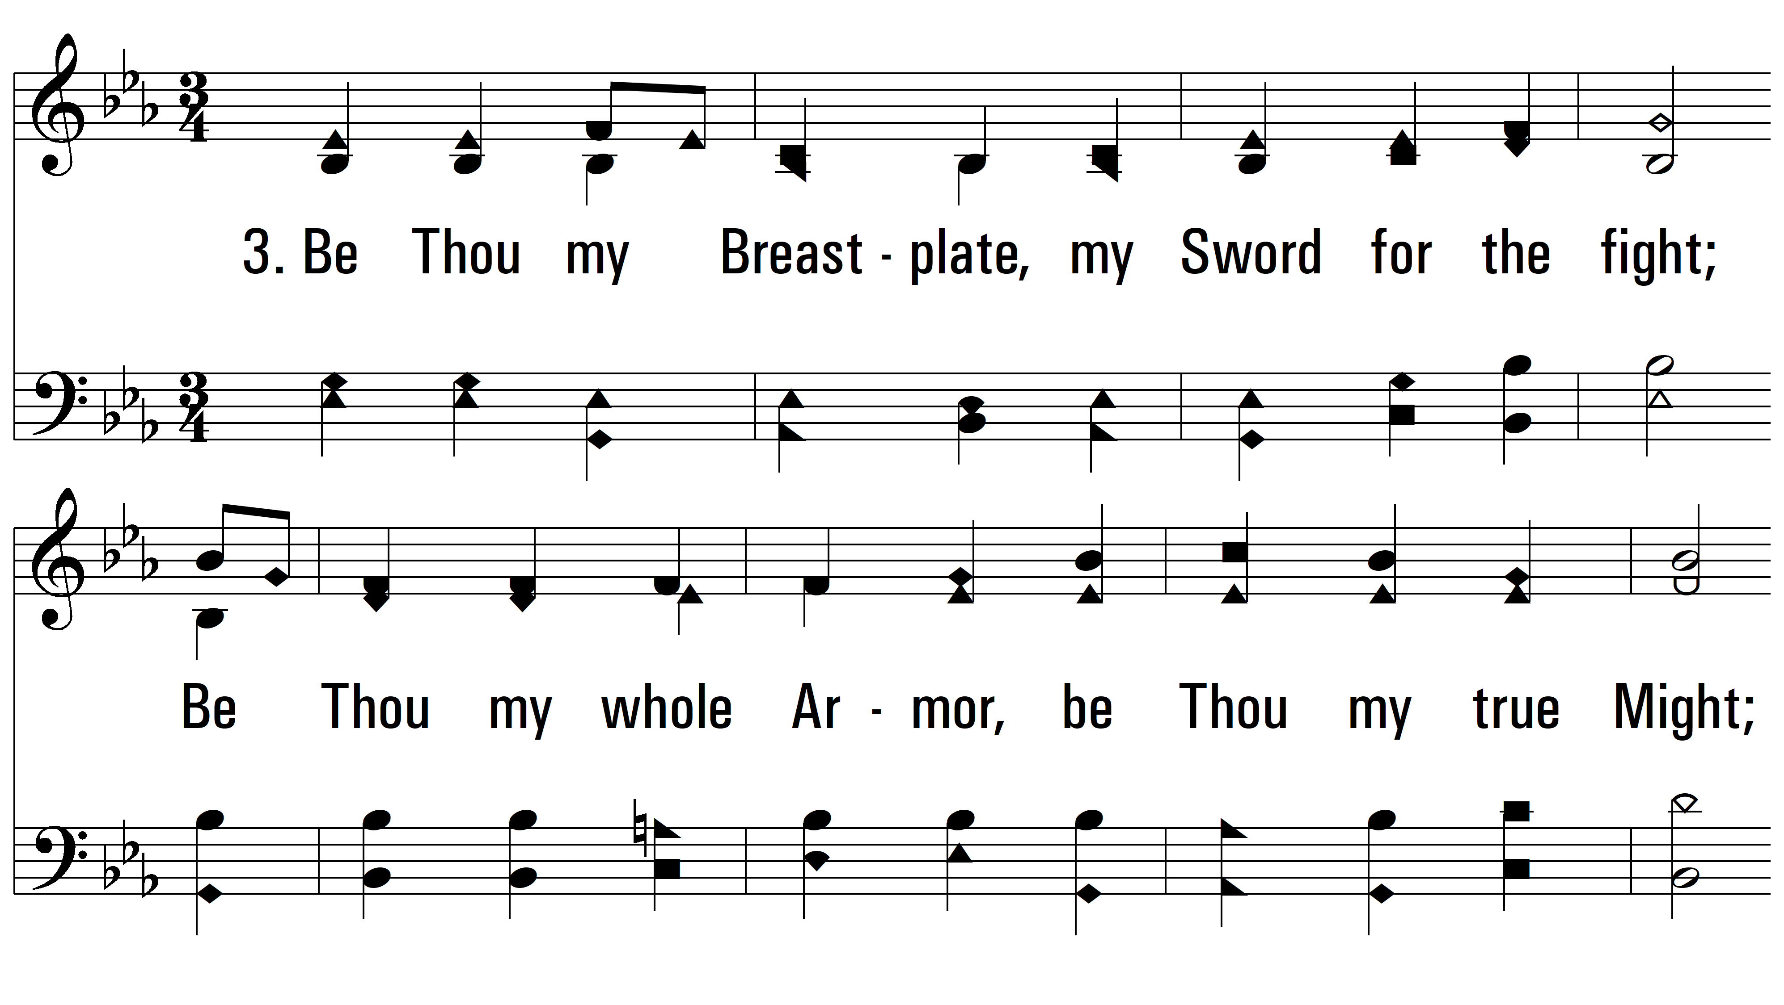
vs. 3 ~ Be Thou My Vision

Slide 7
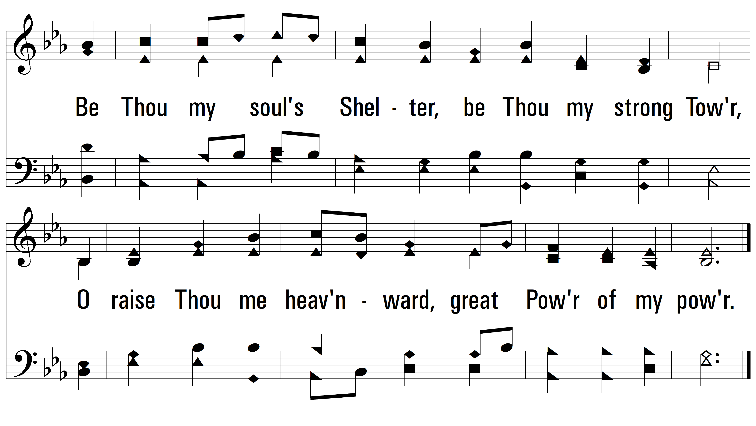
vs. 3

Slide 8
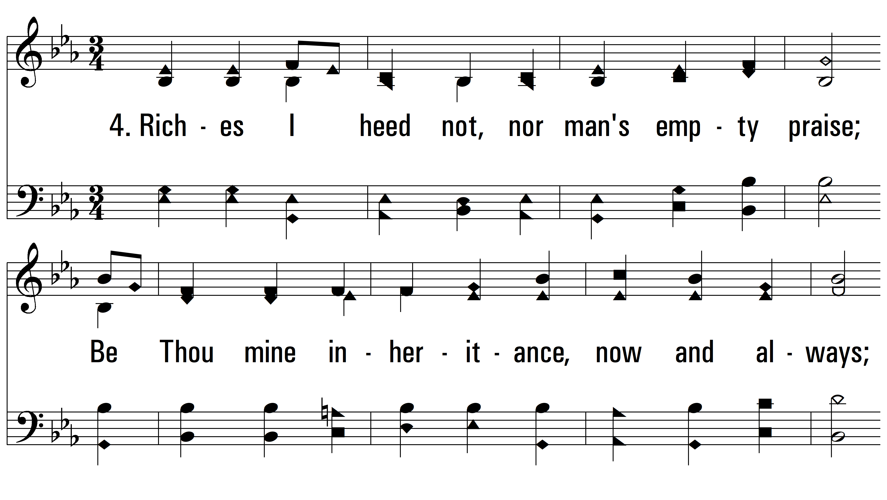
vs. 4 ~ Be Thou My Vision

Slide 9
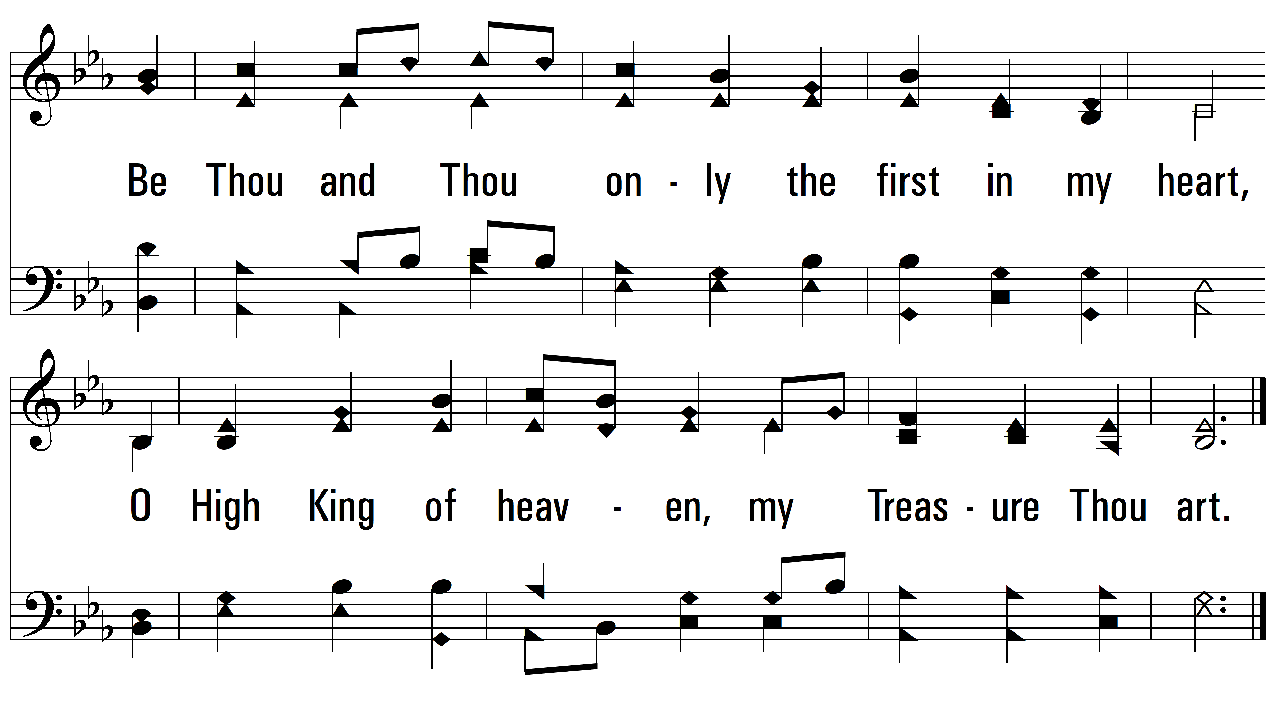
vs. 4

Slide 10
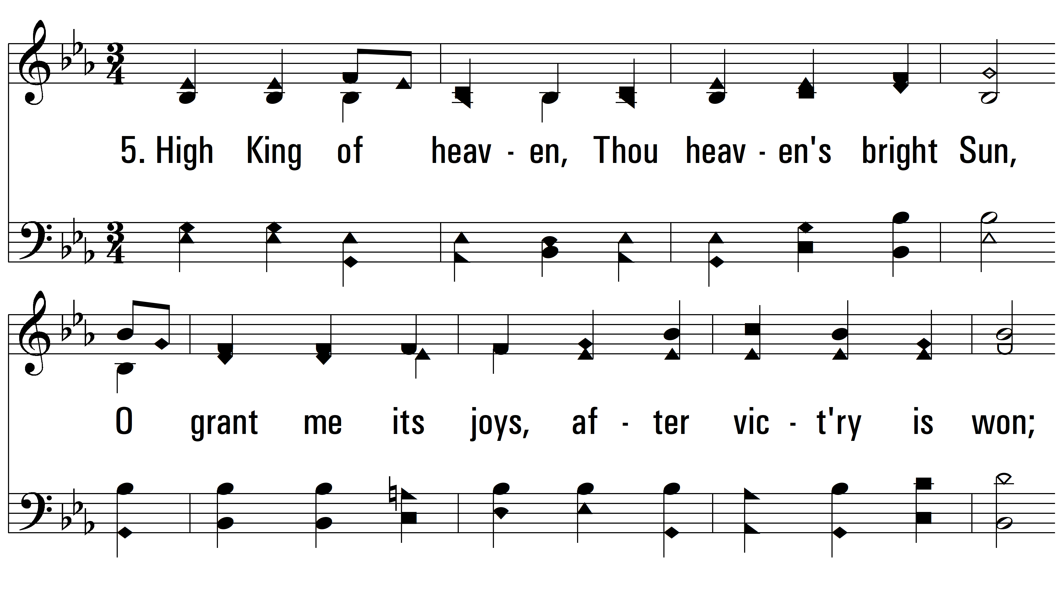
vs. 5 ~ Be Thou My Vision

Slide 11
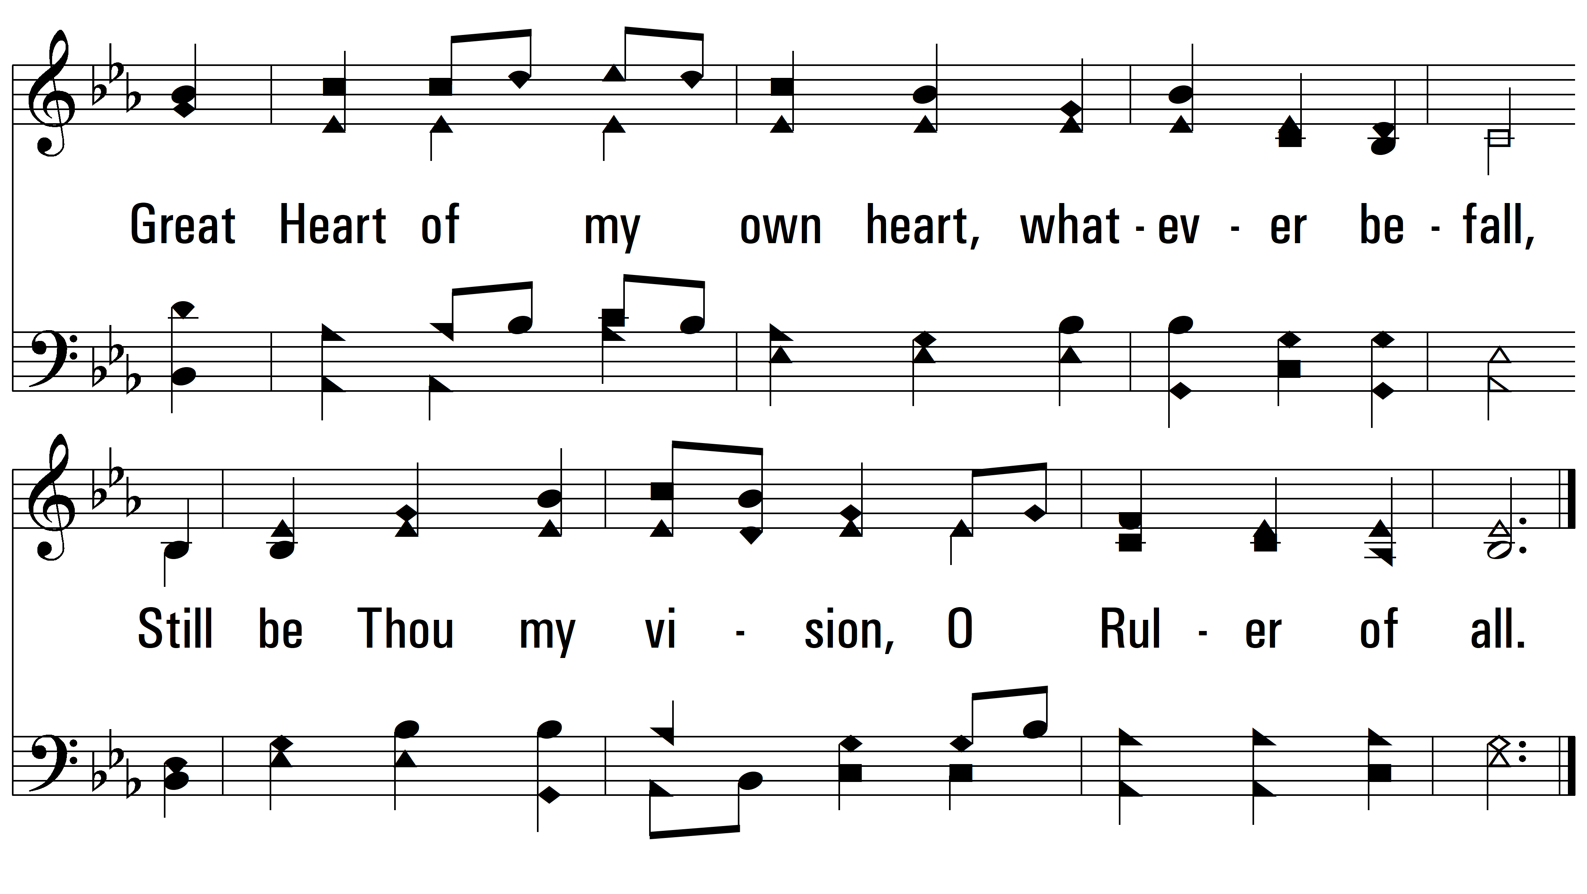
vs. 5
PDHymns.com
END

