Slide 1
Be Still And Know
Words: | Anonymous, Based On Psalm 46:10, Exodus 15:26
Music: | American Folk Melody
3/4
D/A - SOL
Verses: 2
Lead - | SOL
Alto - | MI
Tenor - | DO
Bass - | DO
PDHymns.com

Slide 2
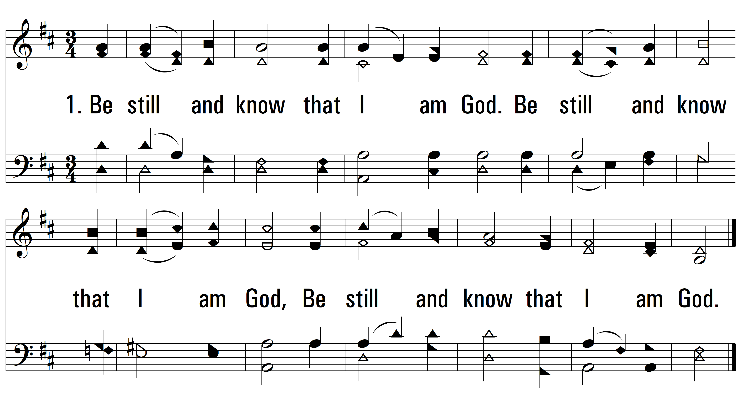
vs. 1 ~ Be Still And Know

Slide 3
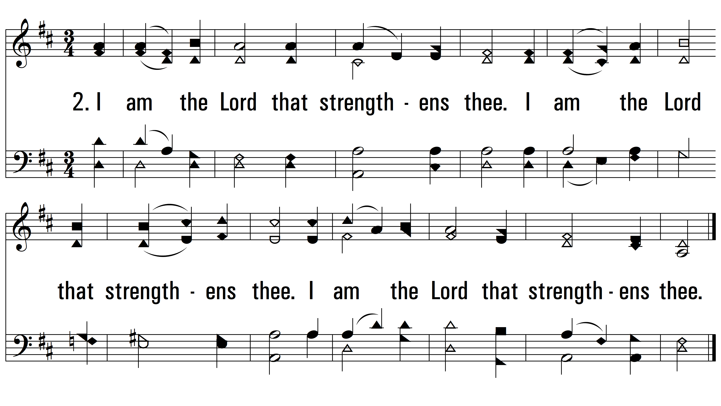
vs. 2 ~ Be Still And Know

