Slide 1
Be Still, My Soul
FINLANDIA
10.10.10.10.10.10
Words: | Katharina von Schlegel (1752), Tr. by Jane L. Borthwick (1855)
Music: | Jean Sibelius (1899)
2/2
F/A - MI
Verses: 3
Lead - | MI
Alto - | DO
Tenor - | SOL
Bass - | DO
PDHymns.com

Slide 2
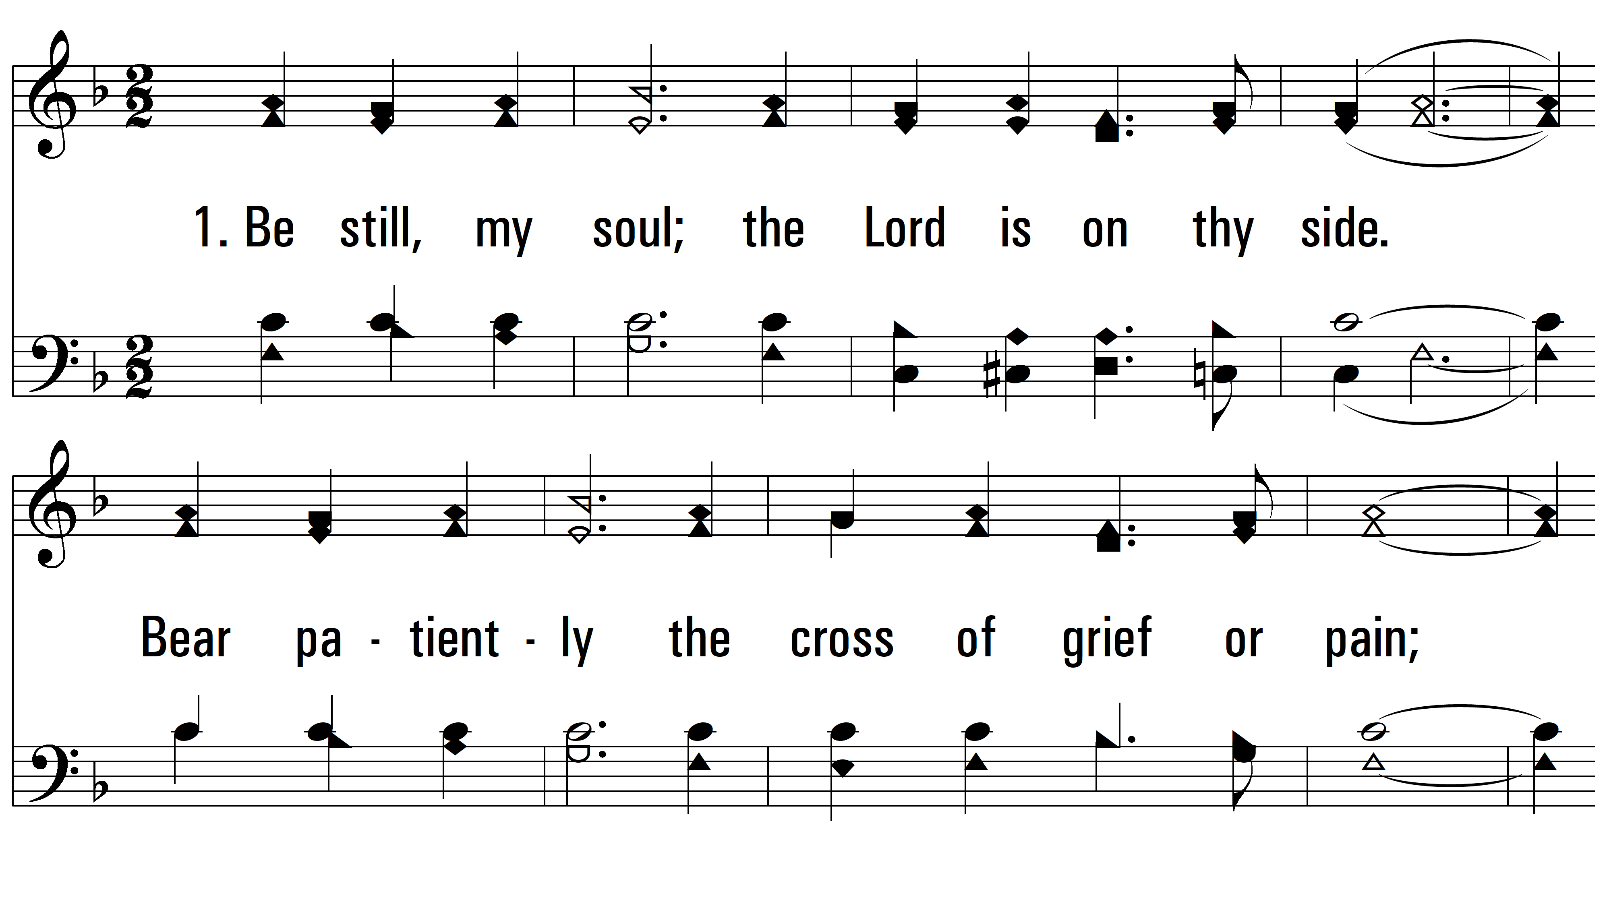
vs. 1 ~ Be Still, My Soul

Slide 3
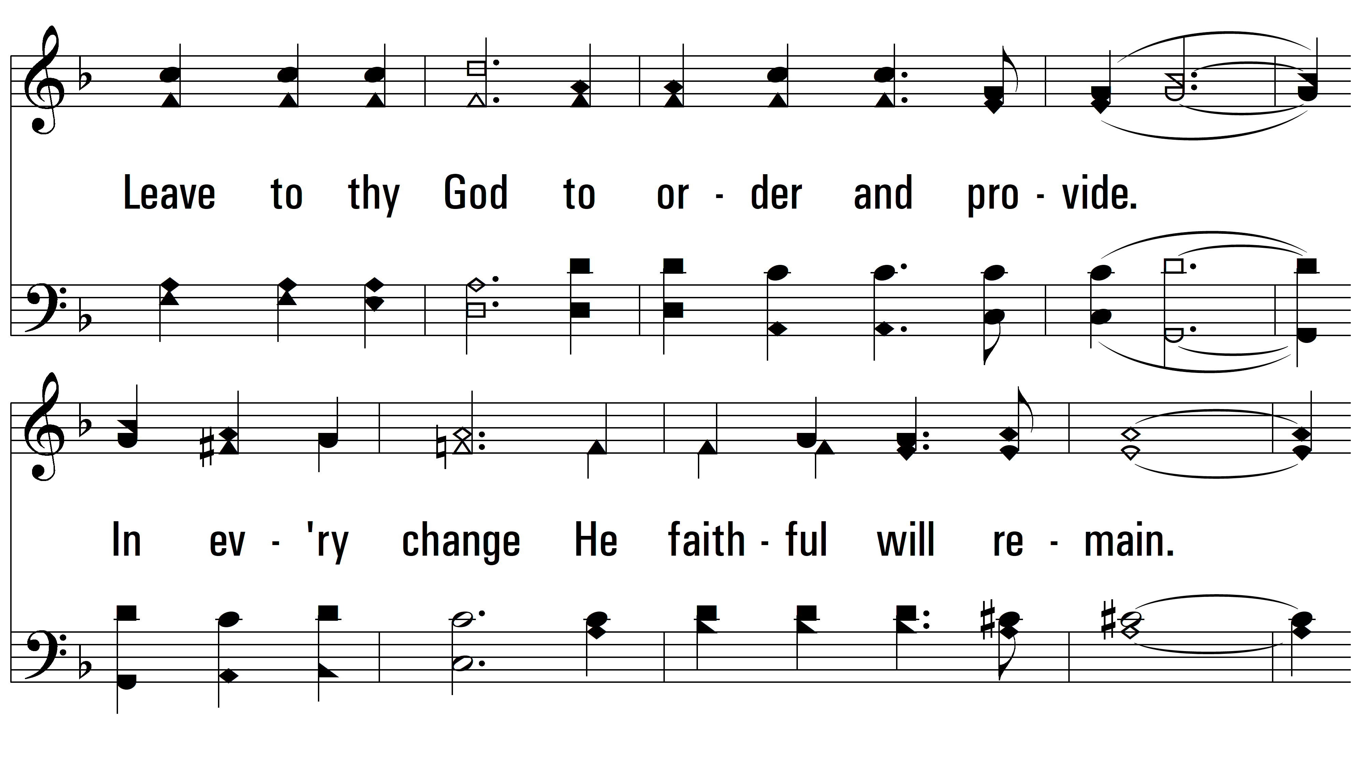
vs. 1

Slide 4
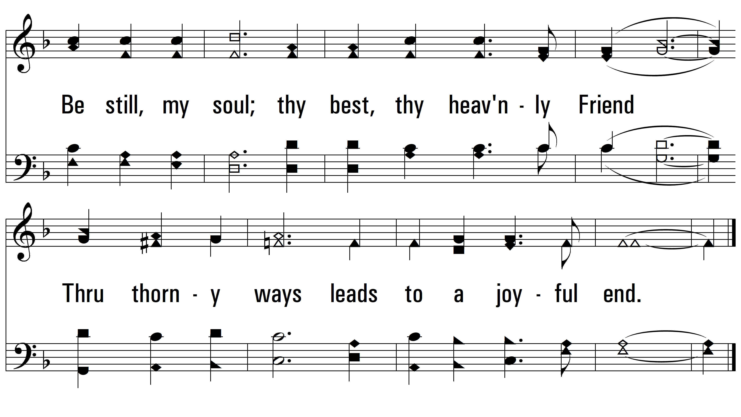
vs. 1

Slide 5
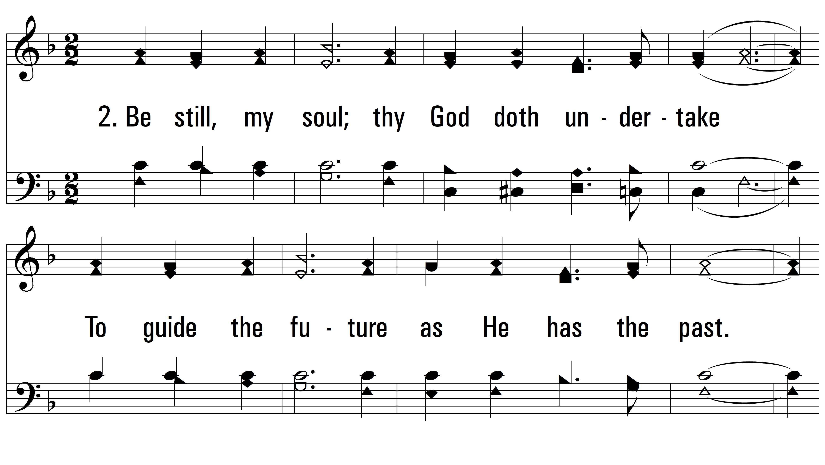
vs. 2 ~ Be Still, My Soul

Slide 6
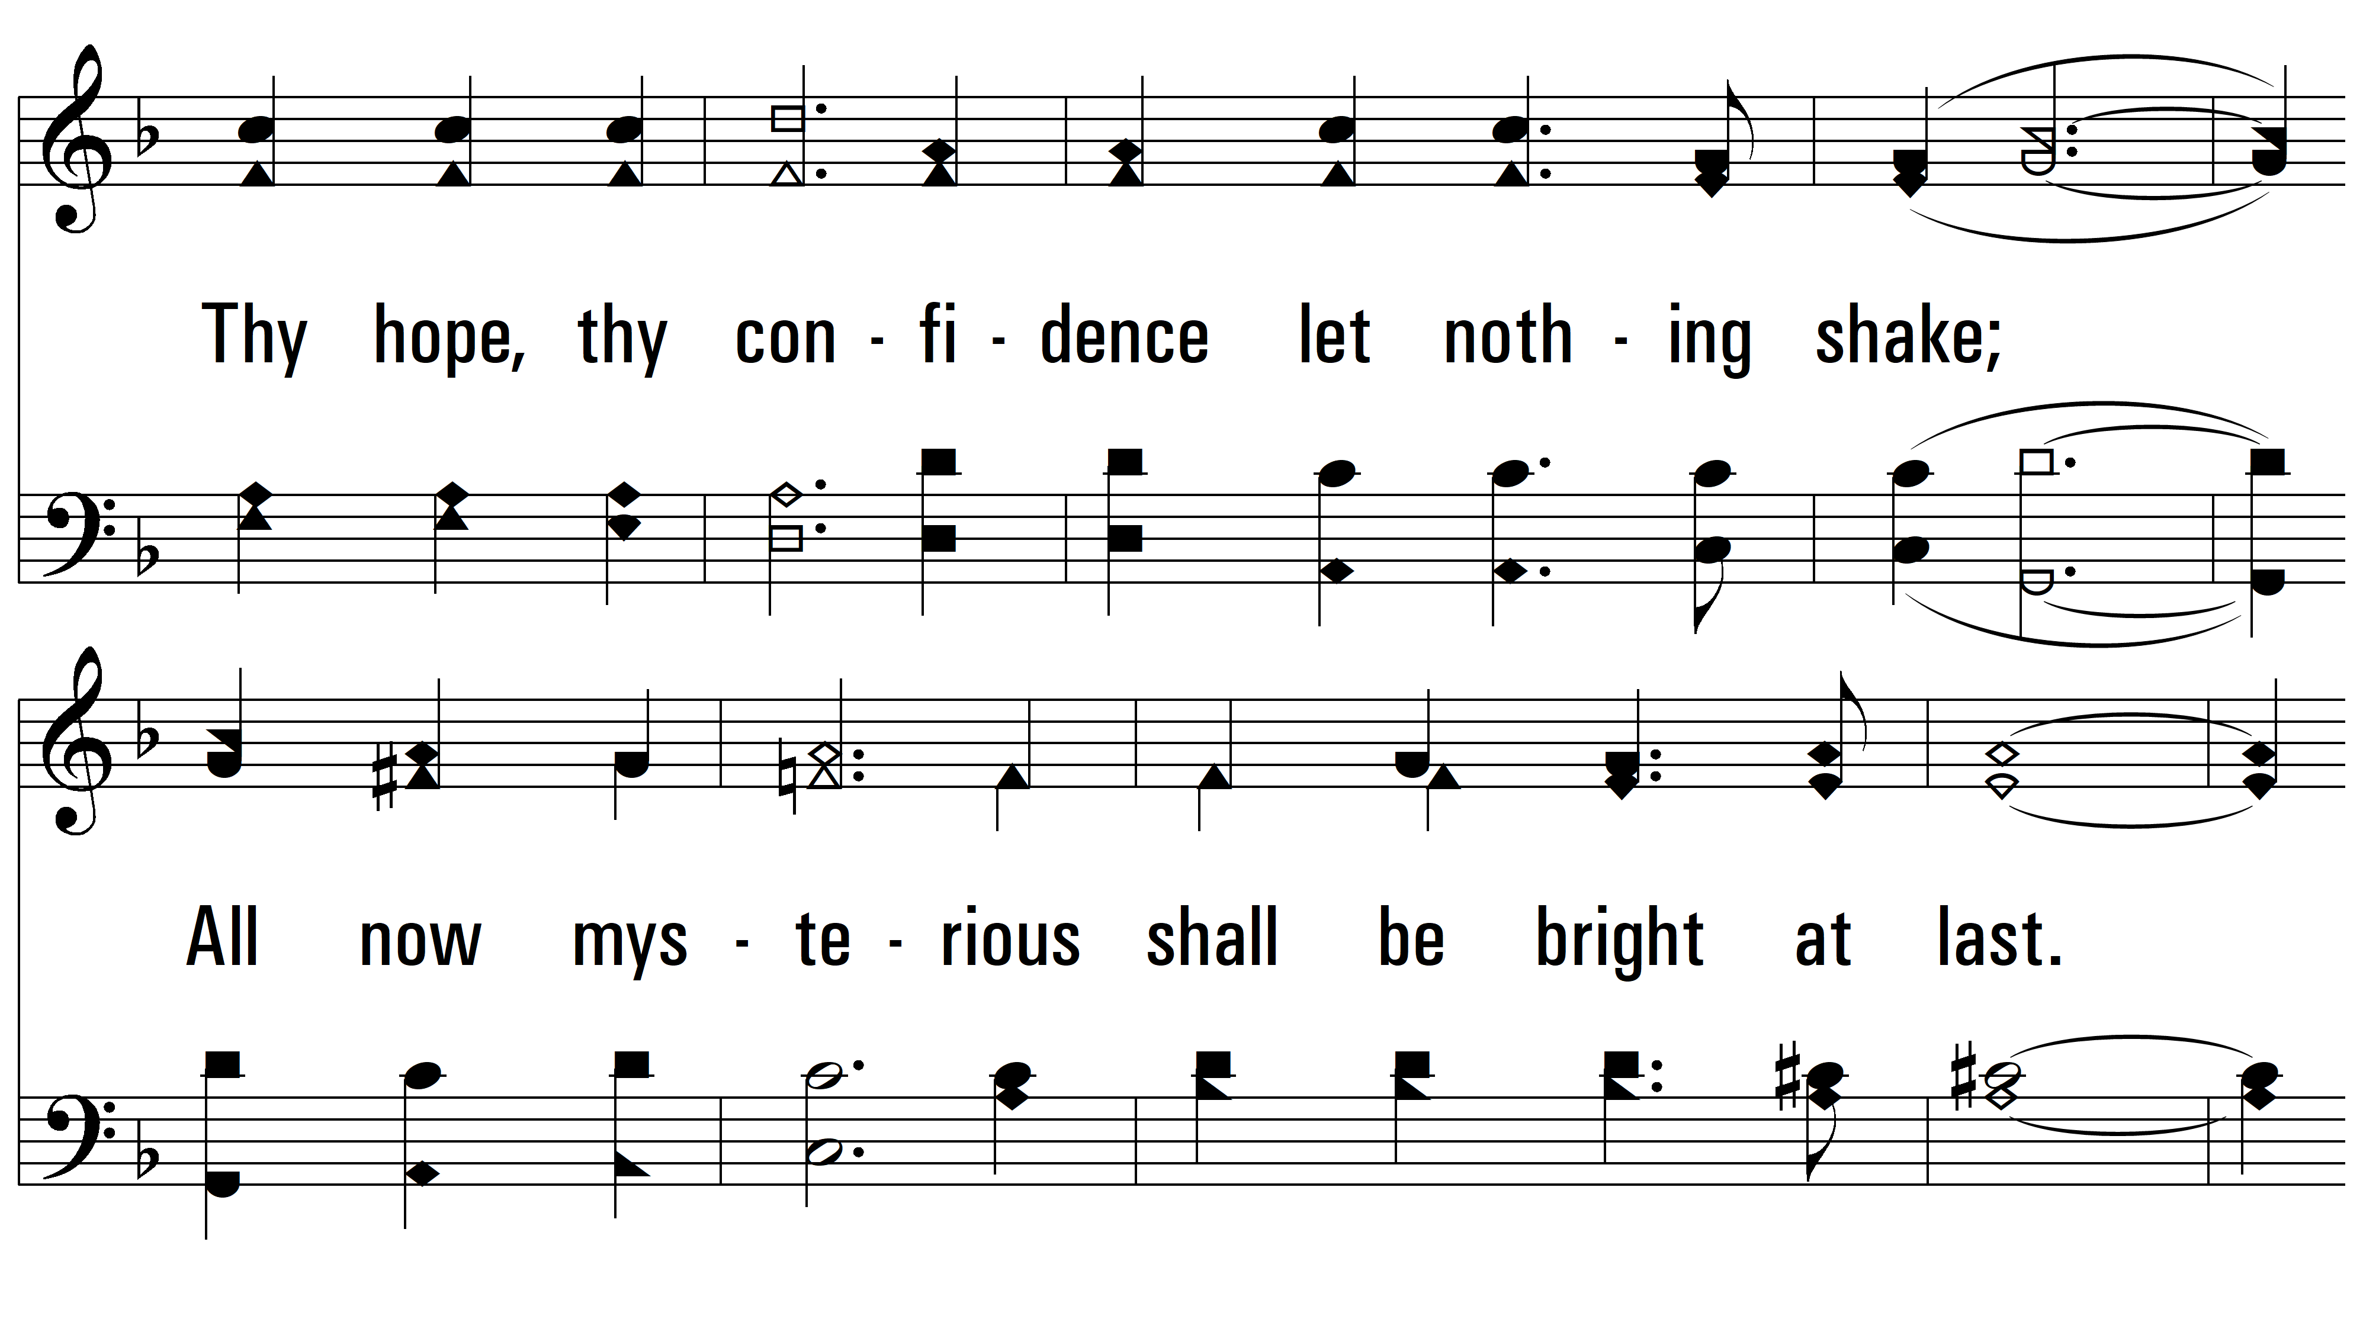
vs. 2

Slide 7
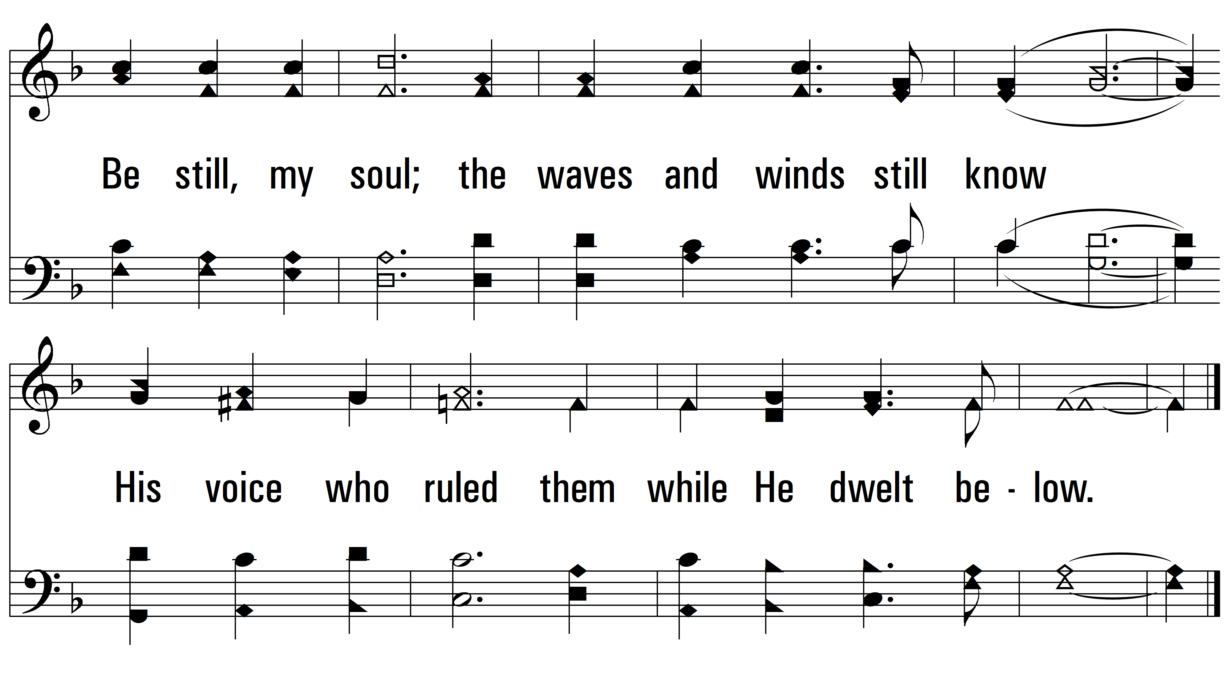
vs. 2

Slide 8
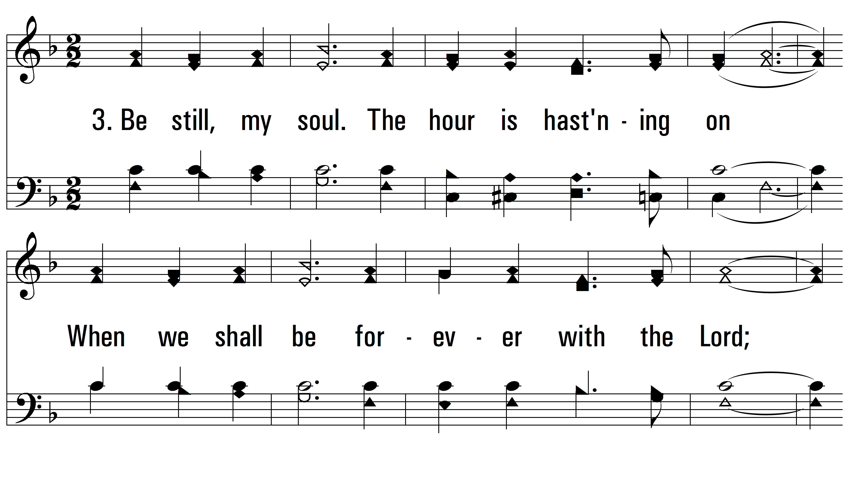
vs. 3 ~ Be Still, My Soul

Slide 9
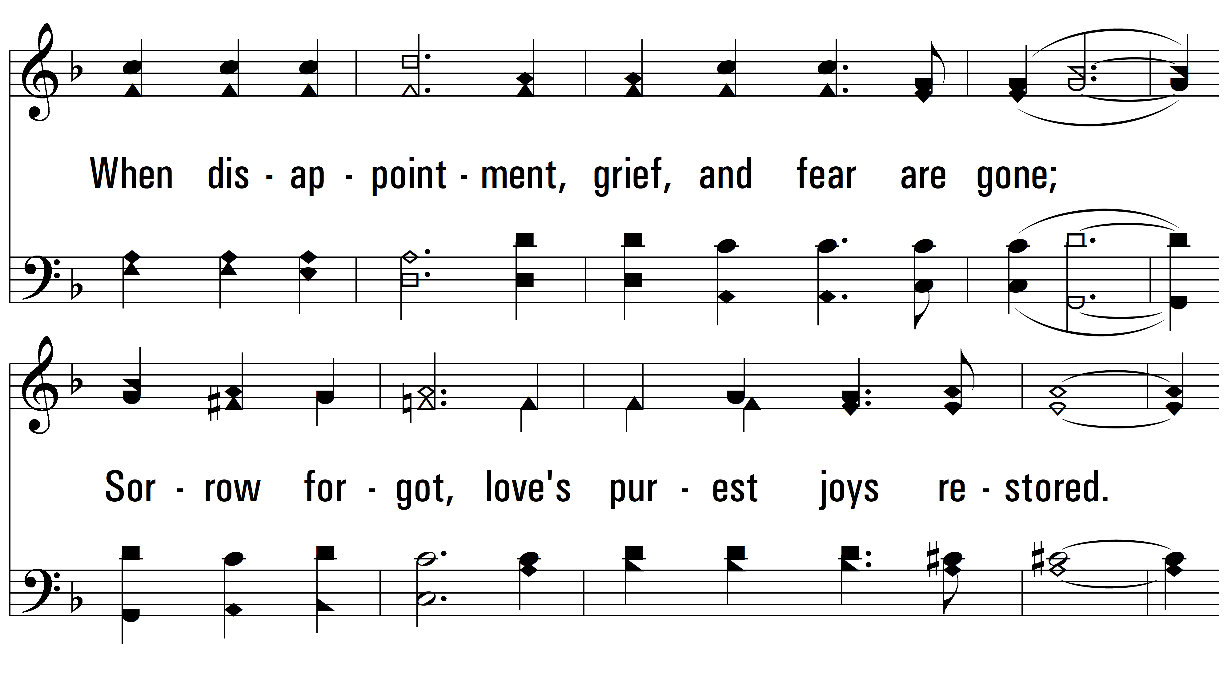
vs. 3

Slide 10
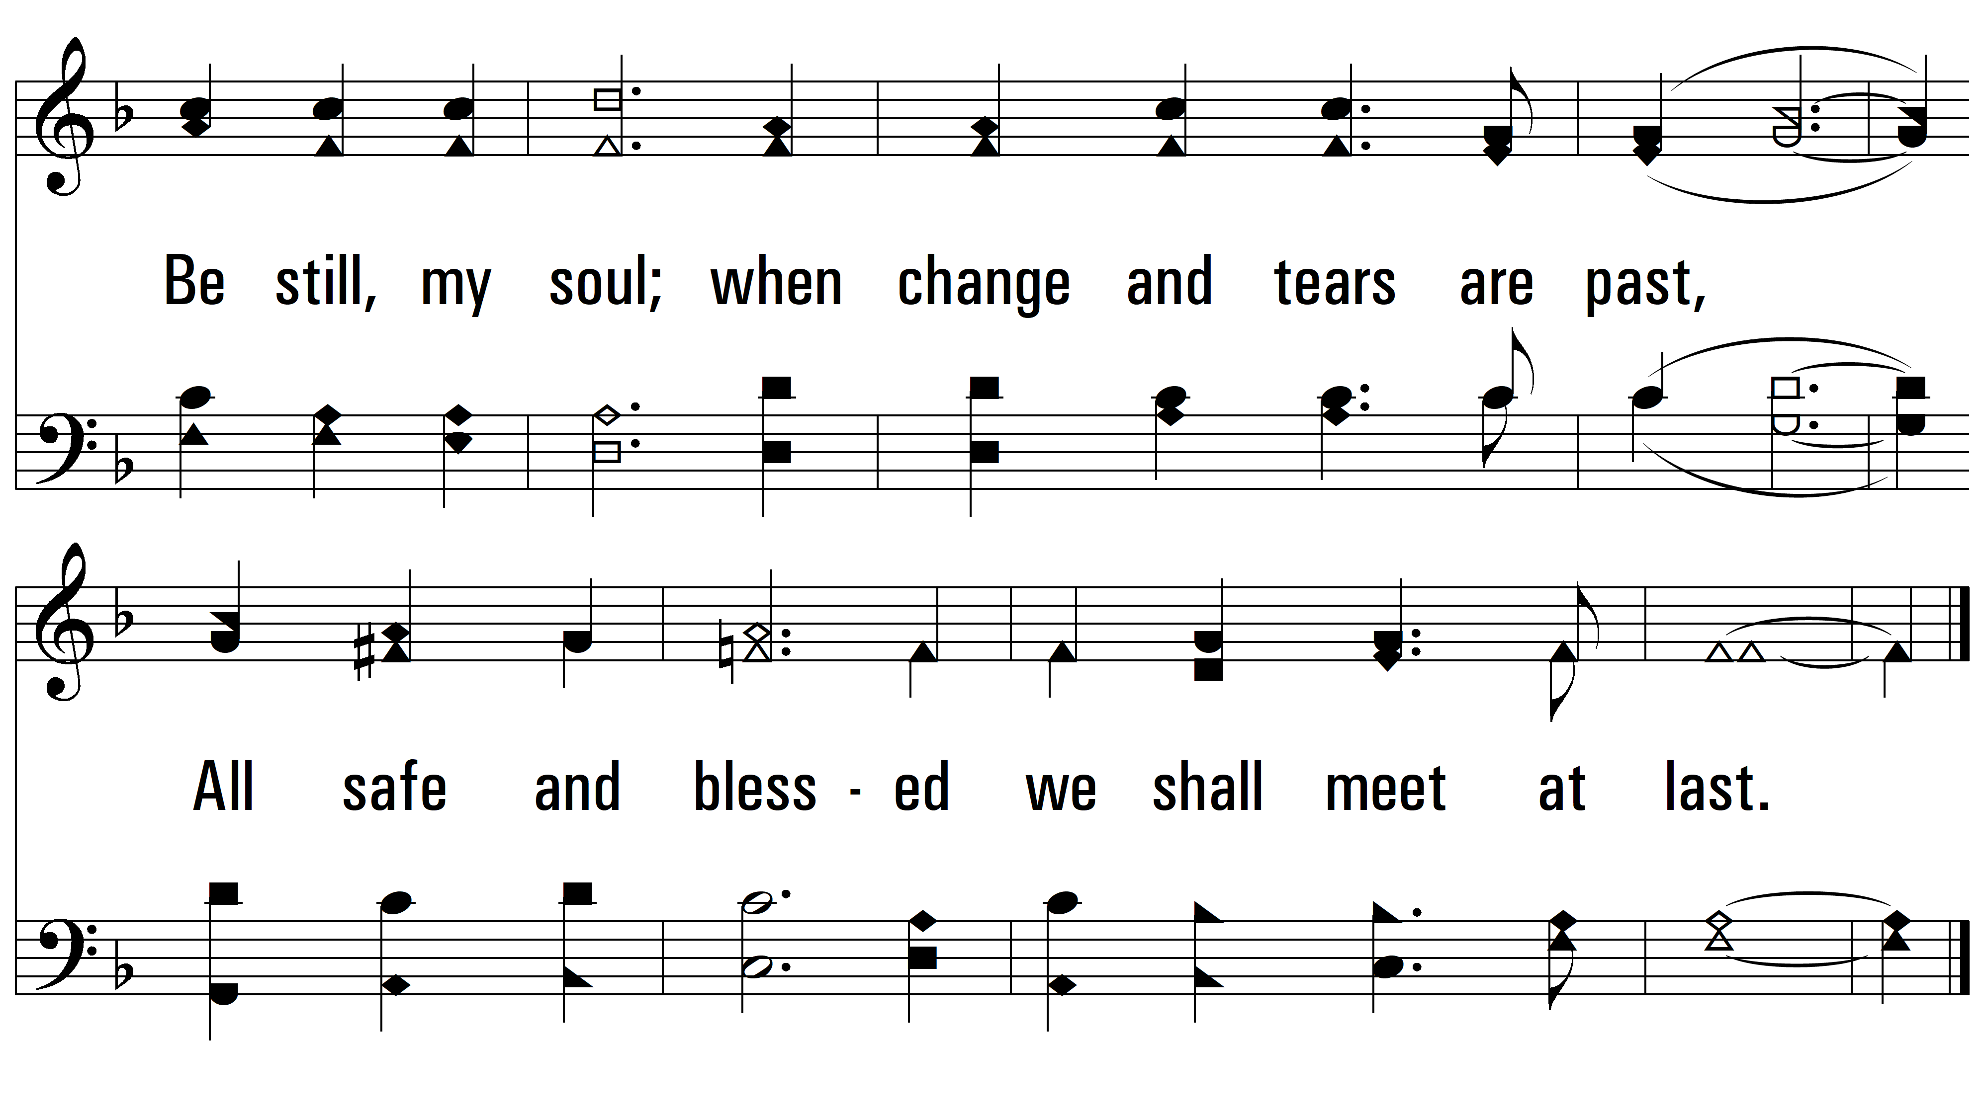
vs. 3
PDHymns.com
END

