Slide 1
Be Not Dismayed Whate’er Betide
(God Will Take Care Of You)
Words: | Civilla D. Marin (1904)
Music: | W. Stillman Martin (1904)
6/8
B^{b}/D - MI
Verses: 5/Chorus
Lead - | MI
Alto - | DO
Tenor - | SOL
Bass - | DO
PDHymns.com

Slide 2
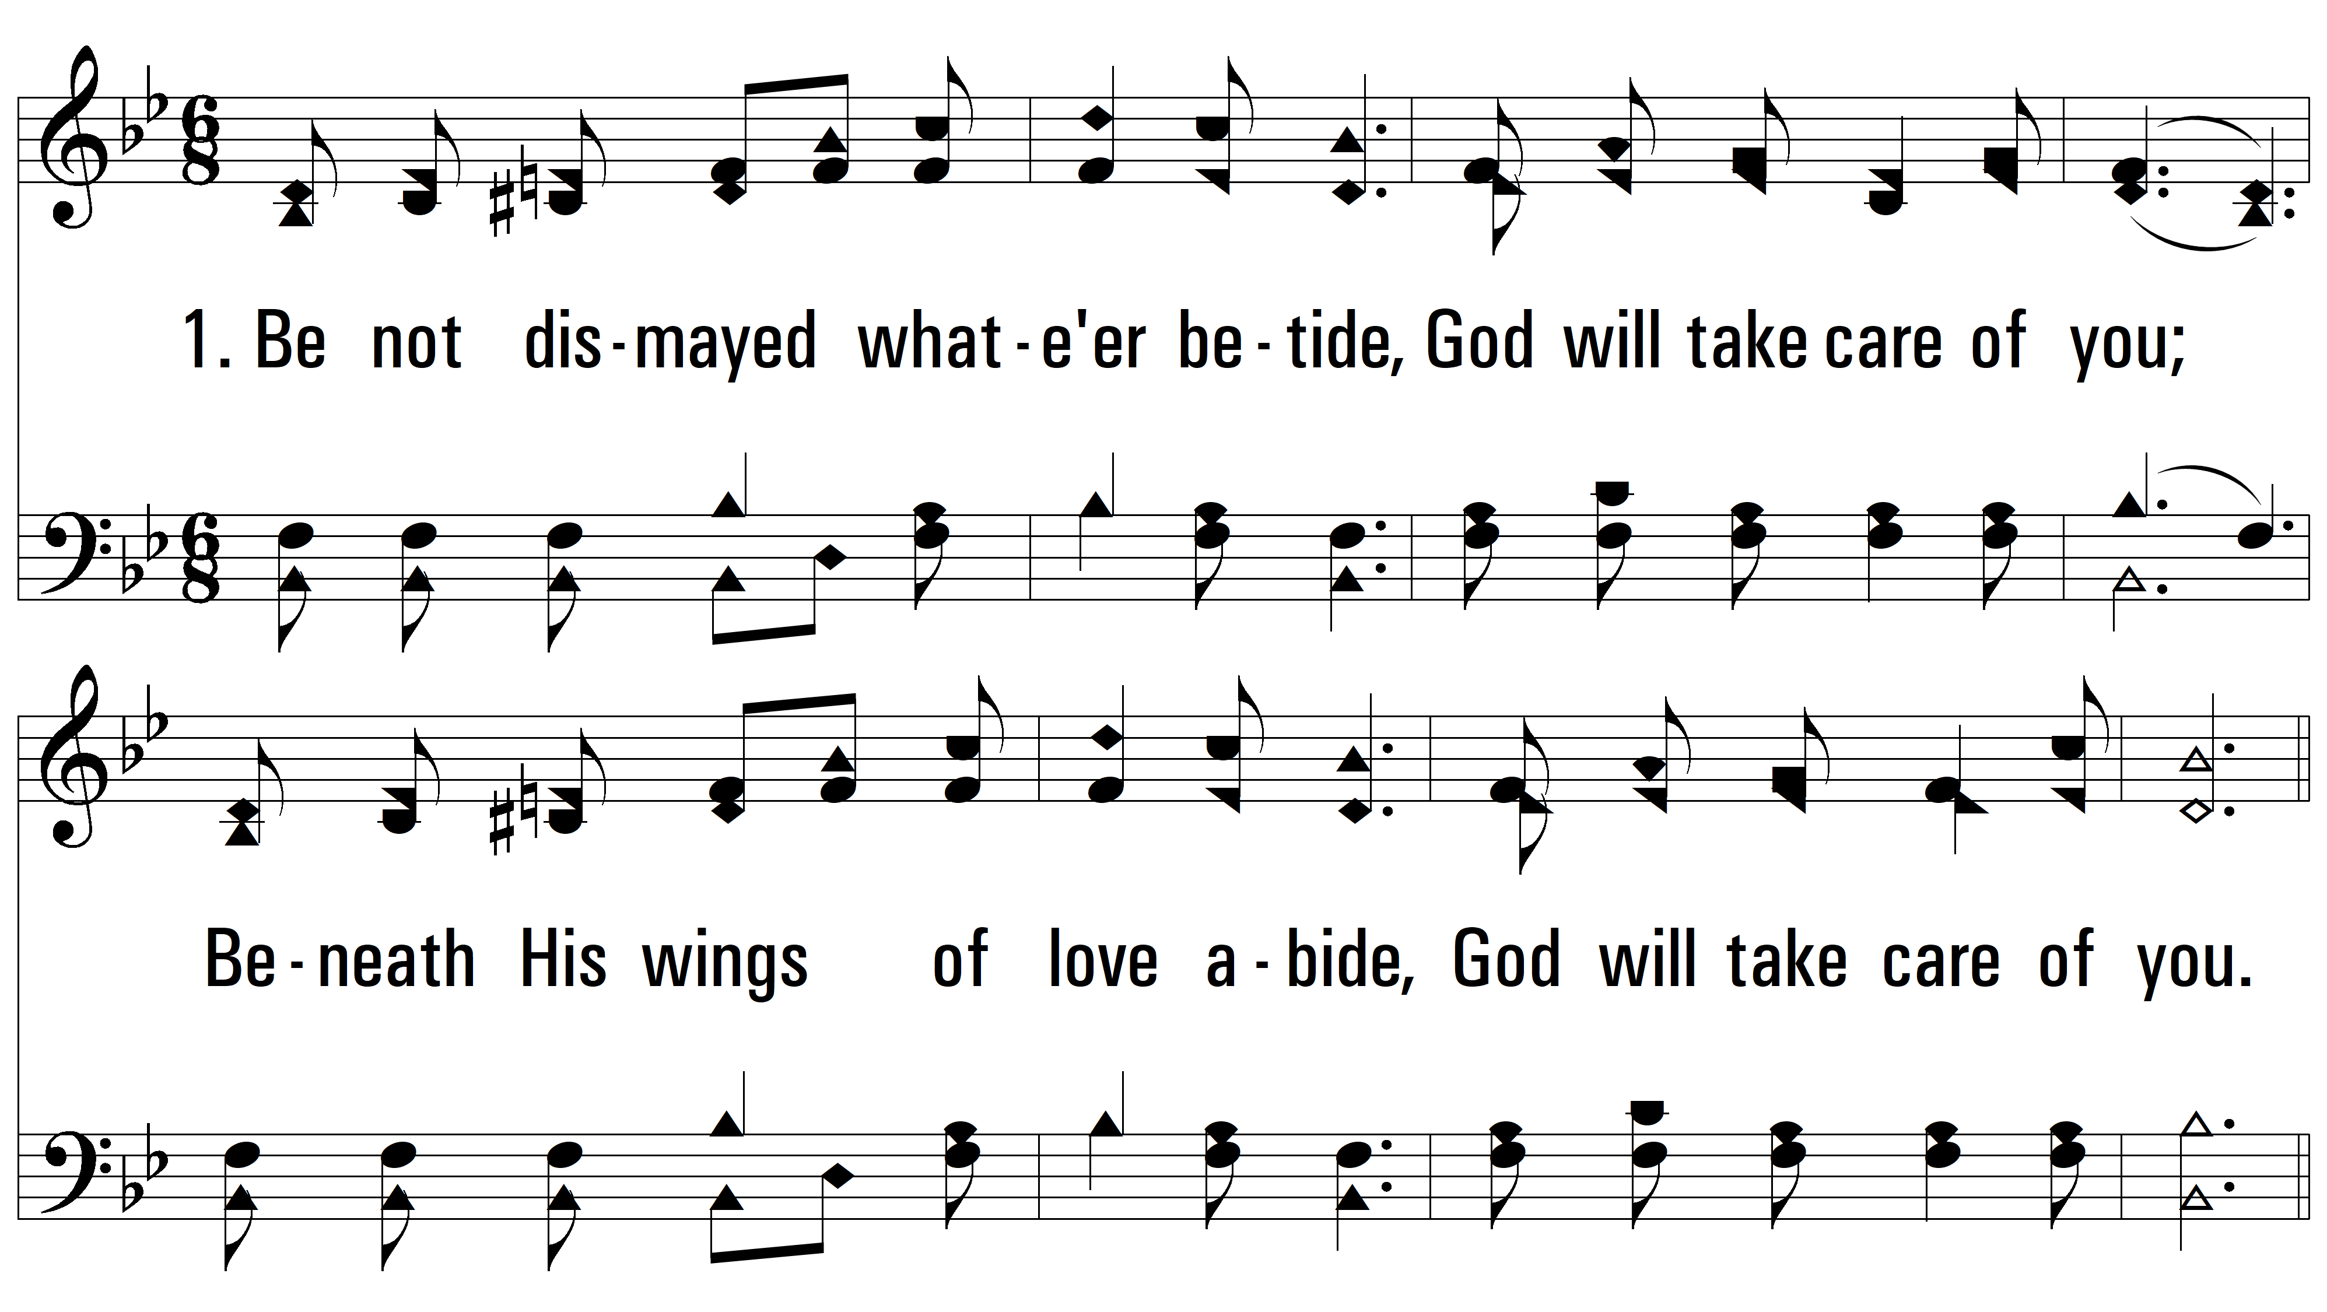
vs. 1 ~ Be Not Dismayed Whate’er Betide

Slide 3
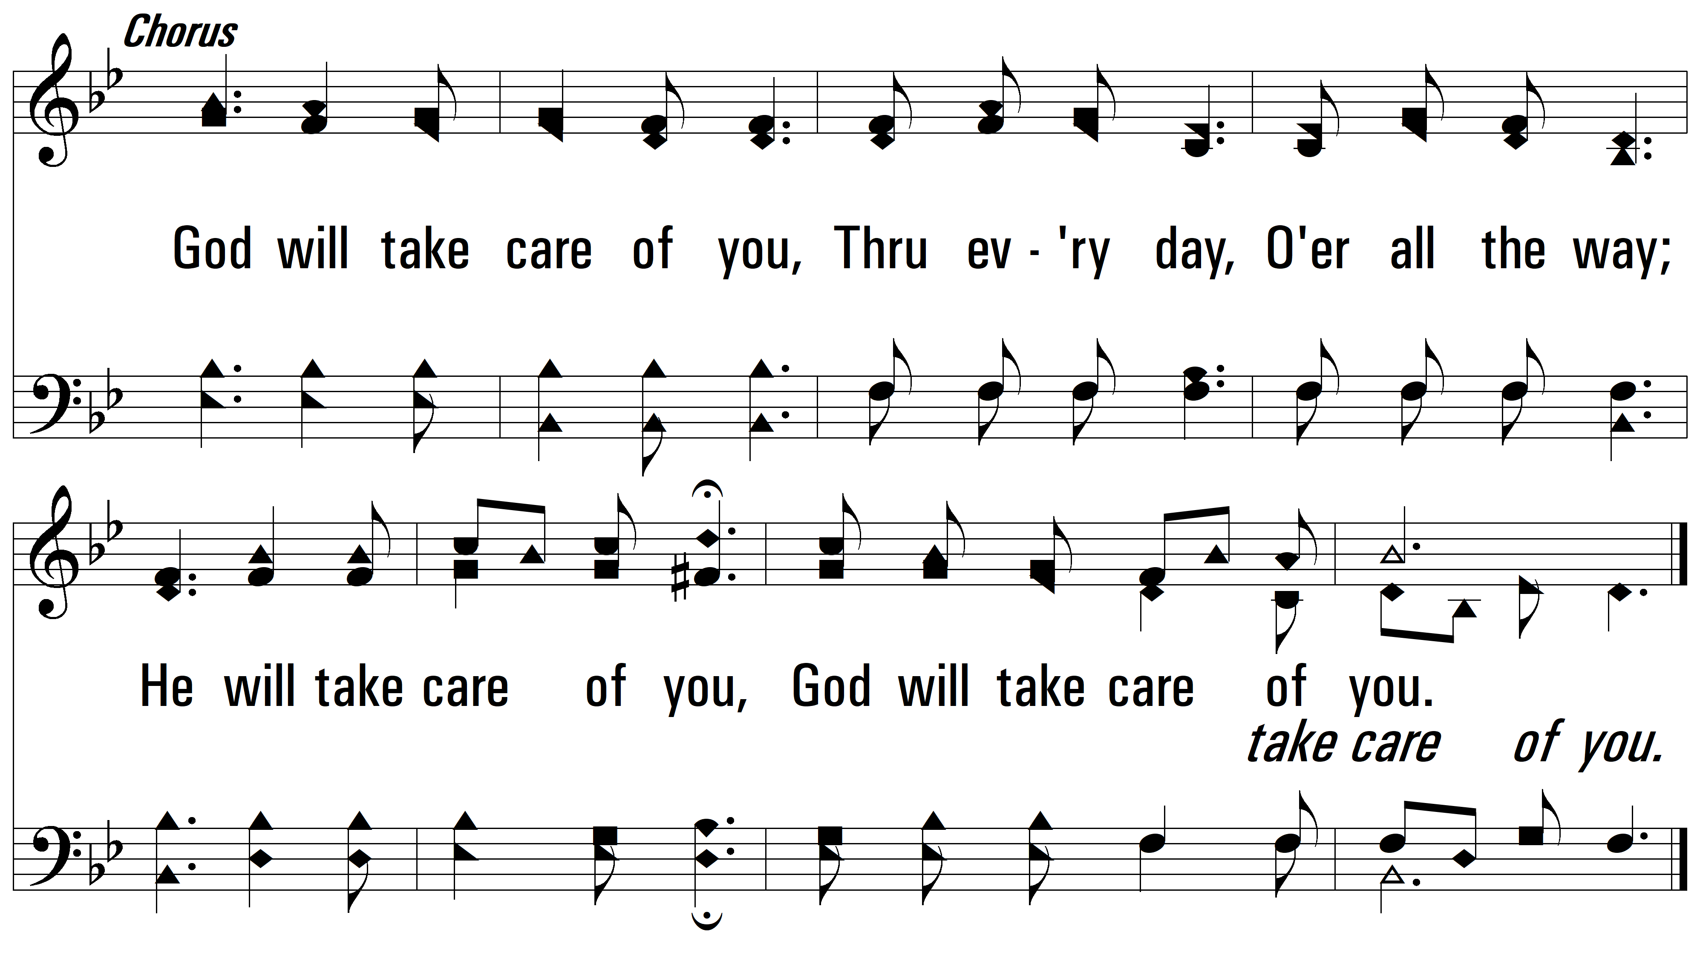
vs. 1

Slide 4
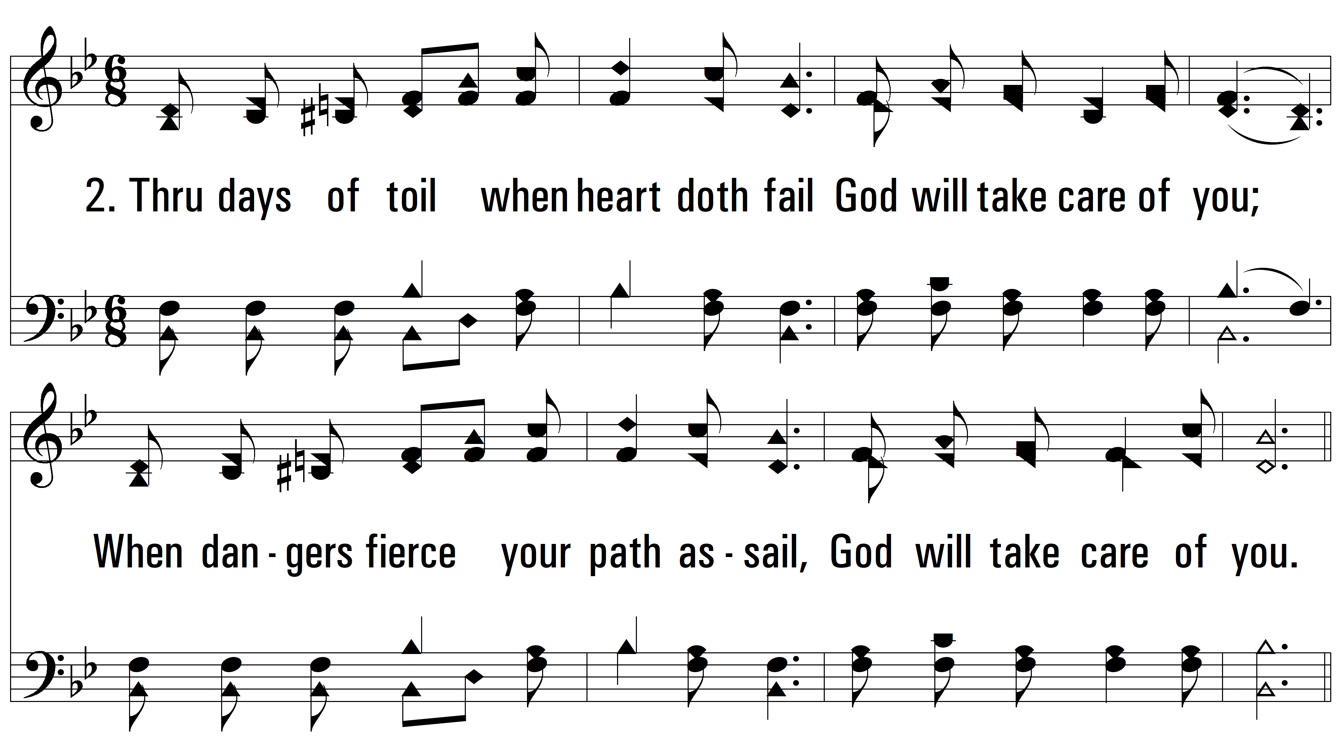
vs. 2 ~ Be Not Dismayed Whate’er Betide

Slide 5
vs. 2

Slide 6
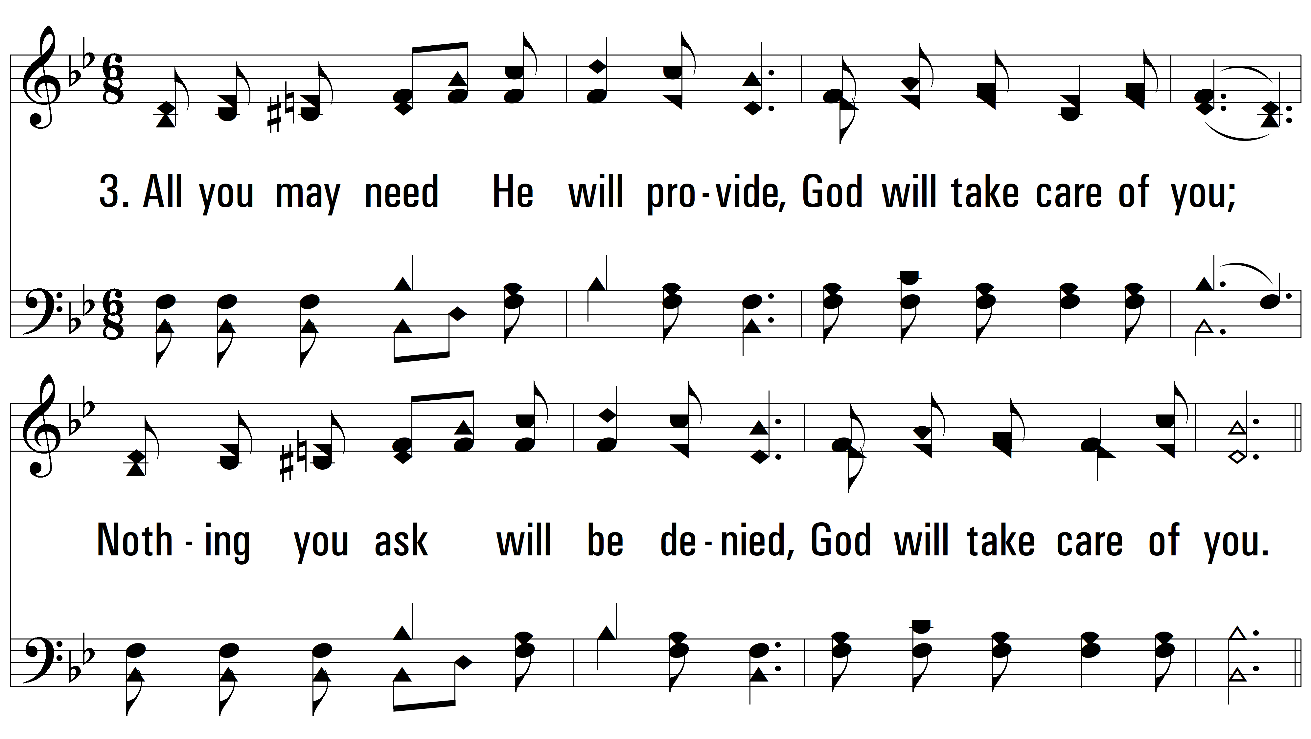
vs. 3 ~ Be Not Dismayed Whate’er Betide

Slide 7
vs. 3

Slide 8
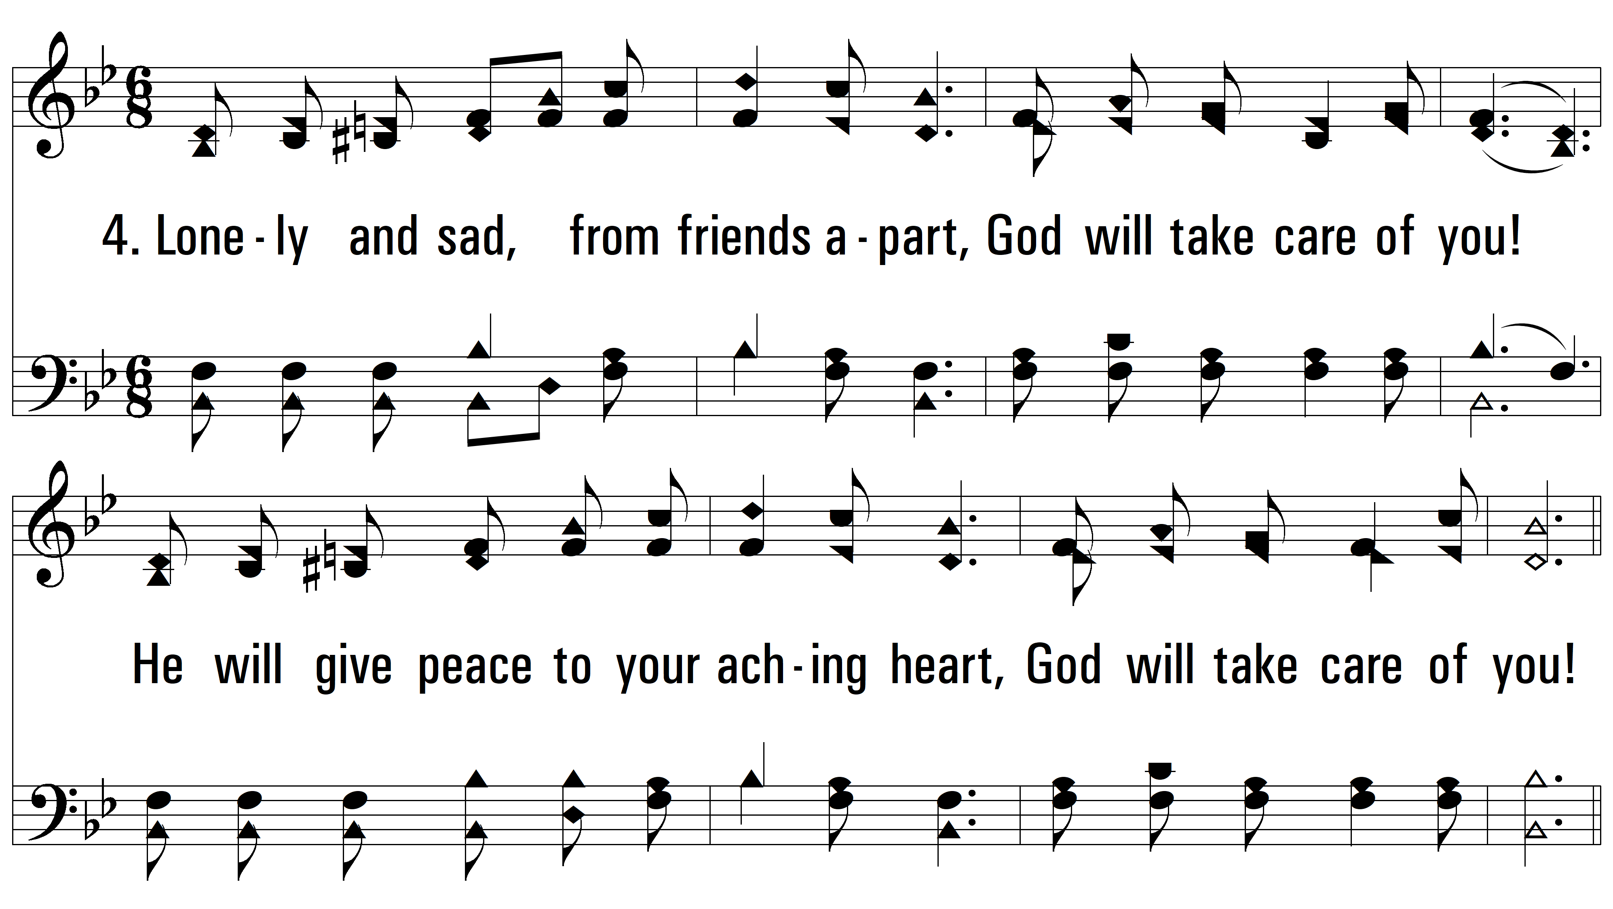
vs. 4 ~ Be Not Dismayed Whate’er Betide

Slide 9
vs. 4

Slide 10
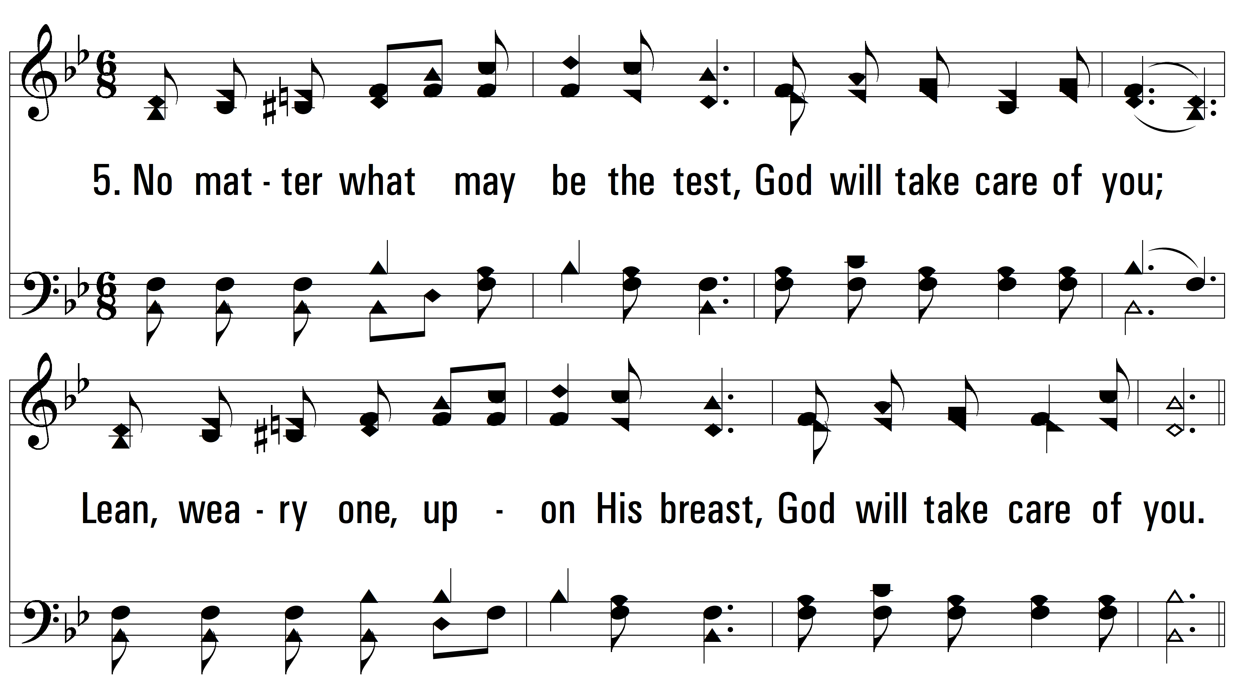
vs. 5 ~ Be Not Dismayed Whate’er Betide

Slide 11
vs. 5
PDHymns.com
END

