Slide 1
Baptized Into Our Savior’s Death
EVAN C. M.
Words: | Philip Doddridge (1702-1751)
Music: | Lowell Mason (1846), Arr. by William H. Havergal (1850)
3/2
A^{b}/E^{b} - SOL
Verses: 4
Lead - | SOL
Alto - | MI
Tenor - | DO
Bass - | DO
PDHymns.com

Slide 2
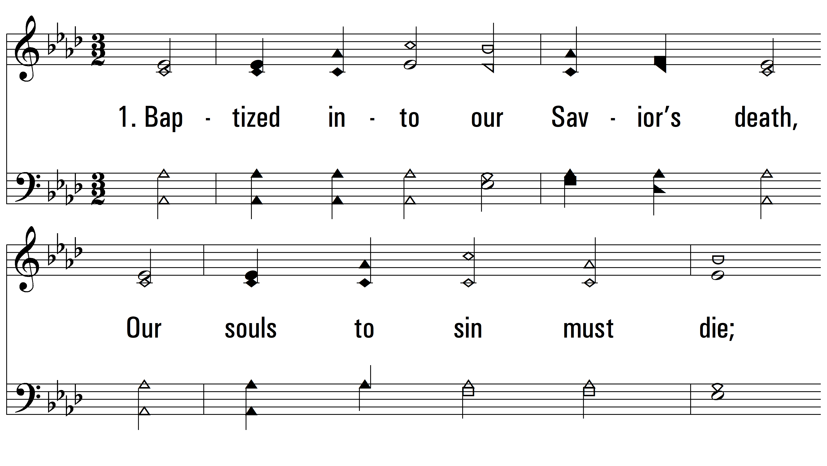
vs. 1 ~ Baptized Into Our Savior’s Death

Slide 3
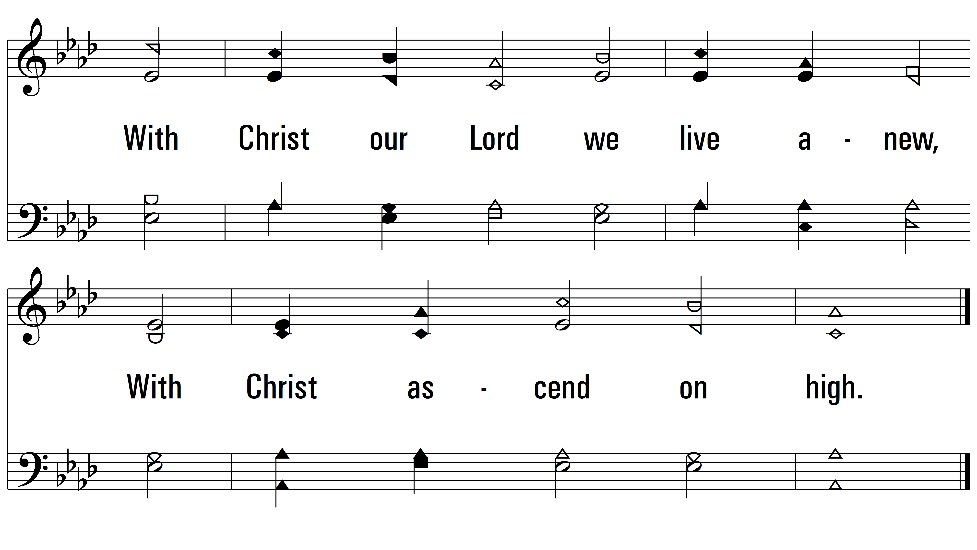
vs. 1

Slide 4
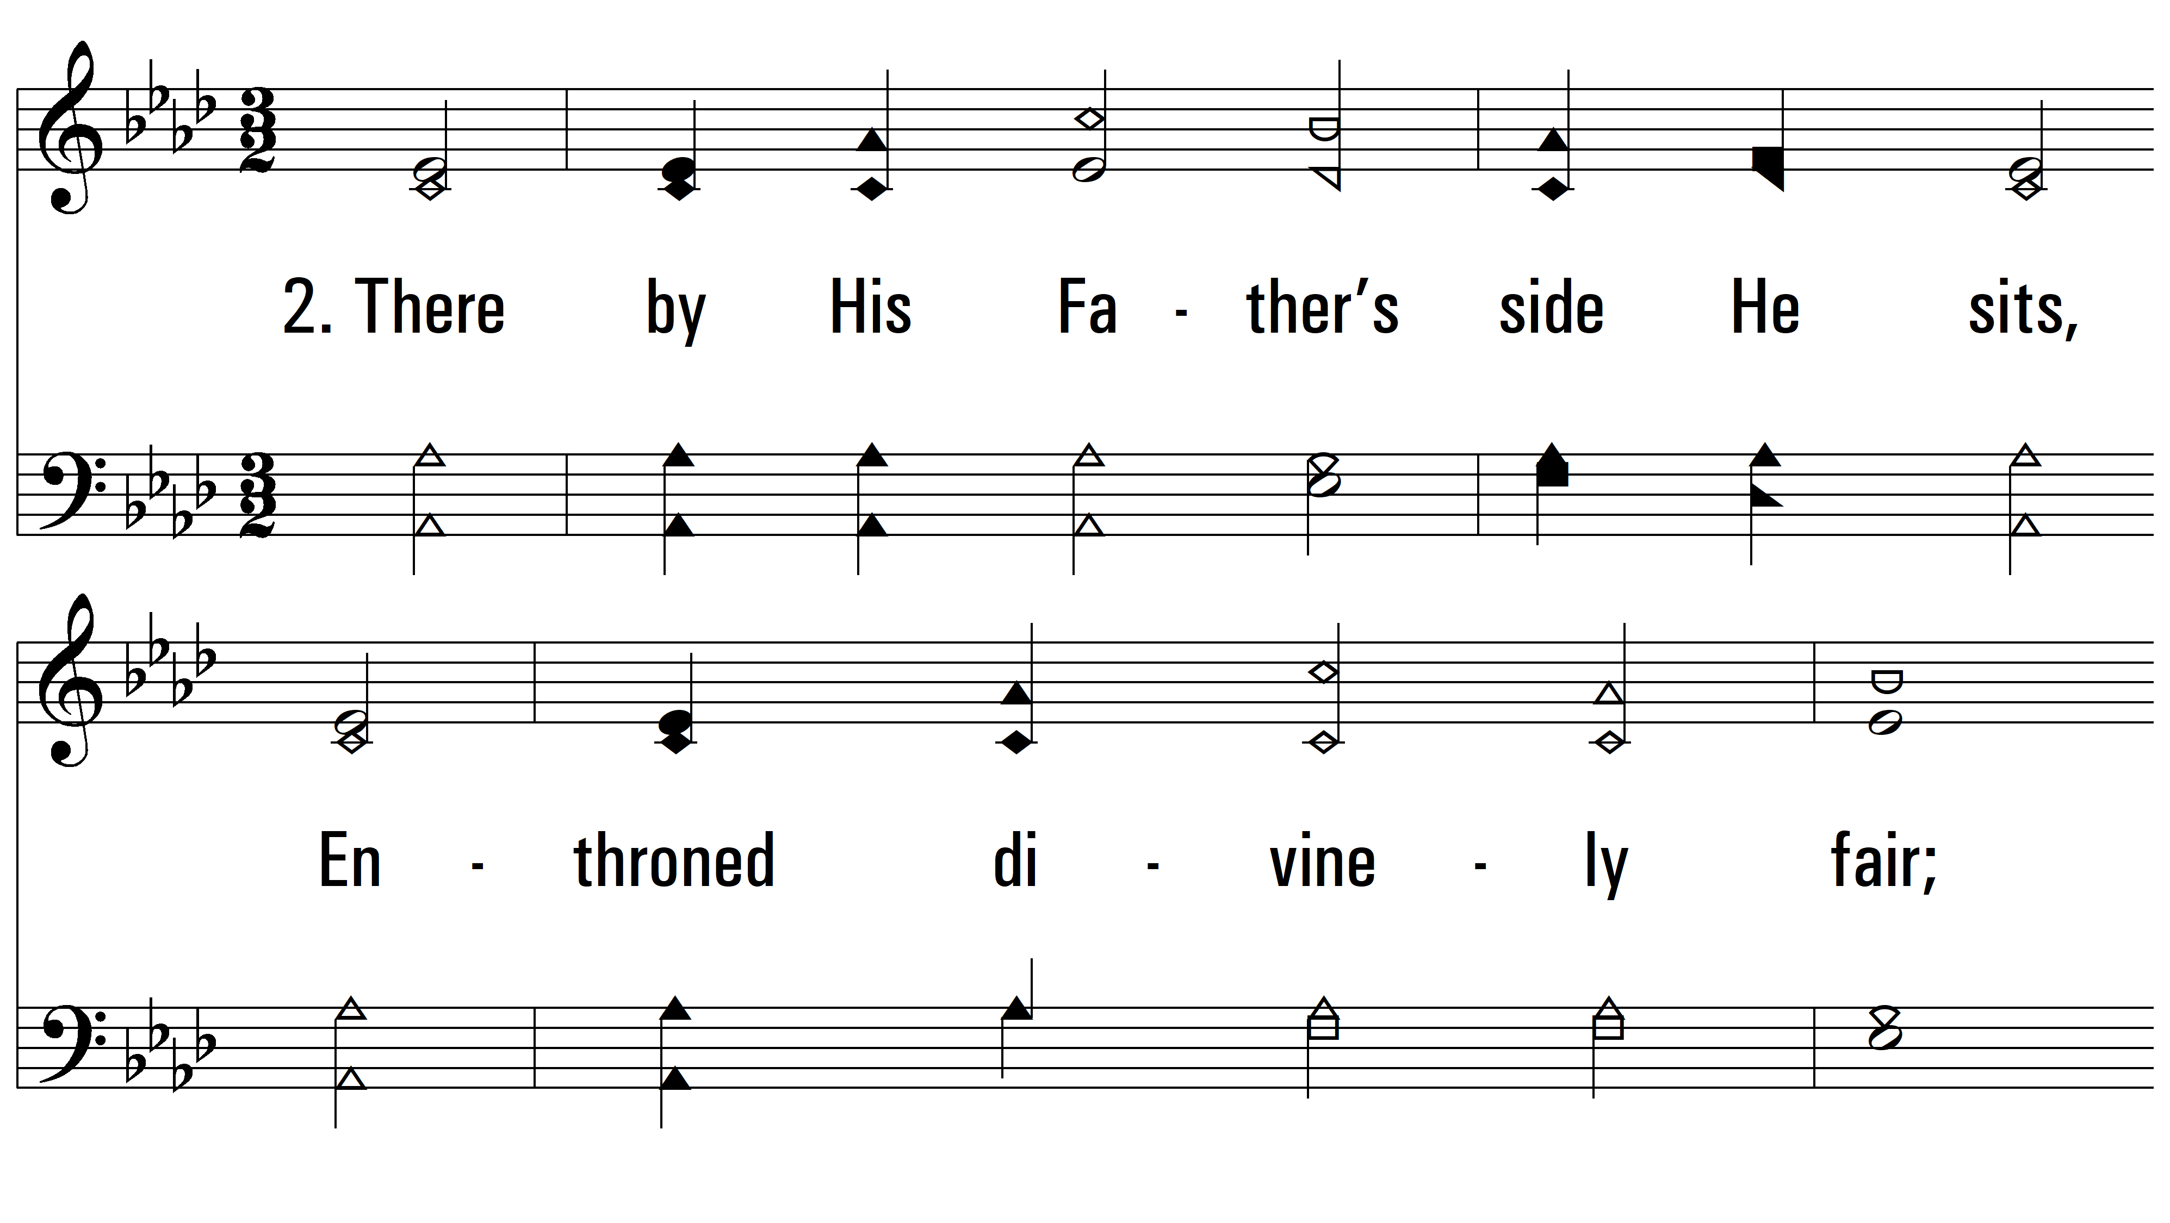
vs. 2 ~ Baptized Into Our Savior’s Death

Slide 5
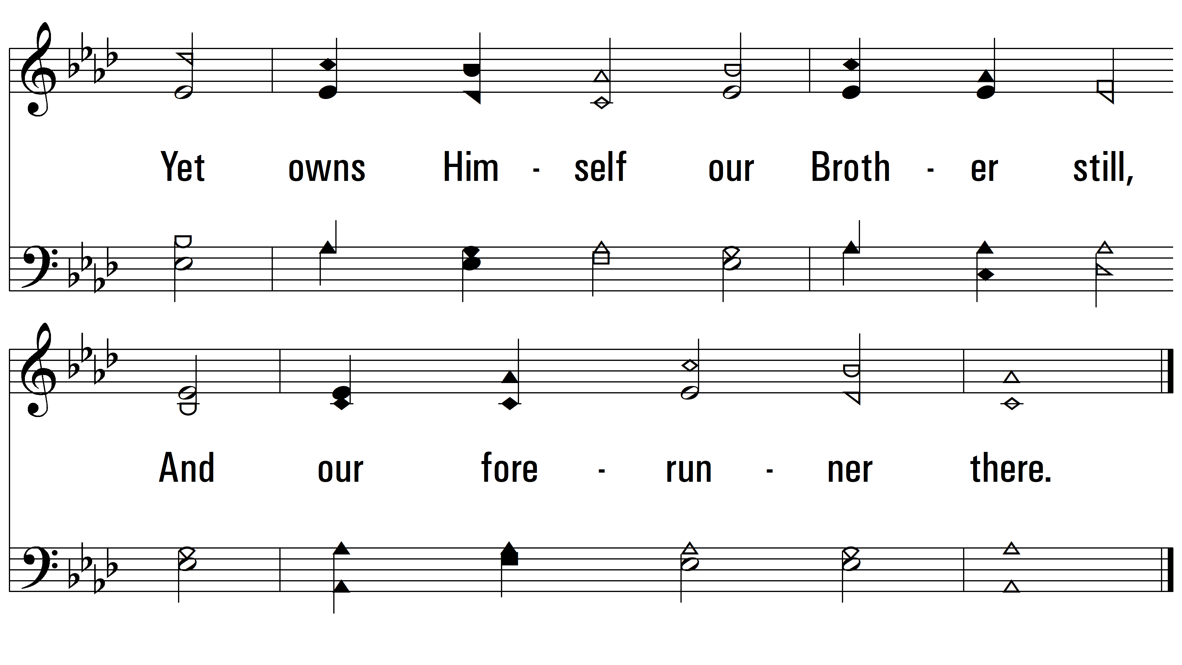
vs. 2

Slide 6
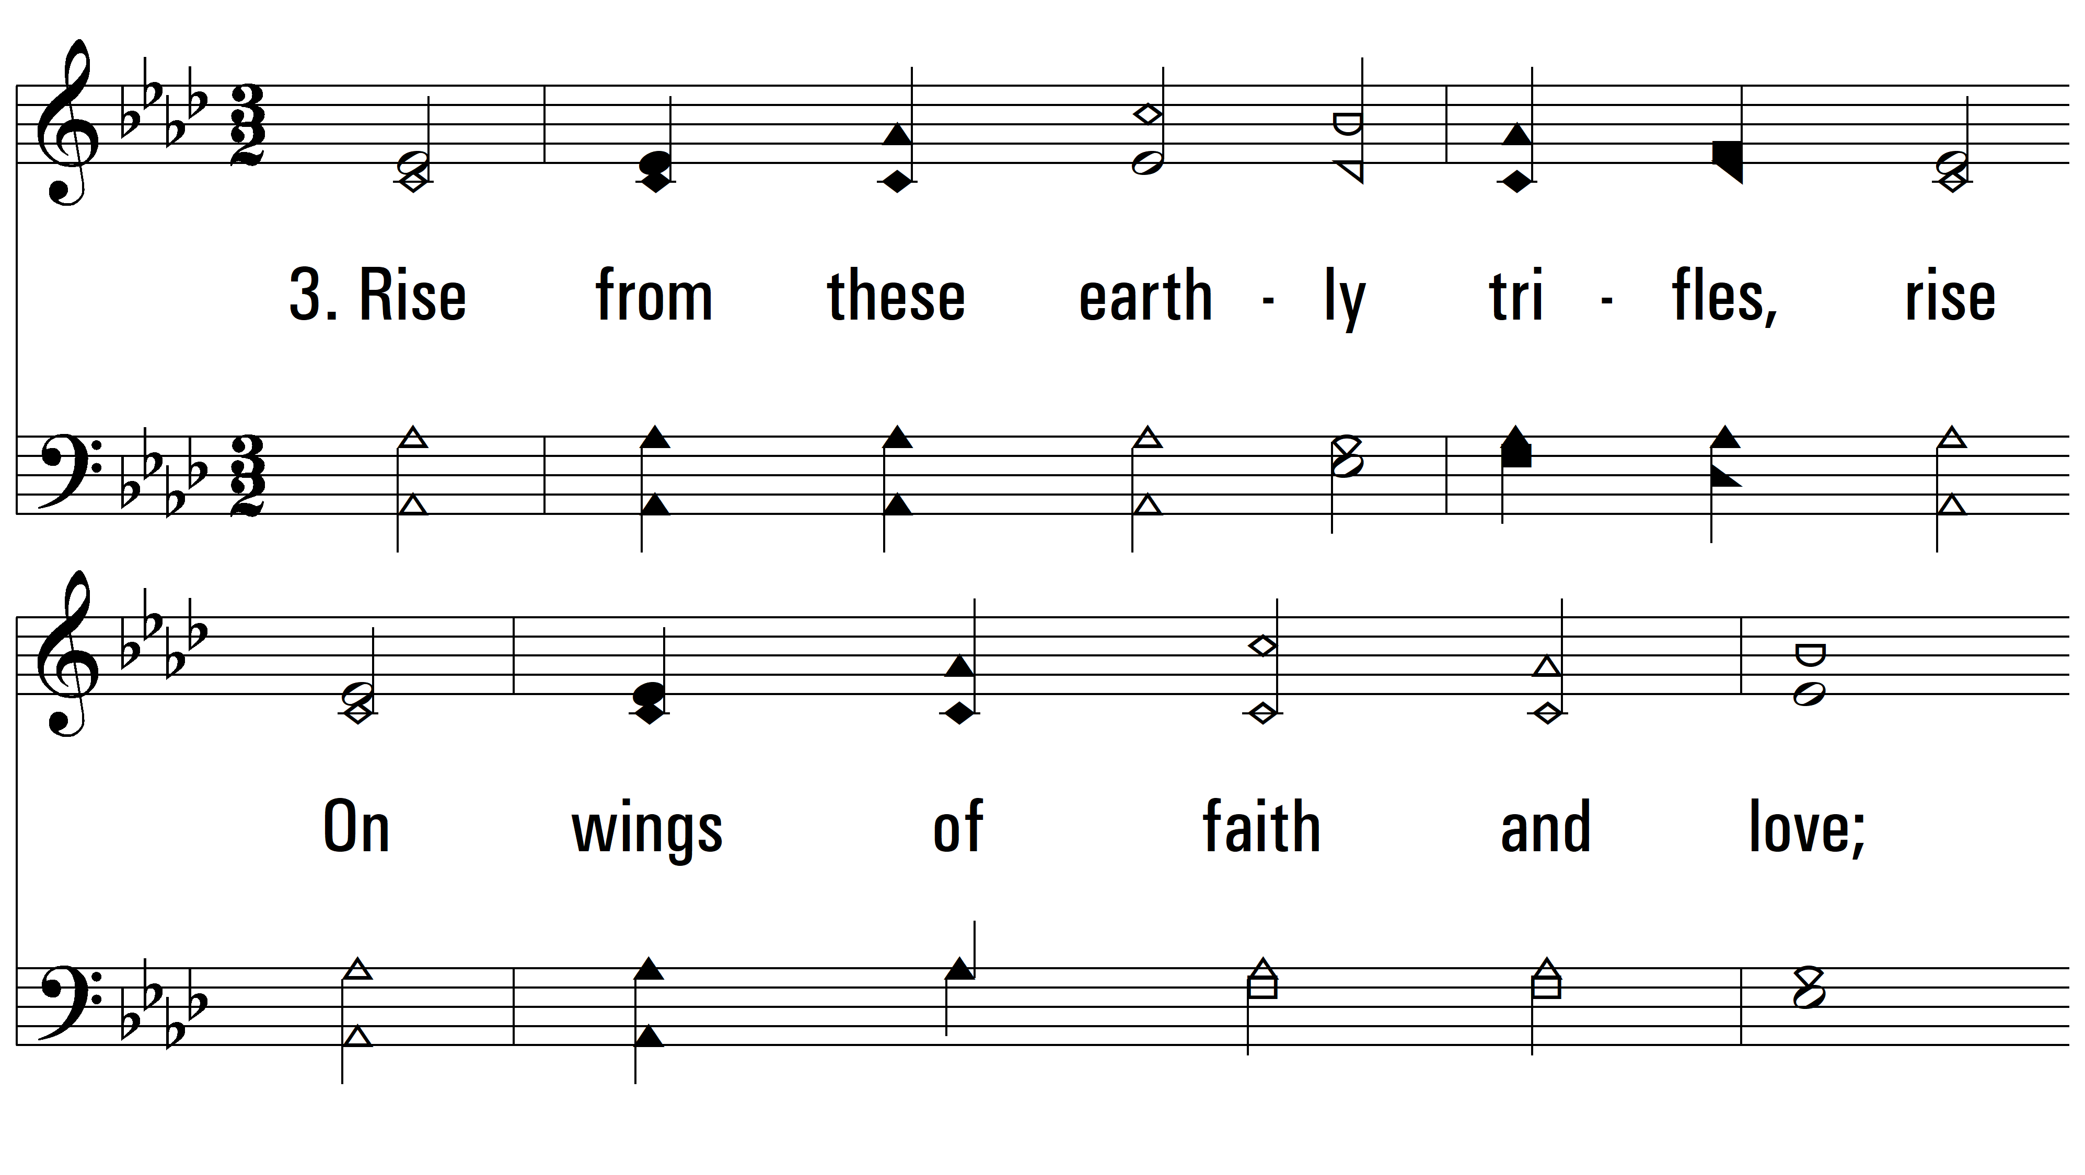
vs. 3 ~ Baptized Into Our Savior’s Death

Slide 7
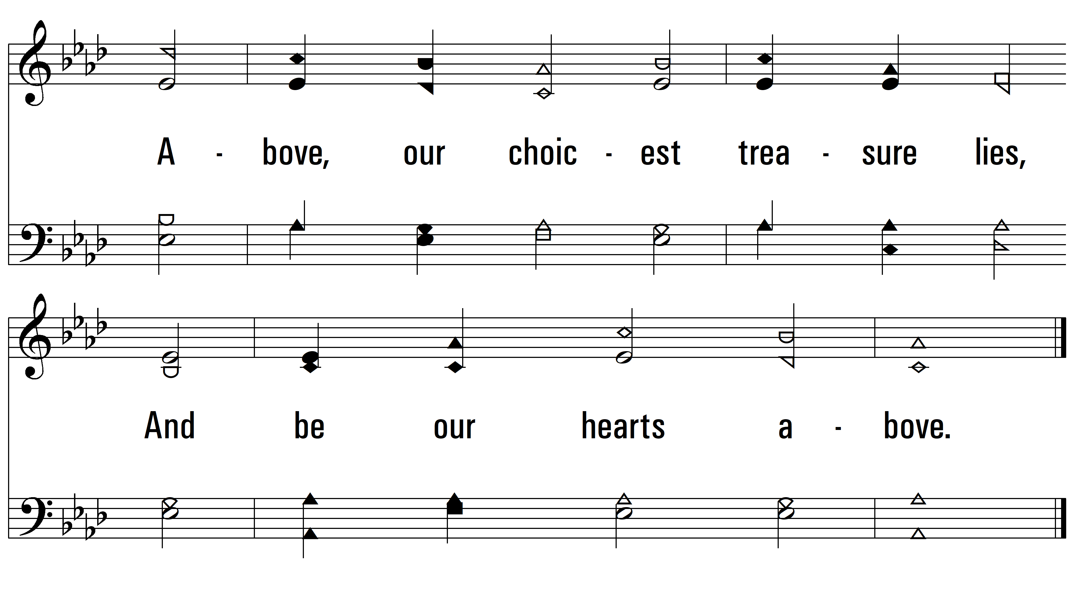
vs. 3

Slide 8
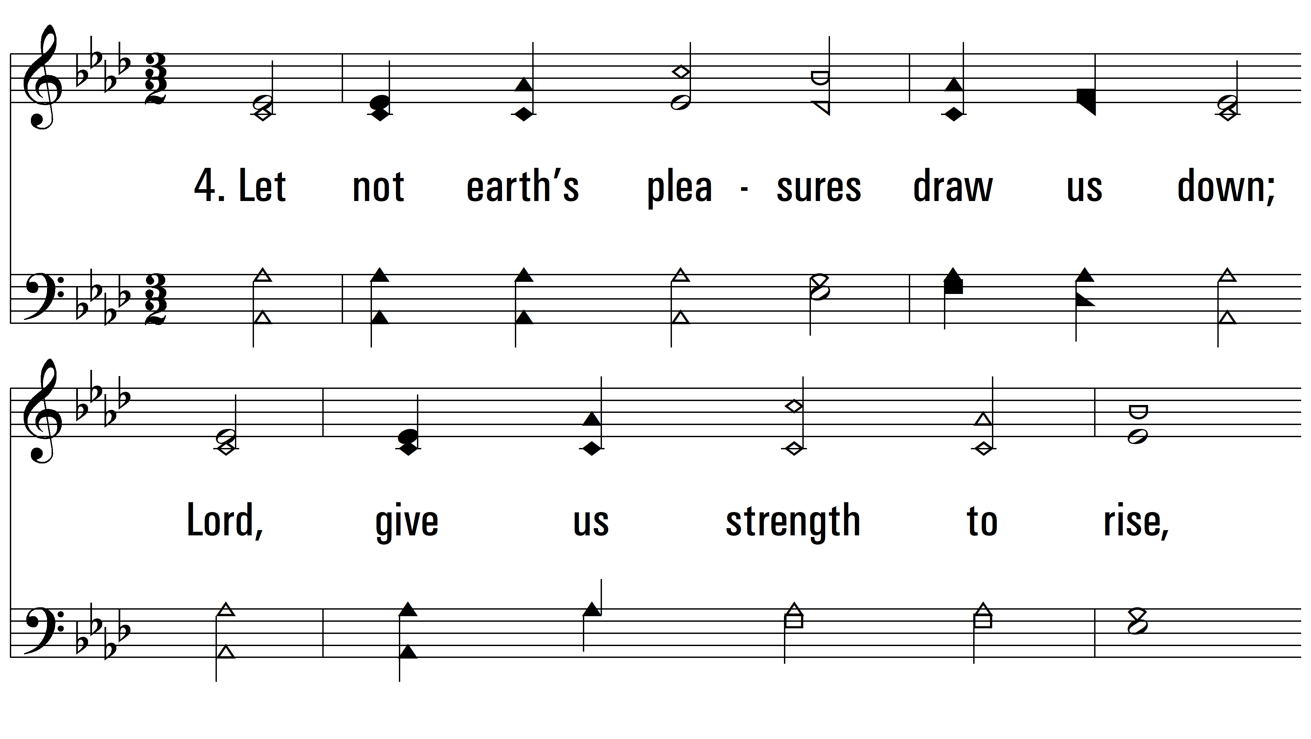
vs. 4 ~ Baptized Into Our Savior’s Death

Slide 9
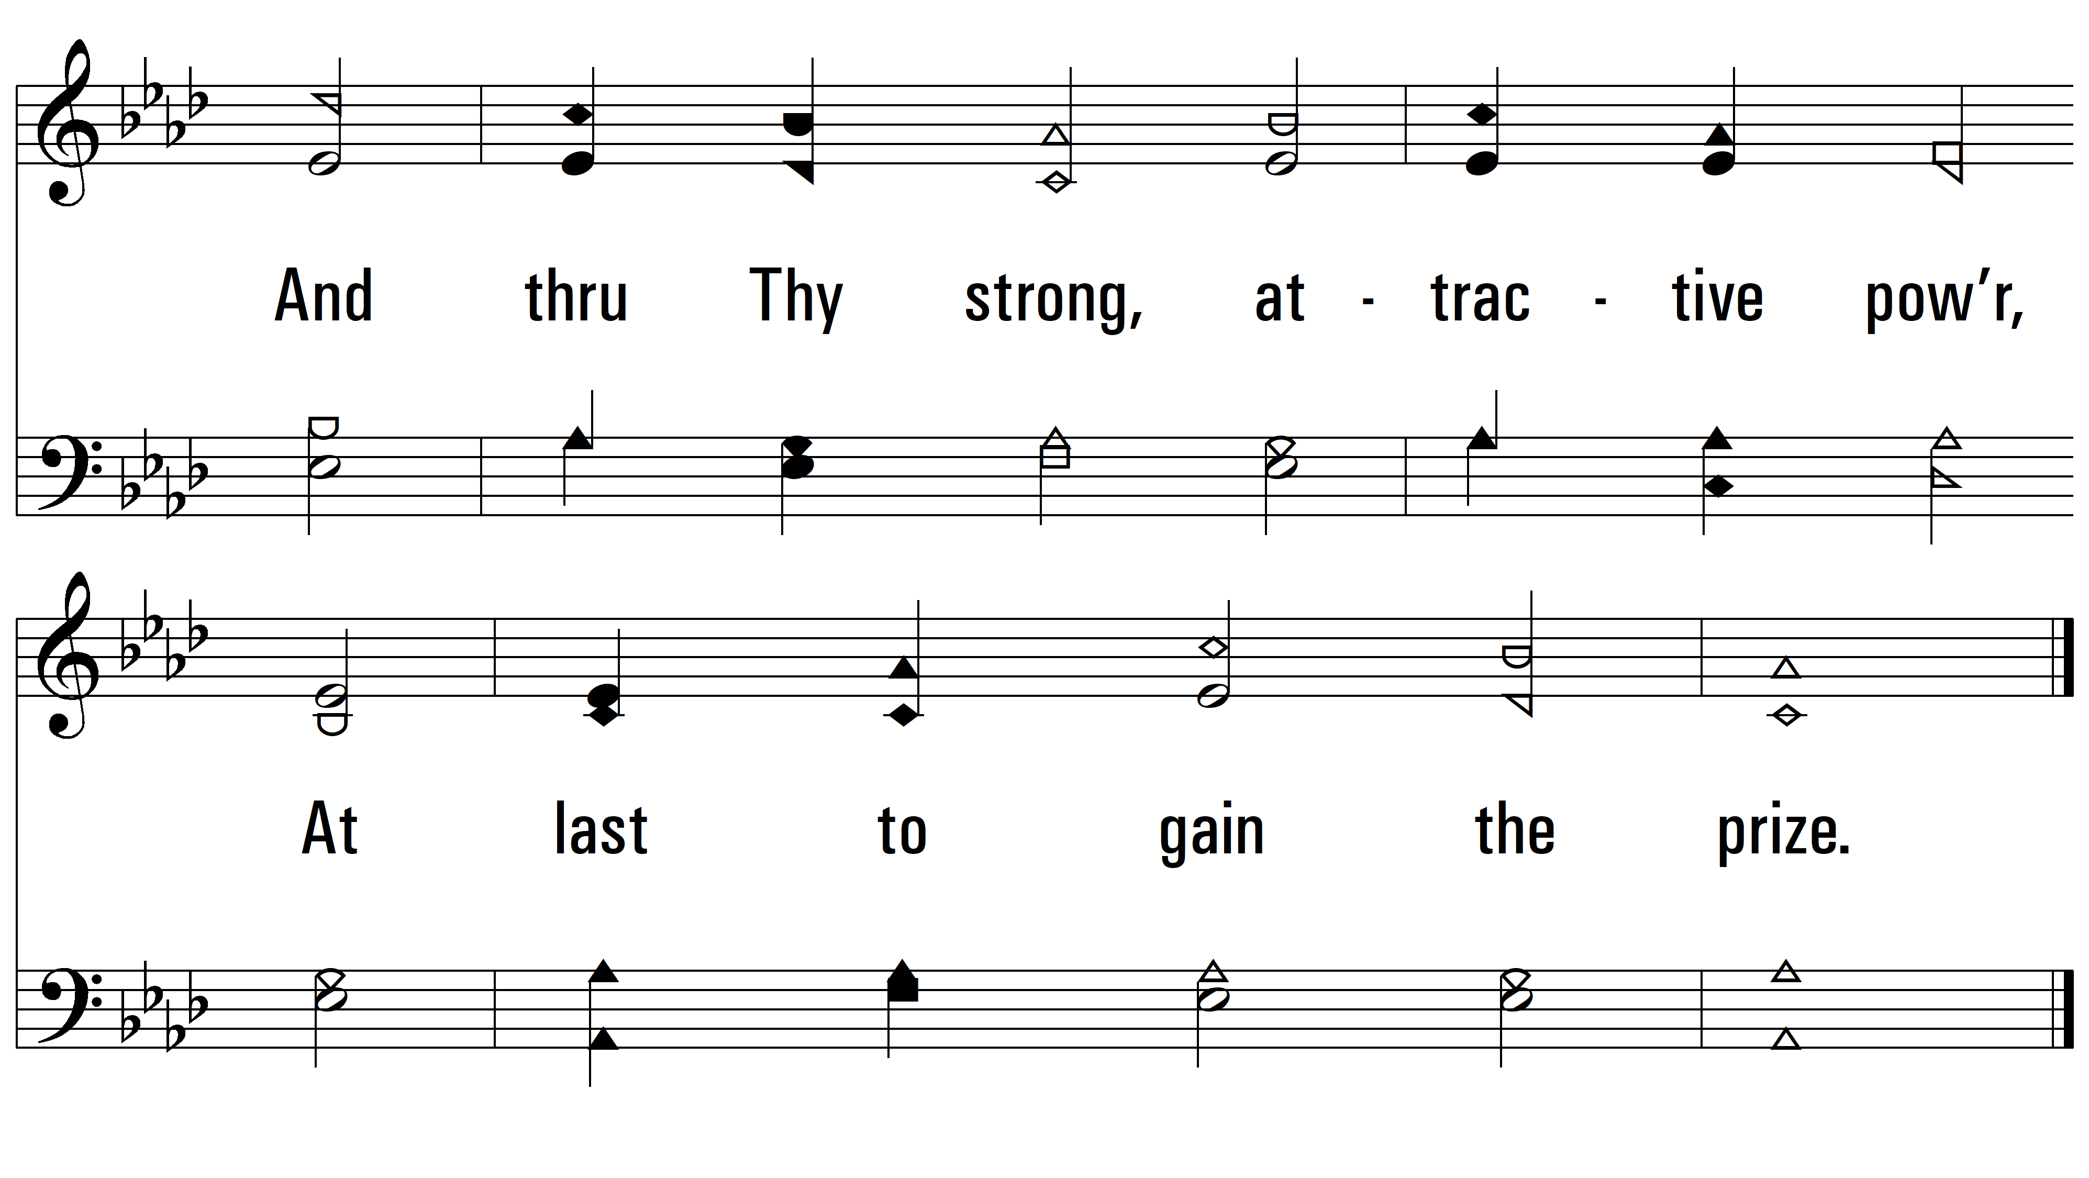
vs. 4
PDHymns.com
END

